Slide 1
Incident technology support specialist training
April 2019

Slide 2
L C E S
Local support personnel (Lookouts)
Anything with an ON switch set to SILENT
(Communication)
Fire Exits (Escape Routes)
Restrooms (Safety Zones)
Class Hours
Breaks

Slide 3
Welcome
Erik Torres-Jacquez, NPS FAM

Slide 4
Cadre Introduction
Kevin Hoffman - USFS CIO, FAM-IT
Paul Dzialowy - BLM, AD
Donna Tate - USFS, e-ISuite Project Manager
Mike Gascon – BLM, IT Security (CDM)
James Whiteside – USFS, R5 - FAM
Heather Wiskow – BLM CIO, Desktop Support
Jenifer (Ward) Stefanic – NPS, IT Specialist

Slide 5
Participant Introductions
Where are you from?
What is your day job?
Any incident experience?

Slide 6
Course Outline
Introductions and housekeeping
What does an ITSS do?
S-110 Basic Wildfire Orientation
Make and test an Ethernet cable
Equipment used on incidents
Transfer of property
Network layout and setup
Wireless Devices

Slide 7
Course Outline
e-ISuite Configuration, Administration and
Functions
Physical and Logical Security
InciWeb and Team Websites
Incident Simulation
Internet Access – do’s and don’ts
FireNet

Slide 8
ITSS Class Life Lessons
SHARE EVERYTHING – Especially Knowledge to Help Your Fellow Participant Be
Successful In This Class.
PLAY FAIR – Let everyone have a turn, don’t dominate your team.
DON’T HIT or HIT ON PEOPLE – Treat Them With Respect – Play Nice & Treat
Others The Way You Want To Be Treated.
PUT THINGS BACK WHERE YOU FIND THEM – Especially Tools You Borrow
From The Instructors.
CLEAN UP YOUR OWN MESS – We Are Guests of This Facility.
Don't take things that aren't yours – There Will Be Enough Trinkets
For Everyone.
Say you're sorry when you hurt somebody – We All Make mistakes
From “ALL I REALLY NEED TO KNOW I LEARNED IN KINDERGARTEN" by Robert Fulghum

Slide 9
ITSS Class Life Lessons
Wash your hands before you eat
BREAKS – We Will Take Breaks As Needed
Live a balanced life - Learn some and think some and draw and paint and sing and dance and play and work every day some – This class will be fun and interactive.
Keep the sand in the box – stay focused on the class & materials being
presented … do not try to read your email during the class.
Please hold off on questions until the end of a session, you may get the answer during the lecture.
From “ALL I REALLY NEED TO KNOW I LEARNED IN KINDERGARTEN" by Robert Fulghum

Slide 10
SAFETY FIRST
Safety is ALWAYS our top priority
You’re going to be tired and may have the camp crud
Take the time to think
Especially when driving
https://www.nwcg.gov/committees/6-Minutes-for-safety

Slide 11
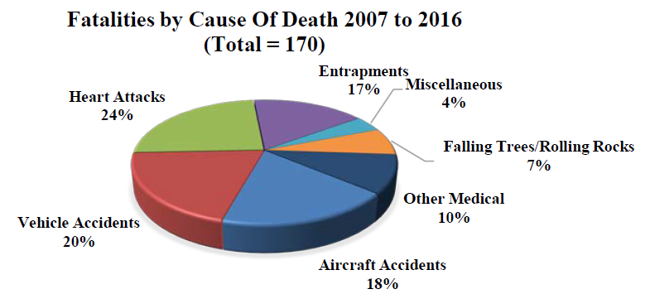
Wildland Fire Fatalities
The four major causes of death—heart attacks (41 fatalities, 24 percent), vehicle accidents (34 fatalities, 20 percent), aircraft accidents (31 fatalities, 18 percent), and entrapments (28 fatalities, 17 percent)—were responsible for 79 percent of the total number of fatalities.
Source : https://www.nwcg.gov/sites/default/files/publications/pms841.pdf

Slide 12
Wildland Fire Fatalities
Every year … no matter how hard we try, people get hurt or perish
https://www.nifc.gov/safety/safety_documents/Fatalities-by-Year.pdf
Year | Fatalities
2011 | 11
2012 | 15
2013 | 34
2014 | 10
2015 | 13
2016 | 15
WATCH FOR THE HAZARDS
FATIGUE & DRIVING

Slide 13
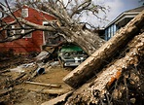
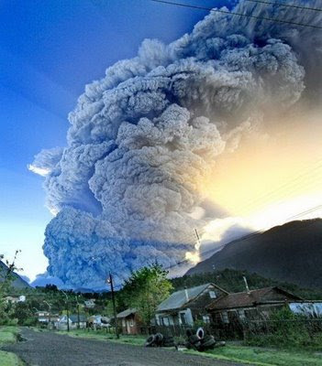
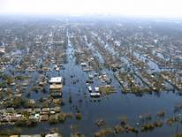
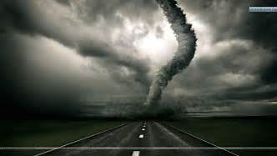
What does an ITSS do?

Slide 14
An ITSS has the skills to:
Support incident information systems and the
professionals that use them
Brief managers on IT issues
Design, build and support a wired and wireless network
Manage hardware and software issues
Identify problems, plan and implement corrective action
Provide professional and timely user support

Slide 15
An ITSS has the skills to:
Maintain the network as it expands and contracts
Deal with the worst possible Environmental conditions
(hot/cold/wet/dry/dusty/bad power)
Administer the e-ISuite system
Manage data and backups
Creatively resolve issues that arise

Slide 16
An ITSS has the skills to:
Work with “hair on fire”
Support technology that appears on an incident
Support the heavy hitters including PIOs, FBANs and
IMETs, GIS Specialists
Teach and Mentor
Stay focused on the mission

Slide 17
An ITSS has the skills to:
Complete Transition documents
Coordinate with other teams
Coordinate within your team
Move a network quickly to another camp location
Close out an incident

Slide 18
Support Your Team
Help incident personnel get their job done.
Don’t get caught in the trap of being a “do-er” just because you know and understand the technology.
“Those who can, do. Those who understand, teach.”

Slide 19
“Don’t build dumb fireline”
-- Joe Stutler, ICT1

