Slide 1
System Access Needed by an ITSS System Access Needed by an ITSS
System Access Needed by an ITSS
System Access Needed by an ITSS

Slide 2
You Will Need These Credentials:
NAP – NESS Application Portal
An Authentication Tool
Secure ftp Site
FireNet Email Account
ITSS Email List Membership
e-Isuite Email List Membership

Slide 3
Request Your NAP Account
Use Internet Explorer
https://nap.nwcg.gov/NAP/ Request a Standard Account
Under Application Access, request:
F&AM-EISUPL
Add these Applications, press the “+” for:
EIS-PROD
F&AM-FTP, and
WSR-Web Status (ROSS) - some agencies do not allow this

Slide 4
Request Your NAP Account
EISUPL and EIS-PROD Access are 2 Step Processes
When you receive notice that you have been granted an account and access to EISUPL, forward that email to the IAA help desk,
IIA-HelpDesk@fs.fed.us
with this message:
“Please add my NAP account to the EISUPL for uploads to the Data Repository”
When you receive notice that you have been granted an account and access to EIS-PROD, you need to contact your Account Manager to have Roles assigned. The IIA HelpDesk can give you that contact information.
NAP Password
Standard NAP Passwords expire every 60 Days
Privileged NAP Passwords expire every 30 Days
Don’t let it expire, your account will be locked
Request Your NAP Account

Slide 5
Request Your NAP Account - QRC
Request Your NAP Account
https://famit.nwcg.gov/sites/default/files/ROSS_QRC_Requesting%20a%20NAP%20User%20Account_122617_0.pdf

Slide 6
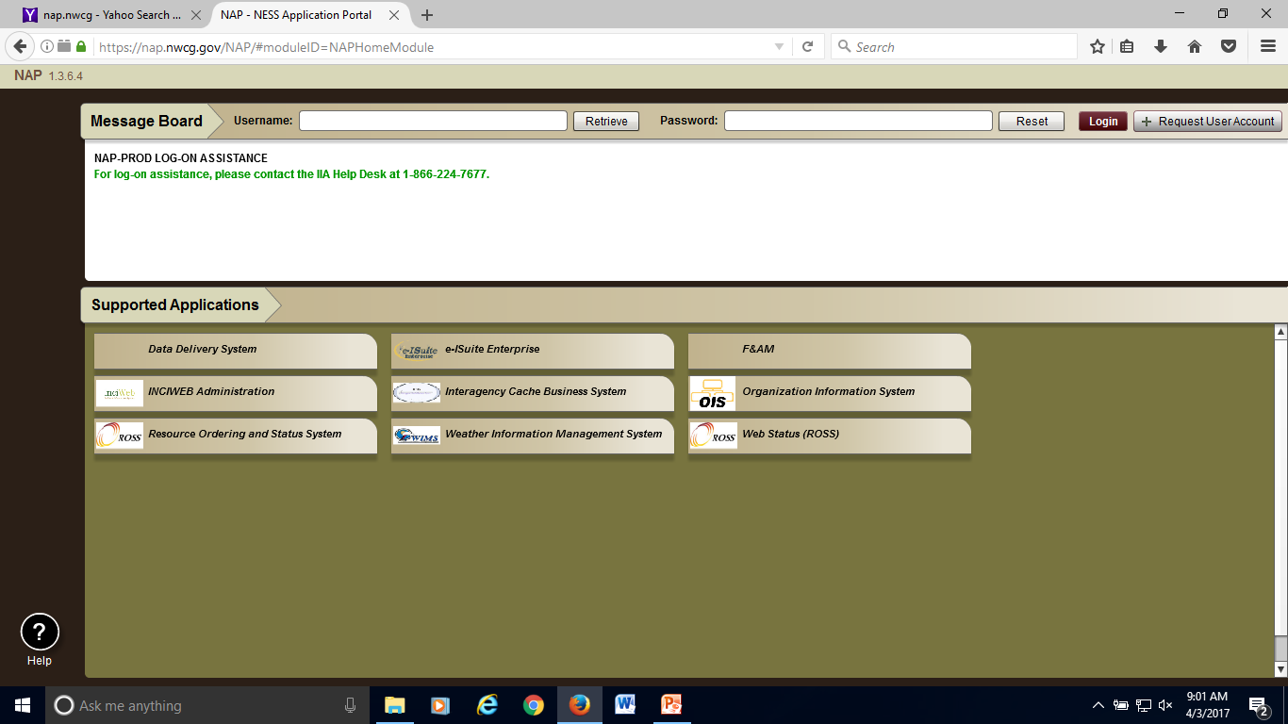
NAP – NESS Application Portal

Slide 7
Request Your FireNet Account
https://sites.google.com/a/firenet.gov/firenet/home/access-to-firenet-environment

Slide 8
ITSS Email List
Your responses will assist with other current ITSS initiatives. These include the development of GACC ITSS subgroups and the use of the new mailing list to authenticate ITSS participation in preparation for the provisioning of FireNet accounts. link: https://goo.gl/forms/ohSHH484bYme3HNF3 Populate the form and submit your request.

Slide 9
E-ISuite Email List
Receive important information and interact with the
e-Isuite team: https://docs.google.com/forms/d/e/1FAIpQLSdC63ryF-g1uBb95RwYcORDq6dTrBd4MqbxP1q9v1vr5oDumg/viewform
Populate the form and submit your request.

Slide 10
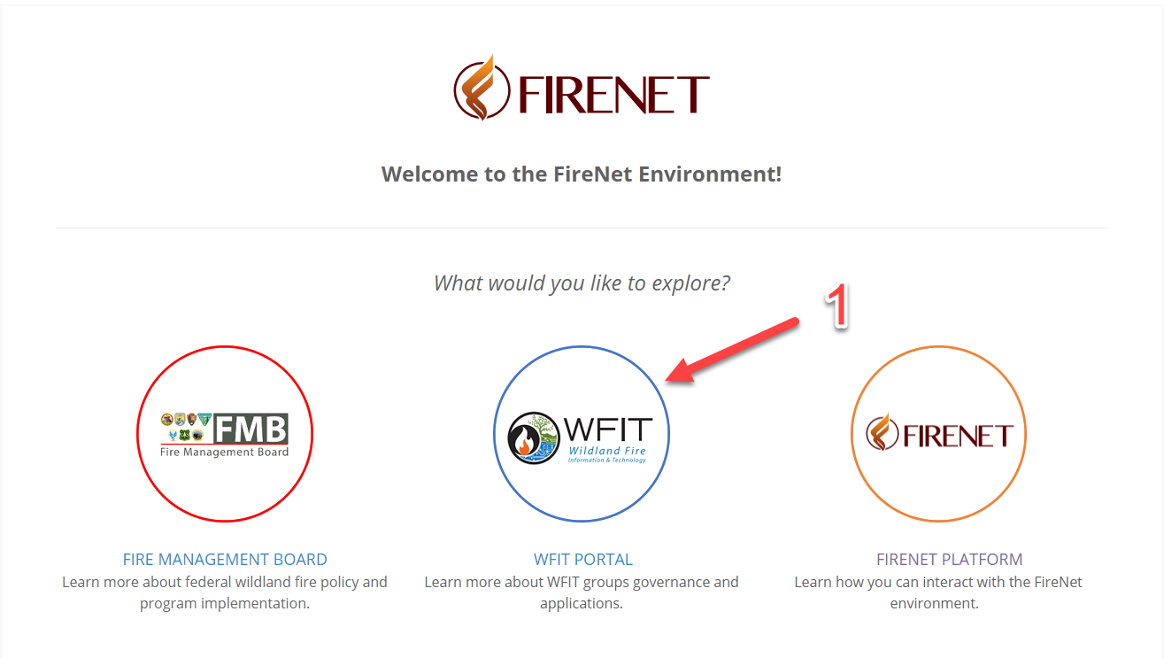
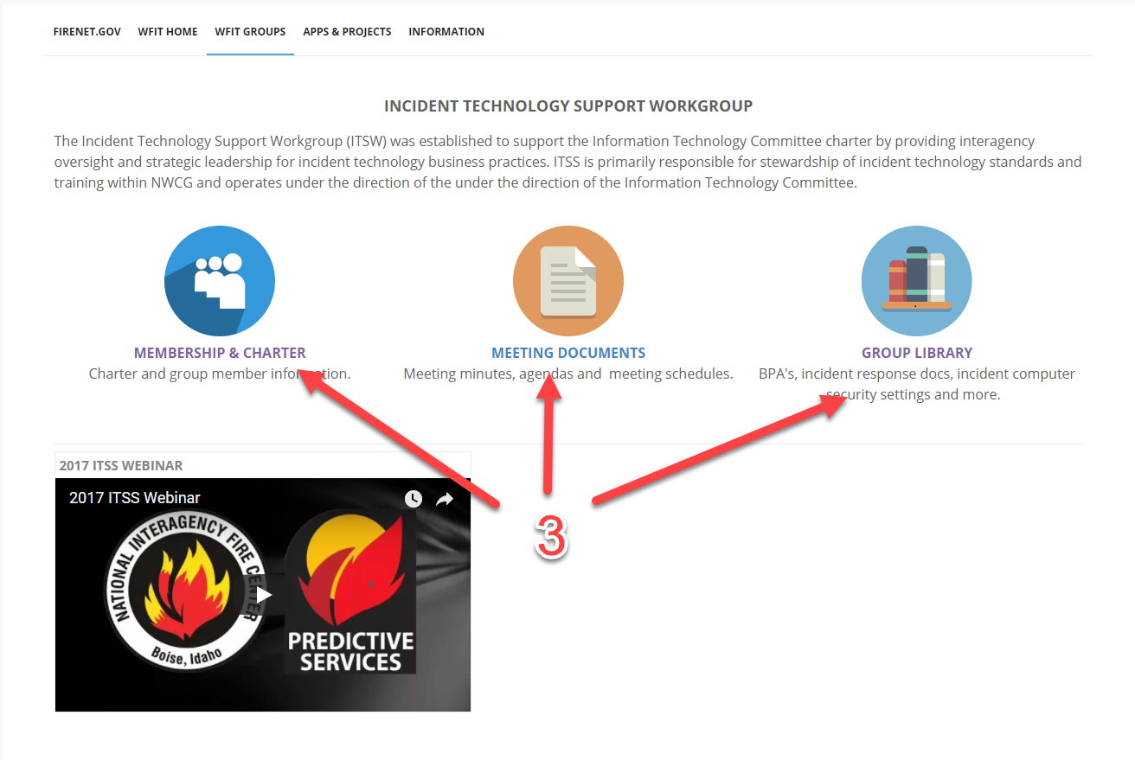
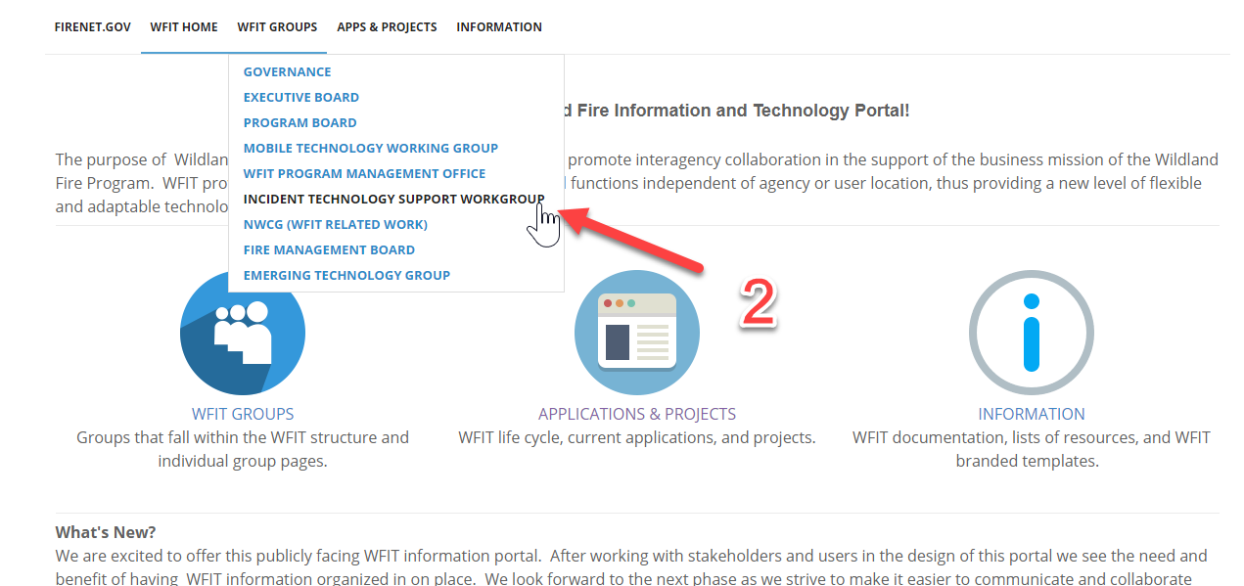
Stay Informed at the IT Support Workgoup Page - www.firenet.gov

