Slide 1
Incident Technology Security
Logical, Technical, and Physical Security

Slide 2
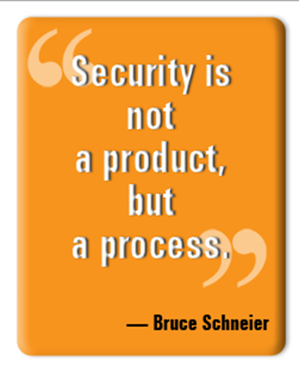
Objectives
Looking at Security from different angles
  Logical
  Technical
  Physical
Understanding Security and your Role
Approved Operating Systems
Cover the Security Policies
  White Paper #001
Understand Public Law 113-187 sec 10

Slide 3

Security Activity…

Slide 4



Security Activity…
Logical
Technical
Physical

Slide 5


Understanding Security…
Logical
Logically
Thinking
Technical
Physical

Slide 6
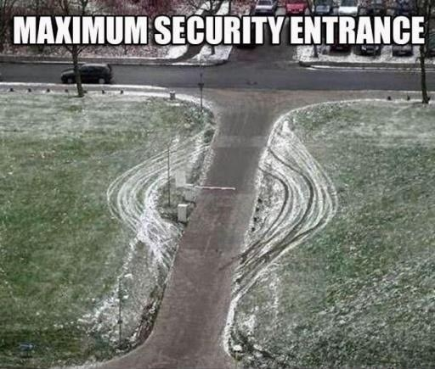
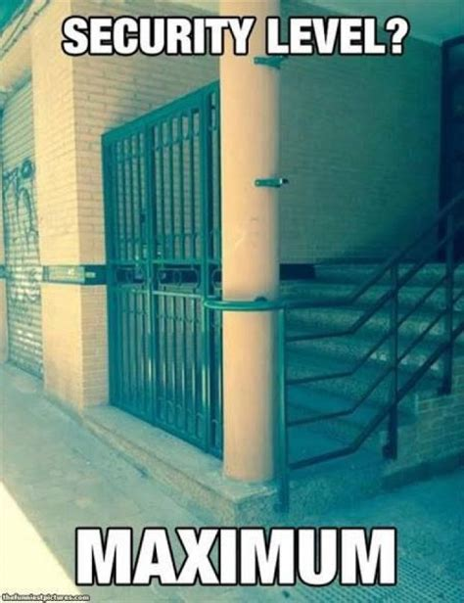
Understanding Security…

Slide 7

What is your Role?
Office vs Incident

Slide 8
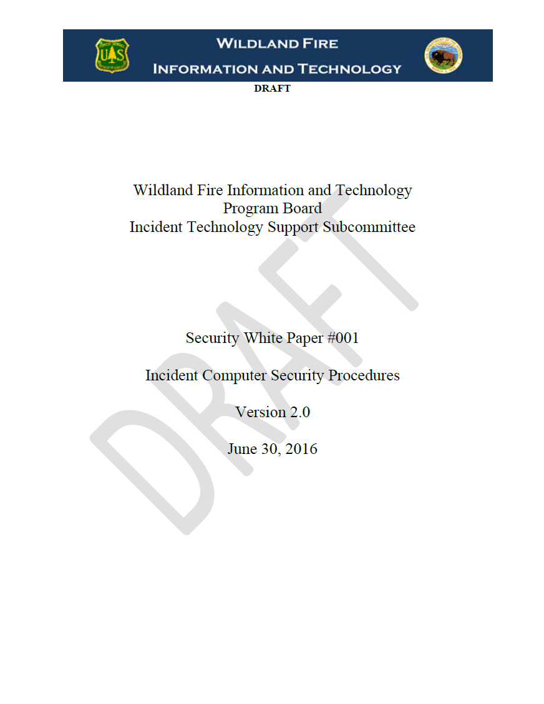
Current Security Policies
FireNet ITSS Library
ITSS Class Drive
Interagency Agreement
  WFIT Program Board
  (ITSS) Incident Technology Support Subcommittee
Used for Fire & All-Hazard incidents

Slide 9
Approved Operating Systems
 | Approved | Unsupported | ITSS Discretion
Windows 10
Windows 8.1
Windows 7
Windows XP
Mac OSX
Chrome OS
Linux
Unix

Slide 10
Security White Paper

Slide 11



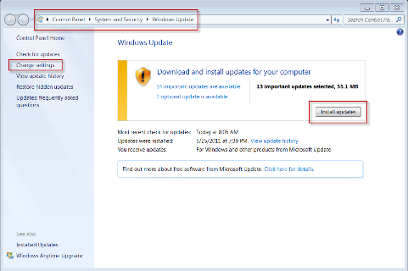
Security White Paper
1. Anti-Virus
  Definitions are up to date prior
  Authority to check regardless of ownership
2. Updates
  Automatic updates enabled
  Automatic updates turned off on incident

Slide 12
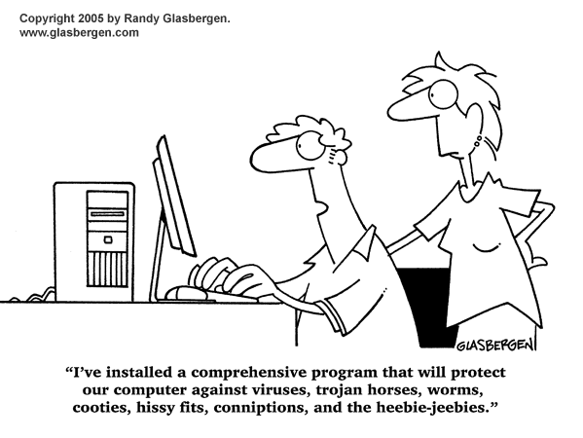

Slide 13
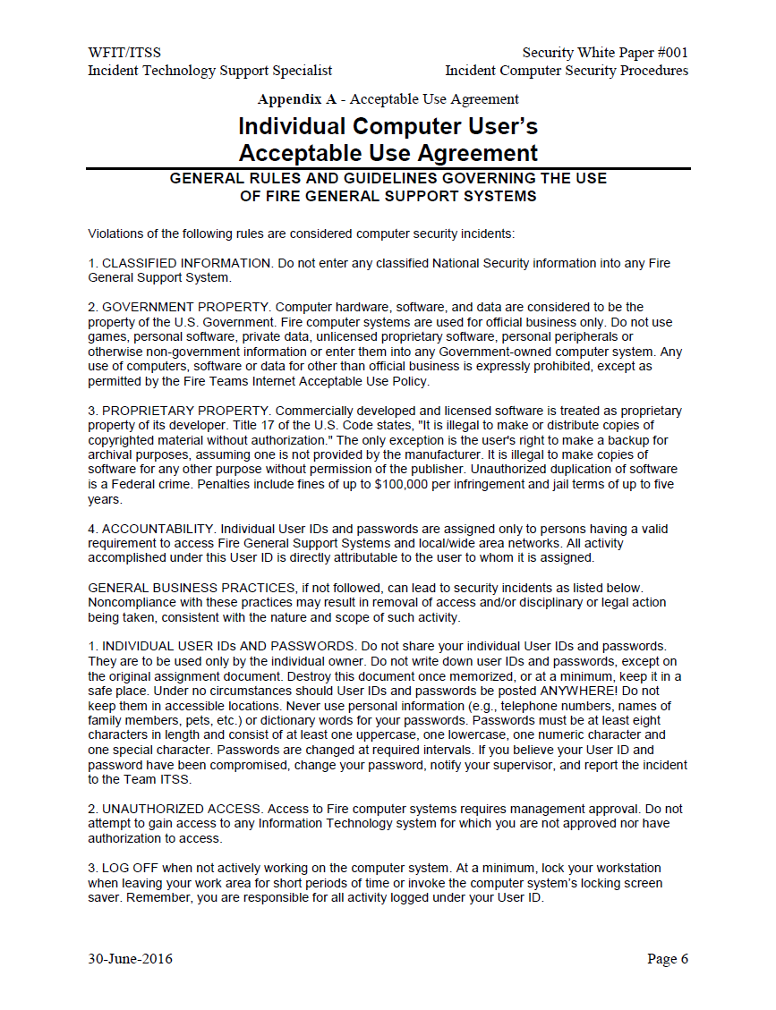
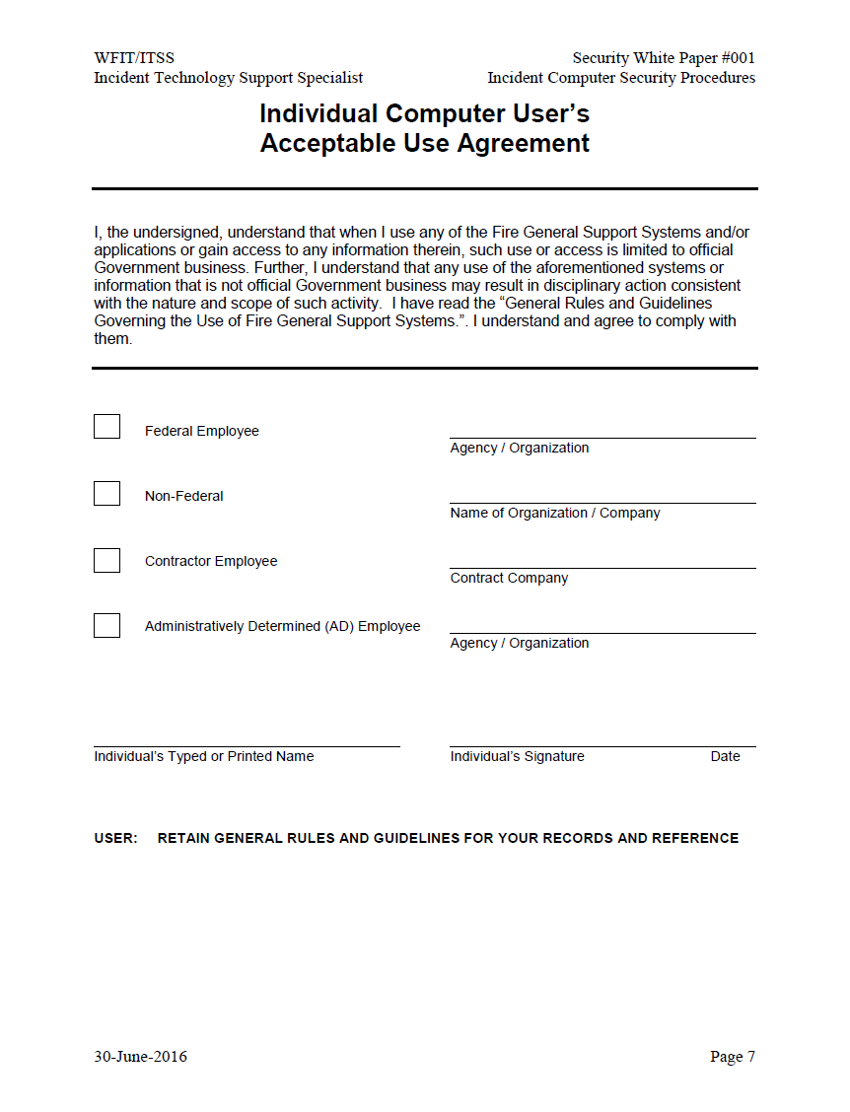
Security White Paper Cont…
3. Computer User’s Acceptable Use Agreement
  White Paper Agreement form
  DOI – Roles of Behavior/FISSA Completion
  USDA – Policy Form
  One form is mandatory per year
    Copies sent to local GACC
    On incident forms filed to the Incident documentation box

Slide 14
Security White Paper Cont…
3. Computer User’s Acceptable Use Agreement
  Classified Information
  Government Property
  Proprietary Property
  Accountability
  Individual User IDs and Passwords
  Unauthorized Access
  Log Off

Slide 15
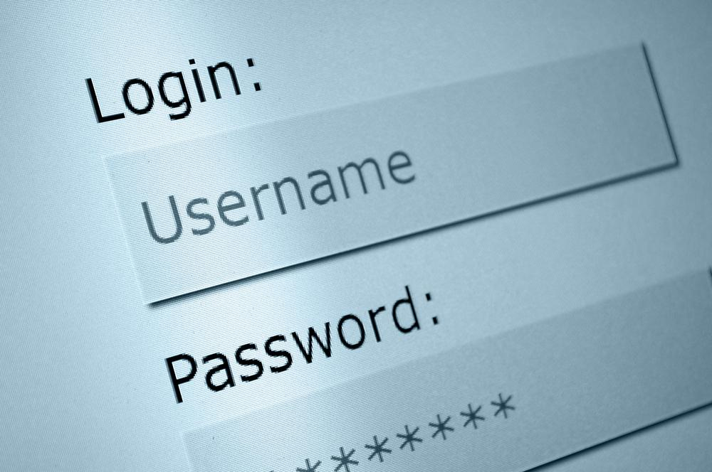
Security White Paper Cont…
4. Unique Usernames and Passwords for all users
  Use username standard for that IMT
  Typical username standard
    First initial with full last name
    Add in middle initial
    Spell out first and last name
  No ‘generic’ shared user accounts
  Password requirements
    >12
    1 number
    1 lowercase
    1 uppercase
    1 special character
  NEVER share passwords

Slide 16
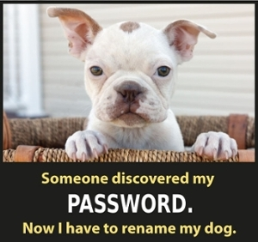
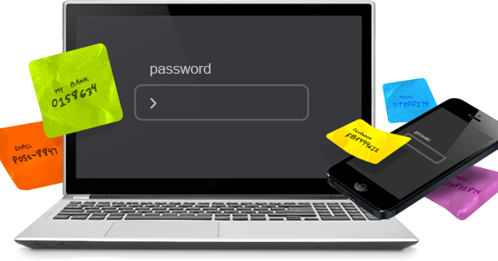

Slide 17


Security White Paper Cont…
5. Locking Screensavers
  Standard is 15 mins
  Require a password to unlock
  Master DB will lock after 5 mins
  Users should logout when finished
6. Assigned the minimum role privileges in e-ISuite
  Checks and Balances
  Takes a team to work e-Isuite
  It is designed this way
  Separate accounts for separate roles

Slide 18
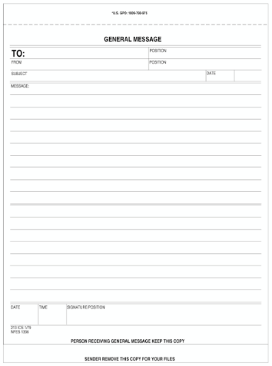

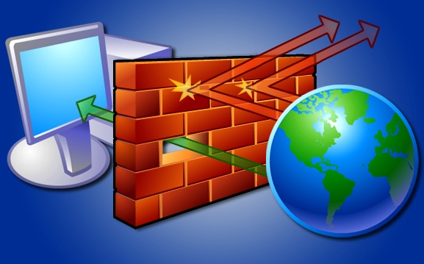
Security White Paper Cont…
7. Document account access
  E-iSuite
  User Account/Access Request Form
  or
  General Message Form
8. Perform periodic account reviews
  Periodic audits of user accounts
  Review documentation
  Cleaning up roles and accounts
9. Network Security
  Firewalls
  WIFI networks
  Access Points

Slide 19
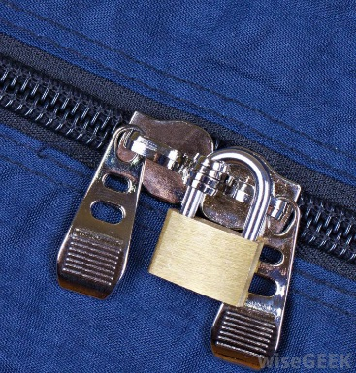
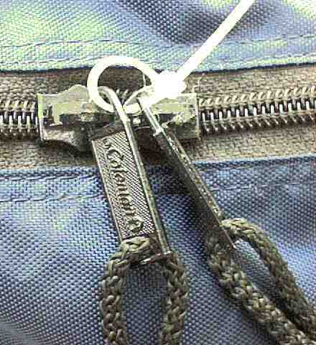
Security White Paper Cont…
10. Physical Security
  Federal incident are labeled Sensitive but unclassified
  Responsible party
    Equipment assigned
      NAS, data server, cameras, GPS units, etc
    Should be physically secured
    Know where your equipment is at all times
  Pay attention to high traffic areas
  Common areas are not considered secure
  Provide specific security measures for equipment during non-business hours
?

Slide 20

Security White Paper Cont…
11. Account for all Equipment
  Equipment logs
  Minimum Information needed:
    Responsible party
    Item location
    Serial number of item
  Transitions
    All equipment accounted for
      Power supply
    Receiving team will sign for it all
  If your name is on it your responsible for it

Slide 21

Security White Paper Cont…
12. Personally Owned Equipment PROHIBITIED
  Incident is not responsible for unauthorized equipment brought or used on the incident
    Computers/laptops
    iPad/tablets
    Smartphones
    GPS Unit
    Anything not owned or purchased by your agency

Slide 22
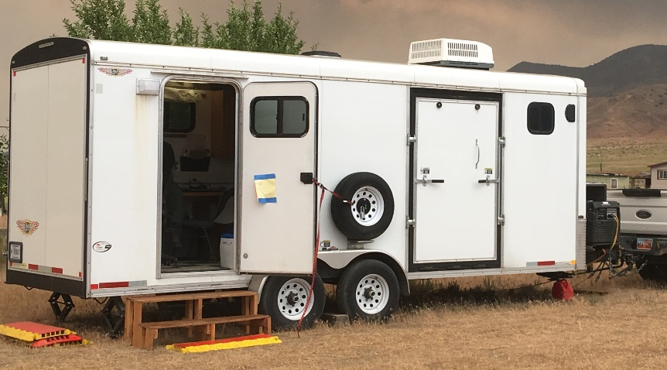
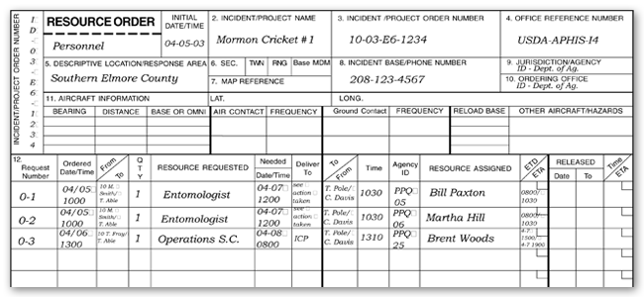
Security White Paper Cont…
12. Personally Owned Equipment PROHIBITIED cont…
  Resource Orders
    Only bring what’s listed
    You will see some Resource Orders with private equipment listed on them
      You are NOT required to support them
      We have no control over Resource Orders
      You DO have control what is on the incident network
  Authorized equipment and computers will be issued to you at the incident
    Rentals
    IMT inventory

Slide 23
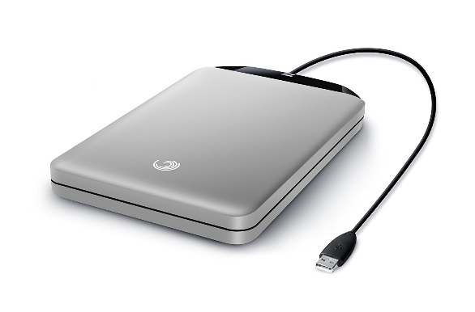


Security White Paper Cont…
13. Perform backups regularly
  Don’t always rely on automatic backups
  Manual backup daily
  Refer to E-iSuite moduals
  External drives must be encrypted
14. Sanitize non-agency computers
  Wipe rentals
    DBAN
    Wipedrive
  Reset SSD’s
    Built in firmware
    ATA Secure Erase
  “Electronically Shredding”
    Format good enough?
  Vendor is required to wipe drives

Slide 24
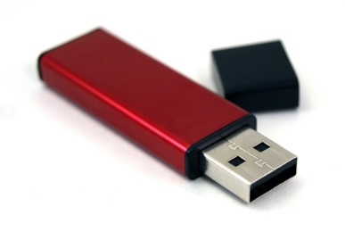
Security White Paper Cont…
15. Maintain control of external storage devices
  Incident data should remain on the server or database
  Limit use of external hard drives
    Must be encrypted
    Sanitize external drives after use and incident
  Help reinforce the policies for the data
    ROB’s
16. How to handle digital images
  Agency images must be treated as data - sensitive
  Limit your copies
    Approved by managing entity
    Licensing

Slide 25

Security White Paper Cont…
17. Reporting loss of data or equipment
  ITSS responsibilities
    Securing the network
    Safeguarding the data
  Who can be liable for loss of data?
  Who can be liable for equipment loss?

Slide 26
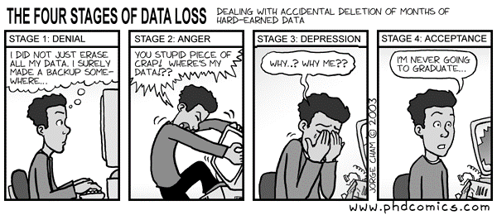
Security White Paper Cont…

Slide 27
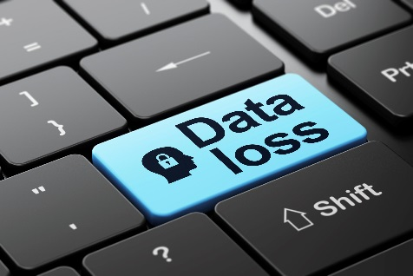
Security White Paper Cont…
17. Reporting loss of data or equipment cont…
  Report loss of sensitive data or equipment
    Federally owned
      Inform command
      Security Manager
      Managing agency
      Reporting procedures for the owner agency
    Rental owned
      Inform command
      Security Manager
      Managing agency
      Reporting procedures for the contractor
    Computer Security Incident Response Team (CSIRT) may need to be activated

Slide 28
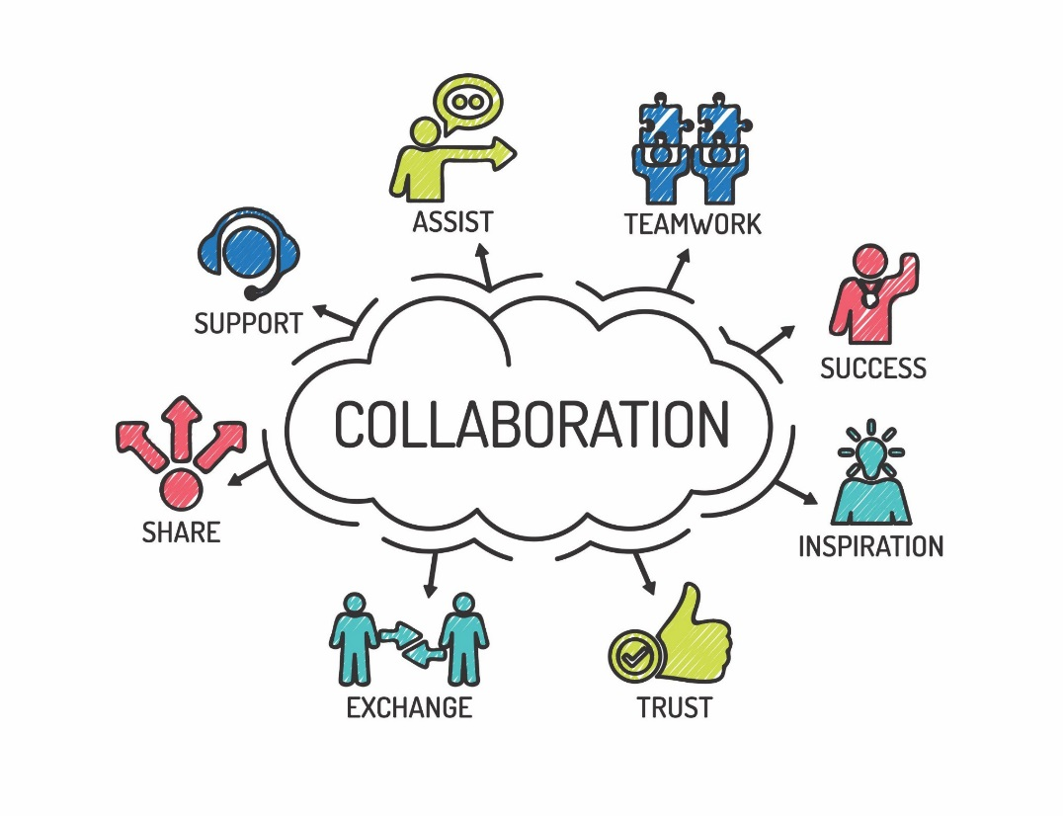
Security White Paper Cont…
18. Team computer configuration
  “Should”
    Password protected BIOS
    Boot devices turned off
    Document passwords
    Clear BIOS password at end of incident
  Teams can be different
  Ask questions as a trainee
  Follow the guidance of the team ITSS

Slide 29
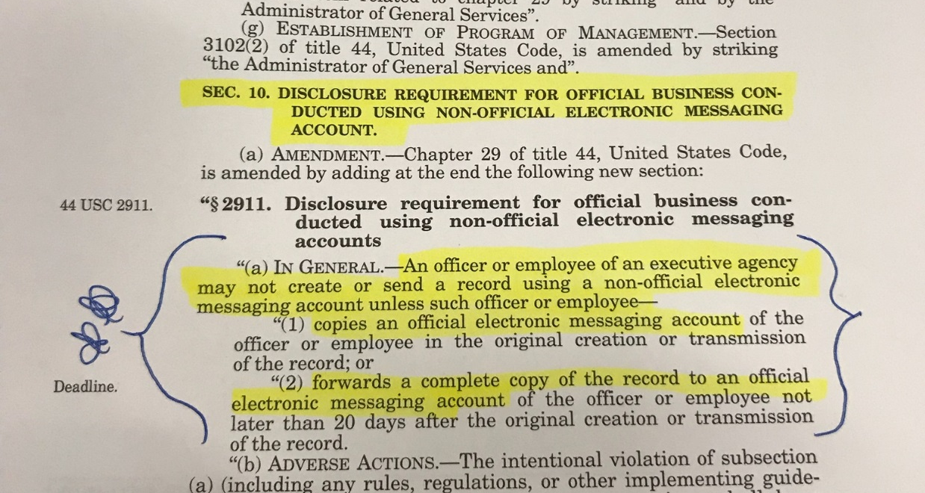
Public Law 113-187
Sec 10. Disclosure Requirement for Official Business Conducted Using Non-Official Electronic Messaging Account.

Slide 30
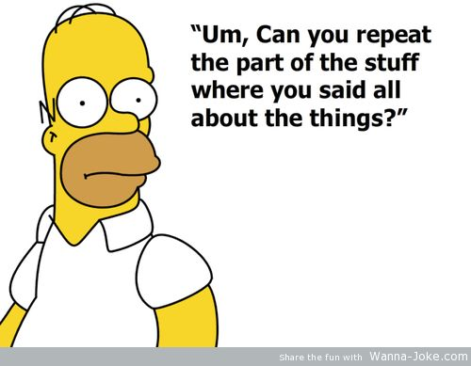
Questions?

