Slide 1
Types of ITSS Trailers
CROW
MIMIT

Slide 2
CROW (Computer Room On Wheels)

Slide 3
CROW

Slide 4
CROW

Slide 5
Cables, APC, Etc….

Slide 6
EISuite Server - Drobo

Slide 7
Battery Power – Pumpkin?

Slide 8
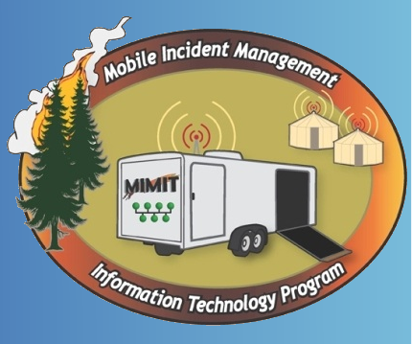
MIMIT
(Mobile Incident Management Information Technology Program)

Slide 9
5 total trailers in Great Basin

Slide 10
Window Server 2008 R2

Slide 11
Router - 1GB Switch - RADIUS – LAN Controller

Slide 12
APs and Thin Clients, now Laptops

Slide 13
Printers and Power Strips

Slide 14
Backup Plan for APs

Slide 15
Large screen for IAP

Slide 16
e-ISuite Server

