Slide 1
E-ISuite ITSS Tips and Tricks
April 2017
http://famit.nwcg.gov/applications/eISuite

Slide 2
Site Basics
Only install Site on Server, Clients do not need it
Officially supported environment
Windows 7
Internet Explorer 11
Other browsers usually work ok
Chrome may have TAB key issues
Firefox generally works well

Slide 3
New Transition File Types
Data Transfer Completely Rewritten, Works Well
Transition File Types are different
Ent-to-Site
Site-to-Ent
Site-to-Site
System will name files accordingly
KYBURZ_Site-To-Site.isw
TNSPTESTGROUP_Ent-To-Site.isw
FROG_Site-To-Ent.isw
Remember your password as we cannot decrypt it

Slide 4
2046 Error
May see it on older laptops
Usually, just accessing e-ISuite Enterprise will clear it up
If that does not work, and you have admin privileges, try creating a new user just for e-ISuite.

Slide 5
404 Page Error on Server
First thing to check is to look for competing web services
Go to Control Panel, Programs and Features, Add or Remove Windows Features
Make sure Internet Information Services is Unchecked (not black, not grey, completely unchecked)
May require a reboot

Slide 6
404 Page Error, Cannot Display Web Page on Client
USFS Network? Must use url
http://192.169.1.5:59123/isuite/fx/welcome.html#
(put your server address in the url, this is just a sample)
Not on USFS Network?
Make sure Port 80 on Server is open for incoming TCP Traffic
(May require creating a new Inbound Rule for Windows Firewall)
Windows Firewall can be turned on as long as Port 80 allows incoming TCP Traffic

Slide 7
Create New Database Error
Random, may not see it, but if you do…
Should be able to log into a good database and remove bad one
Work-around
User Restore Database function to restore blank, empty database
Use C:/ProgramData/E-ISuite/NWCG-Backups folder/eisuite.del.bak.bak
Password is eisuite (all lower case, no dash)
Can Restore it with any name you want
Can change database password if you wish

Slide 8
Windows 10…
Not officially supported
Works Fine as Server (Use Edge or IE or Chrome for Database Management functions such as Create Initial Database, Create New Database, Restore Database, etc.)
Users will be happier using Firefox for data entry (Edge, IE 11, and Chrome: TAB key does not always go to next field and users have to use mouse to get to next field sometimes)
Just as in Windows 7, Internet Information Services needs to be unchecked in Turn Windows Features on and off

Slide 9
Macs
Not officially supported
Works fine as client using Safari, Chrome, Firefox
Server will work fine but must be running in a Windows VM

Slide 10
iPads, Android Tablets
Can use as clients only via Remote Desktop Connection
Ties up one laptop/PC for each connection
Chrome Books can be used as clients

Slide 11
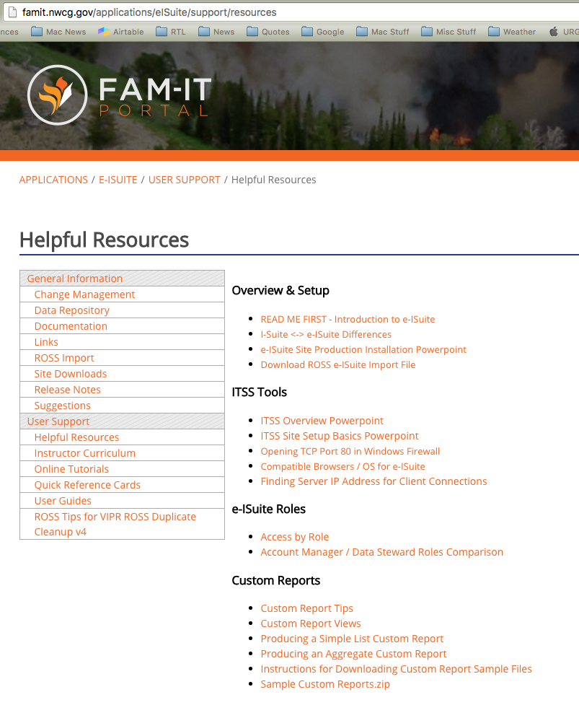
Other Helpful Resources

Slide 12
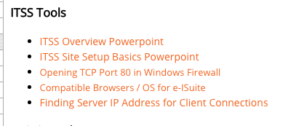
Helpful Resources

