Slide 1
e-ISuite
….the basics…

Slide 2
Server Requirements
Windows 7 Professional or Windows 2003/2008 Server
Windows 8/10 Server 2012 (discussion)
No competing http Services (Tomcat6 will provide web services on server machine)
Windows 10 and Server 2012 have IIS (Internet Information Services) running – turn off services in Windows Features
Must have Visual C++ 2010 Runtime Redistributable installed
Browser Requirements
IE 11 Officially Supported
Popup Blockers Turned Off
Latest Adobe Flash Installed
Use F11 for Full Screen

Slide 3
Install e-ISuite on Server
Download Site Installer from https://famit.nwcg.gov/applications/eISuite
Check for Latest Release and any Patches
Download Release Notes
Must have Administrator/Elevated Privileges to Install
Review Install QRC

Slide 4
e-ISuite Site Install
Navigate to location of the install package
Important – Launch the e-ISuite Installer using your agency’s install protocol
Admin Privileges or Run Elevated
Accept Installation Defaults
Repeat Steps above for any Patches
No Reboot Necessary

Slide 5
Application Navigation
After Installing e-ISuite Site, 2 ICONS will be added to your desktop
One to Launch the e-ISuite Site Application
One to Access the e-ISuite Data Folders

Slide 6
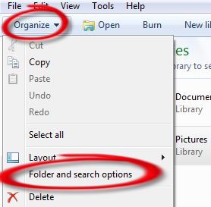
e-ISuite Data Files ProgramData Folder View and Access – Windows 7
The ProgramData folder is often identified as a Hidden Folder. Follow the instructions below to change the Folder settings to “Show” hidden folders:
Open Windows Explorer by clicking the Icon in the Task Bar
Click Organize
Click Folder and Search Options
Continued on Next Slide

Slide 7
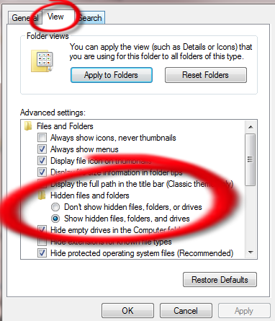
e-ISuite Data Files ProgramData Folder View and Access – Windows 7 Cont.
Click the View Tab
Expand the Hidden files and folders folder
Click the Radio button next to Show hidden file, folders and drives
Click OK
The ProgramData folder should now be visible

Slide 8
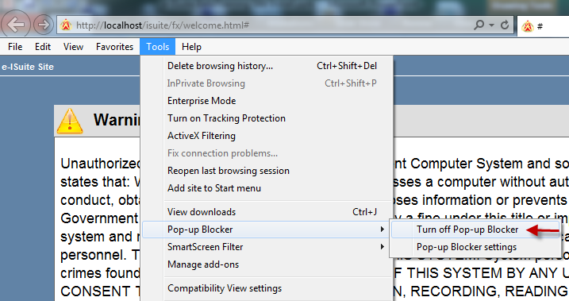
e-ISuite - Setup
Navigate to the Desktop:
Launch e-ISuite Site
After e-ISuite Site Warning Banner Screen loads, turn off Pop-up Blockers
Click Accept to acknowledge the Security Warning Banner

Slide 9
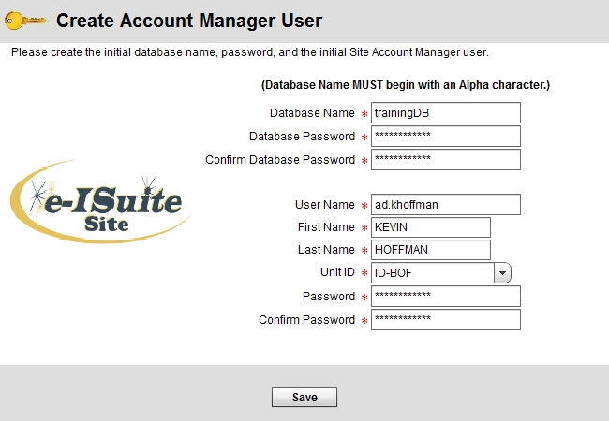
e-ISuite Site – Setup Cont.
rabase and Account Manager

Slide 10
Site Account Manager (Admin User)
Account Manager Performs 2 major Functions in e-ISuite
User Account Management (Privileged vs. Non-Privileged)
Add, Update, Delete User Accounts
Importance of Secondary Account Manager Account
Assign Roles
Import/Export User Accounts
Database Management
Create/Copy/Restore Database
Create Backups
Automatic vs. Manual
Database Password Recovery Tool

Slide 11
Database Management Decisions
How will you be managing your incident data on this Server?
Import a Transition File from Enterprise
Requires an attached database
Requires a Data Steward User Account
Import is done by the Data Steward
Start Incident Manually or with a ROSS Import file
Requires an attached database
Requires a Data Steward User Account
Import is done by the Data Steward
Restore from a Backup File
Restore is done with the Account Manager Role
Will include user accounts prior to backup

Slide 12
Setup Incident Using Enterprise Transition File
Create new Database
Configure Auto Backups
Add Users
Manually
User Import File
Login as Data Steward User
Import Transition File

Slide 13
Setup Incident Using ROSS Import File
Create new Database
Configure Auto Backups
Add Users
Manually
User Import File
Login as Data Steward User
Import ROSS Incident File

Slide 14
Setup Incident Manually
Create new Database
Configure Auto Backups
Add Users
Manually
User Import File
Login as Data Steward User
Manually add Incident Data

Slide 15
Setup from Database Backup File
No Need to Create new Database
Use Restore Option
Enter Backup Password
Manage Users
Must Create a New Data Steward User
Add New Users
Manually
From Import File
Deactivate User Accounts (audit accounts - Security)

Slide 16
Site Data Steward Functions (DOES NOT need to be performed on Server Machine)
Add/Delete/Edit Incident and Incident Data
Accounting Codes
Reference Data Tables
ROSS Import (Requires NAP Acct with ROSS Access)
Financial Export (Requires DMS Acct)
Data Transfer to/from e-ISuite Enterprise
Could be performed by different Sections
Finance could Edit Incidents and do Financial Exports
Resources could do ROSS Imports

Slide 17
Setup Client Machines
Client Configuration Requirements
LAN Connectivity to Server Required
Browser Setup Requirements
Latest Version of Adobe Flash
Turn off Popup Blockers
Browser must have Javascript Enabled
Launch Web browser
Type in e-ISuite URL
http://ServerIP/isuite/fx/welcome.html#
Create Desktop Shortcut
Create Favorite

Slide 18
Uninstall e-ISuite Site
Administrative/Elevated Privileges are Required
User Account with Administrative Rights
PowerBroker
CPALaunch Programs
Uninstall Methods
Control Panel - Programs and Features
e-ISuite Program Files - Uninstall
e-ISuite Installer Package

Slide 19
Data Transfer Functions
Performed by Data Steward
Transfer and/or Sync data between Site and Enterprise – Requires NAP/e-ISuite Acct
Transfer Incident from Enterprise to Site
Transfer Incident from Site to Enterprise
Sync Data between Site and Enterprise
Basic mechanism is a special file transfer between Site and Enterprise

Slide 20
Tutorials Available
User Account Management
Database Management
Data Steward
ROSS Imports
Financial Exports
Edit Incidents
Transfer Data to/from e-ISuite Enterprise

Slide 21
Troubleshooting
Adobe 2046 Error (Certificate Error)
Connect Machines to Internet after Install
Access the e-ISuite Enterprise URL to Ensure Current Certificate is Installed –Touch Enterprise before relocating
Services – e-ISuite Server Machine
Tomcat6/7
Postgres
Data Manager Account Recovery
Error Creating 2nd Database
IIS Conflict
Reports will not Render
Time Zone Conflicts

