Slide 1
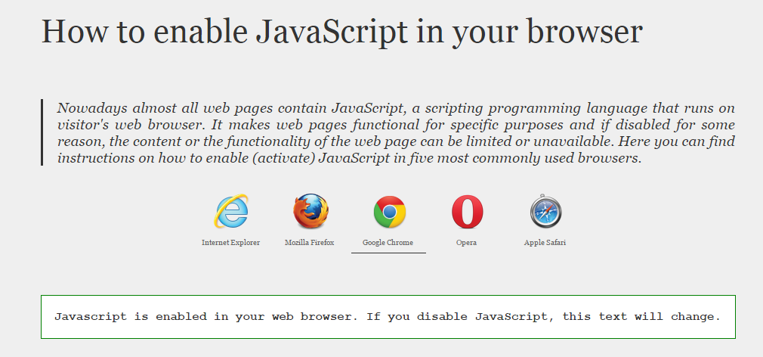
E-ISuite Tricks
02/10/2015
To Check To See If JavaScript is ENABLED
1) Open your desired BROWSER (IE / Chrome / Etc.)
2) GoTo: http://www.enable-javascript.com/
The First Message Tells You The Status Of Your JavaScript …
Below This Message on the Web Page Is How To Set JavaScript Enabled For Most Browsers

Slide 2
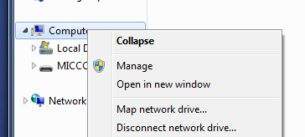
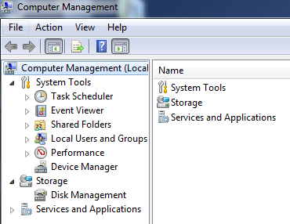
E-ISuite – 404 Error
02/10/2015
1
3
Stop Both Applications (Note Order)
[Right Click – Stop]
4
1)
2
2)
START Both Services (Note Order)
[Right Click – Start]
5

