Slide 1
Wildland Fire Information and Technology Management
Mobile Satellite Solution
for Internet
April 2017
2017 ITSS class Mike Gascon mgascon@blm.gov

Slide 2
Agenda
Need Internet?
Cons
Pros
Process
Installation
Helpful Tricks
Billing
Fun Facts
Summary

Slide 3
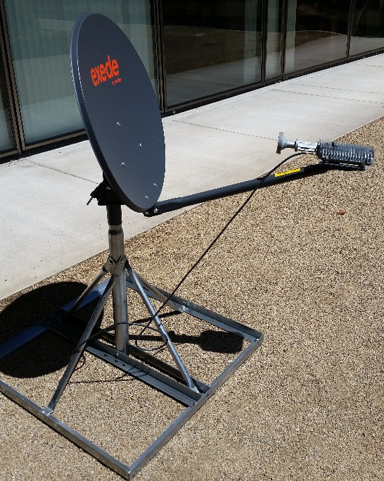
Process
ICP will order Satellite.
ViaSat will be notified to activate full data package by NWCC.
Currently, NW National Cache has 3 units for use.
Cache will deliver to ICP.
A Southerly view of the sky will be needed. In the NW, it should not be an issue to get line of site over mountains. IE, in AK, the angle would be so low, it would be very difficult to hit the Satellite.
Satellite is set up, beam found, fine tuned and secured.

Slide 4
Installation
Stable power will be needed. Prefer a UPS solution.
Flat, solid ground will be needed for the base.
Flagging around Satellite along with a wide radius around to keep people out of the line of site. Also, the coax cable will need to be buried or at least protected from boots walking across it and damaging or destroying it.
The Satellite will need to be deployed within a maximum of 40 feet from where the modem will be due to coax cable length.
An unobstructed line of site to the S/SE sky will be needed.

Slide 5
Installation (cont)
Once all hardware is set up, power on modem and laptop. It will take a couple of minutes for the modem to power on.
While the modem is booting up, determine what beam you are shooting for. There is a code associated with that beam and you will need it.

Slide 6
Installation (cont)
Open a web browser to http://192.168.100.1/install
Enter the code for the beam and hit the next button.
Once the code is entered and accepted, the tria will emit a heartbeat. Start sweeping the Southern sky until the tone changes. Once you get a solid tone, the start the fine tune process. It is helpful to either have the laptop close by or another person to help with the fine tune process.
Once the tone is locked, tighten down all bolts on dish to secure from movement.

Slide 7
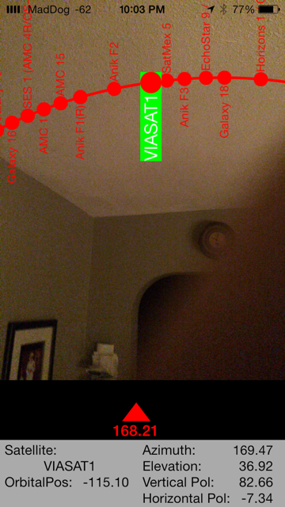
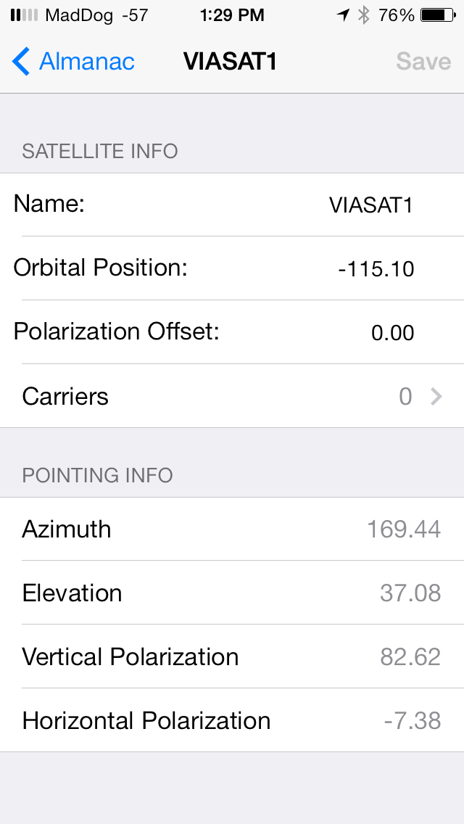
Helpful Tricks
There are apps out there to help with initially finding the satellite. One of my favorites is SatelliteLocator. You will need to manually enter the Satellite info but after that, it is pretty slick. Where ever you are, it will give you the Azimuth and Elevation to shoot for.

Slide 8
Helpful Tricks (cont)
If tone never changes from heartbeat, change the elevation and try re sweeping the sky. Elevation is more important than Azimuth.
ViaSat is available via phone support for assistance.
ViaSAT NOC (855) 656-6623.
Current installation documents: https://www.viasat.com/exede-enterprise-installer-documents
115 or 110 degrees. If you ever find documentation that says it is 115 or 110, that is true, but that is off of the equator, not the Azimuth. (That little mistake cost me hours of testing time!)

Slide 9
Billing
Our dish has an active data plan 365 days per year. It IS limited to 1 GB per month. This is for set up, testing, and firmware updates. It is $1000 per year for this plan.
When the dish is dispatched, ViaSat must be Notified to activate the full data plan. At that point they will start a new billing plan. The beauty of that is the incident is billed exactly what was used. IE, The dish gets dispatched July 2. ViaSat is notified. Incident demobs July 19. ViaSat is called again and Satellite goes back on maintenance plan. That way the incident gets billed exactly for what was used. The finance section needs to know this. They wont like the surprise bill at the end of the incident. Host unit will be invoiced after the deployment
The cost of data when activated is $2995 per 40 GB. ($75 per GB) This is why monitoring and restricting will be important.
They also have a 500GB plan for $12,495 ($25 per GB) That is a huge savings if it will be an extended incident.

Slide 10
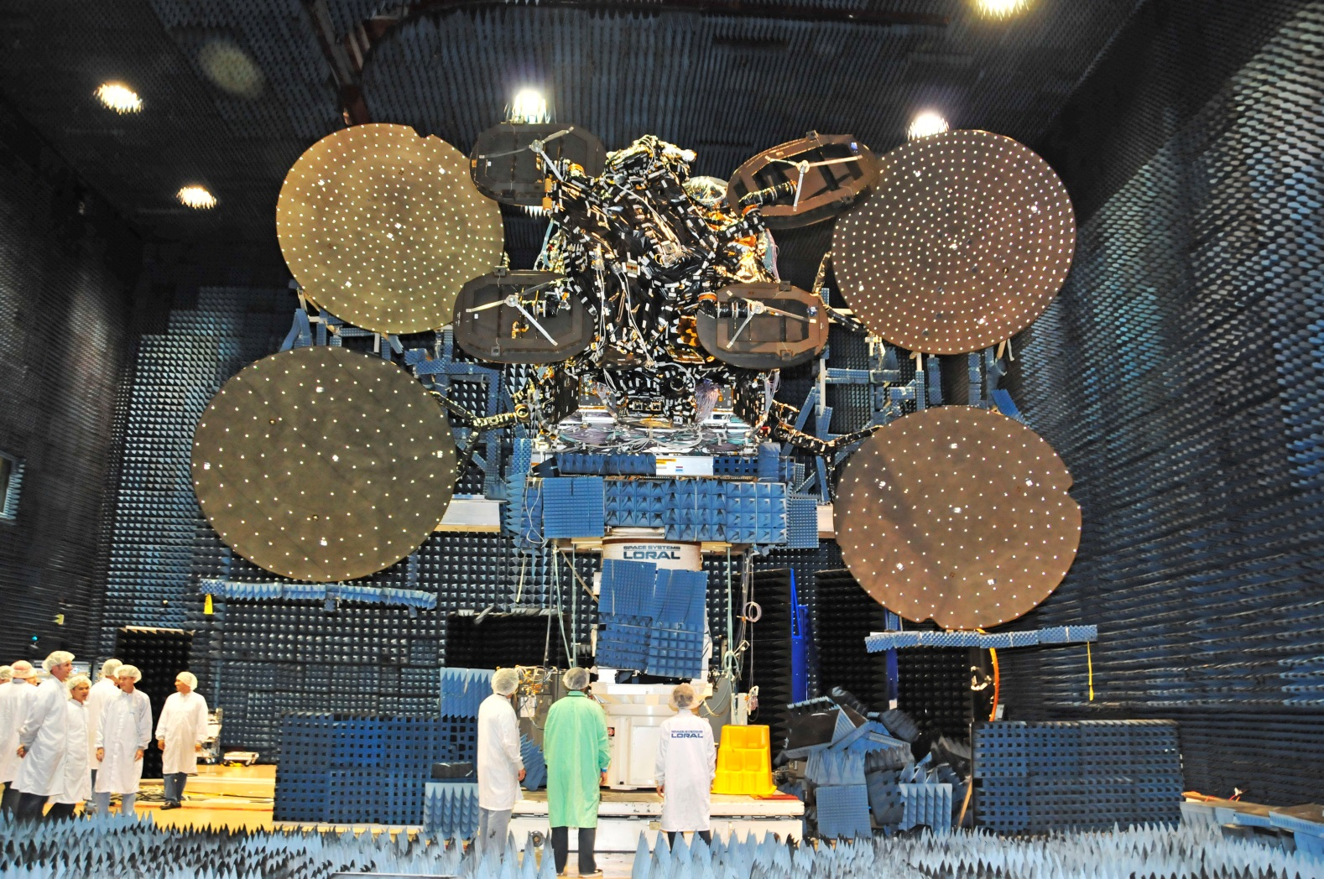
Fun Facts

Slide 11
Fun Facts (cont)
Distance from Earth: 22,000 miles.
If you angle from earth is off by ½ degree, you miss the Satellite by 190 miles.
63 spot beams over the 50 US states.
ViaSat-1 is a communications satellite owned by ViaSat. Launched October 19, 2011 aboard a Proton rocket, it holds the Guinness record for the world's highest capacity communications satellite with a total capacity in excess of 140 Gbit/s, more than all the satellites covering North America combined, at the time of its launch. Source: Wikipedia

Slide 12
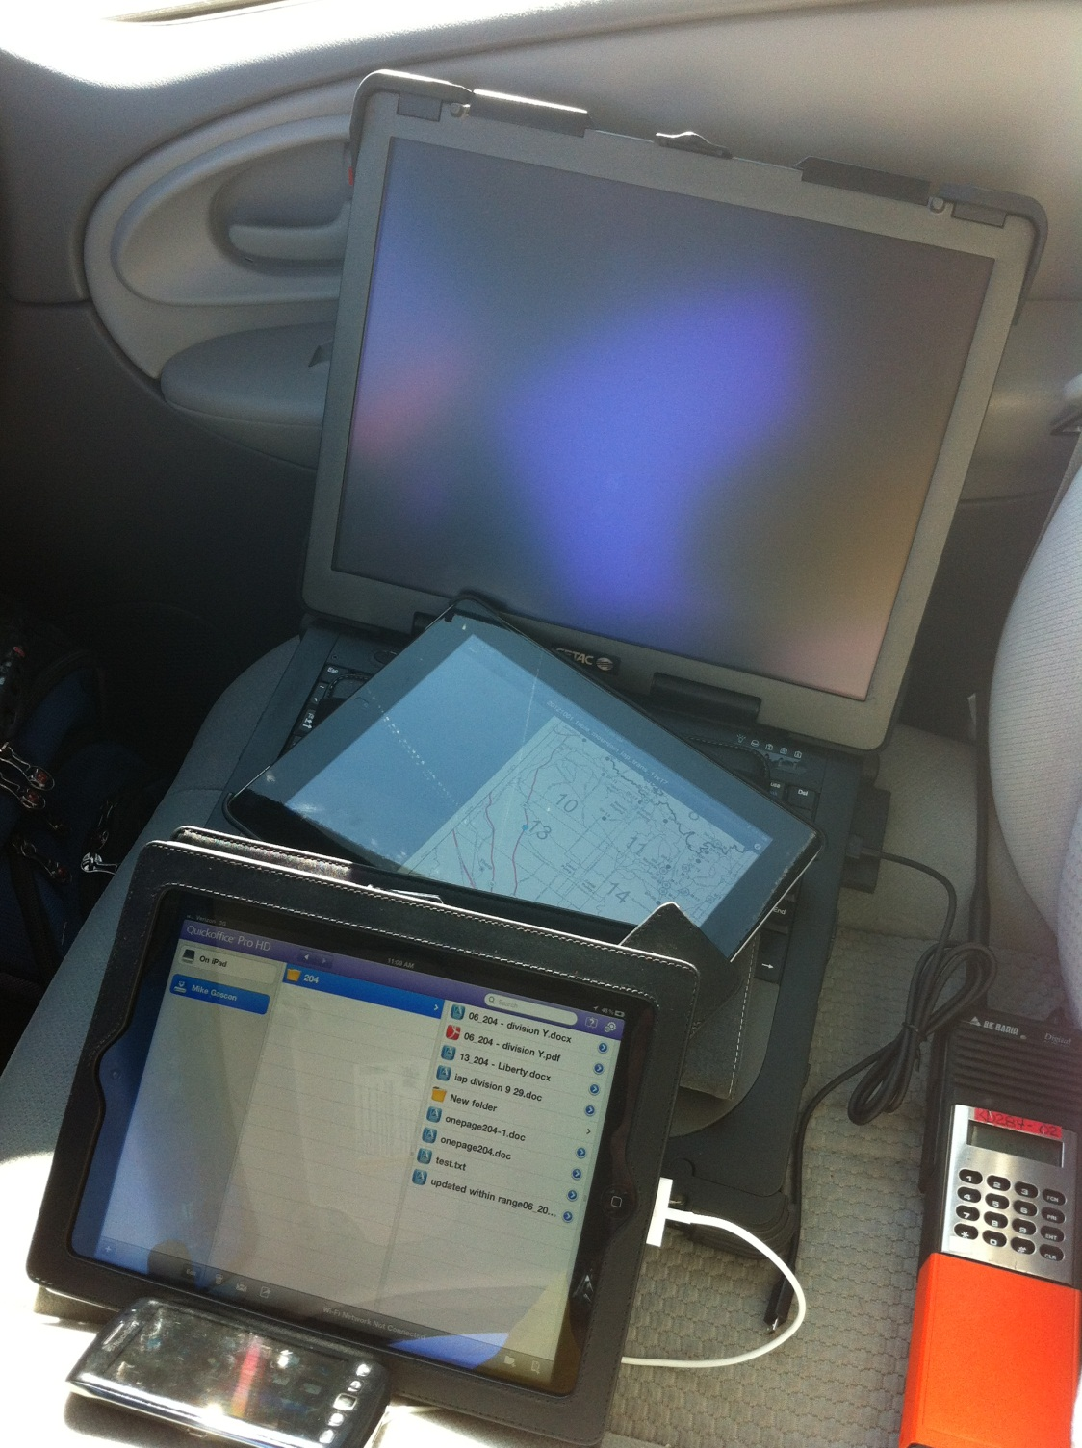
Summary
This is an evolving project.
We have seen great results from our counterparts in MT. 50 days deployed. Down time of 10 minutes for a firmware update.
Documentation and lessons learned will be ongoing.
There are vendors that provide the same dish and possibly enhanced service (phones). These will vary depending on GACC.

