Slide 1
Wildland Fire Information and Technology Management
Mobile Technologies
Smart devices in the field
April 2017
2017 ITSS class Mike Gascon mgascon@blm.gov

Slide 2
Agenda
Stats
Devices
Applications
Websites
How can a mobile device be used at an incident?
Informational sites
Whats a QR code? And his is it used?
Avenza PDF Maps
Mobile Technology goals
New news / Summary

Slide 3
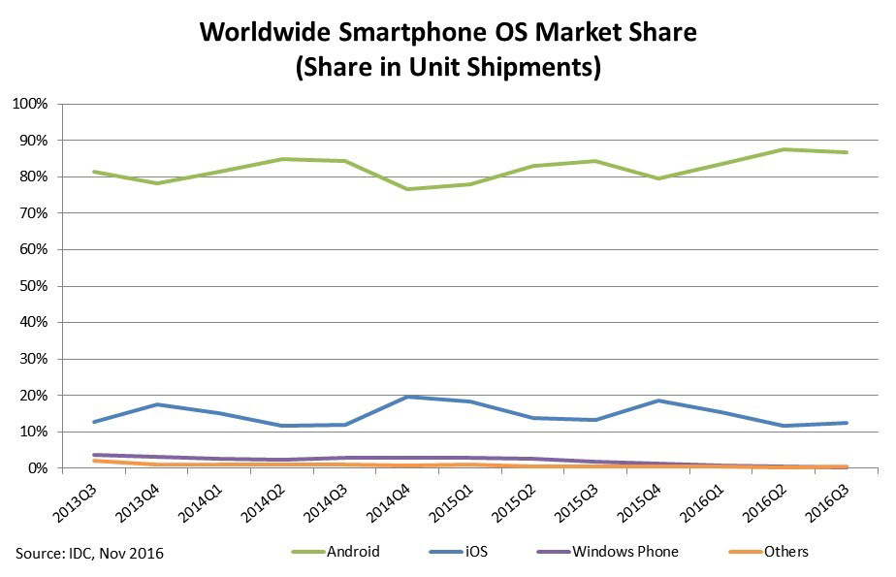
Smart Phone Stats

Slide 4
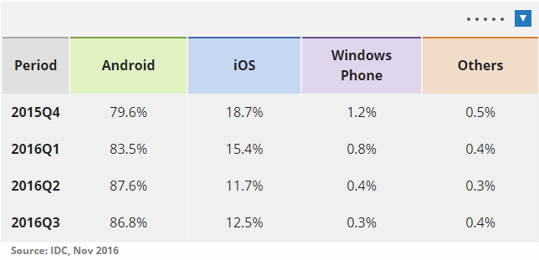
Smart Phone Stats by OS

Slide 5
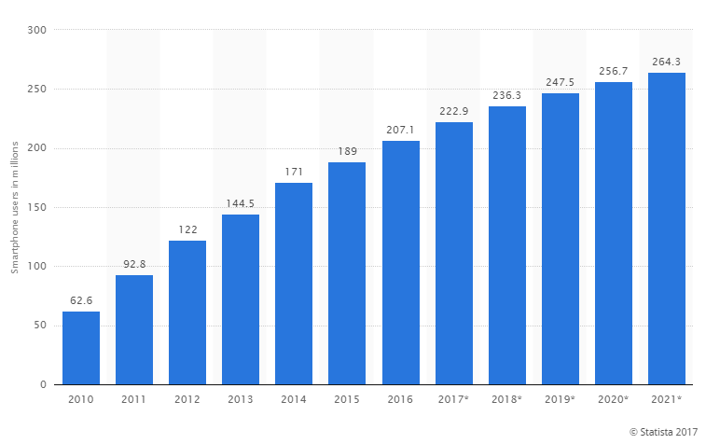
Number of smartphone users in the United States from 2010 to 2021 (in millions)*

Slide 6
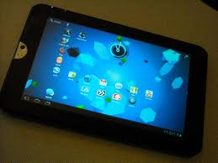
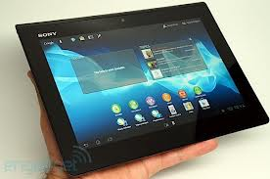
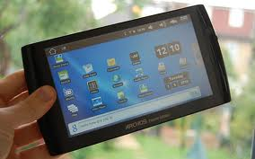
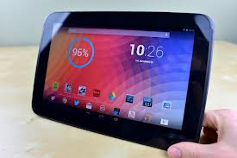
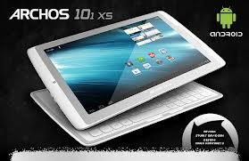
Devices
iPad
iPhone
Google Nexus
Amazon Kindle Fire HD
Barnes and Noble Nook HD+
Samsung Galaxy
Asus Transformer Pad Infinity
Microsoft Surface
iPad Mini

Slide 7
Devices (hardware)
Don’t worry, we don’t support them all. There is no way we could. No one can be an expert with all of the OS’s and hardware that is out there.
Primarily supporting iPad/iPhone with iOS.

Slide 8
Applications (Apps)
Similar to hardware, we can not support every app out there. There are literally 100s of thousands of apps from various sources.
App Store (Apple)
Google Play (Android)

Slide 9
Common Applications
GEOSPATIAL Scenic Map Western USA (Apple) GPS Tracks (Apple) Avenza PDF Maps (Apple, Android)
Weather NOAA High Definition Radar (Apple). Raindar (Android) Weather Calculator (Android)
Aviation ForeFlight (Apple)
Organization IRPG (Apple, Android)
Health Wildland Firefighter Nutrition and Hydration (iBook) OSHA Heat Safety/Heat Index tool Other Fire Project (Android) Firefighter Calculator (Apple) | Firefighter Calculator (Android) Firefighter RH Calculator (Android) Forest Fire Danger Meter (Android) Simple FDI Calculator (Apple) Wildfire Pro (Android) Wildland Toolkit (Apple) Wildland Fire Tools (Android) Wildfires by American Red Cross (Apple)

Slide 10
Common Websites
GEOSPATIAL Mobile Technologies in Fire and Aviation Management at Lessons Learned Center GETA Group (Geospatial Equipment and Technology Application Group) Prescribed Fire Smoke Management Pocket Guide
Weather NOAA Fire Weather
Aviation NOAA Aviation Weather Center

Slide 11
How can a mobile device be used at an incident?

Slide 12
How can a mobile device be used at an incident? The better question is what can it not do at an incident?
Mapping / Safety / Inventory
Fire line / perimeter
Escape routes
Safety zones
Landing area
Hazard areas
Hose Lay
Pump Location
Tree stand locations
Arial pictures
TFR’s
Document sharing/editing
Sharing documents / maps
Editing documents online and offline
Mailing documents
Weather
Current and forecasted
Warnings /alerts

Slide 13
Informational sites
http://www.myfirecommunity.net search Mobile Tech in Fire to find it. Community forum for anything about apps, devices, mobile technology in fire
https://gacc.nifc.gov/nwcc/ctsp / ITSS web site. Mobile technology and ITSSrelated.

Slide 14
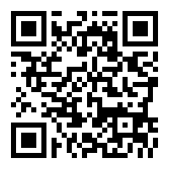
What’s a QR code?
Wikipedia definition: A QR Code is a matrix barcode (or two-dimensional code), readable by QR scanners, mobile phones with a camera, and smartphones. The code...
QR code is a Quick Response code that can link to:
Free Text
URL
Phone Number
SMS
Contact
Great. How does that help a firefighter?

Slide 15
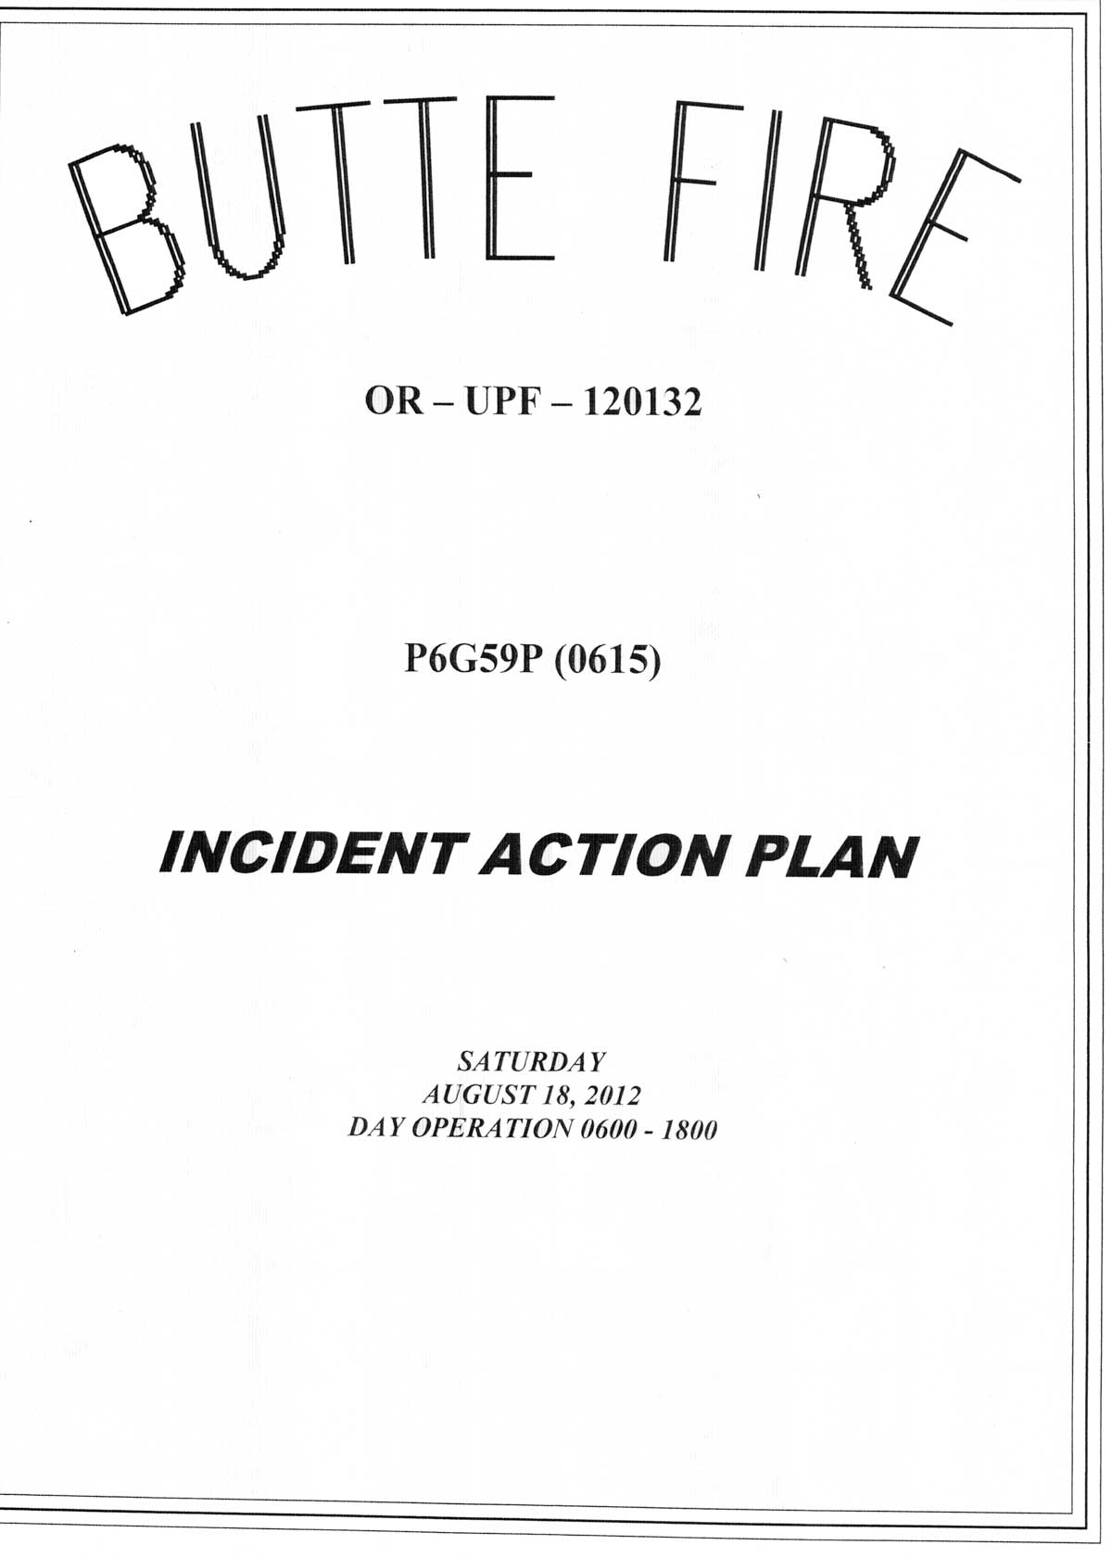
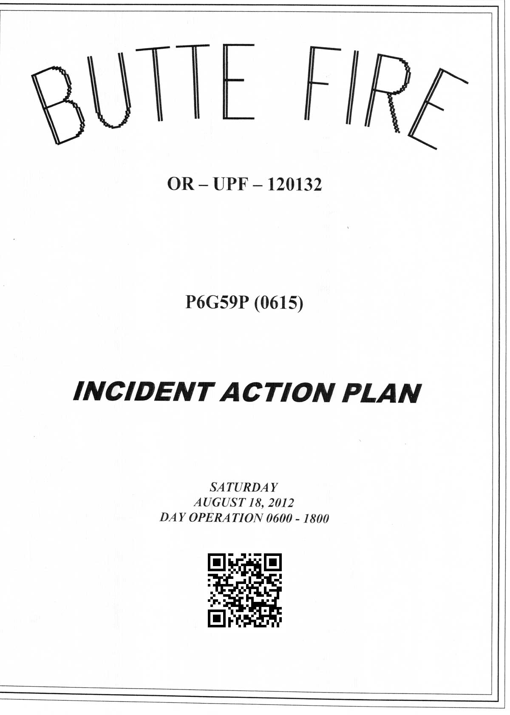
QR code
IAP (Incident Action Plan)
The MOST used document at fire camp. EVERYONE has it or has access to it. Put a QR code on it!
QR code generators are readily found online and crazy easy to use. (And Free!)

Slide 16
QR code uses
QR codes can point to a web site that houses anything really. For fire, typical uses will be:
Maps
IAP
Pictures
Information
NO PII allowed!
You will need to have a website to put data on to keep the content current. No bells and whistles are needed, keep it simple.
NOTE: If possible, point the QR code to a website instead of an FTP site. There have been some instances that iOS did not work as well on FTP as it did HTTP.

Slide 17
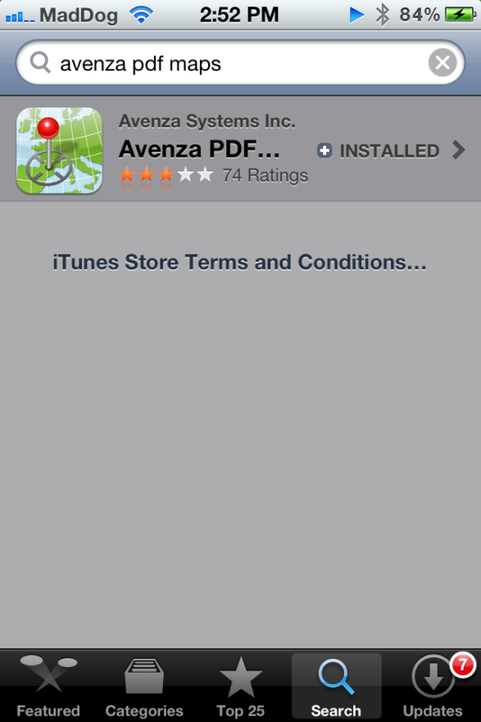
PDF maps getting started
Avenza Maps and how to use it.
What is a geo referenced map? Simply put, it is a pdf that has lat/lon embedded into it. With your smart device, gps coordinates are displayed on the map, showing where you are on the map.
From the App Store, download and install “Avenza PDF Maps”.
After the app installs, open it.

Slide 18
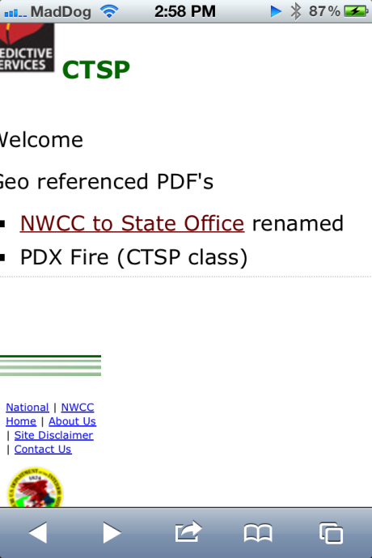
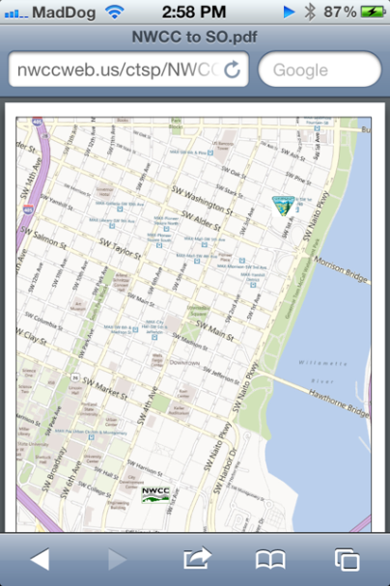
Avenza PDF Maps
Open geo referenced pdf. For This example, we will use one at https://gacc.nifc.gov/nwcc/ctsp Click on the “<training location> PDF” PDF. This is a georeferenced PDF of the <training> area. After it opens, click on the pdf itself. This should prompt on how to open it.
The pdf will open.

Slide 19
Avenza PDF Maps
Both BLM and FS have evolving contracts with Avenza PDF maps. See your agency for licensing information.
Avenza has the ability to download and open a map. Even out of cell/wifi range.
Avenza can add placemarks and/or breadcrumbs to a track.
Can export tracks and photos when done with tracking. Can export to many formats and save or email final file.
Note: When taking pictures in the app, it saves them to your camera roll for future use.

Slide 20
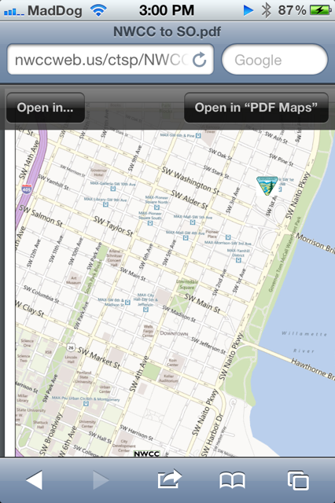
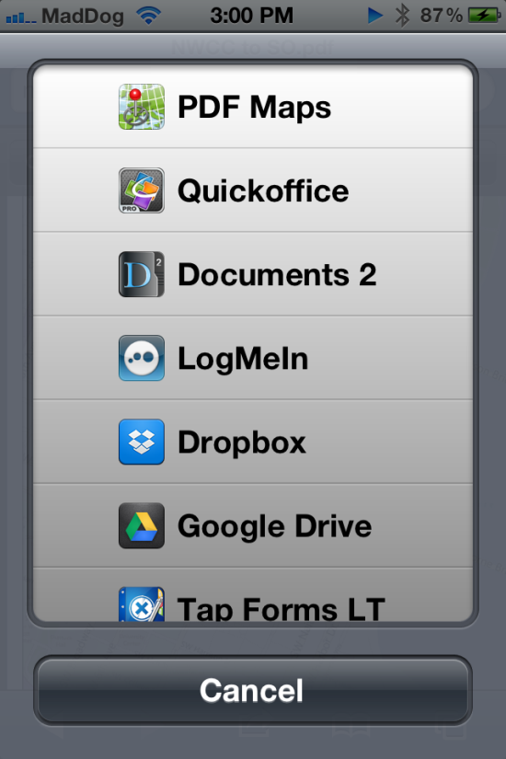
Avenza PDF Maps
Tap on the pdf. You will get a prompt at the top with what to open it in. Click “Open In…”
A list of Apps will display. Choose “PDF Maps”.

Slide 21
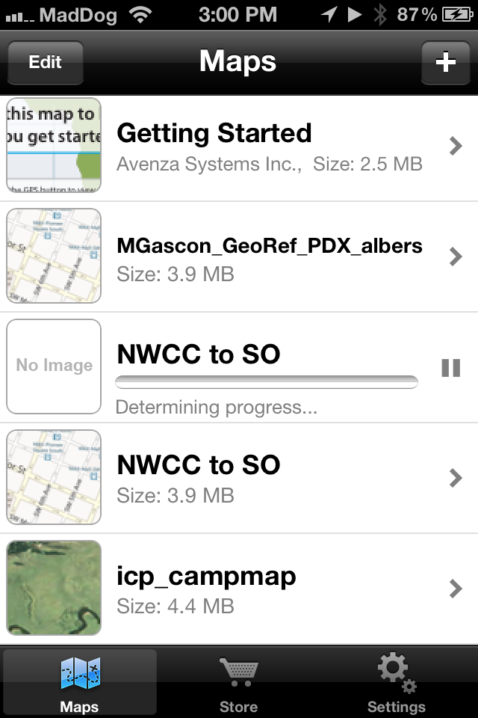
Avenza PDF Maps
Avenza PDF Maps will open. It will start to download the pdf file.
There are other ways to open pdf’s in Avenza.
Local, Dropbox, mail, iTunes file sharing, web sites, etc
To open the map, simply click on it.

Slide 22
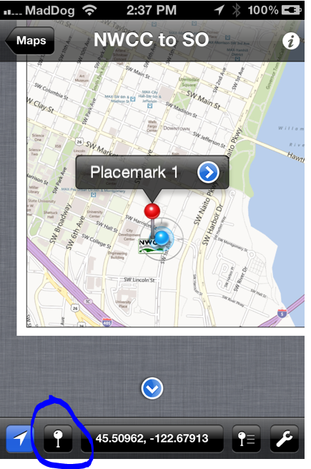
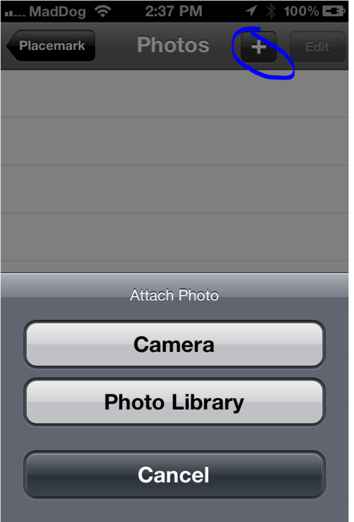
Avenza PDF Maps
To create a placemark, click the icon next to the locator icon. That will place the placemark.
To add a picture, click on the Photo section and click add. Click the plus sign and choose from camera or library.

Slide 23
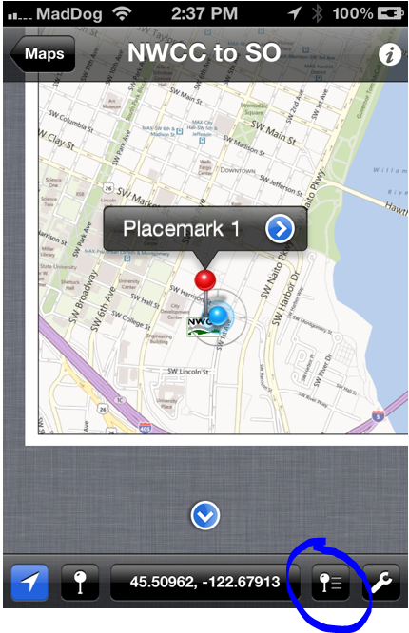
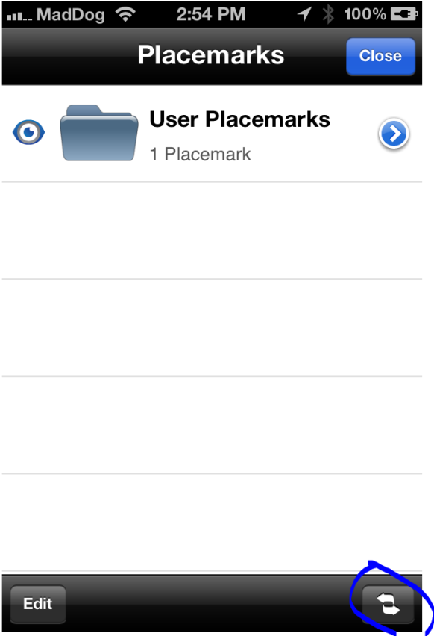
Avenza PDF Maps exporting
To export placemarks to KML file, click the export button.
On the next screen, click the double arrows button.

Slide 24
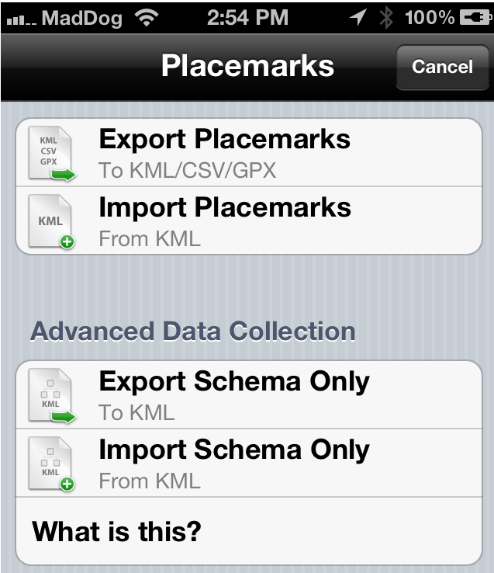
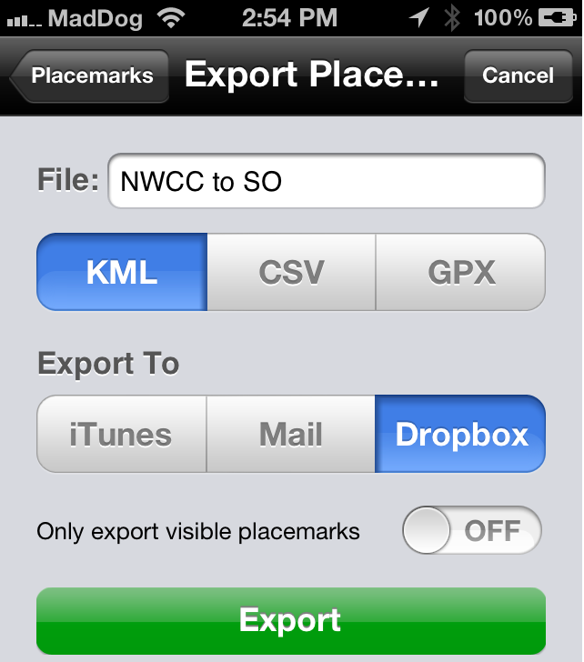
Avenza PDF Maps exporting
From this screen, you have options of what format to export to. Normally Export to KML is best. Work with GISS/SITL for predetermined export format.
From this screen, you can name the file, choose the format and where to export to.

Slide 25
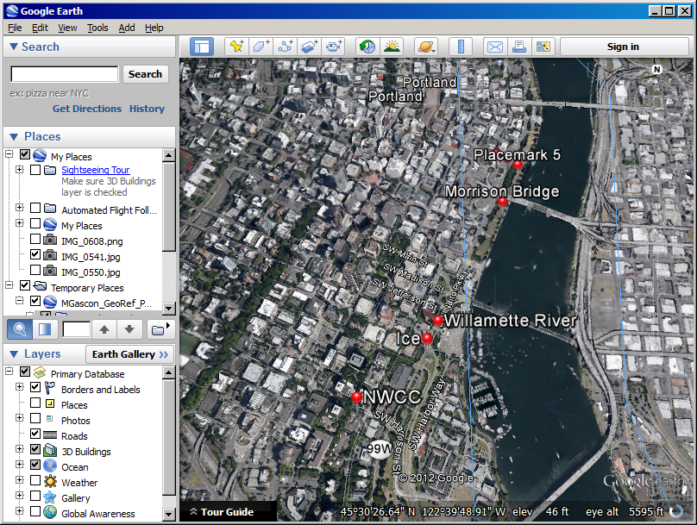
Opening your exported file on a PC
When opening on a computer, it should have placemarks.

Slide 26
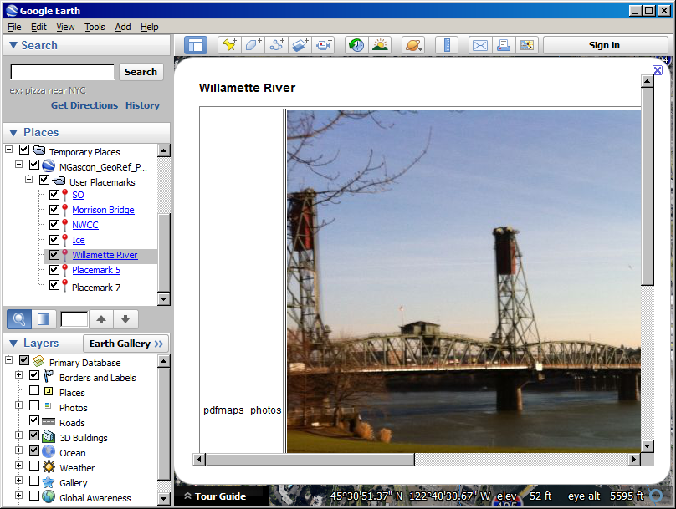
Opening your exported file on a PC
Clicking on the placemarks will reveal the picture taken.
For viewing, this test file is located at: https://gacc.nifc.gov/nwcc/ctsp/ File names “KML NWCC to State Office after export with Pictures.”

Slide 27
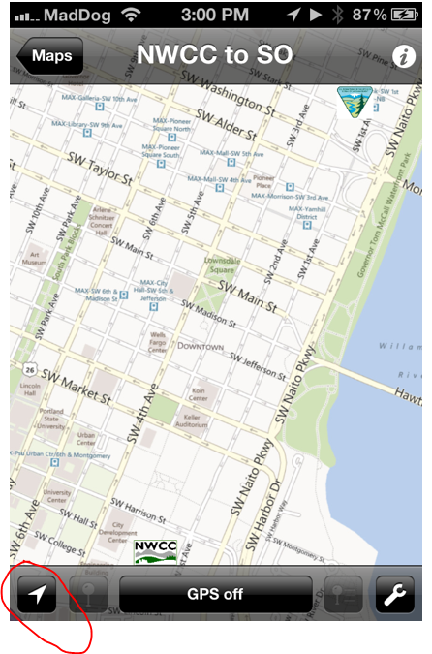
Avenza PDF maps troubleshooting
GPS off message Simply click on the location arrow. It should automatically update GPS coordinates and put you on the map.

Slide 28
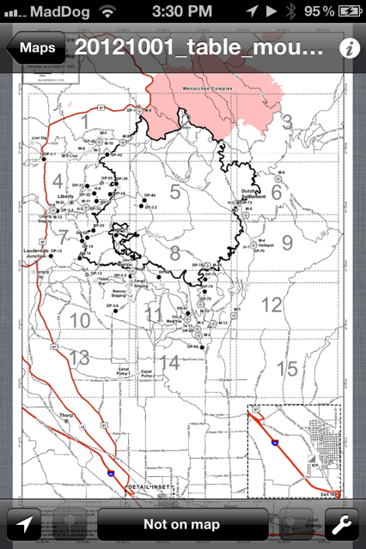
Avenza PDF maps troubleshooting
Not on map. This will happen When you are not within range of the map. When you do get with in range, the “Not on map” will change to the coordinates.

Slide 29
Avenza PDF maps troubleshooting
PDF maps need to be saved as “geopdf” to work. Documentation on how to do that is at https://gacc.nifc.gov/nwcc/ctsp Coordinate and discuss that with GISS/SITL.

Slide 30
Mobile Technology Goals
Goals are to make them as simple to use as possible. They need to be a tool and not a hindrance so people will actually use them.
Many people are supportive of using them and seeing what can be done with them. I only heard one negative comment of “I aint gonna carry that in my pack all day. It aint gonna dig no fire line for me”.
Keep in mind the demographics of wildland fire fighters, young people that are up to speed with technology. Get their feedback if possible.

Slide 31
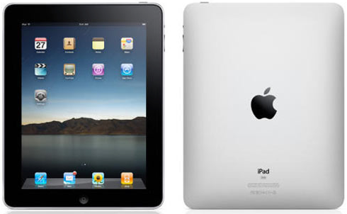
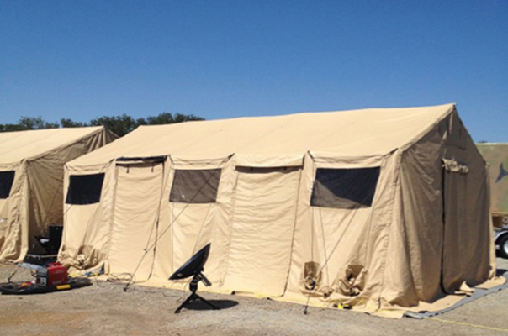
Mobile Technology Goals
iPads will be available on the rental contract. See your team for more info.
ViaSat internet as an option for camps where there is no internet access.

Slide 32
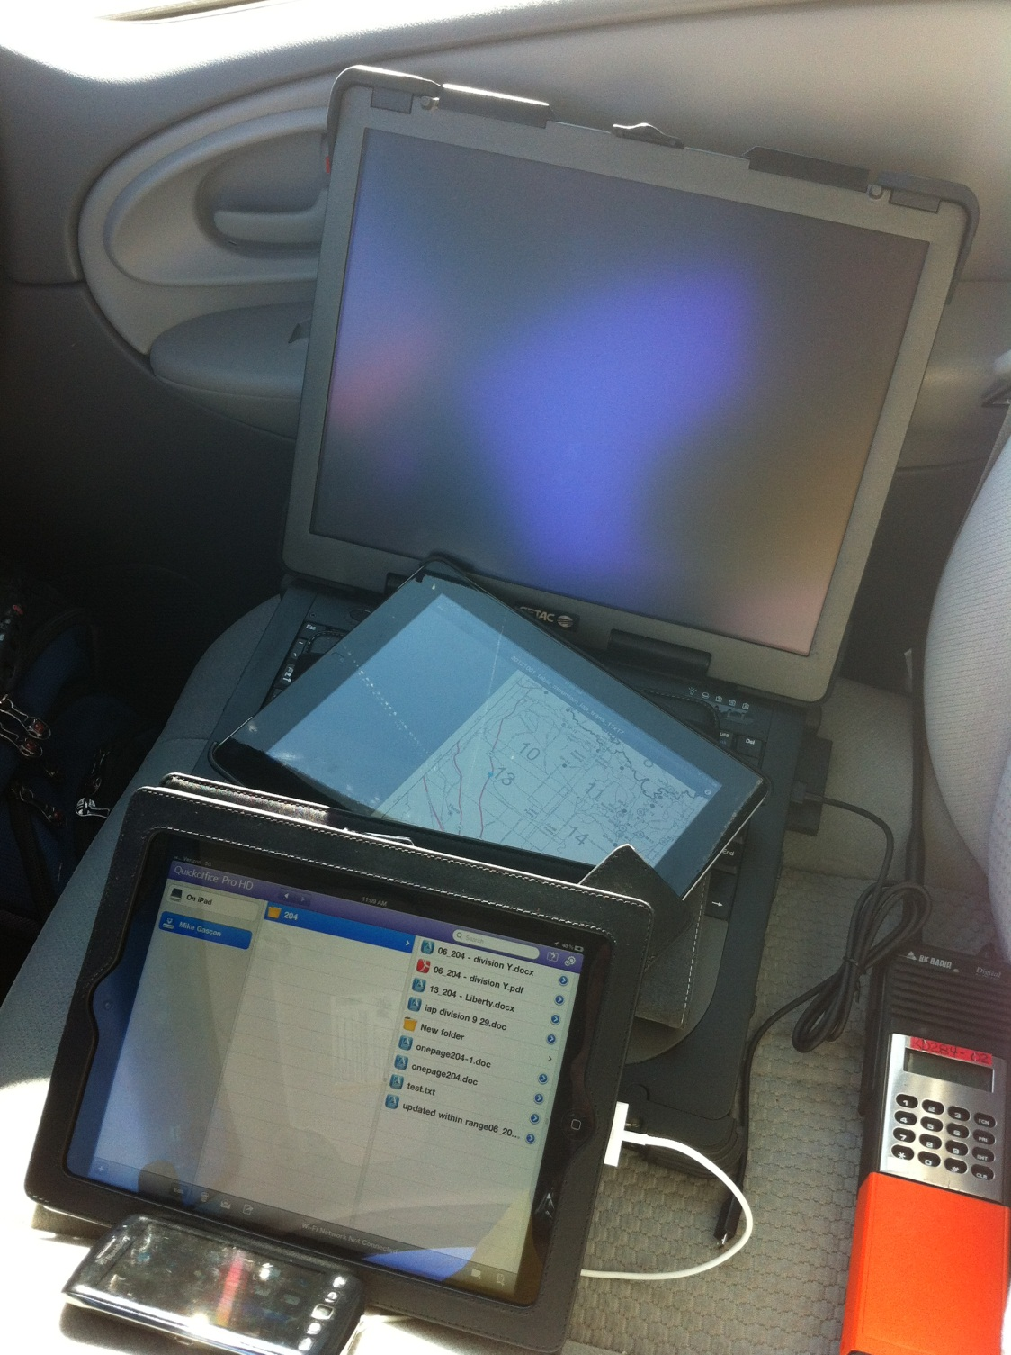
Summary
Ideally, you will have:
Internet access (at least at fire camp)
iDevice (iPhone/iPod)
Web server to store data on and keep it up to date
Supportive users
A successful and safe incident

