Slide 1
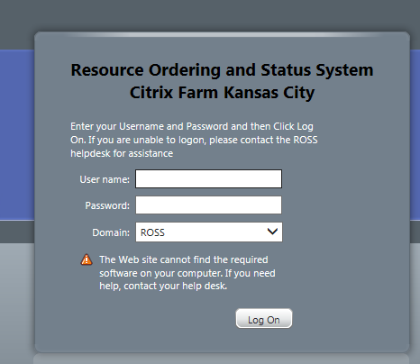
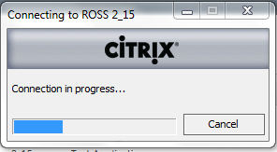
GENERAL USER INSTRUCTIONS
Non FS Citrix Application / ROSS Production Application
Open Internet Explorer (IE)
Click Link To Citrix XenApp
Login In Using NON FS CITRIX ACCOUNT INFO
https://ross.fs.fed.us/XenApp
IF THIS IS A NEW ACCOUNT
You Will Be Prompted To Change Initial Password.
Suggest Using Your ROSS Password for Citrix Password
Select
ROSS
Application
Wait For Citrix Client To Attach To ROSS
Last Updated: 07/31/2013

Slide 2
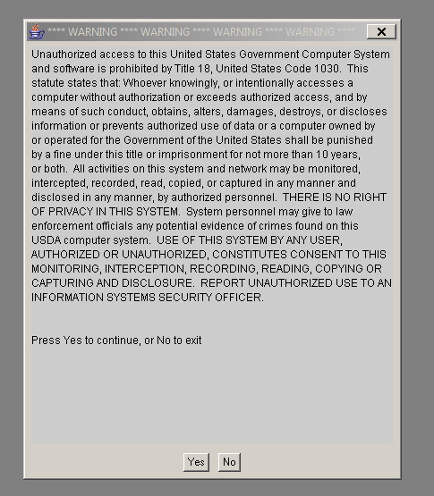
GENERAL USER INSTRUCTIONS
5) FROM THIS POINT ON You Will Access and Utilize The ROSS Production Application As Normal
6) Utilize
LogOff Button
To EXIT the
CITRIX Client
Basic Flow: Login In To The CITRIX CLIENT : Login In To ROSS from IE / Citrix Screen : Utilize ROSS Production Application
To EXIT ROSS Production : Close Application (File Exit) : LogOff Citrix (Closing IE / Citrix Application [NOT LOGGING OFF] Can Corrupt Printer Configurations)
Last Updated: 07/31/2013

