Slide 1
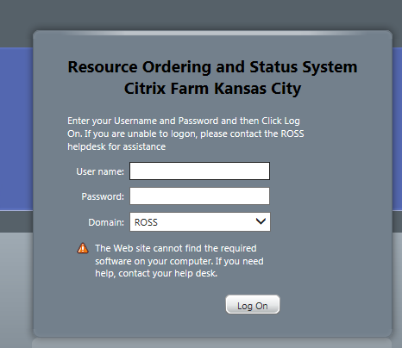
NON FS CITRIX CLIENT INSTALLATION – ACCESSING ROSS FROM NON AGENCY NETWORK
(Utilizing Rental PCs on Non Agency Network)
Last Updated: 07/31/2013
ISSUES: Utilizing ROSS Production Application on Non Agency (USFS / BLM) Network CAN Result In Not Being Able To CONSTANTLY Print Information From ROSS and Editing Information within The ROSS Application.
Information Was Received From ROSS Vendor Support That ROSS Production Application Was Originally Designed To Operate on Agency PCs On The Agency Network. Current Version of ROSS Production Application Is Only Supported On IE8.
The Following Documentation Is An Attempt To Provide An Alternative / Solution To Using Rental PCs (Non Agency Equipment) on a Non Agency Network. Experience Has Shown That This Alternative May or May Not Work Depending On The Non Agency Network Available. Sometimes Rental Equipment Access The Ross Production Application On A Non Agency Network Is Very Successful, Sometimes You Will Experience Printing / Editing Frustrations / Errors.

Slide 2
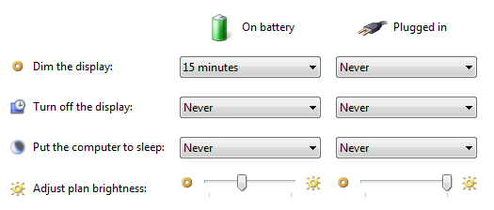
ROSS PRODUCTION APPLICATION ON RENTAL COMPUTERS NOT ON AGENCY NETWORKS
Note: This Documentation Assumes The User Is An Experience Computer User.
Suggested Modifications to Rental Computers
You Can Not Proceed with Complete Installation WITHOUT Non FS Citrix Account
Last Updated: 07/31/2013
1) Install Network Printer(s)
2) Uninstall Mozilla Firefox - 2 Applications
(Control Panel : Programs and Features)
Citrix Application Try To Access Firefox Plugins If Firefox Installed
Mozilla Firefox Can Be Reinstalled
After Citrix Client Installation
3) Adjust Power Options (Control Panel)
Suggested Settings : Modify For Your Requirements
Suggested Settings : Modify For Your Requirements
1

Slide 3
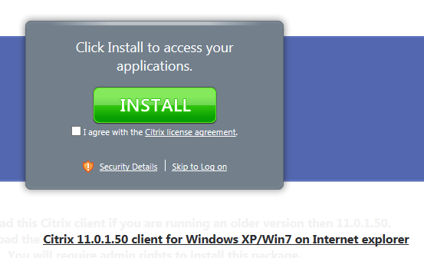
Using INTERNET EXPLORER
Do Not Use Another Other Browser – ROSS Production 2_15 Application Is Designed to Only Operate on IE
Last Updated: 07/31/2013
REQUEST : Non FS Citrix Account : See Application Form
ROSS_Non_FS_Citrix_Account_Request_Form_MICC_MMDDYYYY
You Can Not Proceed with Complete Installation WITHOUT Non FS Citrix Account
2) Using IE : Access https://ross.fs.fed.us/XenApp
3)
2

Slide 4
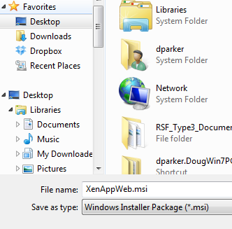
3a)
Last Updated: 07/31/2013
SAVE AS
3b)
Select A Location To SAVE the XenAppWeb.msi Application
DO NOT RUN without SAVING the Application on your Hard Drive
3c)
Do Not Change File Name
3d)
3d) File Downloads : “Wait For It” : Close Download Window
4) Close IE
3

Slide 5
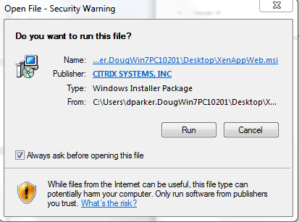
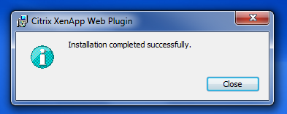
5a) Locate XenAppWeb.msi and Execute Application To Install
Last Updated: 07/31/2013
The Application Opens & Closes A Number of Screens
Just “Follow The Prompts”
5b)
WAIT : BE PATIENT : TAKES A WHILE
5c)
4

Slide 6
6) Using IE : Access https://ross.fs.fed.us/XenApp
Last Updated: 07/31/2013
7) Save Location In Favorites / Favorite Bar
5

Slide 7
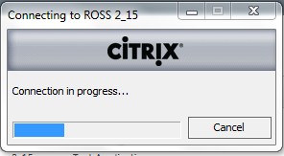
8)
Last Updated: 07/31/2013
IF THIS IS A NEW ACCOUNT
You Will Be Prompted To Change Initial Password.
Suggest Using Your ROSS Password for Citrix Password
9)
Wait For Citrix Client To Attach To ROSS
6

Slide 8
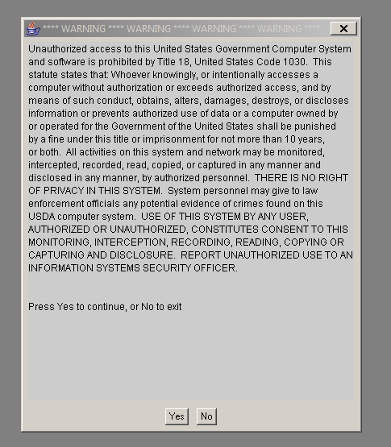
FROM THIS POINT ON You Will Access and Utilize The ROSS Production Application As Normal
Last Updated: 07/31/2013
Browse Around ROSS To See If
You Get Any Printing Errors
11) Utilize
LogOff Button
To EXIT the
CITRIX Client
STRONGLY SUGGEST: REBOOT PC After Installing Citrix Application & You Have Ensured The Application Is Basically Working. Rebooting has resolved a number of minor errors in printing.
Basic Flow: Login In To The CITRIX CLIENT : Login In To ROSS from IE / Citrix Screen : Utilize ROSS Production Application
To EXIT ROSS Production : Close Application (File Exit) : LogOff Citrix (Closing IE / Citrix Application [NOT LOGGING OFF] Can Corrupt Printer Configurations)
7

Slide 9
General Clean Up Recommendations:
Last Updated: 07/31/2013
Remove XenApp.msi Installation File From Desktop
Move / Remove STANDARD ROSS PRODUCTION SHORTCUT/ICON From Desktop
This is recommended to REDUCE confusion of which ROSS Production Application To Utilize.

Slide 10
Contacts:
ROSS Help Desk : (866) 224-7677
Mary Gausen
ROSS Program Specialist
ROSS Project Team
530.598.4187 (C)
720-457-9814 (O)
mgausen@fs.fed.us
Jenny Burris
Citrix / Lockheed
720.457-9814 (O)
jburris@lw-lmco.com
Doug Parker
CTSP / PNW Team 3
541.941.2392 (C)
dwp1955@gmail.com
Last Updated: 07/31/2013
Developed This CTSP Instructions From Various ROSS & User Support Documents
8

