Slide 1
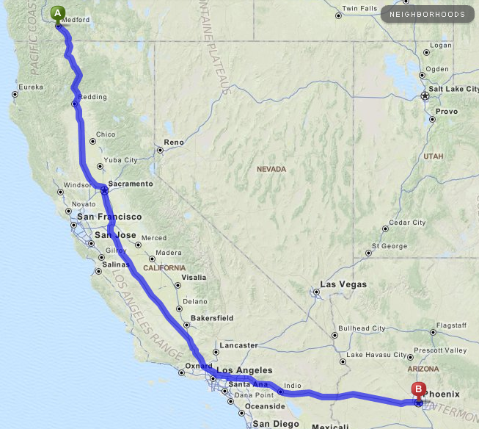
FLY KIT DRIVING ESTIMATES
MEDFORD TO PHOENIX
Estimate:
1 night motel
2 days driving
Plan:
Day 1 -Leave Medford
Spend Night Past LA
Day 2 - Drive to Phoenix/Fire Camp
NOTE: These estimates are for “getting a general idea” use only.

Slide 2
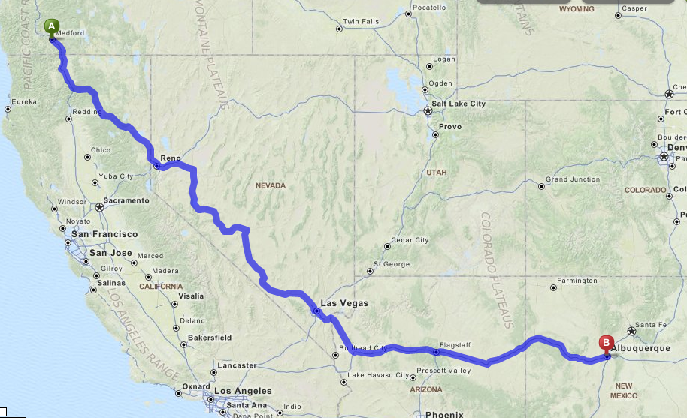
FLY KIT DRIVING ESTIMATES
MEDFORD TO ABQ
Estimate:
1 night motel
2 days driving
Plan (Best Case):
Day 1 -Leave Medford
Spend Night Las Vegas
Day 2 - Drive to ABQ/Fire Camp
NOTE: These estimates are for “getting a general idea” use only.

Slide 3
FLY KIT DRIVING ESTIMATES
MEDFORD TO DENVER
Estimate:
1 night motel
2 days driving
Plan (Best Case):
Day 1 -Leave Medford
Spend Night Salt Lake
Day 2 - Drive to Denver/Fire Camp
NOTE: These estimates are for “getting a general idea” use only.

