Slide 1
Types of ITSS Trailers
Wildland Fire Information and Technology Management
CROW
MIMIT

Slide 2
CROW (Computer Room On Wheels)

Slide 3
CROW

Slide 4
CROW

Slide 5
Cables, APC, Etc….

Slide 6
EISuite Server - Drobo

Slide 7
Battery Power – Pumpkin?

Slide 8
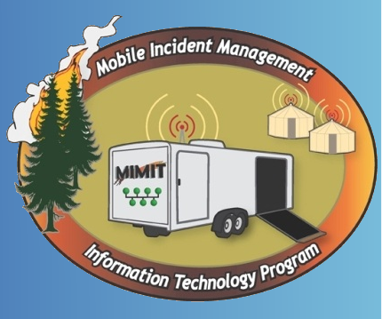
MIMIT (Mobile Incident Management Information Technology Program)

Slide 9
5 total trailers in Great Basin

Slide 10
Window Server 2008 R2

Slide 11
Router - 1GB Switch - RADIUS – LAN Controller

Slide 12
APs and Thin Clients, now Laptops

Slide 13
Printers and Power Strips

Slide 14
Backup Plan for APs

Slide 15
Large screen for IAP

Slide 16
EIsuite Machine

