Slide 1
Incident Command system (ICS)
Organization Structure

Slide 2
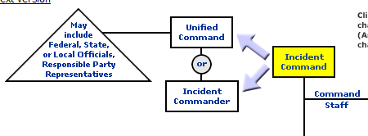
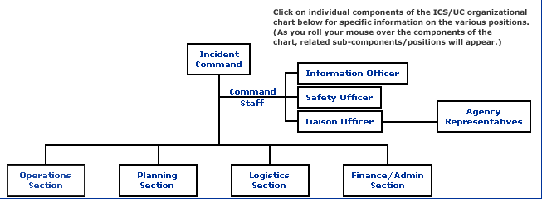
Command and General Staff (C&G)
Expanded Control
(Multiple Incidents / Complex Jurisdiction)
ICS
Incident Command System
Effectively / Efficiently / Safely
Source: http://www.osha.gov/SLTC/etools/ics/org.html

Slide 3
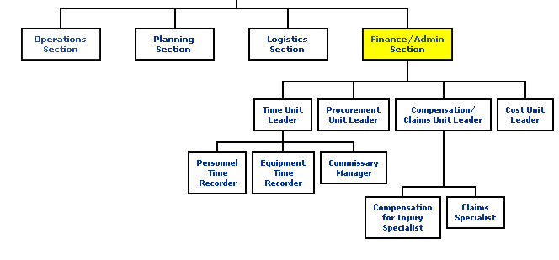
Finance
Source: http://www.osha.gov/SLTC/etools/ics/org.html

Slide 4
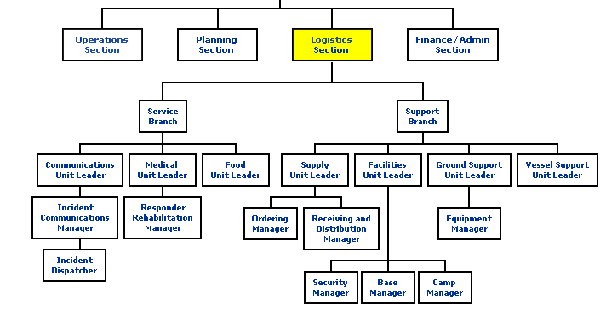
Logistics
Source: http://www.osha.gov/SLTC/etools/ics/org.html

Slide 5
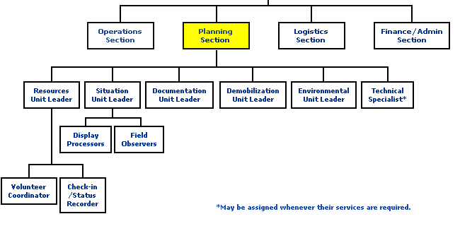
Planning
ITSS
Source: http://www.osha.gov/SLTC/etools/ics/org.html

Slide 6
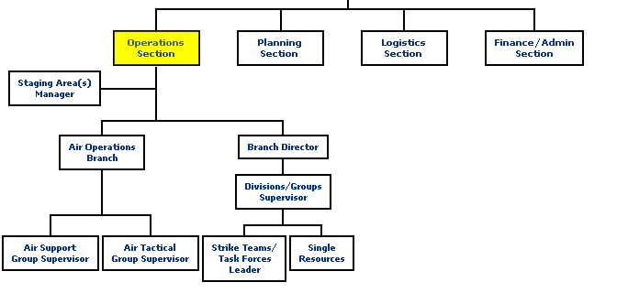
Operations
Source: http://www.osha.gov/SLTC/etools/ics/org.html

