Slide 1
Making and Testing Ethernet Cables

Slide 2
EIA/TIA-568A and 568B Cables
EIA/TIA-568 Commercial Building Telecommunications Wiring Standard
Telecommunications Industry Association (TIA) http://www.tiaonline.org.

Slide 3
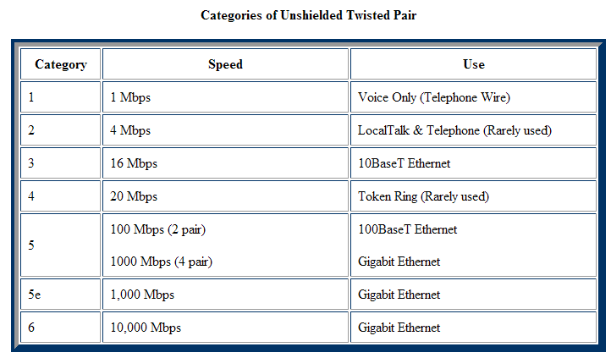
CATx CABLE QUICK FACTS

Slide 4
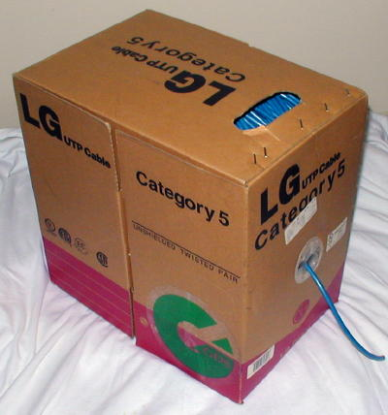
Cable - you can buy a 1000 feet roll of Cat 5/6 cable at computer stores or datacomm supply companies. Get the good stuff.
Solid wire - each one of the 8 wires inside the cable consists of one solid wire. It has better conductivity than stranded cable, which means you can run ethernet over farther distances.
Stranded wire - each one of the 8 wires inside the cable consists of a few dozen very fine hair-like strands that bend and flex very easily.

Slide 5
We’ll Go Through These Steps
Measure
Strip
Untwist
Order
Trim
Punch
Repeat
Test

Slide 6
RJ-45 connectors usually come in bags of 50, 100 etc.
Two different kind of RJ-45 connectors – for solid or stranded wire cables
Using the wrong kind will likely result in a bad connection

Slide 7
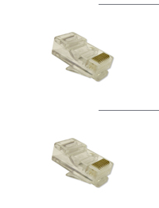
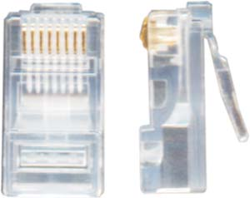
RJ Connectors
8 wire – STRANDED (wire) = 2 “Teeth”
Versus
2 “TEETH”
8 wire – SOLID (wire) = 1 “Tooth”
Stranded (or Solid)
RJ = Registered Jack

Slide 8
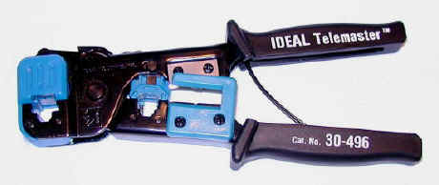
Ratcheting Crimping tool - the crimpers will pay for themselves after you make a few cables.
A good crimping tool has a pair of wire cutters built in, as well as a blade to strip insulation.

Slide 9
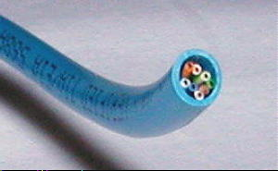
Cut a piece of Cat 5 as long as you need. Remember: Measure twice, cut once. Don’t be afraid to leave some slack
Make sure the cut on each end is clean and straight.

Slide 10
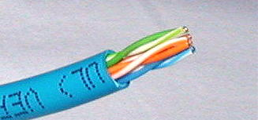
Strip about an inch of the insulation off the cable. Cut it back square. Some crimping tools come with a built-in wire stripper
It is extremely important that you only cut the plastic insulation/jacket and not the wire.
Damaging one of the 8 wires, even if you just nick it or partially cut it, will ruin your cable.

Slide 11
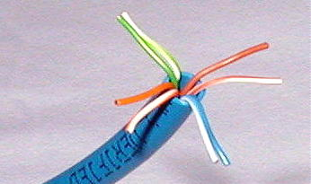
Untwist the wires. You'll notice that there are 4 pairs of multi-colored wires inside. Sort the pairs by color.
You should see wires color coded as follows: blue/blue-stripe, orange/orange-stripe, green/green-stripe, brown/brown-stripe.

Slide 12
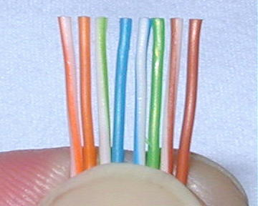
Align the wires in the following order
orange stripe
orange
green stripe
blue
blue stripe
green
brown stripe
brown

Slide 13
orange stripe
orange
green stripe
blue
blue stripe
green
brown stripe
brown
Clip off the tops so that the wires are all the same length and stick out about ¾ of an inch from the insulation.

Slide 14
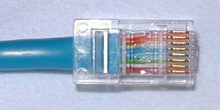
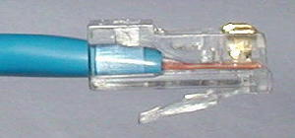
Hold an RJ-45 connector clip down
Insert the sorted and aligned wires carefully into the RJ-45 connector
Verify that the wires are still in the correct order.
Make sure that the wires have gone all the way into and are touching the end of the RJ-45 connector. Now push the jacket as far as it will go into the connector.

Slide 15
RIGHT!

Slide 16
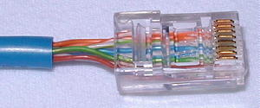
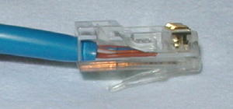
WRONG!

Slide 17
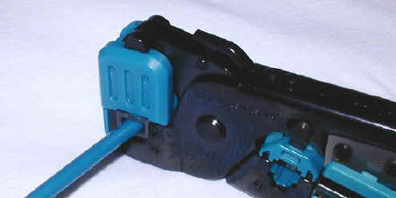
Insert the RJ-45 connector into the crimping tool.
Squeeze the handle.
You will know you’re done when the tool releases.

Slide 18
You’re ½ Way There!
Repeat this procedure to put a 568B connector on the other end of the cable.
Use the same wire order as on the first end
This will make a straight-through cable.

Slide 19
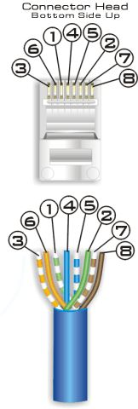
EIA/TIA 568A 568B

Slide 20
Test Your Cables
Test all cables before you install them. It saves hours of data chasing later.
Find a bad cable? Repair it or cut it and toss in the trash. You don’t want broken cables in your kit.

Slide 21
Follow These Easy Steps
Measure
Strip
Untwist
Order
Trim
Punch
Repeat
Test
TEST
Never Install A Cable
You Have Not Tested
http://www.pcnineoneone.com/howto/cat5diy1.html

