Slide 1
e-ISuite ITSS Tips and Tricks
April 2018
http://famit.nwcg.gov/applications/eISuite

Slide 2
Site Basics
Only Install Site on Server Machine
Officially supported environment
Windows 7/10, Windows Server 2008/2012 R2
Mac – Not officially supported (Helpdesk will not be able to support)
Works fine as client using Safari, Chrome, Firefox
Server will work fine but must be running in a Windows VM
Browsers
Internet Explorer 11 (Official Browser)
Chrome (Preferred Browser)
Firefox generally works well
Edge – May require enabling localhost loopback
Flash “End of Life” may start impacting all browsers
See flash article
https://redmondmag.com/articles/2017/07/25/adobe-ending-flash-support.aspx

Slide 3
iPads, Android Tablets
Can use as clients only via Remote Desktop Connection
Ties up one laptop/PC for each connection
Chrome Books can be used as clients

Slide 4
404 Page Error on Server
Clear Browser Cache
Completely close Browser
Check to make sure Apache Tomcat and pgsql Services are running
Establish inbound firewall rule for Port 59123
Check for competing web services (Port 80)
Make sure Internet Information Services (IIS) is Unchecked (not black, not grey, completely unchecked)
Changes to IIS settings requires a reboot

Slide 5
404 Page Error - Cannot Display Web Page on Client
Verify client can ping e-ISuite Server
Verify correct URL
Agency Network
Port 80 is typically blocked
http://ServerIP:59123/isuite/fx/welcome.html#
Non Agency Network
Ensure Port 80 and/or 59123 on the Server is open for incoming TCP Traffic
Tip
If the Client can Ping the Server, temporarily turn off Windows Firewall on the server machine and try to connect Client. If Client can connect, either port 80 and or Port 59123 is blocked. Create a new inbound rule on Windows Firewall.

Slide 6
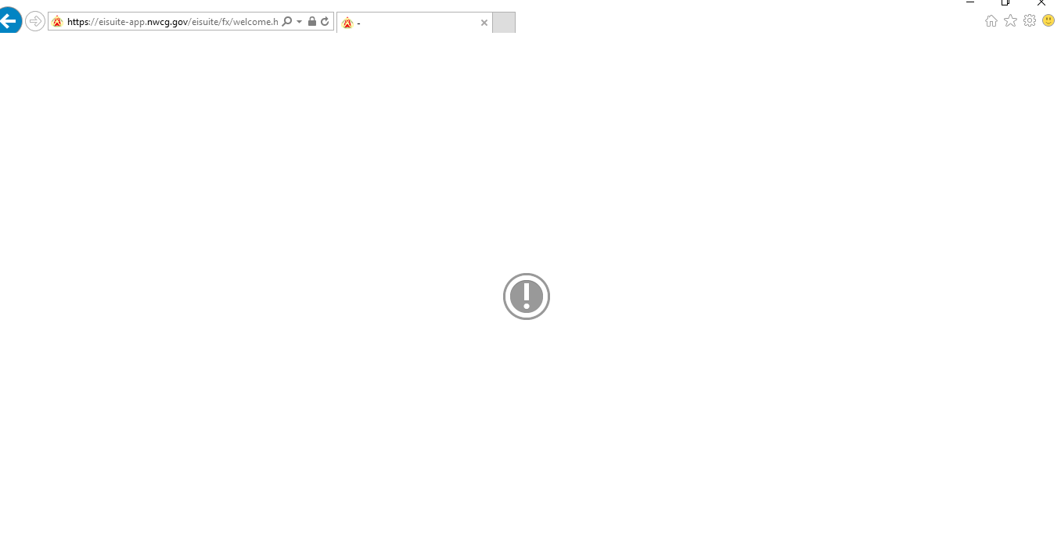
Exclamation Mark Error
Flash Memory Error
Typically occurs on IE and Edge
Can occur when creating a Transition File
Have seen it randomly occur in other areas of the Application
Solution “USE CHROME”

Slide 7
Create New Database Error
Random, may not see it, but if you do…
Log into a good database and remove bad one
Work-around
Use the Restore Database function to restore a blank, empty database
Navigate to C:/ProgramData/E-ISuite/NWCG-Backups folder/eisuite.del.bak.bak
Password is eisuite (all lower case, no dash)
Should be addressed in Release v1.2.4 – April 16th

Slide 8
Transition File Types
Transition File Types
Ent-to-Site
Site-to-Ent
Site-to-Site
System will name files accordingly
KYBURZ_Site-To-Site.isw
TNSPTESTGROUP_Ent-To-Site.isw
FROG_Site-To-Ent.isw
Remember your password there is no recovery tool

Slide 9
2046 Error
May see this on older machines or machines that need updates
Typically accessing e-ISuite Enterprise will clear the issue
Updates Adobe Certificate on Local Machine
Must be done on Server and Client Machines

Slide 10
Webpage Common Links
e-ISuite Webpage
https://famit.nwcg.gov/applications/eISuite
e-ISuite Helpful Resources
https://famit.nwcg.gov/applications/eISuite/support/resources
e-ISuite Site Downloads
https://famit.nwcg.gov/applications/eISuite/general/downloads

