Slide 1
e-ISuite …the Basics

Slide 2
Server Requirements
Operating System
Windows 7/8/10 Professional
Windows 2003/2008/2012/2016 Server
No competing http Services
(Tomcat will provide web services on server machine)
Windows 10 and Server 2012 have IIS (Internet Information Services) running on Port 80 – turn off services in Windows Features
Visual C++ 2010 Runtime Redistributable installed
Browser Requirements
IE 11 Officially Supported
Chrome Provides Better Performance
Popup Blockers Turned Off
Latest Adobe Flash Installed
Use F11 for Full Screen

Slide 3
Install e-ISuite on Server
Download Site Installer from https://famit.nwcg.gov/applications/eISuite
Check for Latest Release and any Patches
Download Release Notes
Must have Admin/Elevated Privileges to Install
Review Install QRC
YouTube Install Video https://www.youtube.com/watch?v=PSdxl47aIak

Slide 4
e-ISuite Site Install
Navigate to location of the install package
Important – Launch the e-ISuite Installer using your agency’s install protocol
Admin Privileges or Run Elevated
Accept Installation Defaults
Repeat Steps above for any Patches
No Reboot Necessary

Slide 5
Application Navigation
After Installing e-ISuite Site, 2 ICONS will be added to your desktop
One to Launch the e-ISuite Site Application
One to Access the e-ISuite Data Folders

Slide 6
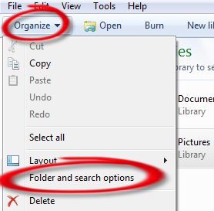
e-ISuite Data Files
The ProgramData folder is often identified as a Hidden Folder. Follow the instructions below to change the Folder settings to “Show” hidden folders:
For Windows 7
Open Windows Explorer by clicking the Icon in the Task Bar
Click Organize
Click Folder an search options
Click the View Tab
Expand the Hidden files and folders folder
Click the Radio button next to Show hidden file, folders and drives
Click OK
For Windows 10
Open Windows Explorer by clicking the Icon in the Task Bar
Click View
Check the Hidden items Check Box

Slide 7
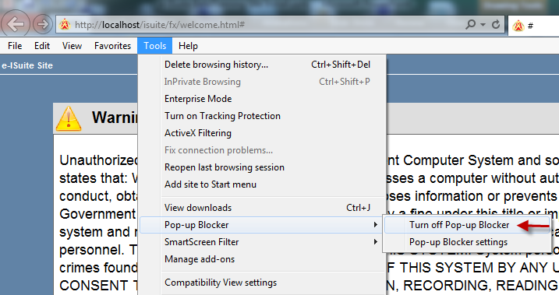
e-ISuite - Setup
Navigate to the Desktop
Launch e-ISuite Site
After e-ISuite Site Warning Banner Screen loads, turn off Pop-up Blockers
Click Accept to acknowledge the Security Warning Banner

Slide 8
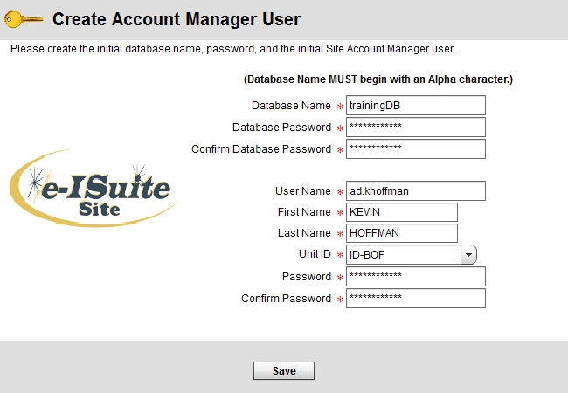
e-ISuite Site – Setup Cont.
rabase and Account Manager

Slide 9
Site Account Manager (Admin User)
Account Manager Performs 2 Major Functions in e-ISuite
User Account Management (Privileged vs. Non-Privileged)
Add, Update, Delete User Accounts
Importance of Secondary Account Manager Account
Assign Roles
Import/Export User Accounts
Database Management
Create/Copy/Restore Database
Create Backups
Automatic vs. Manual
Database Password Recovery Tool

Slide 10
Database Management Decisions
How will you be managing your incident data on this Server?
Start Incident Manually or with a ROSS Import file
Requires an Attached Database
Requires a Data Steward User Account
Import is done by the Data Steward
Restore from a Backup File
Restore is done with the Account Manager Role
Will include user accounts prior to backup
Import a Transition File from Enterprise
Requires an attached database
Requires a Data Steward User Account
Import is done by the Data Steward

Slide 11
Setup Incident Using ROSS Import File
Create new Database
Configure Auto Backups
Add Users
Manually
User Import File
Login as Data Steward User
Import ROSS Incident File

Slide 12
Setup Incident Manually
Create new Database
Configure Auto Backups
Add Users
Manually
User Import File
Login as Data Steward User
Manually add Incident Data

Slide 13
Setup from Database Backup File
No Need to Create new Database
Use Restore Option
Enter Backup Password
Manage Users
Must Create a New Data Steward User
Add New Users
Manually
From Import File
Deactivate User Accounts
Audit accounts - Security

Slide 14
Setup Incident Using Enterprise Transition File
Create new Database
Configure Auto Backups
Add Users
Manually
User Import File
Login as Data Steward User
Import Transition File

Slide 15
Site Data Steward Functions (DOES NOT need to be performed on Server Machine)
Add/Edit/Delete Incident Data
Accounting Codes
Reference Data Tables
ROSS Import
Requires NAP Acct with ROSS or e-ISuite Upload Access
Financial Export
Requires NAP Acct with ROSS or e-ISuite Upload Access
Data Transfer to/from e-ISuite Enterprise
Requires NAP – e-ISuite Enterprise Data Steward Account
Could be performed by different Sections
Finance could Edit Incident Data and do Financial Exports
Resources could do ROSS Imports

Slide 16
Setup Client Machines
Client Configuration Requirements
LAN Connectivity to Server Required
Browser Setup Requirements
Latest Version of Adobe Flash
Turn off Popup Blockers
Browser must have Javascript Enabled
Launch Web browser
Type in e-ISuite URL
http://ServerIP:59123/isuite/fx/welcome.html#
Create Desktop Shortcut
Create Favorite

Slide 17
Uninstall e-ISuite Site
Administrative/Elevated Privileges are Required
PowerBroker
CPALaunch Programs
Uninstall Methods
Control Panel - Programs and Features
e-ISuite Program Files – Uninstall
User Account with Administrative Rights
e-ISuite Installer Package

Slide 18
Data Transfer Functions
Performed by Data Steward
Will not work in IE – Use Chrome
Transfer and/or Sync data between Site and Enterprise – Requires NAP/e-ISuite Account
Transfer Incident from Enterprise to Site
Transfer Incident from Site to Enterprise
Sync Data between Site and Enterprise
Basic mechanism is a special file transfer between Site and Enterprise

Slide 19
Tutorials Available
YouTube Videos
Search eisuitevidios
https://www.youtube.com/results?search_query=eisuitevideos
User Account Management
Database Management
Data Steward
ROSS Imports
Financial Exports
Edit Incidents
Transfer Data to/from e-ISuite Enterprise

Slide 20
Troubleshooting
404 Errors - Server
Check Services
Apache Tomcat
Postgres
Create inbound exception for Port 59123
404 Errors – Client
Ping Server IP
Disable Server Firewall (Temporary)
IIS Conflict (Only if user localhost port 80)
Flash Error
Large Gray Exclamation Mark on White Page
Browser Issue – Use Chrome

Slide 21
Troubleshooting Cont.
Error Creating 2nd Database
Should be addressed in new v1.2.4 (Tentative Release Date 4/16/2018)
Workaround is included in Tips and Tricks
Reports will not Render
Popup Blockers
:59123 not included in the Reports URL
Adobe Reader not installed
Time Zone Conflicts
All machines must be set to the same time zone
Time Zone when Installed is written to the database
Adobe 2046 Error (Certificate Error)
Connect Machines to Internet after Install
Access the e-ISuite Enterprise URL to Ensure Current Certificate is Installed
Data Manager Account Recovery
This functional allows you to create a NEW Account Manger; not recover an existing user account

