Slide 1
CradlePoint Routers
MBR95 / MBR1200B
http://cradlepoint.com/products/small-business-home-office-routers

Slide 2
Why Use a CradlePoint Router?
Simple to configure.
Known to be reliable.
4G AirCard.
Configured with “WiFi as WAN” (using WiFi/MiFi)
Supports an AirCard and Multiple MiFi units with load
balancing (MBR1200B only).
Internet connection early in an incident if there is cell
service.

Slide 3
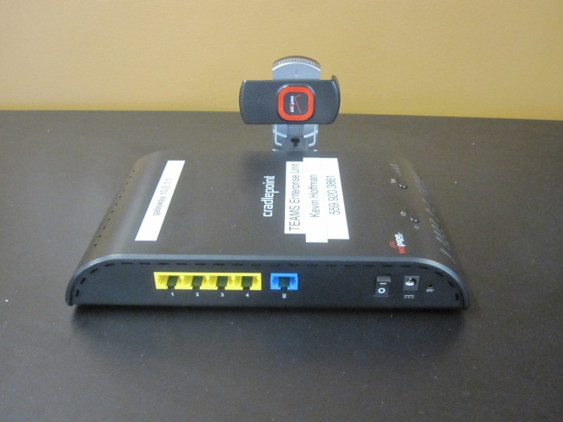
Air Card with Cradlepoint
Advantages:
Simply connect Air Card to the router and power on the Router (Cradlepoint router may need a firmware upgrade for some aircards). (Note: Activate Air Card on PC First.)
Power is supplied for Air Card by the router USB port.
Disadvantages:
Does not work if there is no cell signal.
Air Card is connected to the router (An antenna
may improve signal). Need to move router and
Air Card to improve signal strength.

Slide 4
MiFi with Cradlepoint
Advantages:
MiFi can connect to multiple devices (5 or 10 depending on MiFi device, e.g. cradlepoint, pc, iphone, etc.)
MiFi can be moved to maximize cell signal strength while configured with a CradlePoint router.
Can tether a Verizon MiFi to router
Disadvantages:
Does not work if there is no cell signal
Needs to have an external power source (can be powered with USB on CradlePoint router.)
Can not tether a AT&T MiFi to router

Slide 5
MBR95 vs. MBR1200B
MRB95 is ~$150.00 and MBR1200B is ~$250.00.
MBR95 has one USB port and MBR1200B has two.
MBR1200B can load balance.
Two MBR1200B units can be configured as bridge (good to know)
Both MBR95/MBR1200B can be configured with “fail over”.
See www.cradlepoint.com for more information.
Suggested to go with the MBR1200B, however the MBR95 works in most use cases.

Slide 6
Router Air Card and MiFi Configurations
Load Balancing (MBR1200B ONLY)
Fail Over (Both MBR95/MBR1200B)
Change subnet on Cradlepoint (e.g. 10.2.1.1) so there is no conflict with
192.168.X.X default.
 |  |  |  | MBR95 | MBR1200B
Air Card |  |  |  | X | X
MiFi |  |  |  | X | X
AirCard | AirCard |  |  |  | X
AirCard | AirCard | MiFi |  |  | X
AirCard | AirCard | MiFi | MiFi |  | X

Slide 7
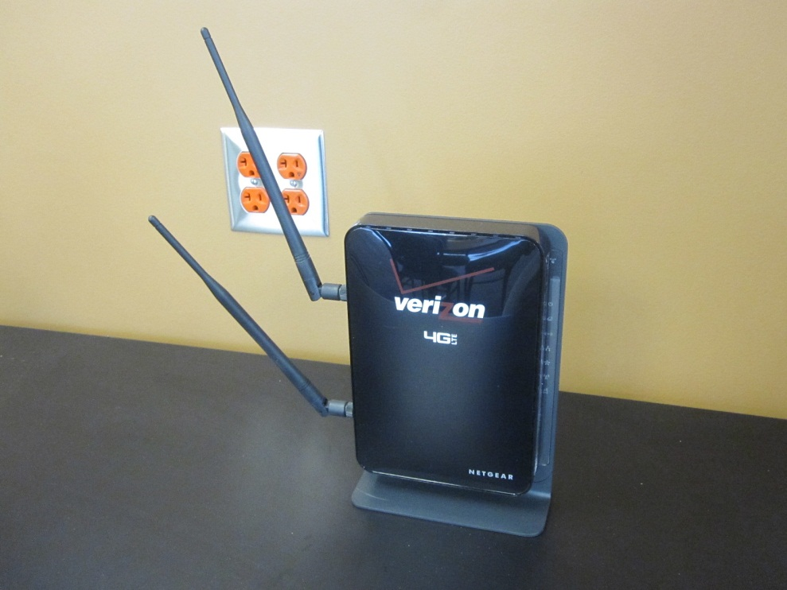
Verizon 4G Router (all-in-one)
Verizon provides an option with a 4G service with router.
WARNING! When using any data device make sure you understand the terms and cost of the data plan. Cradlepoint provides a router with a SIM Card, expensive and requires a data plan.

