Slide 1
Incident Hardware

Slide 2
We Do Not Endorse or Recommend Any Vendor

Slide 3
Overview
Equipment We Use
Document
BPA’s
Routers
Switches
Network Layout
Workstations
Printers and Plotters
GPS Devices

Slide 4
Equipment We Use
Routers
Switches
Servers
Workstations
Network Attached Storage (NAS)
Printers and Print Servers
Plotters
GPS Devices
Satellite Transceivers
Mobile Devices

Slide 5
Document It
Record any and all bits of information regarding your
network
Get in the habit of doing it now
IP addresses, passwords, property location, phone
numbers
Transition documentation

Slide 6
BPA’s
Nationwide or Regional Rental Agreements
Negotiated With Hartford, Smart Source, and Spectrum
Fire, GIS, FBAN and e-ISuite server Computer
Configurations, iPad, networking equipment, Peripherals
(new National Standard being developed)
Check With Your Finance Chief for the latest
Agreements

Slide 7
Let’s Start With the Router
A router is a device that forwards traffic between networks and subnetworks --- yours and the Internet, for instance.
It is the _______ of your network
One per network/subnetwork
Can provide wired or wireless access to networkable devices
Provides DHCP

Slide 8
Router Configuration
Set the admin id and password
Configure WAN Port (the connection to your ISP)
Enable DHCP
Disable wireless access until/unless needed
Reserve a block of static IP addresses for printers, servers,
etc.
Set the DHCP range
Document ad nauseum

Slide 9
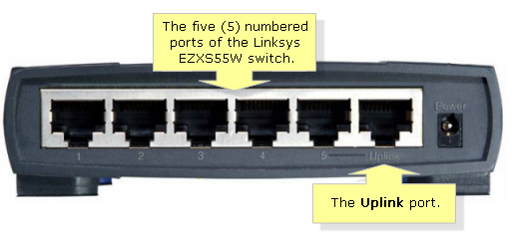
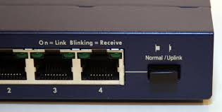
Switches
A Switch is a device that connects networkable devices
Star topology
Uplink or auto-sensing
Last port link or uplink -- careful

Slide 10
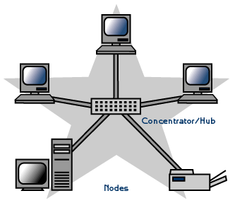
Star Topology
Home Runs
From Central
Server Location
To Individual
“Yurts/Trailers”
Switches w/in
“Yurts” To Connect
PCs w/in “Yurt”
Switch

Slide 11
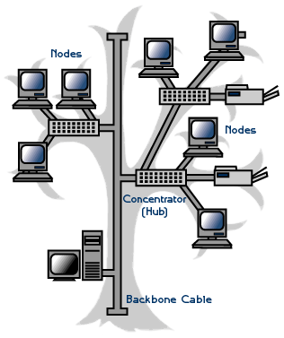
Tree or Daisy-Chain

Slide 12
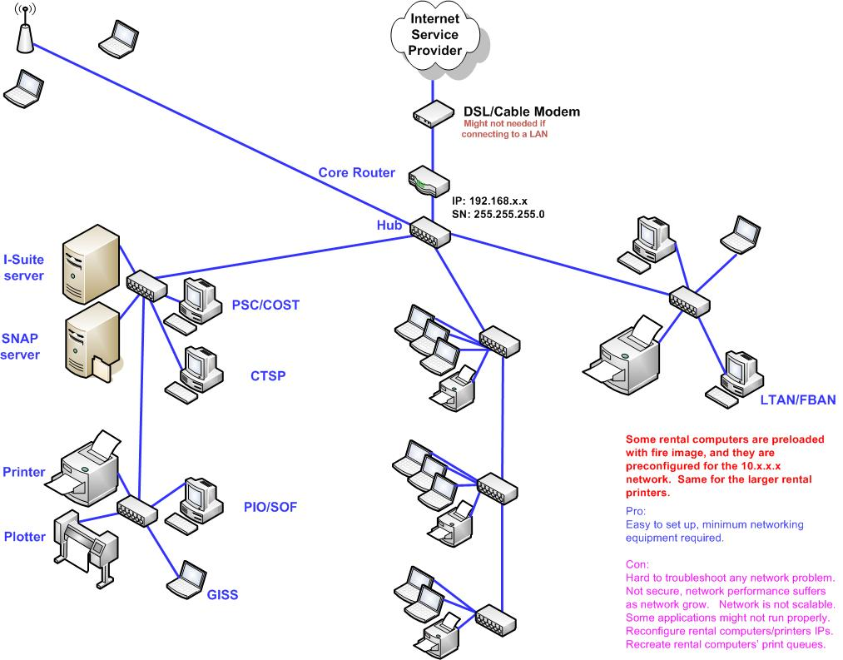
Typical Network Setup in an ICP

Slide 13
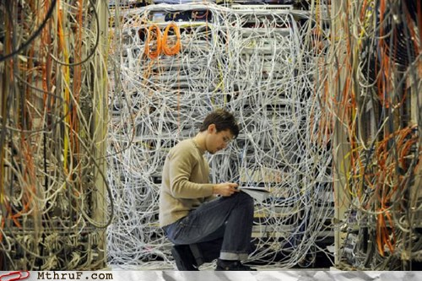
Typical Network Setup in a
Type 3 to Type 2 to Type 1
Fire Camp
DON’T DO THIS TO THE INCOMING ITSS

Slide 14
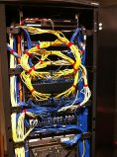
DO THIS

Slide 15
What Kind of Workstations?
Rentals
Agency Imaged
Agency Non-imaged
DO NOT LET Personal Equipment ON YOUR
NETWORK

Slide 16
Keep Your Network Virus Free
Check for Antivirus currency
Don’t put your network at risk
NIMDA at Lakeview Complex
LUVSAN at B & B

Slide 17
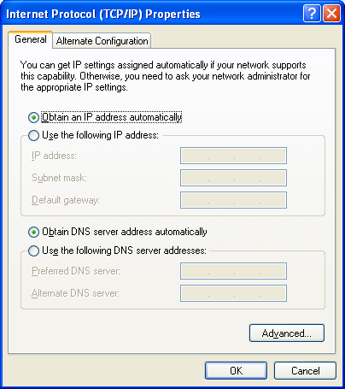
Configure Workstations
DHCP enabled router: set TCP/IP to automatically obtain an IP address and DNS server addresses
Join the appropriate workgroup or domain
Do not UNJOIN Agency PCs
from Their Domain

Slide 18
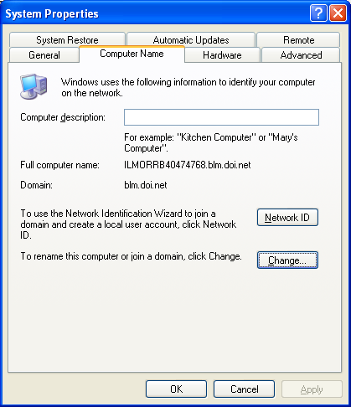
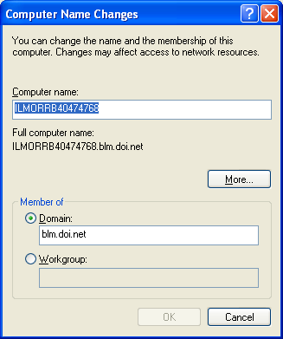
Workgroup or Domain

Slide 19
Not Networked?
Check Connections
Start → Run → cmd
Ipconfig {/all /release /renew}
Check NIC Configuration
Enabled?
DHCP Enabled?

Slide 20
Printers and Plotters
Avoid “Sharing” Printers
Use print servers like JetDirect or D-Link
Use the latest Drivers and BIOS
Static or Reserved IPs
Only set up plotters for users that need them – plotters are a precious commodity

Slide 21
Summary
Equipment We Use
Document
BPA
Router Setup
Switches
Network Layout
Workstations
Printers and Plotters
GPS Devices
Mobile Devices

