Slide 1
Router 101
And
Networking Basics

Slide 2
You Don’t Need Internet Access to Run Site
Connect your devices to an Ethernet switch or Router
Enable DHCP on your router or…
Set Static IP Addresses on computers and printer if using a switch
Copy files to a thumb drive for uploads and downloads

Slide 3
To Connect to Another Network or the Internet, You Need a Router
Your Router is ‘THE BOSS’ of Your Network

Slide 4
The Router Manages:
Connection to your Internet Service Provider or Another Network
IP Addressing via DHCP
Various numbers of Clients
Security – Firewall
Wireless Access Point
And a bunch of other stuff….

Slide 5
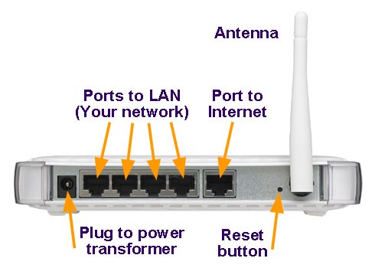
Router ports run at 100/1000 Mbps

Slide 6
Router Speed Continued
For small networks, the router ports are acceptable (100MB is ok)
For larger networks, and for big data users like GIS, connect a Gigabit ethernet switch to increase internal network speed (LAN)

Slide 7
Simple Network Layout

Slide 8
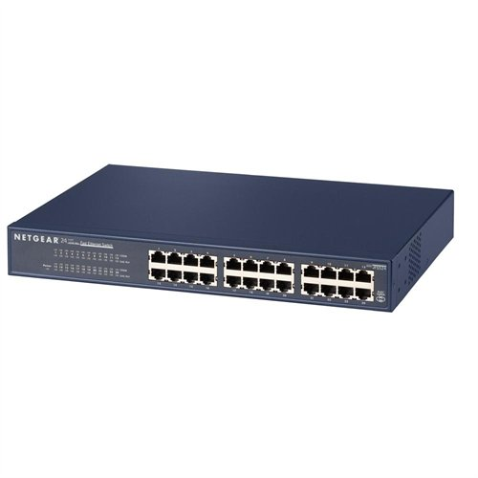
Ethernet Switch Notice – No Port to Internet

Slide 9
Ethernet Switches
Run at 100 Mbps or 1 Gbps
Pass data packets to the destination device with no error checking
Smart enough to know what’s connected to it so cuts router traffic
Older Hubs are much slower due to 10 Mbps speed and error checking (we do come across these)

Slide 10
When you configure a router, be sure to:
Create a new admin password
Change the Admin Username (if possible)
Enable the Firewall
Disable Remote Management
Disable Wireless until it is needed
Set WiFi password to the highest security that your devices can handle (newer routers are dual band - 2.4 and 5.0Ghz)

Slide 11
If you don’t know the router’s address…
Plug your computer into an ethernet port on your router
Make sure your computer is set to receive an IP address automatically
The computer will receive an IP address
At the command prompt:
ipconfig
ipconfig /release
ipconfig /renew
ipconfig /all

Slide 12
ipconfig

Slide 13
ipconfig /release

Slide 14
ipconfig /renew

Slide 15
ipconfig /all

Slide 16
If That Fails
Go to the manufacturer’s website on another device (hard to do if no internet!)
Phone a friend (ITSS)
Or dig out the manual
Reset the router
Try again

Slide 17
Don’t know the router password?

Slide 18
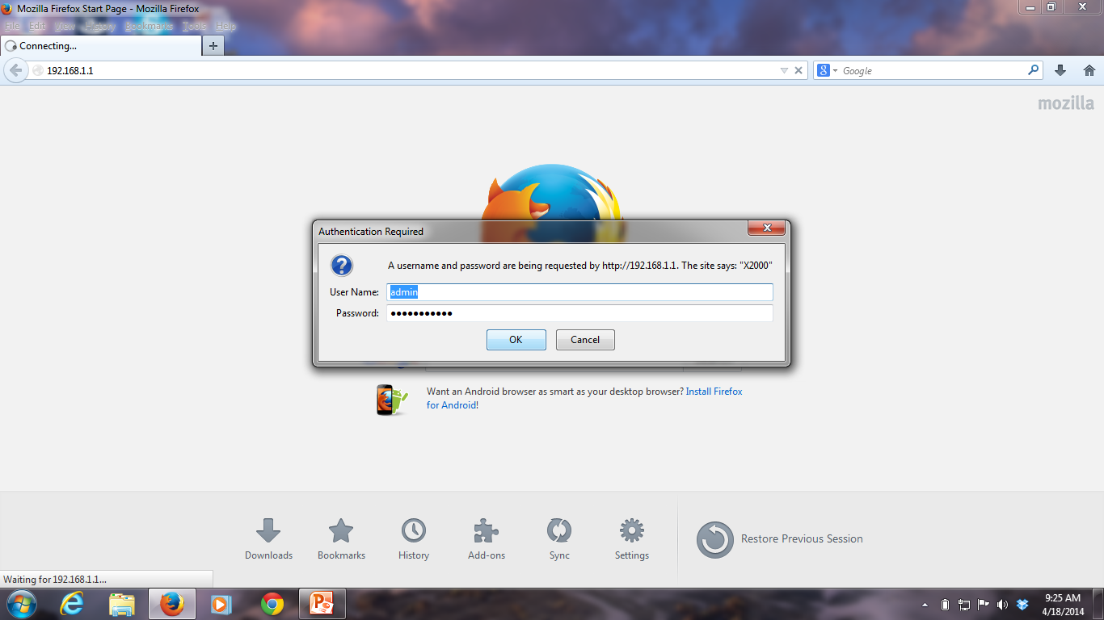
Use a web browser to access the router setup
This is the default gateway

Slide 19
Basic Setup

Slide 20
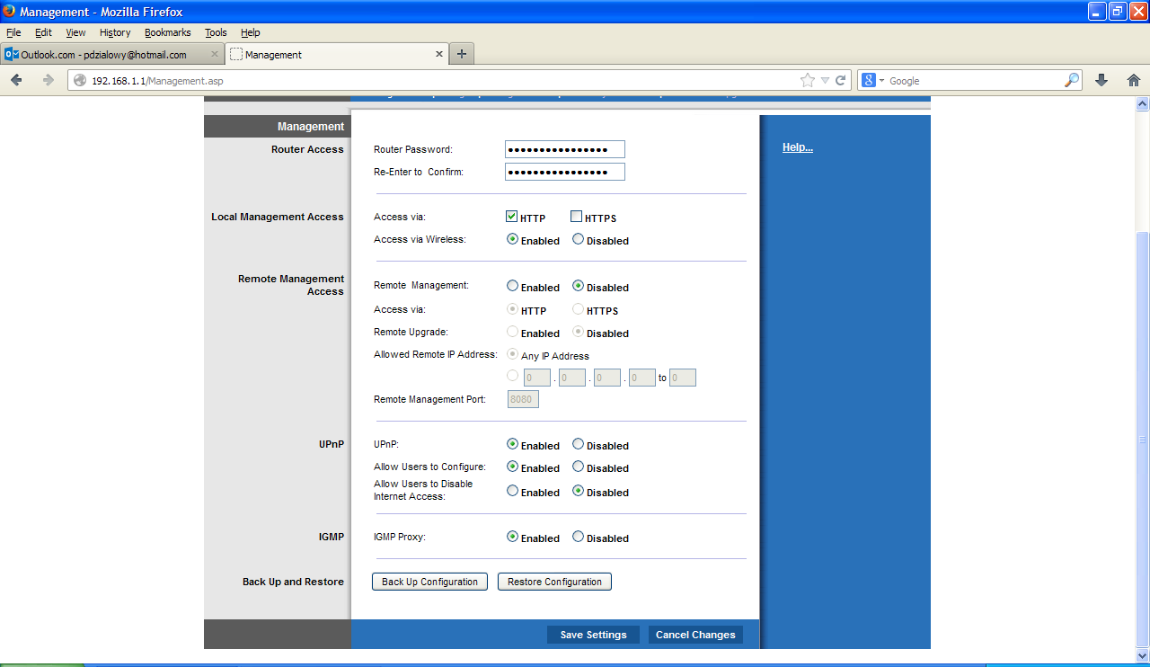

Slide 21
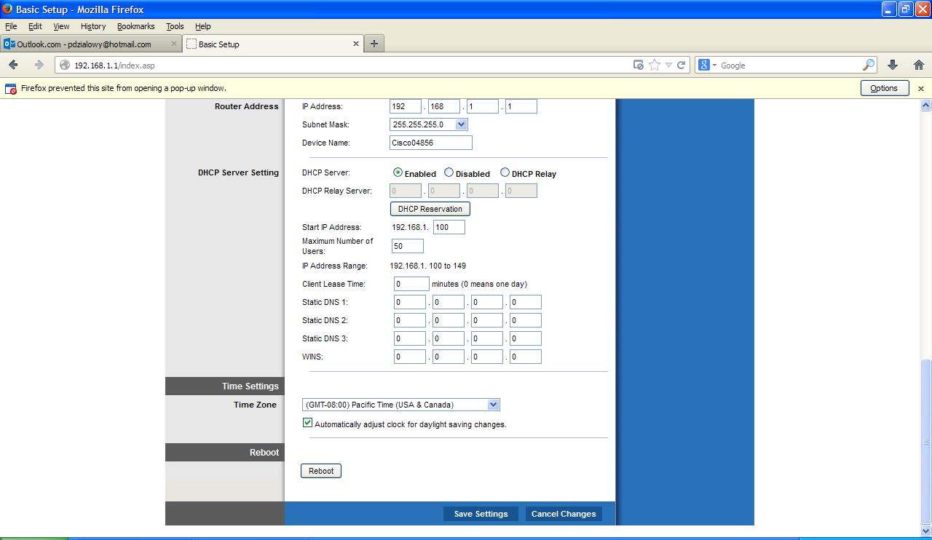
Enable DHCP and choose an IP address Scheme

Slide 22
IP Addresses
10.6.3.X (10.REGION.TEAM.X)
192.168.2.X
Best NOT to use 192.168.1.X -- this can conflict with ISP address handed to your router

Slide 23
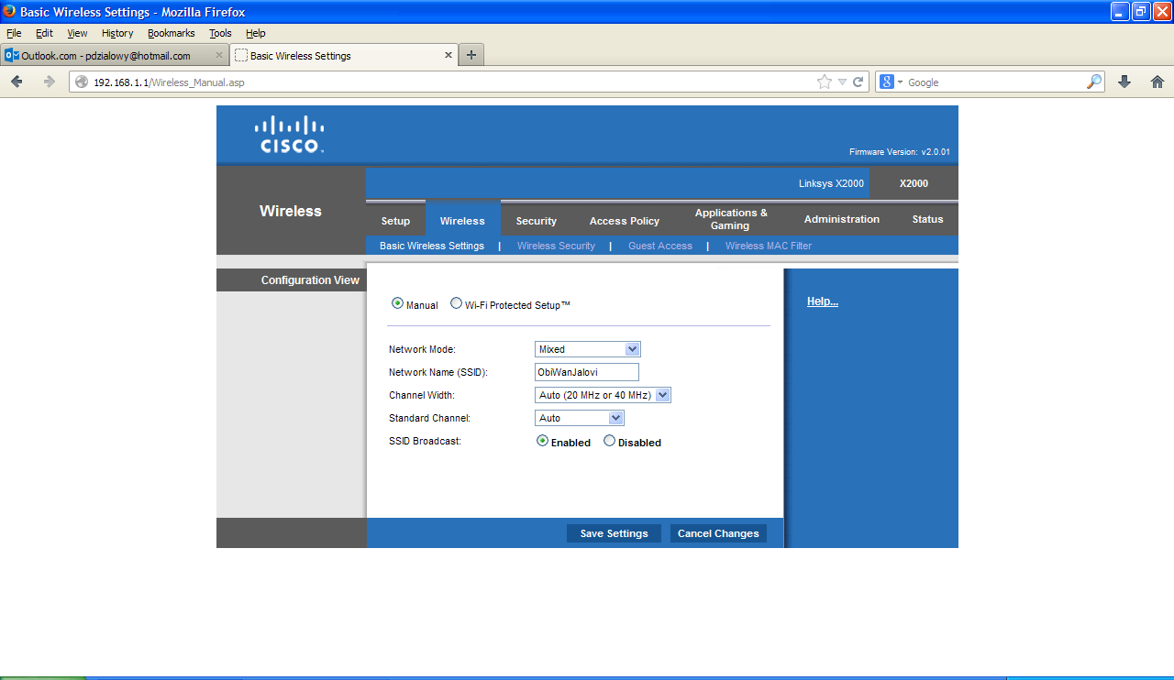
Enabling WiFi

Slide 24
Wireless Security Settings

Slide 25
Wireless Speed Settings

Slide 26
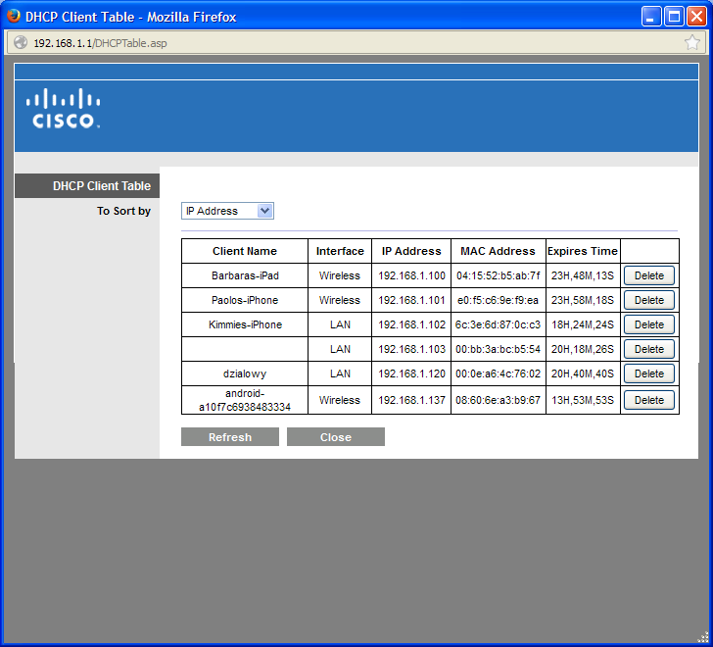
Check the Client Table Often

Slide 27
Simple Network Layout

Slide 28
