Slide 1
Mobile Satellite Solution
for Internet
April 2018

Slide 2
Agenda
Need Internet?
Cons
Pros
Process
Installation
Helpful Tricks
Billing
Fun Facts
Summary

Slide 3
Need Internet?
What camp doesn’t need fast, reliable data?
One solution is satellite internet.
Can be set up reasonably quickly.
DSL can take days to get installed.
Fantastic (advertised) speeds.
MT has had great success with speed, NW simply has not had it long enough to test.
Reasonably priced.

Slide 4
Cons
Not an immediate set up. Will need to be “ordered,” delivered and set up.
Must have a view of the Southern Sky.
Costs. Not the cheapest game in town.
No redundancy. If signal is lost, there is no back up line like DSL.
It is FAST! The negative of fast is users will find inappropriate ways to use it. Monitoring and restrictions will need to be in place.
Per MT AAR, the typical was seen. Streaming movies, music, sports, porn, gaming. Brush up on your blocking and monitoring skills.

Slide 5
Pros
Can be deployed anywhere that has a view of the Southern sky.
In the big picture, the cost is not prohibitive.
Can be deployed much faster than a local telco laying DSL line.
Speed. Advertised speed of 15 MB/s up and 5 MB/s down.

Slide 6
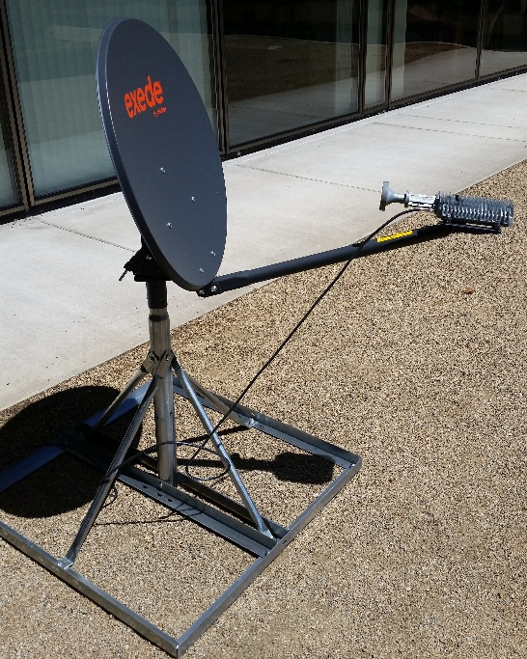
Process
ICP will order Satellite from cache.
TacSat Network will need to be notified to activate data plan.
Currently, NW National Cache has 3 units for use. Cache will deliver to ICP.
A Southerly view of the sky will be needed. In the NW, it should not be an issue to get line of site over mountains. IE, in AK, the angle would be so low, it would be very difficult to hit the Satellite.
Satellite is set up, beam found, fine tuned and secured.
Note: As of this year, TacSat MAY have the capacity to ship a dish to the incident. You may not need to get one from the cache. They have 7 on hand.

Slide 7
Installation
Stable power will be needed. Prefer a UPS solution.
Flat, solid ground will be needed for the base.
Flagging around Satellite along with a wide radius around to keep people out of the line of site. Also, the coax cable will need to be buried or at least protected from boots walking across it and damaging or destroying it.
The Satellite will need to be deployed within a maximum of 40 feet from where the modem will be due to coax cable length.
An unobstructed line of site to the S/SE sky will be needed.

Slide 8
Installation (cont)
Once all hardware is set up, power on modem and laptop. It will take a couple of minutes for the modem to power on.
While the modem is booting up, determine what beam you are shooting for. There is a code associated with that beam and you will need it.

Slide 9
Installation (cont)
Open a web browser to http://192.168.100.1/install
Enter the code for the beam and hit the next button.
Once the code is entered and accepted, the tria will emit a heartbeat. Start sweeping the Southern sky until the tone changes. Once you get a solid tone, the start the fine tune process. It is helpful to either have the laptop close by or another person to help with the fine tune process.
Once the tone is locked, tighten down all bolts on dish to secure from movement.

Slide 10
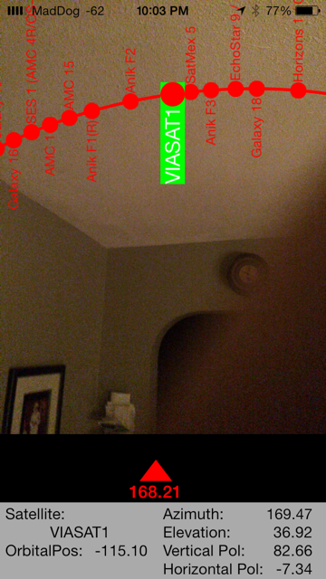
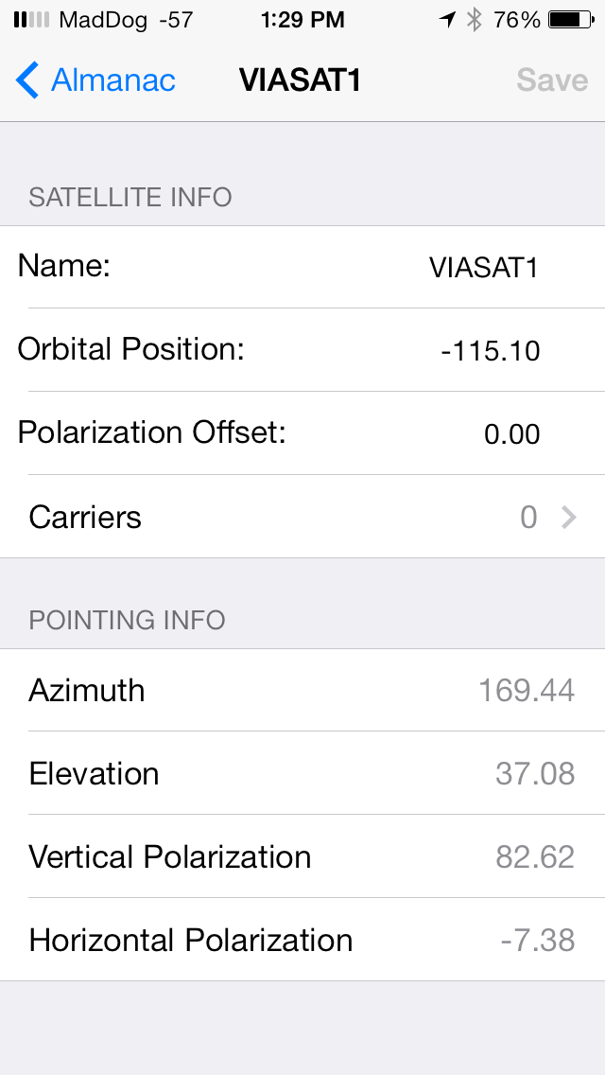
Helpful Tricks
There are apps out there to help with initially finding the satellite. One of my favorites is SatelliteLocator. You will need to manually enter the Satellite info but after that, it is pretty slick. Where ever you are, it will give you the Azimuth and Elevation to shoot for.

Slide 11
Helpful Tricks (cont)
If tone never changes from heartbeat, change the elevation and try re sweeping the sky. Elevation is more important than Azimuth.
TacSat is available via phone support for assistance.
TacSat NOC (855) 482-2728. (24x7)
Current installation documents:
https://tacsatsupport.weebly.com/viasat-pro-2-portable-documents.html
TacSat HQ is 5 minutes from NIFC.

Slide 12
Billing
When the dish is dispatched, TacSat must be Notified to activate the full data plan. At that point they will start a new billing plan. The beauty of that is the incident is billed exactly close to what was used. IE, The dish gets dispatched July 2. TacSat is notified. Incident demobs July 19. TacSat is called again and Satellite gets deactivate. That way the incident gets billed exactly close to what was used. The finance section needs to know this. They wont like the surprise bill at the end of the incident.
The cost of data when activated is $3995 per 40 GB. (approx. $100 per GB) This is why monitoring and restricting will be important.
They also have a 500GB plan for $13,995 (Approx $28 per GB) That is a huge savings if it will be an extended incident.

Slide 13
Fun Facts

Slide 14
Fun Facts (cont)
Distance from Earth: 22,000 miles.
If your angle from earth is off by ½ degree, you miss the Satellite by 190 miles.
63 spot beams over the 50 US states.
ViaSat-1 is a communications satellite owned by ViaSat. Launched October 19, 2011 aboard a Proton rocket, it held the Guinness record for the world's highest capacity communications satellite with a total capacity in excess of 140 Gbit/s, more than all the satellites covering North America combined, at the time of its launch. Source: Wikipedia

Slide 15
Fun Facts (cont)

Slide 16
Fun Facts (cont)
ViaSat-2 launched June 1, 2017 Went into service early 2018.
ViaSat-2 is a commercial communications satellite launched June 1, 2017. Once in service in early 2018, it will be the world's highest capacity communications satellite with a throughput of 300 Gbit/s, succeeding EchoStar XIX launched in December 2016.^{[2]} It is the second Ka-band satellite launched by ViaSat after ViaSat-1. The satellite will provide satellite internet through Exede Internet to North America, parts of South America, including Mexico and the Caribbean, and to air and maritime routes across the Atlantic Ocean to Europe.^{[1]}Source: Wikipedia
Cost of ViaSat-2 = $600 million.

Slide 17
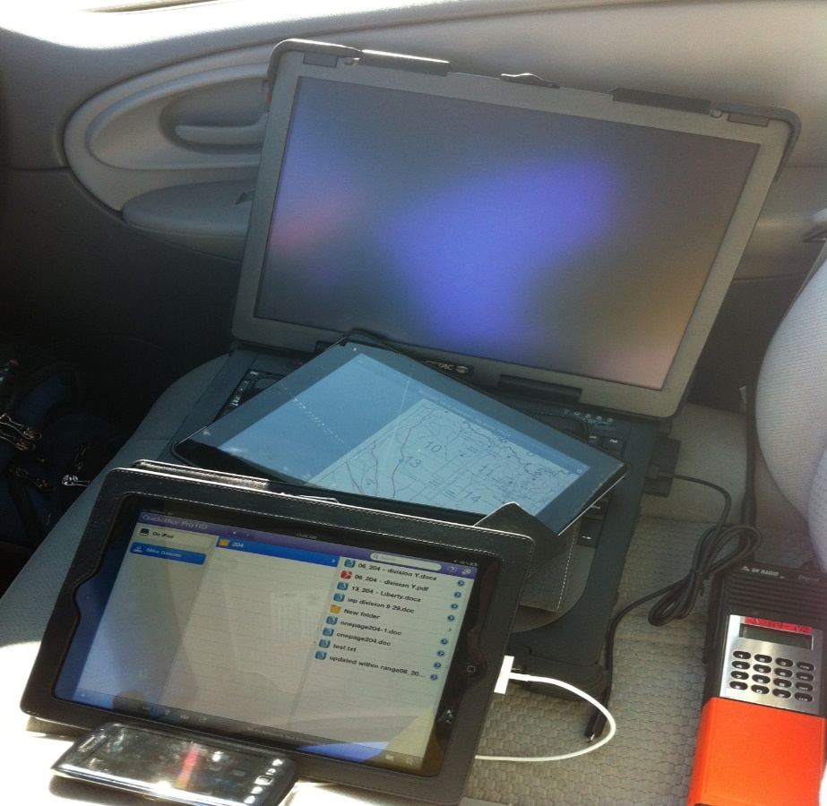
Summary
This is an evolving project.
We have seen great results from our counterparts in MT. 50 days deployed. Down time of 10 minutes for a firmware update.
Documentation and lessons learned will be ongoing.
There are vendors that provide the same dish and possibly enhanced service (phones). These will vary depending on GACC.

