Slide 1
System Access Needed by an ITSS System Access Needed by an ITSS
System Access Needed by an ITSS
Wireless Networks
2018 ITSS Course

Slide 2
Equipment
Wireless Router
Access Point
Wireless Bridge
LAN Switch (higher port density)
Wireless Client (endpoints)

Slide 3
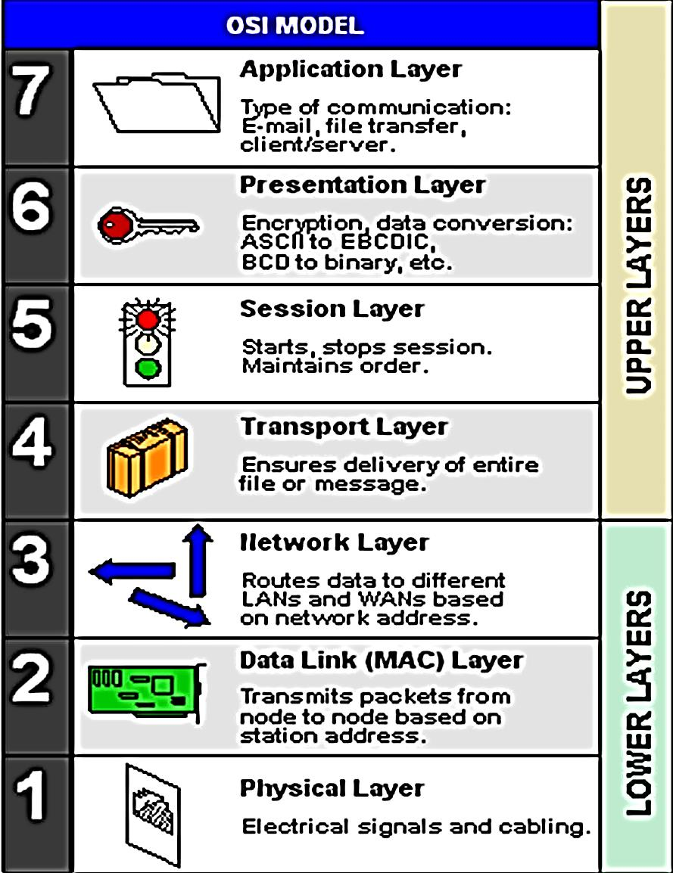
OSI Model

Slide 4
Wireless Router
One WAN port
Gateway to Internet Service Provider (ISP)
DSL modem provided by ISP
Dynamic Host Configuration Protocol (DHCP)
Limited LAN ports (4 ports is common)
Firewall capability

Slide 5
Access Point
One LAN port connection
No WAN port (can not connect to ISP)
Extends your LAN through the radio spectrum
Power over Ethernet (PoE)
IEEE 802.11(a, b, g, n, ac) standard

Slide 6
Wireless Bridge
Point to Point implementation that extends one LAN segment to another LAN segment
Instead of using cables, Radio waves are used as
a conduit
Consist of more than one wireless station
Layer 2 of the OSI model using MAC addresses
Does not see IP addresses, therefore not routable
Ex: Connects two adjacent building in a campus

Slide 7
Wireless Clients
Laptops
Tablets
Mobile Phone
Printers
and Internet-of-Things (TVs, Refrigerators, Cars, Home Security System, smart speakers)

Slide 8
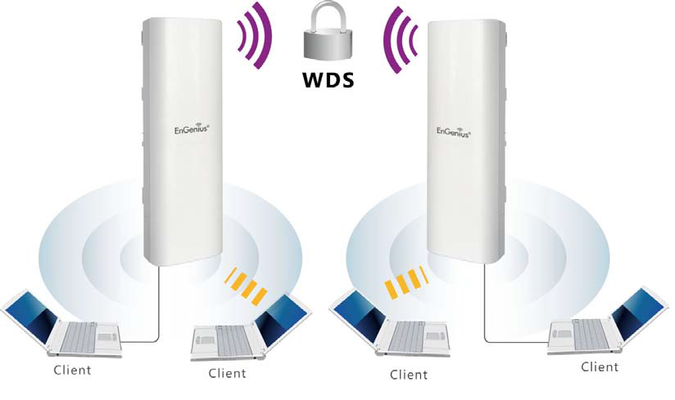
Bridge Pair

Slide 9
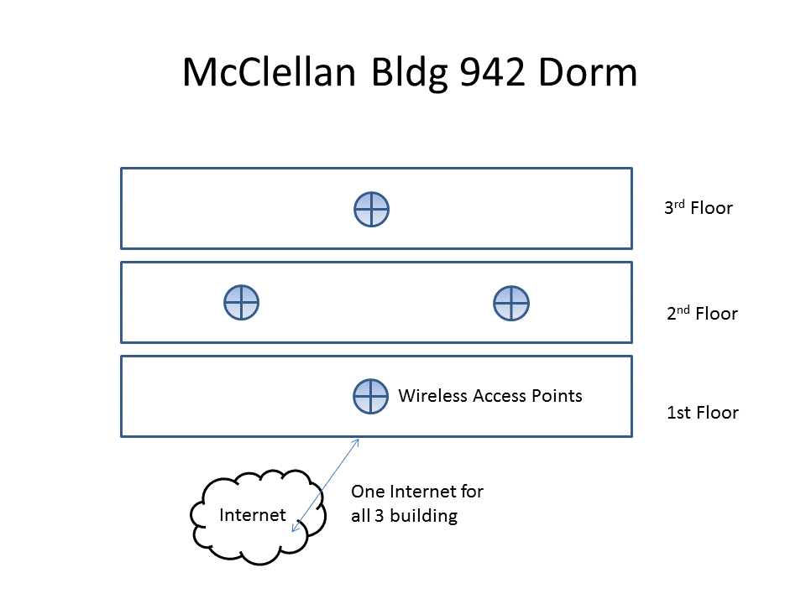
McClellan Dorms APs

Slide 10
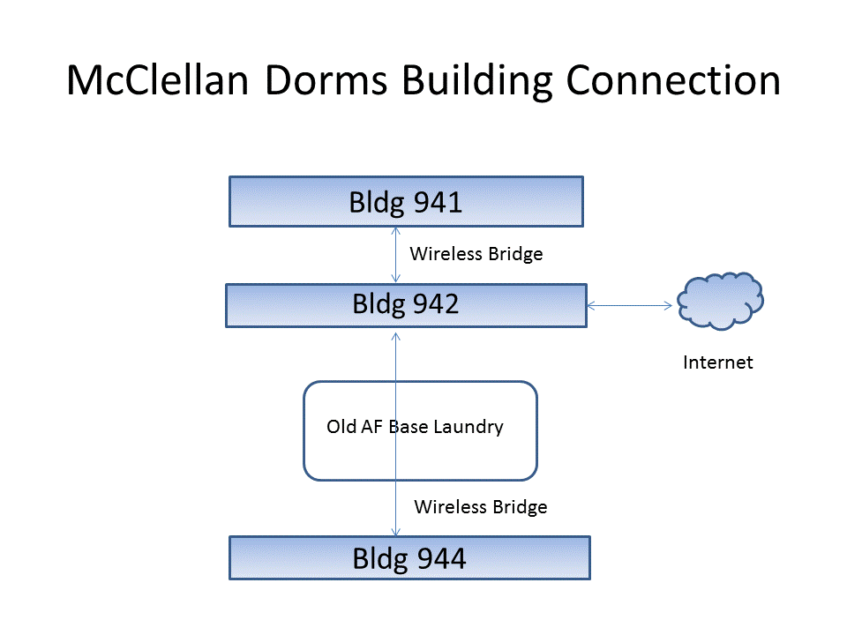
McClellan Dorms Bridges

Slide 11
802.11a
Operates in the 5.15GHz to 5.35GHz radio spectrum.
Speed: Up to 54Mbps (actual throughput is closer to 22Mbps)
Range: 115 feet indoor
Less prone to interference.
More expensive.
Because 802.11b/g/n and 802.11a use different radio technologies and portions of the spectrum, they are incompatible with one another.

Slide 12
802.11b
Operates in the 2.4GHz radio spectrum
Speed: Up to 11Mbps
Range: 115 feet indoor
Prone to interference (it shares airspace with cell phones, Bluetooth, security radios, and other devices).
Least expensive wireless LAN specification

Slide 13
802.11g
Operates in the 2.4GHz radio spectrum.
Speed: Up to 54Mbps
Range: 125 feet indoor
Prone to interference (it shares airspace with cell phones, Bluetooth, security radios, and other devices).

Slide 14
802.11n
Operates in the 2.4 or 5GHz radio spectrum
Speed: Up to 700Mbs
Range: 230 feet indoor
Because 802.11b and 802.11g use the same radio technologies and portions of the spectrum, they are compatible with one another.

Slide 15
802.11ac
Bandwidth: Up to 1000 Mb/s (multi-station) or 500 Mb/s (single-station)
Range: 115 feet indoor
Beamforming (targets clients)
Frequency range: 5.0 GHz
Multi-user MIMO
Up to 8 Spatial Streams
4 Emerging Wireless Standards

Slide 16
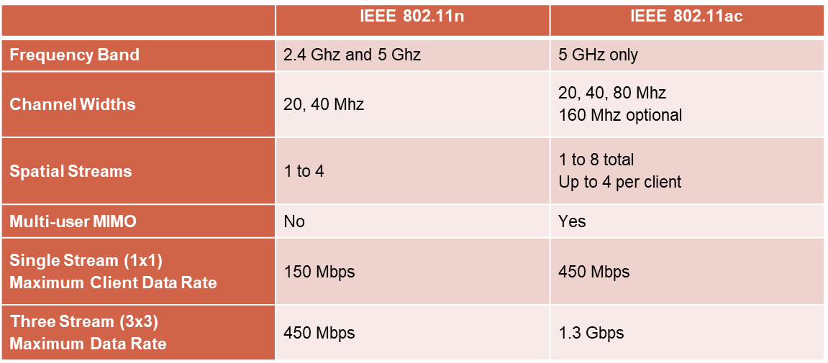
802.11ac

Slide 17
Exercise 1 - UniFi AC MESH
UniFi AC setup as Access Point
Extend your Cat5 LAN with WLAN
IP addresses of your WLAN is in the same broadcast domain as your wired LAN
ISP router will provide DHCP and DNS services
Setup your UniFi Controller software
Test all your clients for connectivity

Slide 18
Exercise 2 - Bridge
UniFi Mesh AP as Bridge
Team up with another group
One Team will be Base Camp and other Team will be Remote Camp
Reverse Team roles

