Slide 1
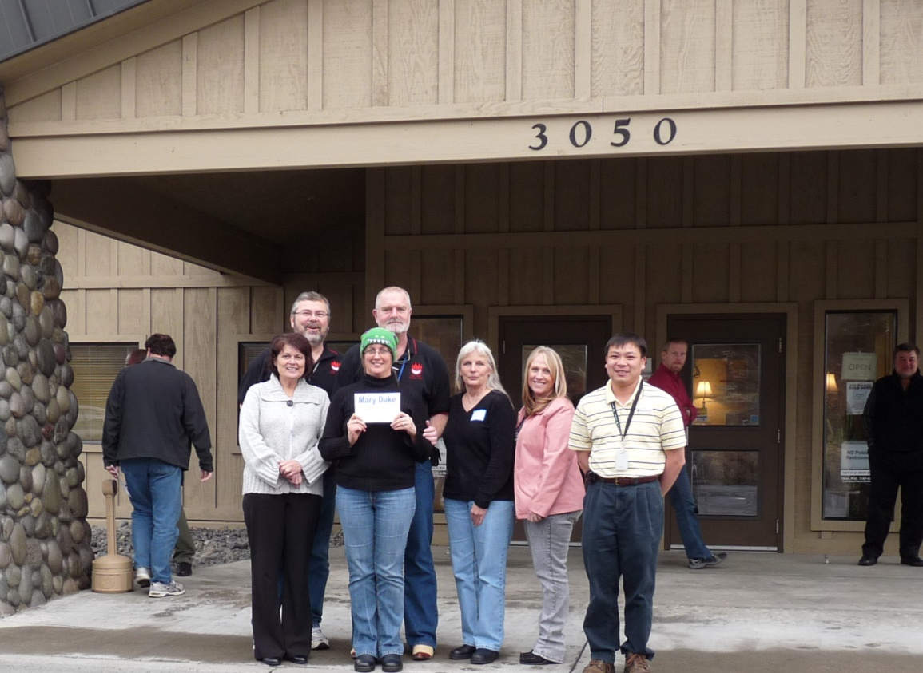
Pacific Northwest Training Center
CTSP Training Cadre
THANKS
CTSP Training Cadre
2014
For The Support
ATTITUDE
- Patience - - Take Deep Breath - - Assume The Best –
Sharing Ways To Apply IT Skills To The Incident Environment
Paul, Doug, Mike, Kevin and Donna

