Slide 1
Unit 8
Monitoring

Slide 2
Objective
Identify and discuss the four levels of monitoring and what needs to be covered in the prescribed fire plan.

Slide 3
Prescribed Fire Monitoring
Prescribed fire monitoring is defined as the collection and analysis of repeated observations or measurements to evaluate changes in condition and progress toward meeting resource and control objectives.
Why do we monitor?
What is the cost of not monitoring?

Slide 4
Level One: Environmental Data Monitoring
The prescribed fire plan should describe:
monitoring to be done
documents or forms to use
who will do it
frequency
Weather
Fuel moisture
Soil / duff moisture
Fuel conditions
Notes:
Added the word “data” to the title to reflect the quiz answer key.
I added an additional bullet at the beginning of this slide to better reflect what is in the outline. This is same bullet that I just copied from the next slide (#5) after editing it. See the editing comments of this bullet under the notes from slide #5.

Slide 5
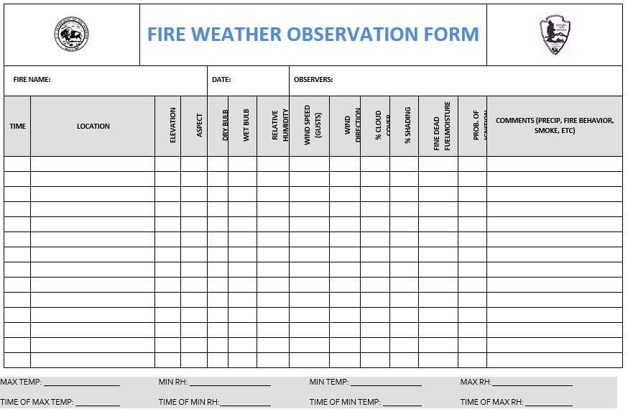
Level One: Environmental Data Monitoring
Notes:
Added the word “data” to the title to reflect the quiz answer key.
I added an additional bullet at the beginning of this slide to better reflect what is in the outline. This is same bullet that I just copied from the next slide (#5) after editing it. See the editing comments of this bullet under the notes from slide #5.

Slide 6
Level Two: Fire Observation Monitoring
The prescribed fire plan should describe:
Monitoring to be done
documents or forms to use
who will do it
frequency
Fire behavior / fire intensity / smoke
Important fire behavior factors
Describe who will monitor fire behavior
Monitor and document smoke production
Notes:
Added the word “observation” to the title so it will match the answer key in the quiz.
Uncapitalized the “D” in documents at the beginning of the second indented bullet.
Added a third indented bullet, “who will do it”, and a fourth indented bullet, “frequency”, to match the instructor guide outline.
I deleted the bullet, “Fire Behavior / fire intensity / smoke”. It served no purpose as everything mentioned in that bullet is repeated in the bullets below. This bullet also had no connection to what’s in the instructor guide outline and the student workbook.
After adding the two indented bullets above, I deleted the bullet, “Describe who will monitor fire behavior”, because that bullet was no longer necessary.

Slide 7
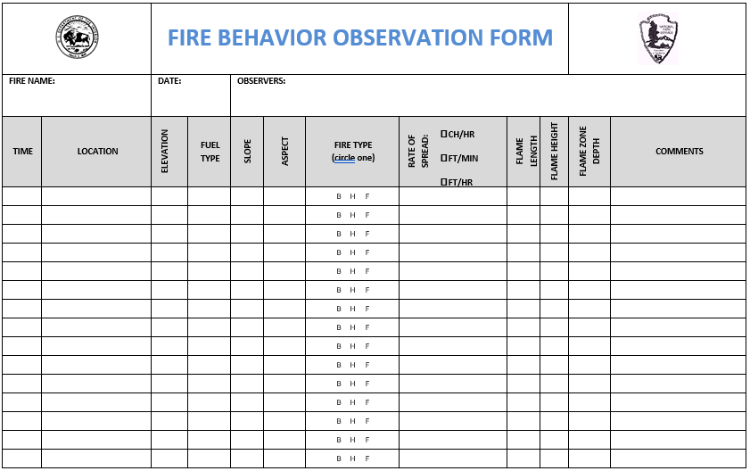
Level Two: Fire Observation Monitoring
Notes:
Added the word “observation” to the title so it will match the answer key in the quiz.
Uncapitalized the “D” in documents at the beginning of the second indented bullet.
Added a third indented bullet, “who will do it”, and a fourth indented bullet, “frequency”, to match the instructor guide outline.
I deleted the bullet, “Fire Behavior / fire intensity / smoke”. It served no purpose as everything mentioned in that bullet is repeated in the bullets below. This bullet also had no connection to what’s in the instructor guide outline and the student workbook.
After adding the two indented bullets above, I deleted the bullet, “Describe who will monitor fire behavior”, because that bullet was no longer necessary.

Slide 8
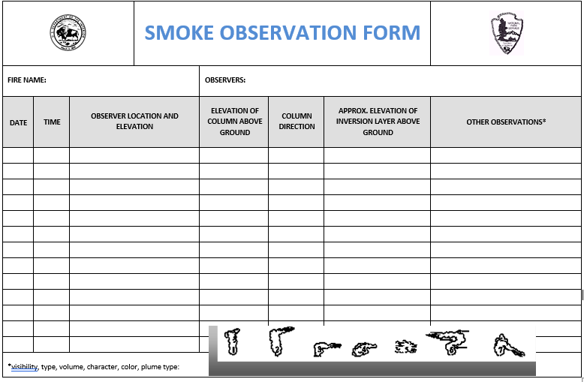
Level Two: Fire Observation Monitoring
Notes:
Added the word “observation” to the title so it will match the answer key in the quiz.
Uncapitalized the “D” in documents at the beginning of the second indented bullet.
Added a third indented bullet, “who will do it”, and a fourth indented bullet, “frequency”, to match the instructor guide outline.
I deleted the bullet, “Fire Behavior / fire intensity / smoke”. It served no purpose as everything mentioned in that bullet is repeated in the bullets below. This bullet also had no connection to what’s in the instructor guide outline and the student workbook.
After adding the two indented bullets above, I deleted the bullet, “Describe who will monitor fire behavior”, because that bullet was no longer necessary.

Slide 9
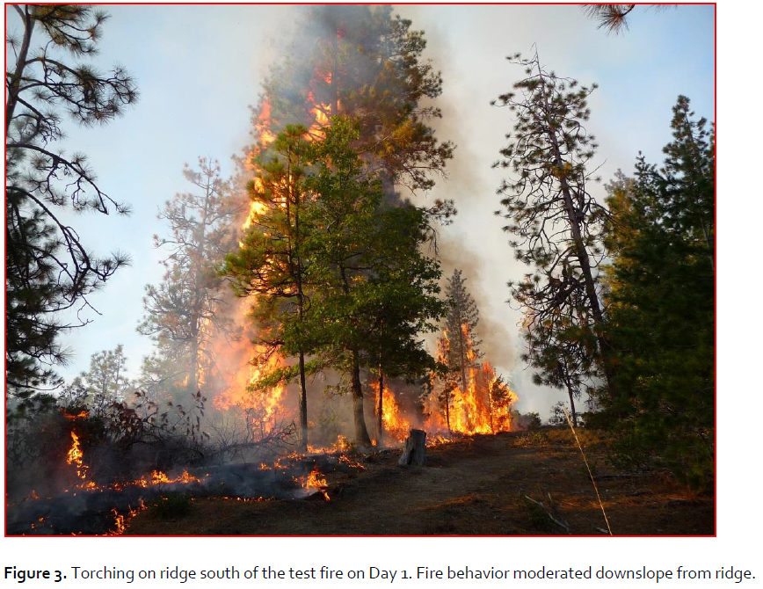
Level Two: Fire Observation Monitoring
Notes:
Added the word “observation” to the title so it will match the answer key in the quiz.
Uncapitalized the “D” in documents at the beginning of the second indented bullet.
Added a third indented bullet, “who will do it”, and a fourth indented bullet, “frequency”, to match the instructor guide outline.
I deleted the bullet, “Fire Behavior / fire intensity / smoke”. It served no purpose as everything mentioned in that bullet is repeated in the bullets below. This bullet also had no connection to what’s in the instructor guide outline and the student workbook.
After adding the two indented bullets above, I deleted the bullet, “Describe who will monitor fire behavior”, because that bullet was no longer necessary.

Slide 10
Level Three: Short-Term Change Monitoring
Prescribed fire plan indicates who, when, and how level 3 monitoring will be done.
Primary measure of success
Detects first order fire effects
Usually related to resource/fuels objectives

Slide 11
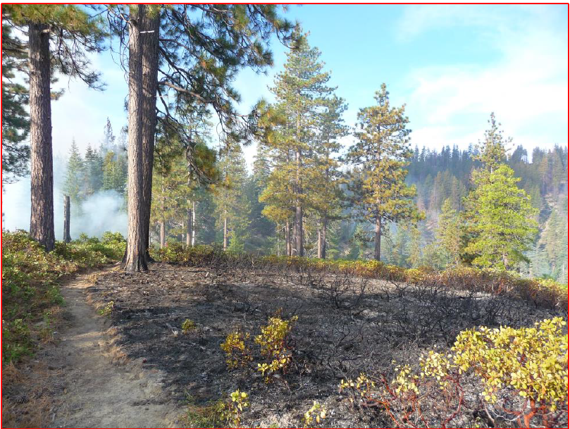
Level Three: Short-Term Change Monitoring

Slide 12
Level Four: Long-Term Change Monitoring
Measure effects over long periods of time.
Often includes multiple management activities.
Not typically included in the prescribed fire plan.

Slide 13
Monitoring Elements Required in the Prescribed Fire Plan
The intensity of monitoring is determined by:
Agency direction
NEPA requirements
Threatened and endangered species concerns
Cultural/archaeological concerns
Goals and objectives

Slide 14
Monitoring Elements Required in the Prescribed Fire Plan
Fuels information required and procedures
Weather (forecast and observed) monitoring required and procedures
Fire behavior monitoring required and procedures
Monitoring required to ensure that prescribed fire plan objectives are being met
Smoke dispersal monitoring required and procedures

Slide 15
Is this project unique?
Unique veg type?
Political interest?
Experimental methods?
Novel treatment?
No prev monitoring
NO
Many similar projects in this veg type on forest or district
Studies widely available for treatment effects
YES
First project of this type, will lead to future similar projects
Lots of management interest
What are the project objectives?
Are they specific?
Do they require stand or fuels data to show achievement?
Monitoring Activity
None
Photo-points
Post-treatment field tour/show me
FEMO report for Rx project
Monitoring Activity
RA Plots
Modified Photo-points with additional data collection
Photo-Points

Slide 16
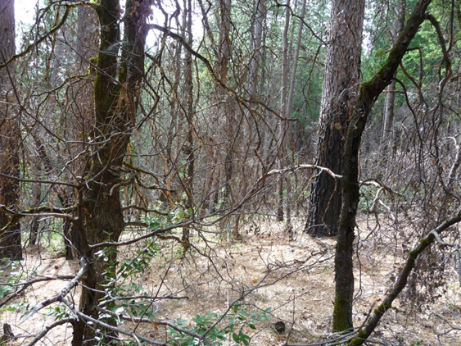
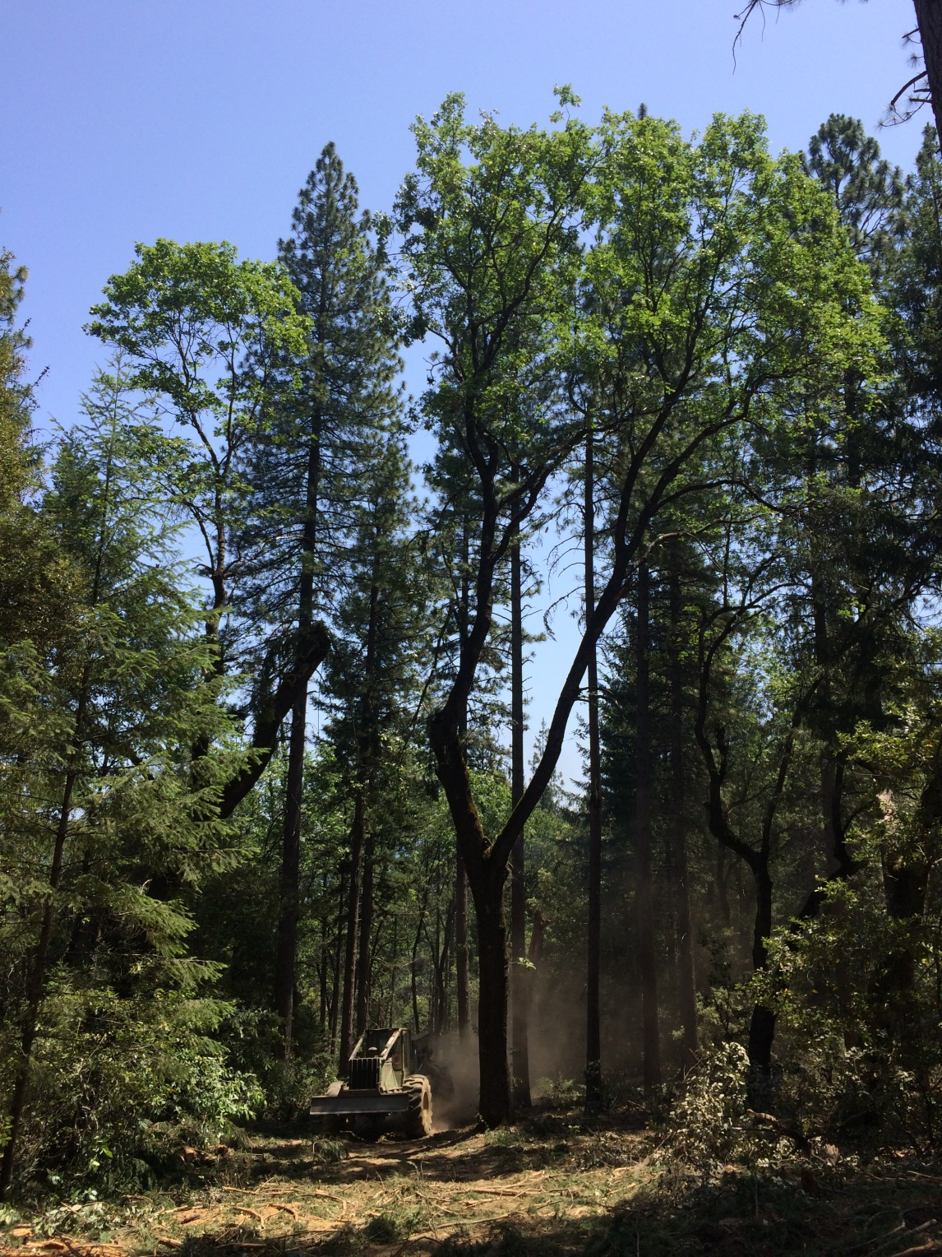
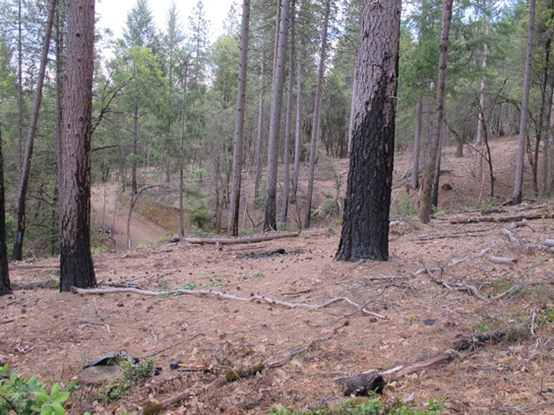
Whiskeytown
Boulder Creek Mechanical

Slide 17
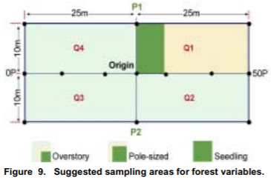

Slide 18
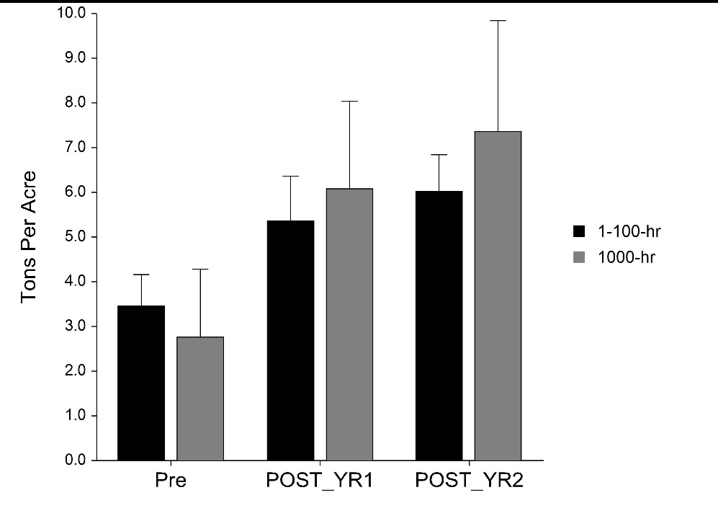
Whiskeytown
Boulder Creek Mechanical
PRE
POST

Slide 19
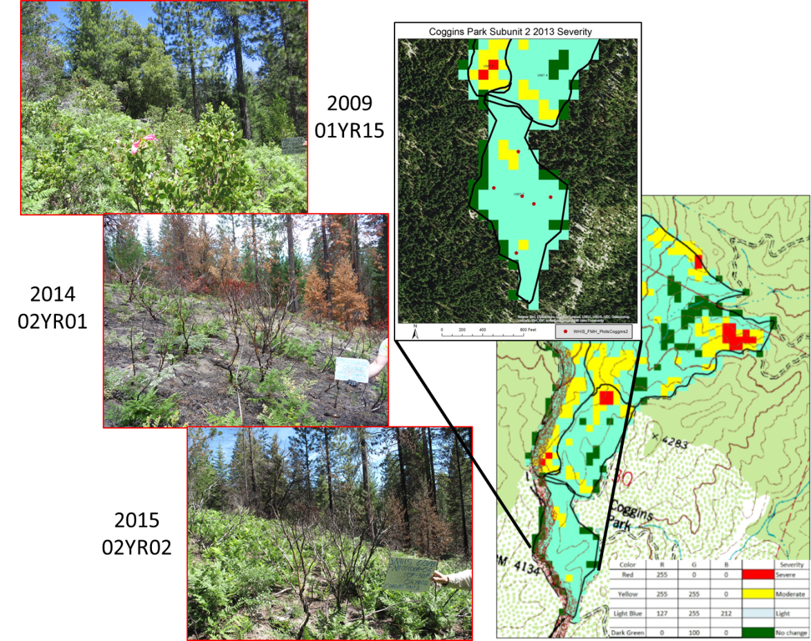
Tools

Slide 20
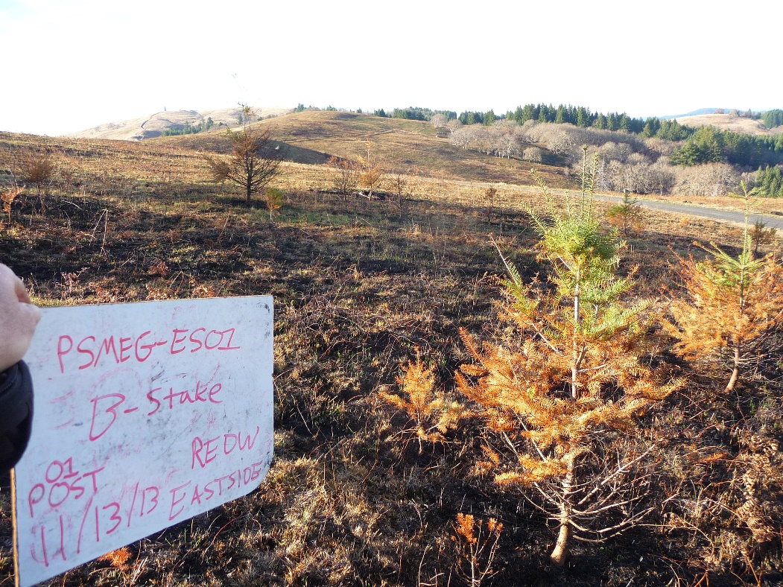
Photo-Points

Slide 21
Objective
Identify and discuss the four levels of monitoring and what needs to be covered in the prescribed fire plan.

