Slide 1
Unit 8
Monitoring

Slide 2
Objective
Identify and discuss the four levels of monitoring and what needs to be covered in the prescribed fire plan.
Understand uses of FEMO and what they can do for you.

Slide 3
Forest Service Monitoring
Ecosystem inventory and monitoring is required by the Forest and Rangeland Renewable Resources Planning Act of 1974 (RPA) as amended by the National Forest Management Act of 1976 (NFMA).

Slide 4
Prescribed Fire Monitoring
Prescribed fire monitoring is defined as the collection and analysis of repeated observations or measurements to evaluate changes in condition and progress toward meeting resource and control objectives.
Why do we monitor?
What is the cost of not monitoring?

Slide 5
Level One: Environmental Data Monitoring
The prescribed fire plan should describe:
What monitoring to do
Which documents or forms to use
Who will do it
When to do it and how often (frequency)
Weather
Fuel moisture
Soil / duff moisture
Fuel conditions – i.e. fuel loading
Notes:
Added the word “data” to the title to reflect the quiz answer key.
I added an additional bullet at the beginning of this slide to better reflect what is in the outline. This is same bullet that I just copied from the next slide (#5) after editing it. See the editing comments of this bullet under the notes from slide #5.
This forms your baseline to determine change after the prescribed fire.

Slide 8
Level Two: Fire Observation Monitoring
The prescribed fire plan should describe:
What monitoring to do
Which documents or forms to use
Who will do it
When to do it and how often (frequency)
Important fire behavior factors
Monitor and document smoke production
Notes:
Added the word “observation” to the title so it will match the answer key in the quiz.
Uncapitalized the “D” in documents at the beginning of the second indented bullet.
Added a third indented bullet, “who will do it”, and a fourth indented bullet, “frequency”, to match the instructor guide outline.
I deleted the bullet, “Fire Behavior / fire intensity / smoke”. It served no purpose as everything mentioned in that bullet is repeated in the bullets below. This bullet also had no connection to what’s in the instructor guide outline and the student workbook.
After adding the two indented bullets above, I deleted the bullet, “Describe who will monitor fire behavior”, because that bullet was no longer necessary.

Slide 9
Fire Observation Monitoring

Slide 10
Fire Observation Monitoring

Slide 11
Fire Observation Monitoring

Slide 13
Level Three: Short-Term Change Monitoring
The prescribed fire plan should describe:
What monitoring to do
Which documents or forms to use
Who will do it
When to do it and how often (frequency)
Primary measure of success
Detects first order fire effects

Slide 14
Level Three: Short-Term Change Monitoring
Most effective when level one monitoring is complete
Examples:
Composite Burn index
Brown’s transects
Overstory tree data
Primary measure of success
Detects first order fire effects

Slide 15
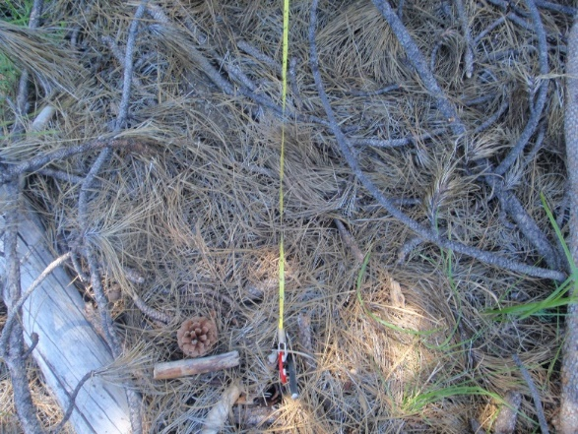
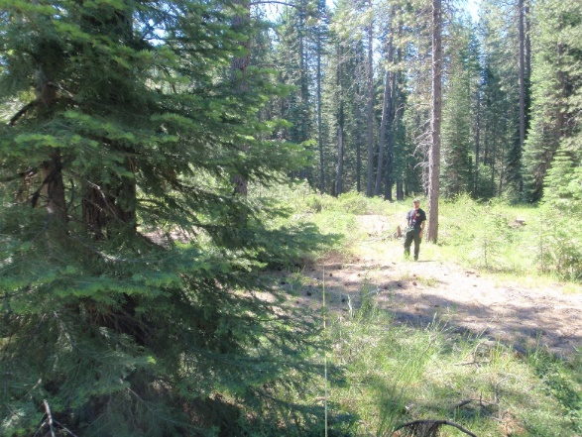
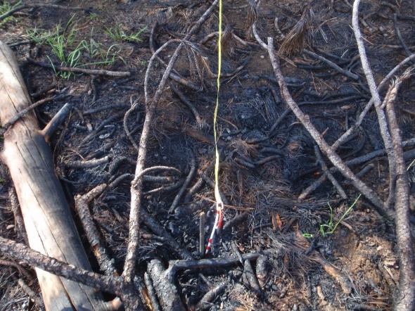
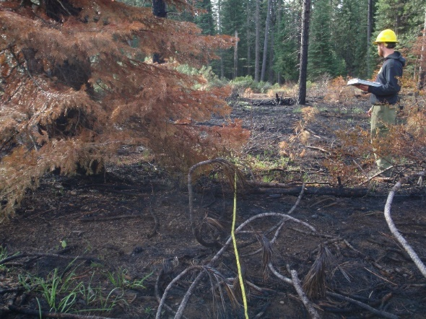
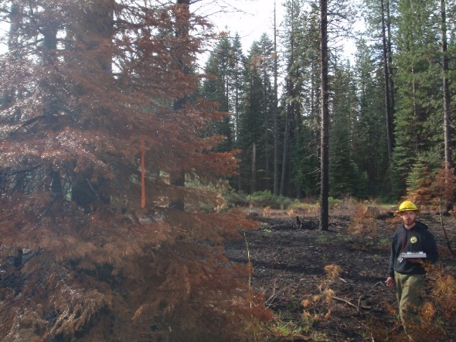
Project ID: Pilgrim Plantation Macro Plot ID: B Monitoring Status: Pre/Post Date: 6/26/2017 & 5/16/2018 GPS Datum: Lat/Long: 41 18.101 / 122 01.848 Bearing from Plot Center: 132 Field Examiners: Muma/Eastman Notes:

Slide 16
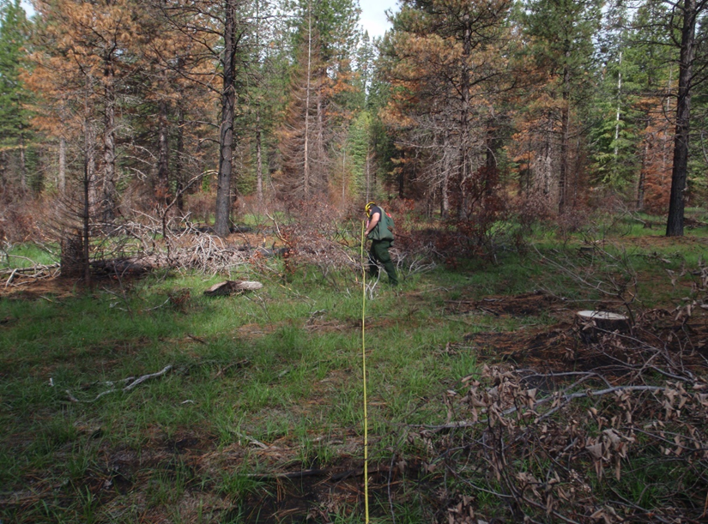

Slide 19
Level Four: Long-Term Change Monitoring
Measure effects over long periods of time.
Often includes multiple management activities.
Not typically included in the prescribed fire plan.
Can be part of a long term project monitoring plan
Can continue level 1 and level 3 protocols

Slide 20
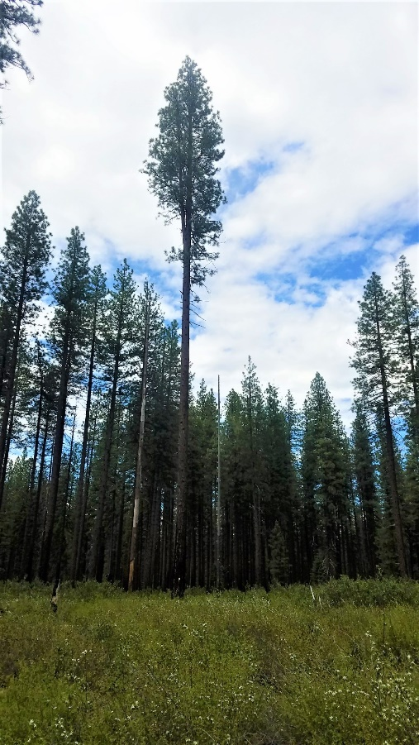
Spring 2010 and 2016 ignition McIntosh Unit #312 Tree #1
Summer 2010
Summer 2011
Spring 2018
Notes:
N41 16 10.4 W121 48 17.9 DBH= 29.5”

Slide 21
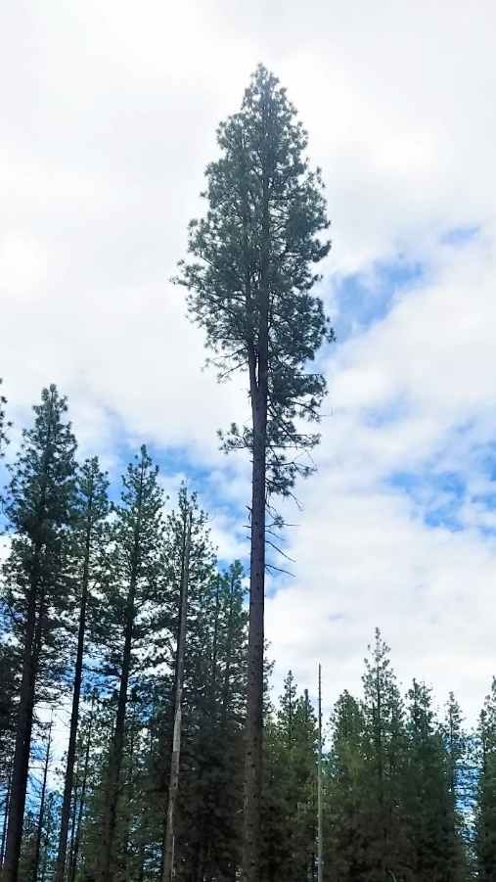
Tree # 1 Zoomed
Summer 2010
Summer 2011
Spring 2018
Notes:
N41 16 10.4 W121 48 17.9 DBH= 29.5”

Slide 22
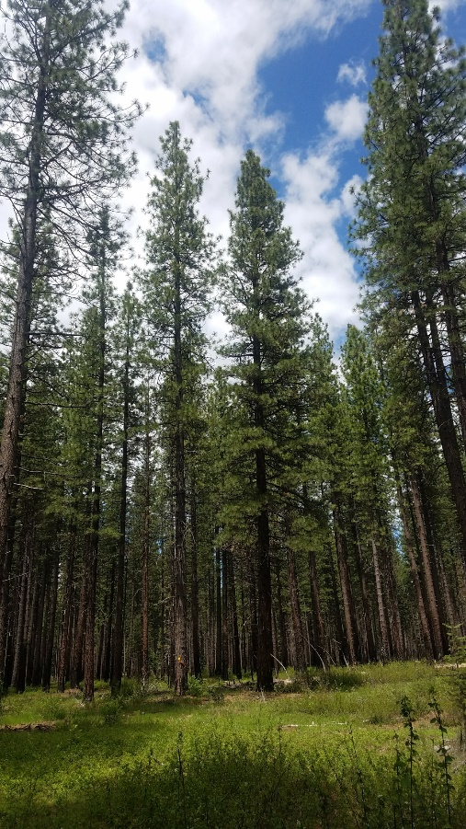
Tree #4
Summer 2010
Summer 2011
Spring 2018
Notes:
N41 16 10.4 W121 48 07.0 DBH = 24.2”

Slide 23
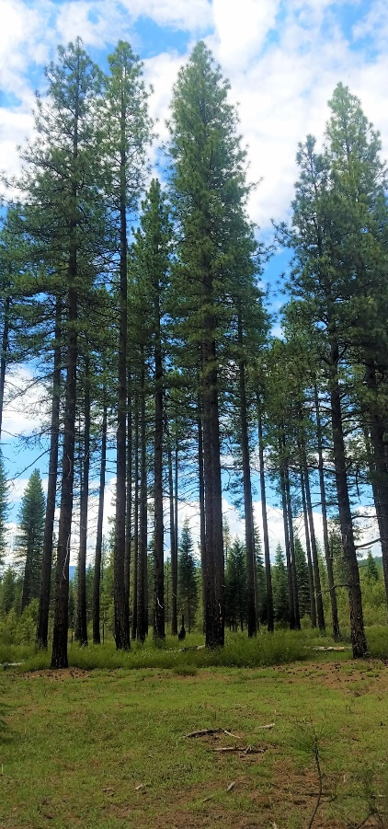
Tree #5
Summer 2010
Summer 2011
Spring 2018
Notes:
N41 16 19.6 W121 48 22.2 DBH = 23.2”

Slide 24
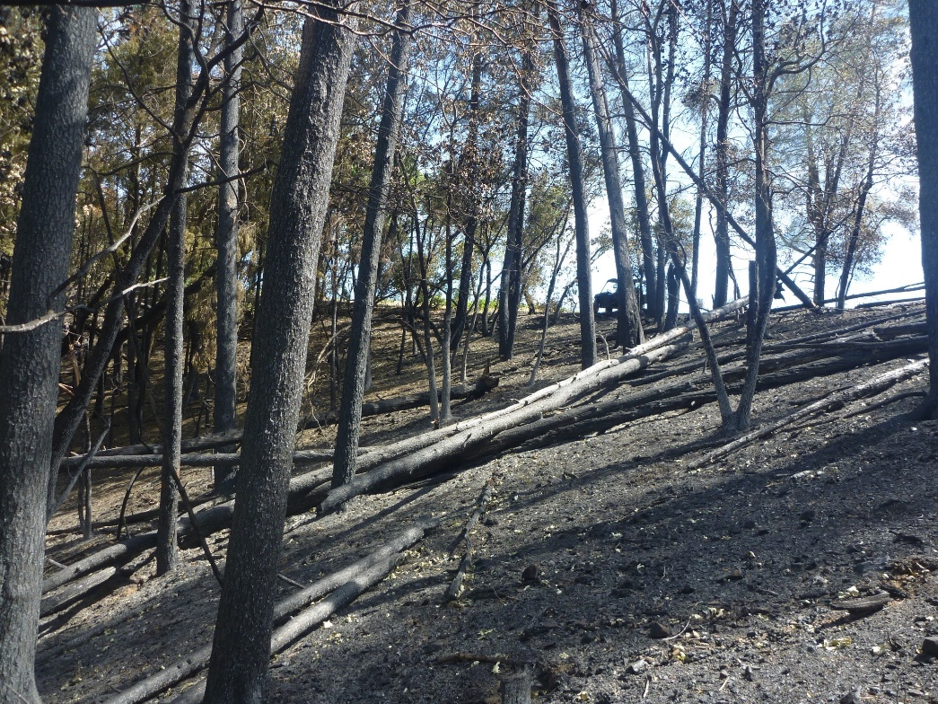
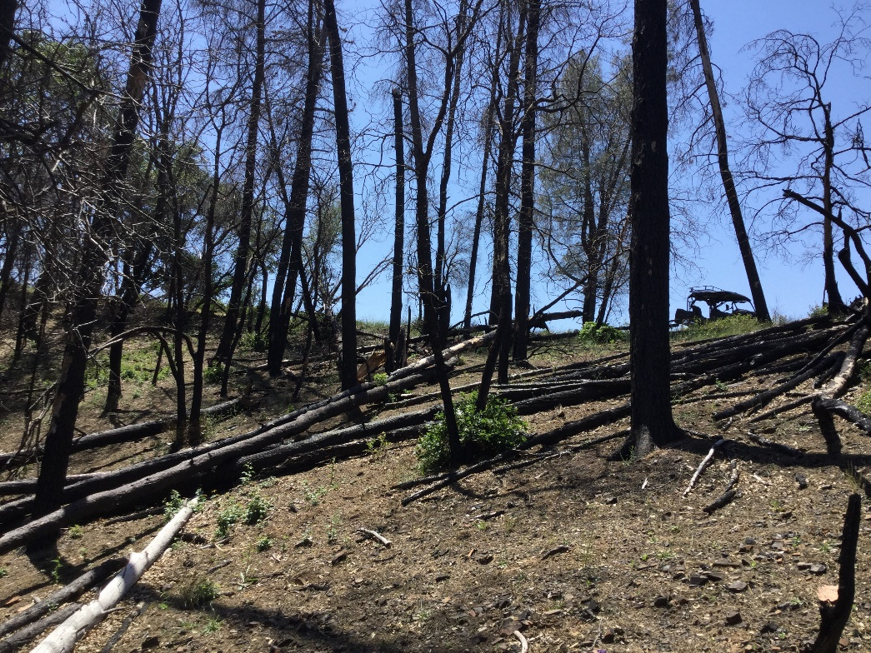

Slide 25
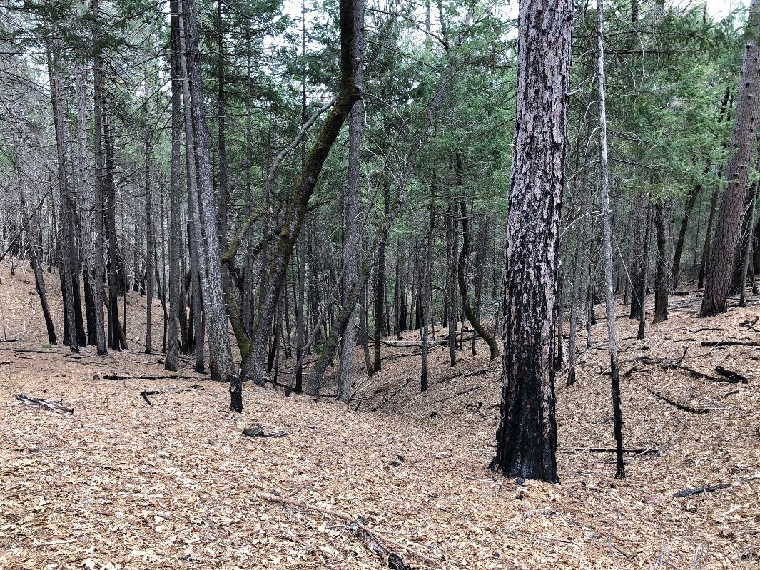
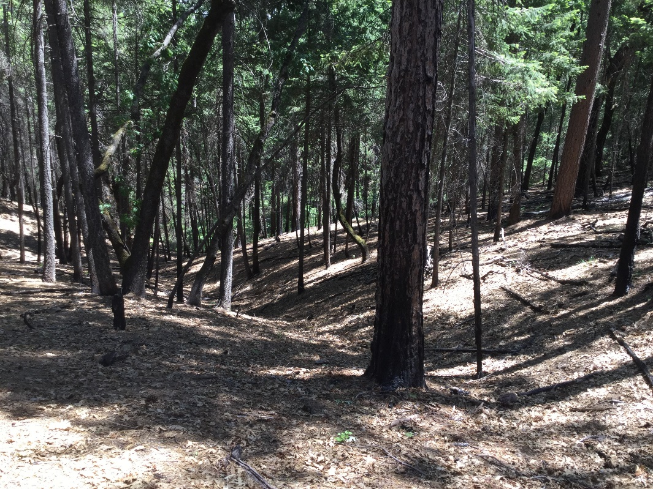

Slide 26
Monitoring Elements Required in the Prescribed Fire Plan
The intensity of monitoring is determined by:
Agency direction
NEPA requirements
Threatened and endangered species concerns
Cultural/archaeological concerns
Goals and objectives.
Project monitoring plans

Slide 27
Monitoring Elements Required in the Prescribed Fire Plan
Fuels information required and procedures
Weather (forecast and observed) monitoring required and procedures
Fire behavior monitoring required and procedures
Monitoring required to ensure that prescribed fire plan objectives are being met
Smoke dispersal monitoring required and procedures

Slide 28
Where can we find this information in the burn plan?
Element 20 - Monitoring Section
Element 7- Prescription
Element 8 – Scheduling
Element 14 – Test Fire
Element 19 - Smoke Management and Air Quality
Numerous places in Appendices
Other places?
Notes:
Added this slide to connect monitoring requirements to the burn plan

Slide 29
What are the most common activities for a FMEO?
Monitor, obtain, and record weather data.
Monitor and record smoke dispersion and air quality information.

Slide 30
What Can a FEMO Do For You?
Recon the ignition unit or assigned area.
Collect appropriate fuel, soil, and vegetation samples for moisture analysis.
Monitor, obtain, and record weather data.
Recognize and report atmospheric characteristics that influence fire behavior.
Monitor and record fire behavior data throughout the fire management operation.
Plot fire progression on a map and record estimates of rates of spread, flame length, and general fire behavior.
Monitor and map ongoing ignitions including burnout or backfire operations and note fire behavior characteristics.
Monitor and record smoke dispersion and air quality information.
Assist in preparing maps.
Review the project objectives, monitoring plan, or management objectives as appropriate. Communicate concerns to supervisor.
Adjust actions based on changing information and evolving situation awareness. Communicate changing conditions to supervisor.
Determine location of assignment, types of information required, priorities, time limits for completion, methods of communication and documentation, and method of transportation.
Provide monitoring summary for assigned area.
Compare observed fire behavior and effects, with planned or anticipated effects.
Describe in narrative format how well wildland fire objectives were met.

Slide 31
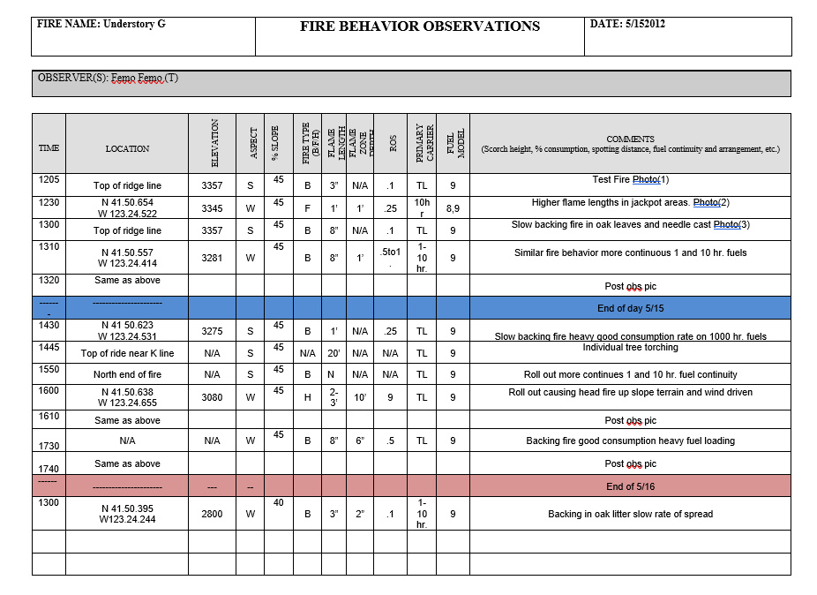
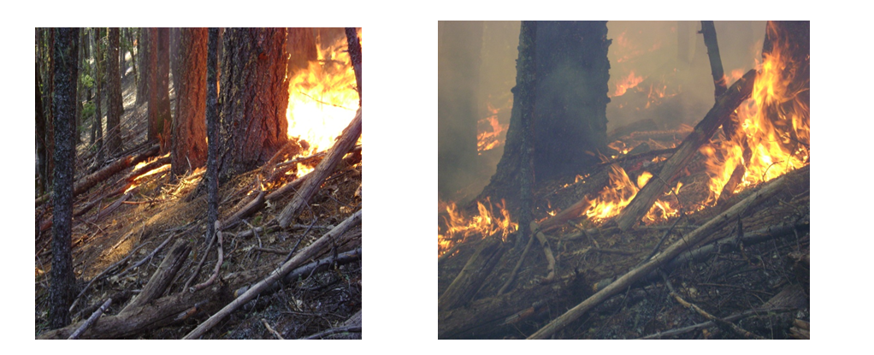
FEMO Products

Slide 32
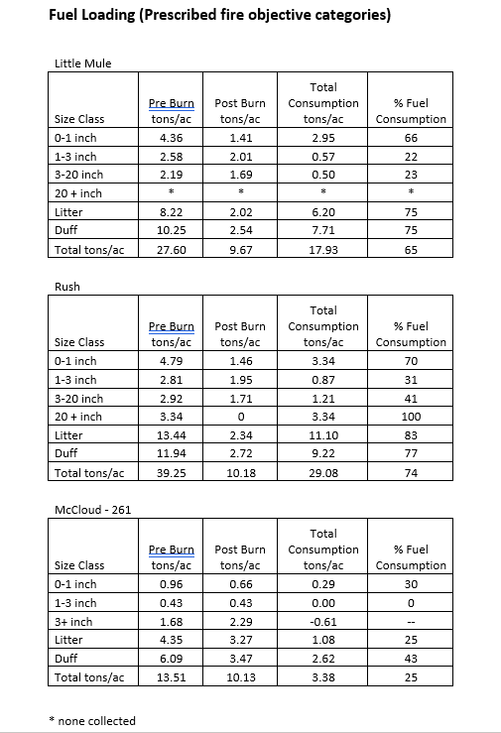
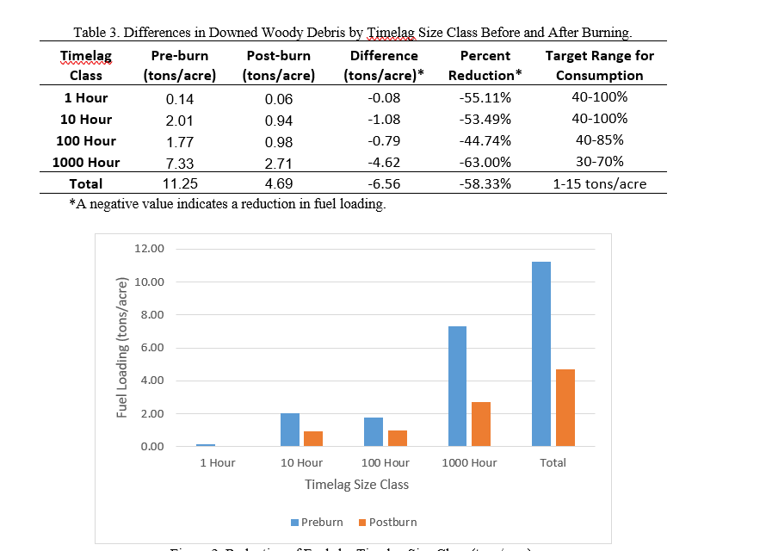
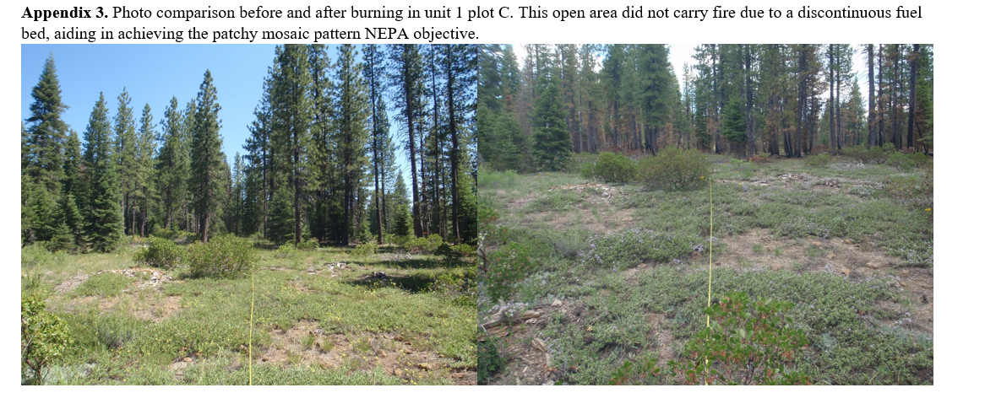
FEMO Products

Slide 33
Objective
Identify and discuss the four levels of monitoring and what needs to be covered in the prescribed fire plan.

