Slide 1
Welcome
Notes:
The Welcome Presentation is provided for all NWCG courses to cover:
NWCG mission.
Administration and logistics information.
Expectations of students.
Course Evaluations.
Instructor and student introductions.
Note to Instructor
Revise these slides as desired to customize the information to the course, location, and agency presenting the course.

Slide 2
National Wildfire Coordinating Group
NWCG provides national leadership to enable interoperable wildland fire operations among federal, state, local, tribal, and territorial partners.
To achieve this, NWCG establishes common national interagency wildland fire operations standards.
NWCG training enables consistent application of these standards in support of efficient, effective, and safe national interagency wildland fire operations.
https://www.nwcg.gov
Notes:
NWCG mission

Slide 3
Administration and Logistics
Course Coordinator- Jason Willoughby Jason.Willoughby@usda.gov 406-494-0216
Sign-in sheet
Training facility layout (restrooms, exits, etc.)
Classroom rules (food, beverages, phones, etc.)
Breaks (coffee, snacks, tobacco use areas, etc.)
Schedule

Slide 4
Expectations of Students
Engage, participate, and contribute to the success of the course.
Build a collaborative and constructive learning environment.
Respect student and instructor diversity in background, experience, and teaching or learning style.
Be punctual.
Provide constructive feedback to improve future wildland fire training.
Professionally represent your home unit and agency.

Slide 5
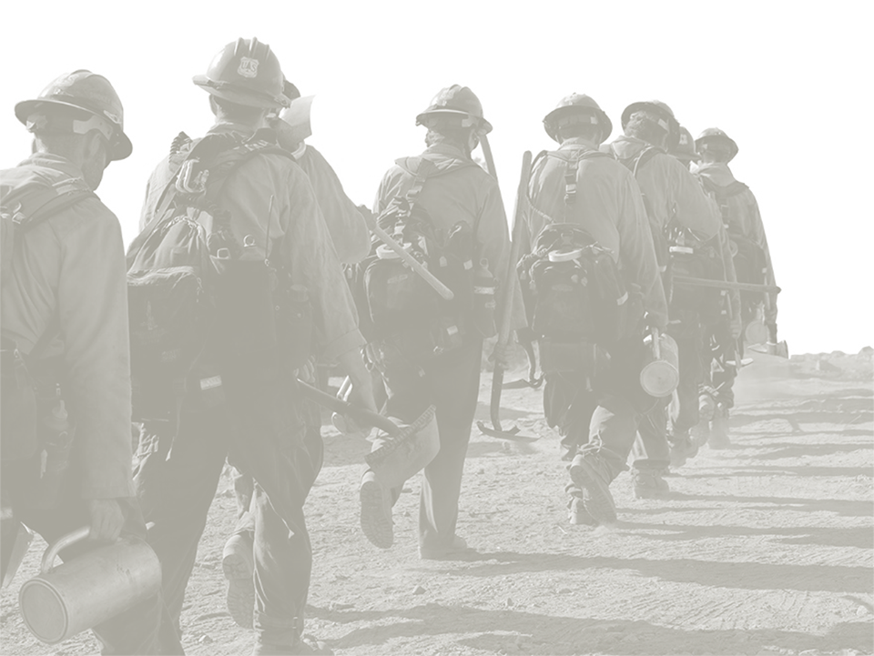
Instructor Introductions
Name
Current job
Home unit
ICS qualifications and experience
What’s on the top of your bucket list?

Slide 6
Kimie Denney
I started my Forest Service career in 2015 on the Helena – Lewis and Clark National Forest, Rocky Mountain Ranger District. I worked 8 years as an Administrative Program Support Clerk in Augusta. In February of 2023 I began my new journey as the Incident Business Specialist for the HLF. I have 9 years of experience in incident finance including 2 years as FFT2.
I work for the Helena SO remotely from Augusta.
Qualifications: FSC3, PTRC, EQTR, TIME, COST, SCKN
I enjoy time with family and friends, camping, fishing, woodworking, and being a KC Chiefs fan for almost 40 years.
Kimie Denney Incident Business Specialist
Forest Service
Helena - Lewis and Clark
c: 406-468-4545 kimie.denney@usda.gov

Slide 7
Charles “Chuck” Tapia
Incident Business Specialist on the Idaho Panhandle National Forests since June of 2020.
Previous experience as a Contract Specialist, timber crewmember, IA Dispatcher, and handcrew member.
Qualifications: INBA, BUYM, COST(t), EQTR, FWPT, HLIA, FLIA, FFT2
Chuck Tapia Incident Business Specialist
Forest Service
Idaho Panhandle/Nez Perce-Clearwater
c: 208-451-4207 charles.r.tapia@usda.gov

Slide 8
Student Introductions
Name
Current job
Home unit
Why are you here?
What’s on the top of your bucket list?

Slide 9
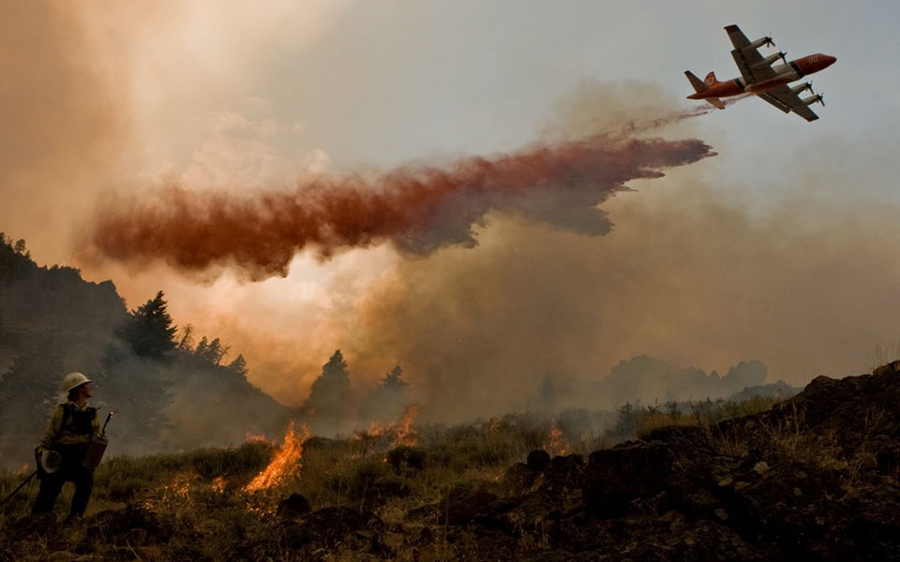
Introduction Exercise
Notes:
EXERCISE: Student Expectations for the Course
Purpose: Students develop a list of their expectations for the course.
Time: 25 minutes
Format: Students work in small groups of four to six students.
Materials Needed: Paper and markers
Instructions:
1. Instruct groups to write their responses to the following question on a sheet of paper:
Question: What do you expect to learn from this course?
2. Have each group present their expectations to the class.
3. Answer any questions.
4. Post lists around the room and refer to them throughout the course to ensure students’ expectations are being met.

Slide 10
Conduct and Ethics
• Prohibited on and off-duty conduct and related consequences
• Ethical responsibilities of incident personnel
• The role and responsibilities of the human resource specialist (HRSP)
Notes:
This course is organized into 12 modules.
Whenever people work together, the issues of proper conduct and ethical behavior come into play.
Module 1 will reinforce:

Slide 11
Recruitment and Classification of Casuals
• Recruitment sources for casuals
• Situations requiring the hiring of casuals
• The pay plan for casuals
• Conditions of hire for casuals
• Required documentation when casuals are hired
Notes:
There are several categories of hired personnel, including government employees, contractors, cooperators, and casuals all working together at an incident.
Module 2, focuses on the category of “casuals”, also know as administratively determined (AD) personnel and introduces you to:

Slide 12
Pay Provisions and Timekeeping/Recording
• Responsibilities relating to timekeeping and time recording
• Pay categories of workers
• Provisions affecting pay, such as tours of duty, travel, and time
• Guidelines and regulations affecting pay
• Types and completion of time reports
Notes:
I’m pretty sure we all care about getting paid? Well before a check makes it into your hand, a lot has to happen, including quantifying the time you work and filling out paperwork.
Module 3 addresses:

Slide 13
Commissary
• Who is entitled and authorized to use a commissary
• Responsibilities related to ordering, processing, and posting commissary issues
• Processing procedures and forms
Notes:
We all are expected to bring our own basic personal items—toiletries, socks, and so on— to an incident. However, what happens if you either forget or run out of something? Sometimes for larger incidents, a commissary is available where workers can purchase items.
Module 4 presents:

Slide 14
Compensation for Injury or Illness
• Authorities providing coverage for treatment and compensation
• Personnel and unit responsibilities
• Types of injuries and illnesses
• Methods of payment and processing
• Claim for compensation forms
Notes:
There are no two ways about it; the realm of wildland fire fighting is risky and hazardous. Working under dangerous and untamed conditions comes the possibility of injury and illness.
Module 5 introduces:

Slide 15
Travel
• Mobilization responsibilities and communications
• Resource orders
• Travel expense reimbursement coverage, policies, and procedures
• Reimbursement processing
• Transportation coverage, regulations, and restrictions
• Other specialized travel considerations
Notes:
The travel mobilization process to, from, and between incidents involves a lot of communication and paperwork. When workers travel, there are expenses and procedures to follow for reimbursement.
Module 6 explores:

Slide 16
Acquisition
• Procurement authorities, policies, and processes
• Requisition processes and documentation
• Methods of acquisition
• Equipment time recording and payment
• Contract claims
Notes:
To fight a fire or other all hazard incident, in addition to personnel you need a lot of equipment, supplies, and specialized services. And yes, you guessed it! There are processes and forms involved in acquiring or procuring these items.
Module 7 you will explore:

Slide 17
Property Management
• Management responsibilities
• Property storage
• Accountability procedures and forms
• Property demobilization procedures
Notes:
Equipment and supplies acquired for an incident become the property of that incident. All incident personnel share the responsibility of accounting for property to minimize costs associated with loss and damage.
Module 8 introduces:

Slide 18
Cooperative Relations
• Purpose and relevance of cooperative agreements
• Types of agreements and their implementing documents
• Impact of agreements on incident management
Notes:
The word interagency appears in the title of this course and implies multiple agencies interacting. Working together requires communication and cooperation, which, in the world of incident management, translates into cooperative agreements.
Module 9 presents:

Slide 19
Claims
• Incident personnel responsibilities
• Types of claims
• Claims processing and documentation
Notes:
Incident personnel, or their families, have the right to file claims against the government for property loss, property damage, personal injury, or death.
Module 10 explores:

Slide 20
Cost Accounting
• Why incident costs are tracked and reported
• Who is responsible for cost tracking
• Cost categories
• Cost analysis methods
• Relationships between actions and costs
• Cost reporting requirements
• Cost containment
Notes:
When you consider all the people and equipment involved in fighting a wildland fire or dealing with any other type of all hazard incident, there are definitely costs involved.
Module 11 addresses:

Slide 21
All Hazard Incident
• Federal Emergency Management Agency (FEMA) involvement
• Response authorities
• Pay provision considerations
• Other general considerations and differences from wildland fires
Notes:
The behind-the-scenes operations of an incident management team that is dealing with a natural disaster or other emergency are very similar to what takes place when there is a wildland fire. There are some additional considerations, however, that apply specifically to all hazard incidents.
Our last Module 12 takes a look at:
I have provided a handout of the course objectives. Please take a moment before or after each module to see if the objectives are being met. And please feel free to ask questions!

Slide 22
Did you bookmark it?
Standards for Interagency Incident Business Management Handbook (SIIBM)
https://www.nwcg.gov/publications/902
Incident Business Supplements for your GACC
https://www.nifc.gov/nicc/
Notes:
The Standards for Interagency Incident Business Management Handbook provides answers to common finance related questions. The SIIBM also known as the Yellow Book is an online publication and you should bookmark it on your computer, tablet, or smartphone if you haven’t already done so. It can be found at the link here.
You MUST have access to it while you work through the course! One reason you’re sure to appreciate is—you can use it for the final exam!
In addition to having the SIIBM bookmarked on your device, you should also locate and bookmark the incident business supplements for the various GACCs. These supplements are significant because in them you’ll find information that is updated ANNUALLY—usually in March—and that is specific to your geographic area. National supplements are also released periodically and apply to ALL geographic areas including examples such as the pay plan.

