Slide 1
Unit 12 All Hazard
March 2024
Notes:
Standards for Interagency Incident Business Management (SIIBM) – Chapter 90, Page 90-1

Slide 2
Unit Overview
Authority
Federal Emergency Management Agency’s (FEMA) Involvement & Reimbursement
Pay Provisions
Other Considerations
Notes:
In this unit, we’ll look at:
• The authorities providing the mechanism for federal agencies to work together
• How the Federal Emergency Management Agency (FEMA) gets involved
• Cooperative agreements between agencies
• FEMA reimbursement policies
• Pay provisions for All Hazard Assignments
• Other general considerations and differences from wildland fire incidents
• Authorities for major disaster response
• Federal Emergency Management Agency (FEMA) tasking and billing basics
• FEMA fire management assistance

Slide 3
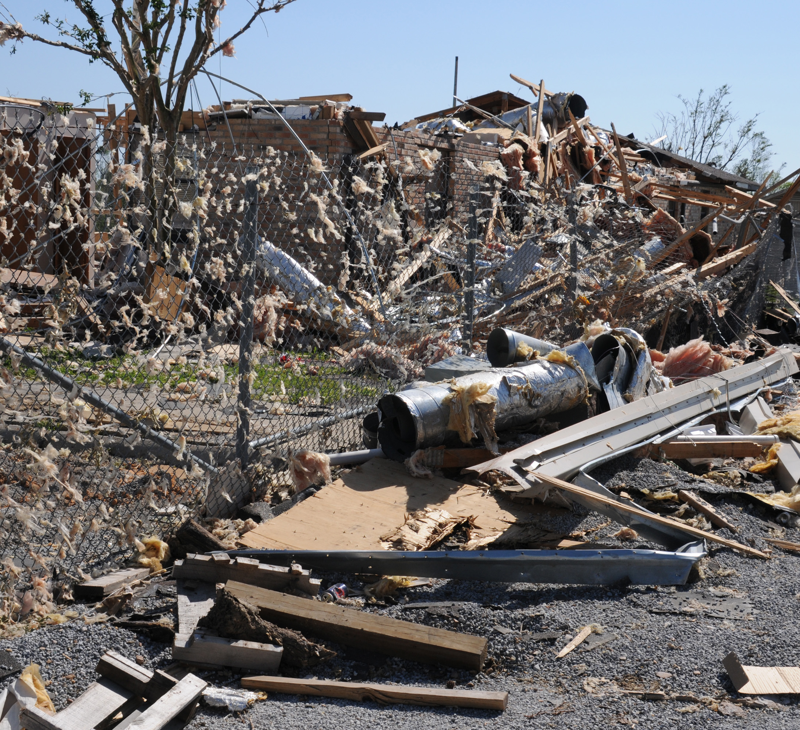
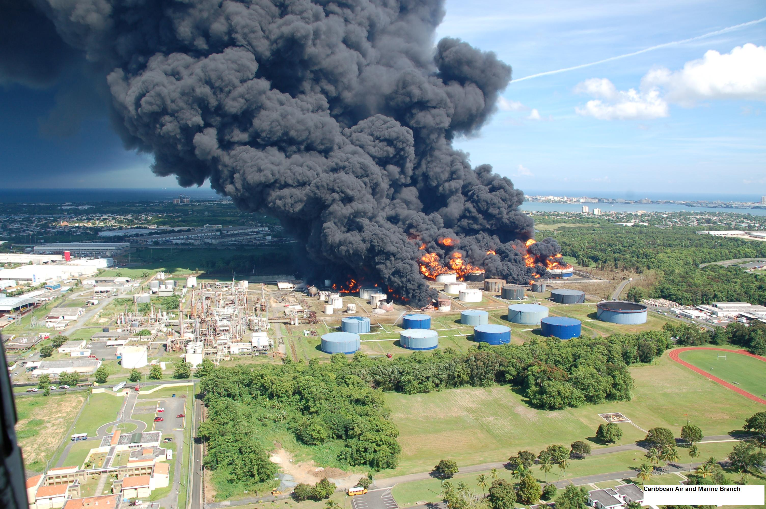
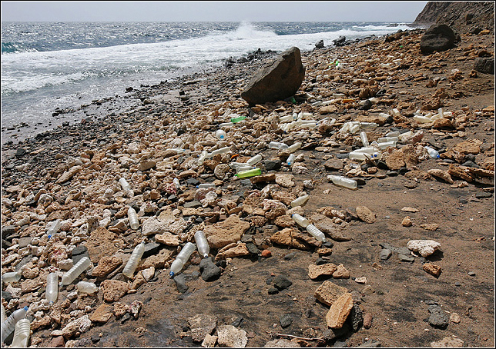
All Hazard
A major disaster, whether natural or man-made, is characterized by two facts:
It cannot be handled just by local or state agencies.
It must be declared a major disaster by the president.
Notes:
What is All Hazard response? All incidents natural or man made, that warrant action to protect Life, Property, Environment, Public Health and Safety and minimize disruptions of government, social and economic activities
Exceeding the capabilities of local or state agencies is key. Those entities either ask for a declaration or as their states to seek a declaration. Once presidentially declared, the federal gov has the authority to respond.

Slide 4
Authority
Robert T. Stafford Disaster Relief and Emergency Assistance Act (Stafford Act).
Allows for response to presidential-declared emergencies.
Stafford Act is implemented through the National Response Framework (NRF) under the direction of the FEMA Administrator.
Notes:
SIIBM Chapter 90, Page 90-1
The Disaster Relief Act of 1974 (Public Law 93-288) is the Federal law that established the process of presidential disaster declarations. In November 1988, Congress amended the act and renamed it the Robert T. Stafford Disaster Relief and Emergency Assistance Act (Public Law 100-707).
The Stafford Act:
Covers all hazards, including natural disasters and terrorist events.
Provides primary authority for the Federal Government to respond to disasters and emergencies.
Gives FEMA responsibility for coordinating government response efforts.
Describes the programs and processes by which the Federal Government provides disaster and emergency assistance to State governments, tribal nations, local governments, eligible private nonprofit organizations, and individuals affected by a declared major disaster or emergency.
The Stafford Act defines “United States” as the 50 States, the District of Columbia, Puerto Rico, the Virgin Islands, Guam, American Samoa, and the Commonwealth of the Northern Mariana Islands. Former Trust Territories (Federated States of Micronesia, Republic of Marshall Islands) receive assistance through compacts, not under the Stafford Act. “United States” does not include areas where the United States has sovereignty, such as embassies and overseas military installations
Information about the NFR is on FEMA’s web site at http://www.fema.gov.
Other Acts provide other guidance; SIIBM Chapter 90, Page 90-1 and 90-2.
The Post Katrina Act provides direction for FEMA

Slide 5
FEMA – National Response Framework
Emergency Support Functions (ESFs)
Provides the greatest possible access to federal department and agency resources.
15 ESFs in the NRF.
Primary ESF agencies based on authorities and availability of resources.
Notes:
SIIBM Chapter 90, Page 90-1
The NRF groups its emergency response resources and capabilities under emergency support functions (ESFs). ESFs provide the greatest possible access to federal department and agency resources. There are 15 ESFs in the NRF.
The NRF identifies primary ESF agencies on the basis of authorities (laws) and the availability of resources in a given functional area. ESFs use standardized resource management concepts to dispatch, deploy, and recover resources before, during, and after an incident.
ESFs use standardized resource management concepts to dispatch, deploy, and recover resources before, during, and after an incident.

Slide 6
FEMA – ESF Coordinator
Responsible for maintaining ongoing contact with the primary ESF agencies and their designated support agencies.
Manage coordination efforts with corresponding private-sector organizations.
Responsible for all phases of a major disaster.
Notes:
Phases include:
Prevention
Preparedness
Response
Recovery
Mitigation

Slide 7
FEMA – Mission Assignments
Once the President declares a major disaster, federal agencies respond by means of a mission assignment.
Federal wildland fire agencies typically work under the following ESFs:
ESF #4
ESF #9
ESF #11
Other ESFs
Notes:
SIIBM Chapter 90, Page 90-2 thru 90-3
MA - formal request for assistance. Specifies exact responsibilities and Dollar amount authorized. Much more defined than a fire assignment- if the MA is to clear roads after a hurricane that is the narrow scope of the work. Cost of response must be tracked very carefully and the ESF liaison notified when reaching threshold.
ESF9 – Search and Rescue -- NPS
ESF11 – Ag and Natural Resources -- USDA. DOI co primary
Both the FS and DOI service as support agencies to other ESFs

Slide 8
FEMA – Mission Assignments
ESF #4 – Firefighting
USFS is primary agency
ESF #9 – Search and Rescue
DOI, National Park Service is primary agency
ESF #11 – Agriculture & Natural Resources
USDA and DOI are co-primary agencies
Notes:
SIIBM Chapter 90, Page 90-2 and 90-3
ESF #4 Exception – For operations occurring in the state of Alaska, the operational lead for firefighting response is the DOI, BLM.
Other ESFs – The Forest Service is designated a support agency to 10 of the other 15 ESFs in the network. The DOI is designated a support agency to 11 of the other 15 ESFs.
For further information, check the NRF on the FEMA Web site for support roles of all the various departments and agencies.
Primary agencies can use other agencies to support by sub-tasking. Dorian and Vax

Slide 9
FEMA Reimbursement
FEMA pays both the primary and the sub-tasked agencies.
Process varies, depending on whether your agency is:
Primary Agency
Sub-Tasked Agency
Notes:
SIIBM Chapter 90, Page 90-2 and 90-3
The role your agency plays in the ESF response to a major disaster determines what your agency must do to receive FEMA reimbursements for money spent on that mission.
Primary agencies provide overall cost tracking and reporting to FEMA for all responders. Sub-tasked agencies send all of their documentation for expenses to the primary agencies for approval before they send on to FEMA for reimbursement.
FEMA pays both the primary and the sub-tasked agencies upon receipt and examination of eligible, documented costs incurred.

Slide 10
FEMA Reimbursement
FEMA provides financial assistance for the following items:
Cost of wages, travel expenses, and per diem
Cost of supporting FEMA associate and regional directors
Cost of materials, equipment, and supplies from regular stocks
Other costs

Slide 11
EXERCISE
Notes:
Instructor Note: Depending on delivery method; use this exercise as a class or small groups.

Slide 12
Choose THREE correct statements:
FEMA requires sub-tasked agencies to submit billing to their primary agency first for approval.
There are 10 ESFs in the NRF.
The President must declare a major disaster in order for federal agencies to become involved.
The Stafford Act provides the main authority for federal assistance.
Only local agencies will respond to a national disaster.
Notes:
Answers: 1,3,4

Slide 13
Pay Provisions
Payment procedures for federal employees responding to all hazard assignments is the same as wildland fire incidents, however, there may be some primary agency regulations that apply. Some differences pertain to:
Biweekly earning limitations
Overtime
Hazard Pay
Travel
Notes:
SIIBM Chapter 90, Page 90-3 and 90-4
Biweekly Earning Limitation
The biweekly earning limitation on premium pay isn't automatically waived for DOI USDA general schedule employees working at all hazard incidents. If an emergency is declared, departmental direction about the biweekly cap will be provided in writing by your agency.
Overtime
Public Law 106-558 doesn't apply to personnel involved in non-fire FEMA incidents or other all hazard assignments.
Exempt employees of the U.S. Forest Service and the Department of the Interior have their overtime hourly rate capped at GS-10, Step 1, or their base rate of pay, whichever is greater.
Hazard Pay
Refer to 5 CFR 550 to determine whether hazard pay is applicable for general schedule employees responding to an all hazard incident and 5 CFR 532 for information about the environmental differential for wage grade employees.
List the specific reason for hazard pay or environmental differential when you complete the Emergency Firefighter Time Report, OF-288, to assist home units in applying pay regulations for personnel responding to an all hazard incident.
Travel
Travel is paid under a presidential-declared emergency since it results from an event that couldn't be scheduled or controlled administratively. Provisions outlined in Chapter 10 of the SIIBM apply to travel reimbursement for presidential-declared emergencies.
If personnel respond to other types of all hazard incidents (not presidential-declared emergencies), compensation for travel will be decided by agencies on a case-by-case basis. You must contact your agency incident business representative for directions on how to handle travel compensation.
TEST QUESTION: Identify three areas in all hazard incidents where there may be differences in pay regulations. Travel, overtime, hazard pay.

Slide 14
Other Considerations
Processing Resource and Procurement Orders
Operating Guidelines
Health and Medical Issues
Cost Share & Cost Accounting
Claims
Notes:
SIIBM Chapter 90, Page 90-4
In addition to some of the pay provisions needing close attention, there may be regulation differences between your agency and the primary agency for the incident.
Processing Resource and Procurement Orders
In the case of procuring accountable or sensitive property and on an all-hazard incident, purchase documentation and transfer of property must follow the tasking agency’s procedures.
Operating Guidelines
You would use the Federal Emergency Management Agency’s (FEMA) operating guidelines if the incident is declared a national disaster.
Health and Medical Issues
Chapter 10 of the SIIBM provides specific information about the roles of incident personnel in authorizing and documenting medical treatment.
Cost Share & Cost Accounting
Chapter 80 of the SIIBM describes cost share agreements for a multijurisdictional incident. Essentially, if the incident is a FEMA incident, FEMA guidelines will apply.
The primary agency is responsible for providing cost tracking and reporting guidelines to incident management personnel.
Claims
Federal employees handling claims for all hazard incidents must follow the procedures outlined in Chapter 70 of the SIIBM.
NOTE: The Incident Agency will determine whether to use standard agency procedures in the SIIBM or business management procedures of the incident’s primary agency.
TEST QUESTION: Select three other business management issues you may need to check for different accounting regulations. Claims, medical and health issues, processing resource and procurement orders.

Slide 15
Summary & Questions
Wildland fire agencies can assist with all hazard incidents through the National Response Framework.
There are some pay provision and other business management differences.

