Slide 1
Unit 7 Acquisition
January 2020
Notes:
Standards for Interagency Incident Business Management (SIIBM) – Chapter 20, Page 20-1
This unit is about acquisitions or procurement; how do we get the resources, equipment, people, supplies, to do the job and then pay for that resource.

Slide 2
Unit Overview
Authorized Procurement Officials
Requests for Equipment and Supplies
Acquisition Methods
Time and Payment Process
Contract Claims

Slide 3
Authorized Procurement Officials
Delegation of Procurement Authority
Authorities are Agency Specific
State Agencies
Full-time employees may be delegated full authority in the state where they are employed.
Procurement authority is delegated to other individuals on a case-by-case basis by jurisdictional agency.
Federal Agencies
Procurement authority is delegated to an individual, not a position
Delegated procurement authorities are a specific amount.
Notes:
SIIBM Chapter 20, Page 20-1
State and federal agencies manage equipment, supplies, and services and ensure correct procedures are followed. These agencies have specific guidelines for who can buy, rent, or otherwise obtain resources. This is referred to as procurement authority.
Federal agencies do not have the latitude to delegate procurement authority to nonfederal agencies.

Slide 4
Procurement Authority
An individual can be held personally accountable and liable for unauthorized procurement actions.
Notes:
It is extremely important to go through the appropriate channels to obtain the resources you need on an incident. That means relying on personnel who have specific procurement authority. If you don’t obtain the proper authority before acquiring an item or service, your agency might not be reimbursed for it.

Slide 5
Procurement Authority
The following federal procurement officers have various levels of warranted authority.
Contracting Specialists
Purchasing Agents
Buying Team Members
Procurement Unit Leaders
Notes:
Contracting Specialists
Specific level of warranted procurement authority in the federal system.
For example, a contracting specialist might have authority to sign agreements including land use agreements up to a set dollar amount.
Purchasing Agents
Purchasing agents might work at the local level.
They may have a limited level of procurement authority.
For example, they might use a government purchase card with a certain dollar limit attached to it.
Buying Team Members
A buying team is a cadre of individuals who arrive at an incident agency to help with procurement.
Team members could come from local, state, or federal agencies, and they may have different levels of purchasing authority.
Buying teams are often used for large incidents or incidents that are expected to obligate the government for a significant amount of money.
They must have a government purchase card issued by their home unit or convenience checks with purchase authority for use at the incident.
Procurement Unit Leaders
A procurement unit leader works for the finance/administration section chief (FSC) at an incident.
A PROC administers financial matters related to cooperators and vendor contracts and supervises equipment time recorders.
Type 1 incidents may have a PROC, but smaller incidents often do not.
PROC may or may not have their own procurement authority (no longer required for currency, will depend on the individual).

Slide 6
EXERCISE
Notes:
Instructor Note: Depending on delivery method; use this exercise as a class or small groups.

Slide 7
Match each position/term with it’s corresponding description:
A cadre of individuals helping with procurement.
Has warranted procurement authority in the federal system.
Reports to the FSC and may or may not have procurement authority.
An individual can be held personally accountable for an unauthorized purchase.
Buying Team
PROC
Incident Personnel
Contracting Specialist
Notes:
Answers:
1 – Buying Team
2 – Contracting Specialist
3 – PROC
4 – Incident Personnel

Slide 8
Process for Ordering thru Payment
Order
Acquisition Method
Pre-Use Inspection
Tracking Time
Invoice
Post-Use Inspection
Notes:
Instructor Note: The remainder of the unit will be discussing the process for ordering a resource through payment. This is a QUICK summary slide.
PreUse for Equipment is required, post use is helpful but not a boiler plate requirement. Documentation of condition of equipment upon demobilization is helpful, but does not preclude the contractor from submitting a claim to their CO.

Slide 9
Requests for Equipment and Supplies
Put your request in writing using a General Message Form, ICS-213.
Write legibly, be specific, and sign and date the form.
Keep a copy for your records.
Give the other two copies to your supervisor (or designated official).
Notes:
Instructor Note: Picture of General Message Form on the next slide.
All procurement officials must follow certain procedures and make sure the necessary paperwork is in place.
Written documentation is required for all procurements.
You may not have procurement authority, but you can request resources to do your job.
All orders on an incident go through the Ordering Manager in the Logistics Section.
ORDM will record GM, give it a number and forward to expanded dispatch
Expanded dispatch will generate and fill RO.

Slide 10
ICS-213 General Message Form
Notes:
GM’s – specific but date/time needed equally crucial

Slide 11
Requests for Equipment and Supplies
Everything ordered for an incident must have a resource order request number.
Resource order is in lieu of an agency requisition form.
Resource order provides the authority and tracking for the acquisition of goods and services.
Notes:
SIIBM Chapter 20, Page 20-2
Instructor Note: Picture of Resource Order on the next two slides.
The resource order form is completed by using the interagency resource ordering capability, (IROC).

Slide 12
IROC Generated Resource Order

Slide 13
ICS-260 Resource Order

Slide 14
Process for Ordering thru Payment
Step 1 – Order
Step 2 – Acquisition Method
Step 3 – Pre-Inspection
Step 4 – Tracking Time
Step 5 – Invoice
Step 6 – Post-Inspection
Step 1 - Order
Resource Order
Notes:
Instructor Note: Progress Check

Slide 15
Acquisition Methods
Government Purchase Card or Convenience Checks
Established Contracts & Agreements
Land Use and Facility Rental Agreement
Unique Acquisitions
Emergency Equipment Rental Agreement
Notes:
SIIBM Chapter 20, Page 20-4
Instructor Note: These are explained in detail on the next several slides.
Incident personnel may need dozers and pack animals, dip sites and rental facilities, or numerous other services, supplies, and equipment. In order to have these needs fulfilled, specific acquisition methods have to be followed.
Purchases are made by authorized personnel using the most efficient method and in accordance with agency procedures.

Slide 16
Government Purchase Card or Convenience Checks
The use of government purchase cards and convenience checks must be authorized.
The authorized purchaser must:
Obtain a resource request number
Maintain proper records of purchases
Provide a copy of purchases for documentation
Notes:
SIIBM Chapter 20, Page 20-4
Authorization for the purchase must be obtained. Agencies may already have agreements established that are used to support incidents in various ways, such as:
Meals
Lodging
Services
Special circumstances may exist requiring the acquisition of food.
Supplemental food and drinks are unique and contain their own purchasing restrictions. Any supplemental food provisions require incident command justification AND concurrence from the agency administrator.

Slide 17
Established Contracts & Agreements
Agencies may already have contracts and agreements established.
Existing agreements ordered through IROC and arriving outside of the local area should be honored and never negotiated.
BPAs and other contracts are found in the Service and Supply Plan.
Notes:
SIIBM Chapter 20, Page 20-2 and 20-5
Service and Supply Plan
Incident agencies are to maintain a service and supply plan identifying local resources that can provide support to the incident. The service and supply plan is a compiled list of contact names, existing agreements, and existing contracts.
The plans should be:
Established preseason
Coordinated with other agencies in the same geographic area
Given to incident management teams and incident support units
National Contracts
Contracts established at the national level and are required to use. They have made a commitment to the government, and in turn, we have made a commitment to the vendor.
Form: Incident Blanket Purchase Agreement (I-BPA), SF-1449
National Contracts:
Airtanker Services
Type I and II Helicopter Services
Aircraft Services for Transport
Portable Retardant Base
Bulk Retardant
Mobile Food and Shower Services
Geographic Area Agreements
Agreements are essentially CWN and. Agreement becomes binding only when services are ordered by the incident and accepted by the contractor.
Form: Incident Blanket Purchase Agreement (I-BPA), SF-1449
Instructor Note: Picture of the Form on the next slide.
Examples:
Engines
Tenders
Heavy Equipment
Medical Resources

Slide 18
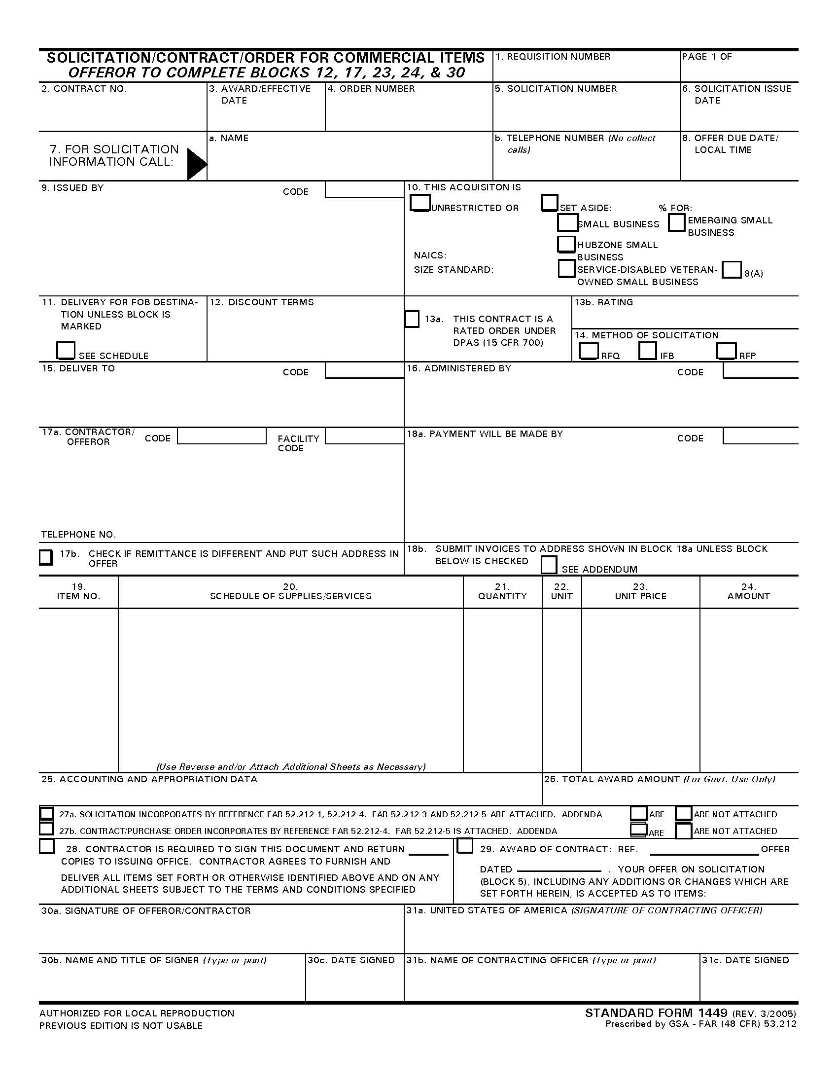
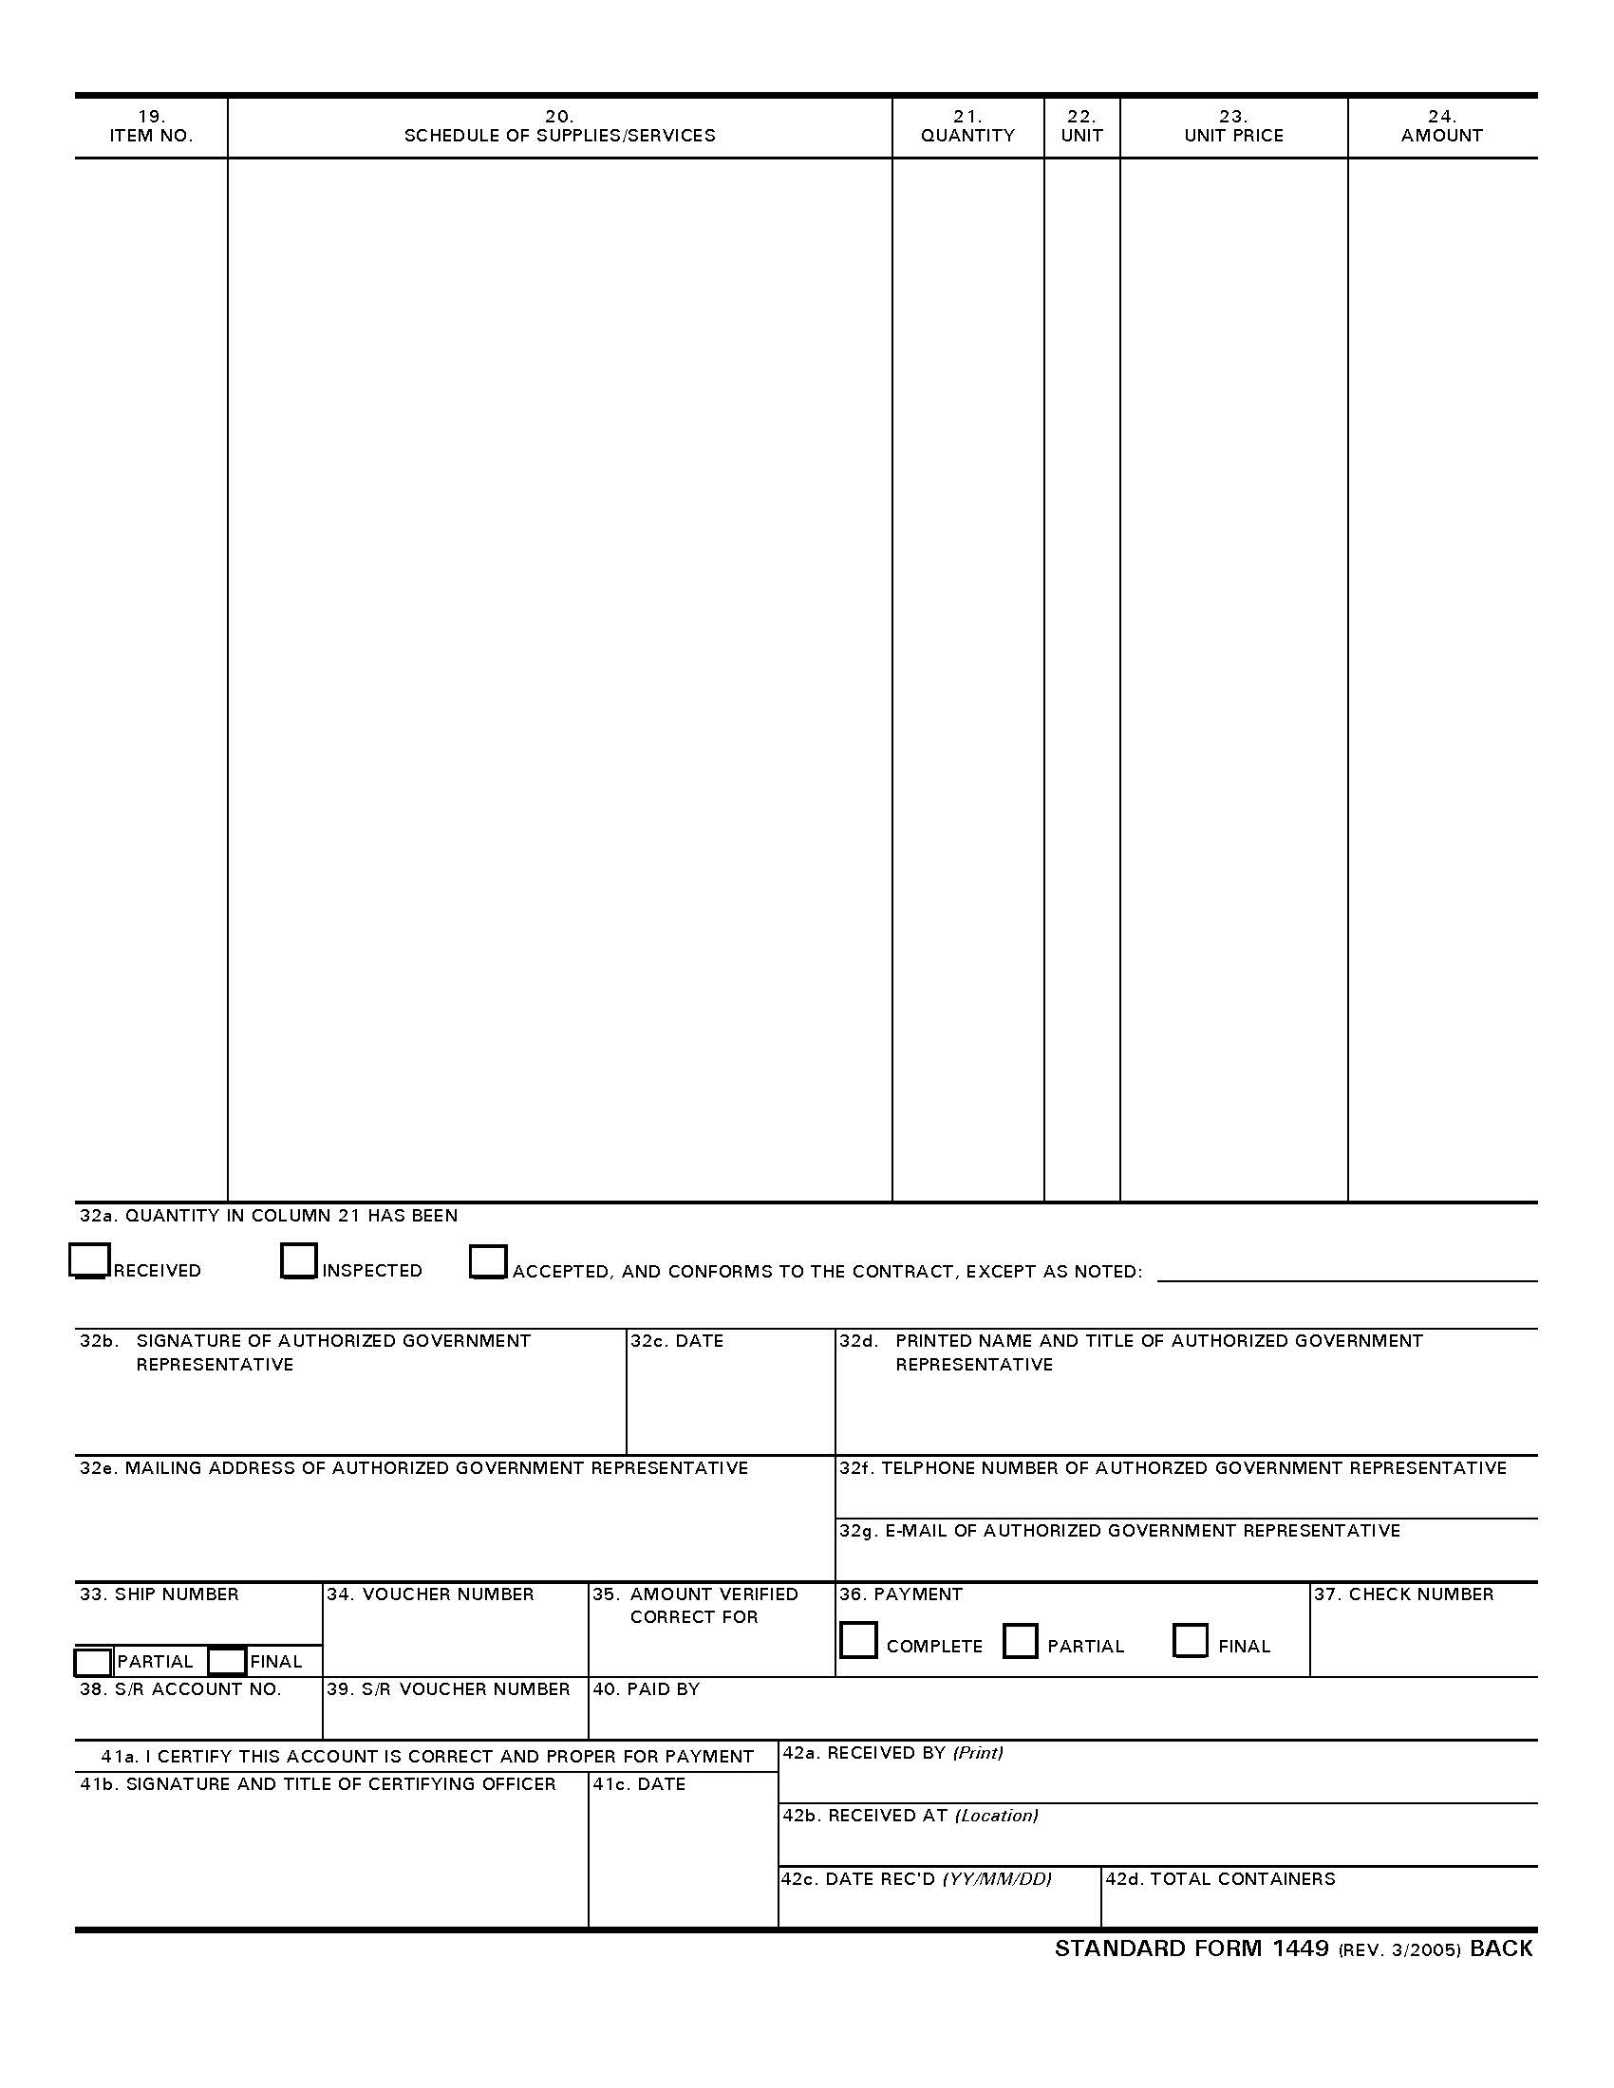
SF-1449 I-BPA Incident Blanket Purchase Agreement
Notes:
SIIBM Chapter 20, Page 20-5

Slide 19
Land Use and Facility Rental Agreements
LUA is an acquisition procedure to acquire the use of non-federal property or facilities.
School for base camp
Pond for dip site
Pasture for parking
Notes:
SIIBM Chapter 20, Page 20-5
Form: Emergency Facilities and Land Use Agreement, PMS-902-2
Instructor Note: Picture of the Form on the next slide.

Slide 20
PMS 902-2 LUA Emergency Facilities & Land Use Agreement

Slide 21
Emergency Equipment Rental Agreement
If there is no established (pre-season agreement for a resource needed, a procurement official may create an Emergency Equipment Rental Agreement (EERA).
Notes:
EERA is written at the incident and good for the life of the incident only. A warranted contracting officer writes the agreement and they are the only person authorized to negotiate rates.
Form: Emergency Equipment Rental Agreement (EERA), OF-294
Instructor Note: Picture of the Form on the next slide.
Fire Chasing – Occurs when a resource shows up at an incident that hasn’t been ordered. Use this equipment ONLY if there is a genuine need and time does not permit ordering through established channels.
In those circumstances, apply the following guidelines:
Before use, establish a resource order to document the need
Refer to a warranted contracting officer to establish an agreement
New agreements are valid for the duration of that incident only
Point of hire should be the incident
Compensation for travel to and from the incident is not allowed
Replace equipment with the most cost-effective resource at the earliest convenience

Slide 22
OF-294 EERA Emergency Equipment Rental Agreement

Slide 23
Contract & Agreement Contents
Documents the rental of property, animals, or equipment and negotiated by a Procurement Official. It includes:
Terms and Conditions
Date of Agreement
Vendor Information
Government Information
Resource Details
Hiring Method
Rates
Clauses
Notes:
SIIBM Chapter 20, Page 20-7 and 20-19
Contracts and agreements are signed by both the Contracting Officer and the Contractor.
Date – Date agreement is valid
Resource Details – Example: Type of equipment, serial numbers, etc.
Hiring Method – Example: Paid based on daily, weekly, monthly, hourly rates.
Rates – Amount paid for resource.
Clauses – Examples:
Equipment condition
Supplies required
Who pays repairs
What/when contractor is subsisted
Required personal protective equipment (PPE)
Who pays for loss, damage, and destruction
Work Rest requirements
Workers' compensation obligations and liability coverage
Incident behavior responsibilities, including conduct and ethics

Slide 24
EXERCISE
Notes:
Instructor Note: Depending on delivery method; use this exercise as a class or small groups.

Slide 25
Match each term with the most appropriate description:
LUA
Pre-Season Agreements
Service & Supply Plan
Unique Acquisitions
Contains a list of contacts, contracts, and agreements.
Established contract allowing nonfederal land to be used during incidents.
Previously arranged agreement with a vendor for lodging.
Acquiring medical providers for an incident.
Notes:
Answers:
1 – Service & Supply Plan
2 – LUA
3 – Pre-Season Agreements
4 – Unique Acquisitions

Slide 26
Process for Ordering thru Payment
Step 1 – Order
Step 2 – Acquisition Method
Step 3 – Pre-Use Inspection
Step 4 – Tracking Time
Step 5 – Invoice
Step 6 – Post-Use Inspection
Step 2 – Acquisition Method
Contract/Agreement
Notes:
Instructor Note: Progress Check

Slide 27
Time and Payment Process
Once a resource has been secured through a resource order and agreement/contract, the supervisor has various responsibilities.
Document pre-use and post-use inspections (ensure it’s completed)
Manage emergency equipment
Document time
Notes:
Incident agencies have established procedures for ordering, inspecting, record keeping, releasing, and paying for resources.
We have covered the first two steps of the process; ordering and the appropriate acquisition method.
Incident supervisors need to understand the agreement or contract and the requirements that affect the wok the contractor is doing in the field.
TEST QUESTION: Three supervisory responsibilities associated with emergency equipment are 1. Managing emergency equipment, 2. Documenting time on a shift ticket, and 3. Documenting pre-use inspection and post-use inspections.
Scenario:
A Type I incident that has requested emergency equipment through IROC. A contractor has accepted the assignment and a resource order has been created. Procurement authorities acquire the equipment using an EERA or incident blanket purchase agreement (IBPA), and it arrives at an incident. What now?

Slide 28
Pre-Use Inspection
Before a resource can be put to work, it must have a pre-use inspection.
Typically completed by Ground Support.
In IA, inspections may be done by Operations.
Form documents overall condition prior to use.
Protects the interest of the government and contractor.
Notes:
SIIBM Chapter 20, Page 20-12 thru 20-15
Pre-Use Inspection
The contractor and inspector must accept and sign the inspection.
Finance immediately receives a copy.
The vendor is given a copy and must bring this copy back for the release inspection.
Although ground support typically performs the pre-use inspection, the supervisor must ensure this is completed prior to allowing the contractor to work.
Instructor Note: Picture of the Form on the next slide.

Slide 29
OF-296 Vehicle/ Heavy Equipment Pre-Use Inspection Checklist

Slide 30
Process for Ordering thru Payment
Step 1 – Order
Step 2 – Acquisition Method
Step 3 – Pre-Use Inspection
Step 4 – Tracking Time
Step 5 – Invoice
Step 6 – Post-Use Inspection
Step 3 – Pre-Use Inspection
OF-296
Notes:
Instructor Note: Progress Check

Slide 31
Emergency Equipment Shift Ticket
Documents daily use of the equipment.
Use is documented in accordance with the agreement terms and conditions.
Government Representative supervising the equipment completes the shift ticket (OF-297) each shift.
Shift ticket is signed by Government Rep and Contractor.
Notes:
In the “real world” the contractor completes the shift tickets, but it is ultimately the responsibility of the government representative.
TEST QUESTION: Who is responsible for completing and submitting the shift ticket? The agency representative responsible for managing the equipment.
Instructor Note: Picture of the Form on the next slide.

Slide 32
OF-297 Shift Ticket
Notes:
Instructor Note: Review the Shift Ticket and the supervisor responsibilities.
In order to fill out the shift ticket, two documents are needed from the contractor:
Resource order
EERA or IBPA
The EERA will specify if the equipment's daily use is recorded by:
Hours
Days
Miles
Guarantee
Hours
Even if the resource is paid a daily rate still need actual hours worked for operated equipment. w/r guidelines apply to all incident resources and need to be tracked.
Hours are recorded daily on the shift ticket (in military time) in order to compare service hours and value, even if the EERA specifies to record equipment use by days.
If the equipment is being used for only two hours a day but is getting paid a daily rate, then appropriate agency personnel might consider renegotiating the agreement or releasing that equipment and procuring a new resource.
Days
Daily rates are negotiated by the procurement officer and the vendor. These rates are paid to the vendor regardless of hours or mileage used.
Miles
Miles are recorded using the odometer. They are written in the start and stop columns of the shift ticket. If the numbers are too large to fit in the space provided, record miles in the remarks section. As long as they are recorded, finance will find them.
Guarantee
A guaranteed rate is a minimum flat-rate payment for services rendered.
Unusual conditions need to be documented on the shift ticket in the remarks section:
Downtime- mechanical issues, personnel issues, etc.
Damage
Release time
Transport
Reason for paid meal break
TEST QUESTION: Mechanical problems and off time are noted in the remarks on the shift ticket.
Meal breaks should be taken and documented on the shift ticket. If they do not show up, document why breaks were not taken.
After the shift ticket is completed and signed, it is submitted to Finance to post to the Use Invoice.

Slide 33
Process for Ordering thru Payment
Step 1 – Order
Step 2 – Acquisition Method
Step 3 – Pre-Use Inspection
Step 4 – Tracking Time
Step 5 – Invoice
Step 6 – Post-Use Inspection
Step 4 – Tracking Time
OF-297
Notes:
Instructor Note: Progress Check

Slide 34
Emergency Equipment Use Invoice
For a contractor to be paid, Finance posts time from the shift ticket to the use invoice.
Payment Document
Posted Daily
Completed by the Equipment Time Recorders
Signed by the Contractor and Finance
Notes:
Instructor Note: Picture of the Form on the next slide.

Slide 35
OF-286 Emergency Equipment Use Invoice
Notes:
Instructor Note: Review the Use Invoice.
Three documents are required to complete the use invoice:
Shift ticket
EERA or IBPA
Resource order
Other pertinent information, such as administrative office for payment and hiring/agreement information, is retrieved from the EERA or IBPA.
Possible additions and deductions on the use invoice include:
Fuel
Unusual wear and tear
Commissary
Parts
M&IE and/or lodging if no incident base or meals provided
At the time of demobilization, the emergency equipment use invoice is:
Totaled and closed out
Signed by the appropriate agency official
Signed by the contractor
Subject to audit (errors are corrected before the contractor payment is sent)

Slide 36
Emergency Equipment Use Invoice
Additional documents related to the rental and payment of equipment may include:
Emergency Equipment Fuel and Oil Issue
Emergency Equipment Rental Use Envelope
Contract Claim Documentation
Performance Evaluations
Notes:
Entire slide agency dependent -- Fuel and Oil Issue
The OF-304 (fuel and oil) is a payment document used by fuel tenders when they issue fuel at an incident. More and more, fuel tenders are accepting credit cards on the incident base and therefore reducing the need for this form.
Tender agreements are also incorporating the credit card utility, so vendors need to be set up to accept credit cards.
Rental-Use Envelope, OF-305
The OF-305 consolidates all pertinent documents related to the EERA or IBPA. It is prepared at the time of hire by the hiring official and contains:
A copy of the EERA or IBPA
Pre-use inspection
Emergency equipment shift ticket book
The materials needed for payment are placed inside the envelope.
Contract Claim Documentation
Contract claims information may be submitted to the procurement unit leader, incident agency, or contracting officer. We get into the specifics of contract claims in the Claims module.
Performance Evaluations
Performance evaluations are completed by the supervisor and forwarded to the contracting officer. A copy is given to the contractor, and another copy is retained for the incident documentation package.
Before equipment is released and paid, the procurement unit leader or the buying team leader ensures the:
Completion of a release inspection
Posting of time, additions, and subtractions is correct
Signing of the demobilization checkout, ICS-221
Documentation of release time and date
Obtaining of legible signatures
Completion of the performance evaluation
Placement of all payment documentation into the emergency equipment rental-use envelope

Slide 37
Process for Ordering thru Payment
Step 1 – Order
Step 2 – Acquisition Method
Step 3 – Pre-Use Inspection
Step 4 – Tracking Time
Step 5 – Invoice
Step 6 – Post-Use Inspection
Step 5 – Invoice
OF-286
Notes:
Instructor Note: Progress Check

Slide 38
Post-Use Inspection
When a resource released, a post-use inspection may be completed.
Best practice is to do one, but not always
feasible.
Notes:
A post-use inspection is not required.

Slide 39
Process for Ordering thru Payment
Step 1 – Order
Step 2 – Acquisition Method
Step 3 – Pre-Use Inspection
Step 4 – Tracking Time
Step 5 – Invoice
Step 6 – Post-Use Inspection
Step 6 – Post-Use Inspection
Notes:
Instructor Note: Progress Check

Slide 40
Process for Ordering thru Payment
Step 1 – Order Resource Order
Step 2 – Acquisition Method I-BPA/EERA
Step 3 – Pre-Use Inspection OF-296
Step 4 – Tracking Time OF-297
Step 5 – Invoice OF-286
Step 6 – Post-Use Inspection OF-296
Notes:
Review the process for ordering a resource through the resource receiving payment.

Slide 41
Contract Claims
Contracting Officer can adjudicate a contract claim and add to use invoice.
Claim must be in writing (no specific form) and initiated by the contractor.
Documentation to support the claim.
Incident Supervisor documents damage and initiates an investigation, if needed.
Notes:
SIIBM Chapter 20, Page 20-16
Documentation should include name, address, phone number, signature, facts concerning damage, itemized listing of the amount claimed and witness statements.
Most common issues resulting in a claim:
Equipment damage
Failure to comply with terms and conditions of agreement
Inadequate documentation
Inadequate pre-use inspections
Lack of communication between reps
Example of a Contract Claim
A hose on a contract engine is used on the fireline and the division supervisor directs the hose to be left in place when the engine is released. Is this a claims situation?
To replace the lost property, the contractor initiates a claim through the contracting officer who then has the authority to bring the claim to resolution.
Some details:
The government cannot give or sell federal inventory to a contractor
Contractors can check out items temporarily from supply
Checked out items have to be returned when demobilizing
The EERA or I-BPA ensures that if the government keeps or damages equipment, then the contractor will have another way of providing materials so that it can do its job.

Slide 42
Exercise: Shift Tickets
Notes:
Instructor Note: Show shift ticket and then cover the other questions. Other questions are on next slide.

Slide 43
Exercise Shift Tickets
Where is the information for the work rate and work unit located for the shift ticket?
On 08/07, what are the dozer’s hours and what is documented in the remarks?
On 08/08, what are the dozer’s hours and what is documented in the remarks?
Notes:
Instructor Note: Show shift ticket and then cover the other questions.
Answers:
1 – a. EERA or I-BPA
2 – 0530-1300, 1330-1800; no remarks needed.
3 – 0530-1000; down at 1000 for mechanical problem and out of service for the day.

Slide 44
Summary & Questions
Employees have a right to the resources required to perform their job, order on ICS-213.
A resource order is required for all resources.
A procurement official must acquire all resources.
Following the process for ordering, inspecting, tracking and posting time will ensure timely payment to vendor.

