Slide 1
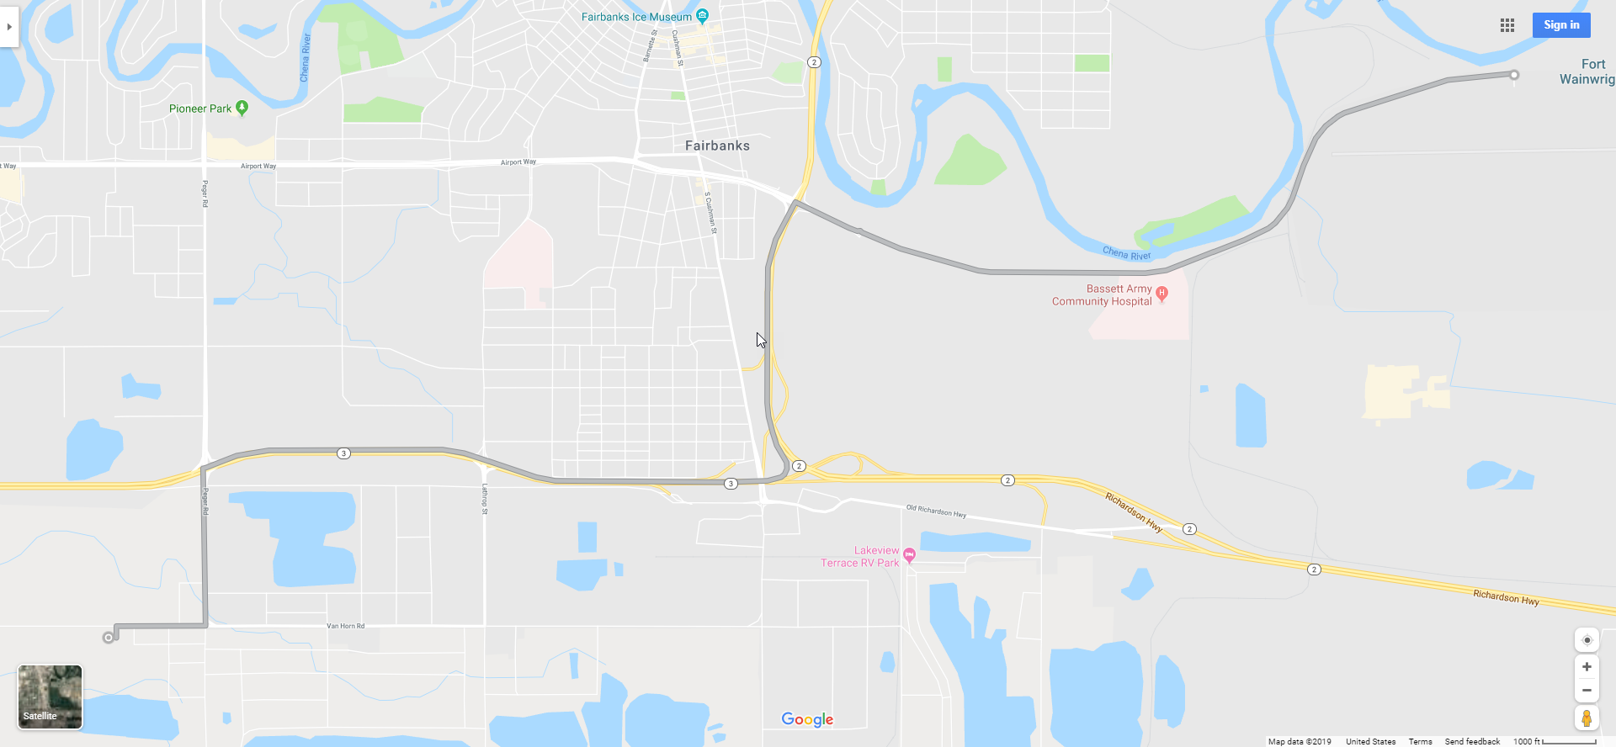
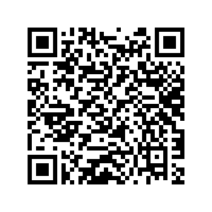
Gaffney
Steese Hwy
Peger
Richardson Hwy
Van Horn
Fairbanks Pipeline Training Center
3605 Cartwright Ct Building C, Fairbanks, AK 99709
Scan to load map on your phone

