Slide 1
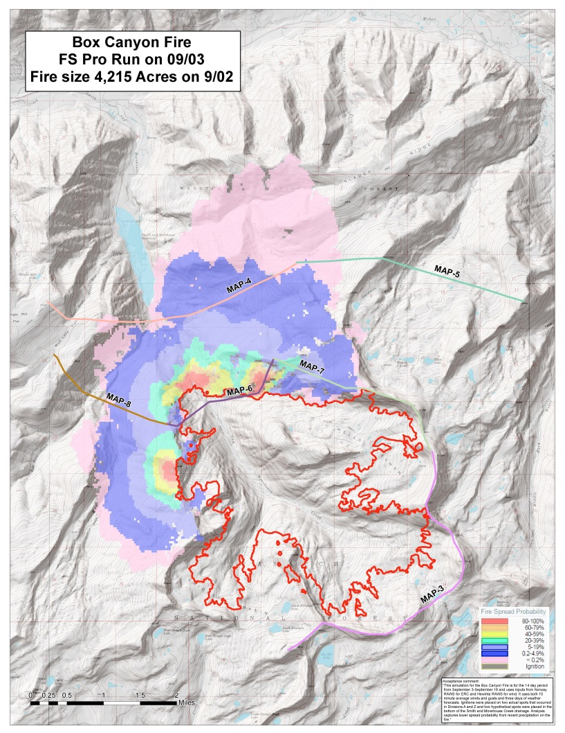
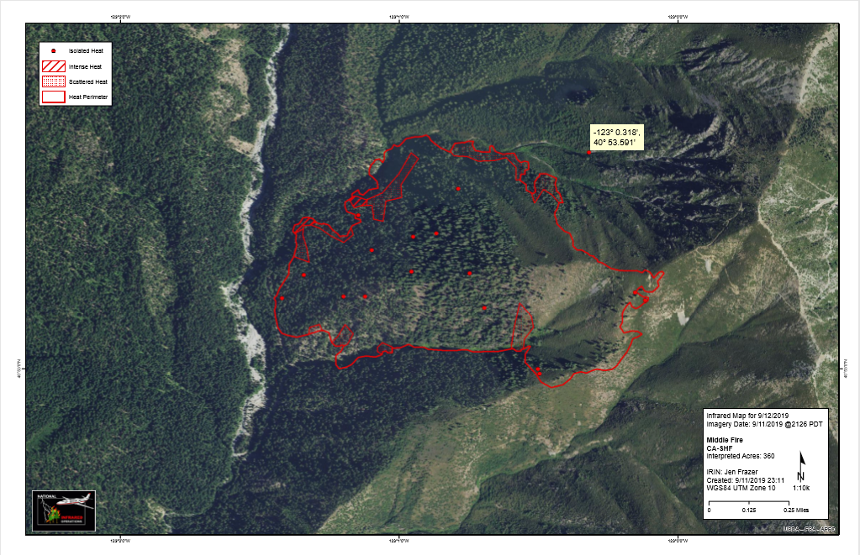
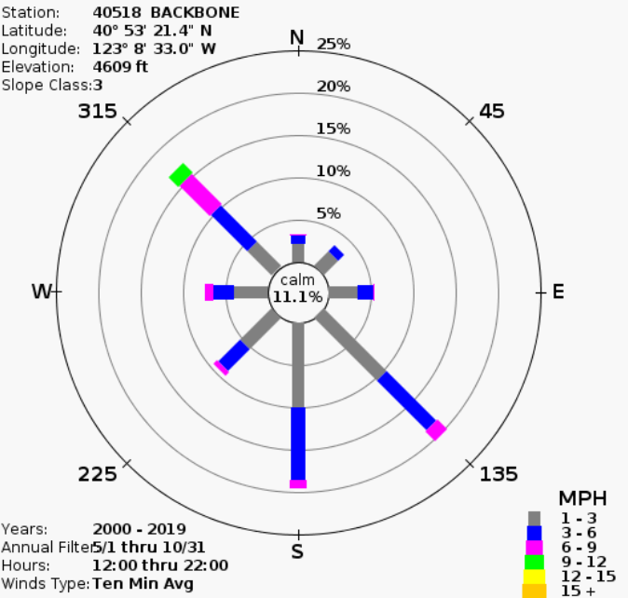
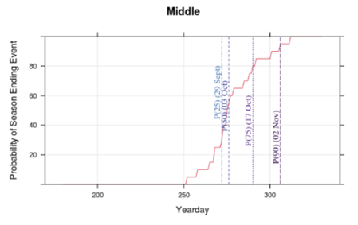
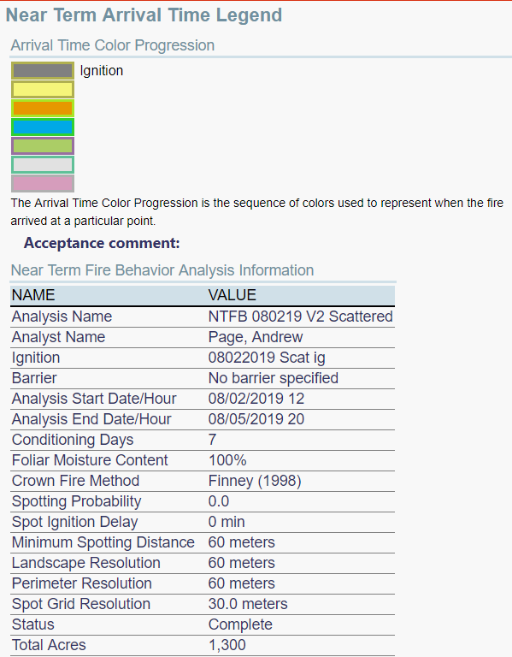
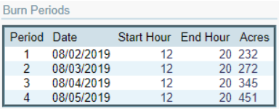
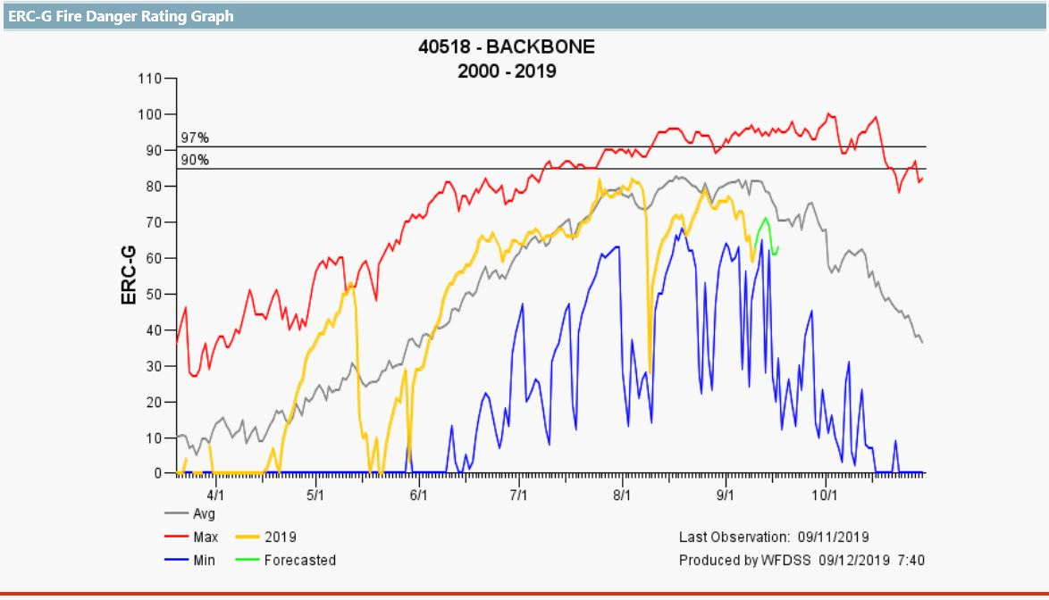
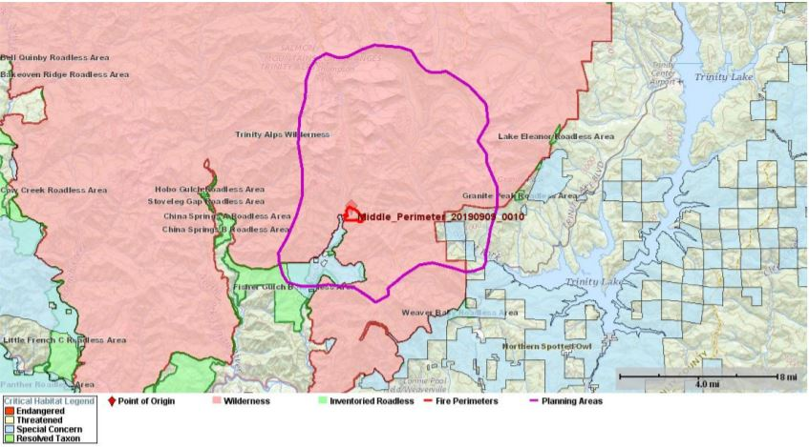
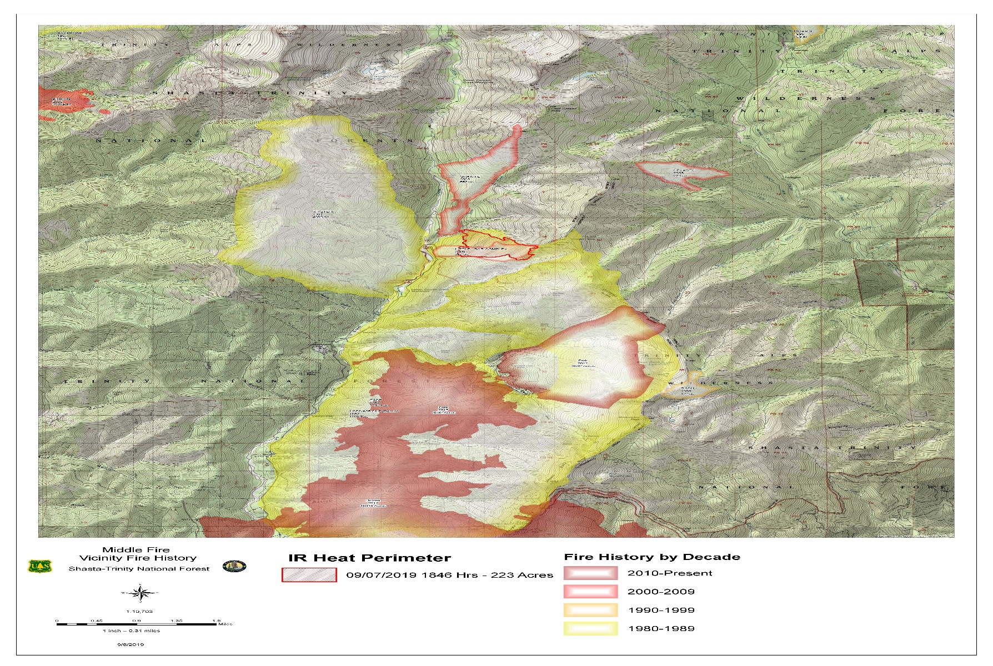
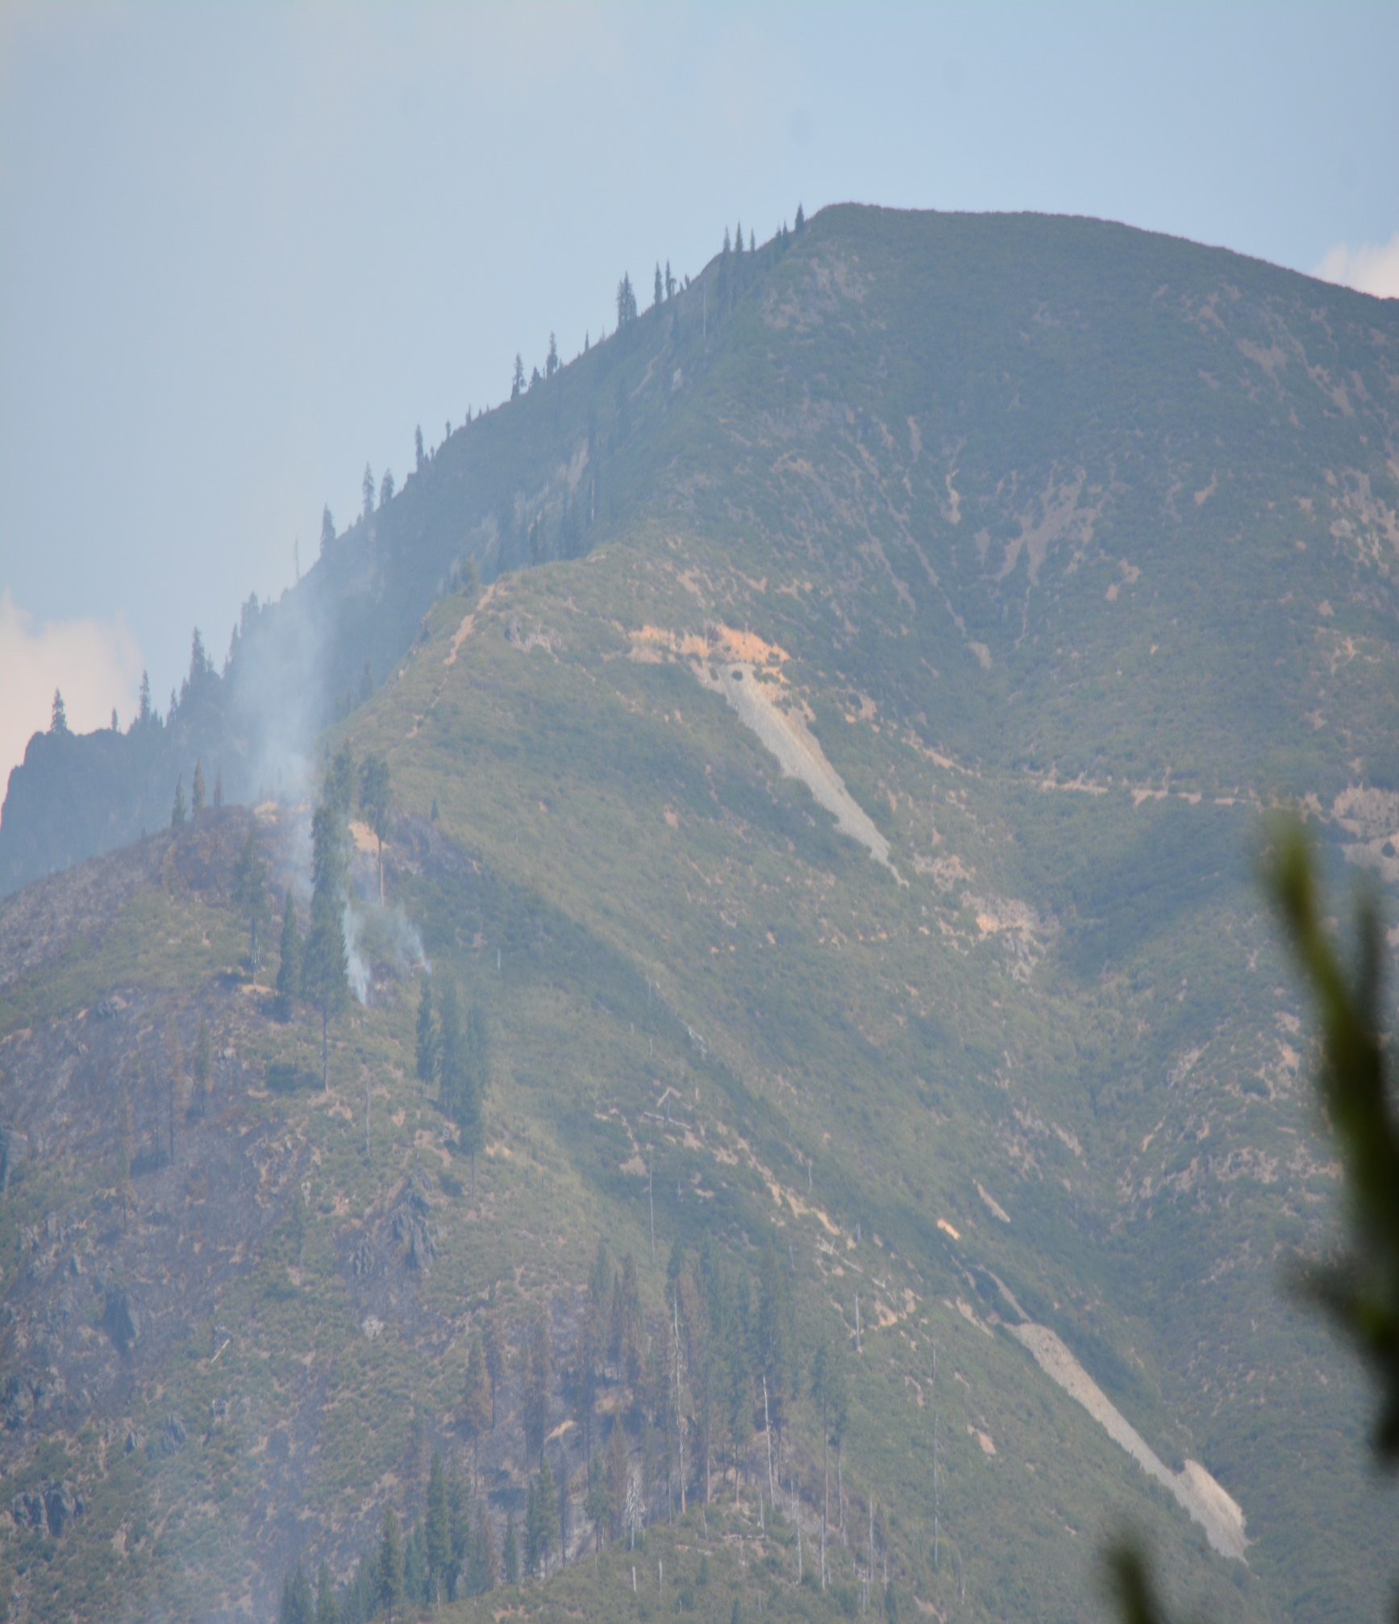
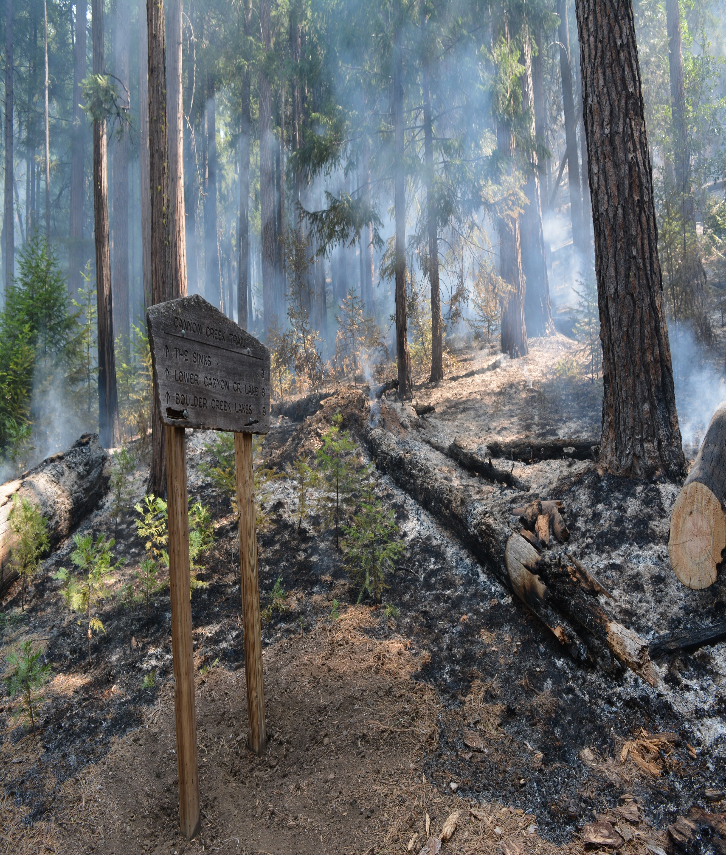
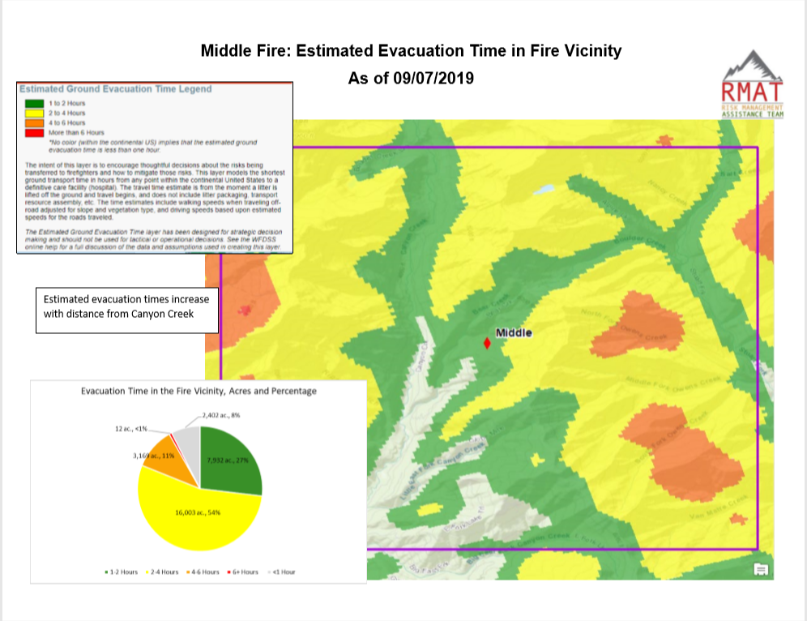
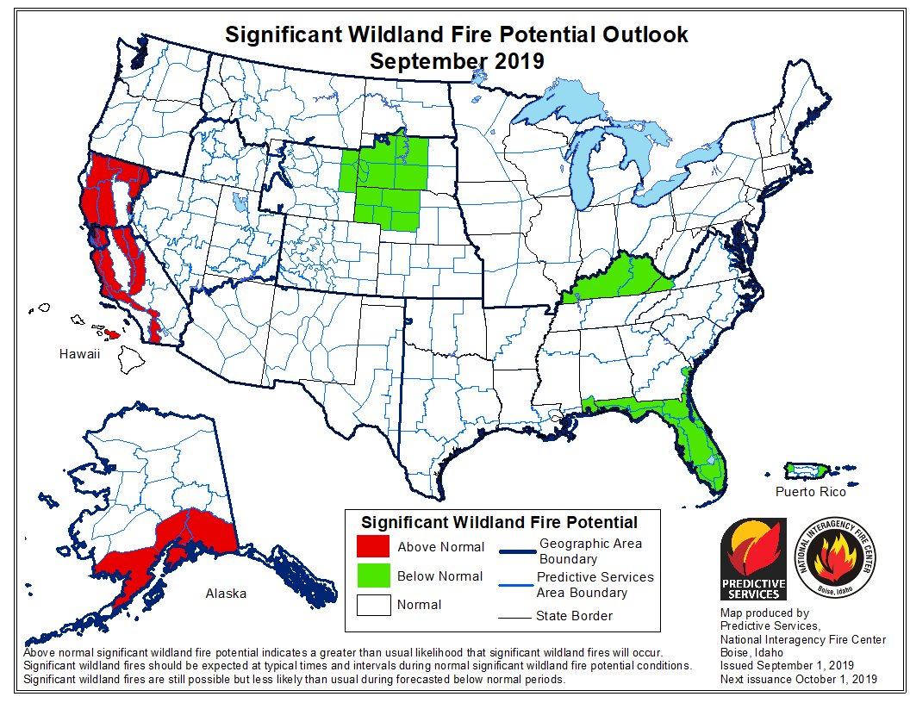
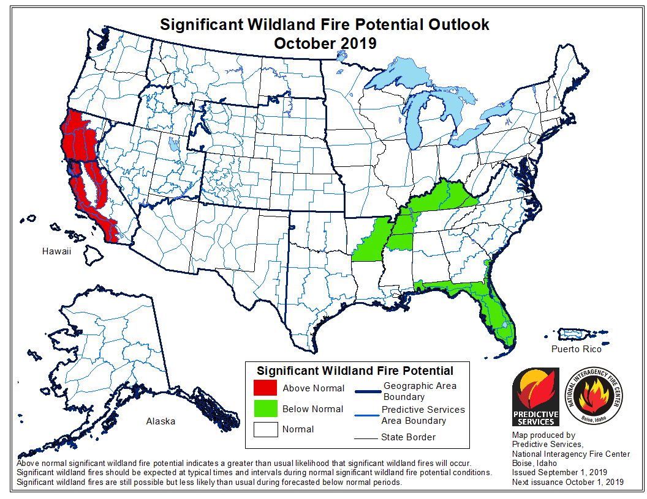
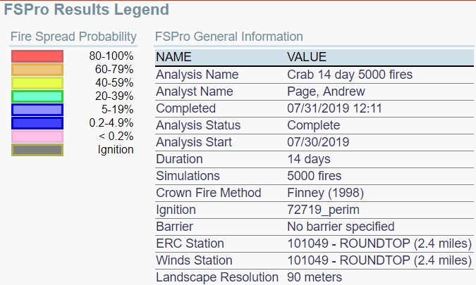
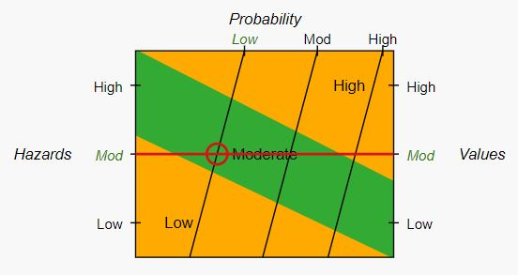
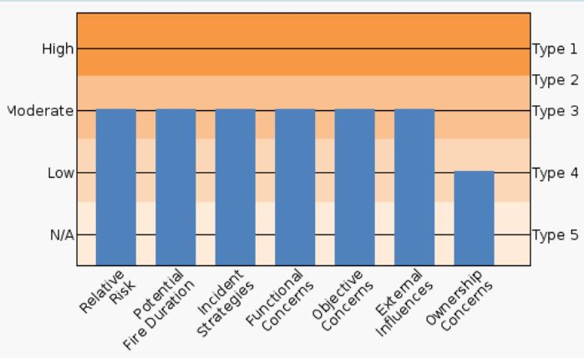
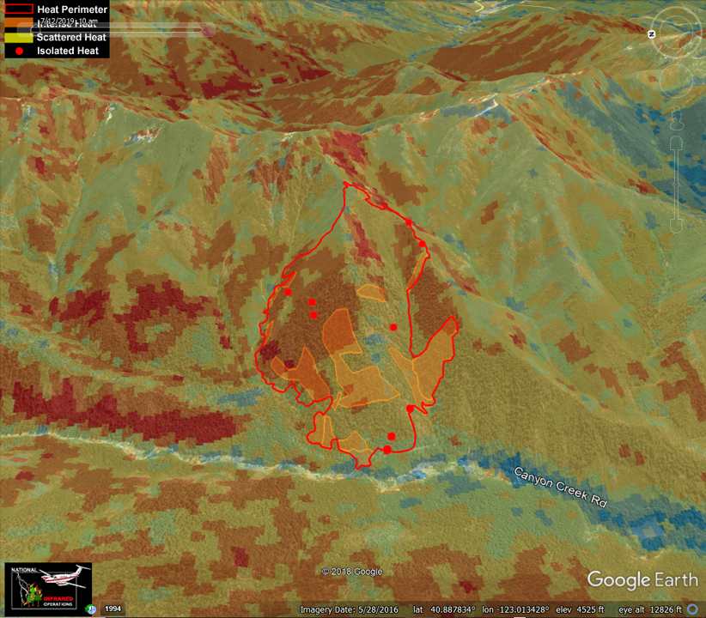
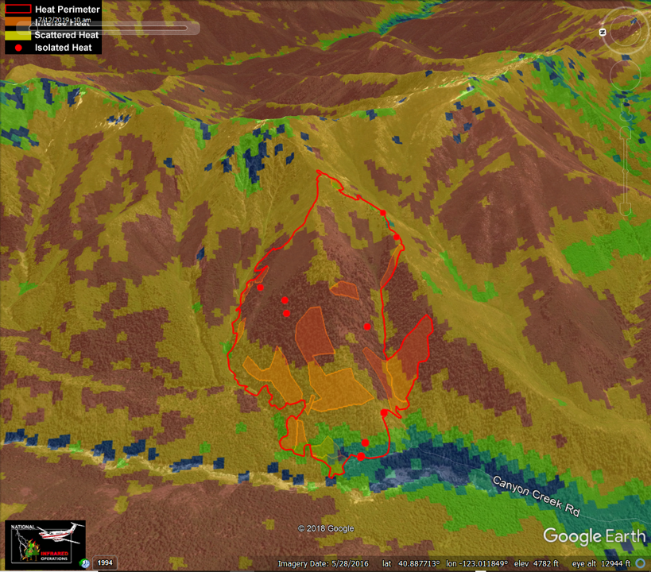
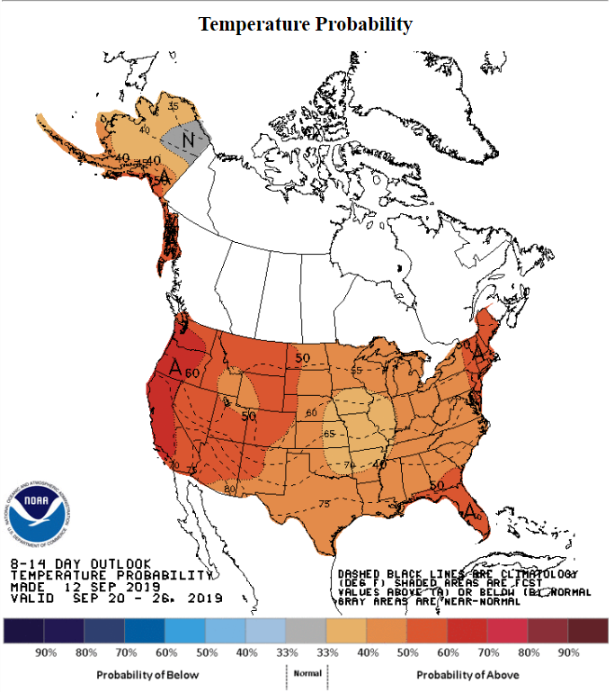
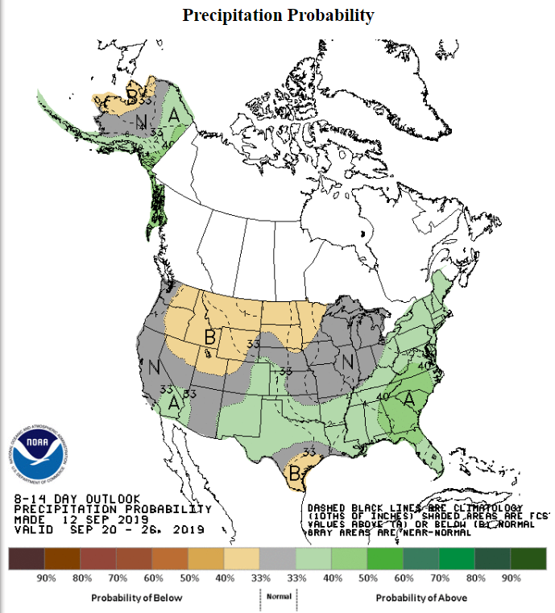
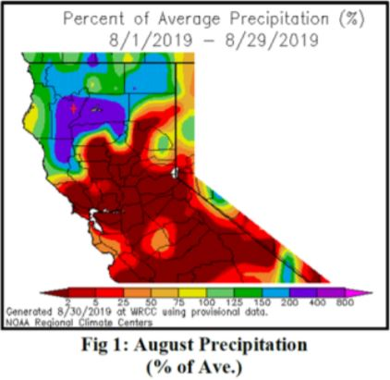
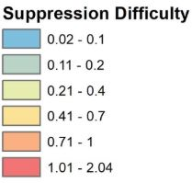
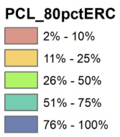
2019 Middle Fire (CA-SHF) - Long Term Strategic Analysis
.
.
Overview
Infrared Map for 9/12/19
WFDSS Near Term
Winds
Season Ending Event
A Long Term Analysis is a tool used by fire managers to identify potential impacts to values at risk and key questions related to such values. It helps managers monitor if management action points are impacted related to the identified values. Such an analysis was complete for the Middle Fire. This poster presents the current situation and projects out the remainder of the fire season in terms of fire spread potential, weather and fire outlook, fire history and end of season analysis. By looking ahead, one can anticipate what to expect and develop critical trigger points to help make informed decisions. This is all put into context of management action points, values that are being protected by those actions, and the probability of the fire reaching those values over time.
Strategy: The strategy for the Middle Fire Incident will be to employ modified suppression, point protection and tactics to achieve incident objectives and protect the values at risk.
This is the story of the Middle Fire in terms of antecedent conditions, the current situation, and where we’re heading as fire season continues.
The following wind rose depicts burn period winds (12:00 -22:00) during the fire season of May 1st through October 31st. the analysis included 2000 through 2019. The wind rose depicts the 2 dominant wind patterns observed at Backbone RAWS, a NW and S-SE wind. Typical winds are not above 10 mph with some records reaching 12 mph over a ten minute average. Winds were calm 11.1% of the time.
Below is a season-ending graph for the Middle Fire. It is based on 18 years of gridded weather data and the most recent fire perimeter. A time series of ERC is extracted for each pixel in the fire perimeter. If the ERC drops below a RELATIVE ERC of 75 (data is scaled 0 to 100)—25% of the historic max—and remains below that threshold the remainder of the year, the season-ending criteria is met.
Current Situation
Natural Resource Concerns
Fire History
Fire growth potential was at its near peak for the 2019 fire season when the Middle Fire was discovered on September 5. Fire behavior has steadily moderated since. Note that the forecasted ERC shows it to not reach high to critical fire danger rating levels and should decline for the rest of the season.
Energy Release Component is a number related to the available energy per unit within the flaming front at the head of a fire. Daily variations in ERC are due to changes in moisture content of the various fuels present, both live and dead, and have an affect on potential fire intensity.
Fire Behavior and Effects
Wildland Fire Outlook
Risk and Organization Assessment
Estimated Ground Evacuation
Above normal significant large fire potential is expected in the higher elevations in September and October followed by Normal significant large fire potential. The general outlook for September through December is for warmer and drier than normal conditions. Higher elevations (above 6,000 feet) are still seeing higher live fuel and soil moisture values from the runoff of the robust winter snow pack.
The Overall risk is moderate due to the few values at risk and infrastructure within the area. Potential fire growth is moderate and fire behavior will trend lower as we begin the fall season.
A type 3 organization is recommended to manage the incident. Some specialized resources and coordination are required in the wilderness. External influences are key as well given the potential for visibility from nearby communities and the impact to recreation from area closures during hunting season.
8-14 Day Weather Outlook
Precipitation % of Average
Suppression Difficulty Index
Potential Control Locations
Findings and Summary
The 8-14 day outlook for Sept. 20-26, above normal temperatures are favored for the conterminous United States. The highest probabilities of above normal temperatures are indicated along the West Coast. There are enhanced probabilities of near normal precipitation forecast over the western United States.
The fire area received above normal precipitation in the spring and in August, leading to higher than average fuel moistures. This fuel moisture has allowed live fuels to retain greenness and are less available for consumption when compared with average of below average precipitation years. This has resulted in lower rates of spread than past fires in the same area at this time of year. If precipitation remains above normal this condition may persist, however, if the next few weeks are at or below average for precipitation, live fuels along with fine dead fuels will continue to cure and contribute to fire spread.
The Middle Fire was discovered on Thursday, September 5th 2019 after overnight lightning the previous night. Line officers and fire management from both the Trinity River Management Unit and the Shasta-Trinity Supervisor's Office met to discuss current situation on the Middle Fire and evaluate management strategies. Given the location of the fire, proximity to wilderness, seasonality, expected fire behavior, risk to firefighters and likelihood for success the decision has been made to suppress this fire using a confine/contain strategy that limits exposure by moving operations to locations with fewer snags and lower potential for rolling debris to impact resources on the fire. The planning area identified is approximately 69,000 acres in order to encompass potential primary, secondary and tertiary control features. The designated planning area is not necessarily the anticipated final fire . The selected course of action will be utilized to achieve an appropriate final that balances firefighter exposure and impacts from fire, smoke and loss of access to recreating public.
Currently threats to the values at risk are low. The fire still has potential for future growth, but strategic locations of firelines and natural barriers have been identified and mitigation measures are in place for the identified values at risk.

