Slide 1
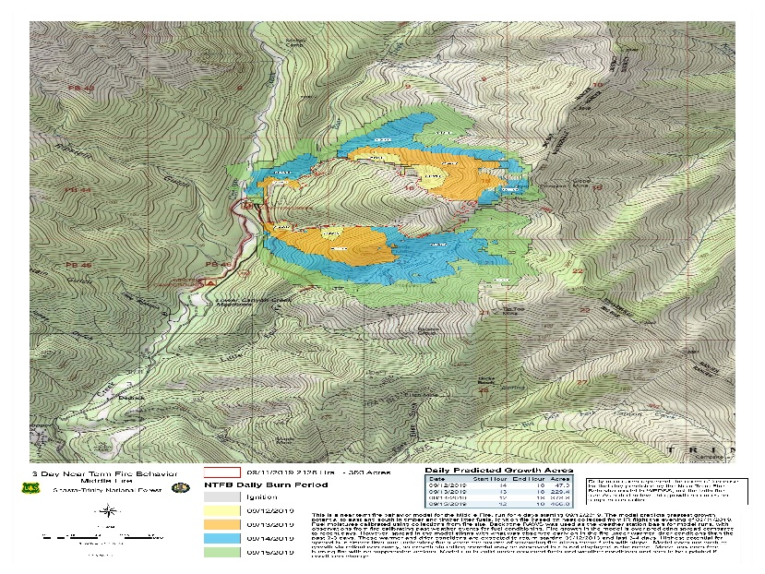
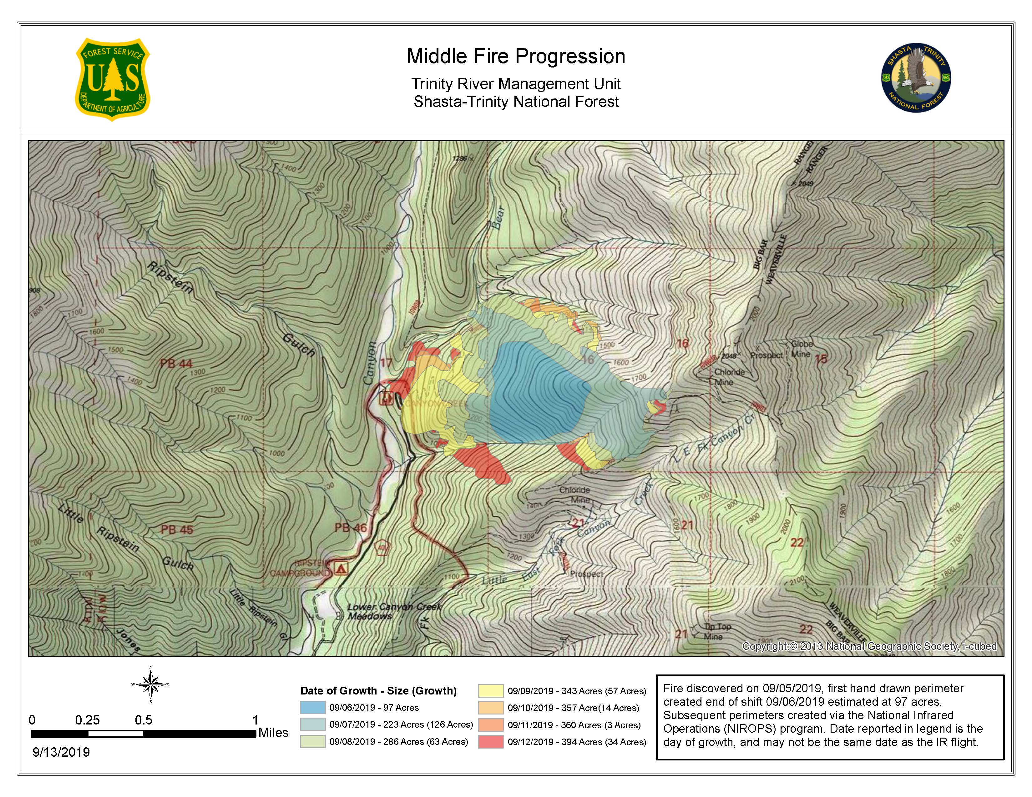
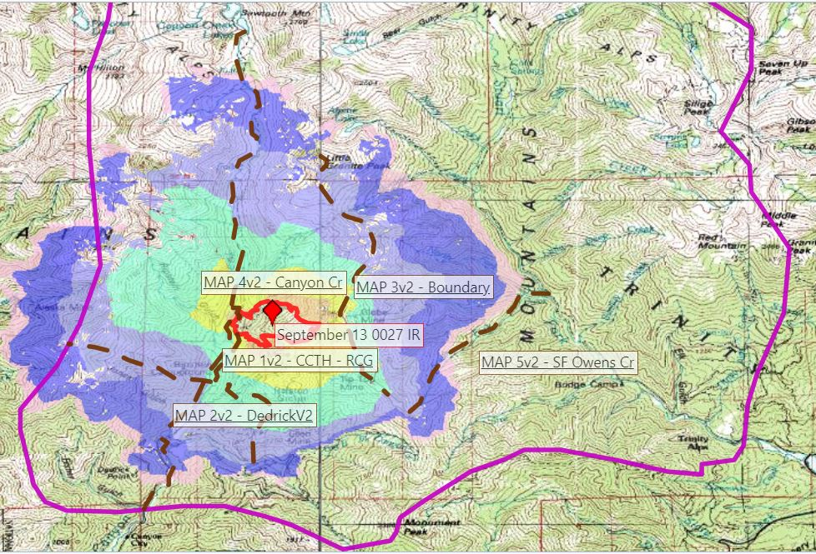
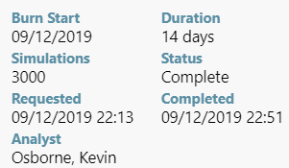
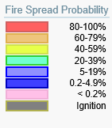
2019 Middle Fire (CA-SHF) - Long Term Strategic Analysis
Firefighter and Public Safety:
-Provide for firefighter and public safety: Implement strategies and tactics that commit responders to operations where and when they can be successful while recognizing when tactics are unnecessary and/or increase exposure to fire responders and pilots.
-Identify site specific hazards and implement mitigations to reduce firefighter exposure to environmental conditions/hazards including but not limited to snags from past fire footprints and historic mining features.
-Ensure public safety through appropriate road and trail closures, road and trail signage and notification of recreationists.
Outreach and Education:
-Develop a comprehensive public outreach and notification plan. Include specific talking points for a confine/contain strategy and information targeted to multiple audiences, including internals, public and external partners.
-Utilize the fire as an opportunity to increase public and cooperator understanding of managing fire with a confinement strategy:
Post information at key locations in the local communities and keep them updated frequently.
Attend pre-planned public and cooperator meetings and include sharing information about strategy and progress on the incident.
Consider hosting public meetings with the intent of sharing the confinement goals and the progress of achieving those goals.
-Develop a short document telling the story of the Middle Fire that can be used as an education/outreach after the fire is out.
Property Protection:
-Ensure adequate protection is in place when fire approaches structures in Canyon Creek and Stuart Fork, including Dedrick, Grasshopper Flat and Trinity Alps Resort, such that they are not damaged by the fire. Consider utilization of a structure protection plan.
Resource Protection:
-Utilize minimum impact suppression tactics and other low impact strategies (no heavy equipment) in order to reduce long-term impacts to wilderness character and values.
-Ensure firing operations are designed and implemented to minimize resource damage, favoring low severity fire and avoiding ignitions at the base of slopes.
-Minimize adverse effects from operations to cultural/historic resources, riparian areas, meadows, Northern Spotted Owl Habitat, plantations, watercourses and anadromous fish bearing streams.
-Consult with resource advisors and cultural resource specialists during strategic planning and to the extent possible on the fireline.
Confine & Control Objectives:
-Prevent fire from impacting Trinity Alps Resort and other values in Stuart Fork by keeping fire west of the dominant ridge that runs north from Weaver Bally through Monument Peak to Little Granite Peak.
-Avoid fire becoming established in the heavy fuels of the 1987 Ripstein Fire footprint by keeping fire east of Canyon Creek
-Utilize combination of Big East Fork of canyon Creek and footprint of the 2017 Fork Fire to prevent fire from moving past the Fork Fire footprint and subsequently impacting the large amount of infrastructure, structures and improvements in lower Canyon Creek.
Limitations and Validation
There are limitations to all long-term decision support models. These models are based on historical weather records, weather forecasts and standardized fuel model mapping. Although expert opinion is used in making adjustment to much of this information, there is a lot of variability in natural systems and complex interactions in our fire environment that cannot be modeled. All models are simplifications of reality, and there are assumptions within the fire spread models that also need to be considered. The results from these models are based on the best available data; models are also limited by this same information.
The displayed Near-Term Fire Spread Model and FSPro-Fire Spread Model runs are only valid under the assumed conditions and assume a free burning fire with no suppression activities. The runs should be rerun periodically, no later than the noted date, or if conditions significantly change.
Dedrick and Grasshopper Flats structures
Cultural Resources
Recreation Infrastructure
Wilderness character
Northern Spotted Owl critical habitat
Stuart Fork area structures, including Trinity Alps Resort
Anadromous Fish Habitat
Plantations
MAP 1 - Protect recreation infrastructure. Consult with READ
MAP 2 - Prepare to tie fire into Canyon Creek and Fork footprint while providing for structure defense/protection
MAP 3 - Notify and protect the recreating public and notify local stakeholders. Trail system notices. Consult with READ
MAP 4 - Identify the appropriate control actions to limit fire spread beyond the planning area. Manage fire intensity.
MAP 5 - Notify and protect the recreating public and notify local stakeholders. Review structure defense plans.

