Slide 1
GIS and Wildland Fire
An Evolution

Slide 2
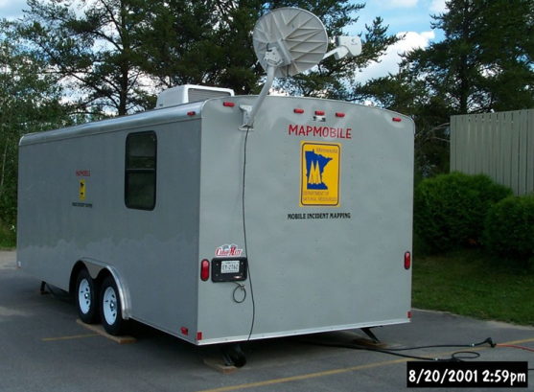
History
Minnesota
1998 GISS on site for the first time.
Remote and mobile.
12 years of capability.
National
Similar timing with regard to capability
Several modeling, tool development programs.
Ability to request DOD, NASA, etc products
Short turnaround (24 hrs).
Incident Types
Wildfires
Hurricanes
Shuttle Recovery
Terrorism (911)
Notes:
Minnesota
1998 GISS on site for the first time.
Remote and mobile.
12 years of capability experience
National
Similar timing with regard to capability
Several modelling, tool development programs.
Ability to request DOD, NASA, etc products in with short turnaround (24 hrs).

Slide 3
National Wildfire Coordinating Group
Mission Statement
The purpose of NWCG is to coordinate programs of the participating wildfire management agencies to avoid wasteful duplication and to provide a means of constructively working together. The goal is to provide more effective execution of each agency’s fire management program. The group provides a formalized system to agree upon standards of training, equipment, qualifications, and other operational functions.
E-mail comments or suggestions pertaining to this or any NWCG course to: nwcg_standards@nifc.blm.gov
NWCG Website: http://www.nwcg.gov/

Slide 4
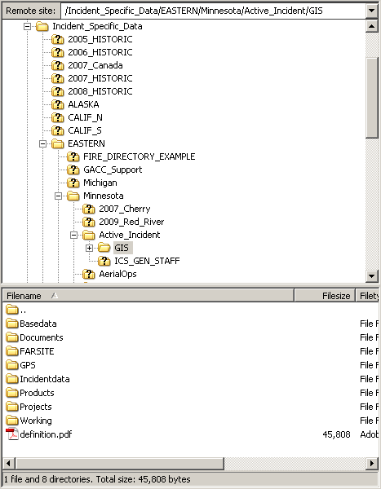
NWCG Standards
GIS Standard Operating Procedures
Products and Standards
http://www.nwcg.gov/pms/pubs/GSTOP7.pdf
http://www.nwcg.gov/pms/taskbook/planning/pms-311-77.pdf
NIFC FTP
ftp://ftp.nifc.gov/Incident_Specific_Data/EASTERN/Minnesota
24/7 support
National Grid
Nat’l Std. Elements Template for Minnesota
Dependent on Training for Operations
Fire Refreshers, etc.
Notes:
National Grid
Education of operational staff should be the priority.
GISS shouldn't implement system not understood or used by operations.
When they are ready, the request to implement must come from operations staff NOT from GIS.

Slide 5
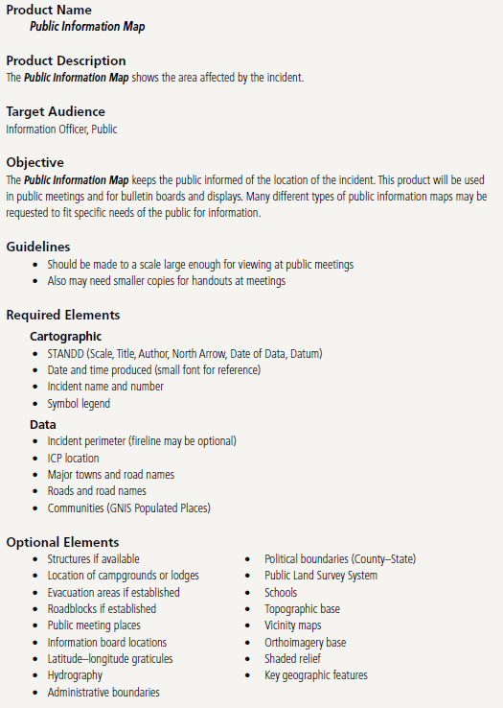
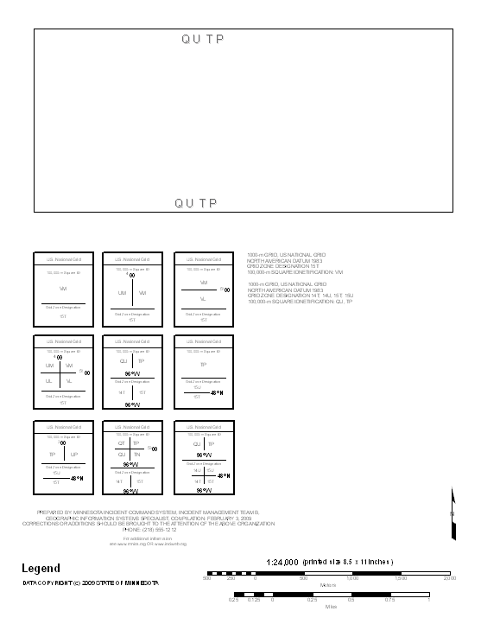
MN USNG Template
Sample Products SOP

Slide 6
NWCG Standards (Cont.)
Training Standards
April 2009, S-341 held at Ft. Snelling.
35 students from 10 plus states
Focuses on organization, naming, product development and elements.
“You work to produce a product for Operations, that means you need to communicate their needed information to their people on the ground.”
Incident Type Independent.

Slide 7
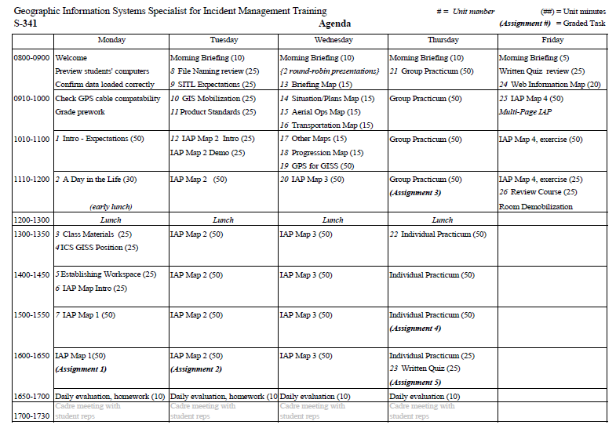
Notes:
Take quality GISS individuals from a variety of backgrounds and teach them how to operate in a high stress environment with constructive evaluation.

Slide 8
NWCG Standards (Cont.)
ICS Command Structure (National Standard)
Incident Commander
Planning Section Chief
Situation Unit Leader
Lead GIS Specialist (GISS) -- Large Incidents
GISS
Technical Specialists
Field Observer
Notes:
Situation Unit Leader
sets workload, monitors products, manages priorities, "a true supervisor".

Slide 9
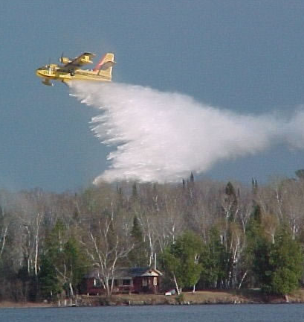
Minnesota ICS Capabilities and Operations
Capabilities
3 Type II Incident Management Teams (All-Risk)
Mapmobile for Onsite Mapping
Support Resources
Statewide Dispatch Center
Aircraft -- Fixed and Rotor
Interagency (7+ State and Federal Agencies Active)

Slide 10
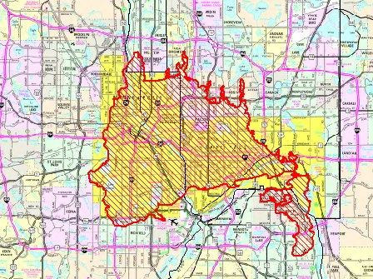
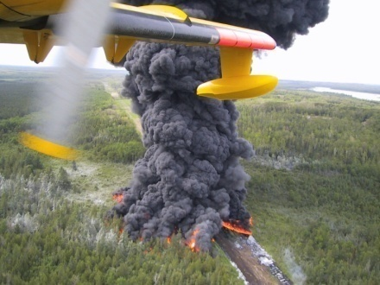
Minnesota ICS Capabilities and Operations (Cont.)
Operation Examples
Wildfires
Minnesota
Wisconsin
Michigan
Montana
California
Eastern Great Basin
Texas
Alaska
And more…
Search and Rescue
St. Peter Tornado Recovery
Grand Forks Flood
Support LE at Hells Angels Motorcycle Club rally
Cohasset Oil spill

Slide 11
Questions?

