Slide 1
FAM IT Geospatial Program
National Interagency Fire Center – Boise, ID
Fire & Aviation Management
Information Technology – FAM IT
Sean Triplett –Group Leader Geospatial & BI
Brian Collins–Remote Sensing Conultant

Slide 2

  Work began in 2009
  Goal: to improve the distribution, display, and analysis of geospatial information to support the wildland fire management decision-making process or
    Putting Data in the hands of fire fighters
  Provides geospatial data capabilities between existing fire applications
  EGP shares standardized fire information:
    Enterprise-wide access to spatial and operations/logistics data
    Business Intelligence and Analytics
    Active Situational Awareness Tools

Slide 3

Partnerships
  DOI Agencies
    BIA & RAMS (Risk Assessment and Mitigation Strategies)
    IFT-DSS – Fuels
    NPS IMT Collector
  State Support
      MMA Support
      CWPP, Risk Assessments, Structure Protection DB
      SMART data integration – Planning supporting Operations

Slide 4
EGP Components
Public EGP
Briefing Tool (Geospatial Dashboard & Analysis)
Business analytics
Incident Risk Console (RisC)
Policy + Allocated Resources + Analytics
Situation Analyst Viewer
Authoritative Fire Data + Analytics
Fire Globe
3D Authoritative Fire Data + Visualization
Fire EGP Data
REST & JSON Links
Authoritative Fire Data
Integration
Remote Sensing Data, AFF, AFUE, ATU, FLIGHT, Short Haul
IMT Collector Pilot
Collector Services, IMT ArcGIS Plugin
https://egp.nwcg.gov

Slide 5
EGP Components
Public EGP
Briefing Tool (Geospatial Dashboard & Analysis)
Business analytics
Incident Risk Console (RisC)
Policy + Allocated Resources + Analytics
Tools for Staff Actions and Pre-Deployment Activities
Situation Analyst Viewer
Authoritative Fire Data + Analytics
Fire Globe
3D Authoritative Fire Data + Visualization
Fire EGP Data
REST & JSON Links
Authoritative Fire Data
Integration
Remote Sensing Data, AFF, AFUE, ATU, FLIGHT, Short Haul
IMT Collector Pilot
Collector Services, IMT ArcGIS Plugin
https://egp.nwcg.gov

Slide 6
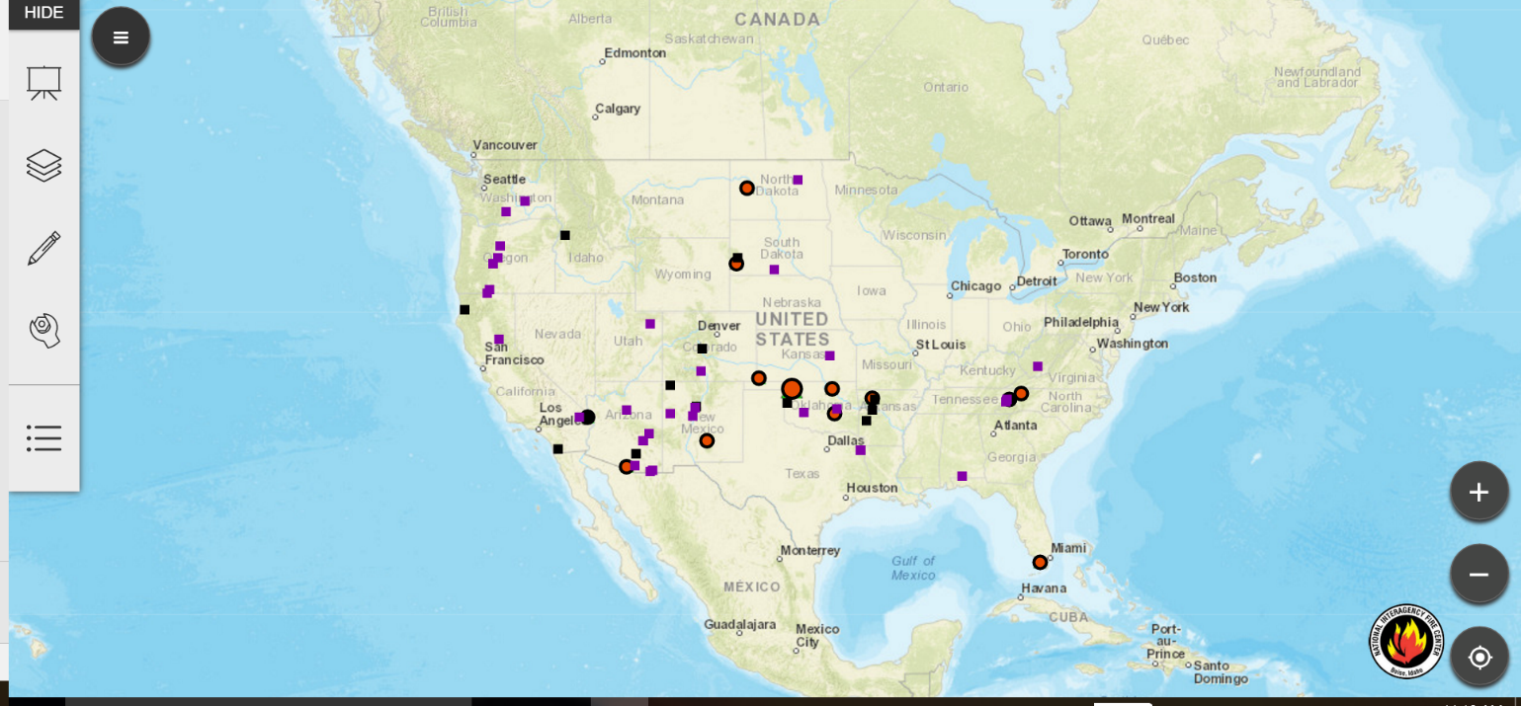
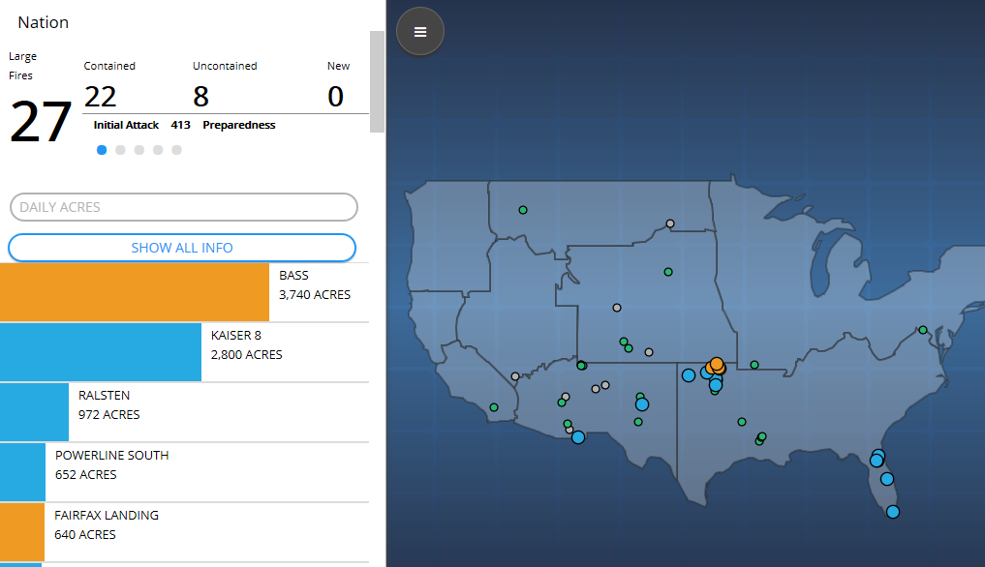
Public EGP
Provides Public/PIO view of fire situation
Subset of fire data
Integrating with Inciweb
https://maps.nwcg.gov
Briefing Tool
National/Regional Level:
  Policy and resource allocation information for fires
Incident Level:
  Provides understanding of any fire of National or Regional significance and early information on emerging events
https://egp.nwcg.gov
Notes:
GEE = Google Earth Enterprise

Slide 7
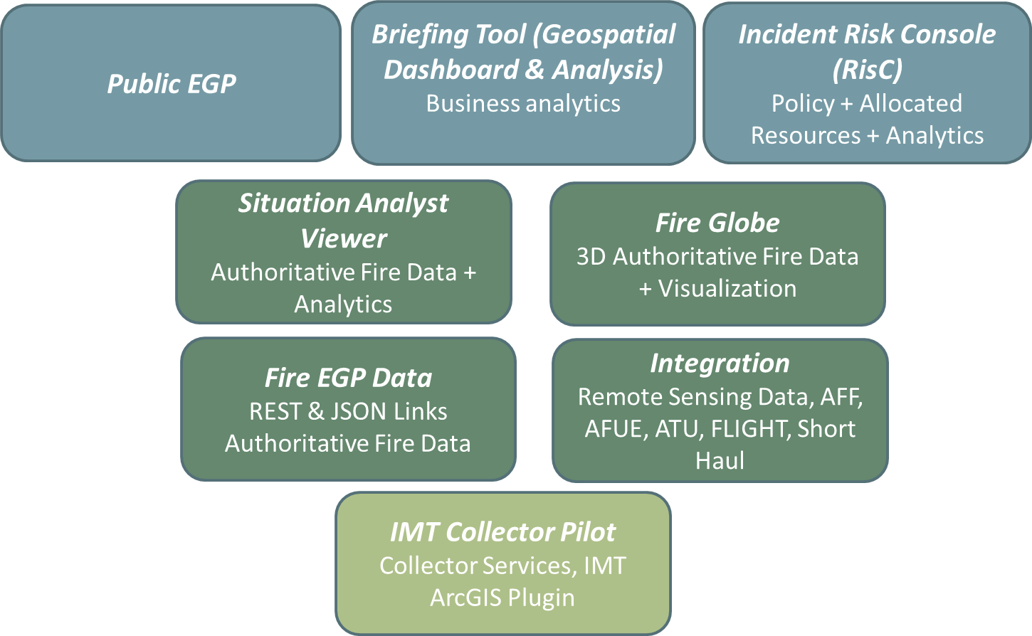
EGP Components
Tools for Situational Awareness and Planning/Operations
https://egp.nwcg.gov

Slide 8
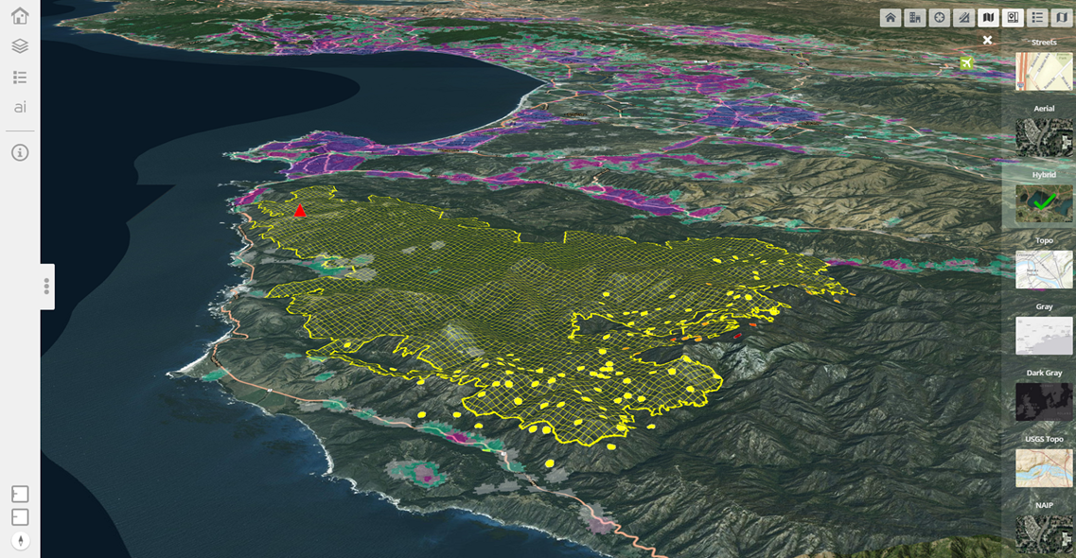
EGP - Fire Globe
Provides situational awareness
ESRI 3D API provides 3D viewer for EGP data
Easy visualization of authoritative fire data
Supports web clients - no license required
https://egp.nwcg.gov

Slide 9
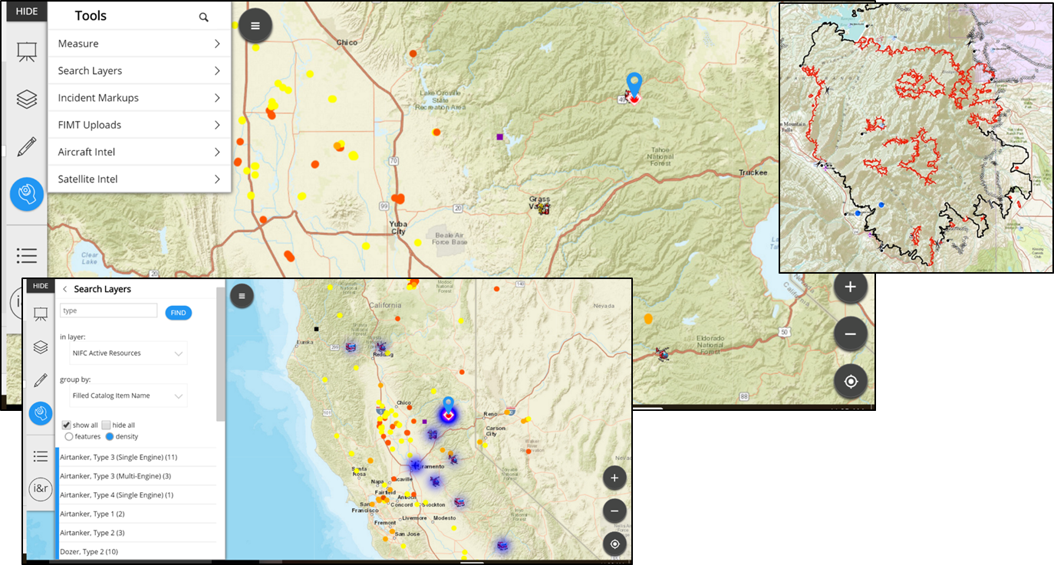
EGP - Situation Analyst (SA) Viewer
Workflow specific content for users
Relevant tactical view for each user
‘Right now’ information straight from the incident
https://egp.nwcg.gov
Notes:
Workflow: Many layers of information floating around, User specific workflows a geared to users groups and roles for ease of use
Right now information – not a COP but dynamic information straight from the incident

Slide 10
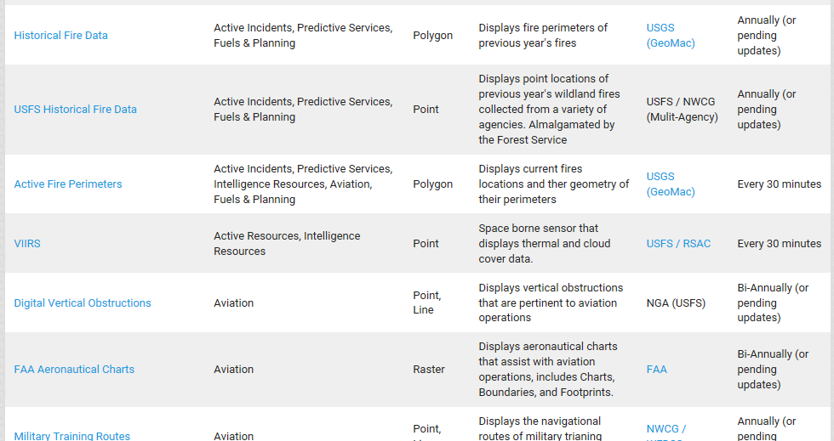
EGP - Fire EGP Data
50+ data layers currently in use
More data sources being added all the time
Both static and dynamic data included
Data grouped into categories
REST & JSON Feeds
https://egp.nwcg.gov
Notes:
GEE = Google Earth Enterprise

Slide 11
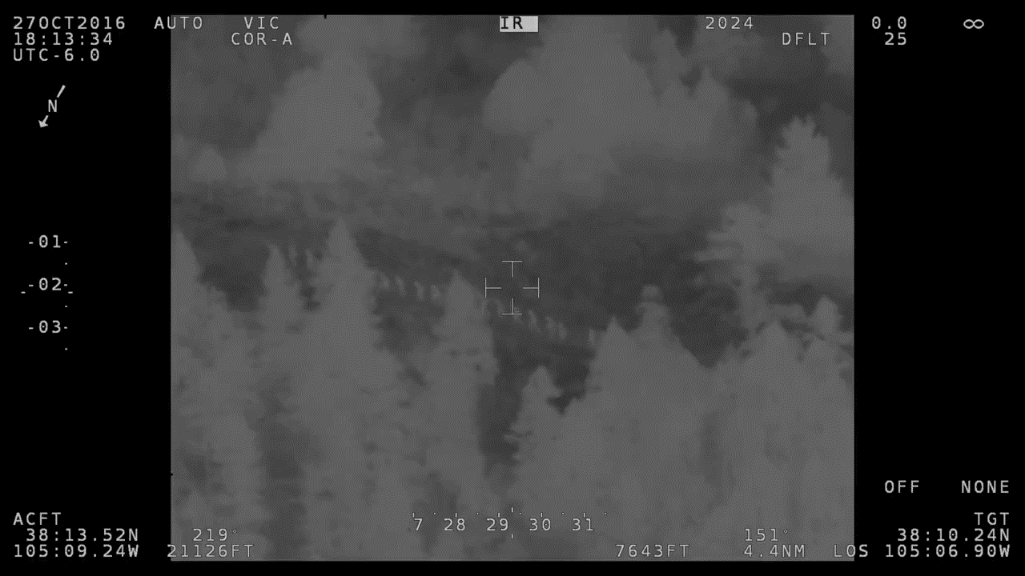
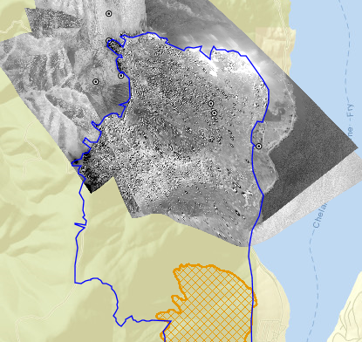
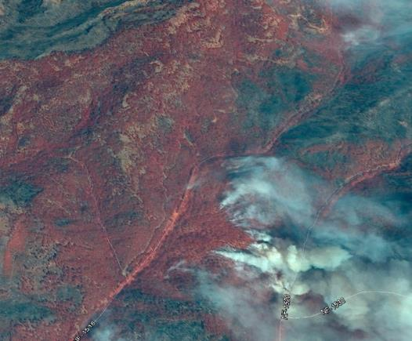
Getting Imagery Products to Everyone
EGP ‘Tool’ designed
to get imagery to decision makers
  Works with any
  sensor or vendor
  Supports
    Imagery (georeferenced or not)
    Vector Products
    Video
  Matches data from
    mission to fire (Irwin)

Slide 12
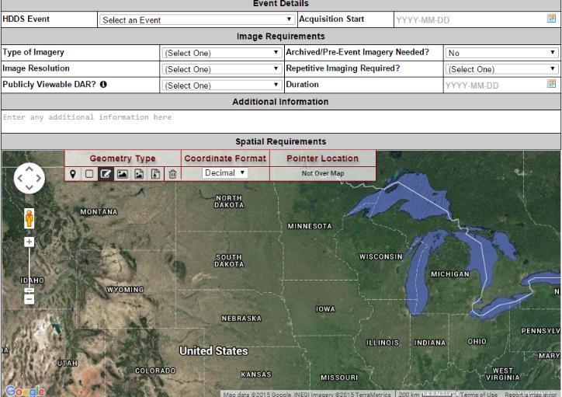
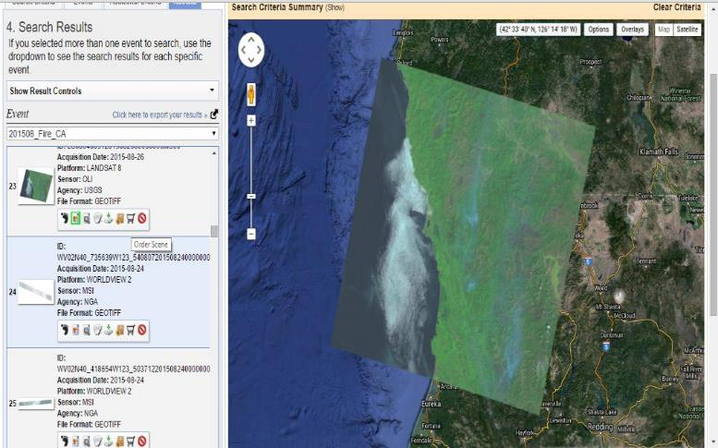
http://cmt.usgs.gov/
Tasking of
Commercial Satellites
Assist Field in Tasking Commercial Satellite Systems
  Focus on Multispectral
  Cooperative effort with USGS
‘Do it yourself’ Tools
  Collection Management Tool
  submit, manage, and track
  tasking
  HDDS
  search, retrieve, and download
http://hddsexplorer.usgs.gov/

Slide 13
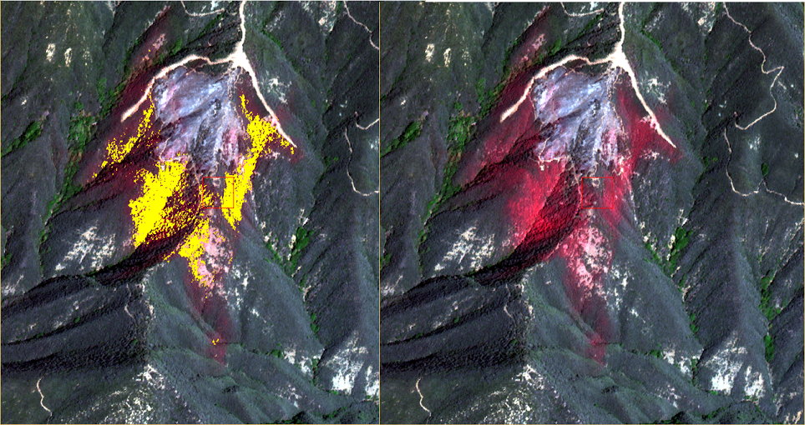
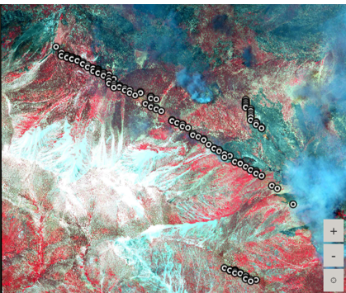
EGP & Data Integration - Imagery
2015 Season Review
  2,447 Images collected
  84 Images posted to Enterprise Geospatial Portal for Operations
  261 Images downloaded for analysis (AFUE and Post fire assessment)
2016 Season Review
  33 Collection Request
  899 Images Collected (heavy use of SP6/7)
  317 Images downloaded and auto-processed by EGP for Operations

Slide 14
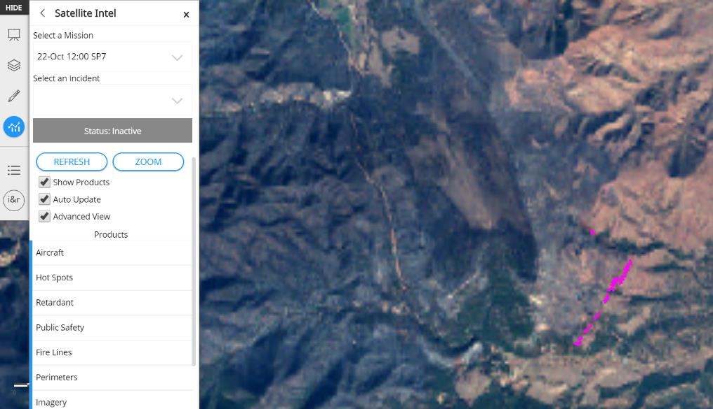
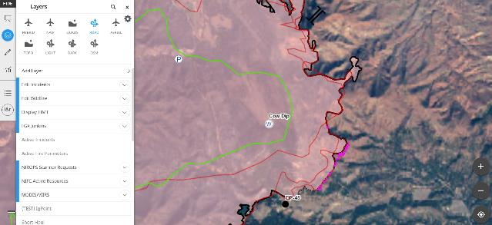
NRL Technology Integrated Into EGP
Linked to Intel Tool
Processes Commercial Satellite Imagery for Queuing and Alerting
  Georeferenced Images
  Automated Spectral Signature Extraction
Stores results in EGP databases

Slide 15
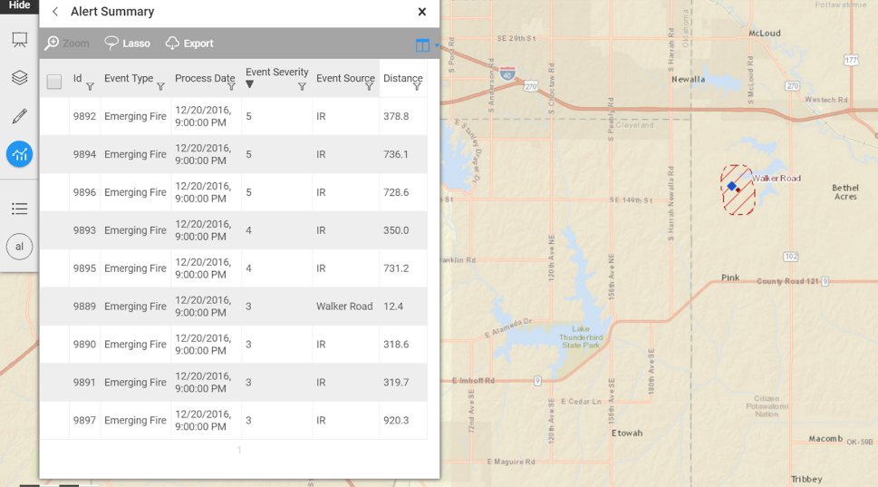
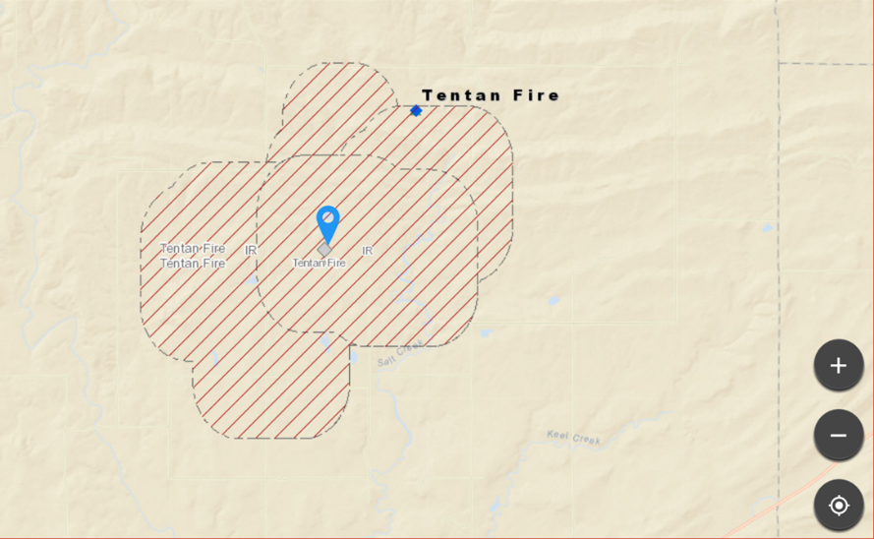
Alerting vs Displaying Map Data
Alerting algorithm for Emerging Fires
  All IR inputs
  Matched with dispatch information
  Scaled by ‘Emerging Fire Severity’

Slide 16
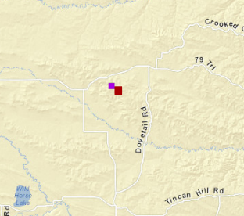
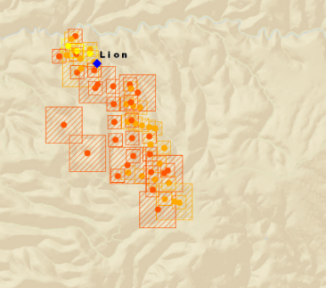
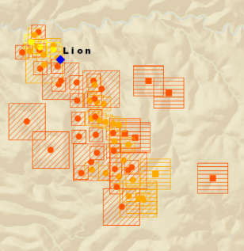
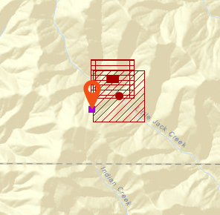
IgPoint
    Miles City Detect
National Data ingested by IgPoint Server
ETL to EGP
Displayed as Layer for Specific Roles
    GCP Monitor fire erupts
    Elko Detect

Slide 17
IgPoint 2017
“Expand use to broader audience”
Align reporting system inputs
Complete forensics review.
  Fire Detection and Reporting (overall comparison of reports and dispatch events)
  Fire Behavior (detailed review of specific fires)
  Fire Characteristics (known ‘pile burning’ event)
Complete Requirements Review
  On-going Remote Sensing Requirements review
Develop educational materials

Slide 18
Fire Imaging Technology Group
Developed a report that outlines
  Operational Needs
  Comparison of Capabilities
  MMA, DRTI, Firewatch
  Conclusion
Recognition that this is not complete
  No space borne systems analyzed
  New project leader is working to move report towards next steps
  IPT is a real possibility
  Need to analyze the last mile

Slide 19
Analysis of existing capabilities *
Capabilities
Platform | IR and Color Capability | Day and Night Capability | Video | Real Time Link to Ground | Display Product on Fire Map | Air Attack Capability | Cost | Notes
NIROPS | Dual Band IR Only | Night Only * | No | Capable | Yes | No | $1250/hr King Air $1850/hr Jet | Covers 6 mile swath width at 10,000 feet
DRTI | IR, EO | Yes | Yes | Yes, range limited | Yes | No
MMA | IR, EO Wide and EO Narrow | Yes | Yes | Radio, text and email | Yes | Yes | @ $1500/hour
Night Watch AA51 | HD IR and color camera, Laser. | Night only | Yes |  | YES | ATGS assigned | $5060/day availability $2249/hr. Flight rate
Firewatch Cobra | HD IR and color camera, Laser. | Day Only | Yes | Yes, BMS M/W data link, Rover units as well | Yes | ATGS assigned | 2,800 per FLT hr. includes ATGS, data van, on site GIS and complete support staff

Slide 20
Where capabilities are used*
Initial and Extended Attack Uses
Platform | IA Perimeter | Large Fire Perimeter | Monitor Burnout Operations | Monitor Impingement on MAPs | Spot Fire Detection | Direct Forces to Hot Spots | Monitor Effectiveness of Tactics | Locating People
NIROPS** | Not Real Time | Best Use | No | Not Real Time | Best Use | No | No | No
DRTI | Yes | Yes | Yes | Yes | Yes | Yes | Yes | Yes
MMA | Yes | Yes | Best Use | Best Use | Best Use | Best Use | Best Use | Yes
Night Watch AA51 | Yes | Yes | Yes | Yes | Yes | Yes | Yes* | Yes
Firewatch Cobra | Yes | Yes | Yes | Yes | Best Use | Best use | Yes* | Yes

Slide 21
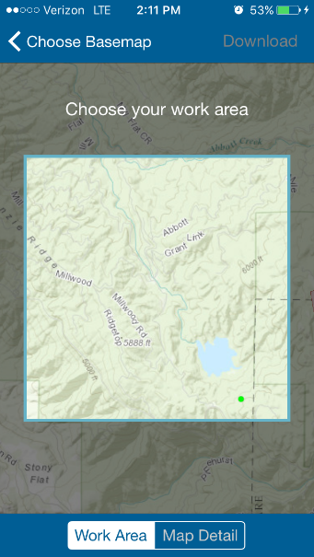
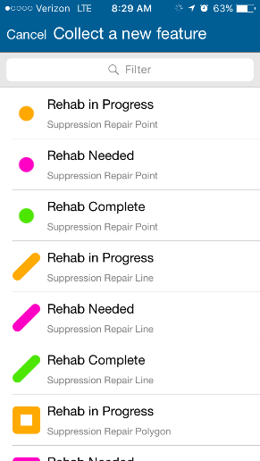
FGX & AGOL Integration
Event Feature Service
  NWCG Data Standard
  Being Integrated into S-341
Feature Service available for viewing:
  EGP
  AGOL
  Your own system
Rehab standard built into workflow
processes!
Yes we know training is needed and
Are working to mature this
Exploring TPK creation and hosting

Slide 22
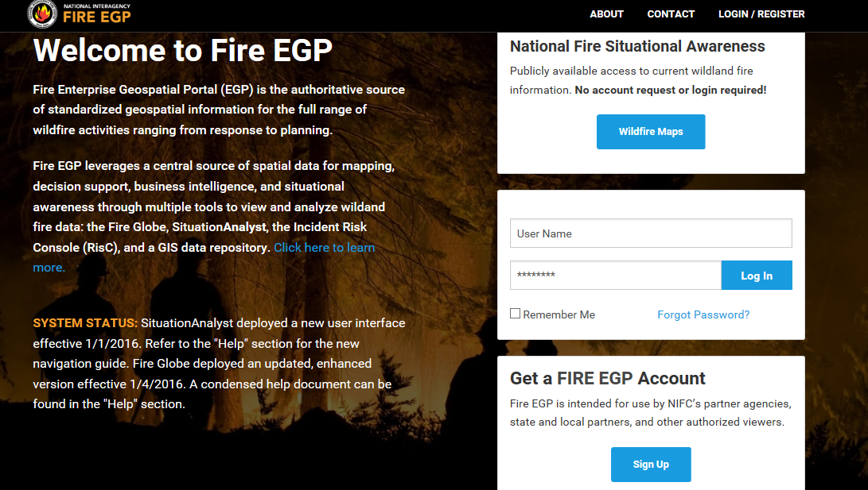
Enterprise Geospatial Portal - EGP
https://egp.nwcg.gov

Slide 23
EGP – Contacts
Sean Triplett
Geospatial Resource Information
Management Group Leader
USDA-Forest Service
Fire & Aviation Management
National Interagency Fire Center
208-387-5284 (W)
208-908-9513 (C)
Email: setriplett@fs.fed.us
Jill Kuenzi
Geospatial Coordinator
USDA-Forest Service
Fire & Aviation Management
National Interagency Fire Center
208-387-5283 (W)
Email: jkuenzi@fs.fed.us
Cole Belongie
Data Integrator
USDA-Forest Service
Fire & Aviation Management
National Interagency Fire Center
208-387-5169 (W)
208-488-5246 (C)
Email: cbelongie@fs.fed.us
https://egp.nwcg.gov

