Slide 1
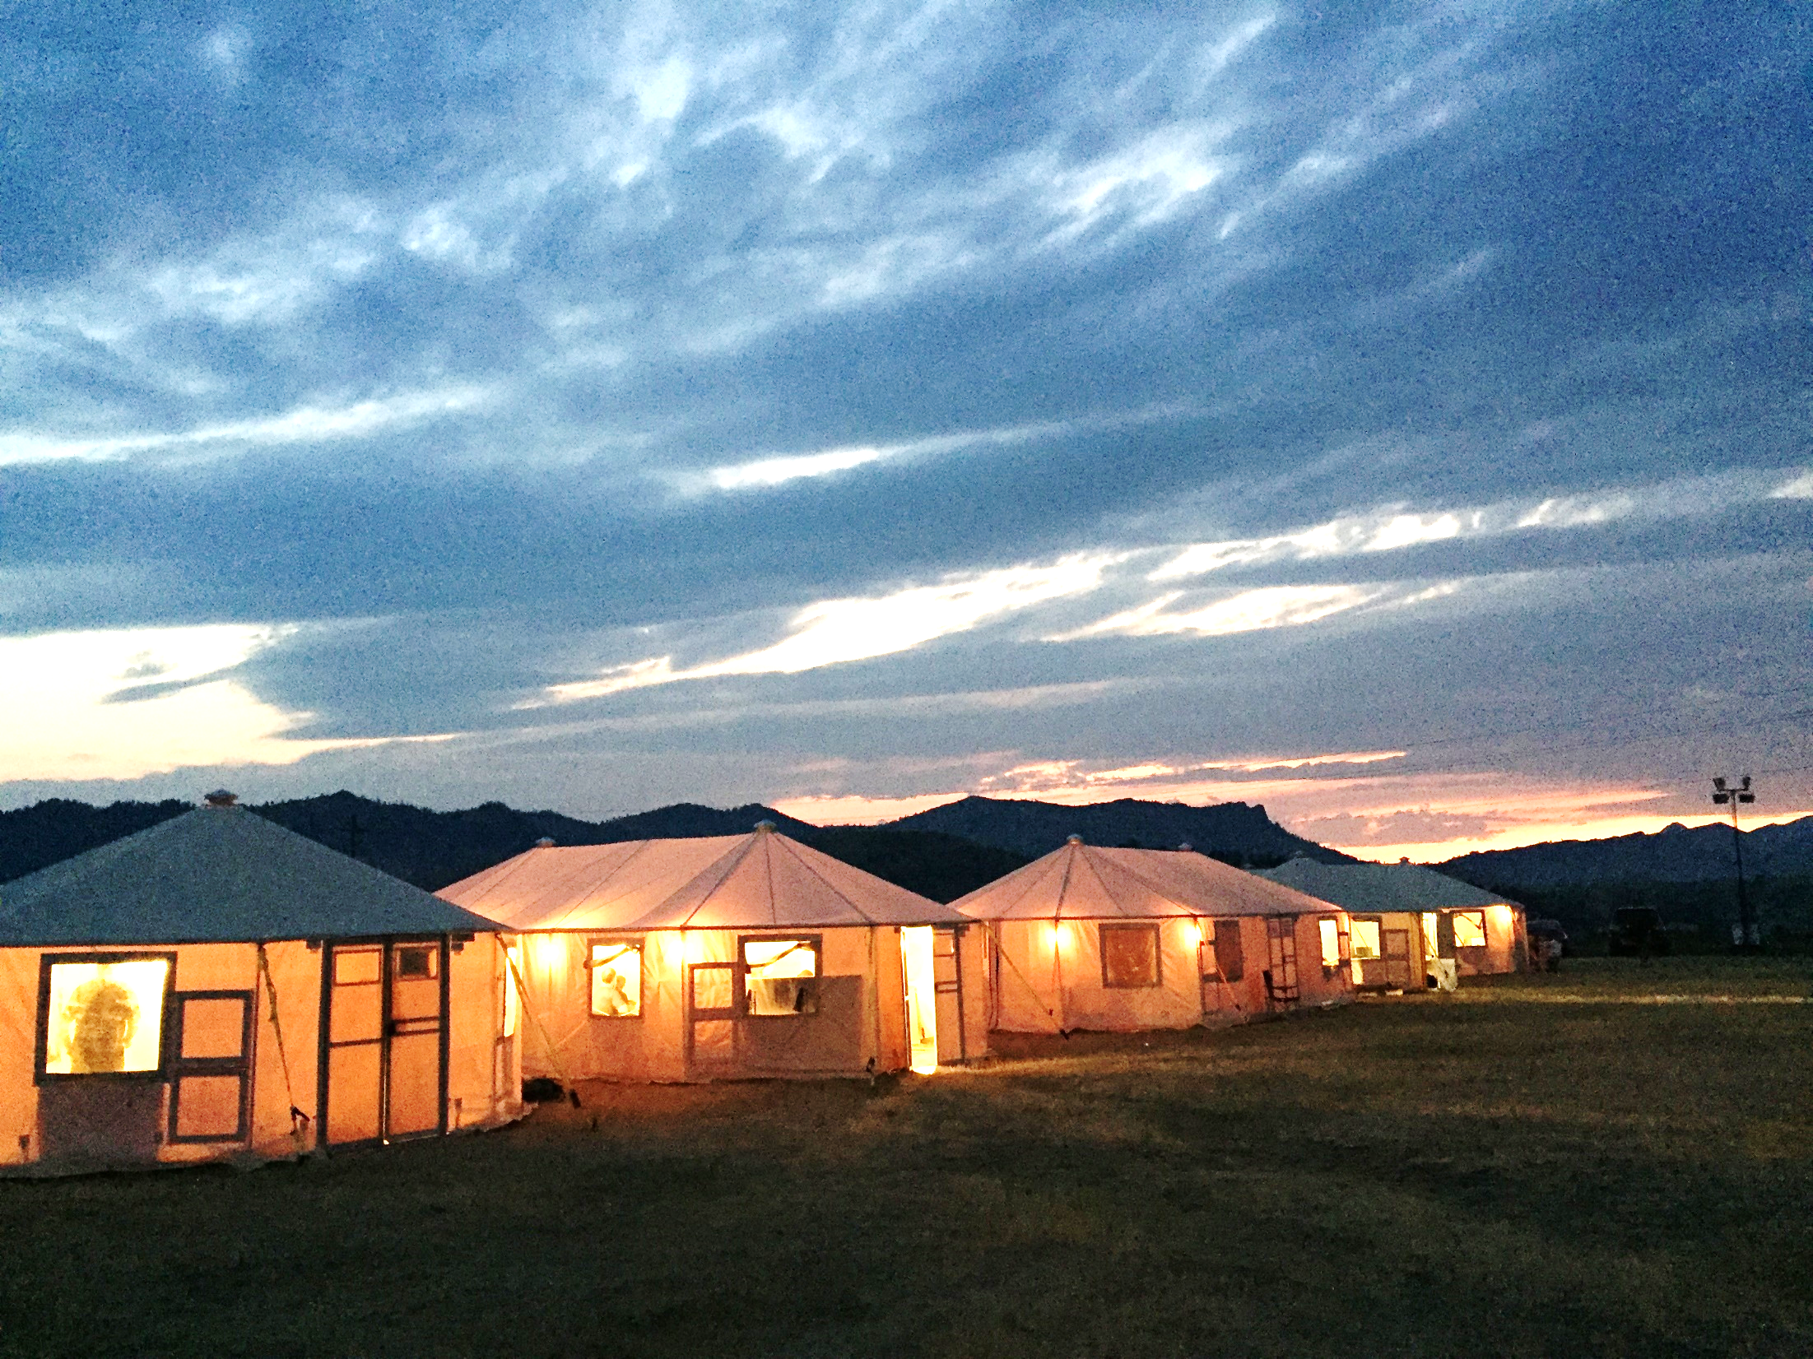
Meeting Facilitation
Kimberly Nelson
Salmon-Challis National Forest
March 2018
Notes:
Kimberly Nelson
Staff Officer on SCNF
Been with FS for over 30 Years
First exposure to Fire was the Fires of 88 when a film crew came to film the movie Always – we had 5 Type 1 PIO’s there dealing with the film crew and all the issues associated with chaos of fire in Yellowstone NP.
Type 1 PIO on Turman’s Northern Rockies National IMT
Started my Task Book under Frye in 2002 after the Biscuit Fire in Oregon
Been with that IMT since

Slide 2
Session Objectives
To review best practices for managing successful and productive meetings, with internal and external audiences, using effective communication, teamwork , and facilitation techniques.

Slide 3
Spend a few minutes with these questions:
Describe the meetings you commonly attend
What percentage of time do you spend in meetings?
Are most of the meetings you attend successful? Why or why not?
What things would make for a successful meeting?
In what situations might a meeting not be necessary?
What type of meetings to you plan to facilitate in the future?
Notes:
Spend 10 minutes or so; discuss as a large group

Slide 4
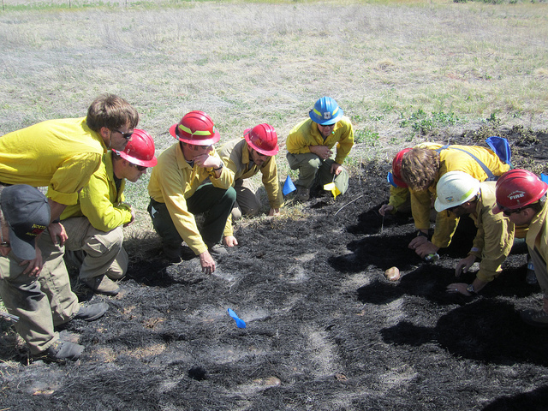
A Meeting Is:
When two or more people come together to discuss one or more topics, often in a formal setting.
Usually used to present or exchange information, make plans, solve problems, make decisions or provide updates.

Slide 5
A Good Meeting is One in Which:
Participants' ideas are heard
The group leader or facilitator understands the purpose
Participants come prepared for the business at hand
You take advantage of all Team Members skills to benefit the greater good.
Notes:
Facilitative behaviors are a good thing for all of us to exercise when we’re in meetings. Some of you may want to learn these behaviors as a participant rather than a facilitator and that is super. Not everyone has to be a facilitator; in fact, the more facilitative participants a meeting has, the better.
Participants' ideas are heard, decisions are made through group discussion and with reasonable speed, and activities are focused on desired results.
The group leader or facilitator understands the purpose, helps keep the discussion on track, works with participants to carry out the business of the meeting in the time allotted, and tries to ensure that everyone is involved appropriately in discussions.
Participants come prepared for the business at hand—with reports ready, concerns over key issues thought out, and questions about key issues organized.
You take advantage of all Team Members skills to benefit the greater good.

Slide 6
Meeting Faux Pas
Recall a meeting you have facilitated or attended that did not go as well as it might have.
What were some of the things that you/the facilitator did that did not work?

Slide 7
Engaging All Participants by:
Developing a structure that allows for everyone's ideas to be heard
Creating a comfortable and safe environment for sharing all ideas and viewpoints
Ensuring that the group feels that the ideas and decisions are theirs, not facilitator’s or meeting managers
Supporting everyone's ideas and not criticizing anyone for what they've said
Notes:
To begin with it is critical to engage all participants as much as possible.
It’s important to keep in mind that it is the group’s meeting, not the facilitator’s

Slide 8
Effective Facilitation
What do you think are some key qualities, skills and roles of facilitators?

Slide 9
Facilitation — Basic Roles
A facilitator guides and helps people move through a process together
A facilitator focuses on HOW people participate, not just on WHAT gets achieved
A facilitator helps the group find winning solutions
A facilitator is neutral and never takes sides
A facilitator encourages participation
Notes:
The facilitator is not the seat of wisdom and knowledge. That means a facilitator isn't there to give opinions, but to draw out opinions and ideas of the group members.
The facilitator is attentive to 3 different dimensions:
1. The results—getting to the desired outcomes
The process—making sure that it is clear how move from here to there and what decision-making rules will be used
The relationships—how participants experience their interactions with the facilitator and one another—team building, collaboration

Slide 10
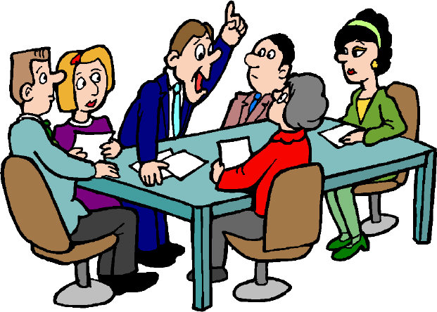
Facilitation — Basic Tasks
Understanding the goals
Creating an effective agenda
Setting the tone
Creating ground rules or meeting agreements
Identifying methods of decision-making
Engaging all participants
Keeping the meeting moving and on-track
Handling difficult people and challenging situations
Notes:
Understanding the goals & Creating an effective agenda are the first most critical tasks
Setting tone: Ice breakers; Personal manner + meeting on time, sticking to agenda, etc.
Creating Ground Rules Jointly first meeting; keep them posted for the future
Decision-making Everyone should know who will make decisions and how
Keeping it on track: 3 common problems
Topic drift "OK, let's come back and focus on the problem we need to solve. . ." Table it or change agenda
Breaking time agreements—notice and ask for new agreement "I notice that we don't heed our stated start and end times, which causes a bind for me. Could we make a new agreement that reflects our true intentions and practice?"
Subgroup focus--Make the spontaneous break-out session public by saying: "This discussion appears to involve only a few people. Is it something that can be resolved rapidly or is there another way to handle this? What does the group want to do?"
Engaging all Participants: engaging quiet ones and dealing with domineering Once-around, brainstorming, direct questioning
Keeping the meeting moving: Watching the clock; shepherding the agenda
Handling Difficult people and challenging situations:
Preventions—planning essential
Early managing of expectations and setting tone
Interventions—range of options

Slide 11
Key Roles in Meeting Management
Group or Team Leader:
The meeting manager is often a leader or decision maker.
The meeting manager does not have to be neutral and is viewed most often as the opinion leader and final decision maker.
Meeting Facilitator:
The facilitator’s main purpose is to help guide the group’s effectiveness.
The facilitator makes an agreement with the group and the manager to keep the meeting on track and stay in a neutral role.
Notes:
Group or Team Leader:
The meeting manager is often a leader or decision maker, but he or she is typically the person who convenes the meeting. The meeting manager will coordinate with the facilitator on meeting planning and preparation.
Meeting managers opt for the use of a facilitator in order to allow themselves to take part in discussions, offer opinions, listen fully to the content, and make decisions. The meeting manager does not have to be neutral and is viewed most often as the opinion leader and final decision maker.
Meeting Facilitator:
The facilitator plans the meeting, manages participation, offers useful tools, helps the group determine its needs, keeps things on track, and checks on how things are going. The facilitator is neutral and does not influence “what” but “how” the meeting topics are being discussed. The facilitator’s main purpose is to help guide the group’s effectiveness.
The facilitator makes an agreement with the group and the manager to keep the meeting on track and stay in a neutral role.

Slide 12
Key Roles continued….
Recorder:
At a minimum, the recorder should keep a summary of the meeting that includes action items (task, who’s responsible, timeframe), decisions, and open issues to carry forward.
The recorder works in tandem with the facilitator to record discussion items during information sharing and brainstorming sessions.
The recorder asks the group to ensure that their comments are recorded correctly and to help the recorder that in their role.
Group Member:
Facilitative group members participate fully in meetings, listening to and soliciting other’s contributions.
Notes:
Recorder – when might using a recorder in a fire environment be a good idea?
At a minimum, the recorder should keep a summary of the meeting that includes action items (task, who’s responsible, timeframe), decisions, and open issues to carry forward.
The recorder works in tandem with the facilitator to record discussion items during information sharing and brainstorming sessions.
The recorder asks the group to ensure that their comments are recorded correctly and to help the recorder that in their role.
Group Member:
Facilitative group members participate fully in meetings, listening to and soliciting other’s contributions. It is perfectly appropriate, and encouraged, for meeting participants to keep an eye on the process and promote meeting effectiveness, thereby supporting the facilitator’s role.

Slide 13
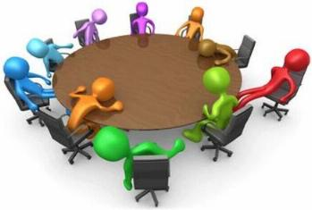
Elements of a Good Meeting
Agenda
List of participants
Key points of discussion
Summary of key decisions
Action items and associated tasks (who, what, when)
Unresolved issues; tasks to be taken up at future meeting
Meeting critique

Slide 14
KEY QUESTIONS TO ASK THE MEETING MANAGER FOR AGENDA PLANNING
1. What is the purpose of the meeting? What are your objectives? What would success look like to you?
2. What are the priority items for this meeting? What could wait if we run out of time?
3. What concerns do you have about the meeting?
4. How much time do you anticipate the meeting will take?
5. Where will the meeting be held? Who will set up the room? Can I get into the room early? How would you like the room to be arranged?
6. Will a note taker be provided for the meeting? May I coordinate with this person prior to the meeting?

Slide 15
7. Who will be making decisions at the meeting? What will be the decision making method?
8. If consensus is desired, how does the group define it? What is the fall back method if consensus cannot be reached?
9. What will be your involvement in the meeting?
10. Has the group worked with a facilitator in previous meetings?
11. What do you want from me during the meeting?
12. Will you close out the meeting?
13. List other questions that you think are important to ask.
Notes:
Who in fire might need to ask these questions of? When?
AA’s
Cooperators
Landowners

Slide 16
Creating an Effective Agenda
Specify name of group, date, time, location, etc
Specify starting and ending times
Identify the name of the presenter
Include an appropriate number of topics for the allotted meeting time
Include clear statements of objectives in terms of the decision or action desired
Strive for a mix of informational and decisional items
Prioritize urgent items first
Present items in a logical sequence
Include topic or briefing papers with agenda
Allow enough time to thoroughly address the topic
Notes:
An agenda is the roadmap for the meeting. It is made to be flexible, can be changed.
Different types:
Bubble: Fairly vague; not defined. 10 minutes here….60 minutes there. “ish” timelines
Defined: What, how, who, how long? Developed in chart format. Most common that I use
Large chunks of time: All morning on one general topic, all afternoon on another. Also very common and allows more flexibility. This session was developed with this type of agenda.
When a change is needed in an agenda, get agreement from the group. It is the group’s meeting, not the facilitator’s.
Average attention span is 40 minutes! Keep that in mind when planning your agenda.
Allow enough time… but don’t allow so much time that the topic becomes burdensome. A good rule of thumb: if an agenda item is two hours or more, perhaps a separate meeting is needed.

Slide 17
Meeting Agreements (Ground Rules):
Are standards for meeting behavior that are agreed to by the whole group at the beginning of the meeting
Can be the prevention tool for the facilitator to use if the meeting goes off track
Can be used at future meetings of the same group
Can be amended as needed
Notes:
Sometimes you may need ground rules – have you used them in a fire environment?
What example of ground rules can you think of?
One person speaks at a time – hear each other out
Be respectful to each other
Allow for presentations and then we will open the floor to questions – or we will break up in groups where there are maps.
Stay focused on the topic at hand, not going to focus on any other issues (i.e. fire vs fuels management or suppression tactics)
Give me some examples where they might be helpful.

Slide 18
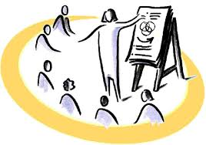
Conditions favoring recording in front of the group:
When the group is engaging in problem-solving
When the group is engaging in decision-making
When there are multiple options for solution or decision
When it is desirable to generate multiple options, and to put them all before the group
When the problem or discussion topic is new or unfamiliar to the group
When the topic is complex
When the topic is controversial
When stakes are high; when the decision to be made is important
When the group members do not know each other well
When there is low trust among the members, and/or a history of conflict
Notes:
Work with your local AA to determine when this needs to be used.

Slide 19
Components of Meeting Notes /Group Memory
Agenda
List of participants
Key points of discussion
Summary of key decisions
BIN items
Action items and associated tasks (who, what, when)
Unresolved issues; tasks to be taken up at future meeting
Meeting critique
Notes:
As the facilitator, you may also be the recorder and note taker. Although this is a big task, it can be done. Focusing on these items for your notes will help you ensure to capture the key points.

Slide 20
Defining an Outcome
An outcome is a clear and concise description of what will ‘come out’ of the meeting.
Outcomes are important because they answer the question, “Why meet”?
Outcomes meet these criteria:
Brief
States desired end results
Product (a list, an agreement, a plan)
Information and its purpose (information, decision, action)
Notes:
An outcome is a clear and concise description of what will ‘come out’ of the meeting. It is the specific purpose or desired end result.
Outcomes are important because they answer the question, “Why meet”? They require us to be clear about what we intend to accomplish. They focus a group on what they will do and provides a measure of success at the end of the meeting.
Outcomes should meet these criteria:
Brief
States desired end results
Product (a list, an agreement, a plan)
Information and its purpose (information, decision, action)

Slide 21
Outcomes….
Written from the viewpoint of the participants
Include a verb
An outcome is clearest when it includes both the product and the action that will occur during the meeting (agree, develop, update).
Examples:
“Agree on a plan of action to communicate operational tactics.”
“Update Sheriff on fire progression as it approaches residential areas. ”
“Discuss tactics for fire suppression as fire approaches Green Acres subdivision.”

Slide 22
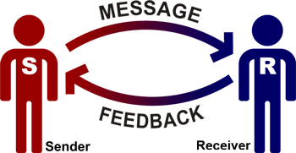
Active Listening
Active listening is:
being non-judgmental
emphasis on listening and not solving the issue or problem
being attentive and respectful to the person talking
listening closely, paraphrasing back to the speaker what you hear, clarifying what you think you hear, etc.
Active Listening is not:
planning your response to what the person is saying
day dreaming while they are talking
solving their problems or giving advice.

Slide 23
Active Listening
Working consciously to hear the words another person is saying and understanding the full message that is being sent.
Ways to actively listen to what is being said:
Reflecting – feeding back the content and feeling of the message
Clarifying – restating an idea or thought to make it more clear
Summarizing – stating concisely the main thoughts.
Shifting focus – moving from one speaker or topic to another; used mostly while working in a group setting
Notes:
Reflecting “Let me see if I’m hearing you correctly…”
Clarifying “What I believe you are saying is…”
Summarizing “It sounds to me as if we have been talking about a few major themes…”
Shifting focus “Thank you, John. Do you have anything to add, Jane?” “We’ve been focusing on views 1 and 2. Does anyone have strong feelings about the other views?”

Slide 24
Teamwork!
Using Team Members is the best way to facilitate a meeting. Each individual offers you a resource and perspective that can be used in achieving success.
7 Key Elements to a Successful Team Coordination (The Doolphy Team)
Having a good picture of all the work that has to be done
Setting a common goal
Knowing your Team
Defining team roles
Planning
Communicating
Finding the correct tools

Slide 25
When a meeting needs help
What to do during a meeting that can help the group re-focus, get back on track, or ‘intervene in a difficult situation.
Have the group decide
Enforce the agenda and ground rules
Be honest: say what's going on
Use humor
Accept or legitimize the point or deal
Use body language
Take a break
Use your Teammates, they might be able to provide some clarity to an issue
Notes:
Finally – when a meeting needs help – here are a few ideas to get you back on track.
1. Have the group decide throw it back to the group and ask them how they feel. Let the group support you.
2. Use the agenda and ground rules remind folks of the agreements made at the beginning of the meeting.
3. Be honest: Say what's going on If someone is trying to intimidate you, if you feel upset or undermined. It's better to say what's going on. Everyone will be aware of the dynamic in the room.
4. Use humor If there is a lot of tension in the room, if you have people at the meeting who didn't want to be there, if folks are scared/shy about participating, if you are an outsider: self-deprecating
5. Accept or legitimize the point:
6. Use body language If side conversations keep occurring, if quiet people need to participate, if attention needs to be re-focused: Move closer, Make eye contact
7. Take a break invite the disruptive person outside the room and politely but firmly state your feelings about how disruptive their behavior is to the group and that it needs to end. But also try to find out if there are other ways to address that person's concerns.
8. Use your Teammates – maybe they have a better solution than you do!

Slide 26
Questions?

