Slide 1
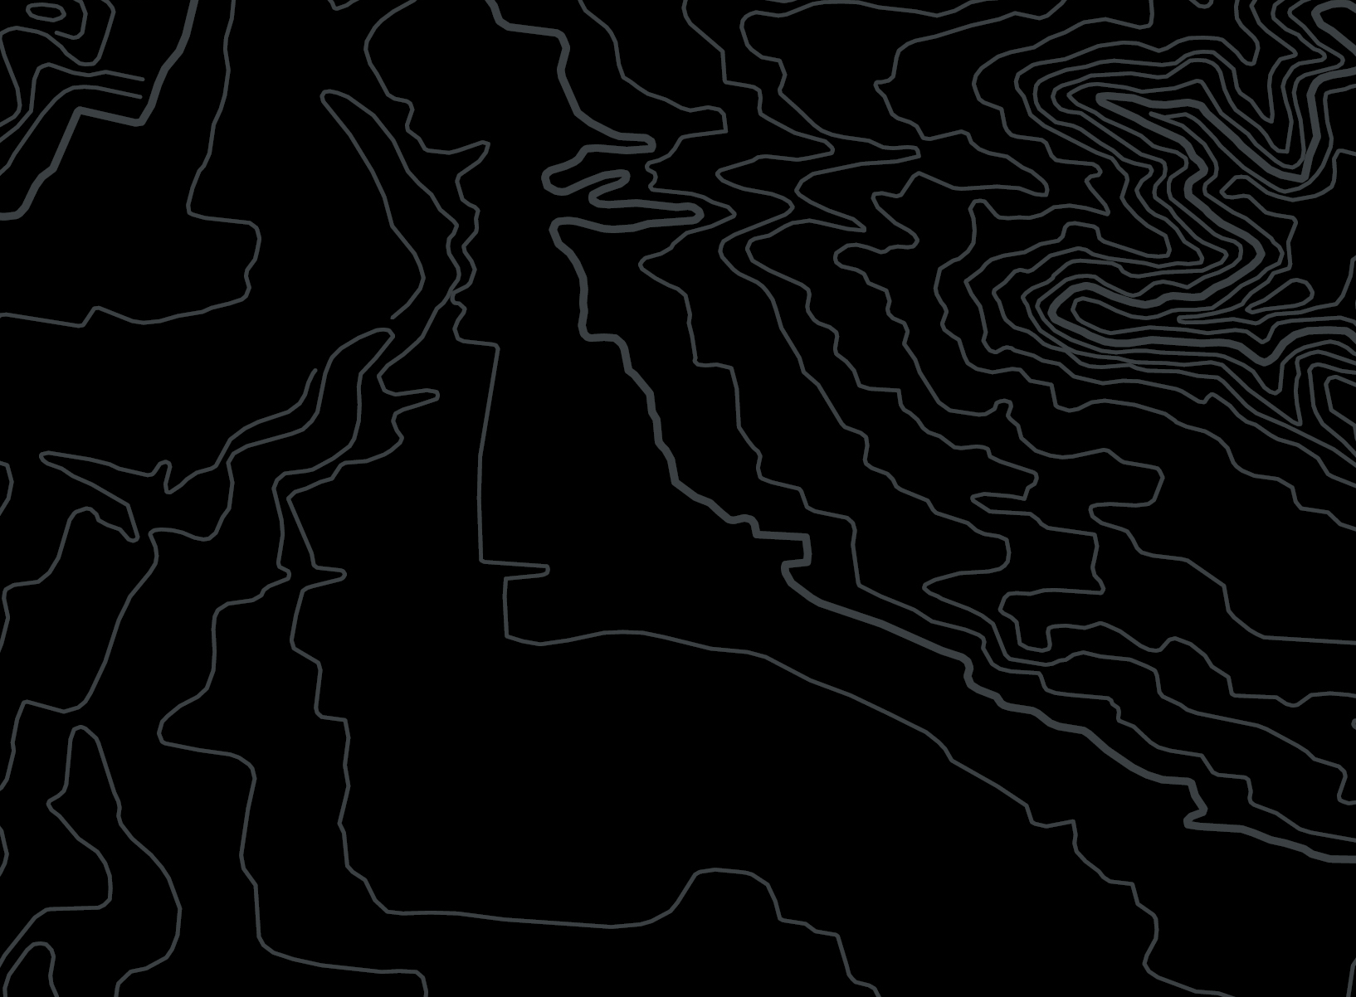
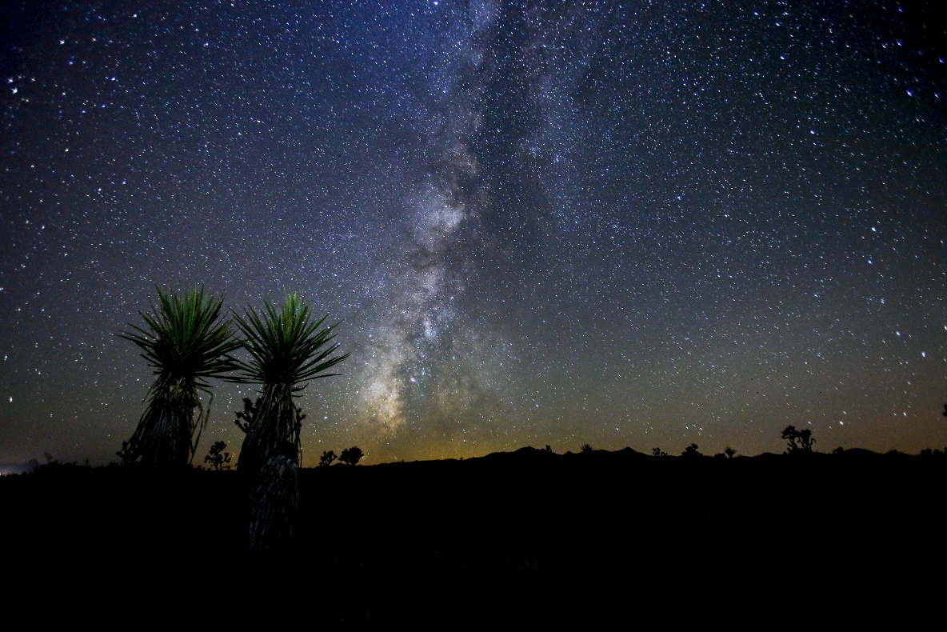
Bureau of
Land Management
Social Media and Fire Information Sharing

Slide 2
Social Media & Fire Information
9 accounts
5 accounts
Websites-6
BLM,
Humboldt-Toiyabe NF,
Nevada Division of Forestry (3)- regions
Dispatch – Elko, Central, Southern Nevada DO, Minden
BLM,
HTNF,
NDF,
Ely Dispatch,
Minden Dispatch
NDF, BLM- Fire specific
HTNF,
Minden,
BLM,
NDF,
Elko Dispatch
Notes:
Setting context
20 accounts in all
Agencies have so many more ops for social media now that they did 3 years ago. The real question now is what are we trying to accomplish with what do we have and where do we start when we have an incident?
I think the issue of staying in your lane becomes a tough situation.
This is just to give context to what I‘m sure each state deals with when it comes to fire info. Obviously we have local Fire Depts that have their own and all of their chief’s have accounts too.
I think it brings into question where do we send people looking for information- I experienced multiple calls from internally where should we tell people to get info.
We finally have put together an interagency website to hopefully mitigate this question

Slide 3
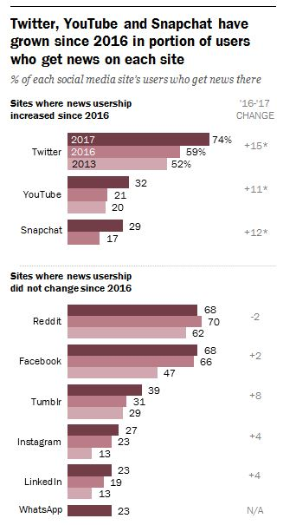
Social Media & Fire Information
2/3 (67%) of U.S. adults get news from social media
Notes:
PEW research had a great paper from Aug. 2016
Pew said that while a very large share of its users (74 per cent) obtain news via the site, given that its user base is also significantly smaller than Facebook’s or YouTube’s this results in a smaller overall reach for news: With just 11% of U.S. adults get news via Twitter.
Interesting that recently Twitter has the smallest following, next to FB an Youtube
Facebook stats stayed the same while Twitter and Youtube jumped.
Snapchat is a relatively new one, gaining more popularity. Companies and agencies can really hit a target market with the users.
Agencies haven’t mastered the skill or time needed to make Snap Chat a viable platform.

Slide 4
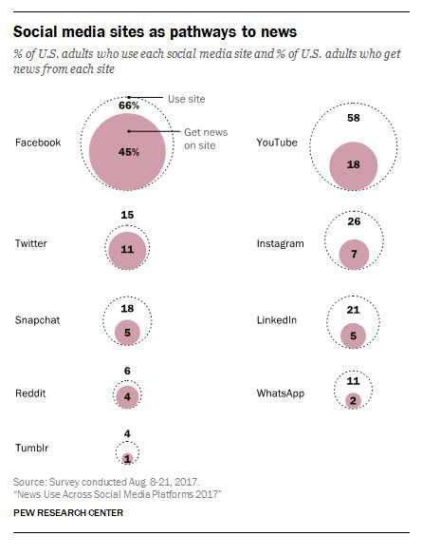
Social Media & Fire Information
The Internet’s social platform giants are busily consuming broadcast/TV news media, not just print.
Notes:
The researcher concluded that Americans are now more likely than ever to report getting news from multiple social media sites — with around a quarter of all U.S. adults (26%) getting news from two or more sites, up from 18% in 2016.
In additional research it also said its data shows the Internet is closing in on television as a source of news. As of August 2017, 43% of Americans report often getting news online, compared with 50% who often get news on television — so just a seven-percentage-point gap. While in early 2016 the gap between the two news platforms was 19 points.
So, in short, the Internet’s social platform giants are busily consuming broadcast/TV news media, not just print.

Slide 5
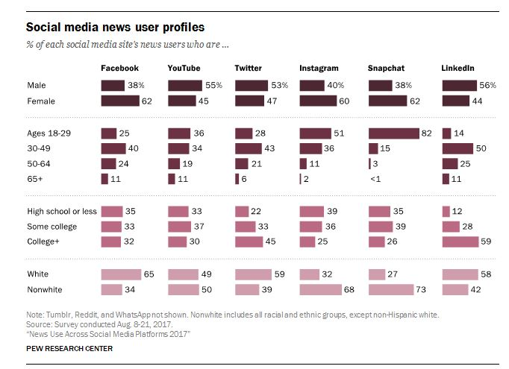
Demographics

Slide 6
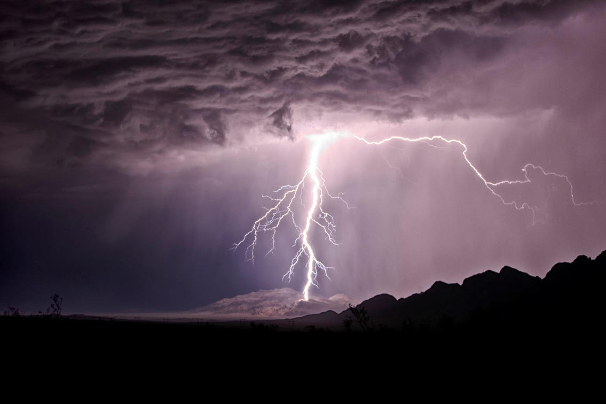
Social Media & Fire Information
Access to accounts
Open access
Limited access
No access
Misconceptions
Anyone can manage it
Only the local unit can manage it
All millennials are proficient
Notes:
Personal exp this summer- 16 fires and 8 teams transition in 2 weeks. 1st time ever and many of our PAOs didn’t have a clear del auth and were giving verbal direction. Then I would end up with multiple calls and/or follow up on how to do what we required for social.
This is unique to everyone- I’ve heard all different interesting ways to get access.
Nevada we give access and have a standard with FB only that the first few posts are scheduled, then after clearance from me or tweeks we publish. There’s only 2 posts a day for FB.
No Twitter access, but unlimited composed tweets can be sent via text and I tweet those. Challenging and a bottleneck but had zero complaints from teams in 2017
I think there is definitely control/territorial issues, but maybe it’s trust issues as well? Lack of fire information experience on the local unit? Or have there been times the local unit was burned?
Limited, maybe you only get Facebook or only Twitter. Problem solve to get your info out in the best way. Might be time to designate a liaison from the team to the unit?
Zero access, how do you get the info out? Are there other options? Other units to share? Is the social media lead open to having one person on the team manage?
Recommendation- Try developing the post and then share with the unit – do the work for them. Recommend a liaison if there’s zero access
Generation gap
Millennials- stereotyping… because millennials are native to social they are proficient in business/professionally
not necessarily. Lack of experience in business, lack of ability to know strategy or protocols. Even personal use can end up in a bad reputation- people are fired.
Discussion?

Slide 7
Social Media & Fire Information
Social Media Transitions
1st Instant gratification from users
2nd Social Media Leads have the need to instantly share
3rd Consequences
Lessons Learned in Nevada- CHECKLIST
Discussion
Notes:
Gets tricky- We get caught up in the rush of things and trying to spin plates while standing on our heads.
Team transitions are never perfect
These are 3 things that came to mind when making this prez.
Now jump to the transition part-
How can we make it better? Is there a way that we can streamline it?
We learned the hard way and weren’t as prepared as we thought.
Example- Nevada has a checklist and I share that with all of our districts. Next slide. Meanwhile I’m constantly monitoring our channels.
Territorial- different personalities to deal with, BLM Nevada- I share access to FB and 2 posts per day per incident, and unlimited Twitter but that goes straight to me. Twitter can crucify us fast!
What have you experienced and ideas to make it better? Discussion

Slide 8
Nevada Example
BLM Nevada Social Media Checklist for incoming teams
Coordinate with social media lead to obtain Facebook access
- Rita Henderson, 775-461-6753
Facebook- two posts per day per incident, unless an emergency
Schedule the first 2 posts for approval
Ensure that your post is spaced out about an hour from the most recent post
No Twitter access- unlimited tweet content can be sent to the social media lead an will be posted ASAP
Photos or video should be in every post
Please- No sharing from BLMNV Facebook, requests can be made to the social media lead
-- No commenting on posts prior to coordinating with the social media lead
Monitor your posts and correct mistakes if need be, coordinate with social lead

Slide 9
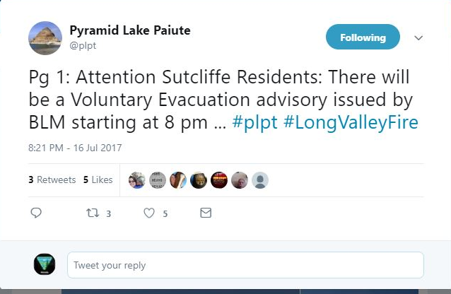
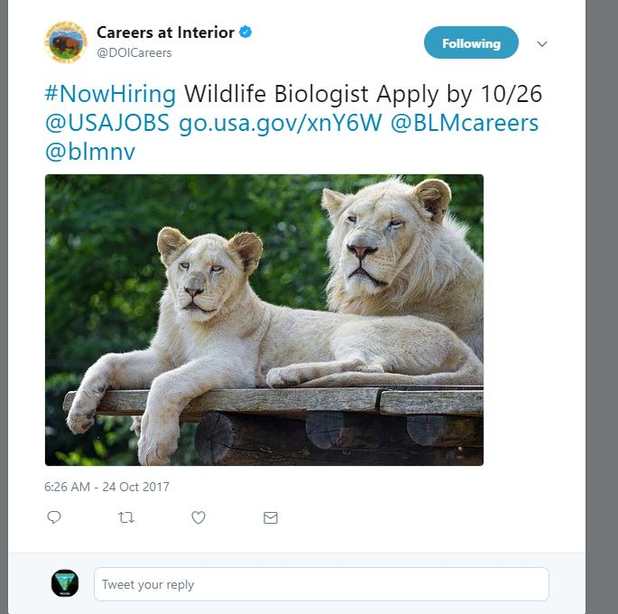
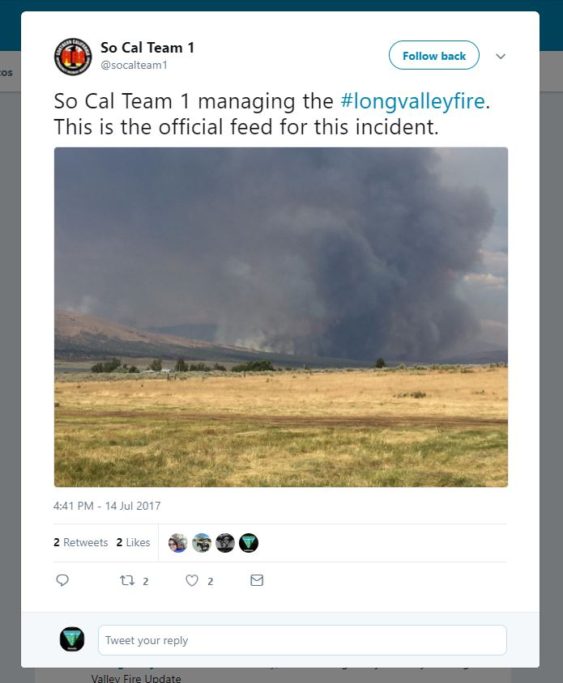
Ugly Content

Slide 10
Team Accounts
Great Basin IMT Social Accounts
Internal
External
Incident specific
Staying consistent is important.
Do you have an SOP for using your social accounts?
Who manages it, and what happens if that person goes away?
Is it worth the time to keep it updated?
Is it something that is serving a purpose?
Recommendations
Useful internally
Not recommended from the Social Media leads in BLM
Notes:
I did some research and found not all the GB IMTs have a facebook and some haven’t been updated since Sept 2017
Broken links and small follower #s, GACC twitter only has a small following too- around 2000, most BLM twitters have around 5k-8k
Internal--- could be super useful and keeping your team members updated – Roide’s team uses periscope to stream briefings if camps are separated.
I recommend keeping it internal and not for use on incidents.
External– It’s definitely not recommended for external use by the Social Media leads in BLM. Refer to my questions…
Incident specific--- Really frowned upon, it’s just too, challenging to get it up and make it successful. I’d suggest using a local account before doing this.
if the fed state or local accts are not working with you as a team, a chamber of commerce or city social account that’s established, now you are helping them add followers and grow their reach.
I think the team and incident FB and twitters may have proven useful 3-5 years ago when agencies weren’t allowed social accounts yet. Times have drastically changed!
-- Staying consistent is important.
-- do you have an SOP for using your social accounts?
-- who manages it, and what happens if that person goes away?
Is it worth the time to keep it updated?
Is it something that is serving a purpose?

Slide 11
Best Practices
DO GOODER
Connect with the local unit
Incidents on BLM will use BLM existing social accounts.
Post photos and videos that tell a story.
Post Maps
Post consistently.
Monitor
USE Inciweb
When in doubt ask the local PAOs
Closing down- transitions
Sharing/Retweeting- Just don’t

Slide 12
Questions?

Slide 13
Rita Henderson Social Media Lead BLM NV ritahenderson@blm.gov (775) 461-6753
Bureau of
Land Management

