Slide 1
Four Corners Fire (GBT4)
Long Term Plan Meeting
Notes:
This presentation is for Agency Administrators. The IMT will present three potential alternatives for managing the fire. The presentation outlines the factors contributing to the Relative Risk Assessment, costs, firefighter exposure, and aviation asset use for the alternatives.

Slide 2
Agenda
Introduction and Intent - Gary
Situation Update
Weather- Incident Meteorologist - Steven
Fuels and Fire Behavior - Richard
Fire Growth Projections: Near Term and FSPro - Casey
Values at Risk - Management Action Points (MAPs) - Carolyn
Strategic Operations - Kris
Seasonal Outlook - Carol
IC Perspective - Steve
What's Next - Gary

Slide 3
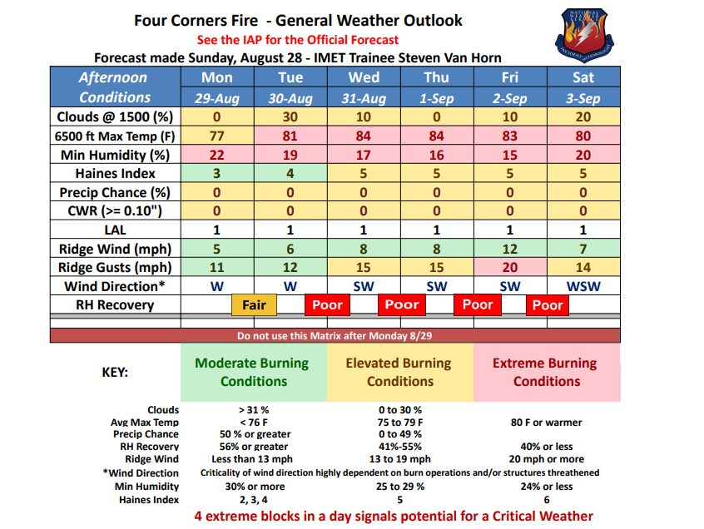

Slide 4
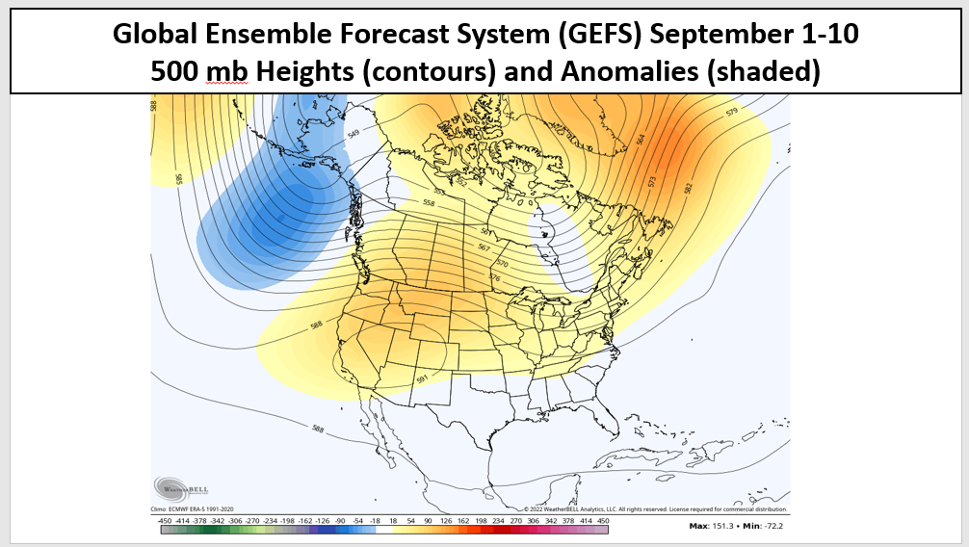

Slide 5
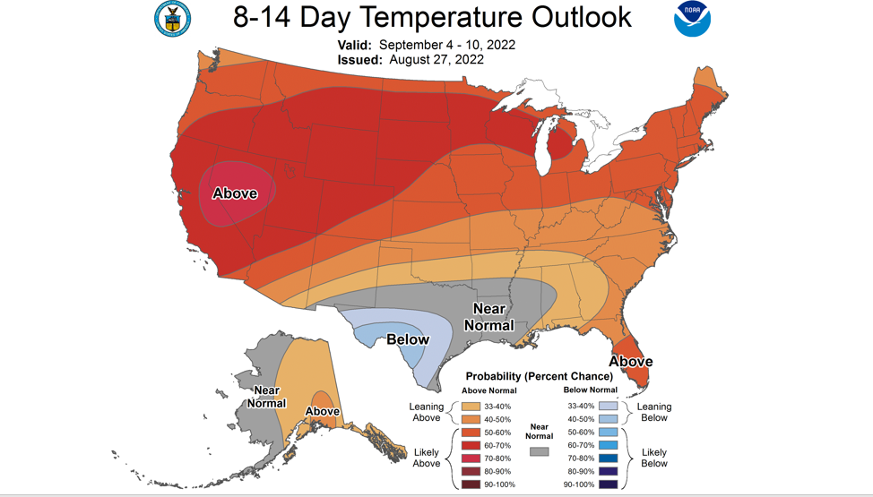

Slide 6
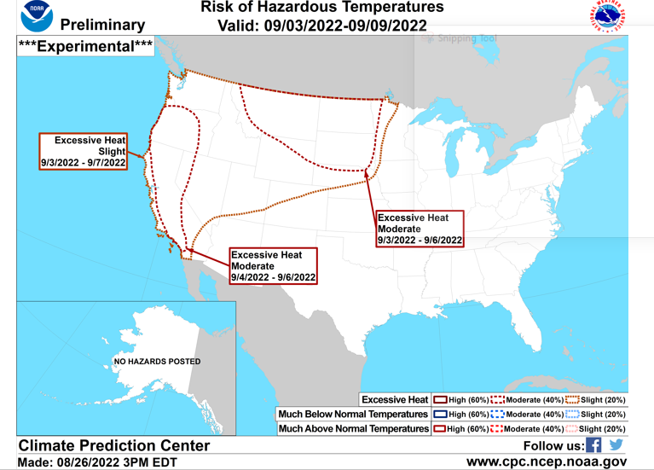

Slide 7
<</a>

Slide 8
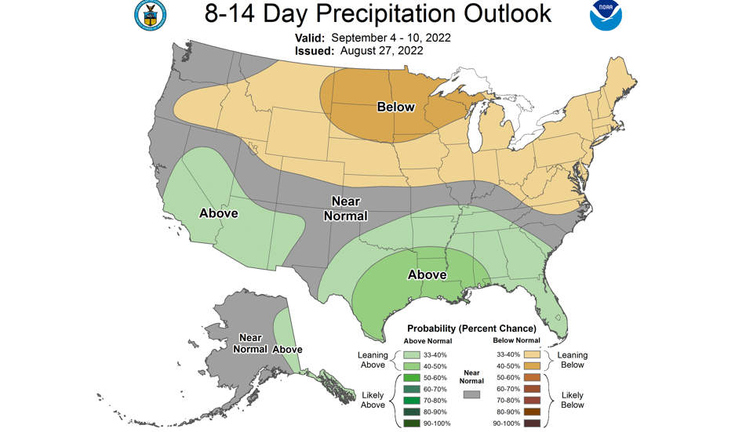

Slide 9
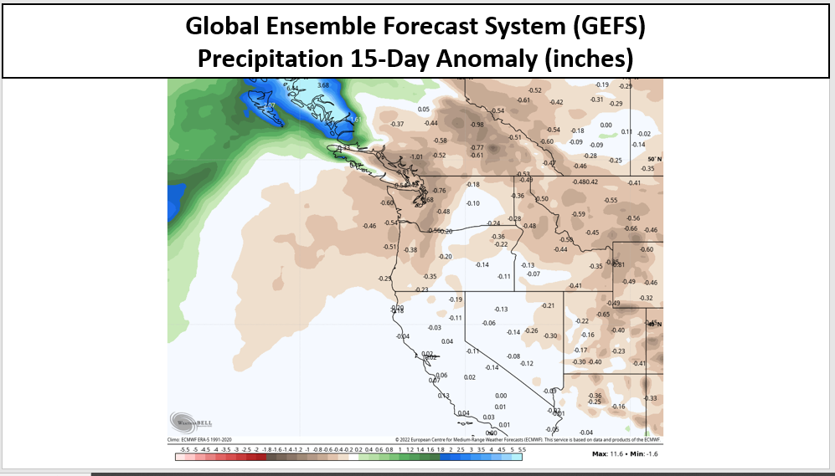

Slide 10
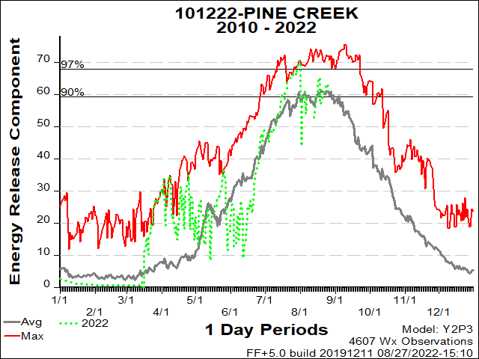
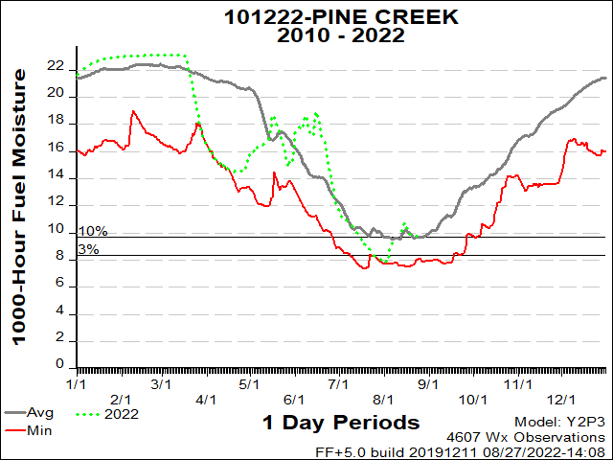
Current Situation- Seasonal Fuel Conditions
Notes:
Show where fire is contained, where is open line, where is heat/VIIRS

Slide 11
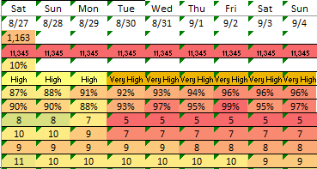
Short Term Fire Danger Outlook
Notes:
Show where fire is contained, where is open line, where is heat/VIIRS

Slide 12
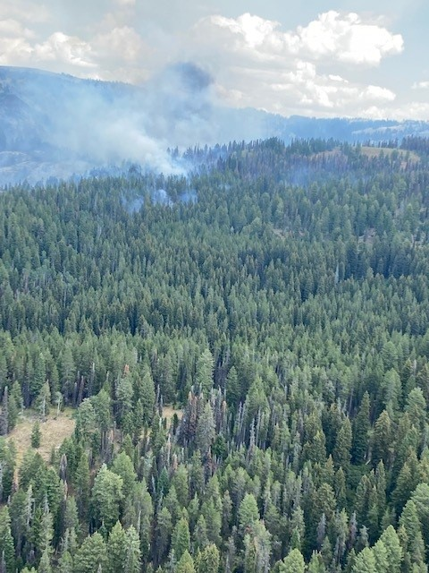
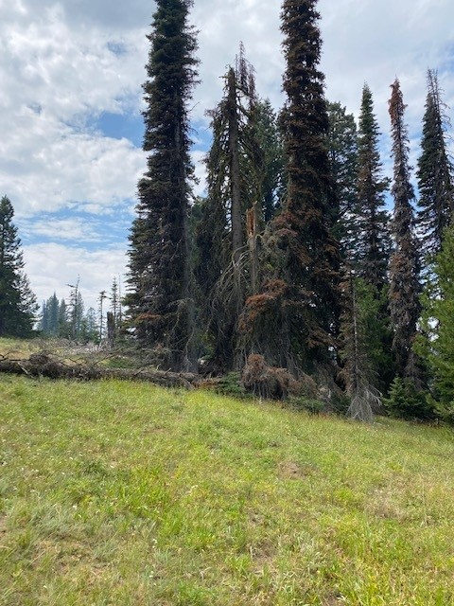
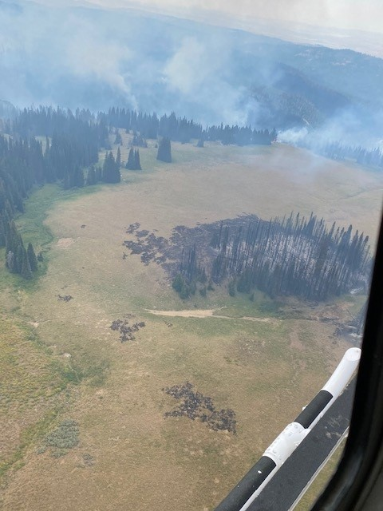
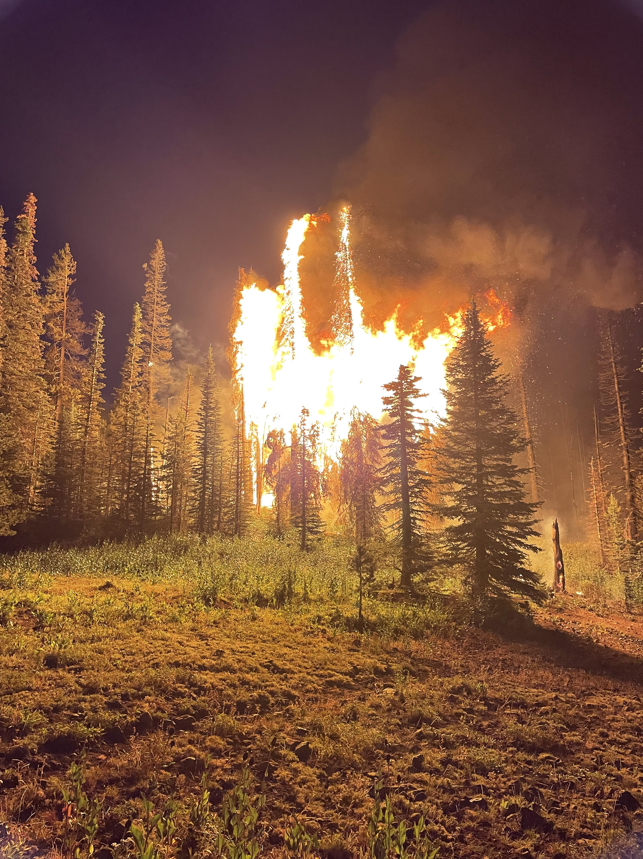
Current Situation: Sub-Alpine Fir Fire Behavior
Notes:
Show where fire is contained, where is open line, where is heat/VIIRS

Slide 13
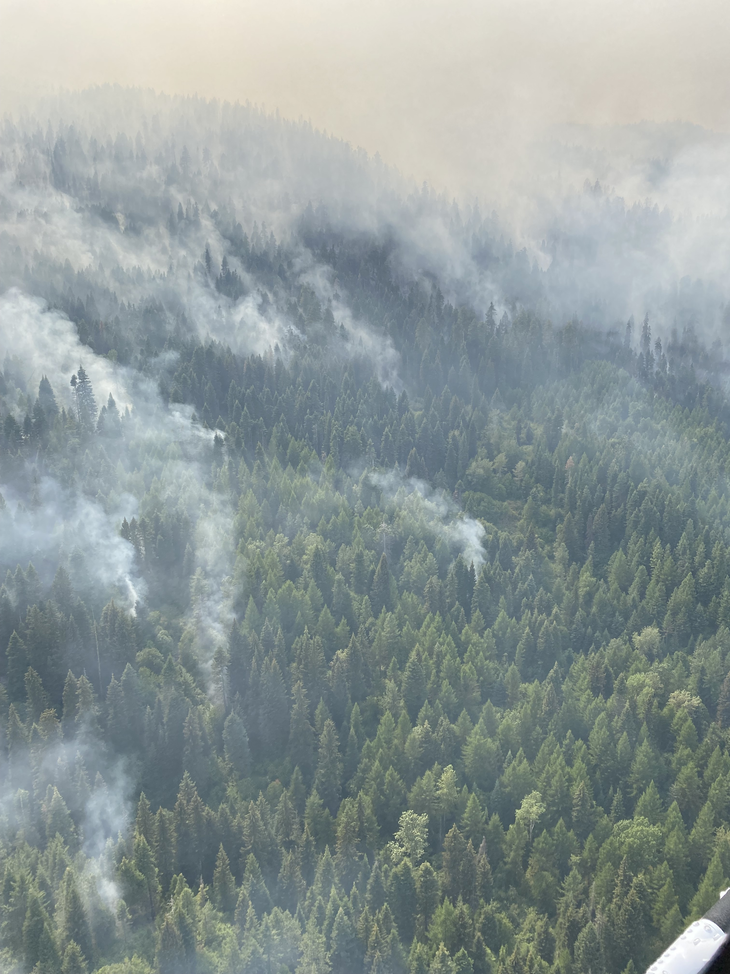
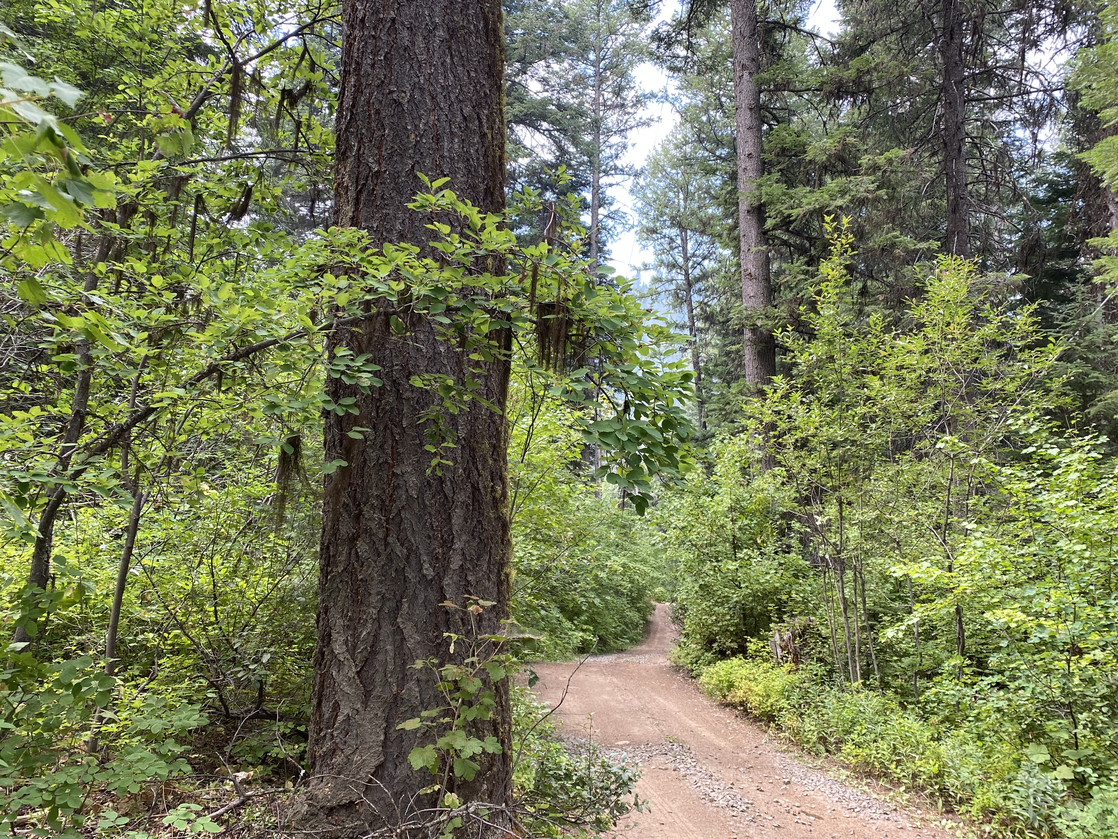
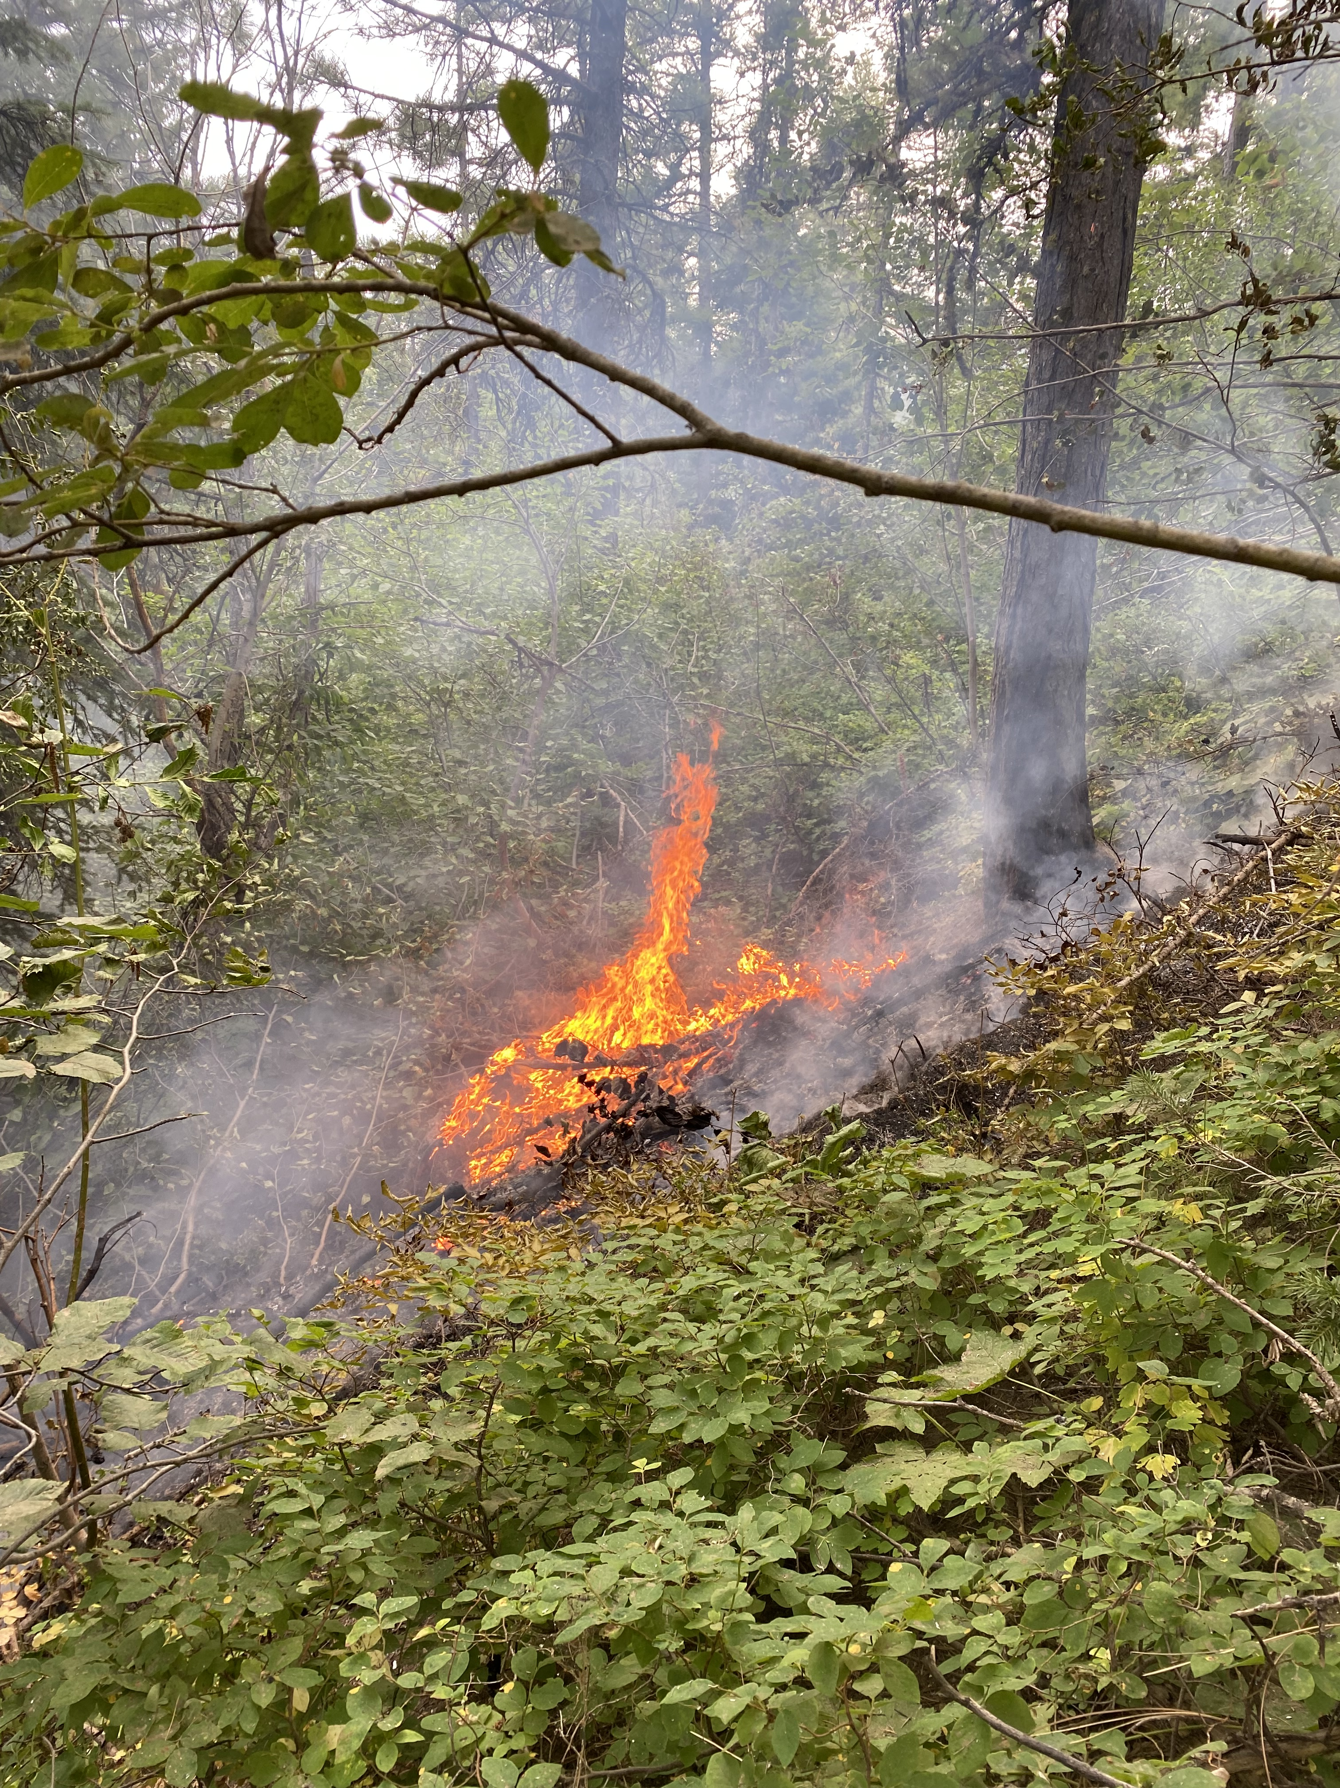
Current Situation: Mixed Conifer Fire Behavior
Notes:
Show where fire is contained, where is open line, where is heat/VIIRS

Slide 14
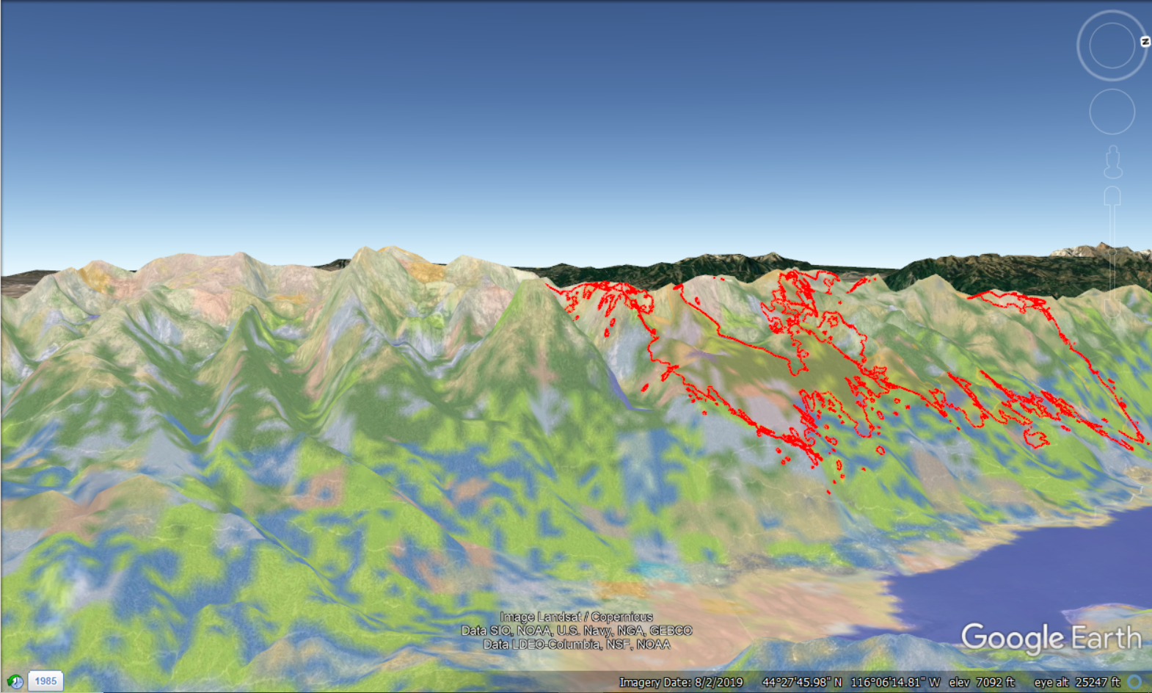
Current Situation: Layout of Fuel Types
Notes:
Show where fire is contained, where is open line, where is heat/VIIRS

Slide 15
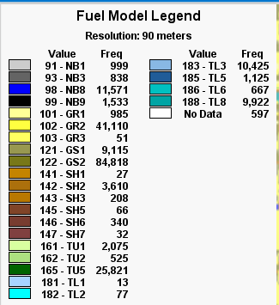
Vegetation Overview

Slide 16
4-DAY NTFB (8/28-31)

Slide 17
14-DAY FSPro (8/28 - 9/11)

Slide 18
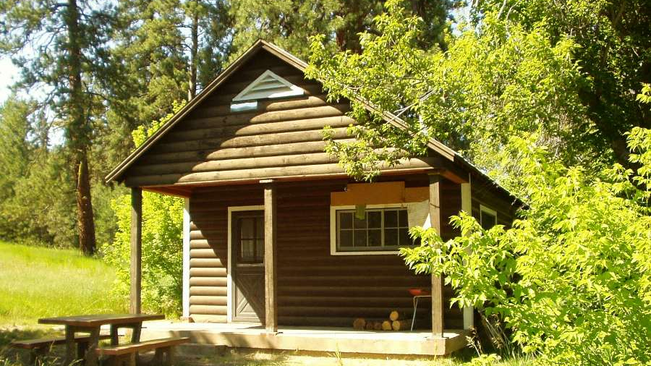
Values at Risk – Management Action Points
Notes:
New decision: Increased the planning area size to the south, MAPs 6-13 approved.
Have identified several values in the expanded planning area: Tripod LO, Third Fork cabin, sage hen reservoir
Beginning to develop more MAPs to address values

Slide 19
VAR Map Placeholder

Slide 20
Strategic Operations
Tripod Lookout
Primary control lines
Contingency lines
Risk and exposure
Two additional MAP’s proposed

Slide 21
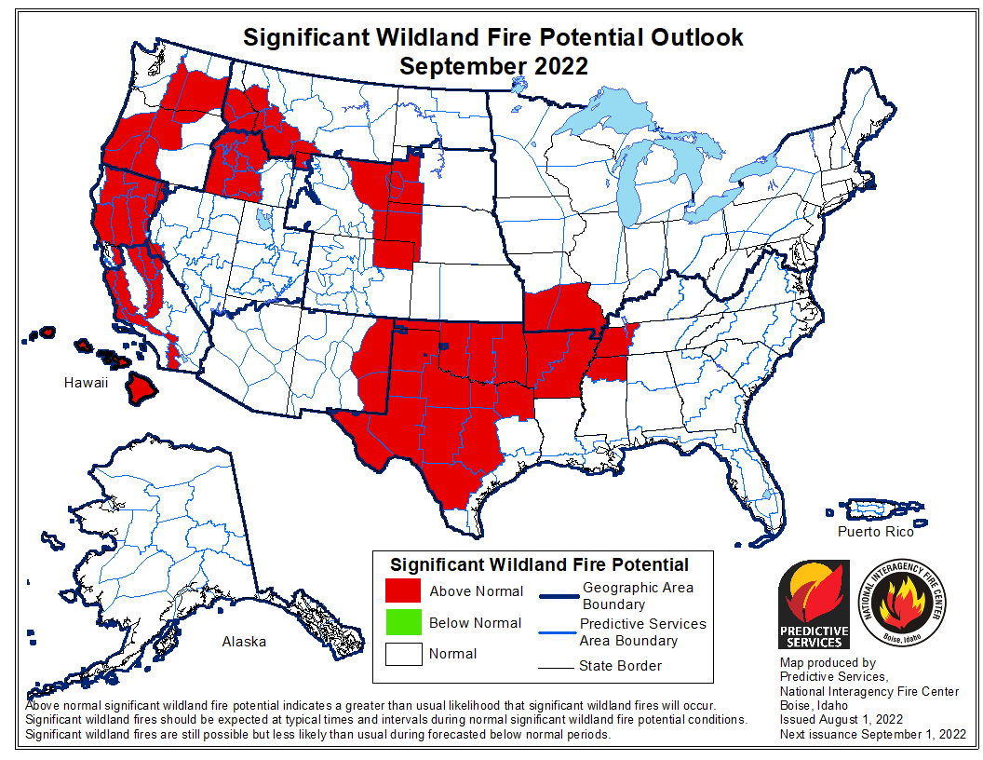
Notes:
New outlook is at end of month

Slide 22
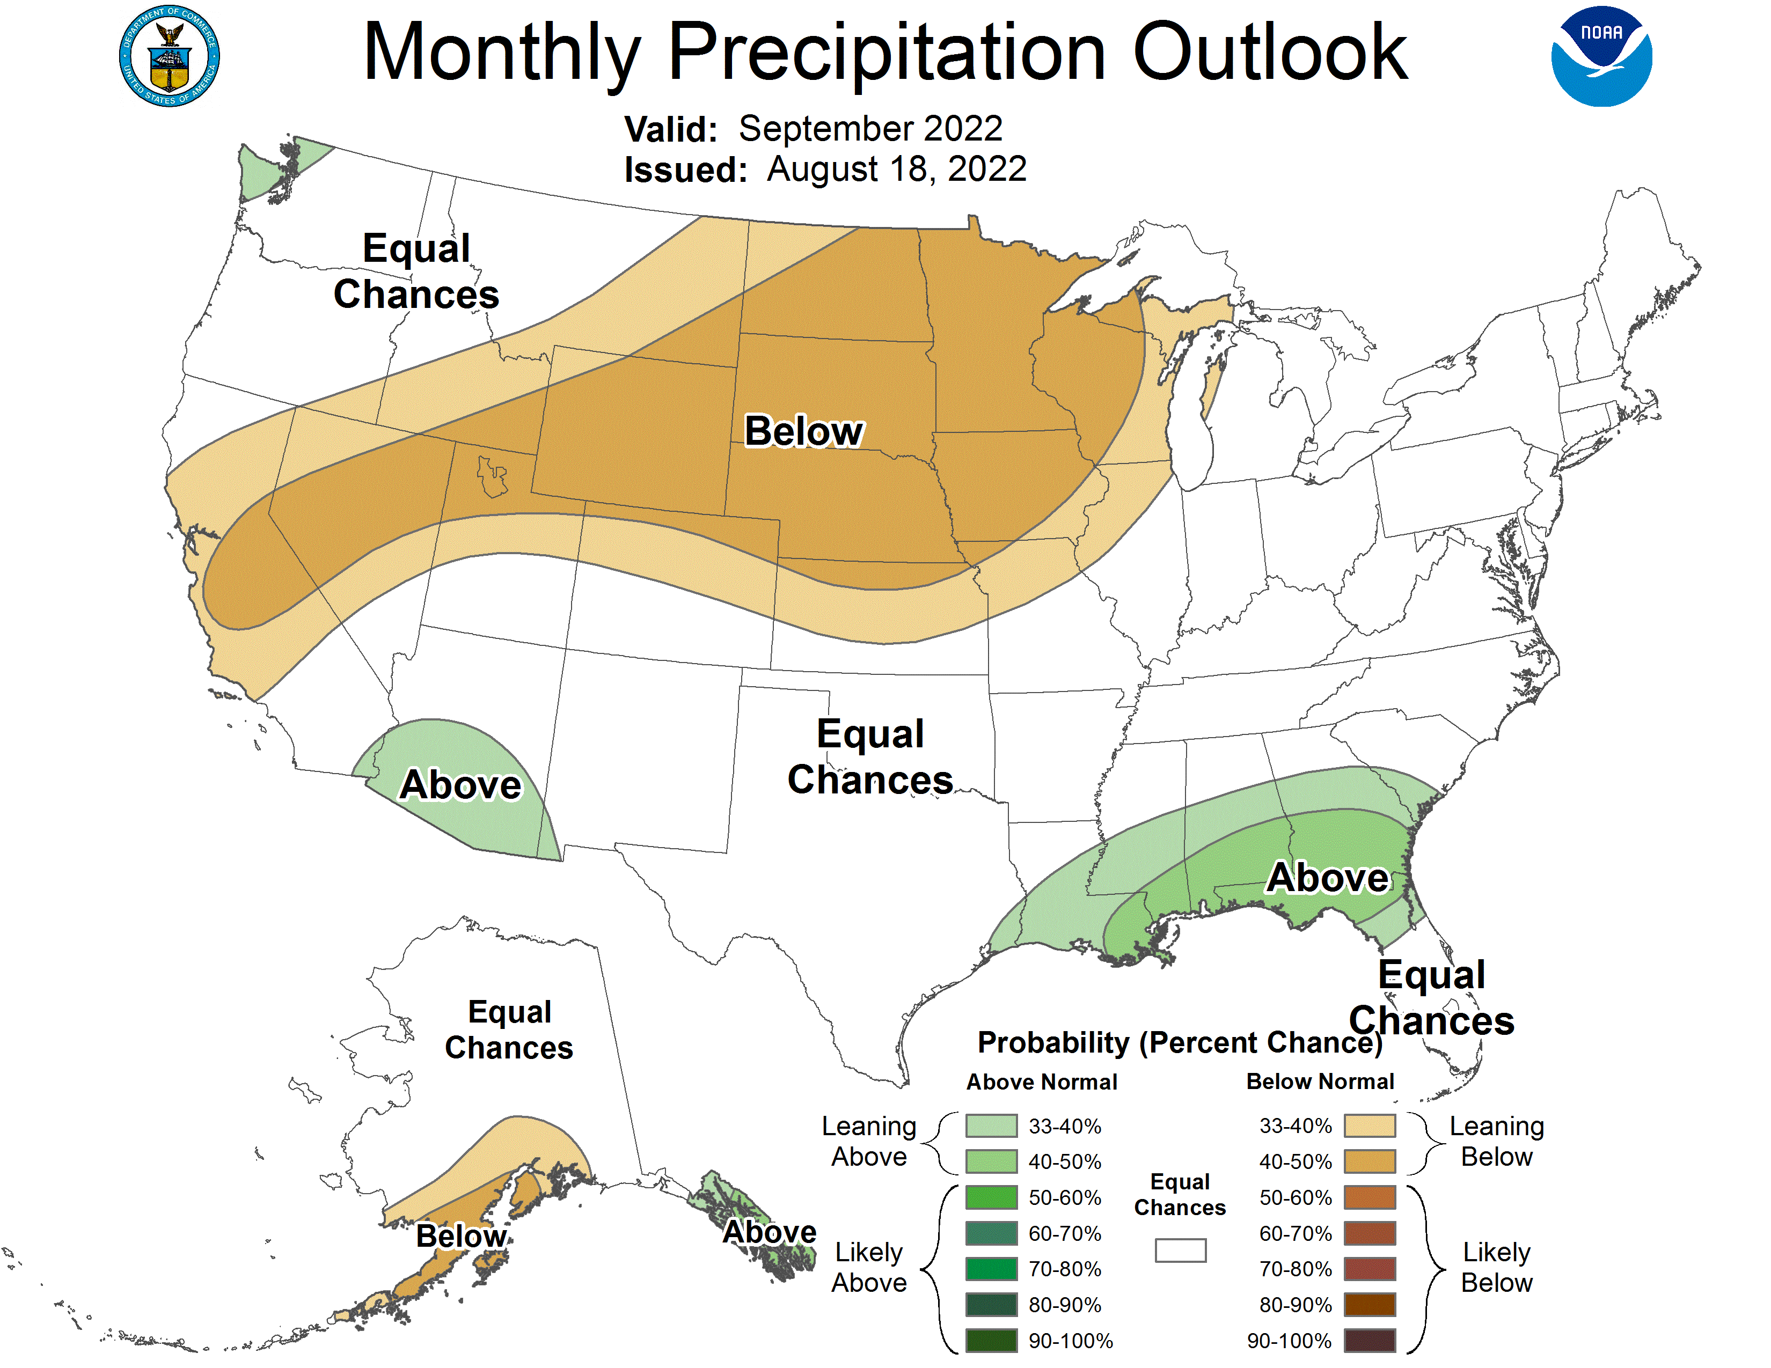

Slide 23
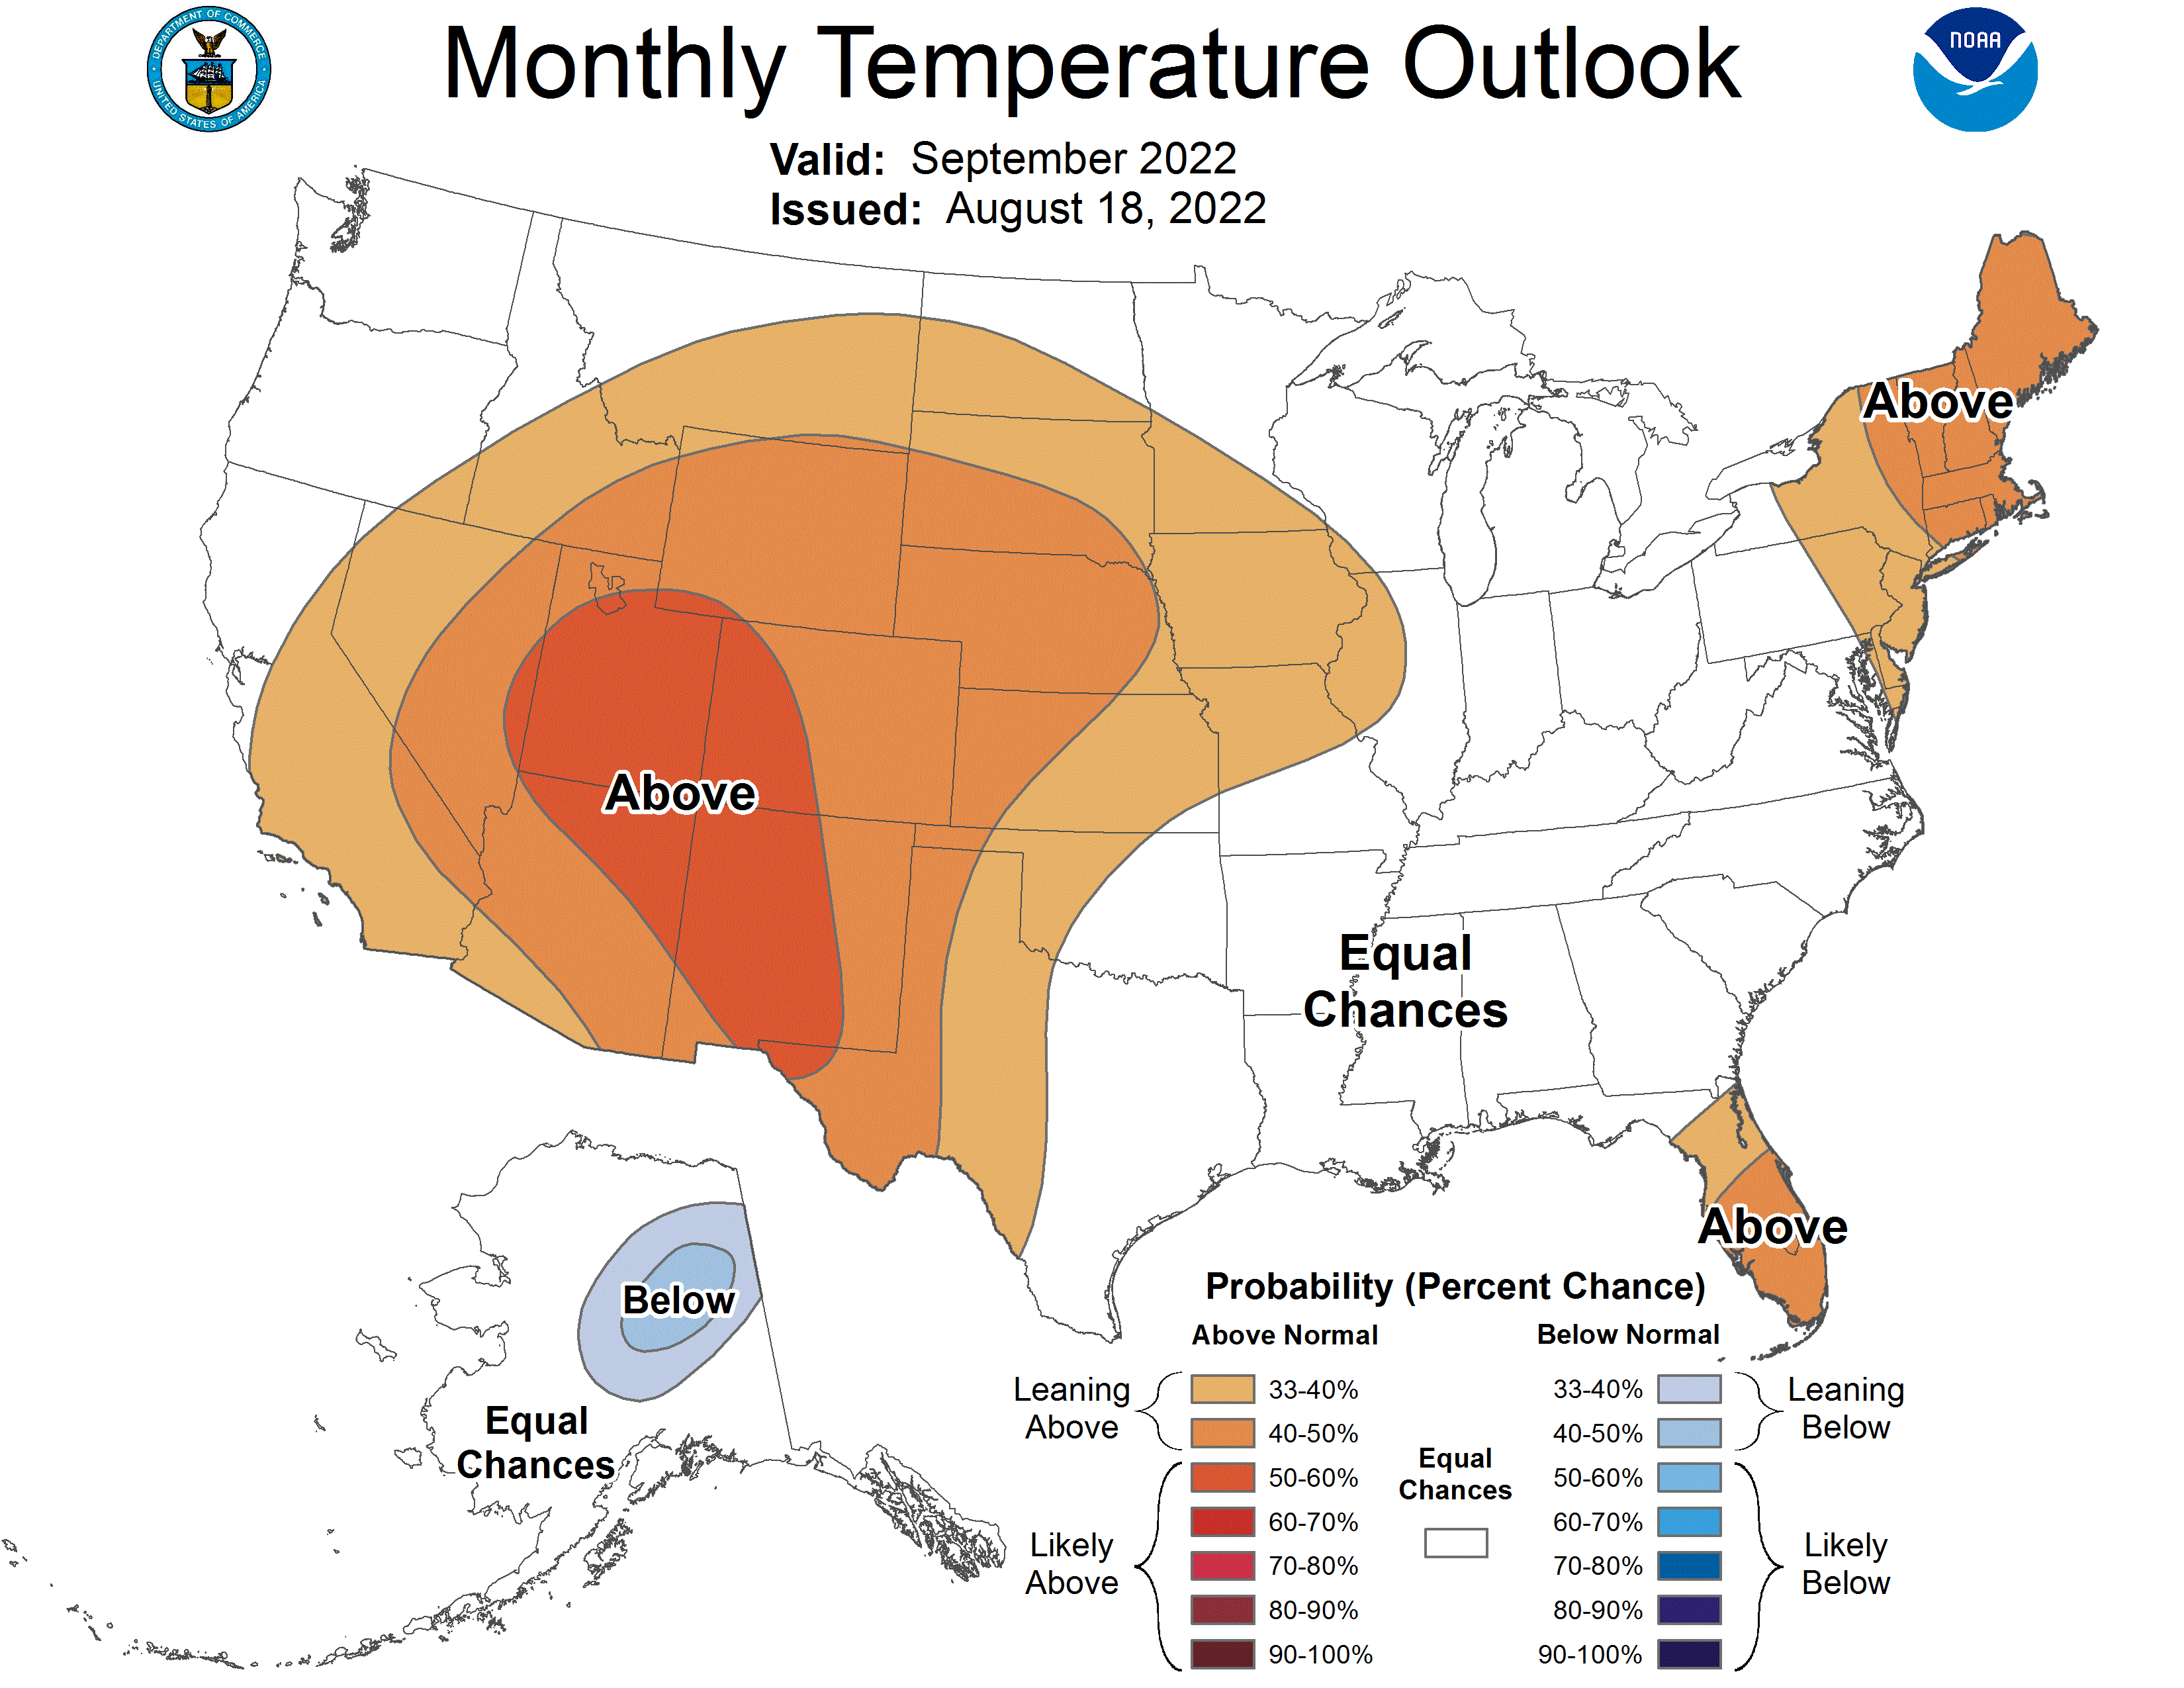
Notes:
Climate Prediction Center - Seasonal Outlook (noaa.gov)

Slide 24
Aug 27
Date | Probability
Sept. 9 | 25%
Sept. 24 | 50%
Oct. 2 | 75%
Oct. 5 | 90%
Notes:
Updated last week’s version of the RMA season ending event prob. For Aug. to Oct. 31, using 08/26/22 ~midnight IR perimeter as the GIS fire perimeter.
vertical line in yellow to show today,
bottom axis is a count of which day of the year we are at -we are at the 238th day of the year.
The graphic is already titled with which months we considered.
P = probability, so the graphic shows:
P25 = 09Sept, which means Sept. 9th is 25% probability of season ending
P50 = 24Sept, which means Sept. 24th is 50% probability of season ending
...Oct 2nd have 75% probability, and Oct 5th is 90% probability...
This product is based on last night's IR perimeter, and gridded ERC trends for that spatial footprint based on data from the RAWS in the area. Here's a citation or website where it's from, which includes a more thorough background if anyone is interested:
Risk Management Assistance Dashboard (arcgis.com) (go to top menu and find "season ending analysis".

Slide 25
Closing: Are we on Track?
What's Next:
"Draft" Long-Range Plan by 8/31
Submit New WFDSS Updates
Support In-Brief and Transition Meeting as Requested

