Slide 1
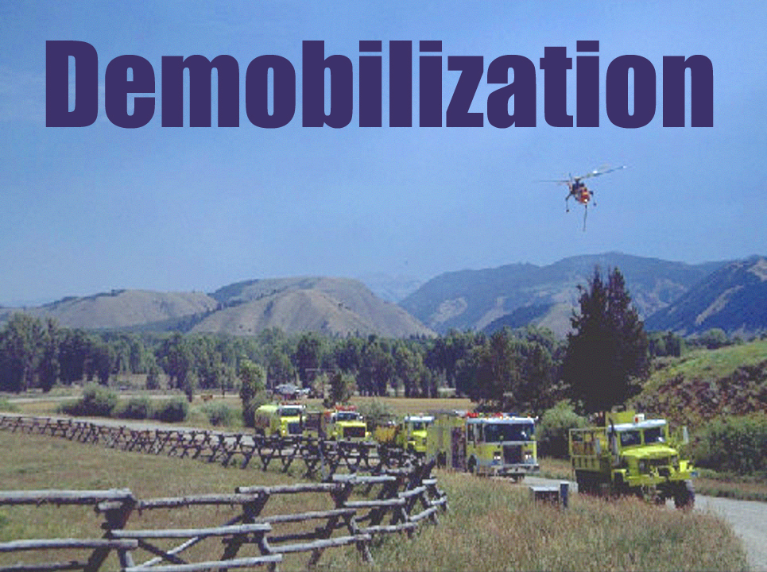
Unit 10
Slide 10-1

Slide 2
Unit 10 Objectives
Identify basic elements of the demobilization process.
Identify conditions/situations which may limit resource availability for reassignment.

Slide 3
Unit 10 Objectives
Describe the demobilization information flow in expanded dispatch, geographic area coordination center and the national level.
List the information required to place a request for demobilization transportation.

Slide 4
Demobilization
The safe and orderly removal of resources from the incident in a cost effective, efficient manner that requires coordination between the incident and expanded dispatch.

Slide 5
Communication
Present a professional attitude and work ethic.
Work closely with each dispatch level, incident, area command, etc.
Help each other work together.

Slide 6
Demobilization Plans
The planning section on the incident is responsible for making the demobilization plan.
The incident’s demobilization plan must follow national, area, and MAC demobilization plans.

Slide 7
Demobilization Process
Planning at the incident
Demob Plan
Initial organization
Incident Action Plan (IAP)
Implementation at the incident
Surplus resources (checked against other orders)
Tentative release

Slide 8
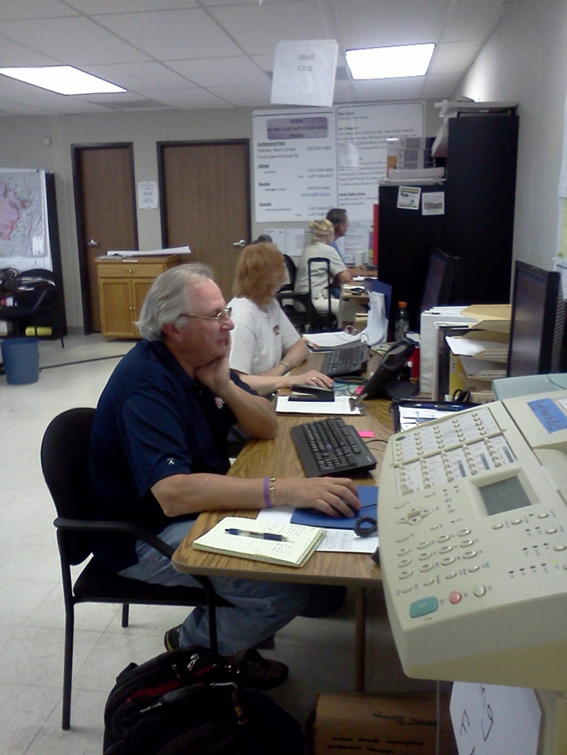
Expanded Level

Slide 9
Reassignment and Availability
When tentative releases are received, reassignment and transportation need to be considered.
Identify conditions which may limit availability for reassignments.

Slide 10
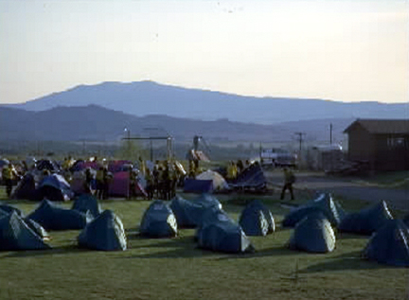
Reassign Locally
To the same or another incident
To a mobilization center
To a staging area

Slide 11
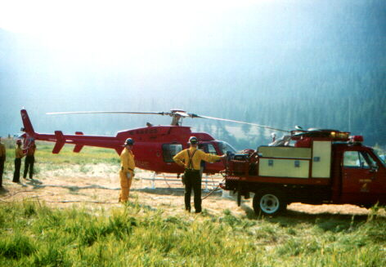
Demobilization Resources/Transportation
Identify the process required to release resources

Slide 12
Information Required to Place a Request for Transportation
Incident order and request number.
Number of people or pieces.
Manifest/Roster (information from check-in or demobilization unit).
a. Names and Weights (personnel and baggage weighed separately).
b. Flight Manager

Slide 13
Information Required to Place a Request for Transportation
4. Date and time available at what pickup point.
5. Destination (both jetport and home unit location).
6. Support along the way (meals and lodging).

Slide 14
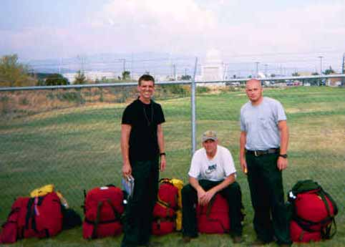
Transportation Needs
Local contacts:
Aircraft Dispatcher
Equipment/ Transportation Dispatcher
Agency-designated travel agent
Non-local contacts:
GACC to NICC for large aircraft

Slide 15
Relay Travel Plans To:
Local ground transportation, equipment dispatch, or transportation dispatcher.
Local mobilization center or staging area.
Next coordination level.

Slide 16
Potential Demob Problems
Examples:
Weather
Wrong or different request numbers
Wrong demob points
Passengers don’t show at assigned pick up point

Slide 17
Resources that Help During Demobilization
Interagency Resource Representative (IARR)
Interagency Contract Representative
Cache Demobilization Specialist (CDSP)

Slide 18
Resources that Help During Demobilization
Other Dispatch Offices (e.g., IA)
Demobilization Unit
Other aids:
ROSS
Isuite
T-cards
Other local examples may exist

Slide 19
Demob Summary
Cancel outstanding orders
Finish all travel
Release all resources, etc.

Slide 20
Unit 10 Objectives
Identify basic elements of the demobilization process.
Identify conditions/situations which may limit resource availability for reassignment.

Slide 21
Unit 10 Objectives
Describe the demobilization information flow in expanded dispatch, geographic area coordination center and the national level.
List the information required to place a request for demobilization transportation.

