Slide 1

Aircraft
Unit 2
Slide 2-1

Slide 2
Unit 2 Objectives
Describe the interaction of the EDSD as it relates to the aircraft function.
Identify the difference between tactical and logistical missions.
Identify the different types of logistical aircraft requests.
Effectively utilize flight planning forms and methods.

Slide 3
Support Dispatcher Duties
Giving and receiving information to mobilization and demobilization of resources utilizing aircraft.
Examples?

Slide 4

Types of Aircraft Resources
Tactical Aircraft
Airtankers
Single Engine Airtankers (SEATS)
Lead Planes
Smokejumper Aircraft
Infrared Aircraft
Air Attack Aircraft
Helicopters (Types 1-3)

Slide 5
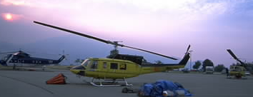
Types of Logistical Aircraft Orders and Tasks
Tracking of incoming logistical flights.
Gather information for flight plan.
Prepare a flight request.
Communicate information to other functional areas.

Slide 6
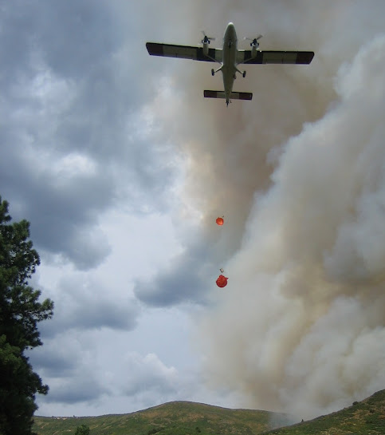
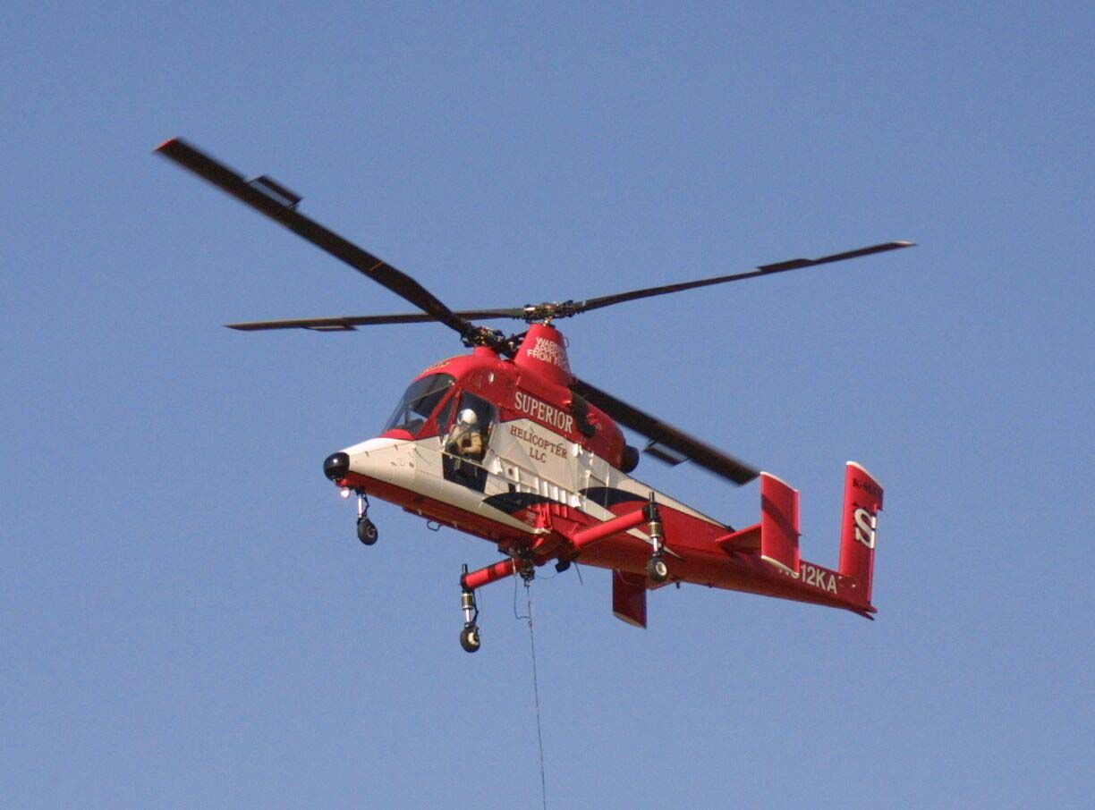

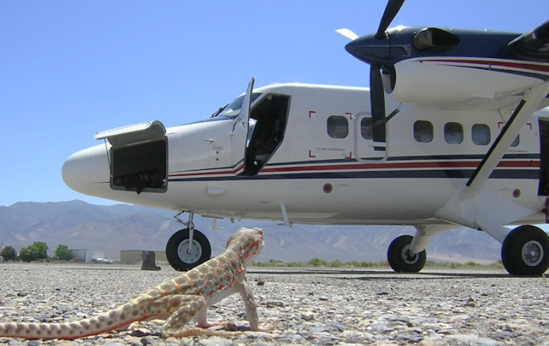
Aircraft Dispatch Channels
NICC-National Resources
Large transport aircraft
Contract lead planes
Smokejumper aircraft
National contract airtankers
National contract Type 1 and Type 2 helicopters
Slide 2-6

Slide 7
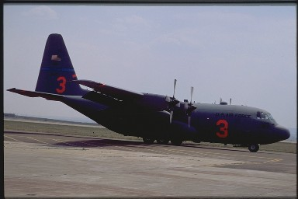
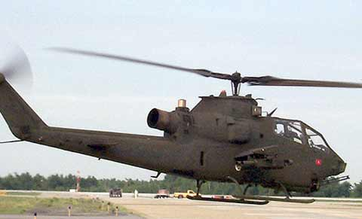
Aircraft Dispatch Channels
NICC-National Resources
MAFFS
Military aircraft
Aerial Supervision Module

Slide 8
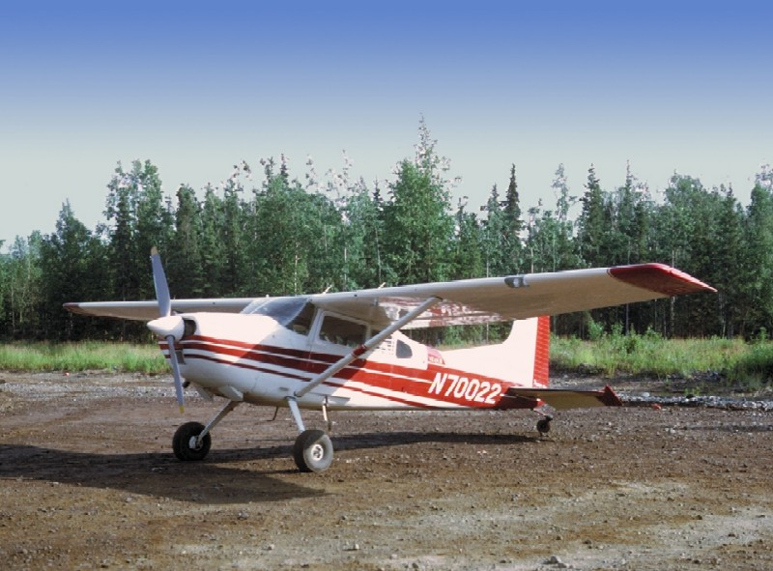

Aircraft Dispatch Channels
NICC-National Resources
Infrared aircraft
Aircraft frequencies (can also be GACC and local)
Logistical charters (can also be GACC and local)

Slide 9
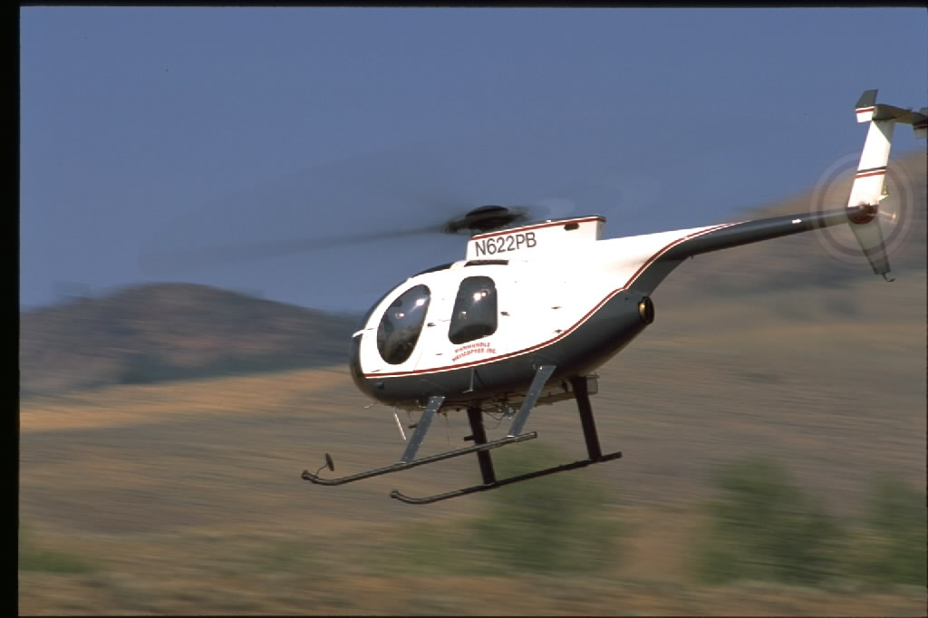
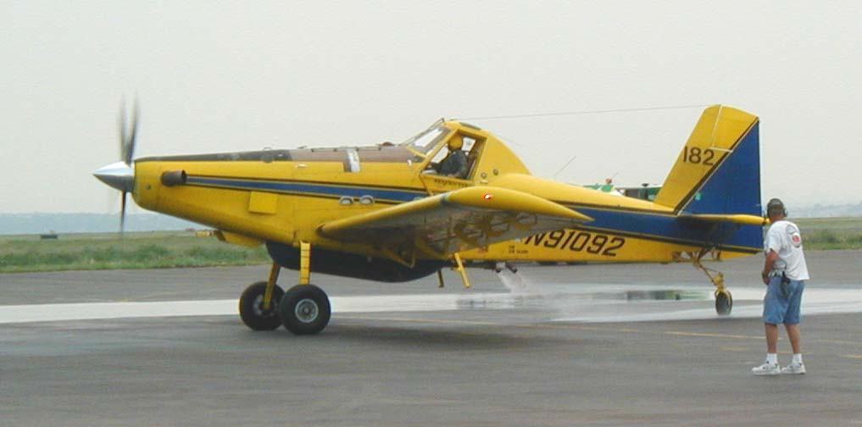
Aircraft Dispatch Channels
GACC - Area Resources
Temporary Flight Restrictions (TFRs)
Type 3 CWN helicopters
Single Engine Airtankers (SEATs)
Logistical aircraft
Aircraft frequencies

Slide 10
Dispatch Center
Local Resources
Local tactical aircraft resources.
Logistical aircraft within locally
designated response area with
GACC assistance.

Slide 11
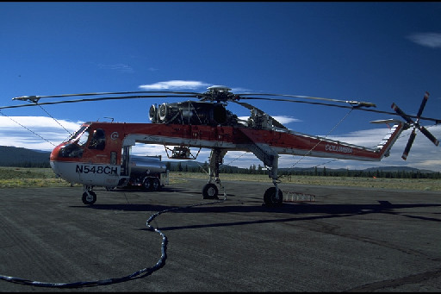
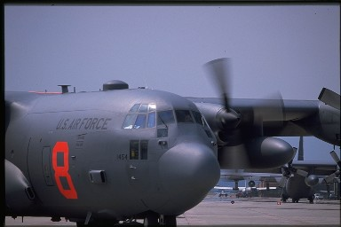
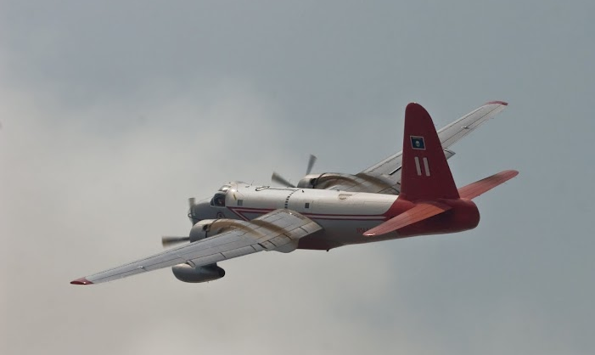
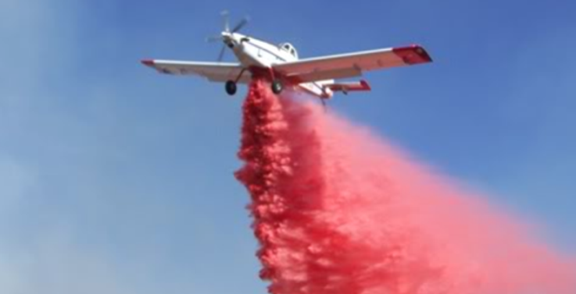
Aircraft Resources Summary
Slide 2-11

Slide 12
Aircraft Flight
Request Form
Flight Planning
Identifies elements of the flight.
Identifies hazard and safety information.
Provides a format to track the flight from point of origin to final destination.

Slide 13
Aircraft Flight Request Form
Initial Request Information Block
Passenger/Cargo Information Block
Flight Itinerary Block
EDSD obtains this information

Slide 14
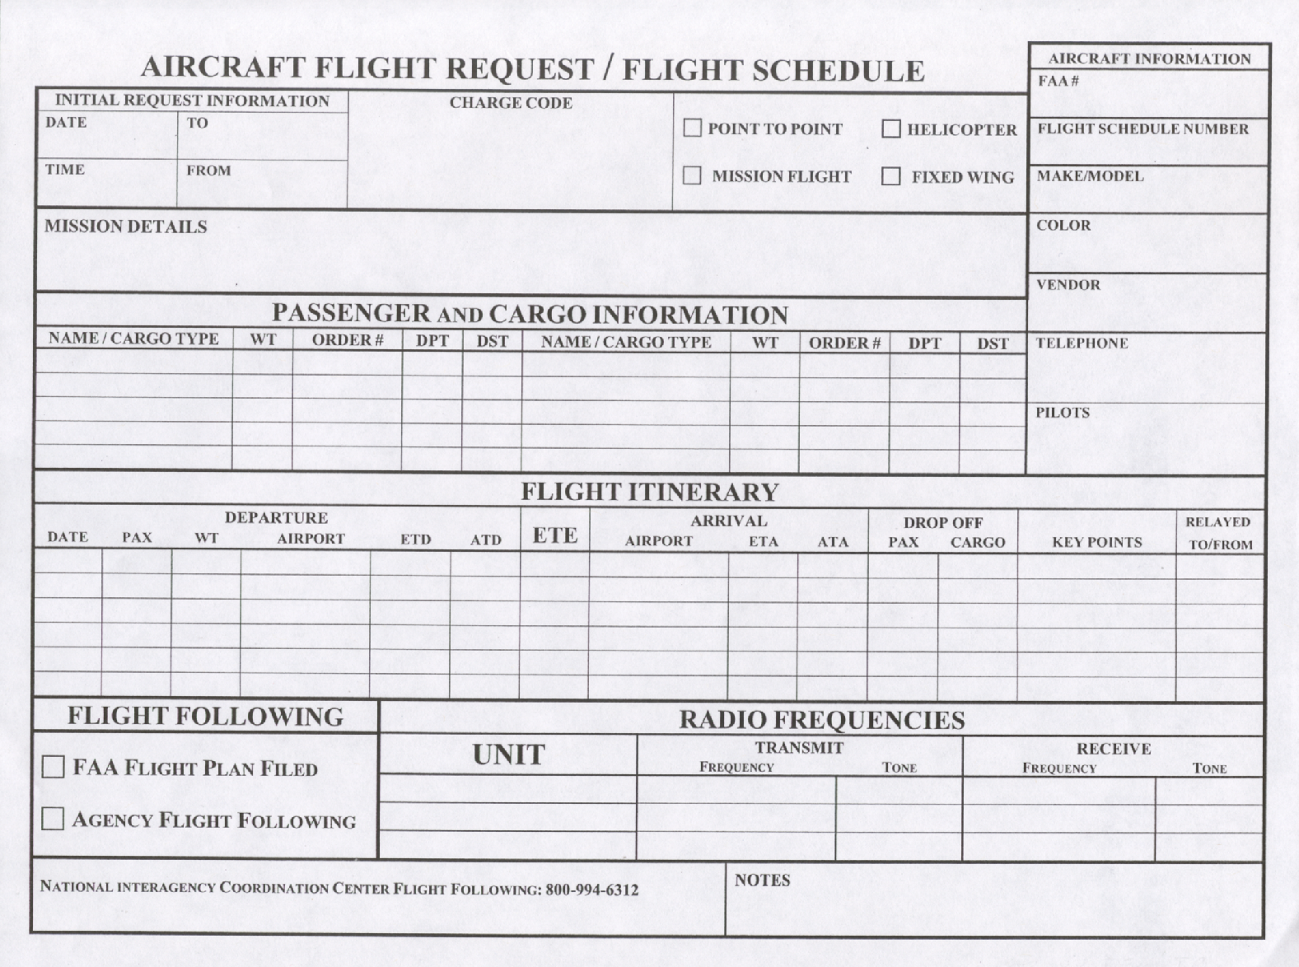
Slide 2-14

Slide 15
Slide 2-15

Slide 16
Slide 2-16

Slide 17
Flight Following/Tracking
The flight following and tracking information is critical in the event of an aircraft emergency.
This is done by the local initial attack office, the EDSD has some responsibilities.

Slide 18
Airport Identifiers
A good source for airport identifiers:
www.airnav.com/airports/

Slide 19
Other Common Acronyms
ETD = Estimated Time of Departure
ATD = Actual Time of Departure
ETE = Estimated Time En Route
ETA = Estimated Time of Arrival
ATA = Actual Time of Arrival
RON = Remain Over Night
PAX = Passengers

Slide 20
Flight Manager
Briefing by the
Aircraft Dispatcher
Review the flight itinerary
Review the passenger list
Discuss the pilot and aircraft information
Establish flight following procedures

Slide 21
Aircraft Orders Pertaining to the EDSD
Expanded Dispatch may order resources to support aircraft
Communication with all functional areas essential part of expanded dispatch
Communication needs – why, how, who?

Slide 22
Crews
Large Transport
Emergency Release of Crew Member
Tool Transport (Saws, etc.)

Slide 23
Overhead
Helicopter Modules
Incident Management Team Support
Individual Resources Mob/Demob

Slide 24
Supplies / Services
Helibase Support
Porta Potties
Trailers
Air Attack Kit
Fuel Tender
Portable Retardant Plant
Transport of Supplies

Slide 25
Relationship with Aircraft
Dispatcher
Communicate, Communicate, Communicate

Slide 26
Exercise: Flight Planning

Slide 27
Unit 2 Objectives
Describe the interaction of the EDSD as it relates to the aircraft function.
Identify the difference between tactical and logistical missions.
Identify the different types of logistical aircraft requests.
Effectively utilize flight planning forms and methods.

