Slide 1
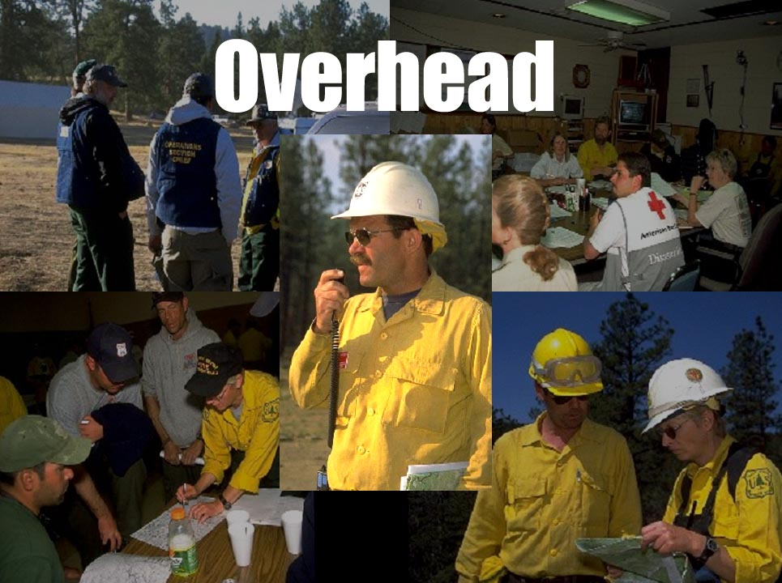
Unit 4
Slide 4-1

Slide 2
Unit 4 Objectives
Mobilize, reassign and demobilize overhead resources in a safe and cost effective manner.
Describe characteristics of specific overhead resources such as single resources, teams, technical specialists, modules, etc.

Slide 3
Unit 4 Objectives
Utilize supplemental forms associated with overhead mobilization, reassignment, and demobilization.
Describe the interaction the Overhead Dispatcher must have with the other functional areas within the incident support organization.

Slide 4
Define Overhead
Personnel ordered with “O” numbers as individual resources assigned to
an incident.

Slide 5
Technical Specialist
Airspace Coordinator
Fire Lookout
Camp Crew Squad Leader
GACC Meteorologist
Slide 4-5
Notes:
Do these have established mnemonics? Look them up on current mnemonics list in the Fireline Handbook, 310-1, or list.
THSPs – catchall, movement to identify THSP specialities.
What questions do you need to ask for a generic THSP? (specialty, tools & equipment needed, where to find?)
Current experience notes – THSPs for timber markers, timber cruisers, engineers, GISTs for hurricane recovery/timber harvest. Other examples? (chicken disease, floods)
Oddities – when and where used? Canine Handler (CANH) – SAR?
Climber (CLIR) – Cone collection/disease eradication (Jumpers)
Packer (PACK) – Wilderness & non-roaded area fires
Scuba (SCUB) – SAR?
Video Operator (VIDO) – Investigation?
Vegetation Specialist (VESP) – when used? Anyone know?

Slide 6
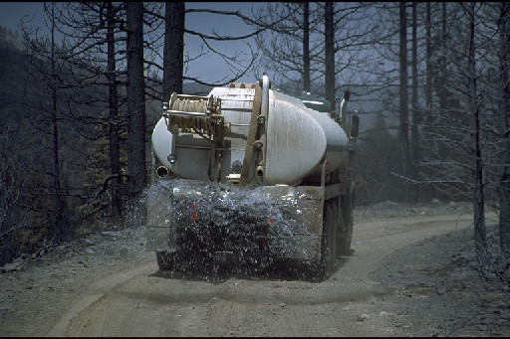
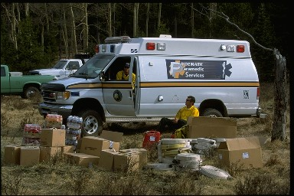
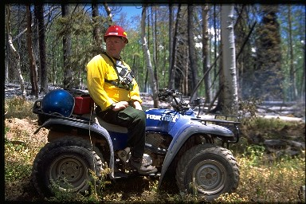
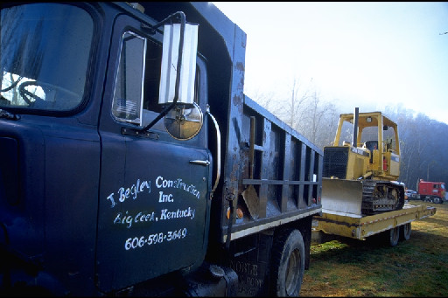
Local Resources
Slide 4-6
Notes:
First rule: Closest Resources
Also is most cost-effective. 2 states away for a driver??
Local knowledge is valuable
Examples of local hires – Cook, Driver, Clerical, General Mechanic – any others?

Slide 7
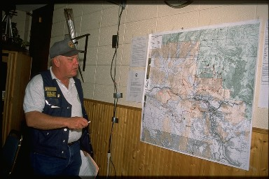
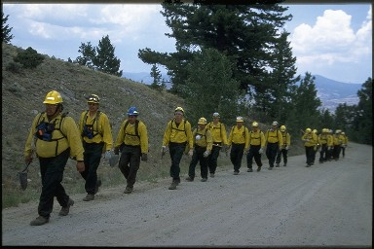
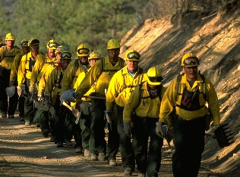
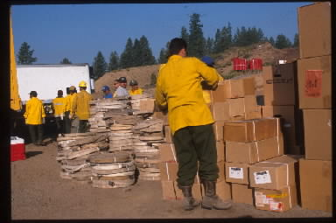
AD/EFF Resources
Slide 4-7
Notes:
What’s AD & EFF stand for? How are they different? Who are they (retirees, etc)?
Rely on Ads for positions we can’t fill with Agency folks
Downsizing, fewer Agency people available, no one to cover at home
To consider:
Agency resources exhausted first? (use resources we’re already paying)
Are they signed up? Everyone understand what I mean by that?
What is the hosting agency, and their responsibility? (verify quals, make travel)
Point of hire – why is that important (like everything else, bottom line – payment issue – explain)
Self-sufficient? Why important? (hotel enroute, commercial travel, food, transportation, rental vehicle, etc)
Qualification – sending agency vouches for qualifications
Any further discussion of AD/EFF?

Slide 8
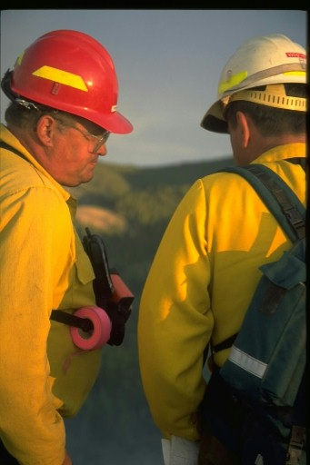
Trainees
What is a trainee?
Will the incident take
them?
Where do you find
trainees?
  Try to use local
  resources first.
  IMTs often want to
  bring their own or
  order them once they are there.

Slide 9
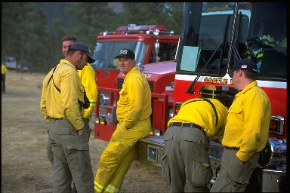
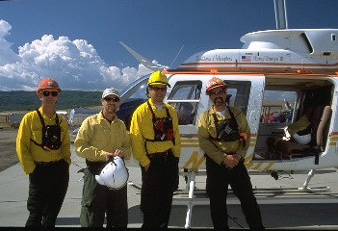
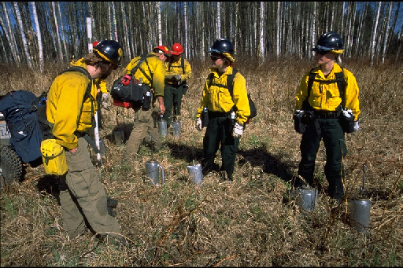
Modules
Engine
Prescribed Fire
Helicopter
Slide 4-9

Slide 10
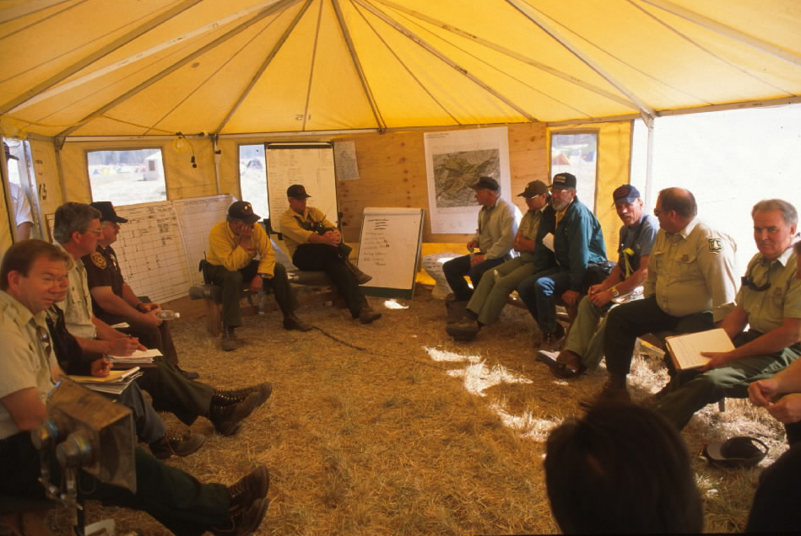
Teams
Type 1 and 2 Incident Management Teams (Short and Long)
Buying Teams (geographical area and national)
Administrative
Payment Teams
(APT)
Critical Incident
Stress Debriefing Teams
Area Command Teams

Slide 11
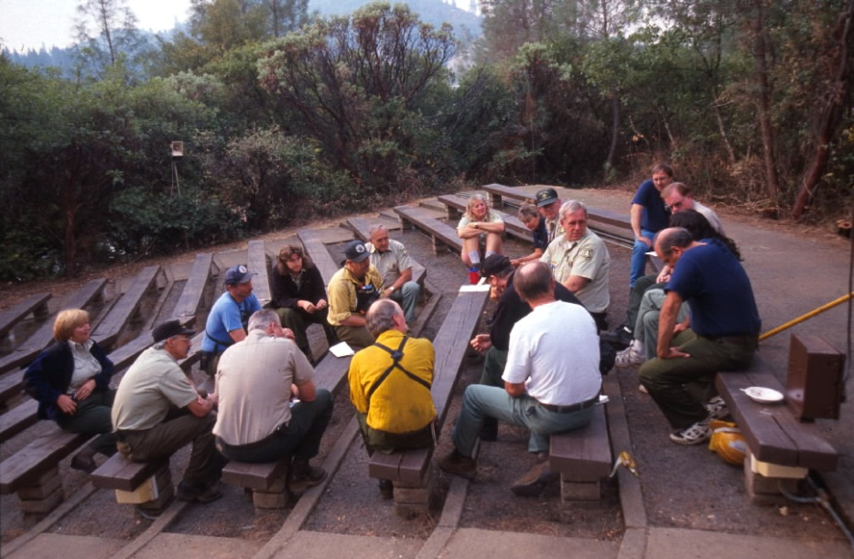
Teams
Burned Area Emergency Rehabilitation Teams (BAER)
Cooperative Wildland
Fire Prevention/
Education Teams
Wildland Fire and
Aviation Safety
Teams (FAST)

Slide 12
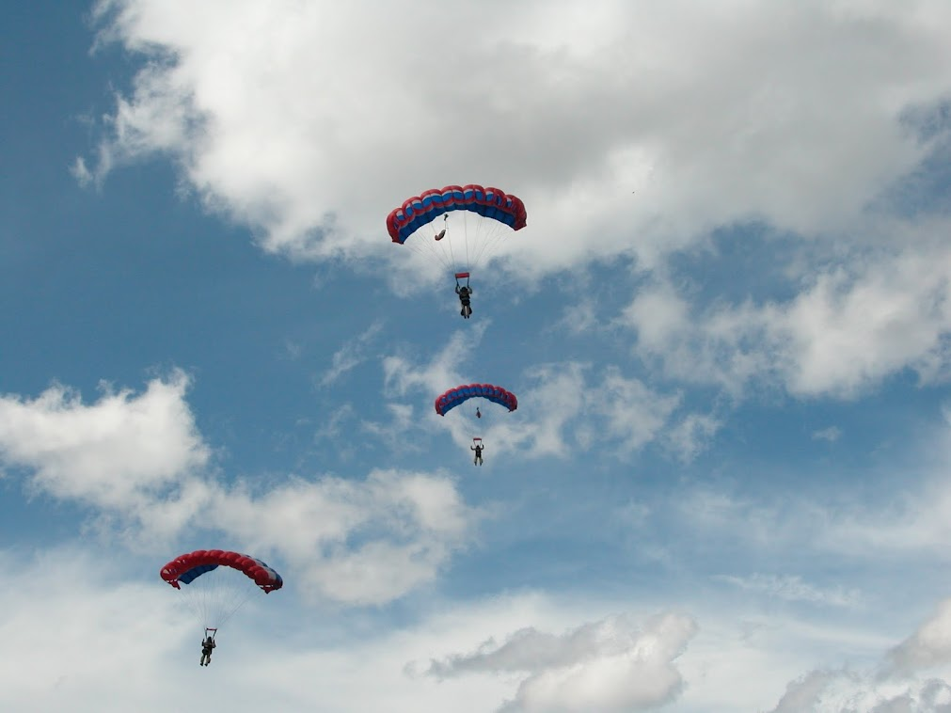
Smokejumpers
Slide 4-12
Notes:
IA orders for SMKJs are A numbers at this time – that may change – you probably won’t see IA SMKJ orders in Expanded.
Booster loads: Describe (jumped-out base, or low on remaining jumpers) More jumpers ordered through NICC, who will send the order to a SMKJ base with excess jumpers (or a base with low fire activity). These are O#’s; the aircraft bringing them in will generally not stay, and they are generally not IA ready. You probably won’t see these in Expanded either, generally handled by the Aircraft desk, but be aware, since you may see the O-#s in ROSS.
Now that we’ve talked about the kinds of OH you may see, next we’ll talk about HOW to order them.
TAKE A 15 MINUTE BREAK.

Slide 13
Receipt of an
Overhead Request
Is it an ICS position?
  Check for proper ICS terminology.
Is it a specialized position?
  Can it be hired locally?
Are position codes being used to order?
  Are they correct?

Slide 14
Receipt of an
Overhead Request
Are tools required with the overhead (programmable handheld radios, GPS, specific equipment, etc?)
Are ADs, trainees, and private contractors acceptable?
Can the needed date and time be safely met?
When in doubt, ask questions. Make sure you know what you’re ordering.

Slide 15
Coordination with
Other Functions
HMGB Aircraft
COTR Equipment
Teams Supervisor/all functions
Airport Pickup Ground support/trans
Incoming AD dispatcher Buying Team

Slide 16
Placing an
Overhead Request
Determine the source of the overhead.
Are resources being held in reserve that could be local hire?
Is it cost effective to place the request outside of the local area?

Slide 17
Outside Sources for Overhead Requests
ROSS
Administrative hires
Private companies or institutions
Other?

Slide 18
Unable to Fill Policy
Refer to National Mobilization Guide for current policy.
If there is a known shortage of the requested resource, consider other alternatives.

Slide 19
ICS Qualifications
Become familiar with ICS qualifications, review FSH 5109.17 or PMS 310-1.
Qualifications are documented on Incident Qualification Cards (Red Card) and in ROSS.
Important for position substitutions and at demob for reassignments.
By default one qualification may qualify a resource for another.

Slide 20
Name Requests
The processing of name requests should always be discussed with the supervisory dispatcher prior to placement.
The person named must be available and qualified for the assignment.
Ordering unit must have specific needs clearly stated when placing “name request.”

Slide 21
Emergency Notifications and Releases
Notify the Supervisor
Document
Determine if replacement is needed
Consider method of notification
Maintain discretion and professionalism

Slide 22
Preparedness/
Severity Orders
Detail request form is in the National Mobilization Guide
Used to supplement staffing and not considered emergency mobilizations
Questions? Ask your EDSP

Slide 23
Reassignments
Follow local policy
Work with the Demob Unit
Check for other qualifications
Arrange travel
Pass order and travel info to relevant parties

Slide 24
Class Exercise
What questions would you ask when processing these requests?

Slide 25
Unit 4 Objectives
Mobilize, reassign and demobilize overhead resources in a safe and cost effective manner.
Describe characteristics of specific overhead resources such as single resources, teams, technical specialists, modules, etc.

Slide 26
Unit 4 Objectives
Utilize supplemental forms associated with overhead mobilization, reassignment, and demobilization.
Describe the interaction the Overhead Dispatcher must have with the other functional areas within the incident support organization.

