Slide 1
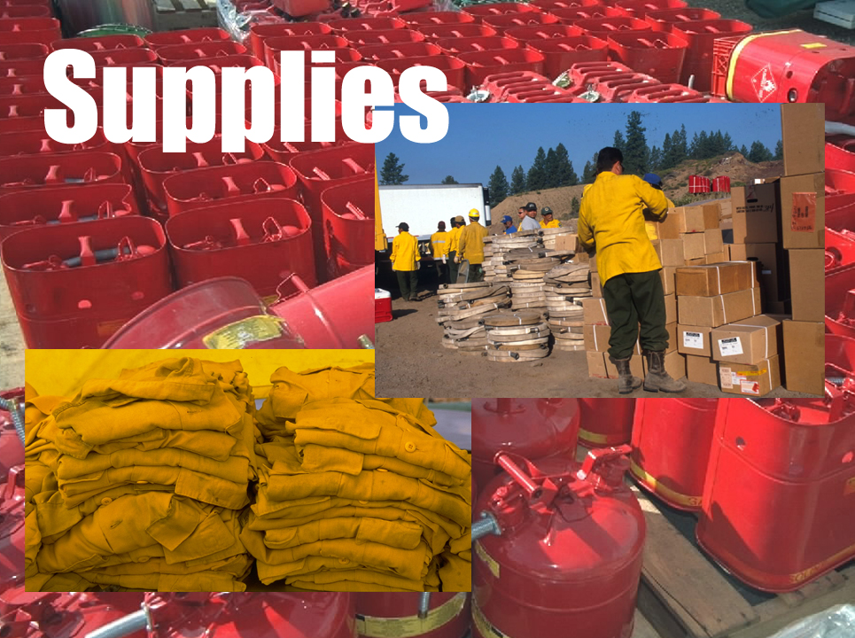
Unit 6
Slide 6-1

Slide 2
Unit 6 Objectives
Mobilize supplies in a cost effective manner to meet time frames.
Describe procedures unique to supplies such as NFES items, local procurement, Buying Team, etc.

Slide 3
Unit 6 Objectives
Utilize the NWCG National Fire Equipment Catalog to accurately process supply orders specific to the catalog number, the catalog description, and unit of issue for cache supply items.

Slide 4
Unit 6 Objectives
Identify the location of national and local support caches and explain how closest forces and time frames affect mobilization and demobilization.
Describe the interaction the supply dispatcher must have with other functional areas within the incident support organization.

Slide 5
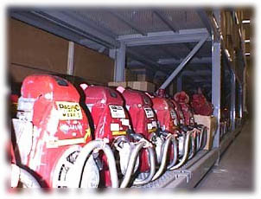
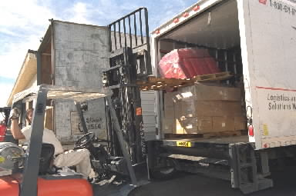
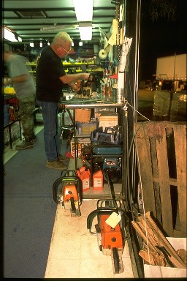
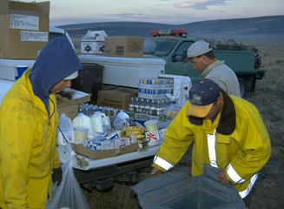
Supply Items are:
Mobile
Cache
Vans
NFES Items
Services
Locally Purchased
Items

Slide 6
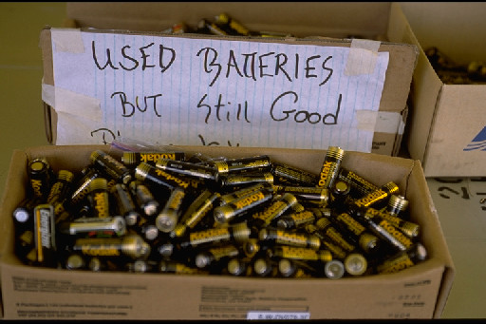
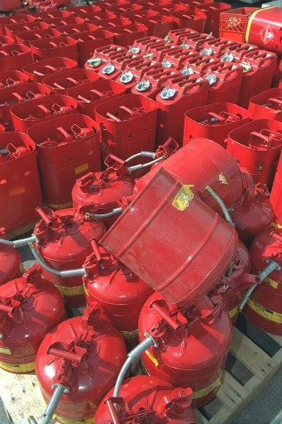
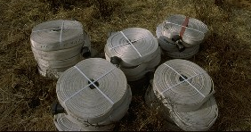
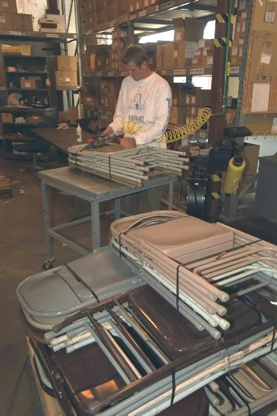
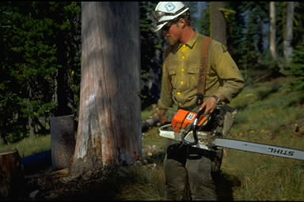
Types of Goods
That Caches Stock
Consumable items
Durable items
Trackable items

Slide 7
Consumable Items
Items normally expected to be
consumed during incident use.
Examples of consumable items are:
Batteries
Plastic canteens
Cubitainers
Forms
MREs
Fusees

Slide 8
Durable Items
Those cache items considered to have
a useful life expectancy greater than
one incident.
Examples of durable items are:
Hose
Clothing
Sleeping bags
Tools

Slide 9
Trackable Items
Those cache items that have a high dollar
value. Items need to be accounted for
from issue until they are returned to cache.
Examples of trackable items are:
Chain saws
Generators
Pumps

Slide 10
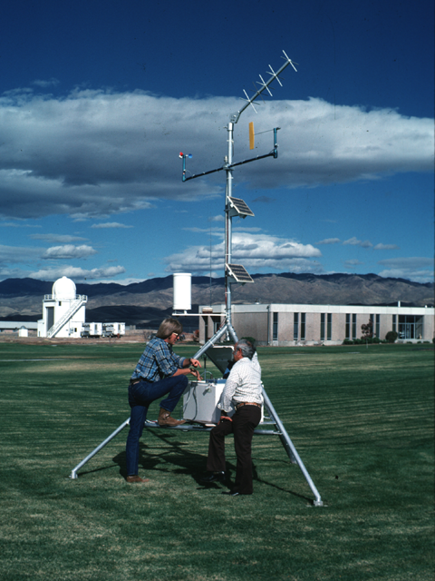
National Resources
Shared – limited number available
  Remote Automatic Weather Stations (RAWS)
  National Incident Radio Support Cache (NIRSC)

Slide 11
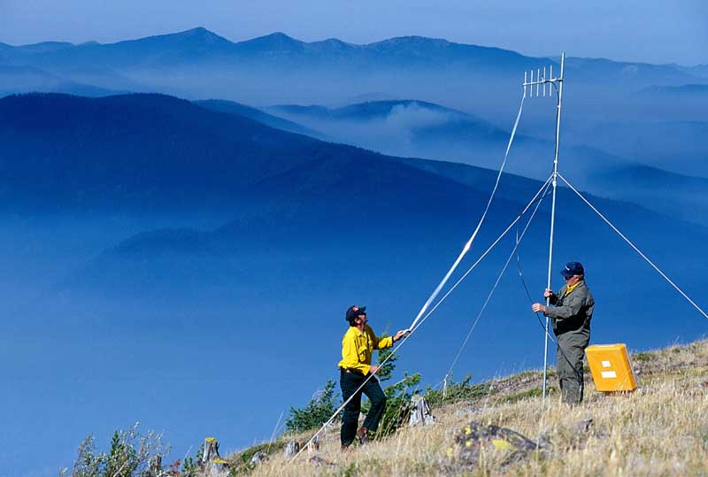
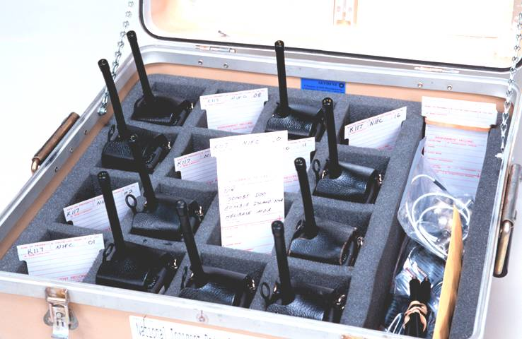

National Incident Radio Support Cache (NIRSC)
Slide 6-11

Slide 12
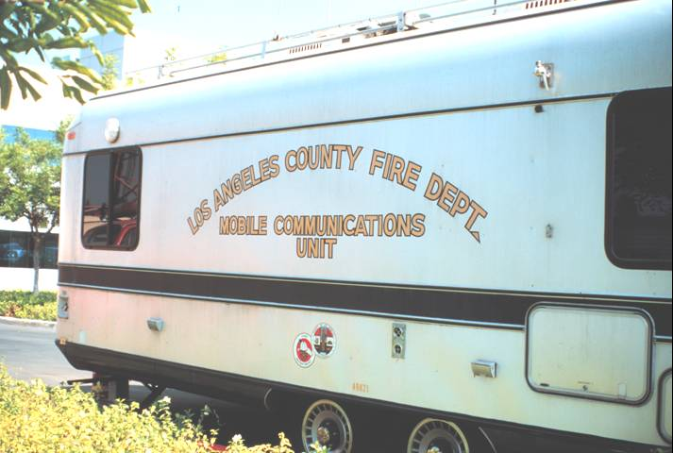
Other Radio Systems
Area communication trailers
(non-standard)
NFES items/numbers unique to region

Slide 13
ICS Starter System (004390)
Components:
CMD/TAC Radio Kits, 3 EA – 48 Radios
CMD/TAC Repeater Kit, 1 EA
Ground to aircraft Radio/Link Kit, 1 EA
Remote Kits, 2 EA
Logistics Repeater Kit, 1 EA
Logistics Radio Kits, 1 EA – 16 radios
Masts, 24 EA

Slide 14
NIRSC System Kit Issue

Slide 15
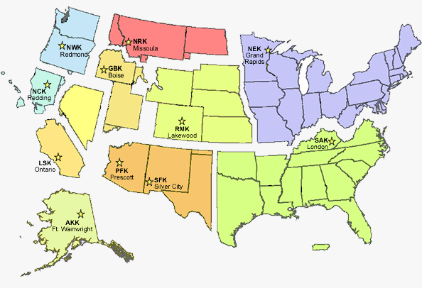
Geographic Area Caches

Slide 16
Local Ordering Procedures
Types of channels
Order consolidation
National resources
  Cache vans
  Telecommunication kits
  Weather sensing kits
Critical items

Slide 17
National
Fire
Equipment
System

Slide 18
Catalog Format
Catalog Part 2
Commo Section
Kit Section
Forms/Signs
Alphabetical Sec.
Hazmat Guide/ Catalog Format
Numerical Index
Alphabetical Index
Introduction

Slide 19
Nationally Stocked
FIRE SUPPORT items,
including Kits
COMMUNICATIONS
and ELECTRONIC Equipment
OTHER, misc.
………000001-006999
…..….004000-005999
……………..007000+

Slide 20
Ordering Procedures
Request number
Quantity
Unit of issue
NFES number
Description
Date/time needed
Delivery address/method
Billing address
Latitude/longitude (radios)

Slide 21
Cache Ordering and Potential Problems
Substitution
NFES items that really should be procured locally
Cost effectiveness – combined order
Non-available items
Make sure you know what you are ordering

Slide 22
Exercise
NFES Catalog

Slide 23
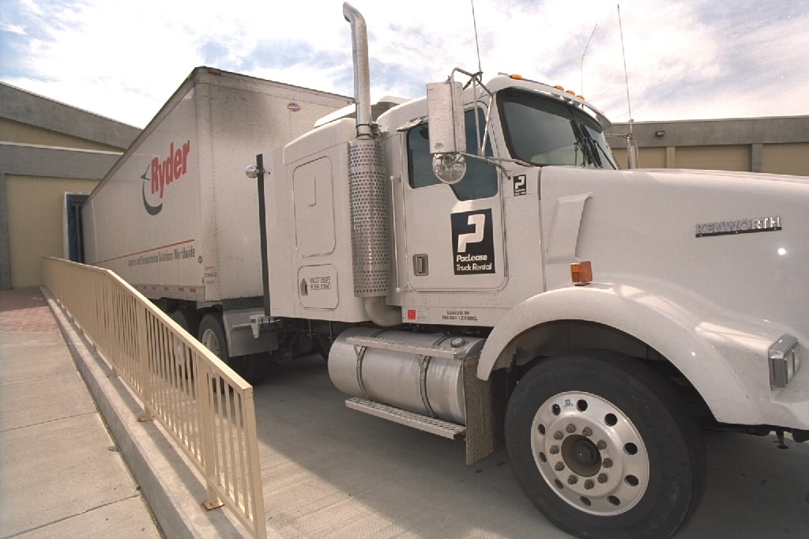
Mobile Cache Vans
Ordering
  Cache vans are ordered from the GACC.
Using the Cache van
  Initial supplies
  support 250
  people.

Slide 24

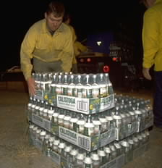

Procurement
Non-cache items available through
local vendors

Slide 25

Non-Cache Items
Usually Available Locally
Common Items
  Ice
  Fruit
  Juice
Uncommon Items
  Golf Carts
  Horse Feed
  Carpet
Maps
  USGS
  Orthophoto
  Aerial Photo
Slide 6-25

Slide 26
Services
Porta potty services
Trash removal
Newspaper delivery
Mobilization center activation
Meals (pre-caterer)
Lodging

Slide 27


Buying Teams
Dealing directly with the incident
Rounding up supplies for expanded
Purchasing food and hotel accommodations
Being assigned a
block of “S” numbers
Procuring services,
supplies, land and
equipment rentals

Slide 28
Shipping and Receiving Methods
Air Freight – Contract/CWN,
agency owned, commercial
Ground Freight – Commercial,
agency owned, private/rental
Considerations – Timeframes,
date and time needed, cost,
quantity/cubic ft./weight

Slide 29
Shipping Status Information
Number of pieces
Date shipped
Shipping mode
ATD/ETA
Government Bill of Lading - GBL
Air bill number

Slide 31
Hazardous Materials
Liquid fuels
Petroleum oil
Fusees
Batteries/battery fluid
Explosives
Compressed gas
Small-arms ammunition
Aerial ignition devices/materials

Slide 32
Demobilization
Requests usually closed out after all transport information is passed
Exception - Trackable items
Recycling

Slide 33
Unit 6 Objectives
Mobilize supplies in a cost effective manner to meet time frames.
Describe procedures unique to supplies such as NFES items, local procurement, Buying Team, etc.

Slide 34
Unit 6 Objectives
Utilize the NWCG National Fire Equipment Catalog to accurately process supply orders specific to the catalog number, the catalog description, and unit of issue for cache supply items.

Slide 35
Unit 6 Objectives
Identify the location of national and local support caches and explain how closest forces and time frames affect mobilization and demobilization.
Describe the interaction the supply dispatcher must have with other functional areas within the incident support organization.

