Slide 1
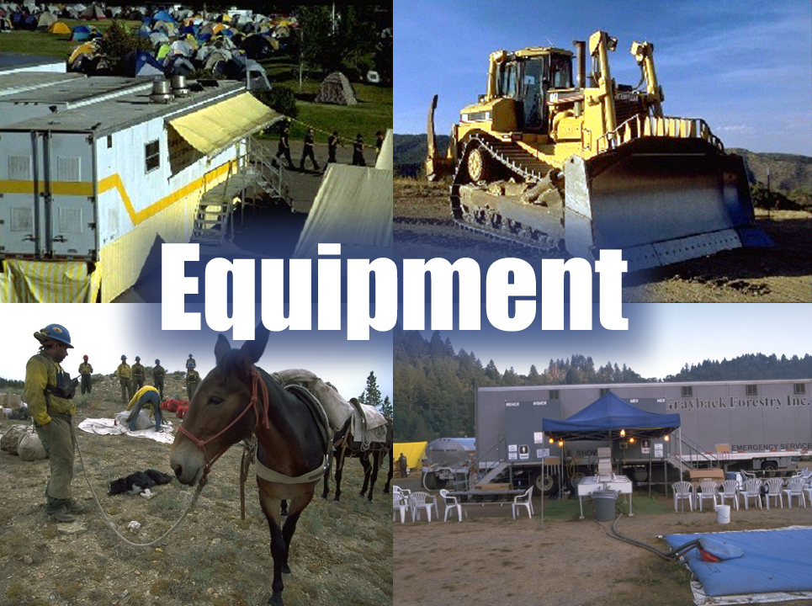
Unit 7
Slide 7-1

Slide 2
Unit 7 Objectives
Mobilize, reassign, and demobilize equipment in a safe and cost effective manner.
Determine the information needed to utilize supplemental forms to mobilize national contract caterer and shower units.

Slide 3
Unit 7 Objectives
Identify types and sources of equipment and unique ordering procedures.
Describe the demobilization process of equipment.
Describe the interaction the Equipment Dispatcher must have with other functional areas within the incident support organization.

Slide 4
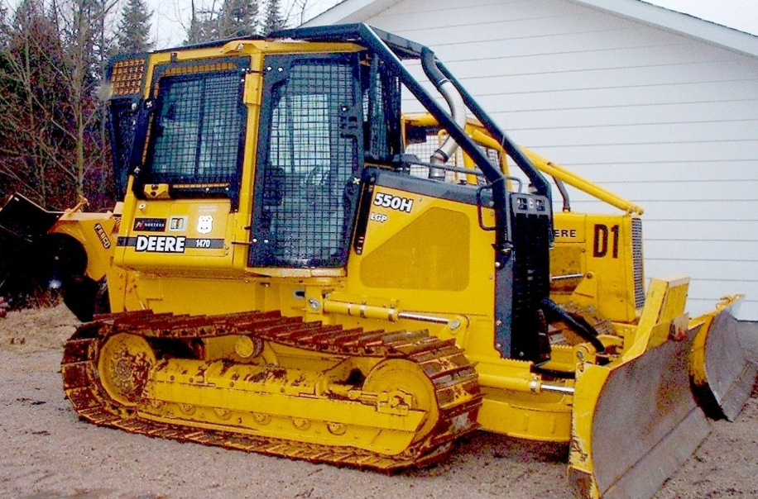
Equipment Resources
National caterers and showers
Engines
Rolling stock (Water tenders, potable, non-potable, dozers, buses, etc.)
Specialized equipment (Palm IR, helitorch, portable mixing plants, etc.)

Slide 5
National Resources Equipment
National Contract Mobile Food Services (Caterers)
National Contract Mobile Shower Facilities

Slide 6
Shower Units (National Contracts)
Information Required When Ordering:
Resource Order Number, Request Number, Name of Incident and Job Code
Exact reporting location
Estimated time needed
Size of Shower Unit: Large (12+) Small (4-11)
Contact information for additional ordering information
Contact information for incident (typically Facilities Unit Leader)

Slide 7
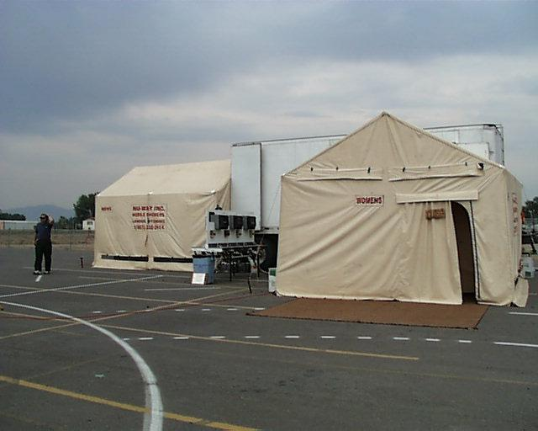
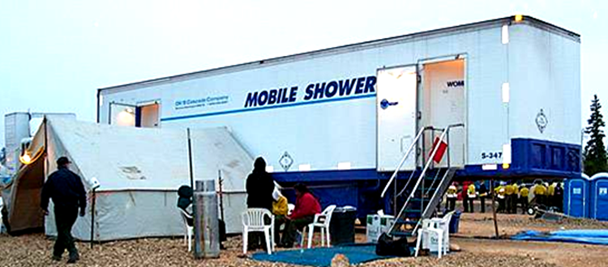
Shower Units (National Contracts)
Arrive with potable water and water tender.
Contractor may arrive with additional/optional equipment (hand wash unit, ADA shower, etc.).
Agency is responsible for removal of gray water.

Slide 8
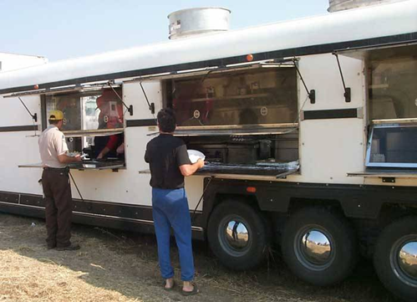
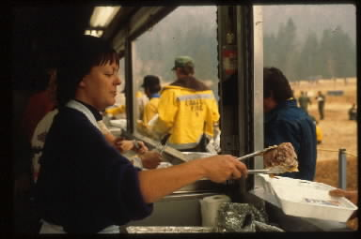
Caterers (National Contract)
REQUIRED USE when the number of people to be fed is at or above 150 persons per meal and the headcount is estimated to remain at those numbers, or greater, for at least 72 hours from when the headcount first reaches 150 per meal.

Slide 9
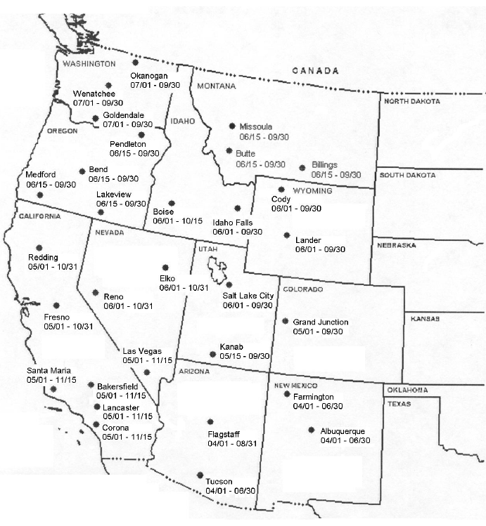
Caterers (National Contract)
Number of units, locations, and mandatory availability period.

Slide 10
Mobilization Information
Food service request form
Based on needed date and time
Estimate number of meals due to food preparation time for the first three meals. This guarantees payment, based on these numbers.
Location of incident
Need accurate directions to mobilization point or incident
Contact person

Slide 11
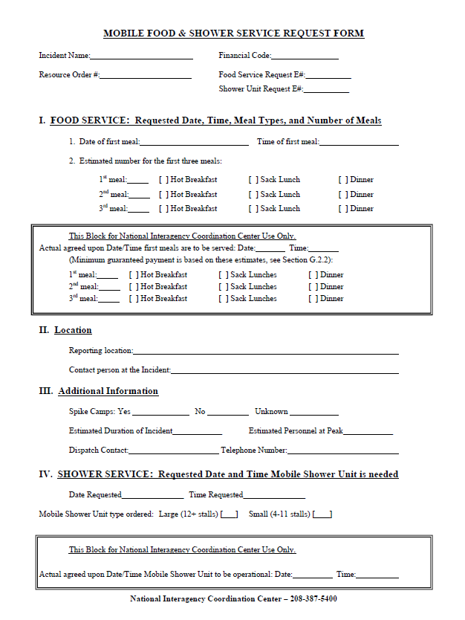
Exercise
Food Service Request Form

Slide 12
Demobilization (National Contract)
Relay release information through the established ordering channels to NICC.
Requests to reassign these resources will be placed by the local unit to GACC.
GACC will forward the request to NICC.
All reassignments of national units will be done by NICC.

Slide 13
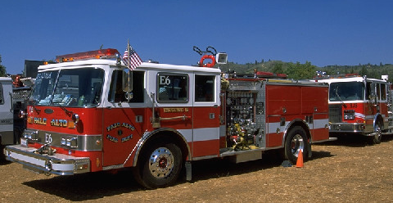
Type 1 & 2 Structure Engines
Minimum Requirements
Type 1 – GPM 1000+, 1200 ft. hose, 4 personnel
Type 2 – GPM 500+, 1000 ft. hose, 3 personnel

Slide 14
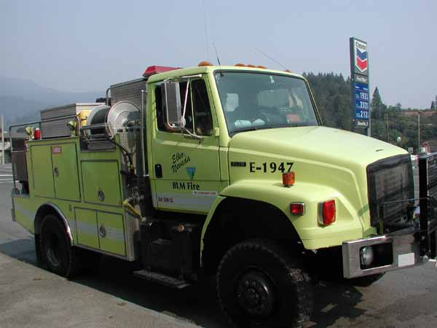
Type 3 & 4 Wildland Engines
Minimum Requirements
Type 3 – GPM 150, 1000 ft. hose, 3 personnel
Type 4 – GPM 50, 300 ft. hose, 2 personnel

Slide 15
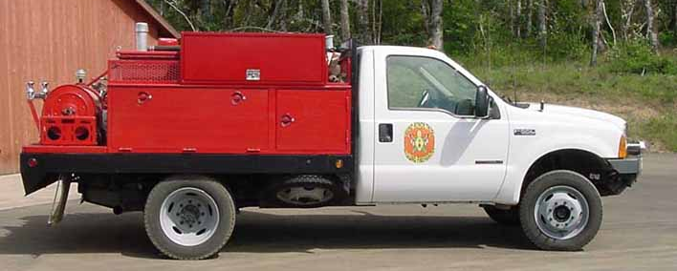
Type 5 & 6 Wildland Engines
Minimum Requirements
Type 5 – GPM 50, 300 ft. hose, 2 personnel
Type 6 – GPM 50, 300 ft. hose, 2 personnel

Slide 16
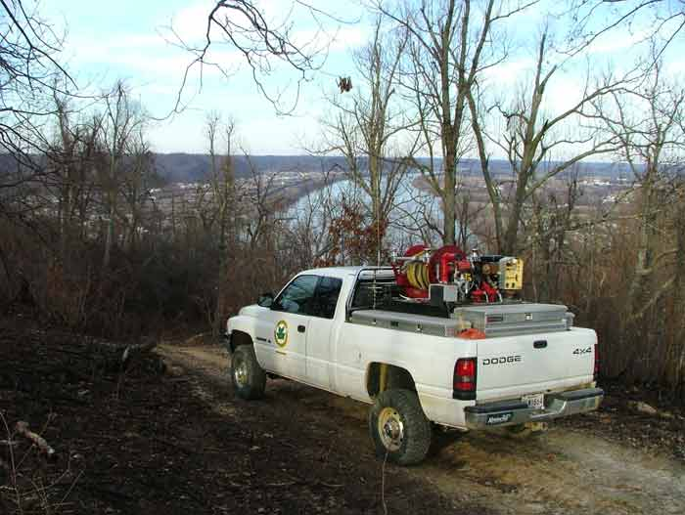
Type 7 Wildland Engine
Minimum Requirements
Type 7 – GPM 10, 200 ft. hose, 2 personnel

Slide 17
Sources of Engines
Agency/Cooperators
Engines may be Federal, state, and/or local government resources.
Incident Blanket Purchase Agreement (IBPA)
Incident Only Agreements
Not available for reassignment

Slide 18
Engine Configuration
Without configuration (single resource)
Each engine assigned an individual equipment request
With configuration
Each engine is assigned an individual equipment request
Roster is in ROSS
Each engine crew member is assigned a request number which is a sequential subset of an equipment number

Slide 19
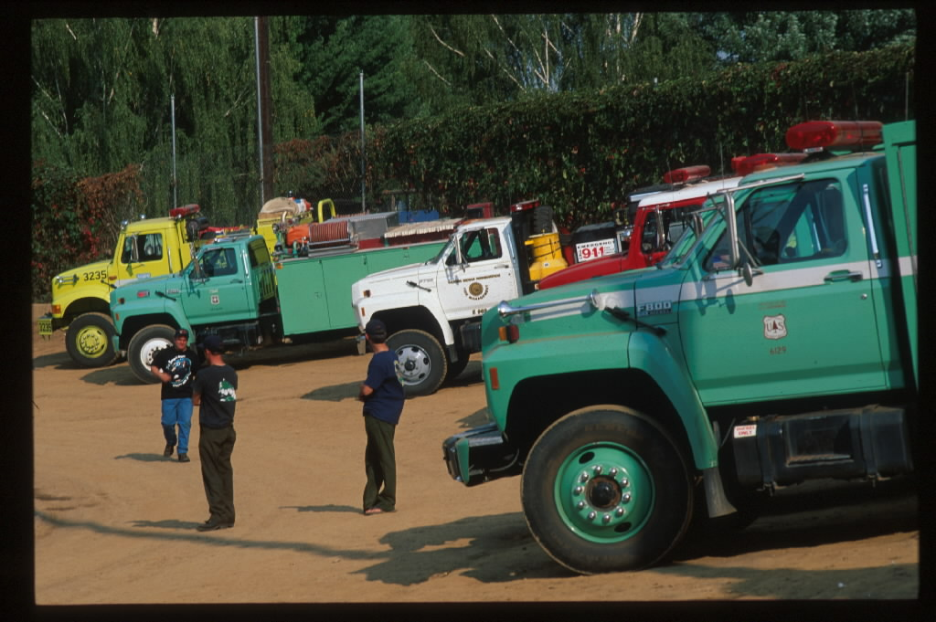
Strike Teams
Generally not ordered nationally
Consist of five or more like engines and a strike team leader
Follow local procedures when ordering
Slide 7-19

Slide 20
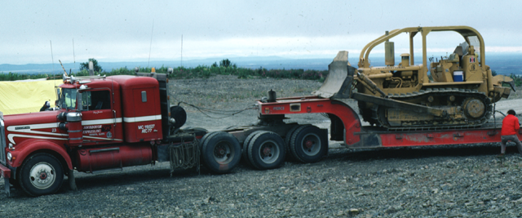
Rolling Stock
Tractor with lowboy and dozer

Slide 21
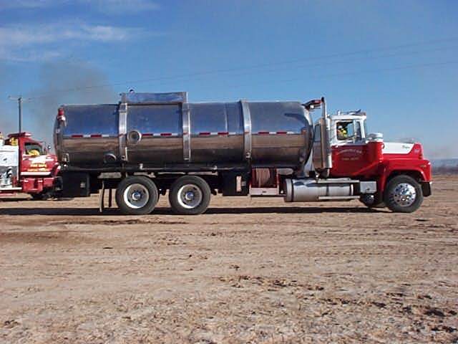
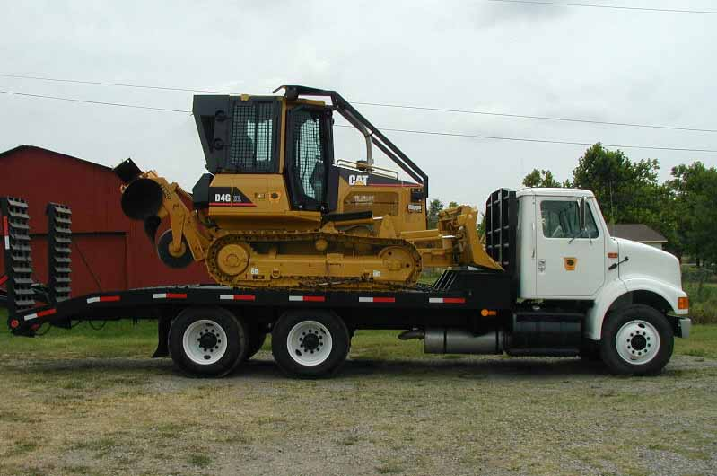
Rolling Stock
Water tender
Tractor/plow

Slide 22
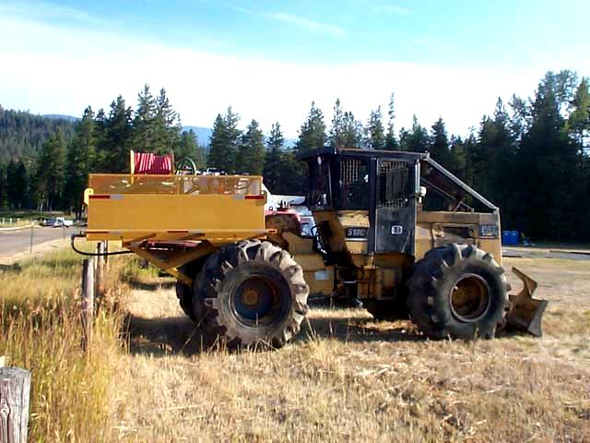
Additional Equipment
Slide 07-22

Slide 23
Sources for Acquisition
Agency
Cooperators
Service and Supply Plan
Admin Unit/Local Agency
IBPAs
Contracting or Buying Team can assist
Inspection and Inventory
National Guard (area, state specific)
Solicitation

Slide 24
Driving Duty Limitations
Federal Motor Carriers Safety Regulations (CDL)
10 hours drive time in a 16 hour duty day
8 hours off between shift
Reference:
Interagency Incident Business Management Handbook, Chapter 10
National Interagency Mobilization Guide, Chapter 10

Slide 25
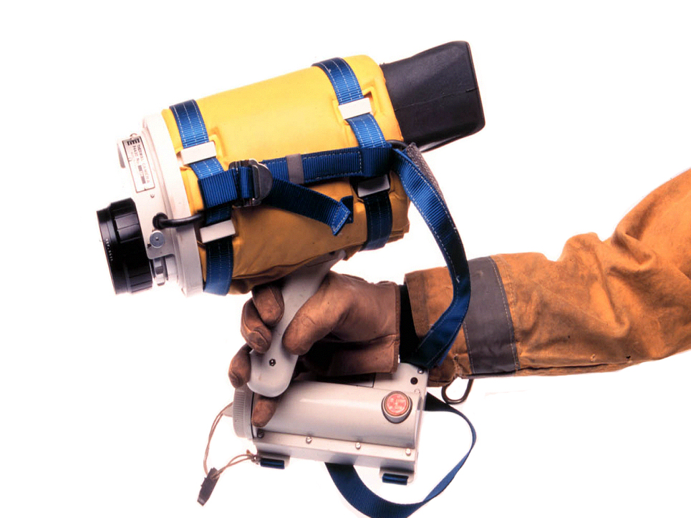
Palm IR
Slide 7-25

Slide 26
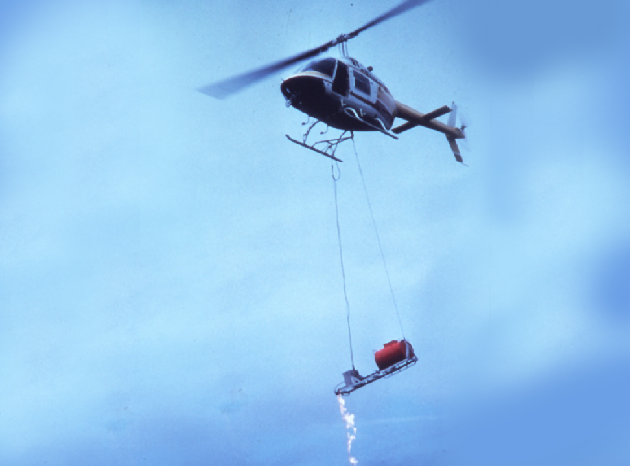
Helitorch
Slide 7-26

Slide 27
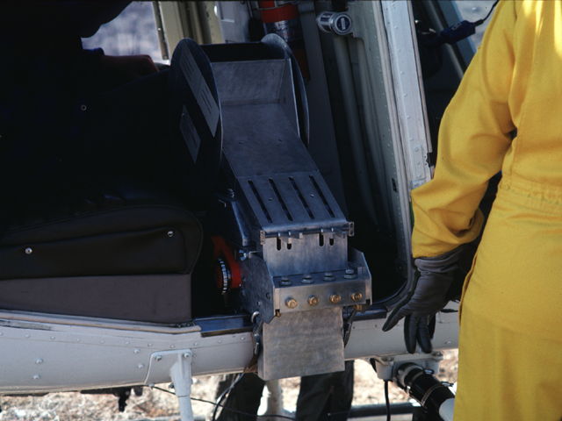
Aerial Ignition Dispenser
Slide 7-27

Slide 28
Equipment Operators
Might be ordered at the same time
May come with specialized equipment (no separate O number)
May be on a support order with an O number (work with the Overhead function)

Slide 29
Unit 7 Objectives
Mobilize, reassign, and demobilize equipment in a safe and cost effective manner.
Determine the information needed to utilize supplemental forms to mobilize national contract caterer and shower units.

Slide 30
Unit 7 Objectives
Identify types and sources of equipment and unique ordering procedures.
Describe the demobilization process of equipment.
Describe the interaction the Equipment Dispatcher must have with other functional areas within the incident support organization.

