Slide 1
NOTE:
This presentation is DRAFT. Additional documentation will be added as PNW Team 3 is able to utilize the “Computer Room On Wheels” Trailer on future assignments.
Primarily the WEBM Screen Room has not been field tested at this time.

Slide 2
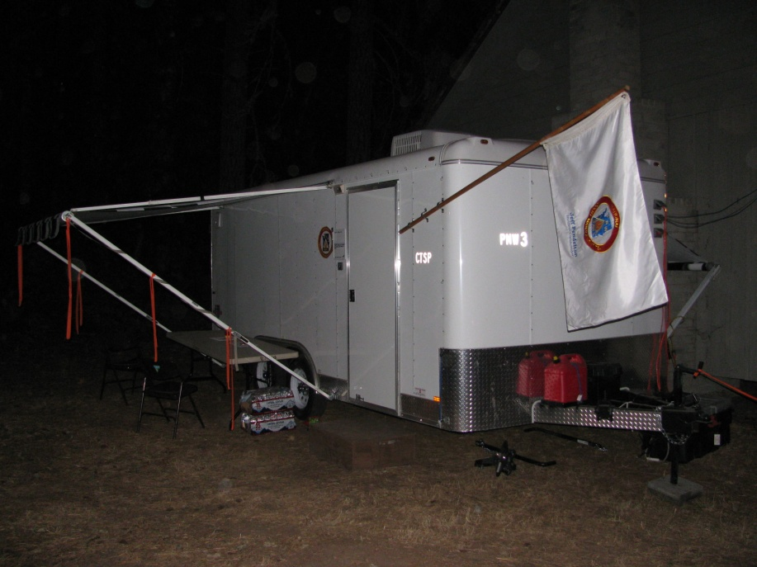
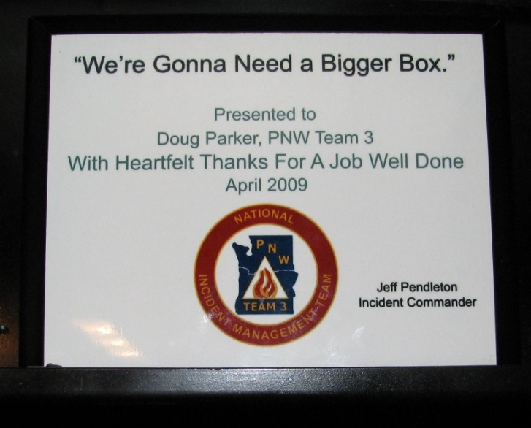
2009 TRAILER PROJECT SUMMARY
“CROW- Computer Room On Wheels”
CTSP Office / CTSP Equipment & Supplies Storage & WEBM Screen Room Office
Funding Provided by Dale Guenther, RO/OSO : Designed / Built by Doug Parker, PNW Team 3 / BLM Medford District Office
Technical Assistance by Paul Dzialowy, PNW Team 3 / BLM Roseburg District Office
Many thanks to all the folks who helped with design ideas, physical help, and good old fashion support:
Jonathan, Shane, Tony, Jon, Brent, Jeff, David and many others behind the scenes.
A special thanks to Kathy Yates for providing “kinder and gentler” suggestions to make improve the trailer working environment.
CTSP = Computer Technical Specialist
Last Updated: 10/01/09

Slide 3
HISTORY
In order to be operational as quickly as possible once arriving at an assignment, individuals and teams have built a variety of mobile office trailers to serve their respective positions.
PNW Team 3 has also built a number of these trailers over the years.
Unfortunately the lessons learned from these efforts have not been well documented to allow others to benefit from our experience.
Incident Management Teams (IMTs) receive little or no funding as an IMT and rely on the support of their local home unit to fund the equipment and supplies they initially respond with.
In 2008, Dale Guenther funded a project to take advantage of the lessons learned by a few individuals and teams. The goal was to build a few mobile office trailers targeted at a few key functional areas. From these trailers, the lessons learned to date would be incorporated and documented. The documentation would be available for others to build upon.
PNW Team 3 was fortunate enough to be funded for a mobile computer room.

Slide 4
HISTORY
The original plan was to acquire a FEMA Surplus Trailer and modify it as needed to meet needs of Team CTSP’s on an assignment.
In April 2008, USFS funding was acquired and converted to BLM funding. Conversion allowed for Doug Parker & Paul Dzialowy (both BLM Employees) to effectively utilize the funds for the trailer acquisition and modification.
A FEMA Surplus Trailer is free except for the transportation costs from their storage location. Trailers are generally from the mid west to east coast. Transportation costs are from $2000-$3000 and borne by the requesting home unit.
A request was made through Dennis Watkins, NIFC Representative, for a 24-32’ surplus trailer. These trailers are used trailers that have been used by families as temporary living quarters following a national disaster, i.e. hurricane or flood.
The trailers are generally one bed room with a slide-out dinning /eating area. They are complete with a kitchen and bathroom.

Slide 5
HISTORY
The original plan for the FEMA Surplus Trailer Modifications:
1) Convert the bedroom into office space for the PNW Team 3 Web Manager & Trainee
2) Convert the kitchen and dinning room slide-out into I-Suite Server & Document Server “Computer Room” and CTSP [2-3 people] office space
3) Convert bathroom into CTSP storage space for equipment and supplies
4) Provide for space for rental computer equipment; space for assembly / cleanup & storage of shipping boxes and materials
MURPHY’S LAW STRIKES
In May, a number of factors challenged the project:
1) FEMA might not have any trailers available for surplus in 2008
2) Formaldehyde found in some FEMA trailers
3) USFS banned FEMA Trailer use and issued recall order of existing trailers in service
4) Gas prices increased / Trailer transportation estimates climbed to $5000 - $6000

Slide 6
HISTORY
WE WAIT
May – August the project was placed on hold as Dale Guenther and others try to get the USFS Formaldehyde Ban lifted.
PLAN B
With the end of the fiscal year approaching and the chance of losing the project funding becoming a real possibility, PNW Team 3 developed an alternative to using a FEMA Surplus Trailer.
Dale Guenther was contacted and agreed to an alternative.
An 8’ x 16’ Cargo Trailer could be acquired for approximately the transportation costs of a FEMA Surplus Trailer.
Previous PNW Team 3 CTSP Trailer items and BLM Medford District surplus furniture items would be utilized to outfit the cargo trailer.

Slide 7
HISTORY
SUCCESS
Thanks to a lot of hard work, creativity and resourcefulness;
PNW Team 3 has a trailer that meets 90% of the original needs
and a new option is now documented for future users.
PLUS … as with each trailer designed and built, lessons are learned and a new tool is available to assist us in meeting our primary objective of Serving the Customer / Efficiently & Effectively Performing on an Assignment.
VERSION 1a [Cargo Trailer Only] of the CROW (Computer Room On Wheels) was utilized on the Lonesome Complex in late summer 2008. This experience allowed us to better utilize space during the construction phase (Fall/Winter 2008/2009). VERSION 1b was completed in Spring 2009 and first “Field Tested” on the NIMO – Boze –Rainbow Creek Fire. Minor modifications to the CROW continue and will continue as it is utilized on future assignments.

Slide 8
Cost Summary
Total Cost of
Project To Date:
Dale Guenther / SORO Contribution: $10,000
Medford (Home Unit) Contribution: $ 2,500
Accumulated IT Equipment
Utilized to Outfit PNW Team 3
CTSP / WEBM CROW
(Servers, Printers, Plotter, Switches, Routers, Cables, Ext Cords, Surge Protectors,
Phones & General Supplies)
$30,000
Region 6 / RAC / Team Kit Machines $7,500
SORO Summary Breakdown:
Cargo Trailer $7,000
Generator $1,800
Misc Items $1,200
Med Summary Breakdown:
Small Awning $ 500
Screen Room $ 1,000
HVAC Upgrade $ 500 Upgrade Tires $ 500
Medford “Reuse Items” Est. Value $2,500
(Furniture / Cabinets / Tables / Chairs / Carpet / New Tires / Etc.)
Total Investment
for a Type 1 CROW
(Parts Only / Does Not Include
Agency Labor & Volunteers)
$52,500
Estimated Incident Savings To Date:
Lonesome (2008) = $ 5,500
Boze (2009) = $ 21,000 - $25,000
(Estimate
But Darn Close)
(Parts Only / Does Not Include Labor)

Slide 9
Not To Scale – Representation Only
Basic Design
OPTIONAL: WEBM Screen Room Office
Inside Dim – 16’ 5” (197”)
P
Desk
34”w x 24”d
Cabinet : 43”w x 15”d
Cabinet : 42”w x 18”d
Sliding Tray & Keyboard
Under Desk Open Storage
Main Storage Side
Wheeled
Adjustable
Chair
Cabinet : 42”w x 19”d
Inside Dim – 8’ (96”)
Roof Vent
?Toner Cart Overhead / Bungee Barrier
Access
Wireless
Access Pt
Bubble
A/C
Battery Gen Gas Can
Front Storage
FRONT
Wheeled
Adjustable
Chair
Server Side
Wheeled
Adjustable
Chair
Cabinet : 42”w x 19”d
Sliding Tray
Sliding Tray
WEBM
“Plans Kit” Box
Desk
34”w x 24”d
3 Drawer File Cab
15”x20”
3 Drawer File Cab
15”x20”
Desk
34”w x 24”d
Open Storage
Trash Basket
Open Storage
Trash Basket
Cabinet : 36”w x 14”d
FAN
Monitor
Monitor
P
P
Step Up
S
32”
~24”
3 – Small UPS & Surge Protector Units (550) / Mounted
[1 UPS per SERVER & 1 for Switch / Router
F
OPTIONAL: General Storage / Outside Work Area & Awning
S
Smoke & CO2
Detector

Slide 10
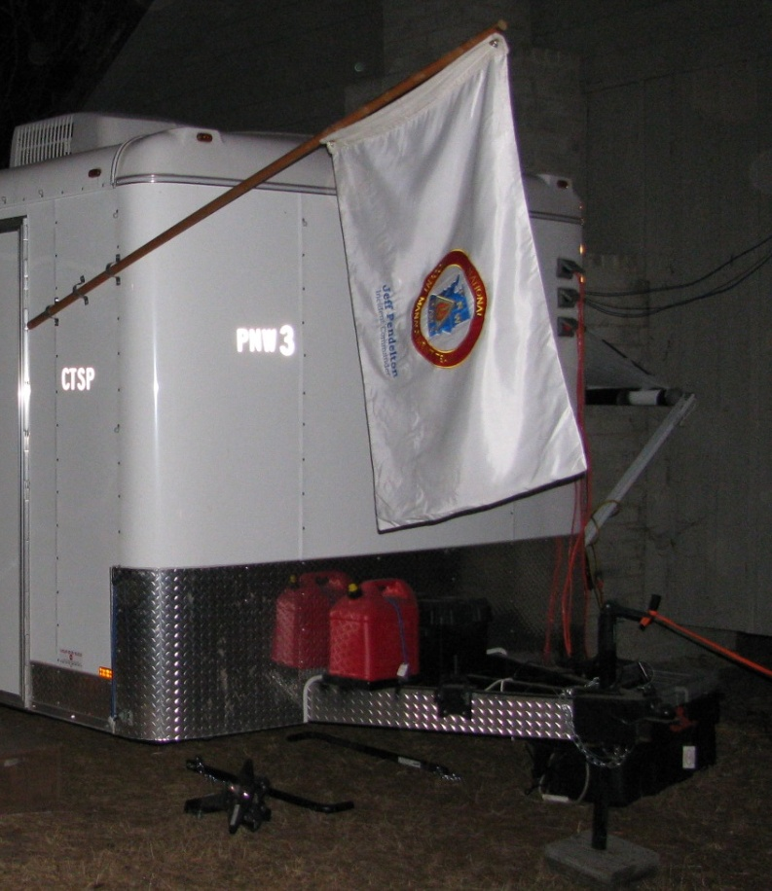
Overview
OUTSIDE / FRONT
The Start of
One
Cool
Tool

Slide 11
GOLDEN RULE
Don’t Use Any Parts/Pieces
You Can Not
REPLACE
at a “Wal*Mart / Staples
Ace Hardware”

Slide 12
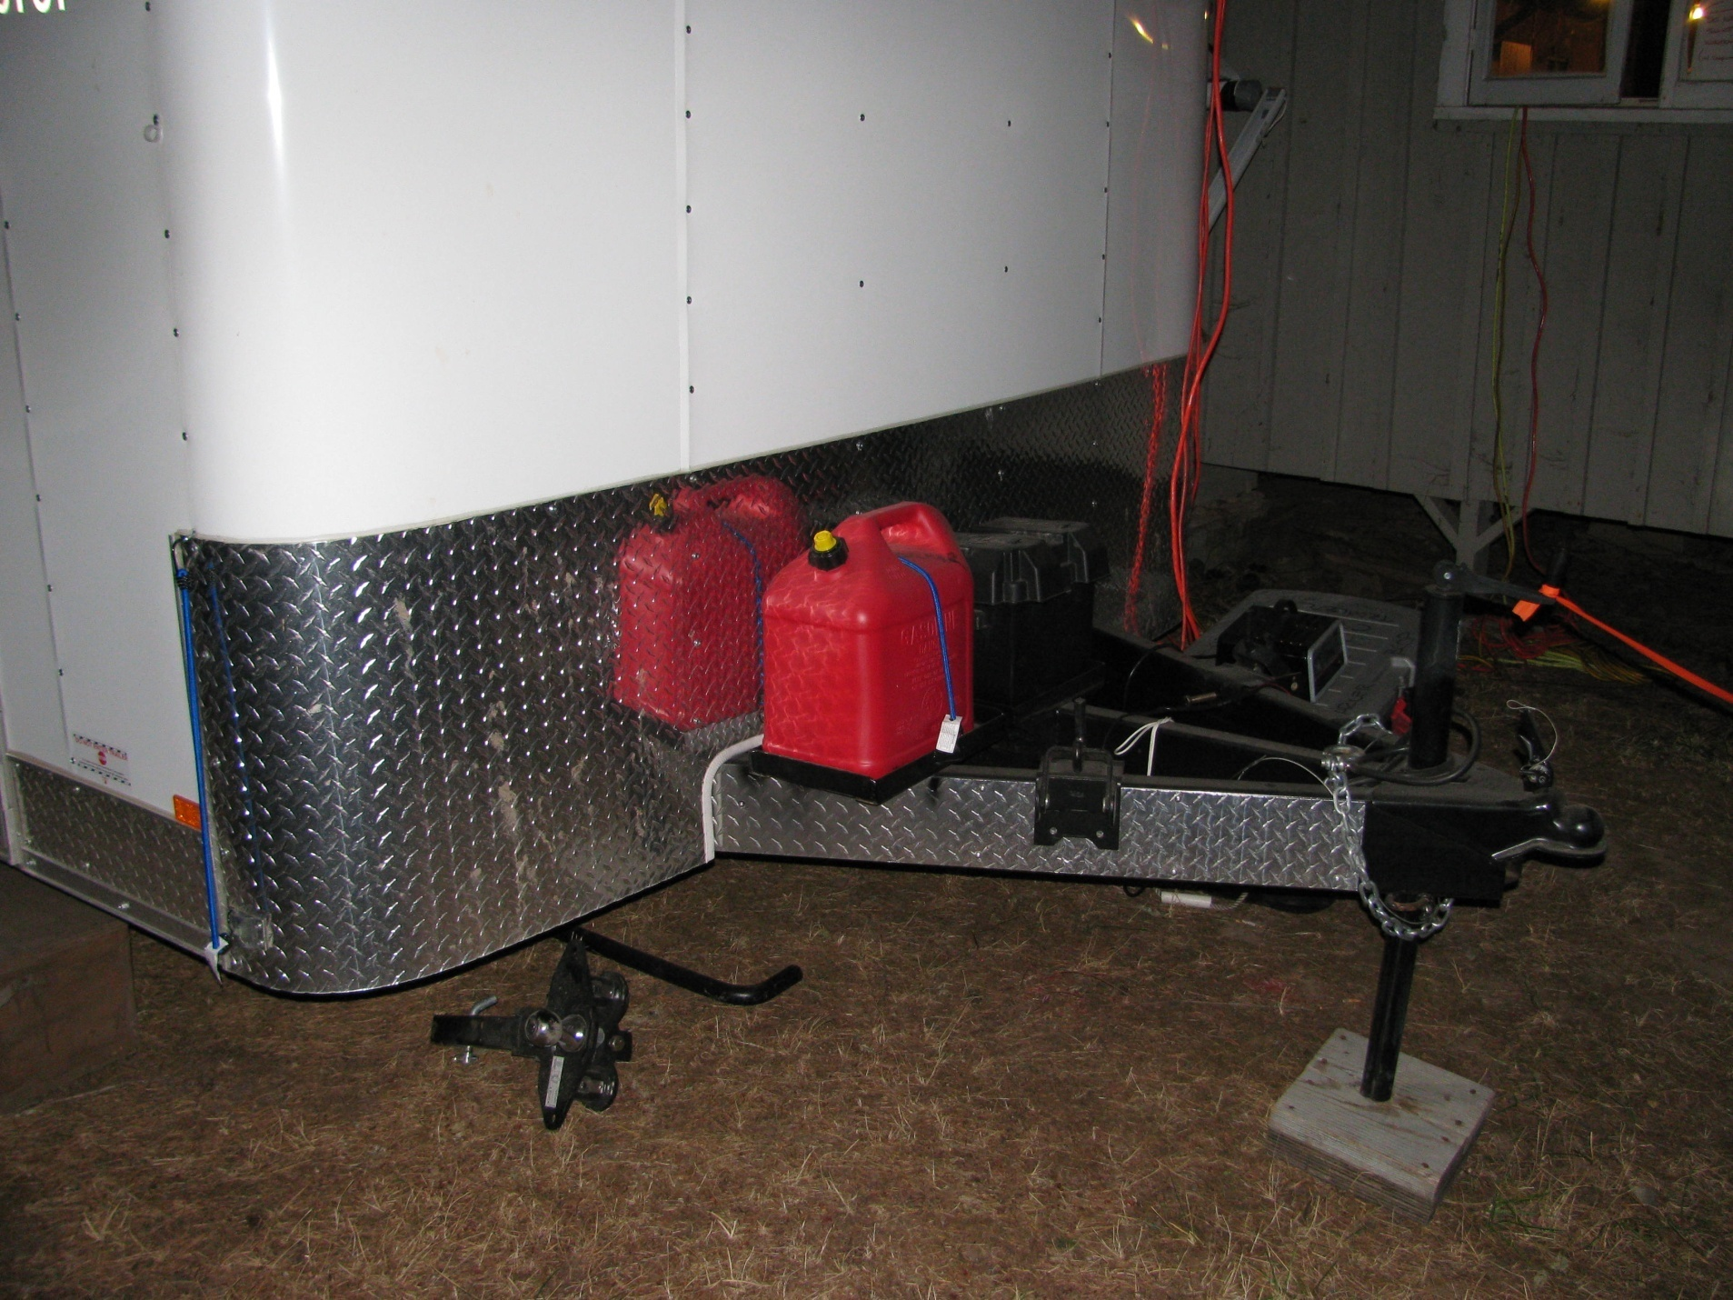
Overview
OUTSIDE / FRONT
Empty Gas Can
For The “Clean Power” Generator If Needed
In The First 24/48 Hrs.
Trailer 12 Volt Battery
Backup Inside Lights
Easy Lift System
The Best Invention
For Pulling a Trailer/CROW
Bits & Pieces

Slide 13
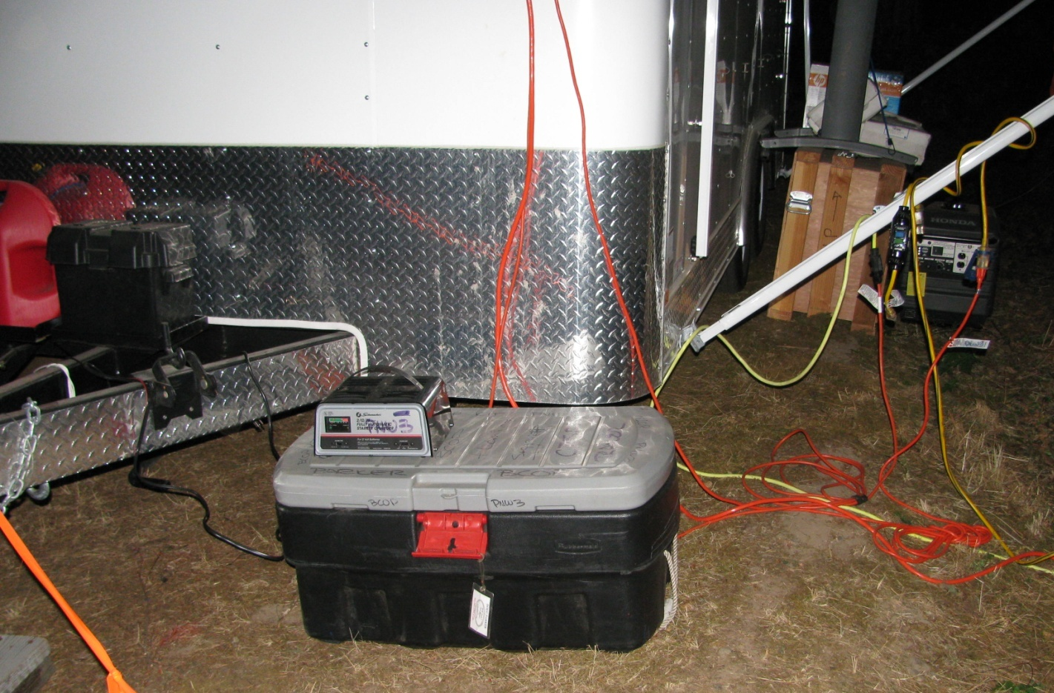
Overview
OUTSIDE / FRONT
One Box For The Front
Extension Cords / “Y” GFI / Gas Funnel / Etc.
Bits & Pieces
Due to Funding & Space Issues
12 Volt Trailer Battery Is Recharged
Using a Standalone Battery Recharger
Simple Solutions Are Sometimes The Best

Slide 14
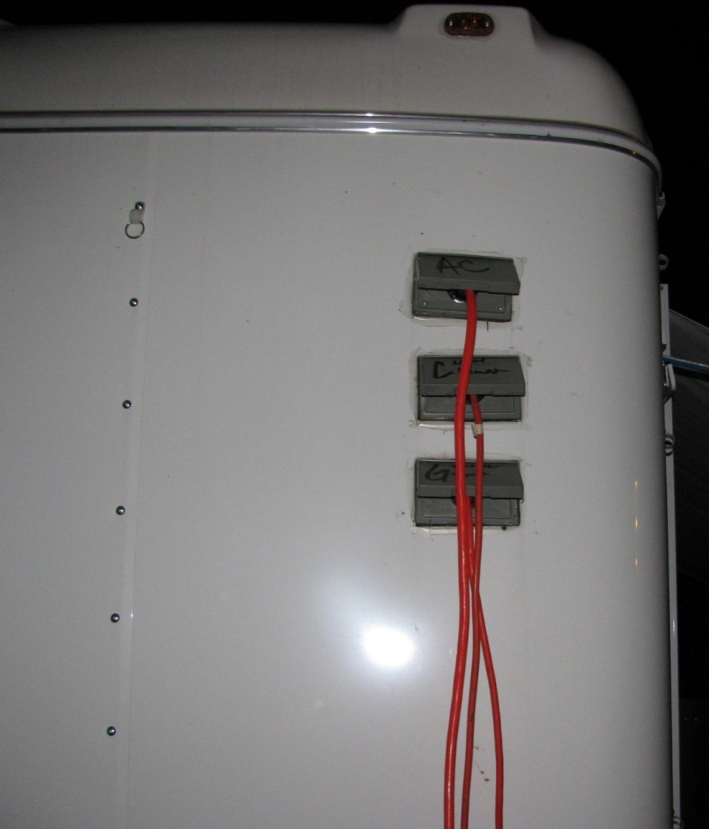
Simple Power / Circuit Management
A/C & Heater Unit - Dirty Power
[Camp Power / Cache Generator]
Server/Switches Only - Clean Power
[Camp Power / Clean Generator Power (Honda EU3000si)]
Other Misc Items – General User Power
[Camp Power / Cache Generator]
Overview
OUTSIDE / FRONT
A/C Power
Trailer Wired So That
If Only Min Electrical
Power Available
Clean Power 1st
(Backup Plan
“Fire Up The Generator”)
Clean Power
General Use Power
Trailer Wired w/ “Breakers” Built Into Individual Appliances and Standalone GFI “Y”
Trailer Primarily Contains Items That Can Be Replaced At A Local Wal*Mart / Staples / Ace Hardware

Slide 15
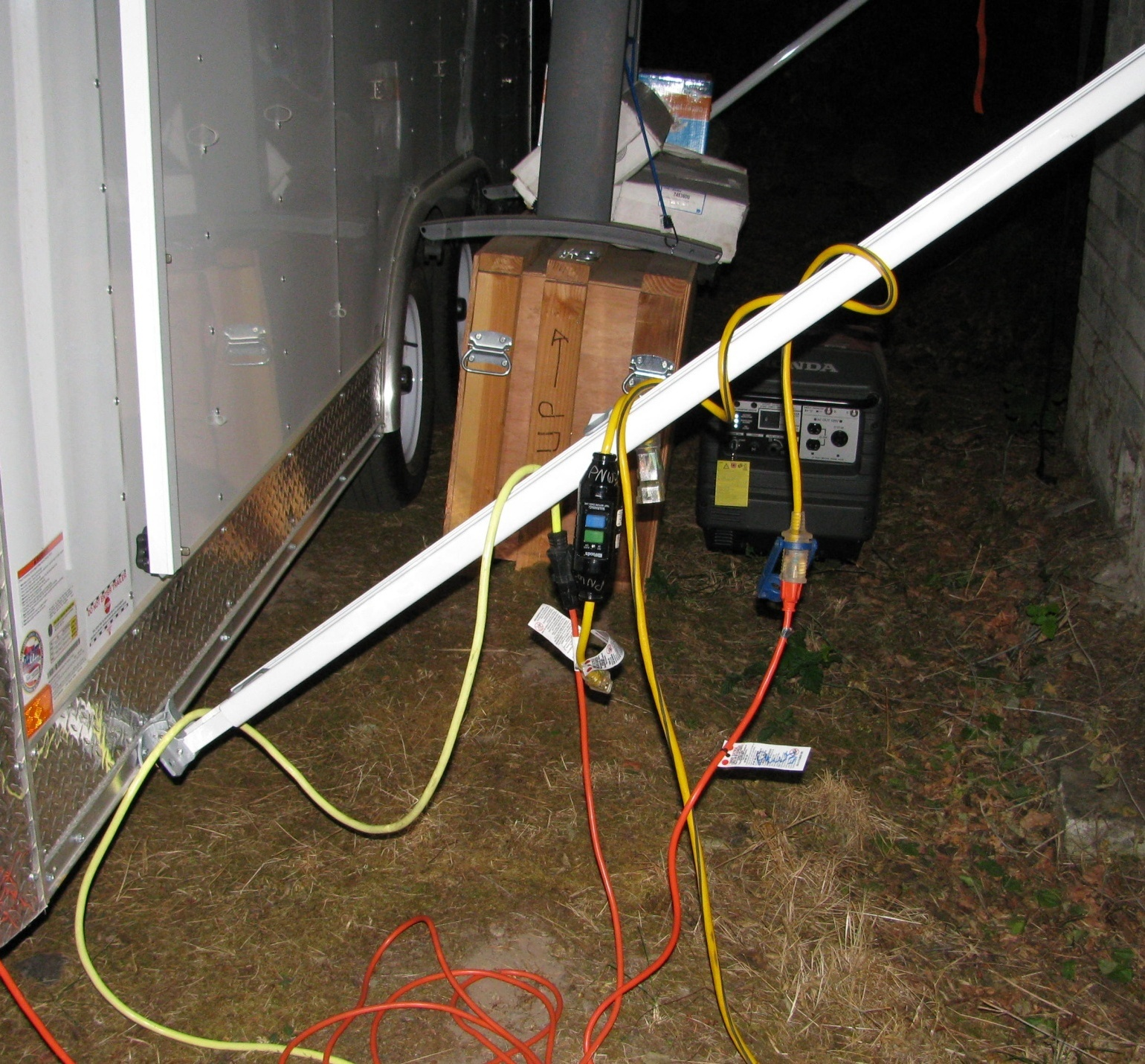
GIS Plotter - Just Can’t Seem To Get Away With Packing Item For Other Folks
Not A Big Issue - Just An Item We Need To “Pull Out Of The Trailer” Before We Can Get Operational
Overview
Bits & Pieces
Front / Storage Side
Clean Generator
On Standby
Fire Camp Electrician
Trailer Wired w/ “Breakers” Built Into Individual Appliances and Standalone GFI “Y”
Keep Those Electrical Connections Up and
Out Of The Dirt/Mud/Wet
Use Heavy Gage, 3-Prong
Extension Cords
(Don’t Need A Fire In Fire Camp)
When Not Needed, Side Screen Room/Awning is a Great Storage Area

Slide 16
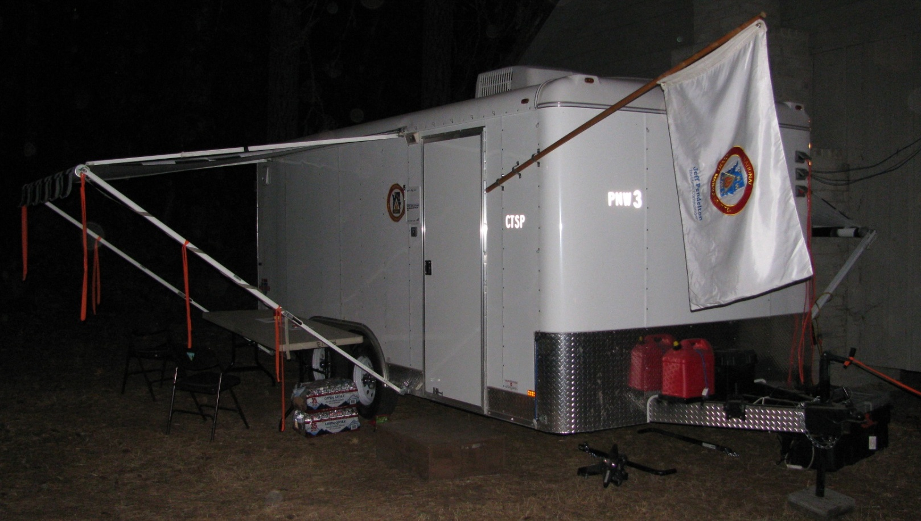
Overview
Front Entrance / Customer Service Covered Area
AND … A Location To Clean Up
Rental PCs, Coil/Test Cables, etc.
One Fine CTSP Start Up / Tear Down Work Area
OUTSIDE / ENTRANCE
Lockable RV Style
Main Entrance / Door
(Versus – Padlock Door)

Slide 17
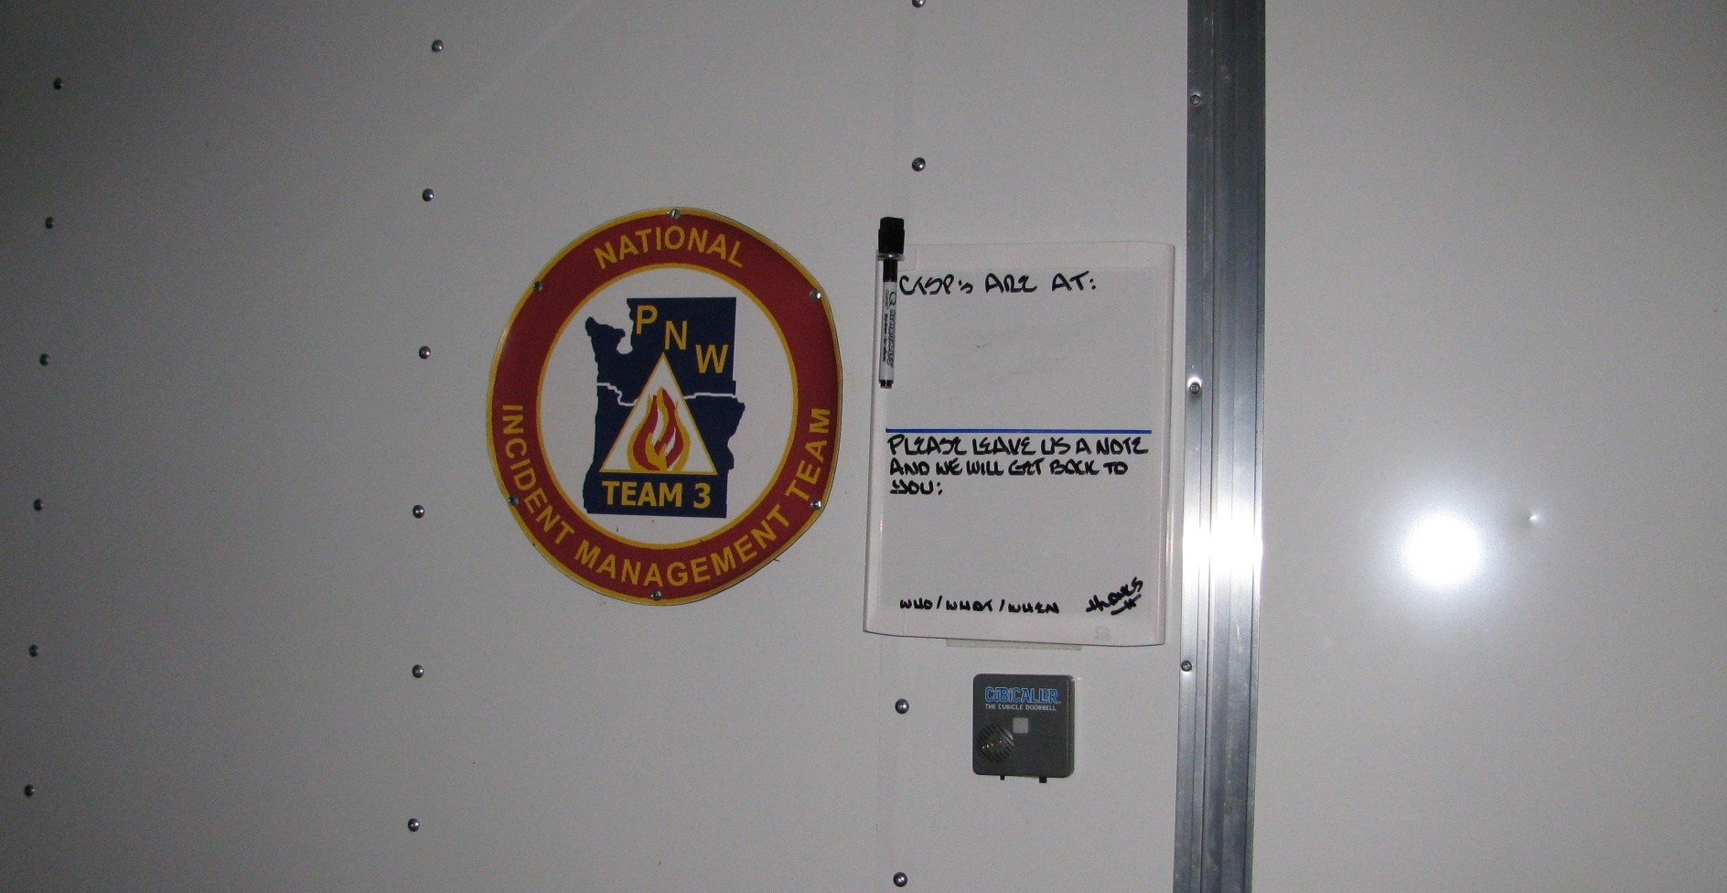
Overview
Customer Service Is A Priority
Velcro Attached White Board
[Removable To Store Inside During Transport]
Letting Your Customers Know Where You Are &
A Place For Them To Leave Ya A Note
Bits & Pieces
Main Entrance/Door
Even Equipped with a Door Bell
(Removable Too!)

Slide 18
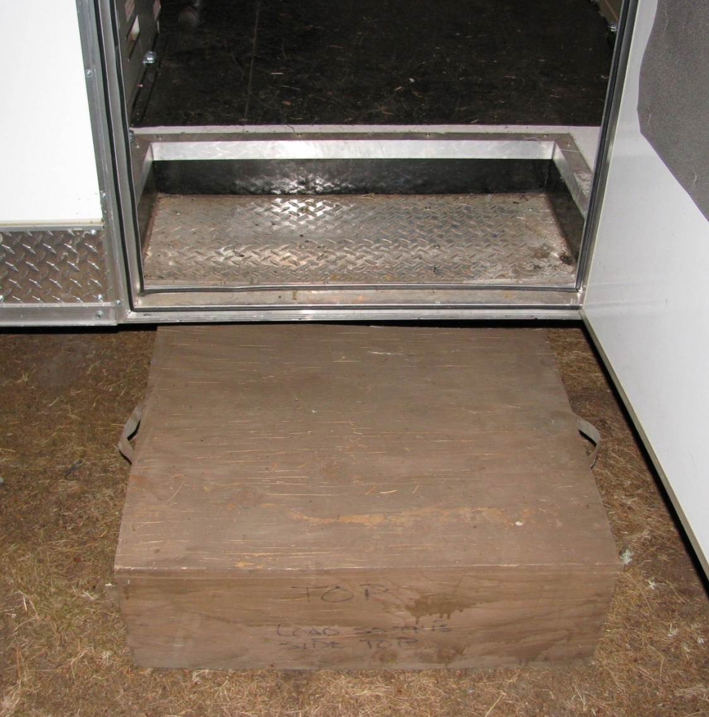
Overview
Bits & Pieces
Main Entrance/Door
Just A Little Step Up
Critical Because of the Varied Terrain
the CROW Can/Will Be Located
Step Fits Inside The Built In Trailer Step Cut Out for Transport

Slide 19
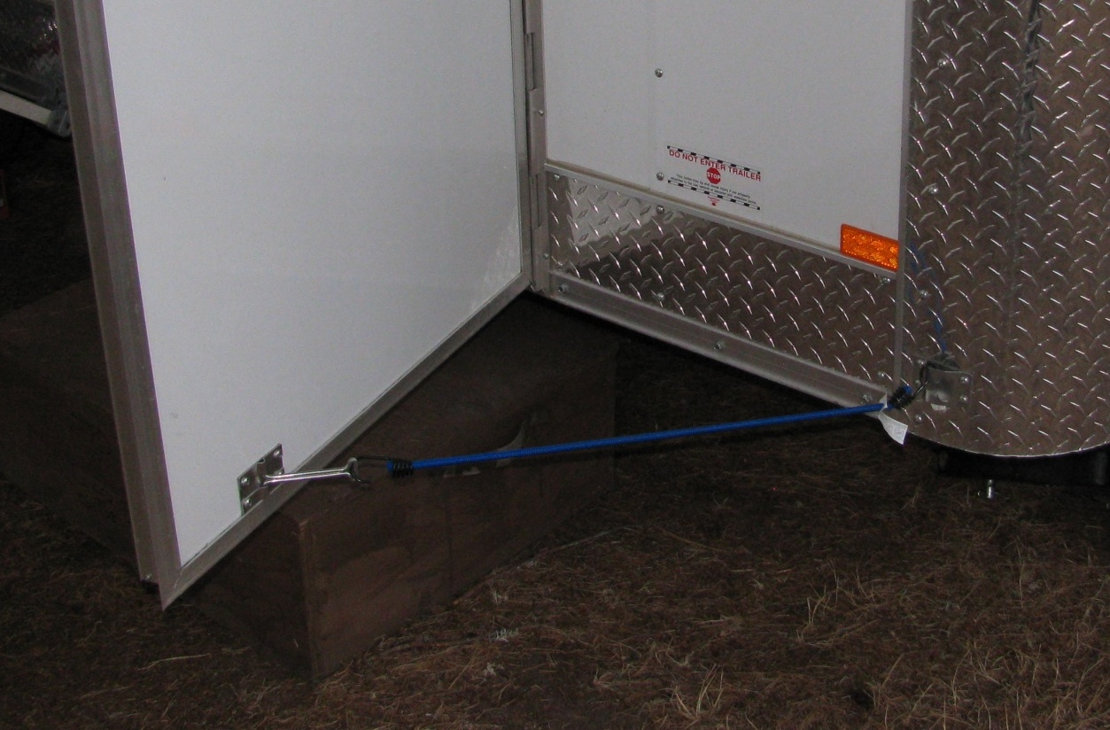
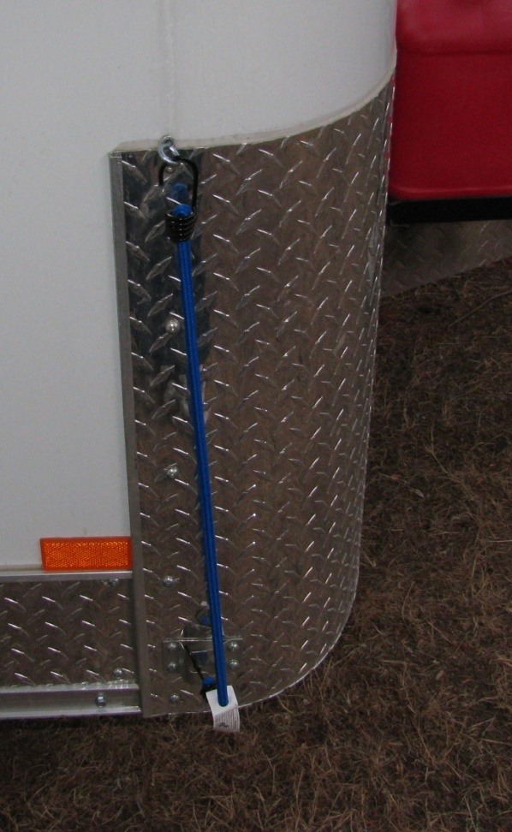
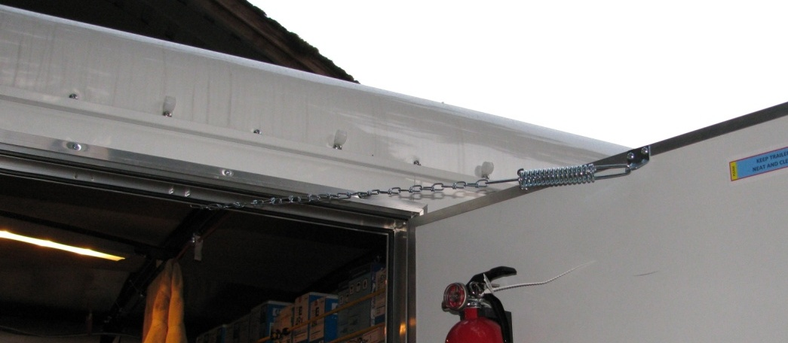
Overview
Bits & Pieces
Main Entrance/Door
Air Flow
Bungee Cord Secures Main
Entrance Door Open
When Using
Bungee Cords
Provide A Place
To Secure Them
Removable Door Chain (Prevents Door “Flying Out of Your Hand”

Slide 20
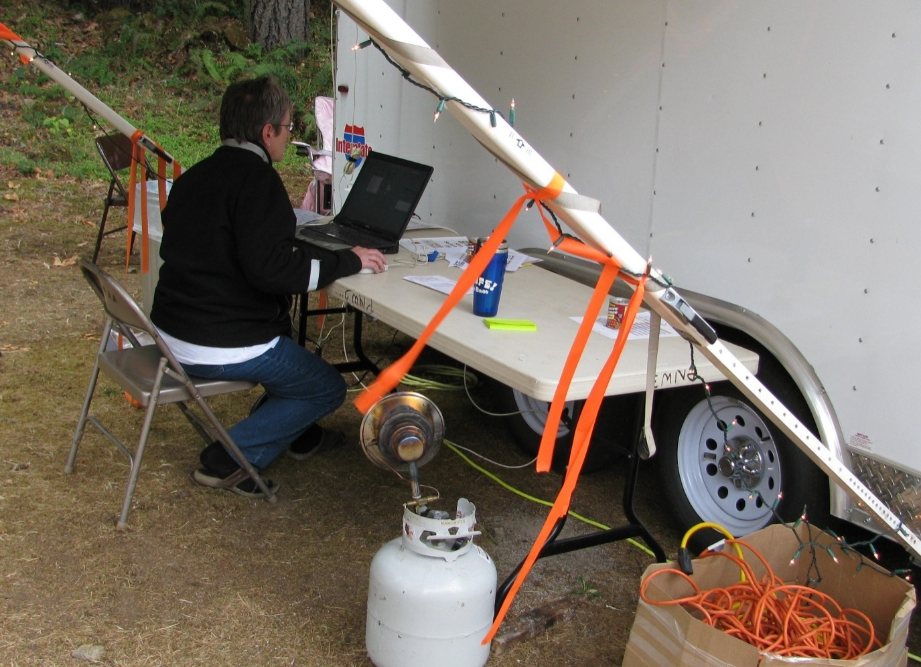
Overview
Bits & Pieces
Main Entrance/Door
Side/Front Awning
This provides a space for a general use PC for Team Members or Short Term Use by Firefighters / Vendors.
This also provides a covered space / “assembly line area” to configure Rental PCs or prepare them (Disk Wipe & Screen Wipes) for return at the end of the incident. With a little creativity (additional portable “Mr. Heater”) you can make it a fairly comfortable area to work.

Slide 21
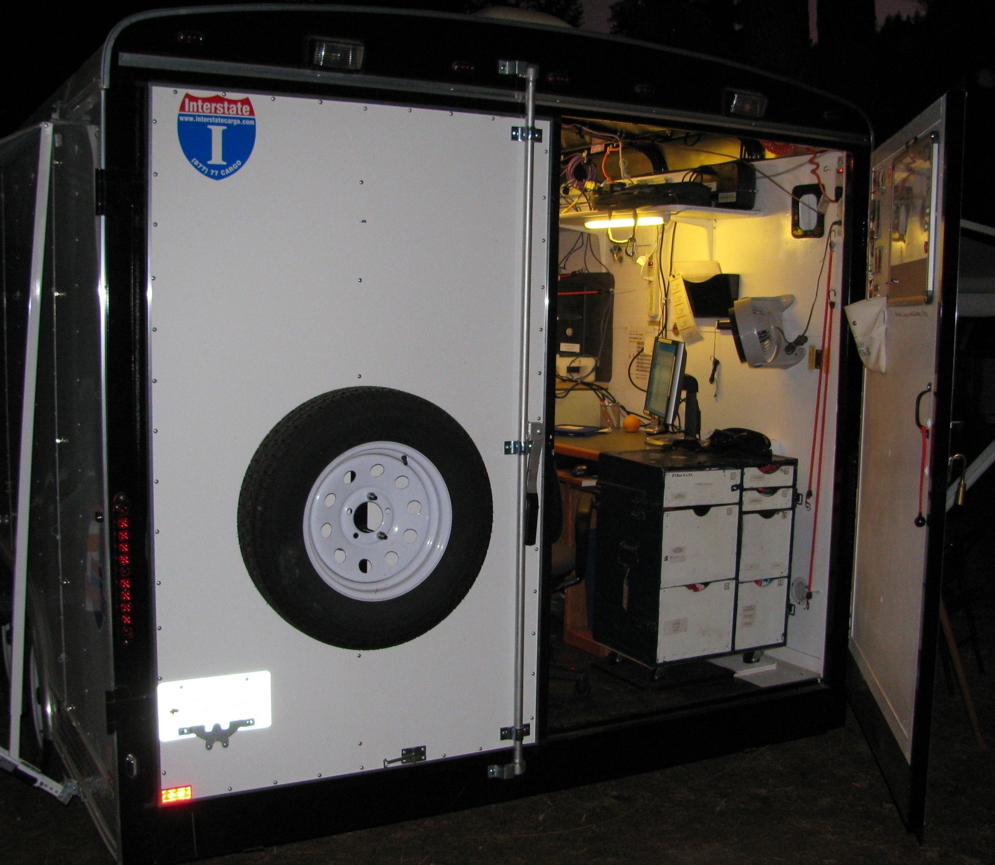
Overview
OUTSIDE / BACK
Suggest Mounting Spare Tire On Outside Door, Provide More Room Inside
The Debate
Lockable Double Door Style or
Cargo Drop Down Door
Advantage to Double Door;
You Can Secure One Side and Other Side Can Be Rear Access / Air Flow
Just a Personal Preference

Slide 22
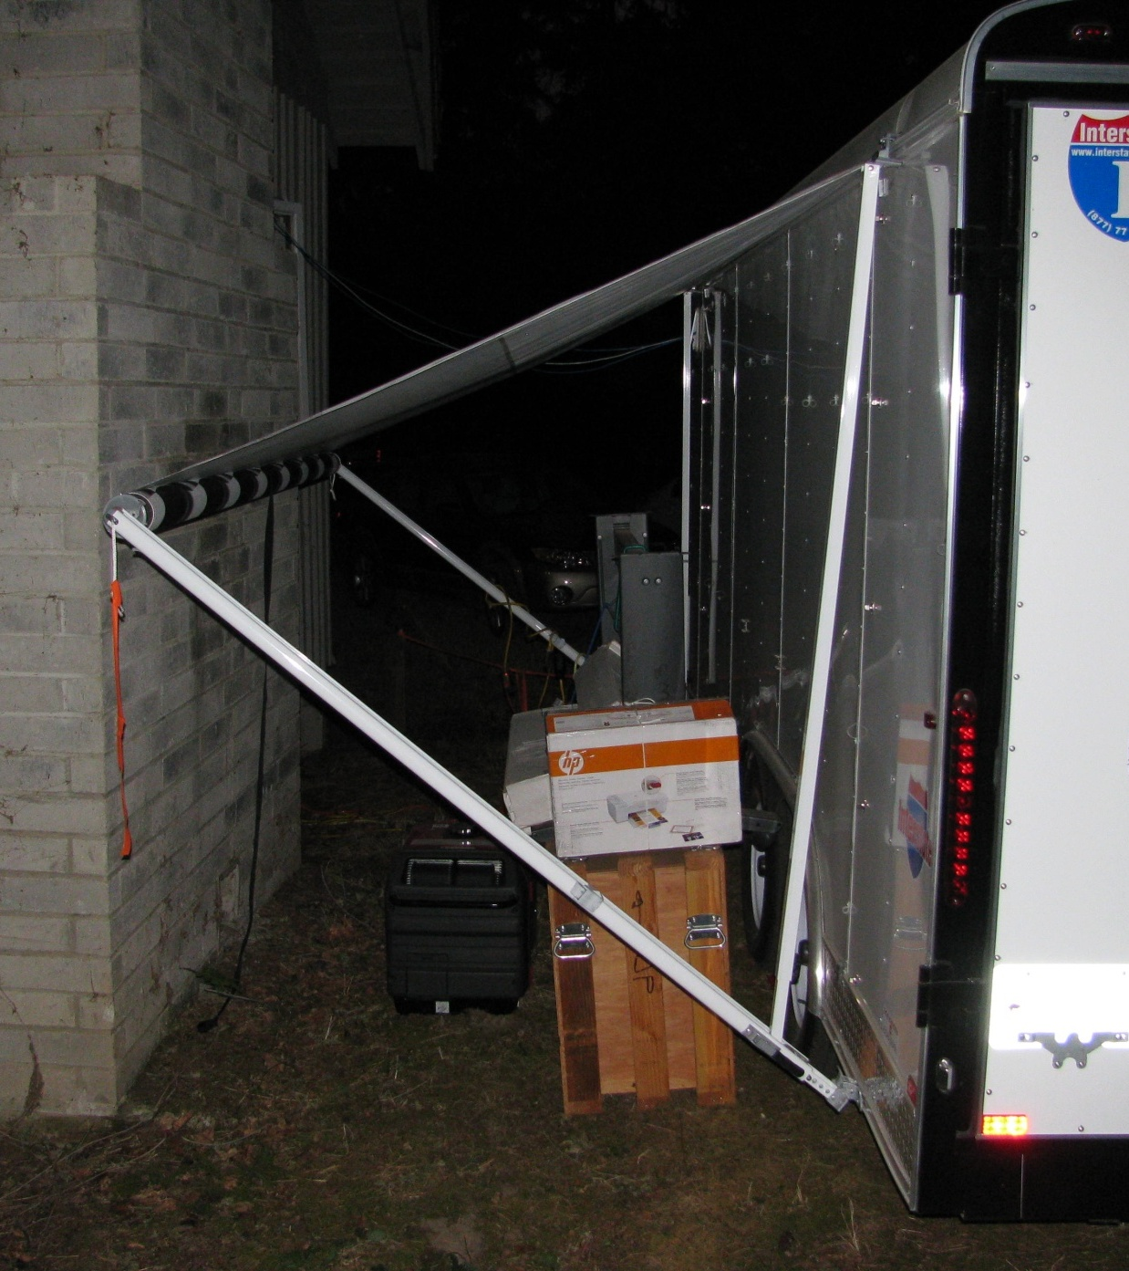
Overview
OUTSIDE / NON-SCREEN ROOM
Extra Space / Storage
When Not Being Utilize As A Screen Room For WEBMs
Provides Covered Extra Storage
Area / Staging Area (Rental Boxes, Etc.)

Slide 23
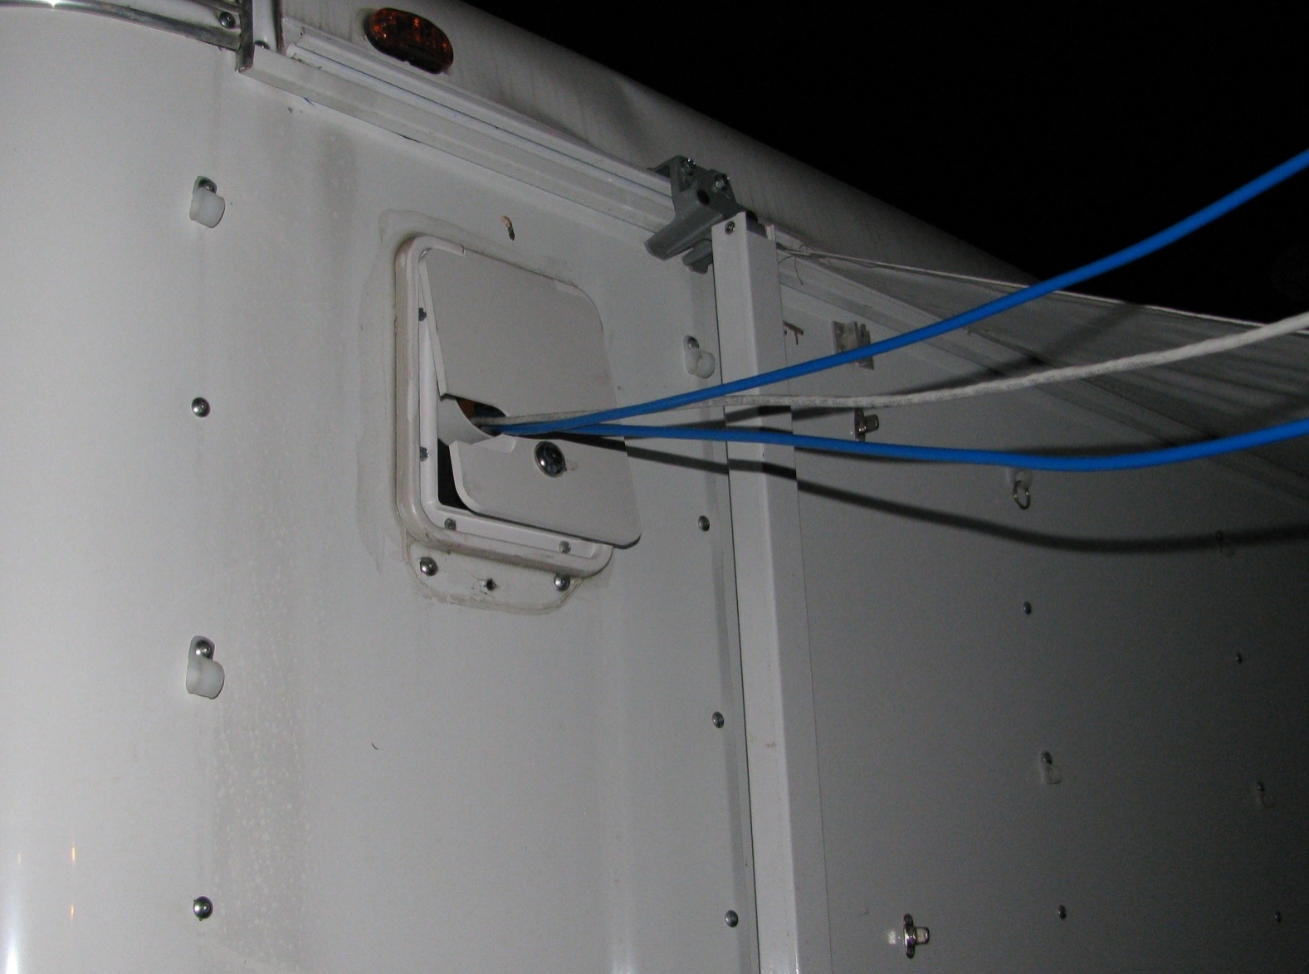
Overview
Bits & Pieces
In/Side Outside
Wire Access
Outside Access
Simple RV Lockable Access Door
One On Each Side Provides
Lots of Options For
Computer Cables, Phone Lines, Etc.
Note: Door Opens Up To Provide Rain Shield

Slide 24
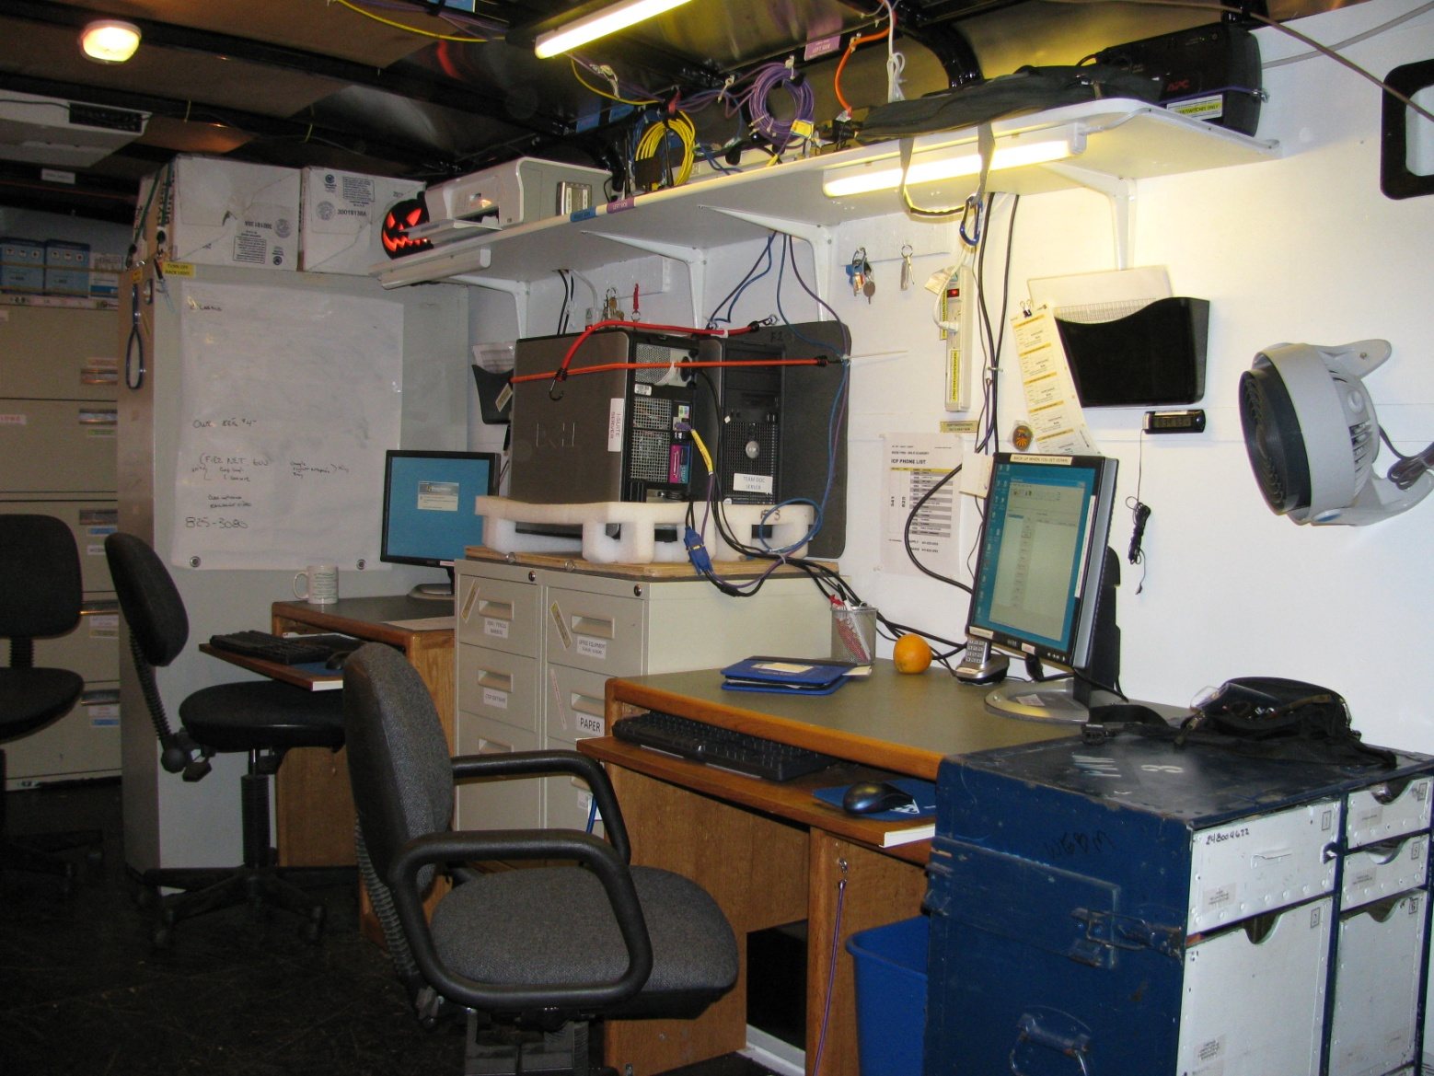
Overview
INSIDE – SERVER SIDE
Looking from
Back to Front
Server Central
One Workstation For Each Server Overhead Storage Routers / Cable Management UPS’s / Etc.

Slide 25
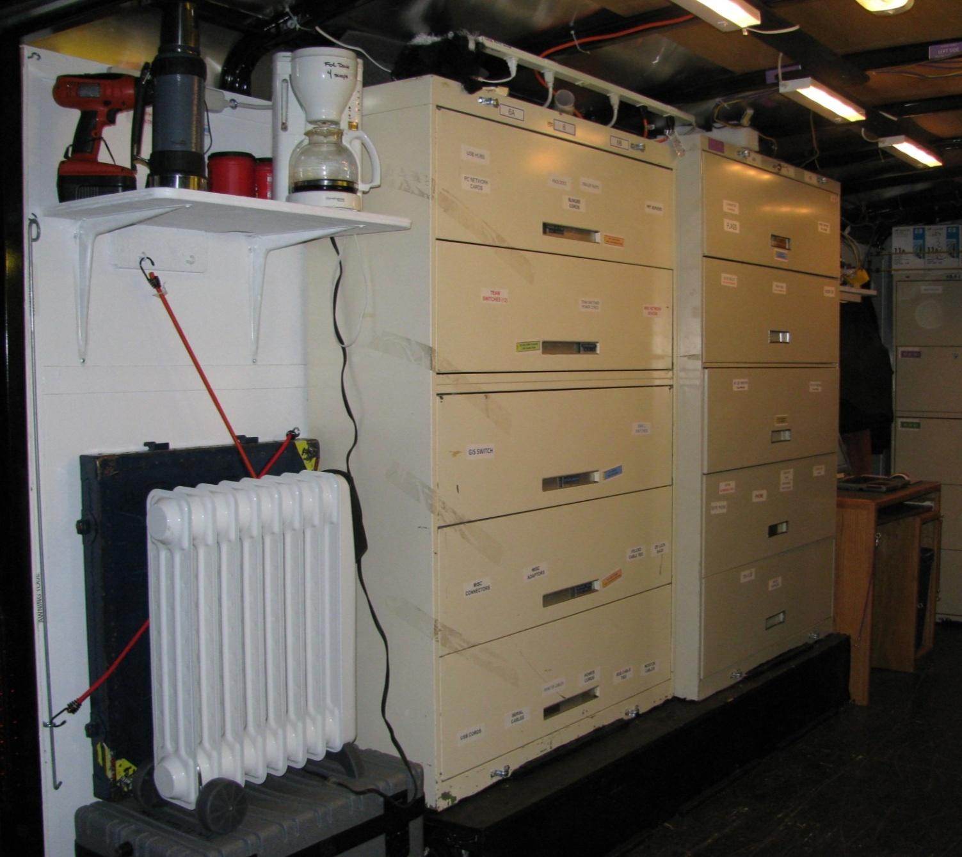
Overview
INSIDE – SUPPLY SIDE
Looking from
Back to Front
Storage Central
Organized and Clearly Labeled Locations For All Those “Bit & Pieces” Needed To Supply A Smooth Running Network In Fire Camp

Slide 26
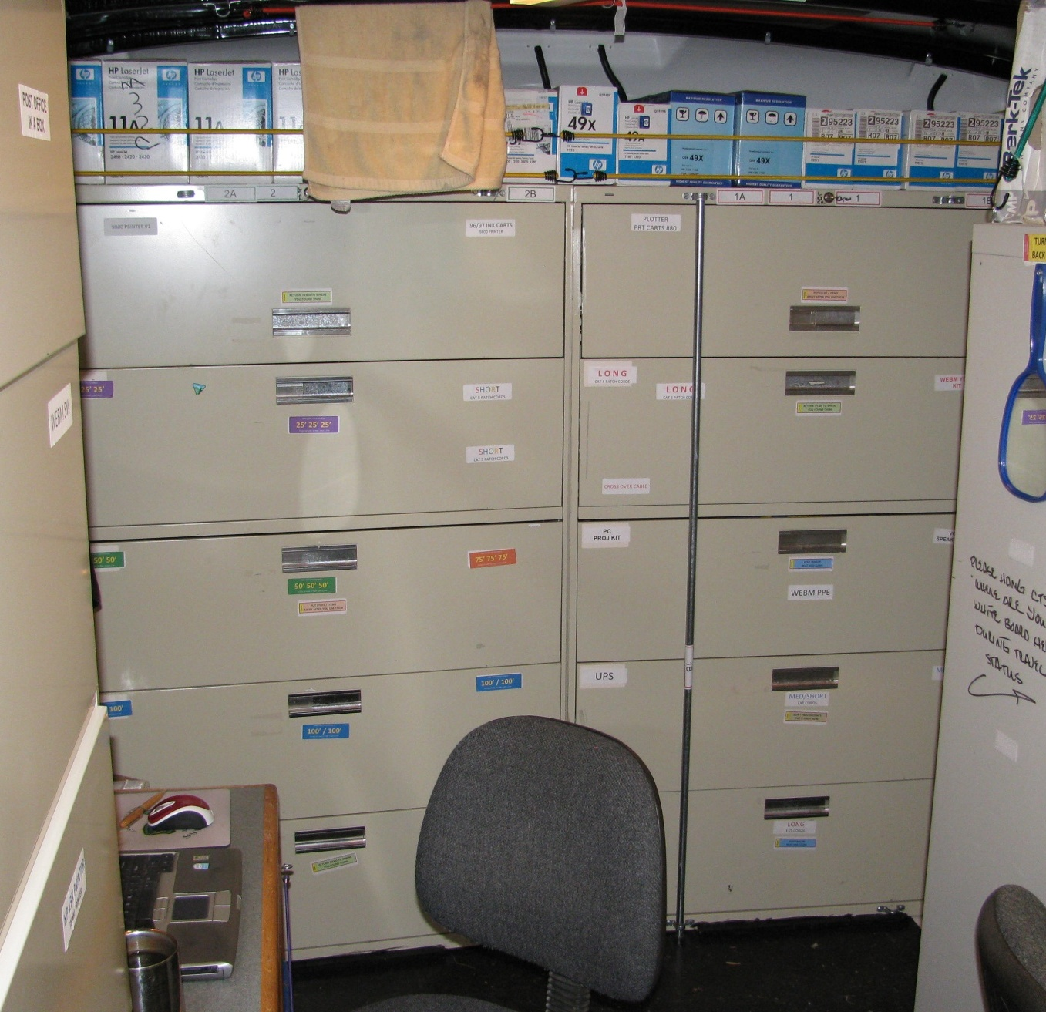
Overview
INSIDE – FRONT STORAGE
Looking from
Back to Front
Front Storage Central
Organized and Clearly Labeled Locations For All Those “Bit & Pieces” Needed To Supply A Smooth Running Network In Fire Camp
“It Is So Nice To Go To A Drawer & Quickly Find A 50’ Network Cable”
All Cabinets Are Bolted To The Trailer Wall and To Themselves
Cabinets Are Locking and Additional Vertical “Pipe” Restraint Added

Slide 27
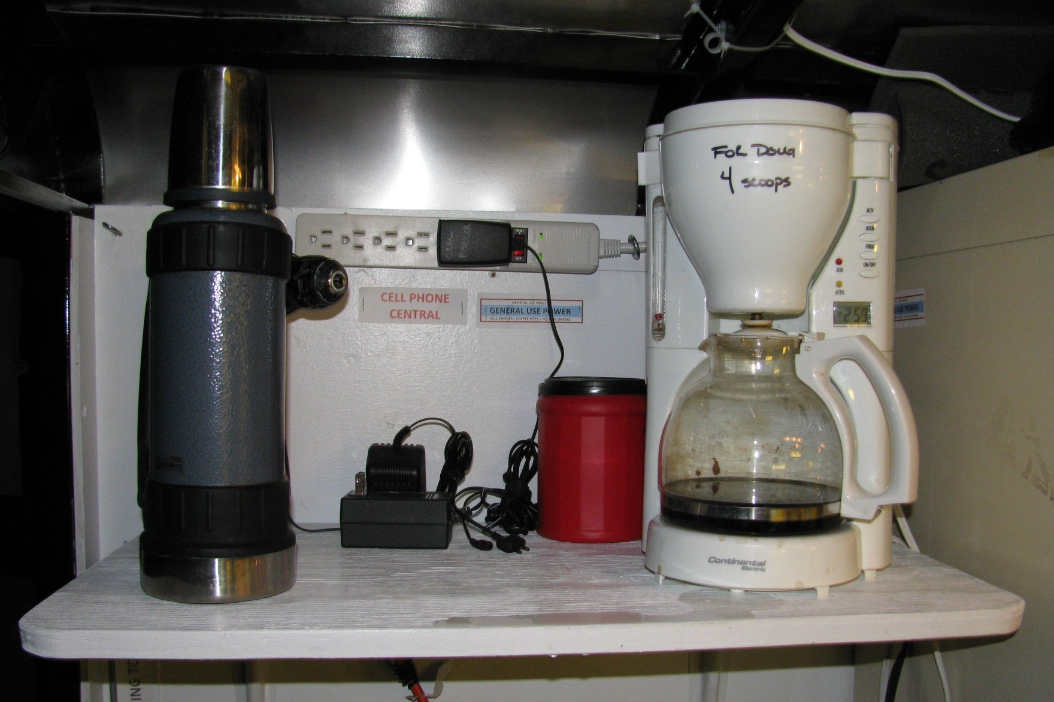
Caffeine – What Keeps Ya Going Sometime
Find A Spot For Items You Know You Might Need
Overview
Bits & Pieces
Storage Side - Back
Note: General Power
Coffee Comes 2nd After
Clean Server/Switch Power

Slide 28
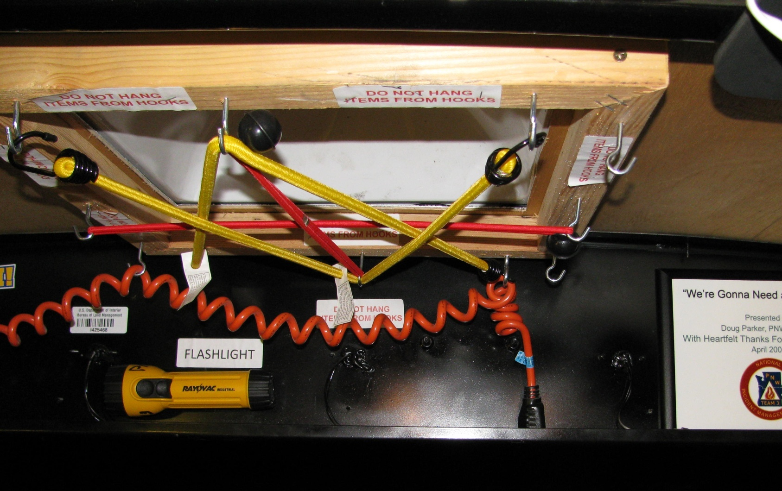
CROW’s Nest
Access Plastic Sky Light – Puts Wireless Router
Above the Metal Trailer Roof/Walls
Overview
Bits & Pieces
Roof - Back

Slide 29
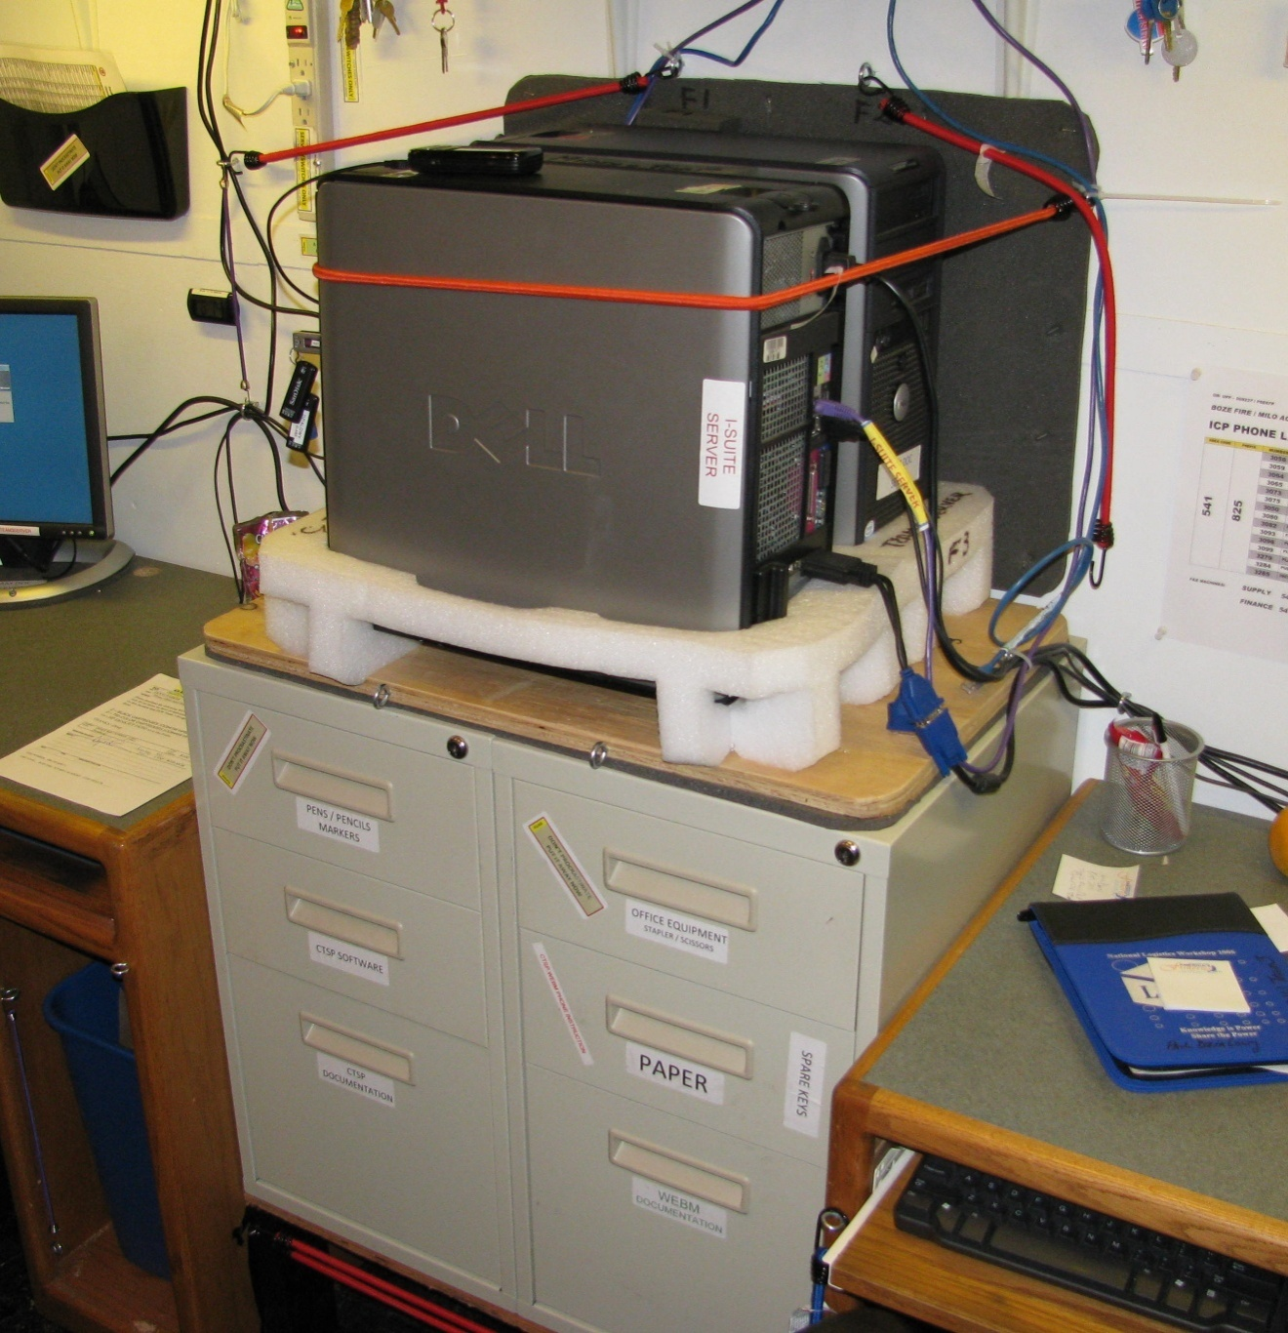
Overview
Bits & Pieces
Server Side - Center
Keep Organized
Electronic Organization
(1 Server for I-Suite / 1 for Documents)
One File Cabinet for Pens/Pencils
& CTSP Documentation
One File Cabinets for Misc Office Tools
& WEBM Documentation
CROW Rule #1 (after Safety First)
Find A Spot For Everything, Label It and Put It Back
Where You Found It
Makes Life Easier, Tear Down Faster and a Safer Work Environment
Might Even Reduce Stress – You Can Find Stuff When You Need IT

Slide 30
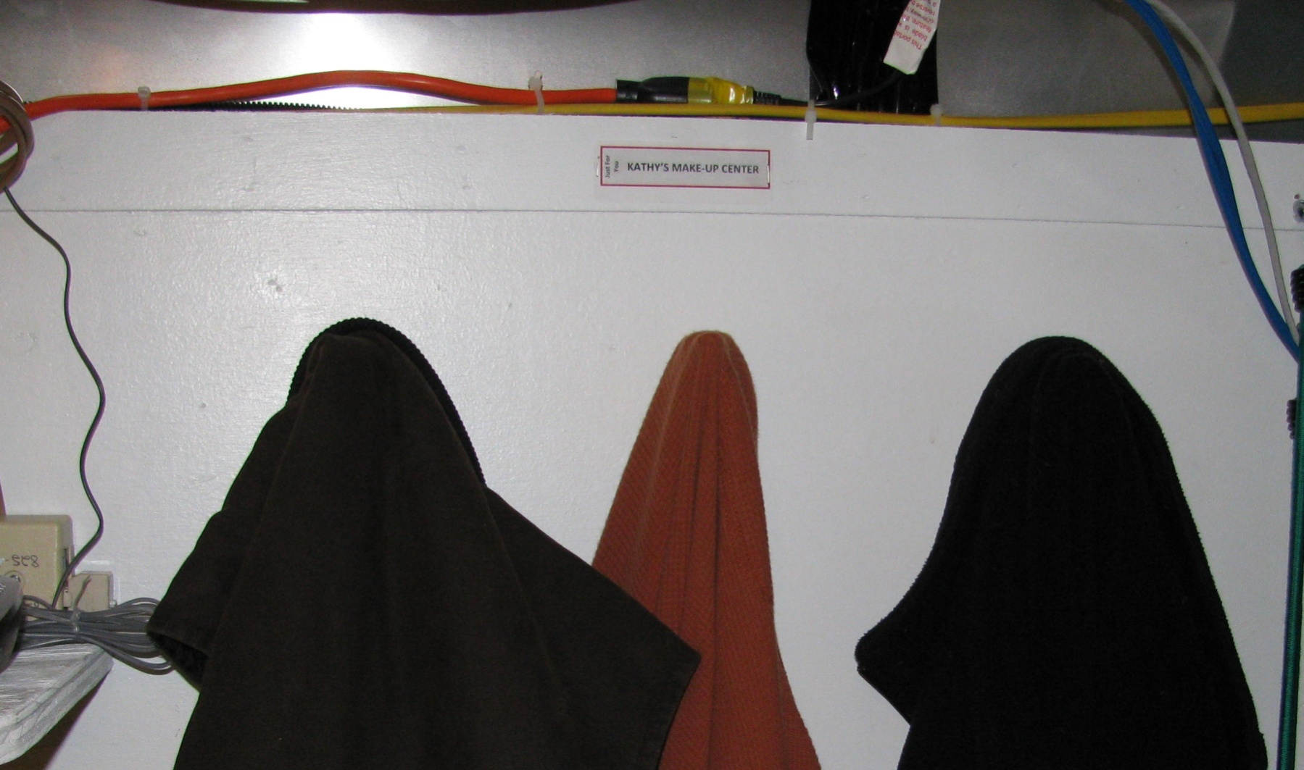
Overview
Gotta Put Them Somewhere
Coats On A Hook or Back of Chair,
(Which Is Really On The Floor Under Foot)
Bits & Pieces
Storage Side - Front

Slide 31
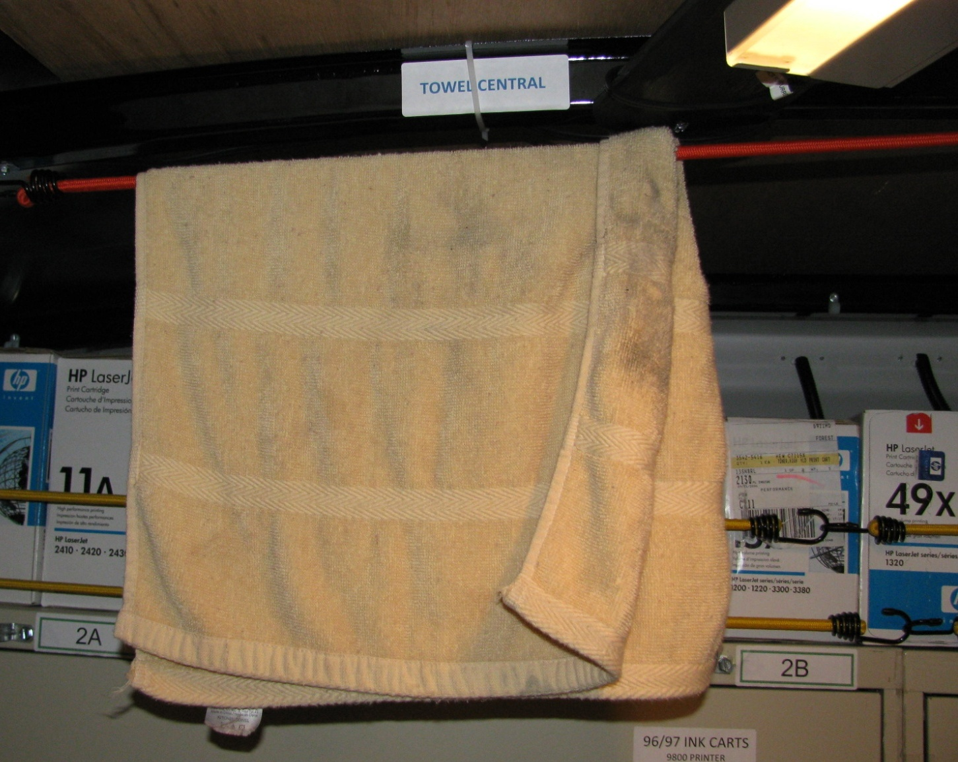
Overview
Bits & Pieces
Center - Front
Provide It or They Will Make
Just A Few Little Extras Here and There
Warm & Dry Computer Room On Wheels
(Good Place To Dry Towel On Cold Wet Day)

Slide 32
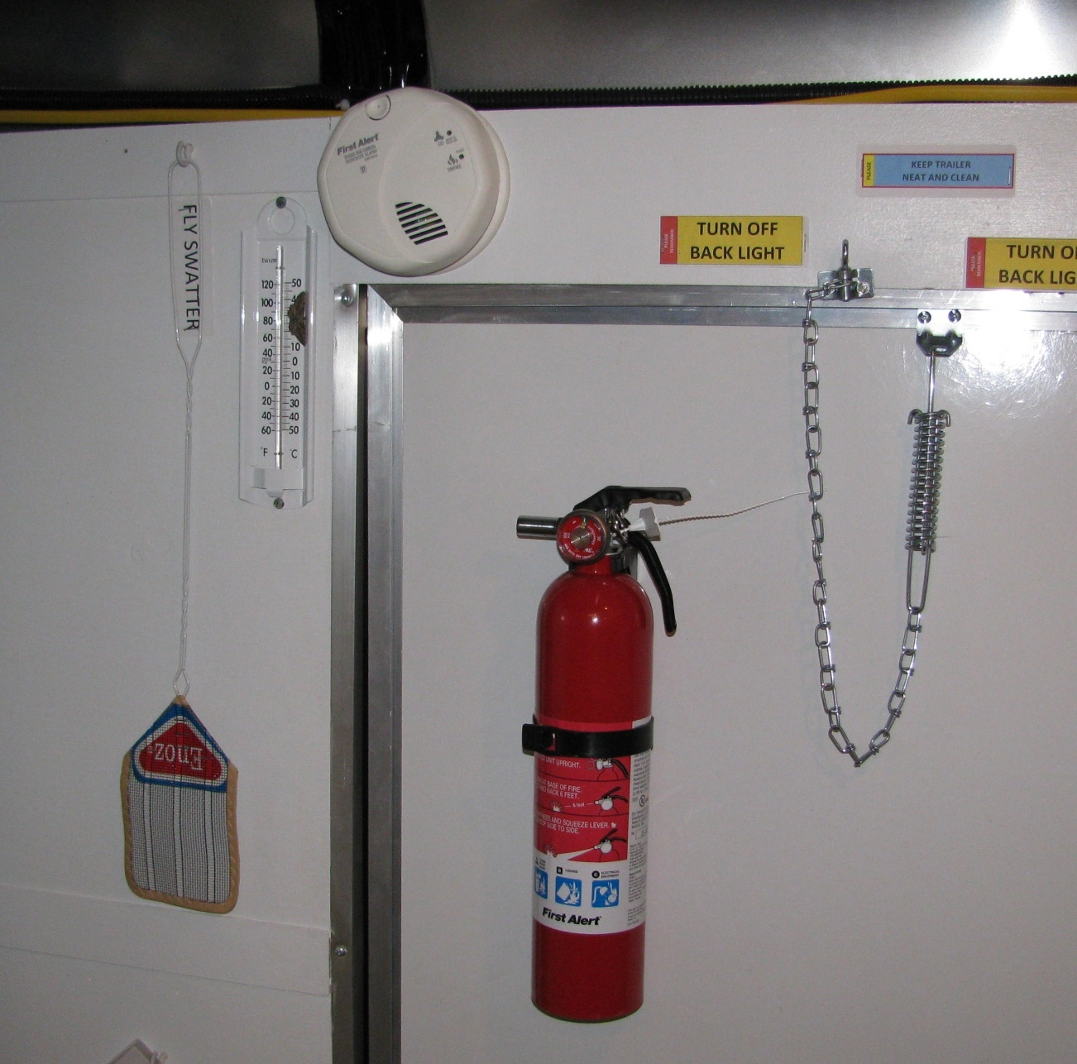
Overview
Bits & Pieces
Main Entrance / Server Side - Front
SAFETY FIRST
General Purpose Fire Extinguisher Carbon Monoxide / Smoke Alarm
Thermometer
Removable Door Chain (Prevents Door “Flying Out of Your Hand”
and Fly Swatter

Slide 33
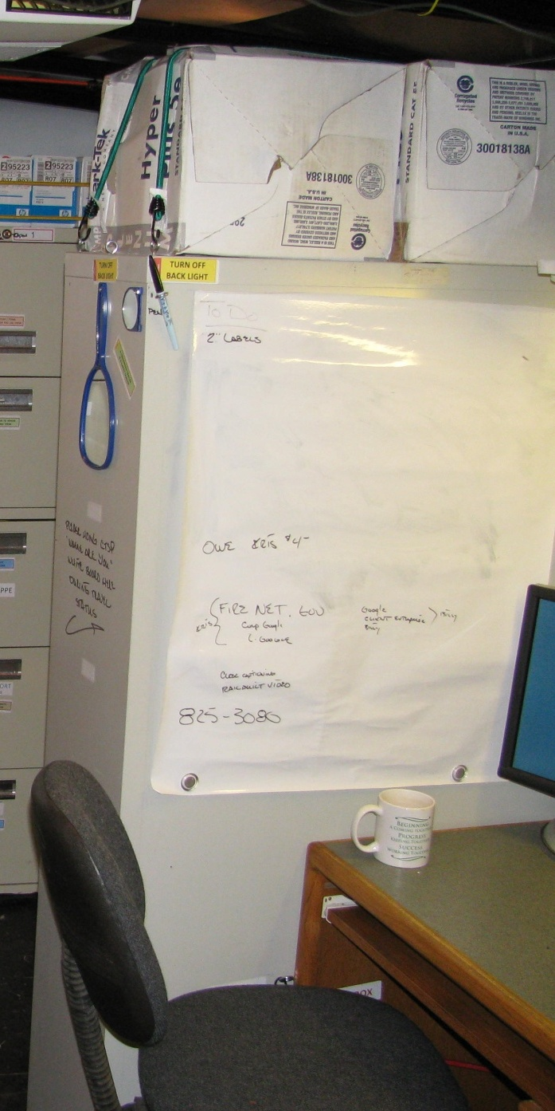
Overview
Bits & Pieces
Server Side - Front
Document / Document / Document
Dry Erase Post-It Note Flip Chart Paper
Handy Tool For “To Do List”

Slide 34
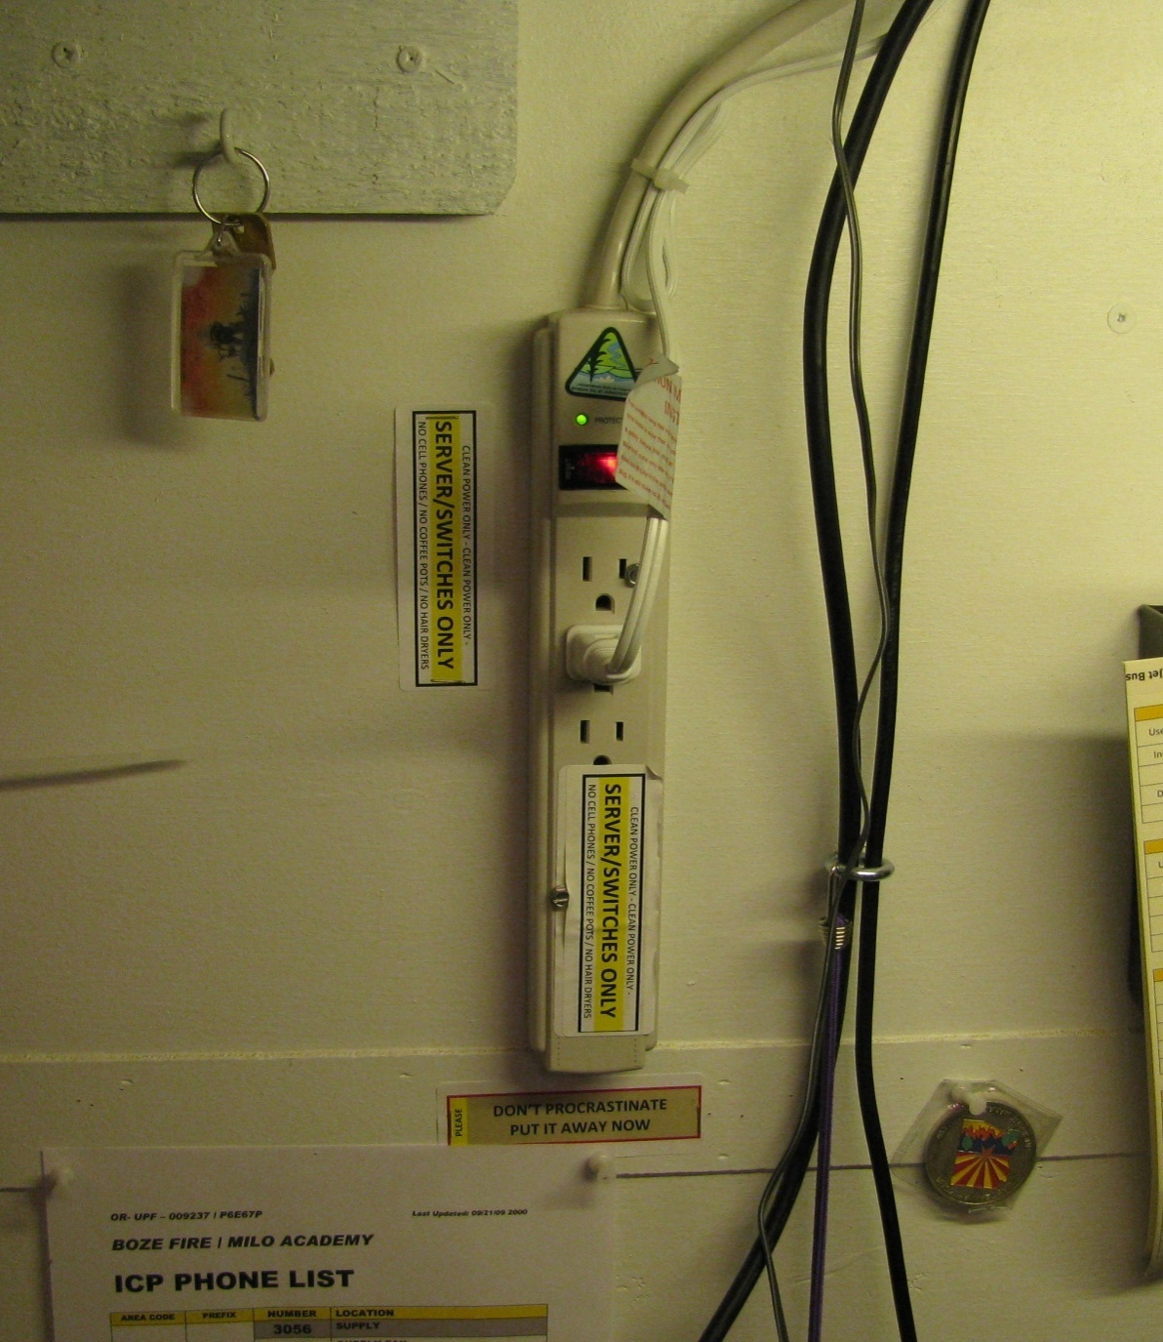
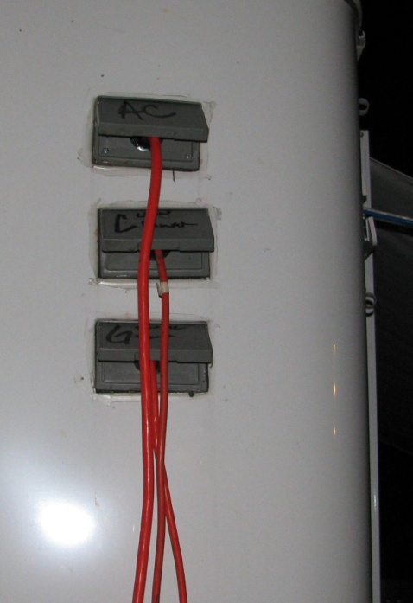
Simple Power / Circuit Management
Server/Switches Only - Clean Power
Camp Power or Clean Generator Power (Honda EU3000si)
Overview
Bits & Pieces
Distributed
Throughout
the Trailer
Trailer Wired So That
If Only Min Electrical
Power Available
Clean Power 1st
(Backup Plan
“Fire Up The Generator”)
Outside Circuits
Clean Power
Label
Label
Label

Slide 35
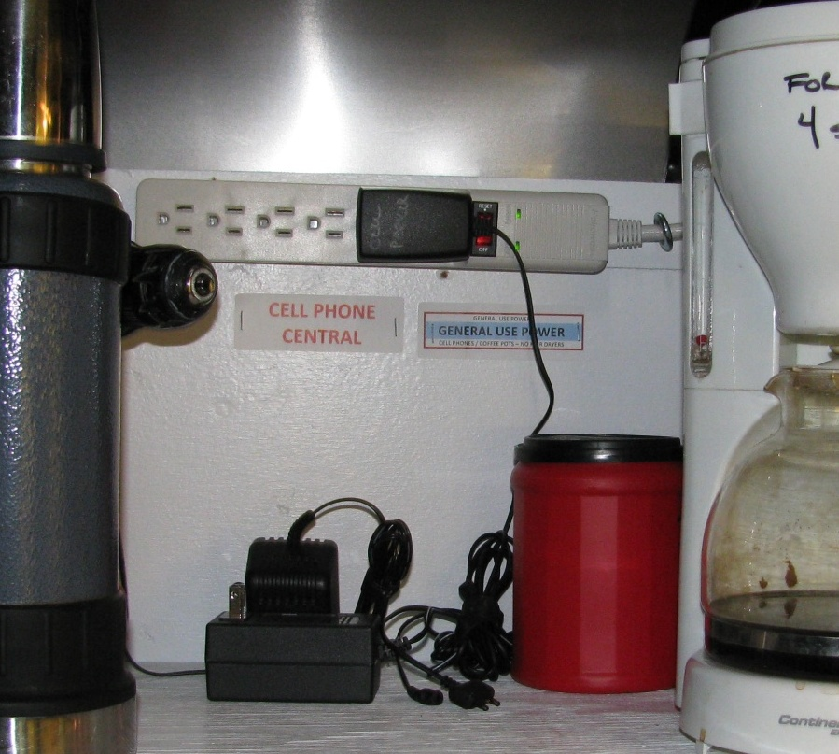
Simple Power / Circuit Management
General Use Power – Camp Power
Overview
Bits & Pieces
Storage Side - Back
Outside Circuits
General Use Power
Note:
Cell Phones
Will Be Charged!
Make A Place For Them

Slide 36
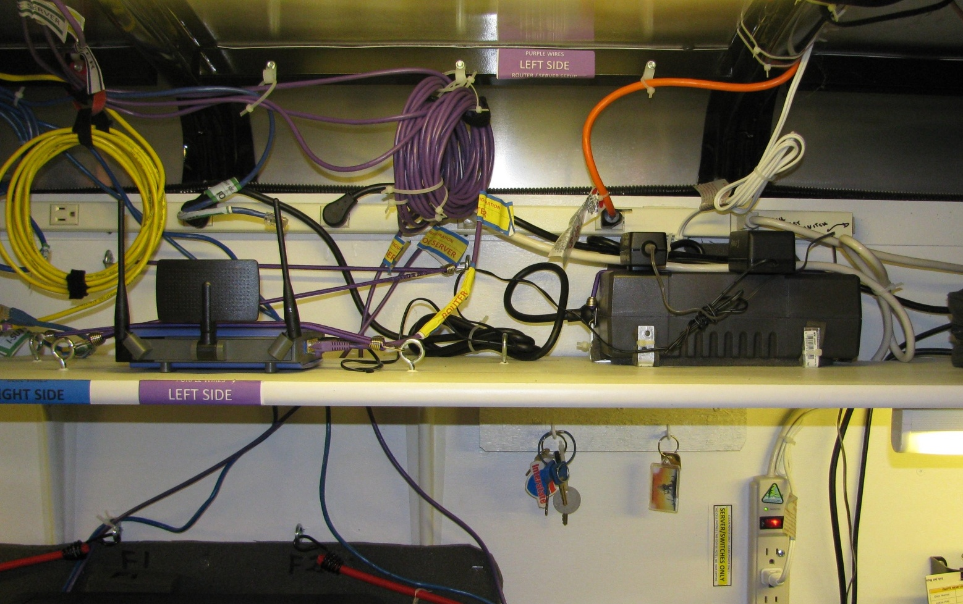
Overview
It Looks Like A Mess
But it is Wired For All Identified Options / Maximum Flexibility
Bits & Pieces
Server Side - Center
Remember The Little Things:
Hooks For Keys
Eye Hooks For Cable/Wire
Management
Simple Electrical Wire Hooks
For “Stringin’ Wire”
UPS’s to Maintain Power
During Frequent Short
Term Outages

Slide 37
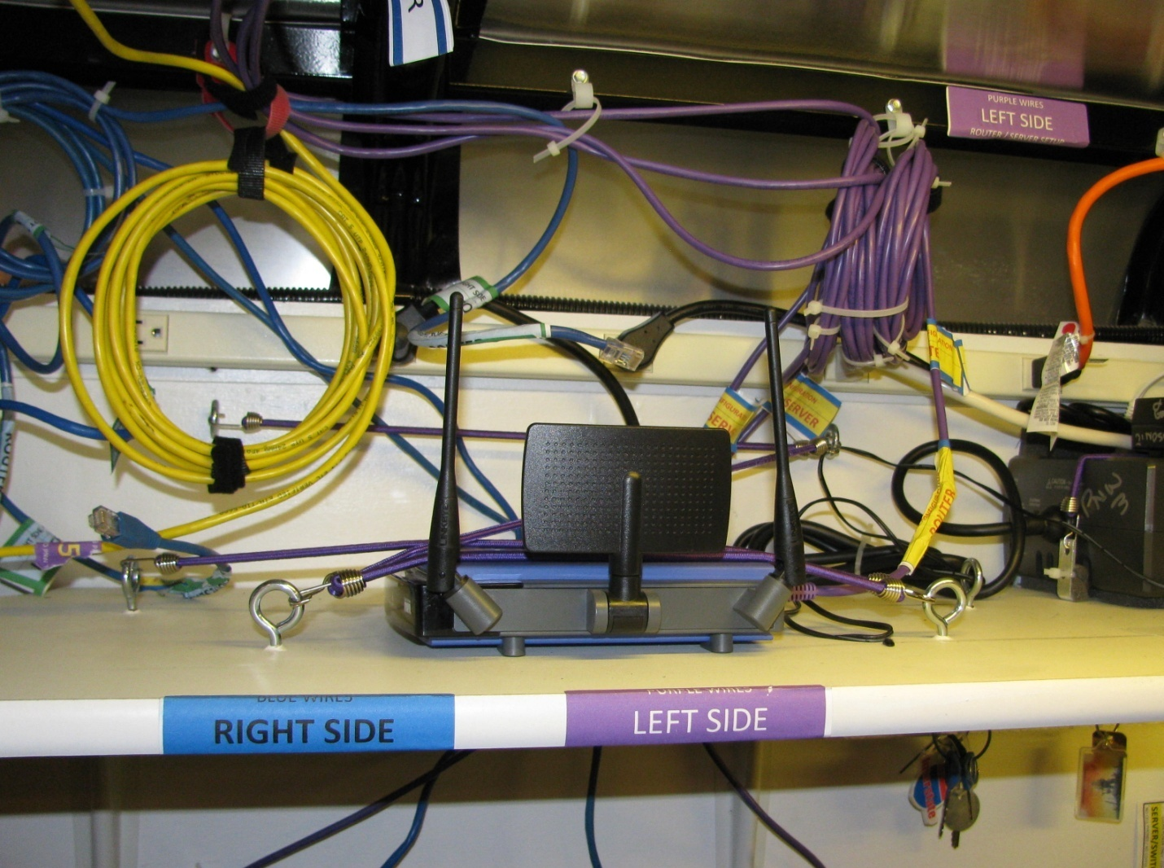
Overview
Bits & Pieces
Server Side - Center
Minimize Moving Equipment Inside
The Trailer
Router Never Moves but High End (1 Gigabyte) Switch
Positioned Easily From Left Side (Purple Wires) To Right Side (Blue Wires)
Depending On “Which Side of the Trailer” the Wires Need to Come In From
Right Side BLUE (Wires & Labels) : Left Side PURPLE (Wires & Labels)

Slide 38
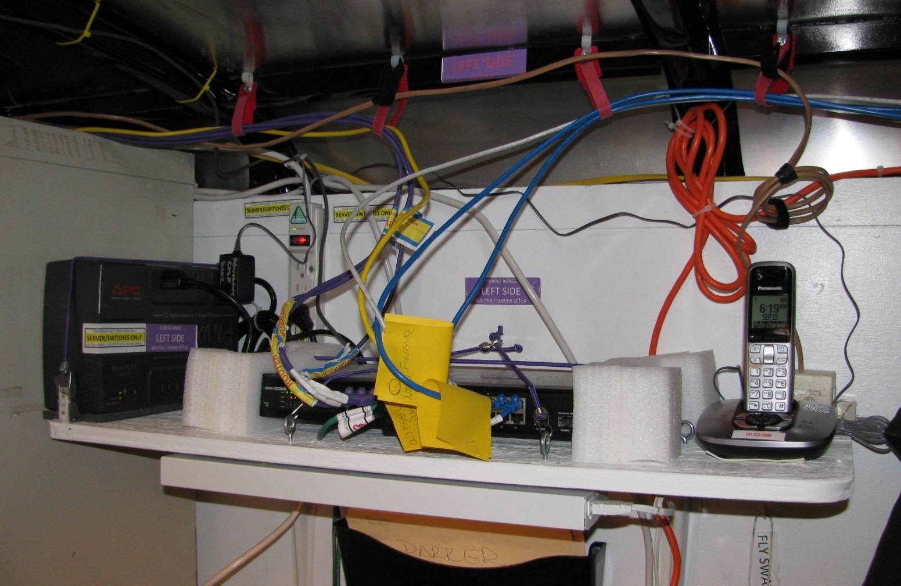
Overview
Bits & Pieces
Storage Side - Front
Cordless Phone w/ Multiple Handsets
Inside Trailer (CTSP’s)
& Screen Room (WEBM’s)
Label Everything – Keep It Simple
A Simple Post-It Note Stapled Around The Home Runs Does The Job
1 – High End (1 Gigabyte) Switch
Positioned Easily From Left Side (Purple Wires) To Right Side (Blue Wires)
Depending On “Which Side of the Trailer” the Wires Need to Come In From
~ UPS For Each Major Piece of Equipment ~

Slide 39
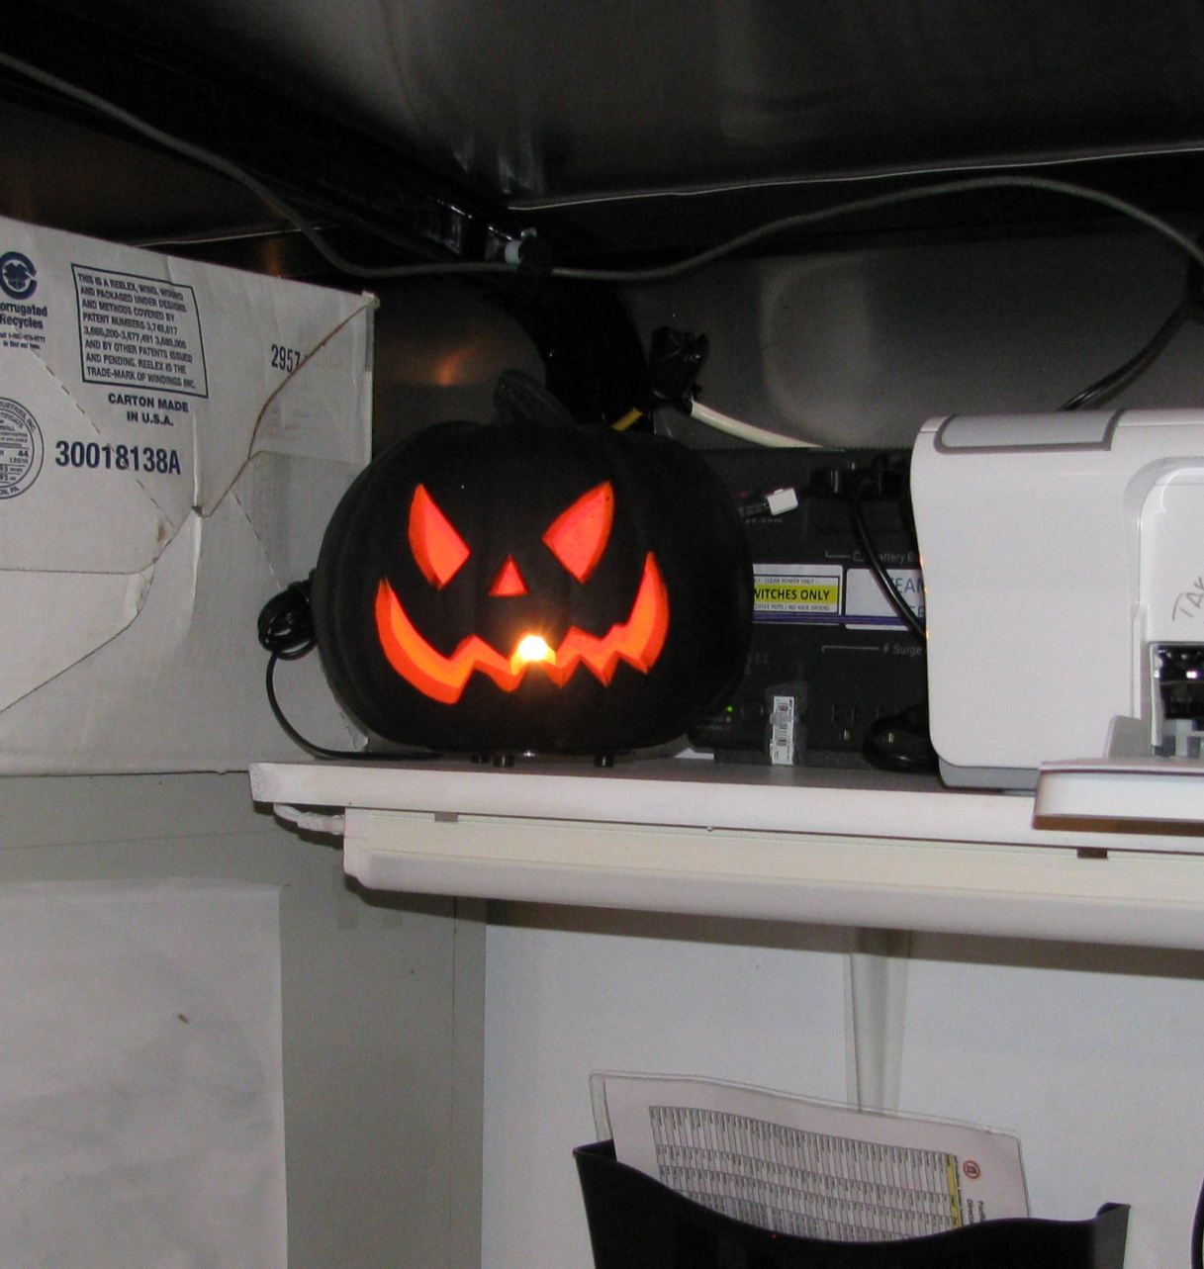
Overview
Bits & Pieces
TESTERS
Always Carry A
Cable Tester &
Electrical Tester
Why Not Have A Fun Electrical Tester?
Work Hard, Be Professional,
but Always Remember To
“Have Fun” & Smile

Slide 40
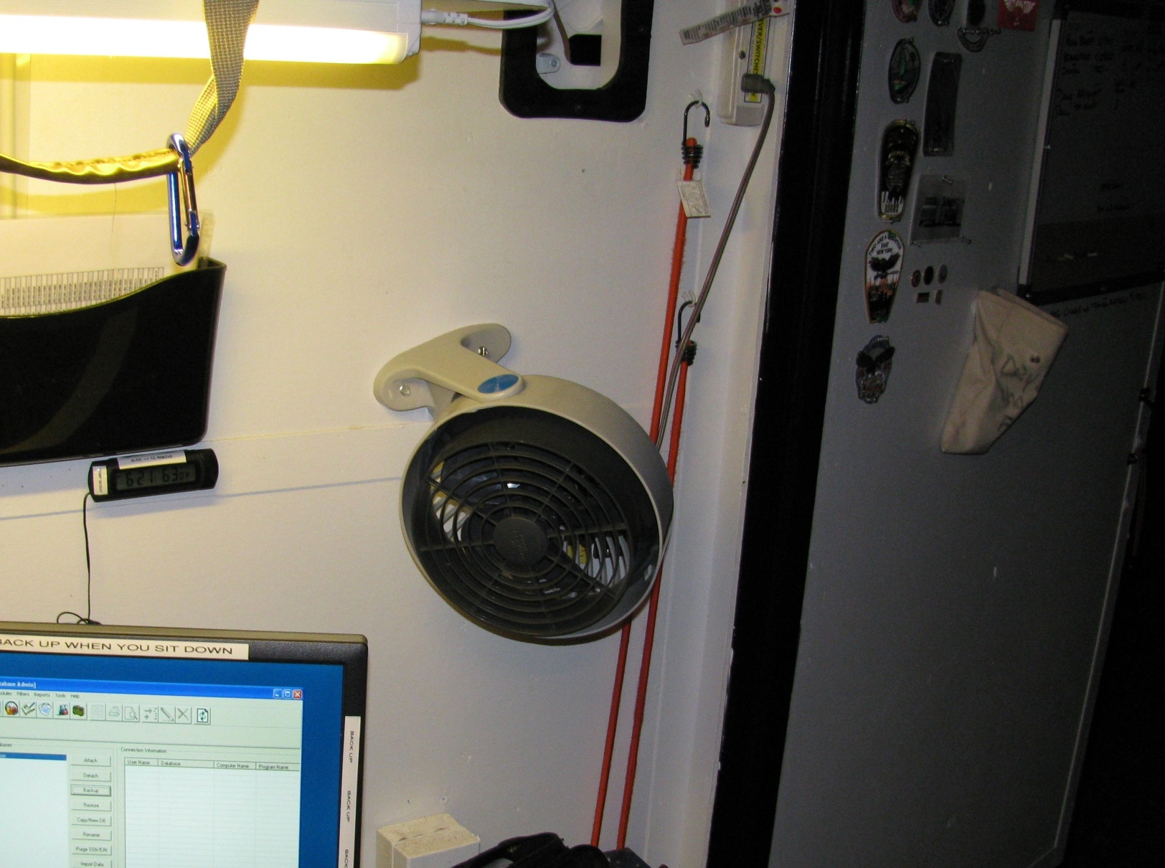
Overview
Bits & Pieces
Server Side - Back
Keeping It Cool
At a Minimum, with a
Minimum of Electrical Draw
CROW Has An A/C – Heater Unit
But They Draw a Lot of Power
A Simple Fan Pushes Air Flow Over
the Servers & Requires
Very Little Electrical Draw
~ Electrical Power In Camp
Is Always A Challenge & Limited ~

Slide 41
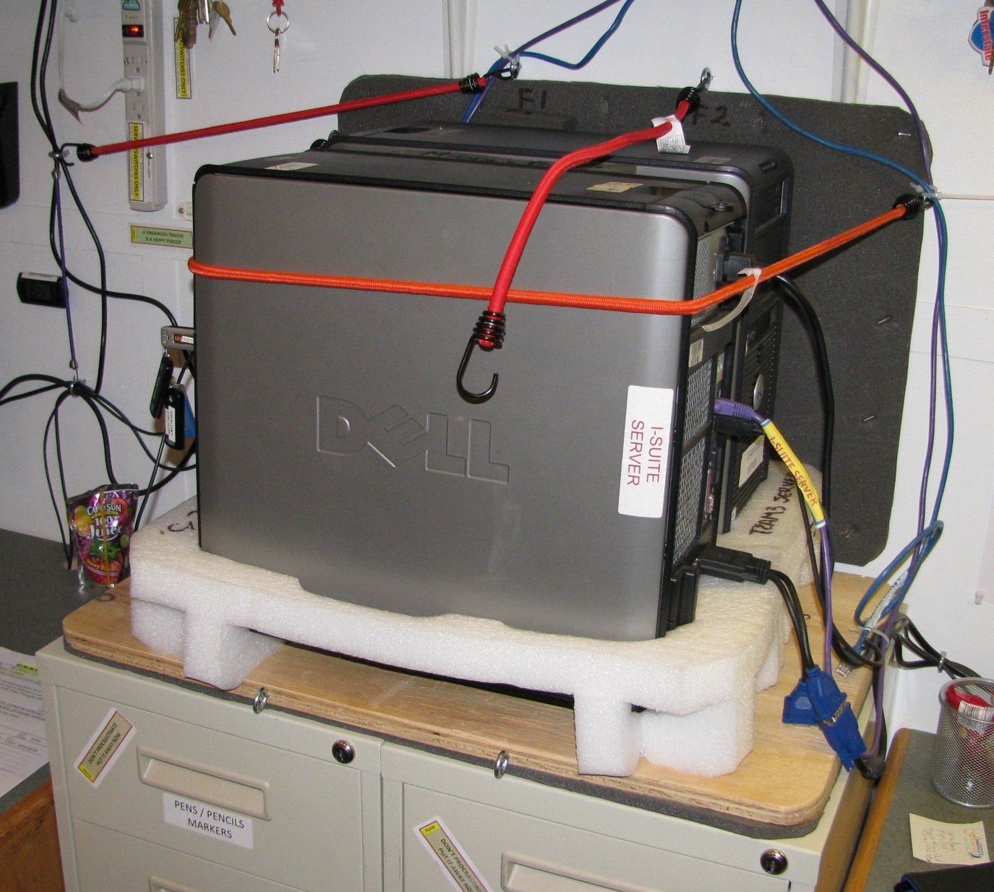
Note: Always Have A Place To Hook Bungee Cords When Not In Use
2 Additional Bungee Cords
To Be Used Only During Transport
Overview
Bits & Pieces
Server Side - Center
Keep It Simple Server Suspension / Travel Platform
Original Server Packing Materials
Sleeping Pad Wall Pad
Shock Absorbing Bungee Cords
Anti-Slip Platform (Unpainted Plywood)
Sleeping Pad Cushion Between File Cabinets & Wood Platform
~ It Works / Cost Effective
Easily Replaced & Modified ~
3 Drawer File Cabinets Bolted Together
Screw Up Into Plywood Platform

Slide 42
Overview
Bits & Pieces
Server Side - Center
Two Servers
[I-Suite & Documents]
Back Up Data To Each Other
(Criss X Cross)
Standard Desktop PCs
w/ Server Operating System
~ Utilize Items You Can
Buy At Any “Staples” ~
Label Everything,
Makes It So Much
Easier When You Are
“Fire Camp Tired”
Both Sides of Trailer
Wired So Servers
Don’t Move

Slide 43
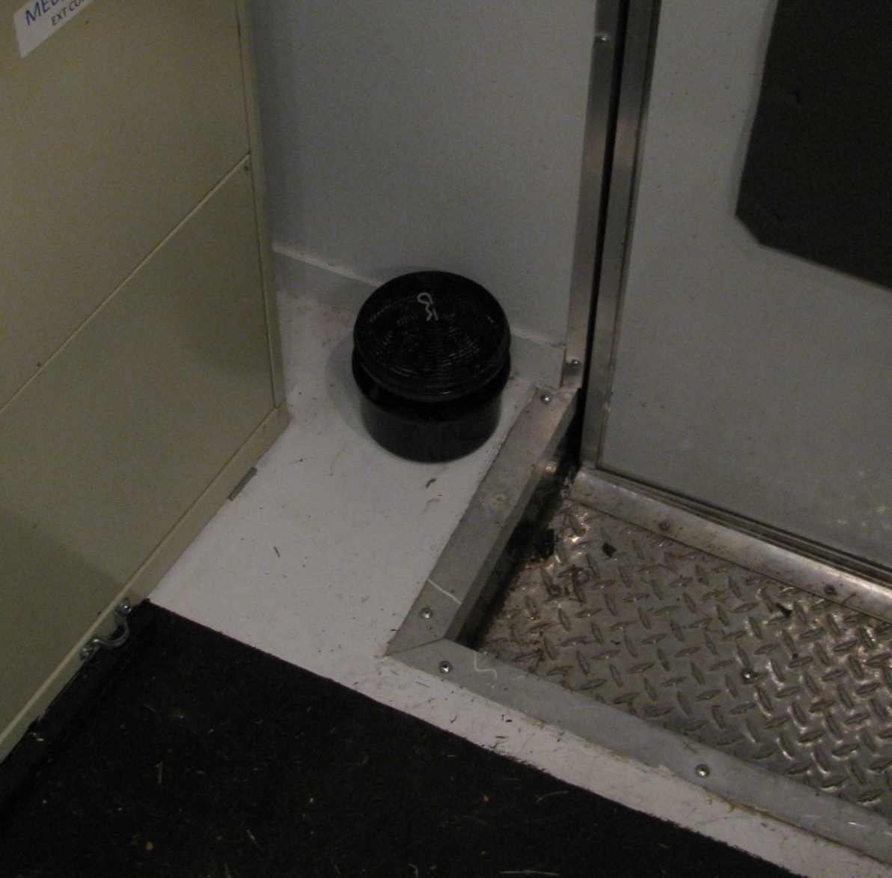
Overview
Bits & Pieces
Near Entrances/Doors
Moisture Control
“Redi-Dry” Moisture Capture Container
& Dryer Beads
~ Keeps Paper & Electronics Happier ~
A Couple Per Trailer – During An Assignment
Utilize Especially During Off Season

Slide 44
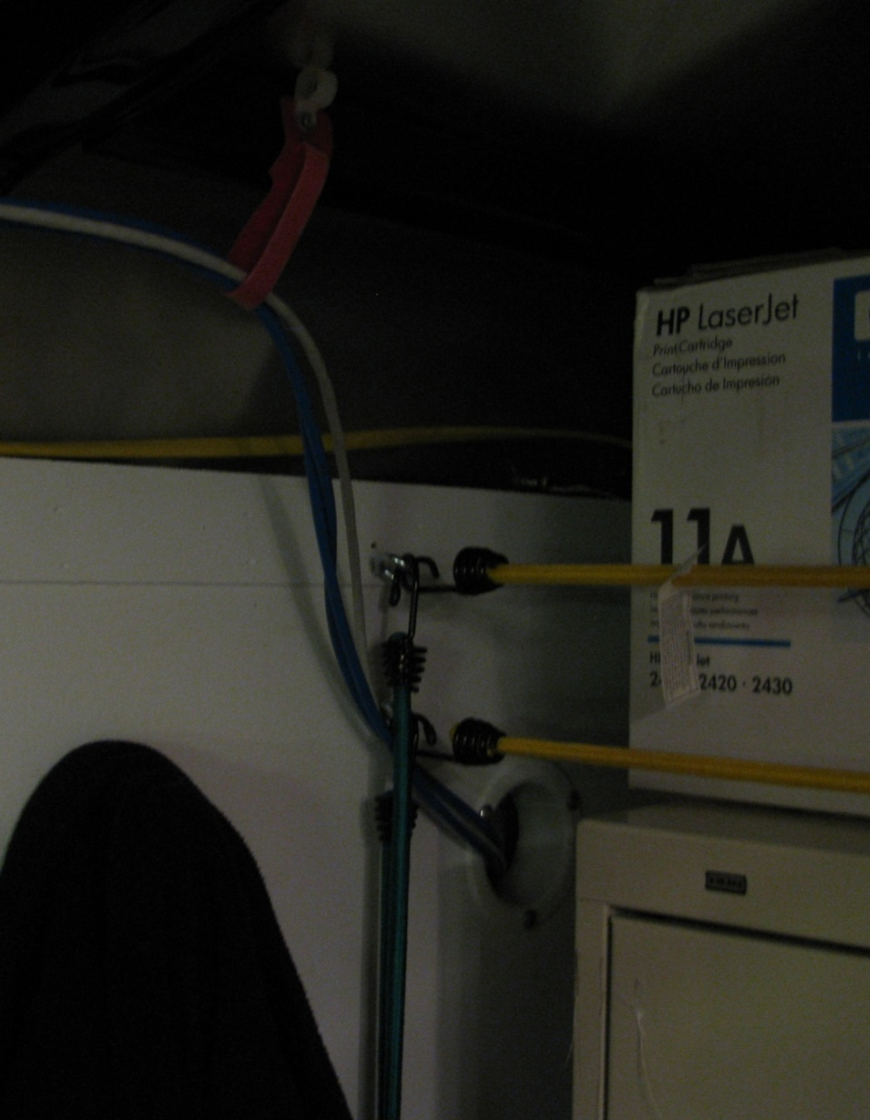
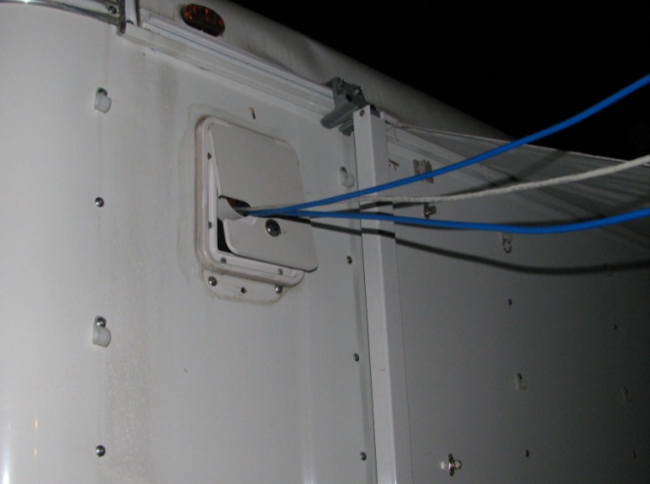
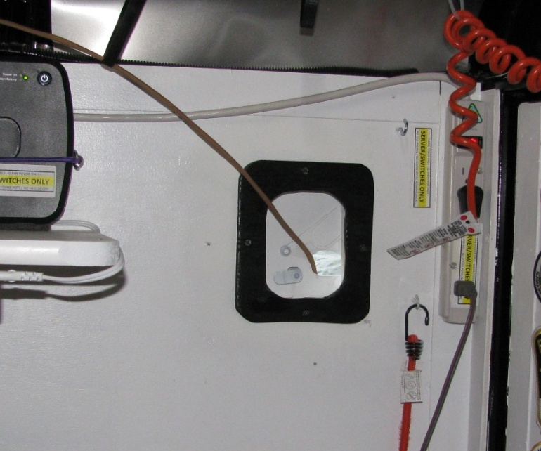
Overview
Storage Side - Front
Lots of Cable Management (Loops)
Bits & Pieces
Outside Cable Access
Outside/Inside Access – Both Sides
Maximum Flexibility For A Safer Camp Reduce Cable Damage / Cleaner & Trouble Free Network
Server Side - Back

Slide 45
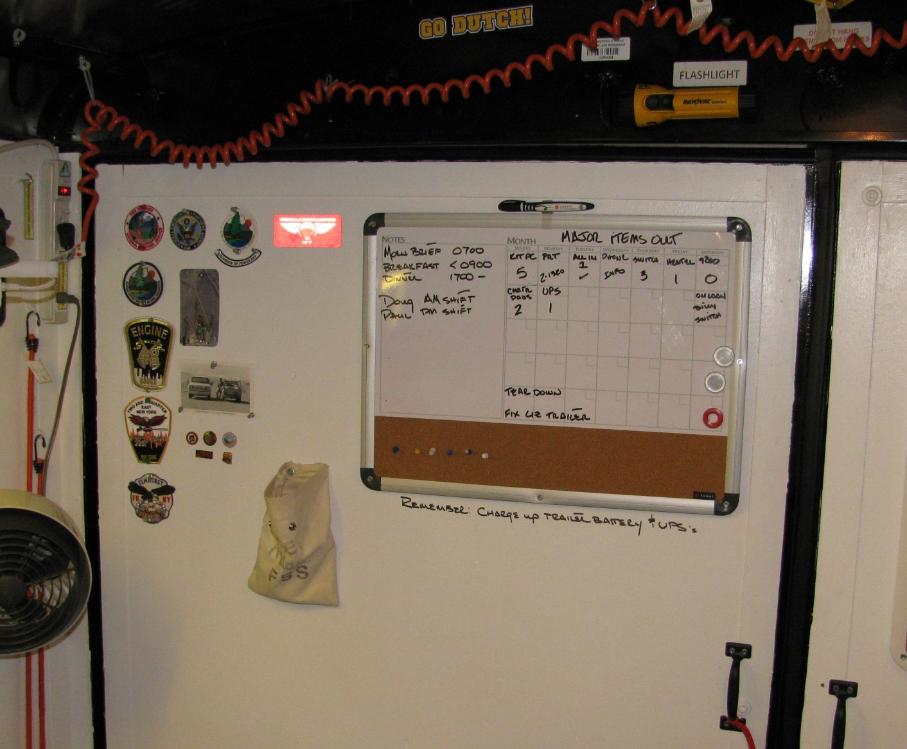
Overview
Bits & Pieces
Back Door / Server Side
Utilize Space For Stuff You Need
White Boards / Place To Hold Dry Erase Pens Flashlights / Etc.
Badge/Pin Hall of Fame
Your going to need them, so you might as well plan and provide space for them.
~ Keeping Organized Is A Key ~

Slide 46
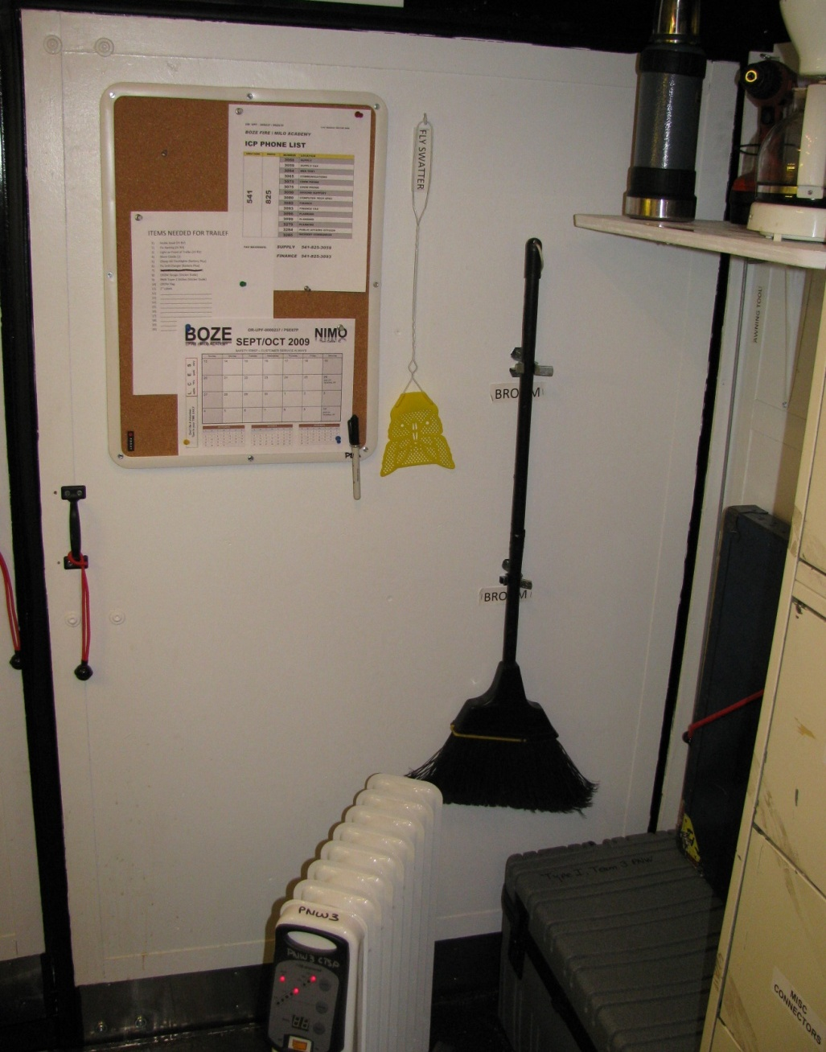
Overview
Bits & Pieces
Back Door / Storage Side
Utilize Space For Stuff You Need
Cork Boards, Fly Swatters, Brooms, etc.
Your going to need them, so you might
as well plan and provide space for them.
~ Keeping Organized Is A Key ~

Slide 47
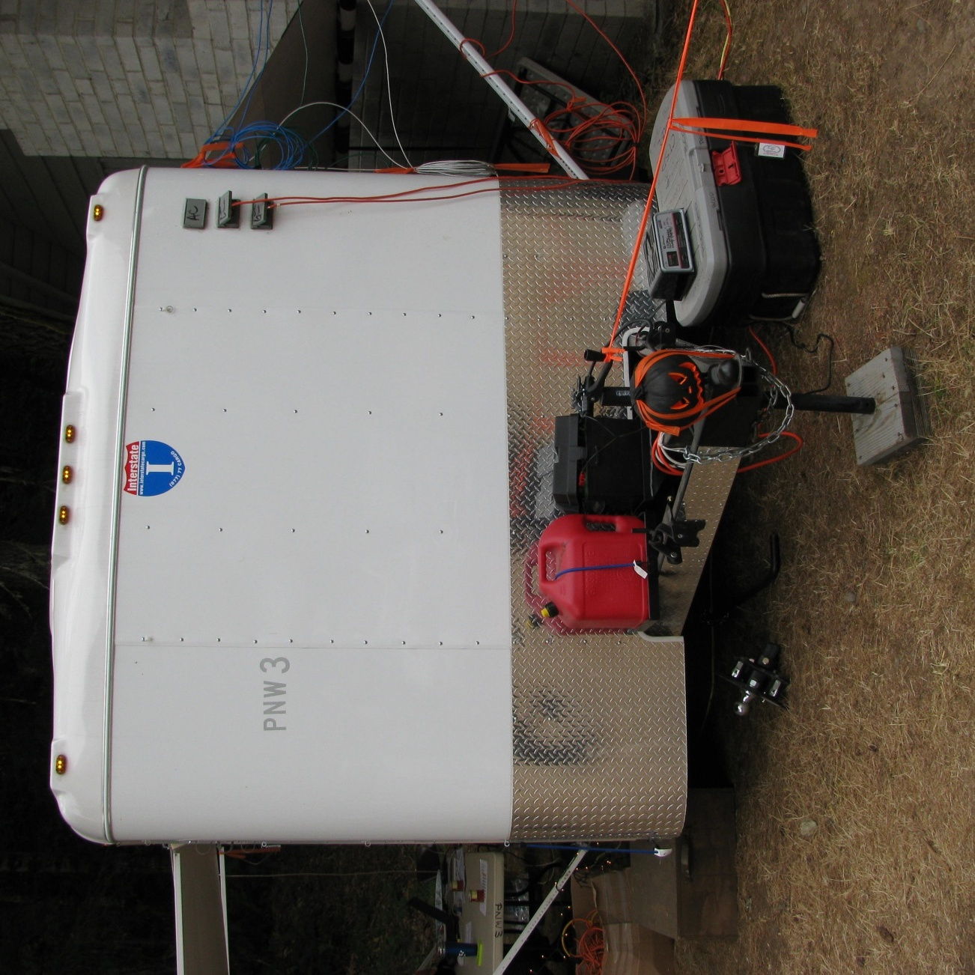
Overview
SAFETY FIRST
Visibility
In addition to standard items (Flagging, Fire Extinguishers,
Smoke/Carbon Monoxide Detectors)
making the trailer visible at night
(so no one runs into it on the way to the Blue Rooms)
is a challenge.
The “Electrical Tester / Pumpkin” makes a nice indicator of the trailer tongue location.

Slide 48
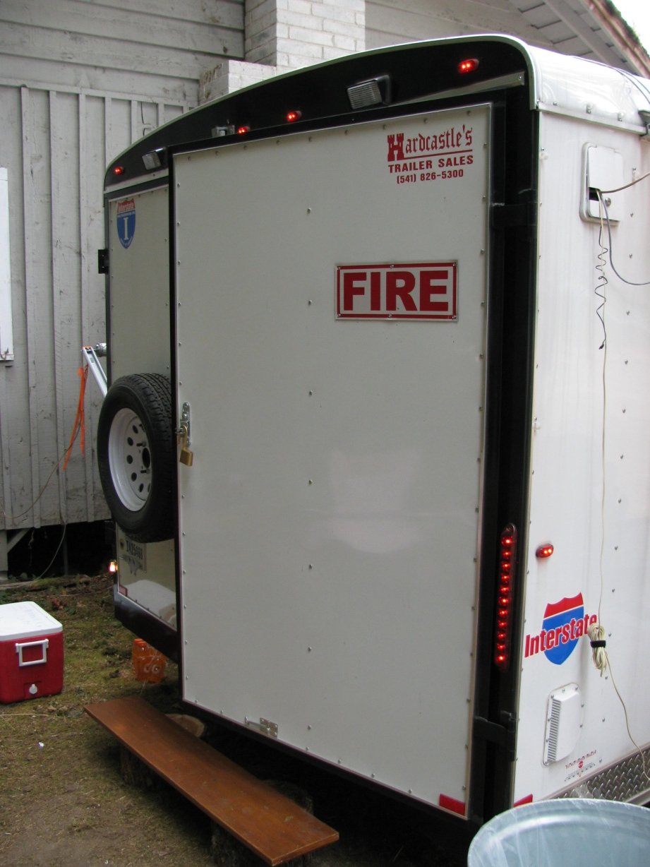
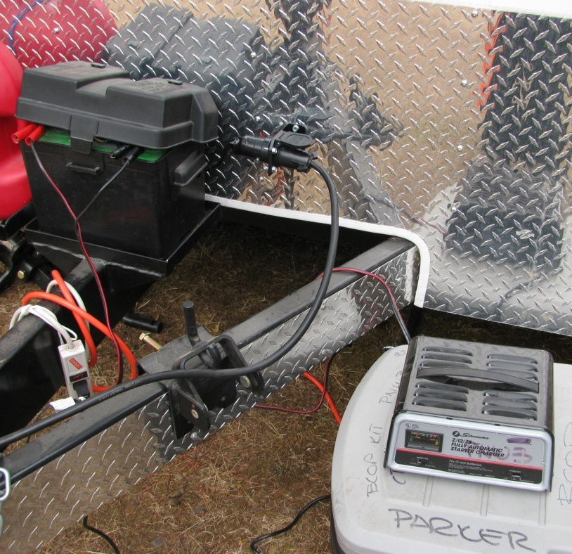
Overview
Visibility
Making use of the existing Running / Trailer Lights is also a good fix.
SAFETY FIRST
An Off-The-Shelf Battery Charger Keeps the Trailer Battery Operational.
Wiring a Vehicle Pig Tail Connector Directly to the Trailer Battery and Plugging the Trailer Pig Tail In, Provides 12V Power to the Trailer Running Lights.

Slide 49
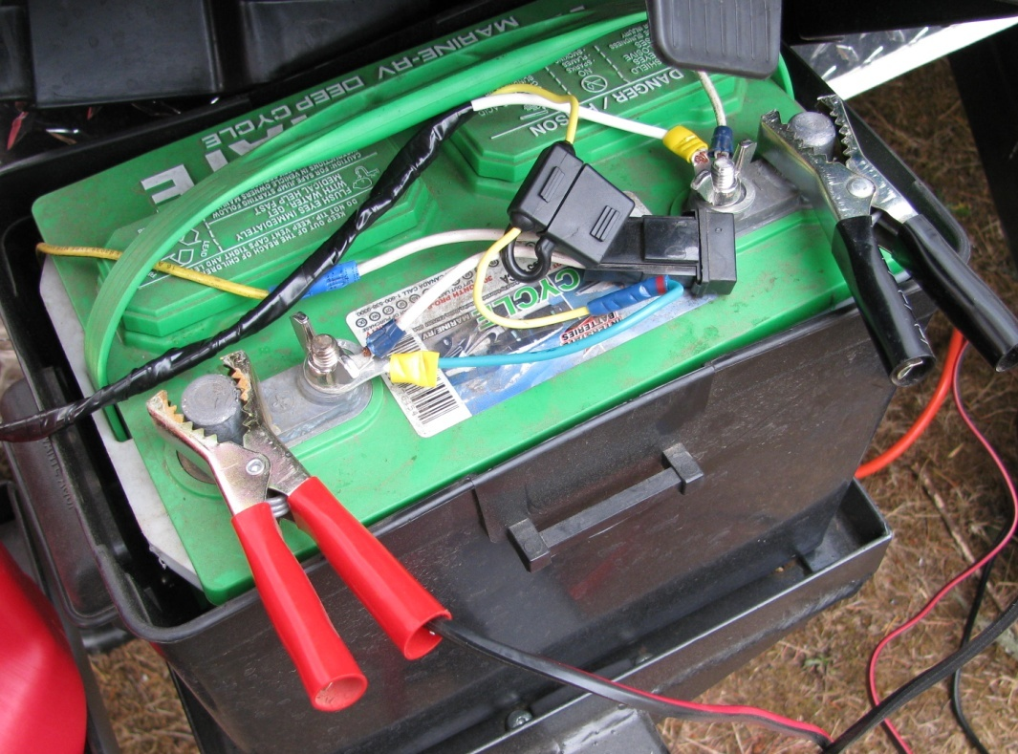
Overview
JUST TO BE ON
THE SAFE SIDE
SAFETY FIRST
Suggest Wiring In An Extra Standard Vehicle/12V Fuse Into The “Pig Tail / Vehicle Running Lights” Loop
15¢ Fuse Is Worth It’s Weight In Gold … Compared to Trailer Running Lights.

Slide 50
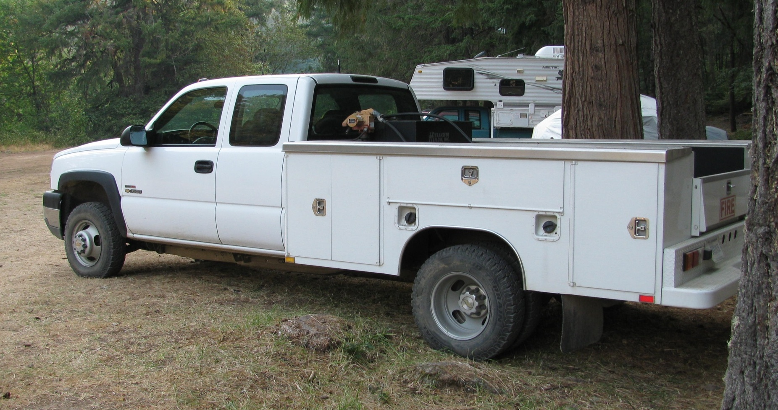
Overview
HEADS UP: You need a REAL TRUCK to pull a CROW!
Recommend: ¾ Ton Pickup or Better & Must Have Trailer Brakes
Bits & Pieces

Slide 51
Screen Room
STAY TUNED … PHOTOS COMING SOON

Slide 52
Lessons Learned
SUGGESTED ADDITION TO PREVIOUS TRAILER SPECIFICATIONS | COMMENT
1) Factory Installed Insulation | A Non-Insulated Trailer is difficult to maintain proper heat/cool temperature environment.
2) Additional Outside 12 Volt (w/ Override On/Off Switch) on Front of Trailer and Non-Door Side) | More Outside Lights the Better. Makes it easier to work outside and safer for people moving past the trailer in a fire camp situation.
3) ALL Outside 12 Volt Lights be Equipped w Override On/Off Switches | Maintaining Battery Life can be difficult. Many times the inside trailer lights are needed but the outside trailer lights are not.
4) Factory Installed 2-12 Volt Deep Cycle “Car” Batteries | This will make it easier to maintain battery life for multiple days without having to continuously charge battery.
5) Bias Ply Tires | Trailer came w/ Radial Tires. Due to weight in the trailer and trailer side to side sway, Bias Ply Tires were installed after market. This improved trailer towing.
6) WATCH YOUR WEIGHT Over All Trailer Weight & Tongue Weight | The “Furniture” is the “Catch 22” in a trailer. You have to find a balance between items that are strong enough to withstand the towing & fire camp use and weight. Metal/Oak is strong but heavy, while plastic is light but will be strong enough to hold up to the fire camp/assignment conditions.

Slide 53
Packing Diagrams
STAY TUNED … PHOTOS COMING SOON

Slide 54
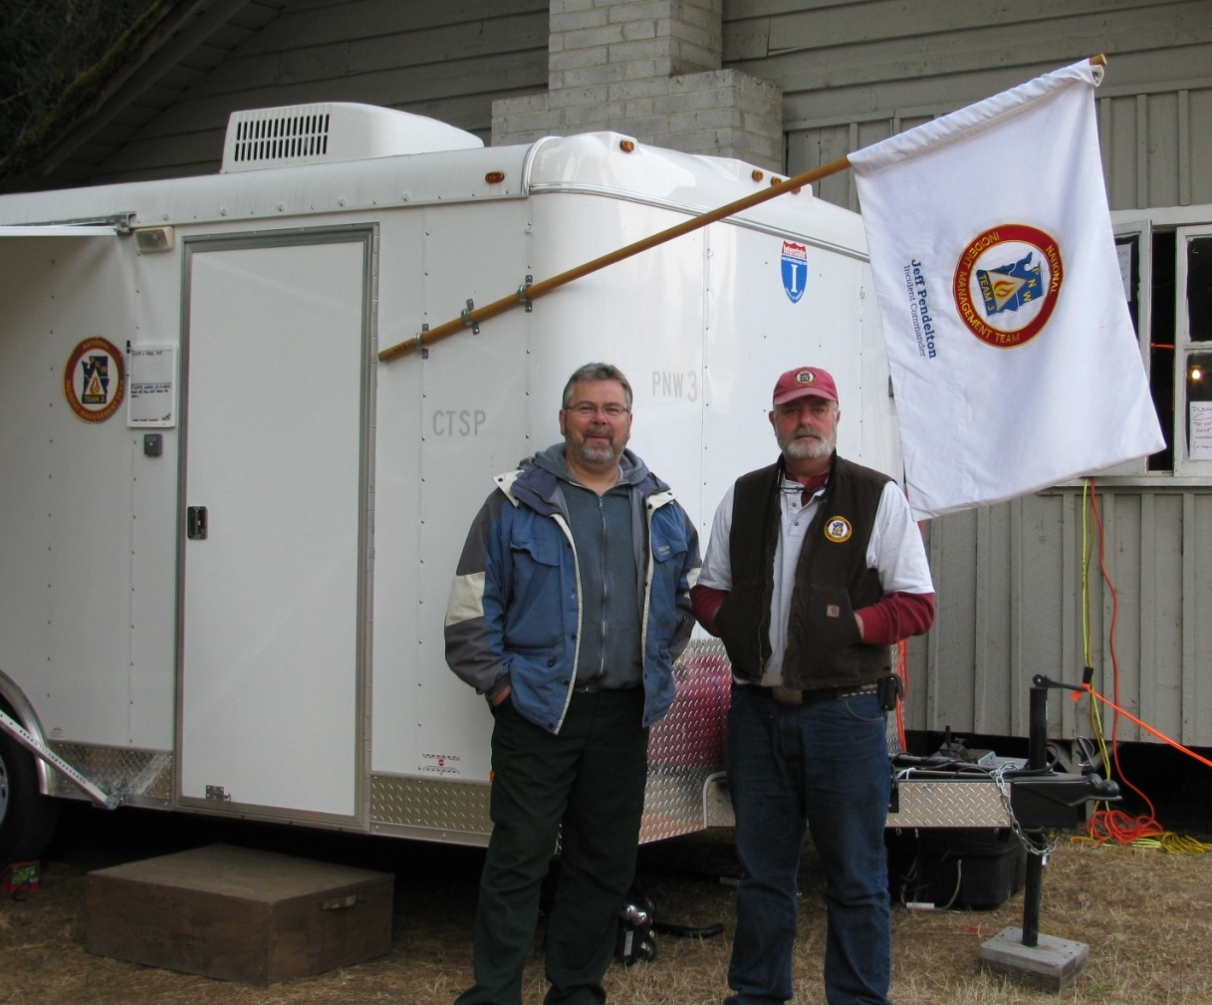
Paul’s Brains / Doug’s Brawn
Together They:
Thought Out of the Box
Took The Initiative to Identify
the Need and Find a Solution
You Put Together:
Experience
Initiative
Team Work
and a Support / Funding
(Thanks To Dale)
You Can “Get A Bigger Box”
and Meet the Needs of the
Customer (Public, Firefighters,
Hosting Agency & the Team).
Thanks Also to Jeff & Ed’s Support to “Let Us Run With It”
(Working Together To Find Solutions
& Fine Tune)
Paul Dzialowy (CTSP) & Doug Parker (WEBM/CTSP) - 2009

