Slide 1
Effective Working Relationships
UNIT 2

Slide 2
Unit 2 - Objectives
Define the professional conduct the LE helicopter crewmember should practice.
Define how to establish and maintain positive interagency working relationships.

Slide 3
Professional Conduct
As a Law Enforcement helicopter crewmember you are a member of an organized group. You are expected to conduct yourself in a professional manner while on an incident assignment.

Slide 4
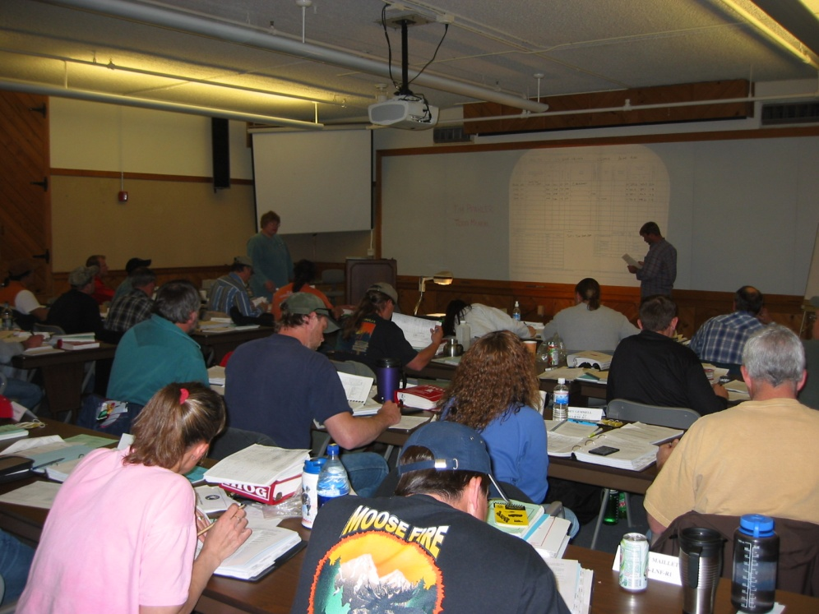
Conduct Exercise
The instructor will provide you with
instructions for this exercise.

Slide 5
Exercise Instructions
Record what you think is expected conduct as a LE helicopter crewmember.
Think of scenarios at helibases and overnight assignments.
When finished, discuss and review answers.
Compare your answers to outline as you proceed.

Slide 6
What is Conduct?
Conduct can be defined as the way one
acts or one’s behavior.
The way you conduct yourself paints an
image of you and who you are, and the agency you represent.

Slide 7
What is Conduct?
Remember, there is always someone, or a group, who is watching how you conduct yourself.

Slide 8
What is Conduct
Conduct yourself in a professional manner:
Be respectful – To others, their property and public property.
Be courteous – To other crewmembers, the public and officials.
Be prompt – For briefings, meetings, and completing tasks.
Be safe – At all times
Set an example – Be a positive role model.

Slide 9
What is Conduct
Off incident “Rest and Recuperation”
(R&R) conduct:
You are responsible for proper conduct and maintenance of fitness for duty.
Drug or alcohol abuse resulting in being unfit for duty will normally result in disciplinary action.
Report any observed drug or alcohol abuse to your supervisor.

Slide 10
What is Conduct
It is extremely important that inappropriate behavior be recognized and dealt with promptly.
Inappropriate behavior is all forms of harassment and all will not be tolerated, e.g., sexual and racial harassment.

Slide 11
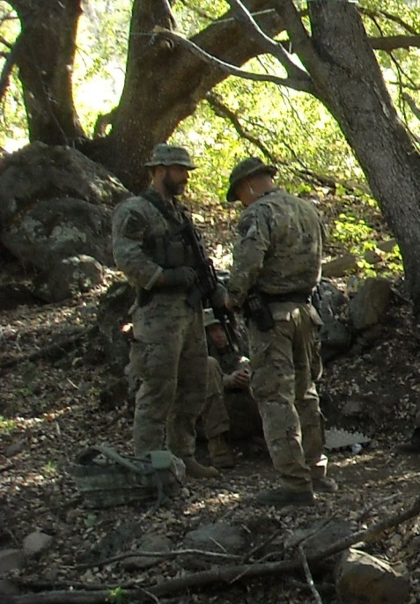
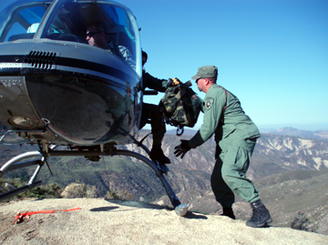
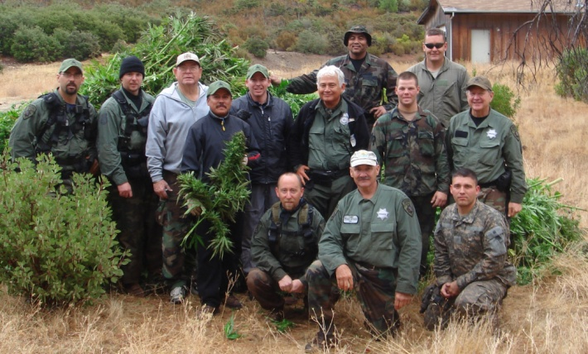
Positive Working Relationships

Slide 12
Positive Working Relationships
Know your crewmembers and look
out for their well-being.
Put the safety of your co-workers above all other objectives.
Take care of their needs.
Resolve conflicts between individuals on the crew.
Keep supervisors/co-workers informed.

Slide 13
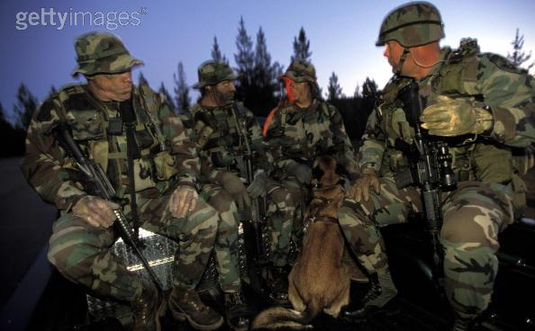
Positive Working Relationships
Establish and Maintain a Positive
Interagency Working Relationship

Slide 14
Positive Working Relationships
When working with other agencies
maintain a professional conduct.
Put safety before and above all other objectives.
Be respectful – To agency policies, and their way of doing business.
Be courteous – To all.
Establish and maintain good communications.

Slide 15
Positive Working Relationships
When working with other agencies
maintain a professional conduct.
Remain focused on the task so they will function safely and efficiently.
Provide clear instructions on the tasks to be accomplished.
Build everyone into an interagency team.
Be honest, personable, professional and presentable.

Slide 16
Unit 2 - Objectives
Define the professional conduct the Law Enforcement helicopter crewmember should practice.
Define how to establish and maintain positive interagency working relationships.

