Slide 1
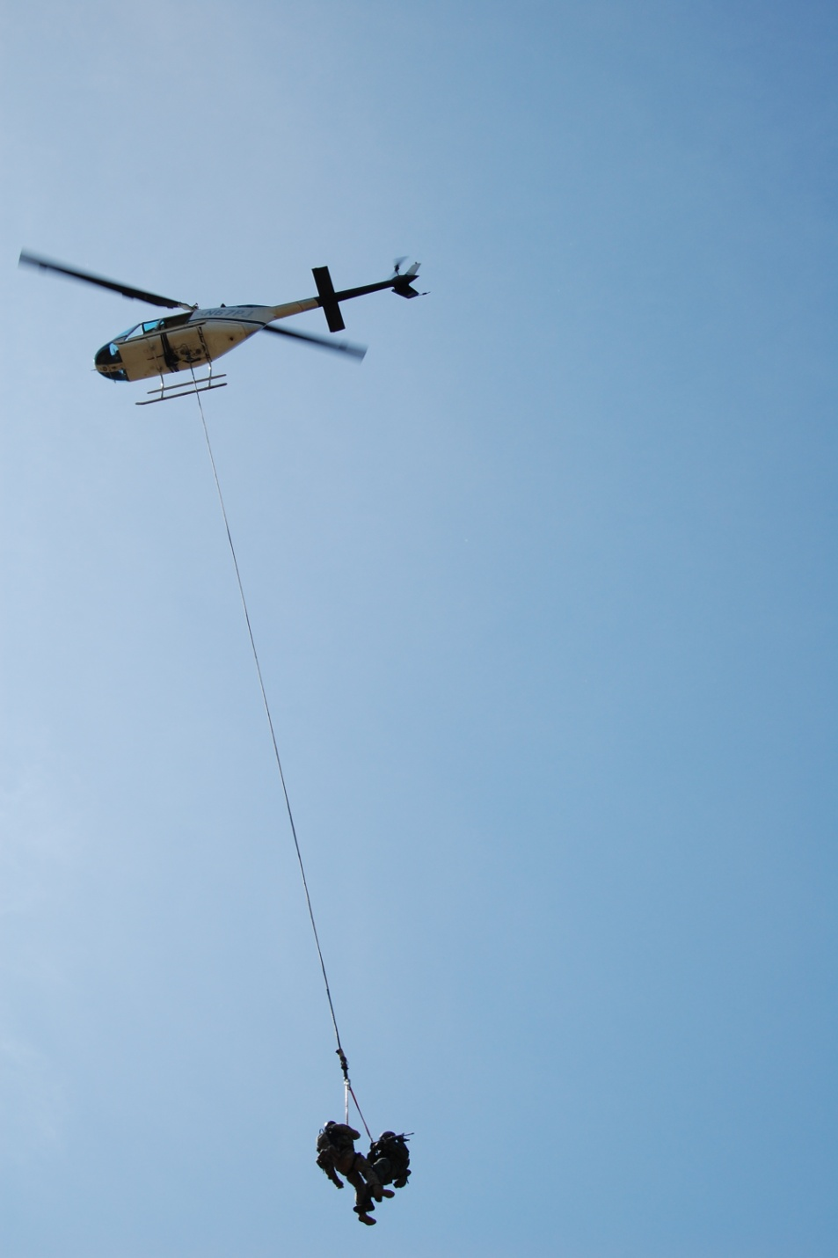
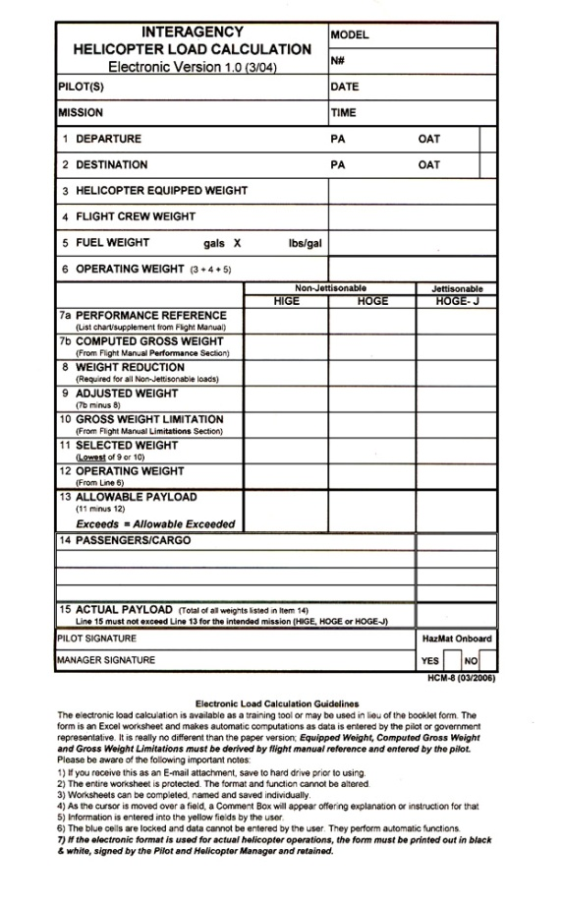
Helicopter Performance, Limitations, and Load Calculations
UNIT 5

Slide 2
Unit 5 - Objectives
Describe general aspects of helicopter design, flight controls, and terminology.
Define “in-ground-effect” and “out-of-ground-effect” as they relate to helicopter performance.

Slide 3
Unit 5 - Objectives
Describe air density altitude and the effects on helicopter performance.
Describe the process for completing a load calculation form.

Slide 4
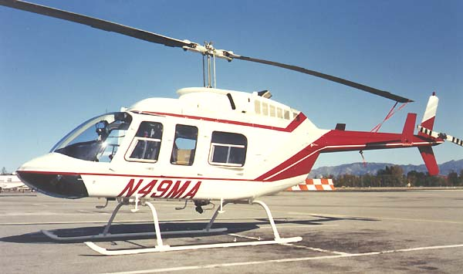
Helicopter Performance
Basic Helicopter Design Rotor Systems
Single-Rotor Helicopter - The most common design uses a single main rotor which imparts lift and thrust, and a smaller tail rotor, which compensates for torque induced by the powered turning of the main rotor.

Slide 5
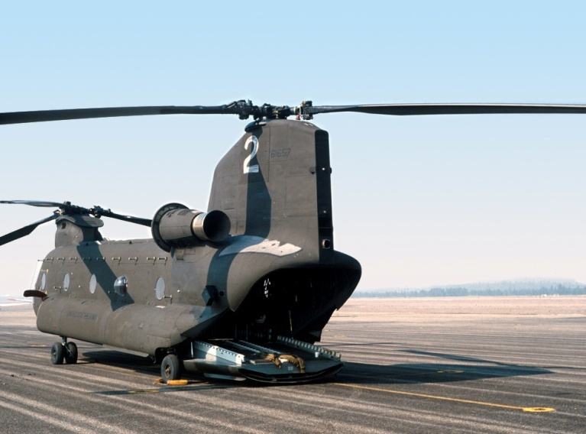
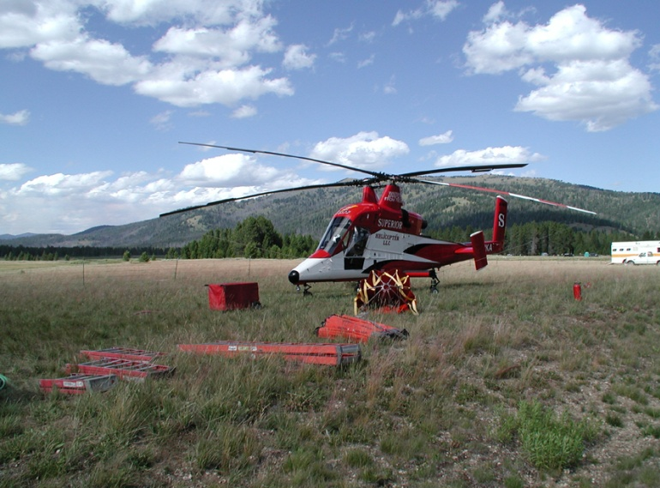
Helicopter Performance
Basic Helicopter Design Rotor Systems
Dual-Rotor Helicopter – Some helicopters have dual main rotors, mounted in tandem or side-by-side.
Torque compensation is achieved by turning the rotors in opposite directions.

Slide 6
Helicopter Performance
Basic Helicopter Design
Helicopter Controls
There are four controls that are used in conjunction with each other when flying a helicopter.
- Collective pitch control
- Throttle control
- Anti-torque
- Cyclic control

Slide 7
Helicopter Performance
Basic Helicopter Design
Helicopter Controls
Collective Control
This changes the angle of the pitch (of angle of attack) of each main rotor blade simultaneously. The collective is controlled by the left hand.
As the pitch of the blades is increased, lift is created causing the helicopter to rise from the ground, hover or climb, as long as sufficient power is available.

Slide 8
Helicopter Performance
Basic Helicopter Design
Helicopter Controls
Throttle Control
On the turbine-powered helicopters, this power coordination is accomplished automatically through the fuel control and governor systems of the turbine engine.

Slide 9
Helicopter Performance
Basic Helicopter Design
Helicopter Controls
Anti-Torque Control
Two anti-torque pedals are provided to counteract the torque effect of the main rotor. This is done by increasing or decreasing the thrust of the tail rotor.

Slide 10
Helicopter Performance
Basic Helicopter Design
Helicopter Controls
Anti-Torque Control
The anti-torque pedals accomplish this by changing the pitch (angle of attack) or the tail rotor blades.

Slide 11
Helicopter Performance
Basic Helicopter Design
Helicopter Controls
Anti-Torque Control
Heading and directional control in hover and at low air speeds as forward air speed increases, the tail rotor becomes less necessary (slip streaming effect).

Slide 12
Helicopter Performance
Basic Helicopter Design
Helicopter Controls
Cyclic Control
The “cyclic” is controlled by the pilot’s right hand.
Aircraft moves in the direction that pressure is applied
to the cyclic.
If the pilot moves the cyclic forward, the lift in the rear half of the rotor disk is increased, and the aircraft moves forward.

Slide 13
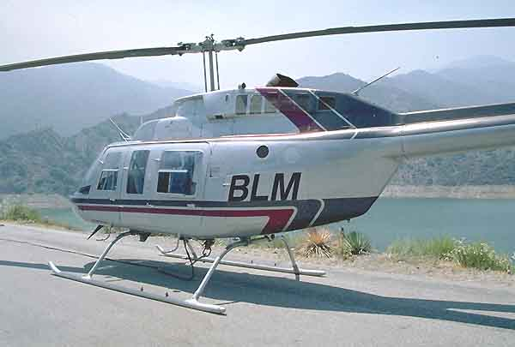
Helicopter Performance
Basic Helicopter Design
Landing Gear
Skids – Skids are the most common type of landing gear used in light and medium-class helicopters.

Slide 14
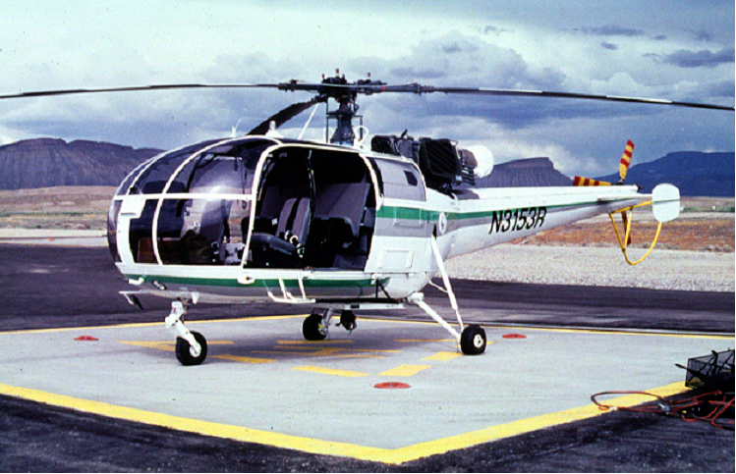
Helicopter Performance
Basic Helicopter Design
Landing Gear
Wheels – Wheels are primarily used on medium and heavy helicopters.

Slide 15
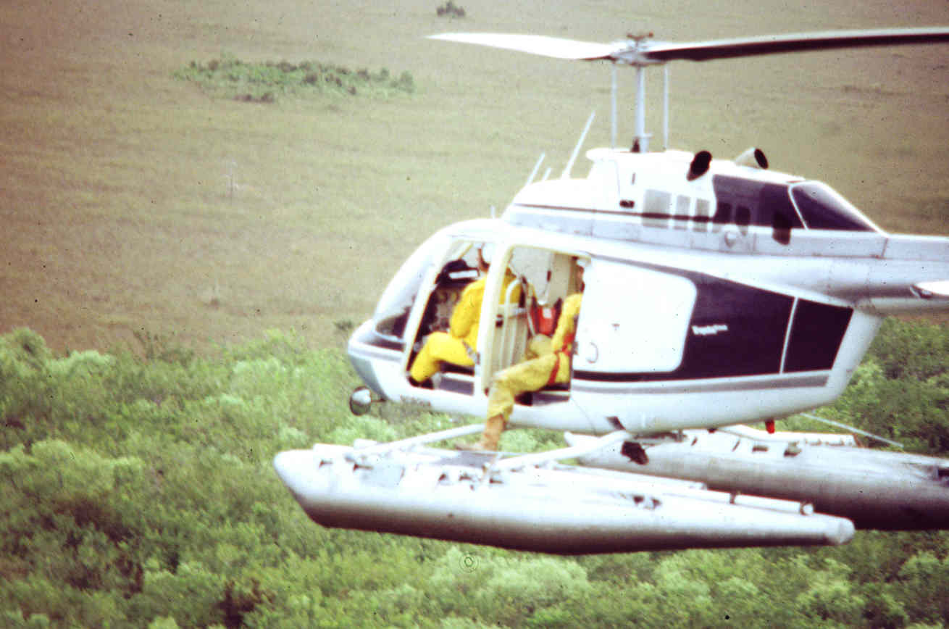
Helicopter Performance
Basic Helicopter Design
Landing Gear
Floats – Floats can be used on land as well as water. There are two types; fixed or inflated. “Pop Outs” are inflated only as needed.

Slide 16
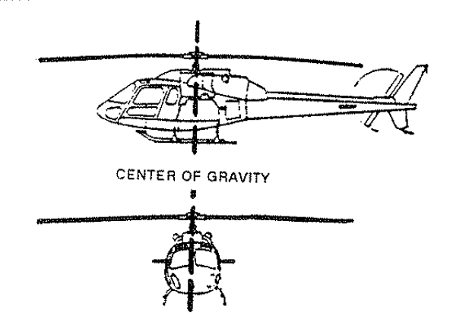
Helicopter Performance
Helicopter Loading
Center of Gravity Effects

Slide 17
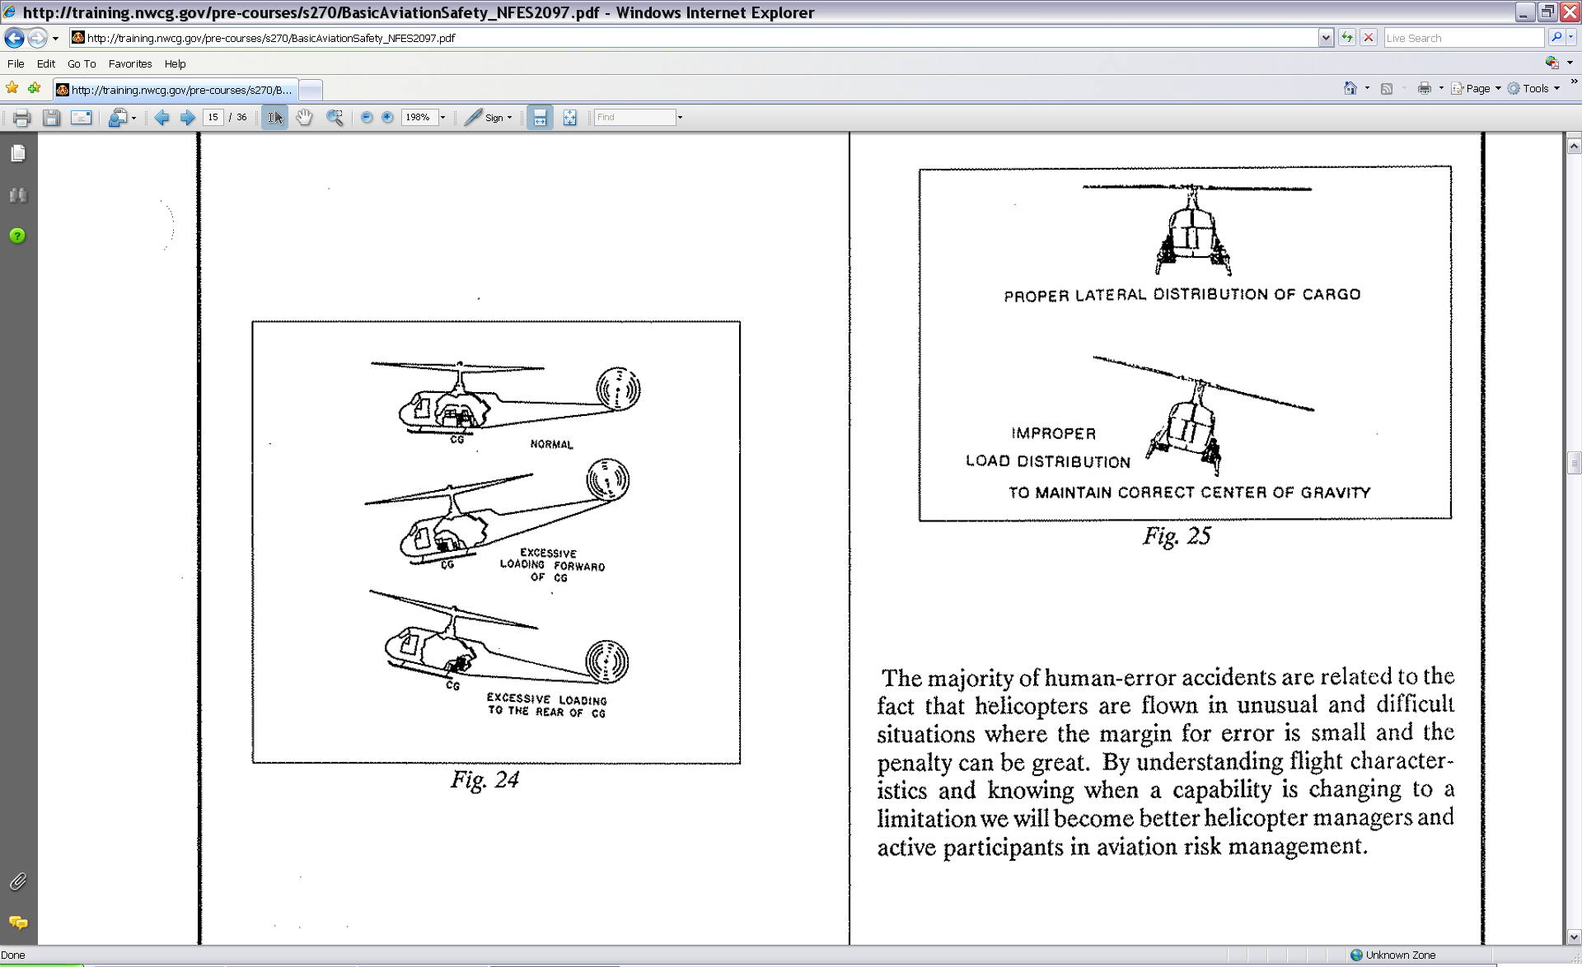
Helicopter Performance
Helicopter Loading
Center of Gravity Effects

Slide 18
Helicopter Performance
Helicopter Loading
Floor Loading
Careful attention must be given to small, heavy parcels loaded into helicopters to determine that the maximum pounds-per-square-inch limitations are not exceeded.

Slide 19
Principles of Flight
Being familiar with terms commonly used in helicopter flight characteristics is important to persons involved with helicopter use.

Slide 20
Principles of Flight
Ground Effect
A condition of improved rotor system performance encountered when the helicopter is hovering near the ground.

Slide 21
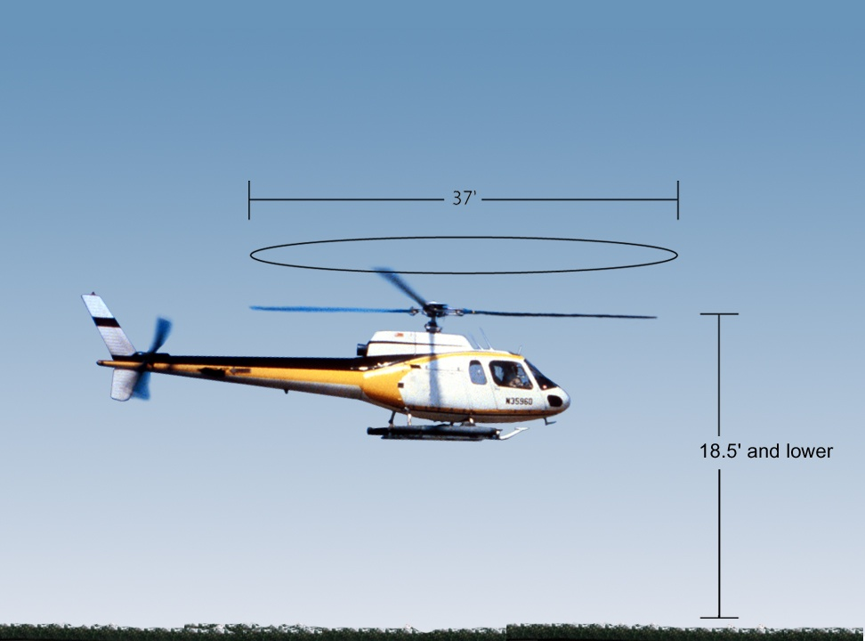
Hover-In-Ground-Effect (HIGE) occurs when helicopter is hovering approximately less than one-half the rotor diameter distance from the ground.

Slide 22
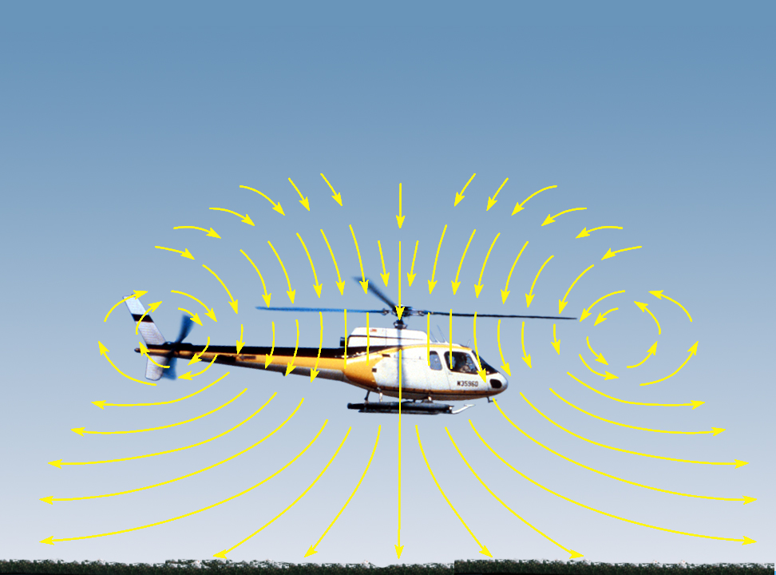
HIGE the airflow is interrupted by the ground under the helicopter; this reduces downward velocity of the air and produces an outward airflow pattern.

Slide 23
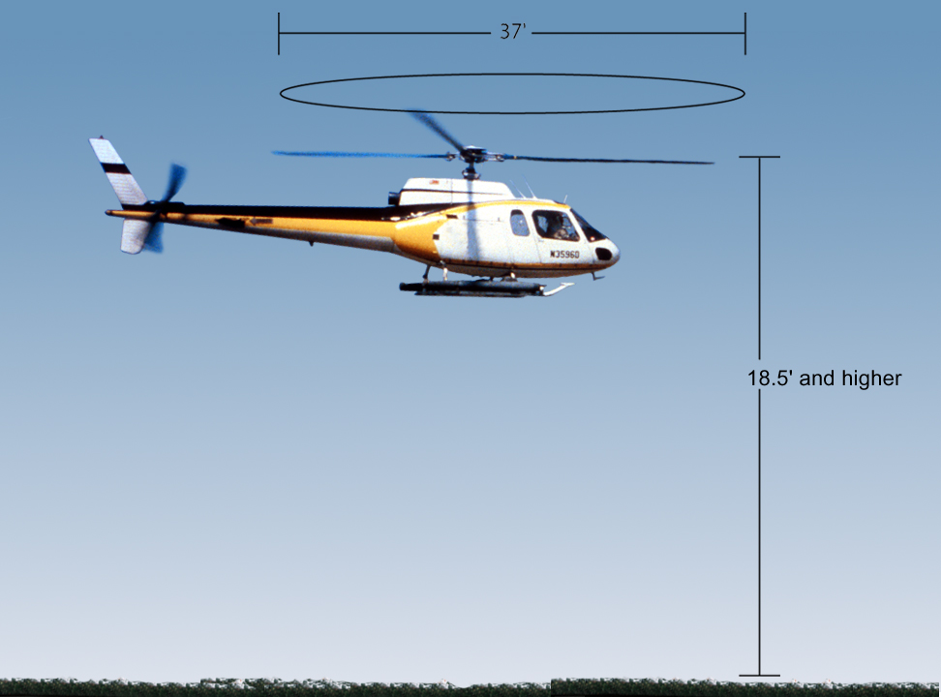
Hover-Out-Of-Ground-Effect (HOGE) occurs when the helicopter exceeds about one-half of the rotor diameter distance from the ground, and the cushion of air disintegrates.

Slide 24
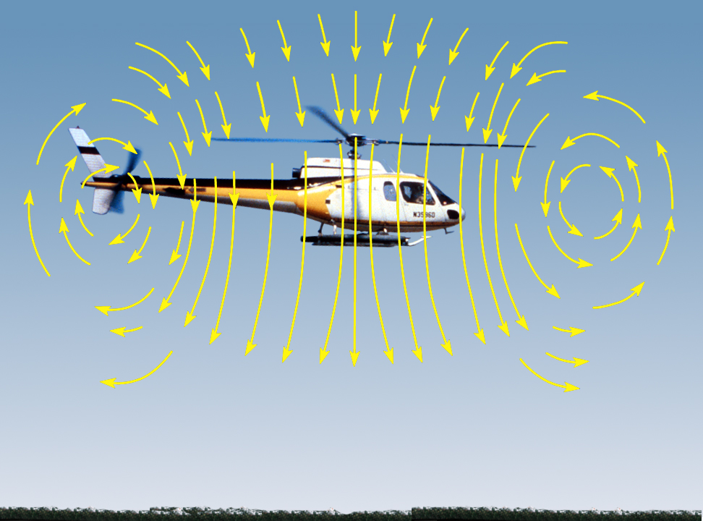
HOGE no cushion of air and maximum
performance of helicopter is required.
Payload may have to be reduced.

Slide 25
Principles of Flight
Ground Effect – Hover-Out-Of-Ground-Effect (HOGE)
It is important to understand the capabilities and limitations presented by ground effect when choosing a landing site

Slide 26
Principles of Flight
Ground Effect – Translational Lift
Translational lift occurs when the helicopter approaches 15 to 18 MPH indicated airspeed and when hovering with a 15 MPH steady headwind.
Can be felt as an aircraft transitions from a hover to forward flight.

Slide 27
Principles of Flight
Autorotation
Autorotation is a non-powered flight condition in which the rotor system maintains flight RPM by reversed airflow. It provides the pilot a means of safely landing the helicopter after an engine failure or other mechanical emergency.

Slide 28
Principles of Flight
Autorotation
Helicopters have a freewheeling unit in the transmission which automatically disengages the engine from the rotor system in the event of failure. This allows the main rotor to rotate freely.

Slide 29
Principles of Flight
Autorotation
When the helicopter is powered by the engine, airflow is downward through the rotors. During an autorotation airflow is upward, “wind milling” the rotor blades as the helicopter descends.

Slide 30
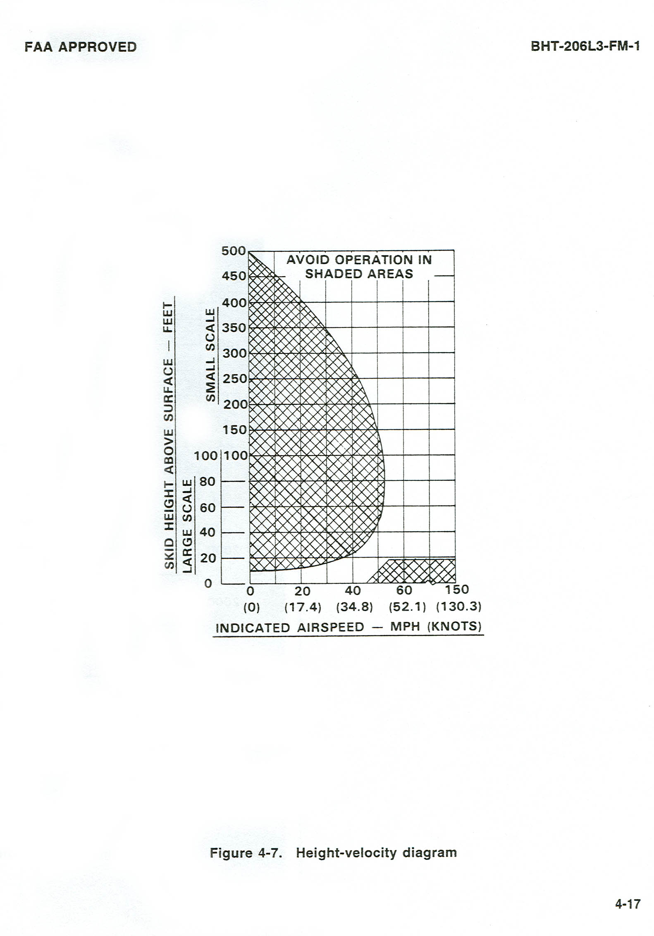
Principles of Flight
Height Velocity Diagram
In flight manuals for each helicopter types is a chart which provides necessary information to complete a safe autorotation.

Slide 31
Principles of Flight
Maximum Performance
Takeoff
Occurs when the helicopter HOGE before or after translational lift. The helicopter is totally power dependent and the margin for safety is significantly reduced.

Slide 32
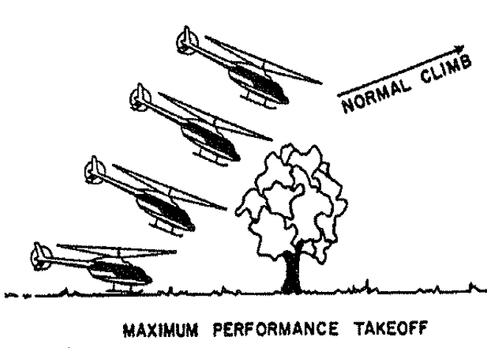

Slide 33
Principles of Flight
Maximum Performance Takeoff
When possible, avoid confined areas, or large obstructions that require the pilot to use maximum power for extended periods.

Slide 34
Principles of Flight
Density Altitude
Density altitude refers to a theoretical air density which exists under standard conditions of a given altitude.
By definition, density altitude is pressure altitude corrected for temperature and humidity.

Slide 35
Principles of Flight
Density Altitude
Can have a profound effect on aircraft performance. Air, like other gases and liquids, is fluid. It flows and changes shape under pressure. Air is said to be “thin” at higher elevations.

Slide 36
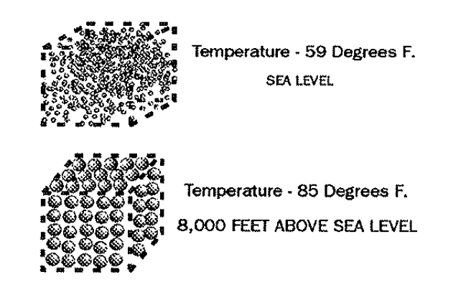
Principles of Flight
Density Altitude
There are more air molecules per cubic foot at sea level feet than at 8,500 feet.
As density altitude
increases, air thins
out and aircraft
performance
decreases.

Slide 37
Principles of Flight
Density Altitude
There are three factors that affect density altitude in varying degrees; atmospheric pressure, temperature, and to some degree, humidity.

Slide 38
Principles of Flight
Density Altitude Chart
Exercise - Density Altitude Chart
Density altitude affects helicopter performance.

Slide 39
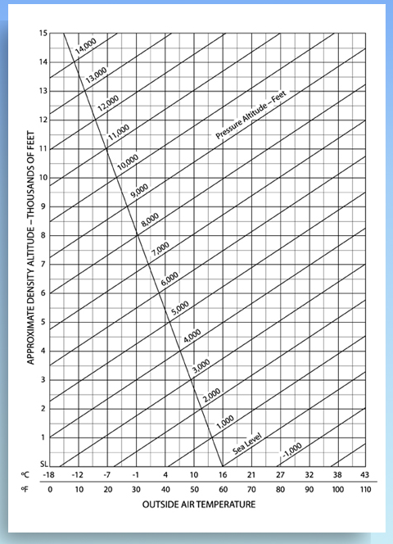
8400 ft.
8400 ft.

Slide 40
Principles of Flight
Density Altitude Effects Performance
High elevation, high temperature, and high moisture content all contribute to high density altitude conditions and lessen performance.
Performance is reduced because the thinner air at high density altitudes reduces blade efficiency.

Slide 41
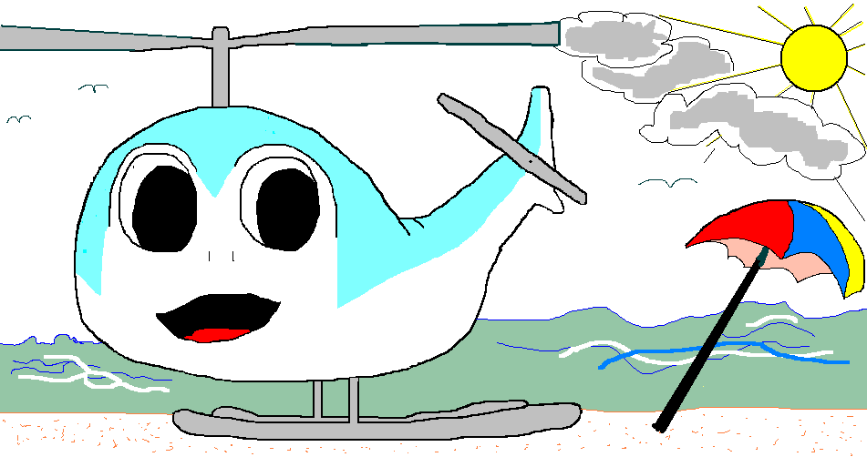
Principles of Flight
At sea level the cool, dense air provides optimum helicopter performance.

Slide 42
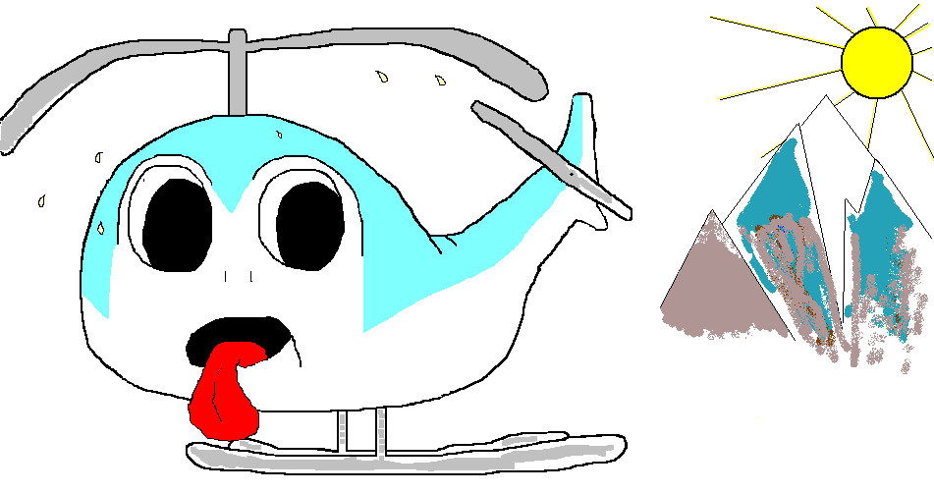
Principles of Flight
But at higher altitude, or hotter conditions, the air is less dense and performance is significantly reduced.

Slide 43
Helicopter Load Calculations
Load Calculation Form
One of the most important documents you will need to become familiar with is the Load Calculation Form.
For a helicopter to fly safely it is critical that you obtain an allowable payload from the Load Calculation form.

Slide 44
Helicopter Load Calculations
The AMD-67 and FS-5700-17 load calculation is required for all helicopter flights conducted on interagency fires and project work.
Any 5 degree C change in outside air temperature or any 1,000 pressure altitude feet change, a new load calculation will need to be completed to ensure safe operations.

Slide 45
Helicopter Load Calculations
Many accidents have happened that involved aircraft that were operating in conditions that were too high or too hot for the weight of the aircraft.

Slide 47
Helicopter Load Calculations
Aircraft model
N Number
Mission
Date/Time
Departure
Destination

Slide 48
Helicopter Load Calculations
Helicopter equipped weight +
Flight crew weight +
Fuel weight =
Operating weight

Slide 49
Helicopter Load Calculations
Performance reference
Computed gross weight
Weight reduction
Adjusted weight
Gross weight limitation
Selected weight
Operating weight
Allowable payload

Slide 50
Helicopter Load Calculations
Passengers and cargo
Actual payload
Pilot signature
Manager signature
HazMat

Slide 51
Unit 5 - Objectives
Describe general aspects of helicopter design, flight controls, and terminology.
Define “in-ground-effect” and “out-of-ground-effect” as they relate to helicopter performance.

Slide 52
Unit 5 - Objectives
Describe air density altitude and the effects on helicopter performance.
Describe the process for completing a load calculation form.

