Slide 1
Unit 7 - Operational Safety
Lesson A General Aviation Safety

Slide 2
Lesson 7A Objectives
List safety precautions to be observed when working around or flying in a helicopter.
Define the requirements and procedures to safely perform special missions.

Slide 3
General Aviation Safety
This unit will provide you with information and skills to perform your job safely.
Accidents/incidents could have been prevented if policies and procedures were followed.
Helicopters are potentially dangerous to all personnel. Through application of the following safety practices, the helicopter operations environment can be safe.

Slide 4
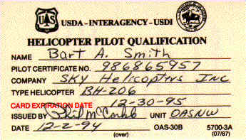
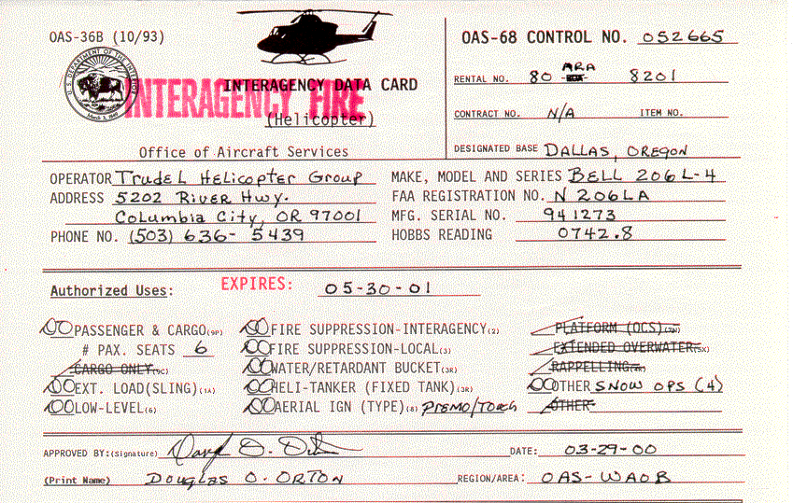
General Aviation Safety
Safety Precautions
Aircraft Data Card and the Pilot Qualifications Card.

Slide 5
Aircraft Data Cards

Slide 6
Pilot Qualification Card

Slide 7
General Aviation Safety
Safety Precautions
Helicopter operations will comply with the user agency manual, Helicopter Contract and Federal and State Occupational Safety and Health Act. Standards applicable to the general safety rules for operations and practices.

Slide 8
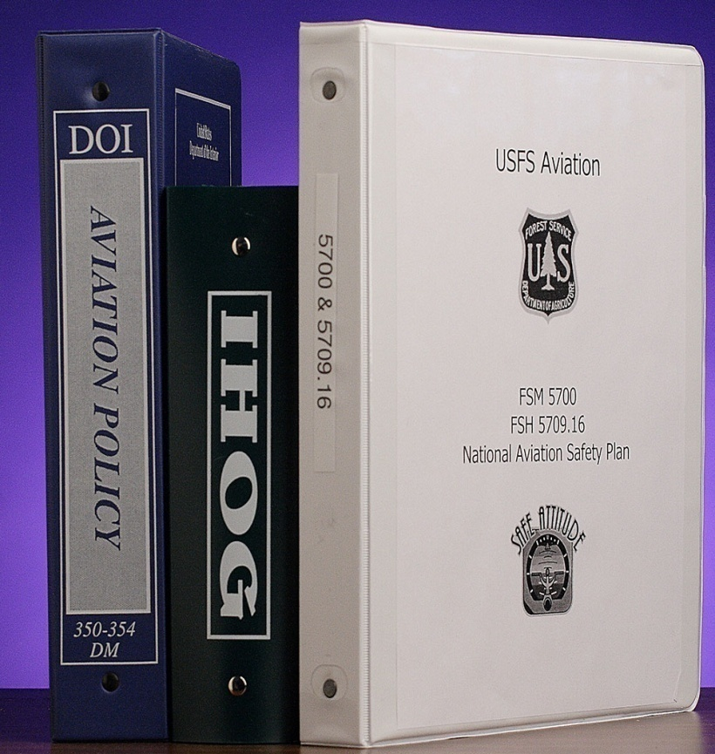
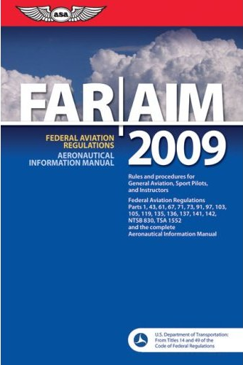
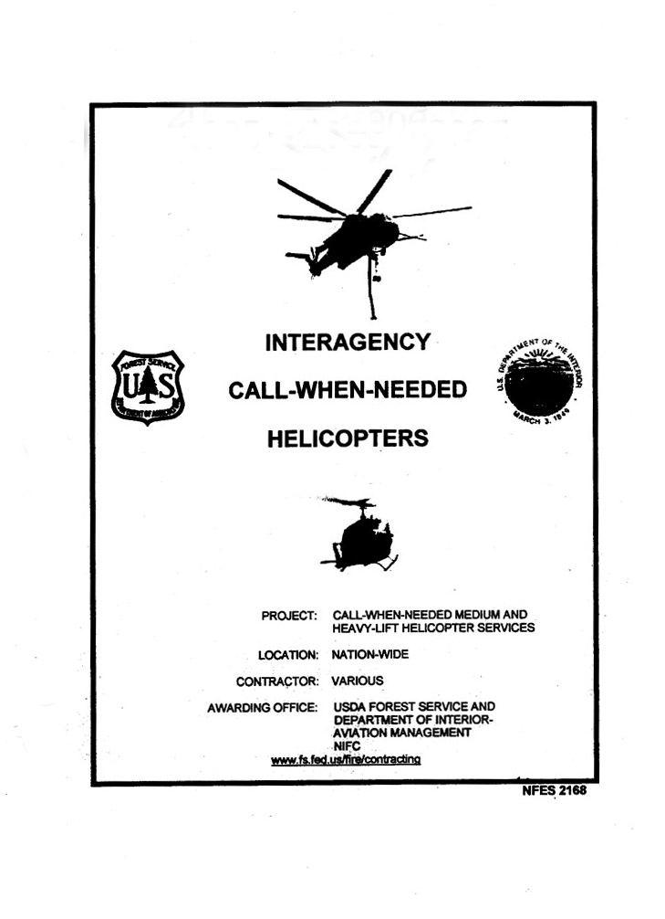
General Aviation Safety
Safety Precautions
Standards

Slide 9
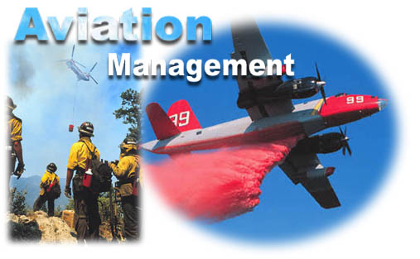
General Aviation Safety
General USDA-FS Policy
General DOI policy
http://elips.doi.gov
http://www.fs.fed.us/im/directives
USDA-FS Aviation-Specific
DOI Aviation-Specific
http://www.fs.fed.us/fire/aviation
amd.nbc.gov

Slide 10
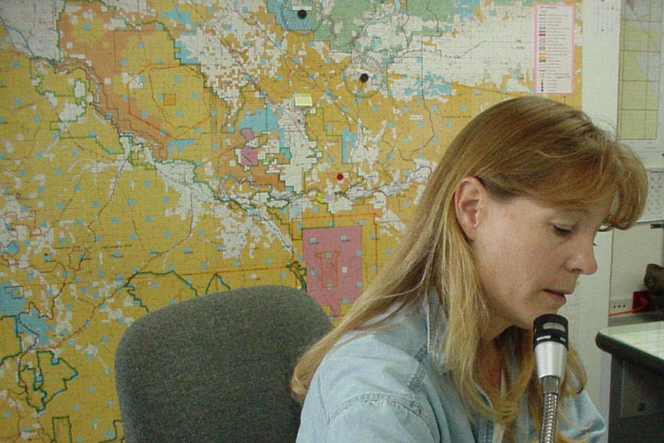
General Aviation Safety
Safety Precautions
Flight following and flight planning will be in place and conducted based on agency policy

Slide 11
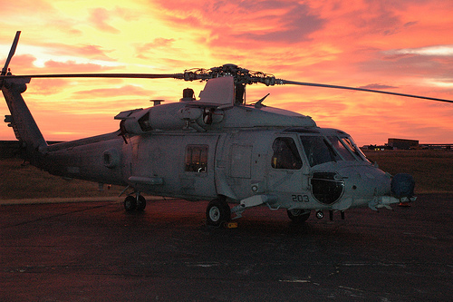
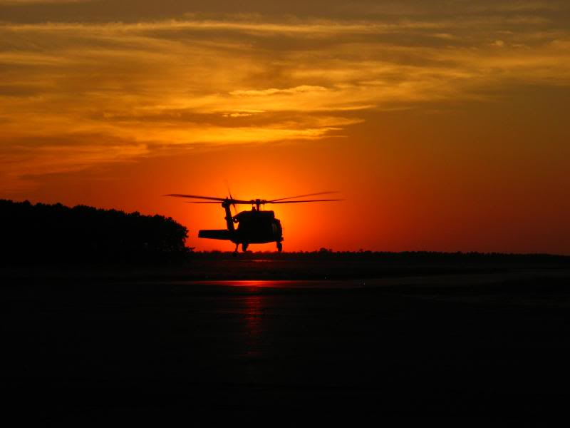
General Aviation Safety
Safety Precautions
Operation of the helicopter will be during daylight hours only. (Defined as one-half hour before sunrise to one-half hour after sunset.)

Slide 12
General Aviation Safety
Safety Precautions
Helicopter pilot duty and flight limitations have been established by the agencies in an effort to reduce pilot fatigue.
8 hours flight time/day
14 consecutive duty hours/day
10 hours rest between days
36 hours in 6 days (not to exceed 42)
2 days off in any 14-day period

Slide 13
General Aviation Safety
Safety Precautions
No unnecessary passengers will be aboard the helicopters.
Maintain control of all passengers and/or individuals in custody.
Do not allow unnecessary flights.

Slide 14
General Aviation Safety
Safety Precautions
Helicopters shall not be dispatched for mountainous flying when average wind velocity exceeds agency or manufacturer limitations.

Slide 15
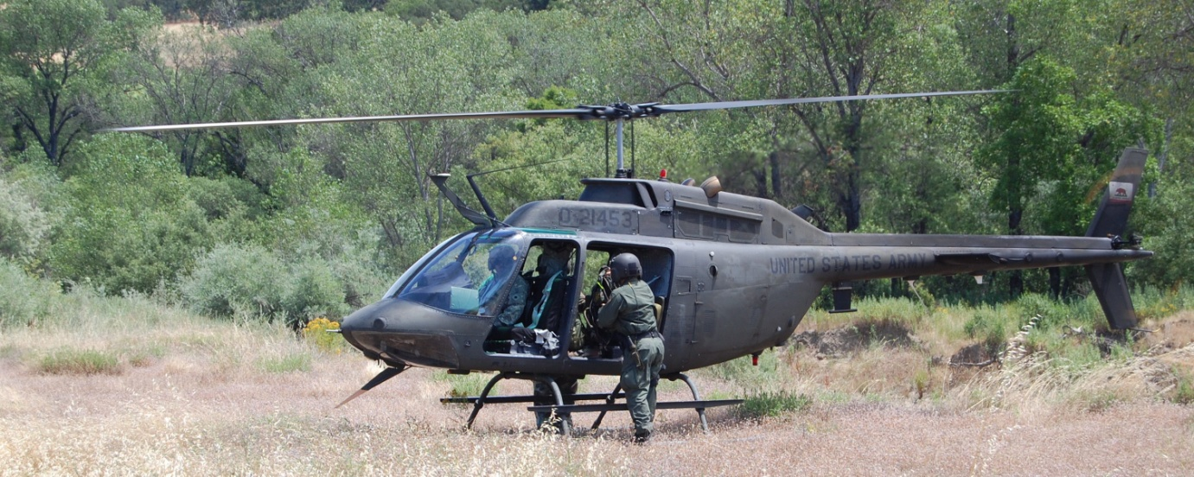
General Aviation Safety
Safety Precautions
Personal protective equipment required for all missions-available and worn by all ground personnel, passengers and pilot.

Slide 16
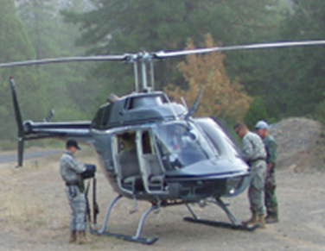
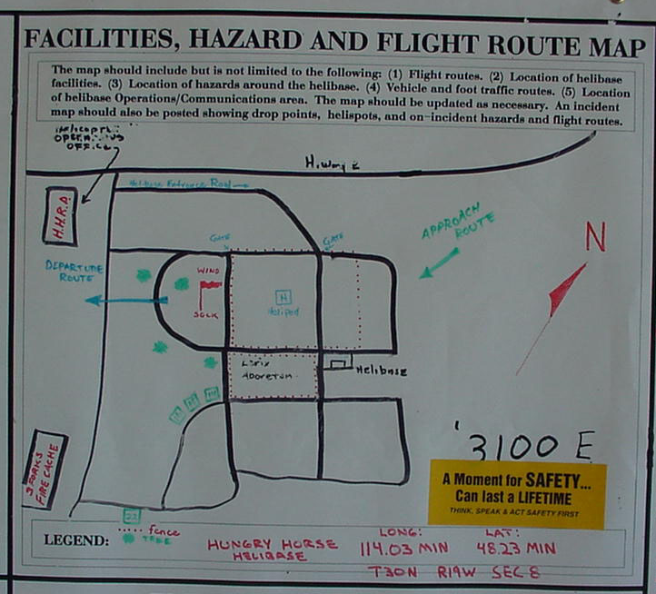
General Aviation Safety
Safety Precautions
Daily or mission briefing
Participants
Pilot
Crewmembers
Ground personnel
Helicopter manager
Briefing items
Ground/Air safety precautions
Safety plan
Hazard map
Mission

Slide 17
General Aviation Safety
Safety Precautions
Responsibilities
Pilot
Safe use of the helicopter at all times.
Participate in the helicopter safety program and the efficient use of the aircraft.
Approve all missions; the pilot’s word is final as to whether or not the flight can safely be made.

Slide 18
General Aviation Safety
Safety Precautions
Responsibilities
All personnel
Ensure mission objectives and hazards are clear and understood.
A passenger may refuse to fly with any pilot or in any aircraft or curtail an existing flight if, in the opinion of the passenger, conditions exist which make the flight unsafe.
Combative in custody person(s) will not be transported by helicopter.

Slide 19
General Aviation Safety
General Helicopter Safety
Keep clear of helicopter’s rotors.
Unless loading or unloading, stay outside safety circle at all times.
Approach or depart in a slight crouch from front or side in full view of the pilot or as directed by the pilot or helitack personnel.
Maintain control of suspects in custody at all times. Do not seat suspect behind pilot. Do not allow the suspect to interfere with flight operations.

Slide 20
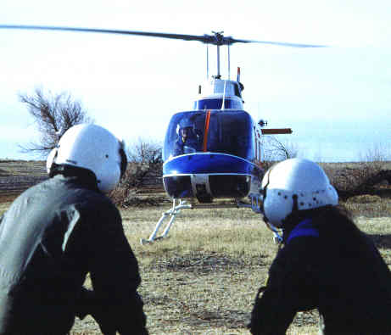
Approach and Departure
From the front and in full view of pilot.
Wait for pilot to give the ok before approach.

Slide 21
General Aviation Safety
General Helicopter Safety
Under no circumstances go near the tail rotor of the helicopter.

Slide 22
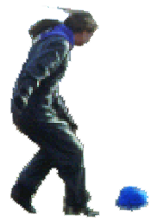
Helicopter Rotor Hazard
DANGER!
STAY AWAY!

Slide 23
General Aviation Safety
General Helicopter Safety
Do not approach from or depart to an area where ground is higher than where the helicopter is sitting or hovering.

Slide 24
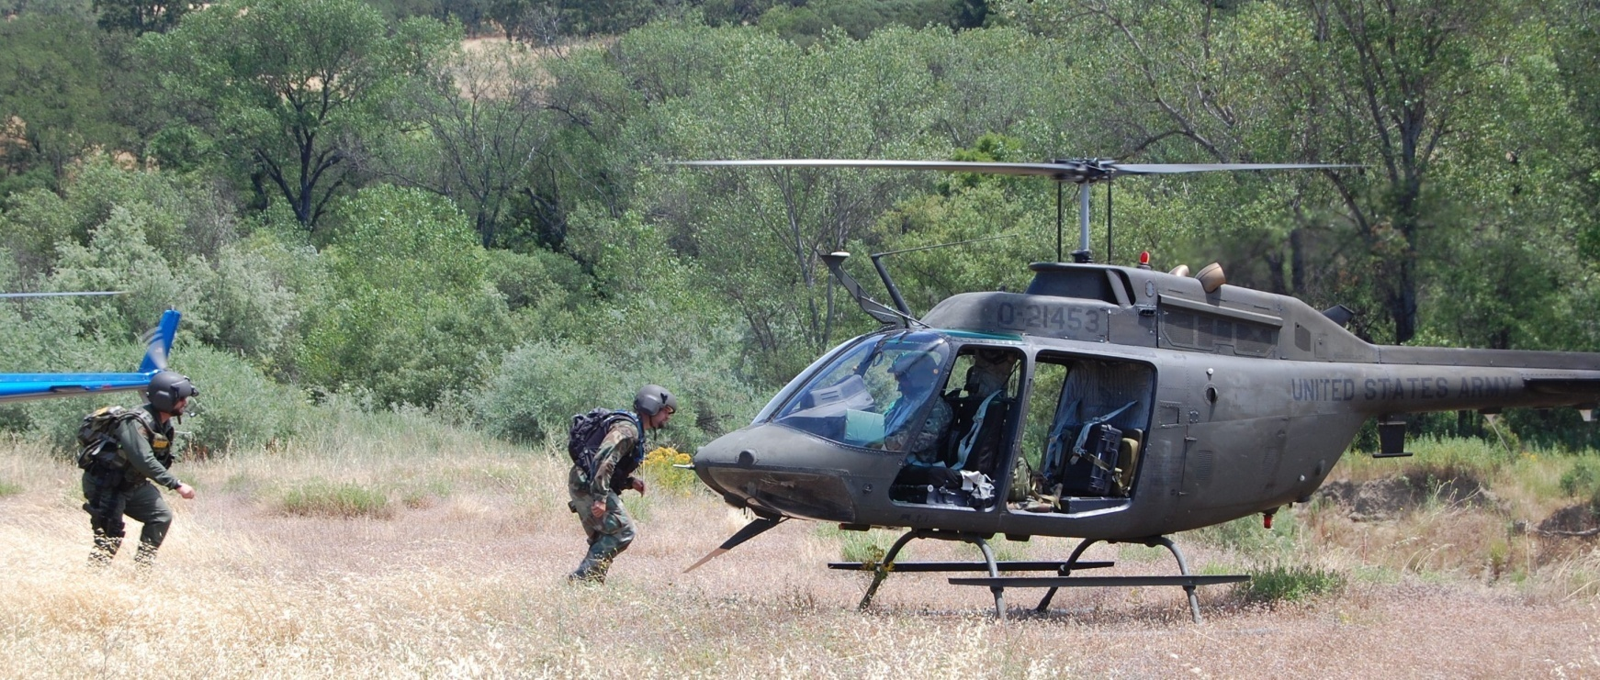
General Aviation Safety
General Helicopter Safety
Never run when approaching or leaving helicopters.

Slide 25
General Aviation Safety
General Helicopter Safety
Carry equipment parallel to the ground.

Slide 26
General Aviation Safety
General Helicopter Safety
Obtain pilot’s approval for all gear stowed in or on the helicopter, especially explosives, flammable, or other hazardous materials.

Slide 27
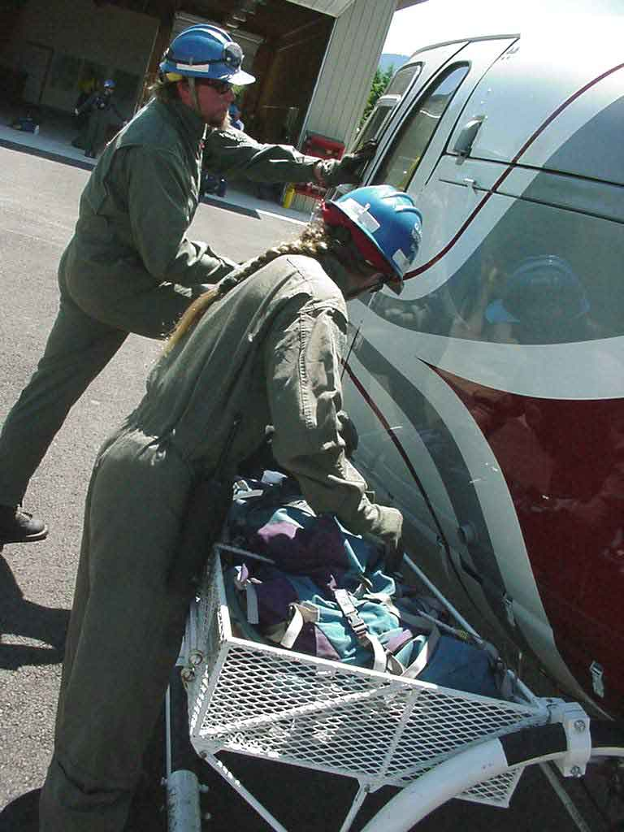
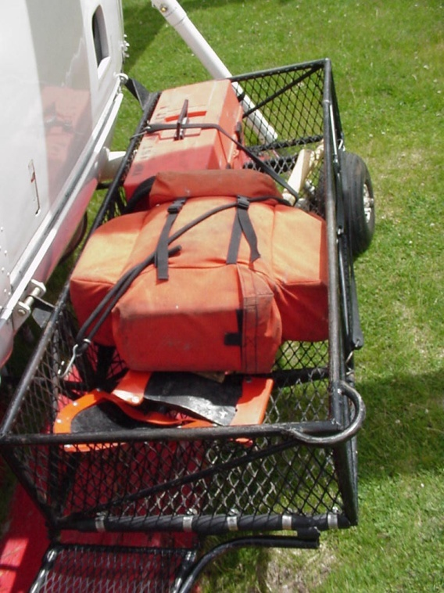
General Aviation Safety
General Helicopter Safety
Cargo in racks or cargo compartments must be enclosed or tied down securely.

Slide 28
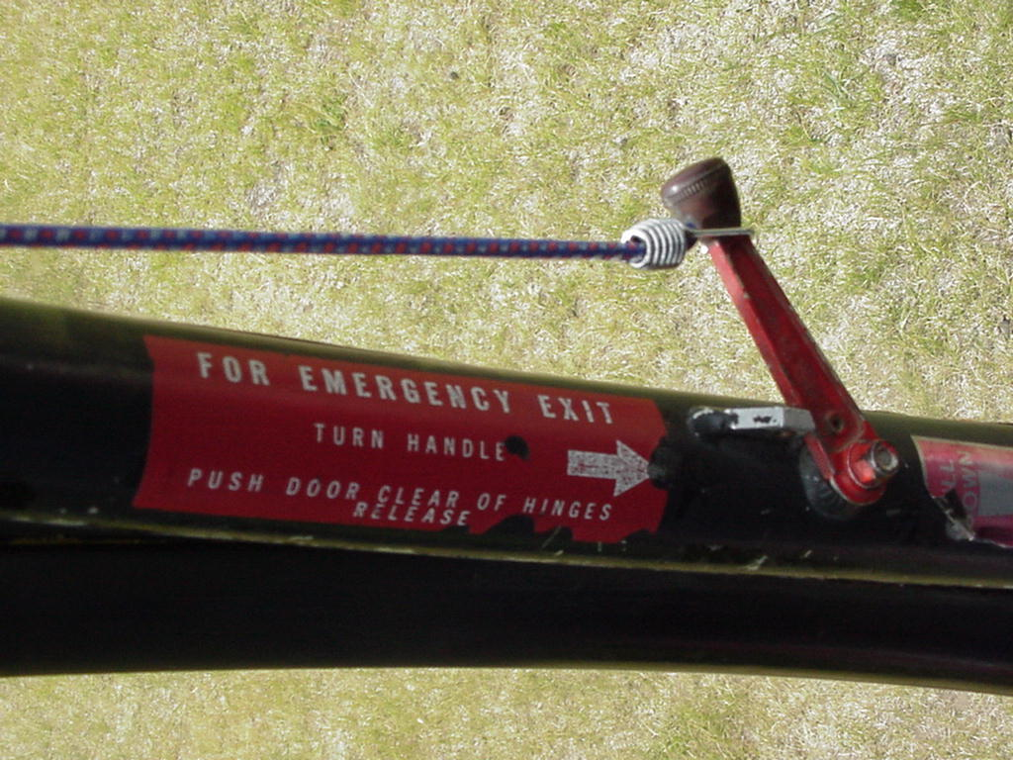
General Aviation Safety
General Helicopter Safety
Know location and operation of doors and emergency exits.

Slide 29
General Aviation Safety
General Helicopter Safety
Know location and operation of:
Fire extinguisher
Emergency Location Transmitter (ELT)
First-aid kit
Survival kit
Restraint systems

Slide 30
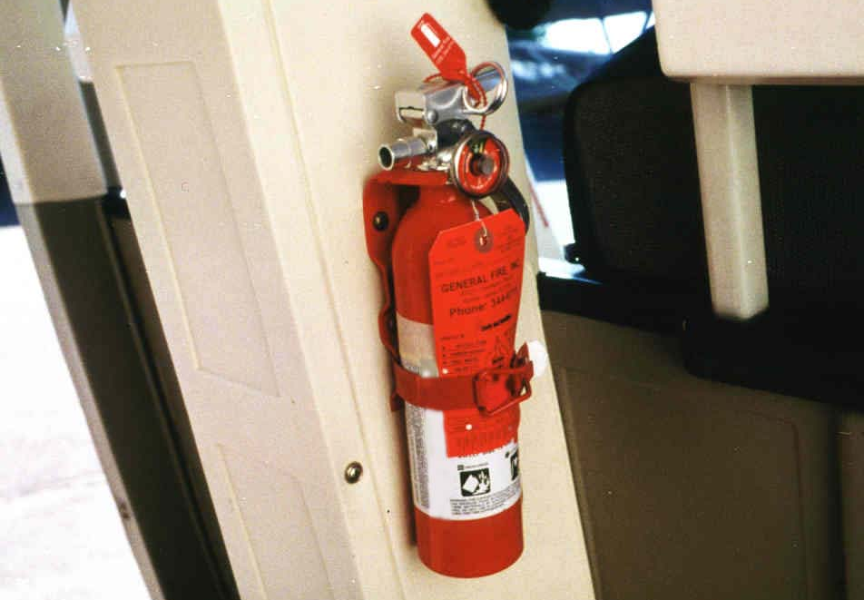
General Aviation Safety
General Helicopter Safety
Fire extinguisher
All DOI and Forest Service aircraft must have a hand held minimum 20B:C rated fire extinguisher.

Slide 31
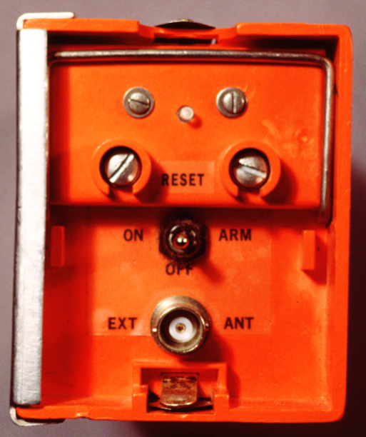
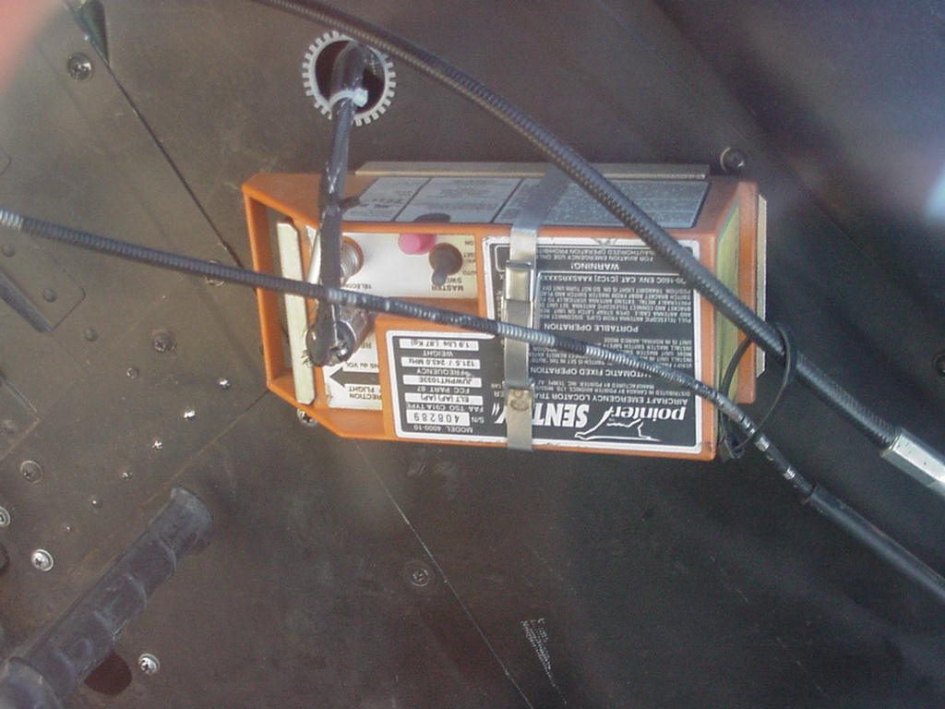
General Aviation Safety
General Helicopter Safety
Emergency Location Transmitter (ELT)
Every aircraft must have an ELT

Slide 32
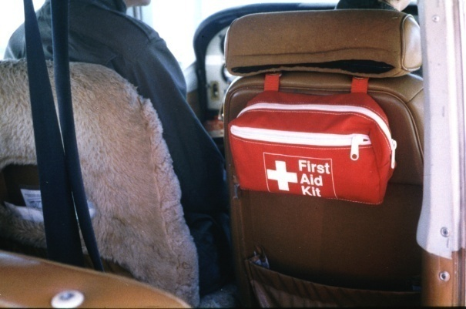
General Aviation Safety
General Helicopter Safety
First Aid Kit
Aircraft owned or operated by DOI and Forest Service are required to carry a first aid kit.
The first aid kit must be readily accessible to all occupants in the aircraft.

Slide 33
General Aviation Safety
General Helicopter Safety
Survival Kit
Survival kits are required to be on every agency contracted helicopter at all time per contract.

Slide 34
General Aviation Safety
Basic Helicopter Safety
Restraint Systems
All aircraft must be equipped with an FAA approved restraint system.
All restraint systems must have a metal-to-metal buckle or latching mechanism.

Slide 35
General Aviation Safety
General Helicopter Safety
Restraint Systems
Three types of restraint systems:
Two-point (no longer used by USFS and DOI)
Three-point
Four-point
Front seat occupants of a helicopter must have a four-point harness.

Slide 36
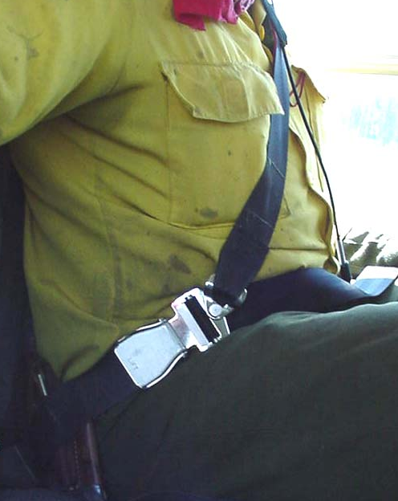
General Aviation Safety
Three types of restraint systems:
No longer used
by USFS & DOI
2-Point
3-Point
4-Point

Slide 37
General Aviation Safety
Basic Helicopter Safety
Restraint Systems
Make sure lap belts are refastened before closing door.

Slide 38
General Aviation Safety
General Helicopter Safety
Fuel and Battery Shut-Off
Know location and operation, specifically which to shut-off first in the event of an emergency

Slide 39
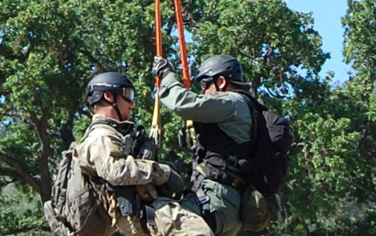
General Aviation Safety
General Helicopter Safety
Use a chin strap or secure helmet when working close to the helicopter.

Slide 40
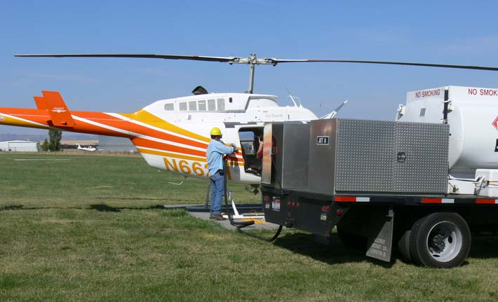
General Aviation Safety
General Helicopter Safety
No smoking within 100 feet of helicopter or fuel trucks.

Slide 41
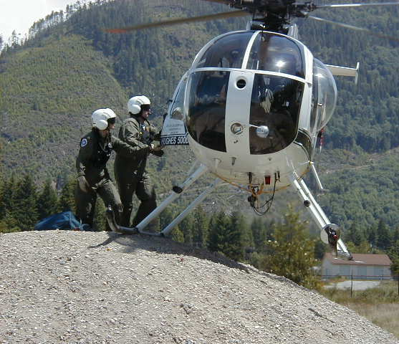
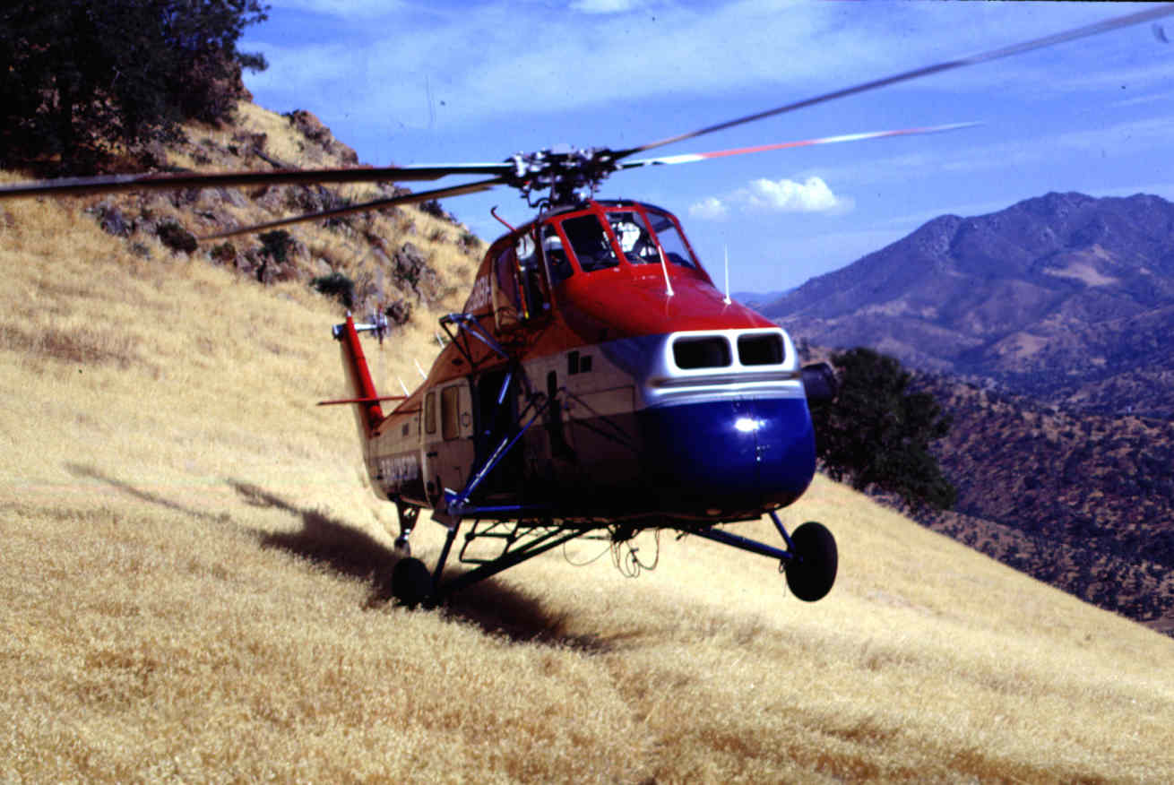
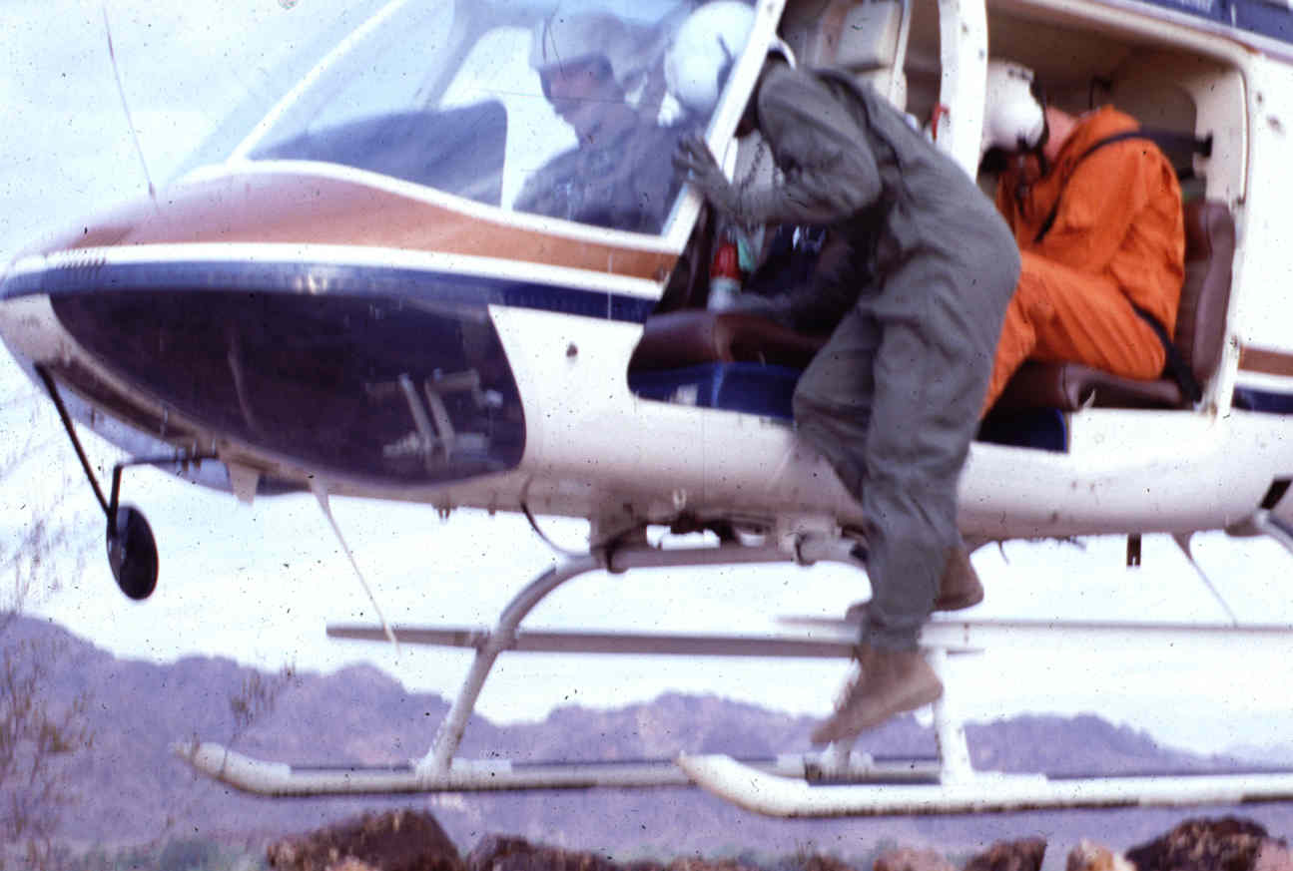
General Aviation Safety
General Helicopter Safety
One-wheel, one-skid, hover stepping, or power-on landing will not be performed without written agency approval.

Slide 42
General Aviation Safety
In-Flight Discipline
No moving about in flight; e.g., changing seats.
Keep arms and legs clear of controls and inside helicopter.
Control objects, such as maps, so as to not restrict visibility.
Keep helmet, gloves and other PPE on.

Slide 43
General Aviation Safety
In-Flight Discipline
Locate the emergency exits and know how to operate. Use only in emergency.
If suspect becomes combative, restrain the suspect, notify pilot to set down in safe location.
No smoking at any time while in flight.

Slide 44
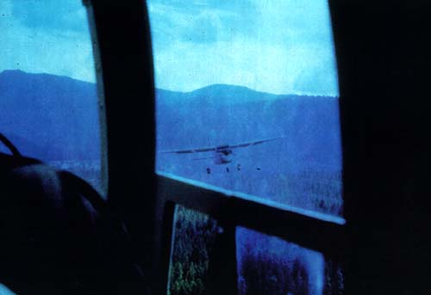
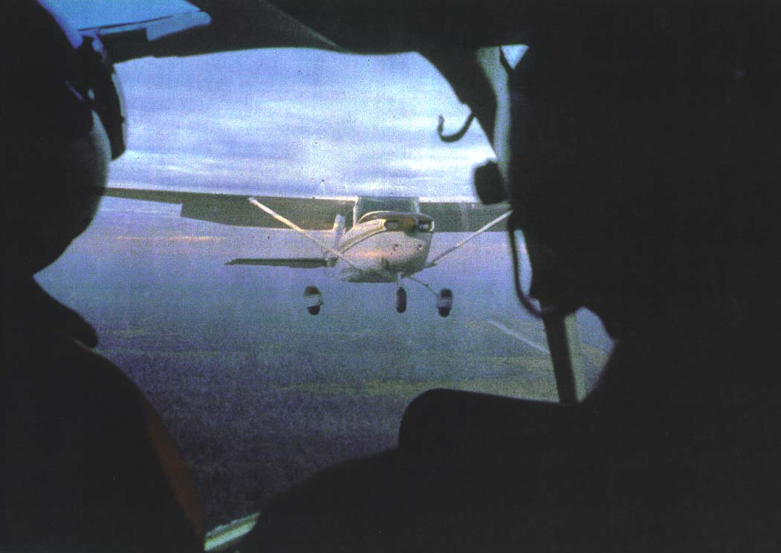
General Aviation Safety
In-Flight Discipline
Keep alert for aerial hazards, particularly other aircraft and power lines; inform pilot of their presence.

Slide 45
General Aviation Safety
In-Flight Discipline
Always know your location so you may assist in flight following and maintain situational awareness.

Slide 46
General Aviation Safety
In-Flight Discipline
Do not throw objects out of helicopter unless trained in procedures and pilot approval is obtained.

Slide 47
General Aviation Safety
Questions and Concerns to Consider
Aviation Watch-Out Situations
Refer to your IRPG for list of Aviation Watch-Out Situations

Slide 48
General Aviation Safety
Questions and Concerns to Consider
Do the risks outweigh the benefits of the operation?
Is there an adequate safety margin?
Has adequate planning been accomplished?
Are the pilot and helicopter carded and equipped for the mission?
Are there sufficient qualified personnel to accomplish the mission?

Slide 49
General Aviation Safety
Questions and Concerns to Consider
Has there been an adequate planning and hazard analysis?
Is there adequate equipment to accomplish the mission?
Have all personnel been briefed on the mission and a positive communication established?
Are contingency plans in place for changes due to bad weather or equipment failure?

Slide 50
General Aviation Safety
Special Mission Safety
What is Special Use?
Operations involving the use of helicopters in support of DOI and U.S. Forest Service programs, which require special considerations due to their functional use. Pilot and aircraft must be carded for special mission.

Slide 51
General Aviation Safety
Special Mission Safety
Example of Special Use:
Flying low-level (below 500 ft.)
Mountain flying
Long-line
Aerial ignition
Short Haul / Rappel
Law Enforcement Missions

Slide 52
General Aviation Safety
Special Mission Safety
Pilot and Helicopter
Approved For The Mission
Before any flight, you must ensure the pilot
and helicopter
are approved
for the planned
mission.

Slide 53
General Aviation Safety
Special Mission Safety
Special use activities require that everyone aboard the helicopter wear a full complement of PPE or abide by agency Law Enforcement waiver(s).

Slide 54
Lesson 7A Objectives
List safety precautions to be observed when working around or flying in a helicopter.
Define the requirements and procedures to safely perform special missions.

