Slide 1
Unit 7 - Operational Safety
Lesson C Cargo

Slide 2
Lesson 7C Objectives
Describe proper procedures for handling hazardous materials.
Describe the entire internal cargo transportation process.
Describe the process to follow for safe external loads operations.

Slide 3
Transport of Hazardous Materials
What is a hazardous material?
A hazardous material is a substance or material which has been determined by the Department of Transportation to be capable of posing an unreasonable risk to health, safety, and property when transported in commerce and which has been so designated.

Slide 4
Hazardous Materials
What is a hazardous material?
Types of hazardous materials and proper transportation procedures can be found in the Interagency Aviation Transportation of Hazardous Materials Guide.

Slide 5
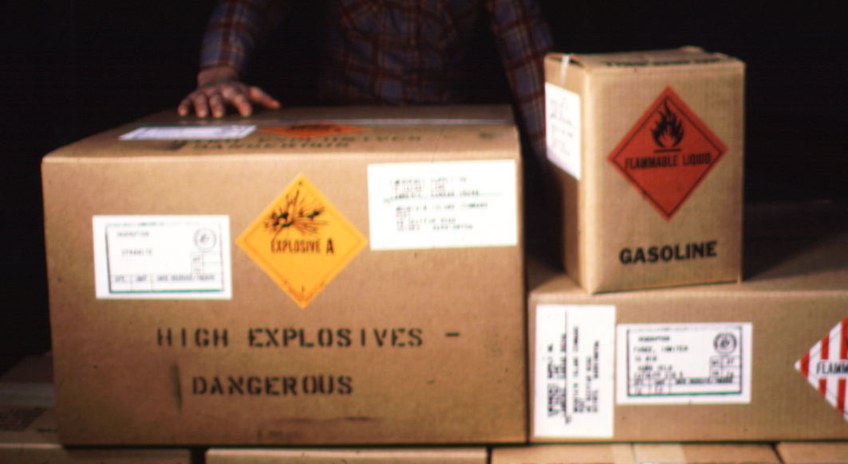
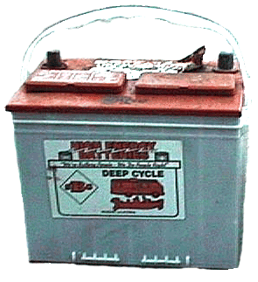
Hazardous Materials
Some of the common hazardous materials are:
Gasoline
Pepper Spray
Batteries
Explosives/Flash Bangs
Propane (compressed gas)

Slide 6
Hazardous Materials
Transport of hazardous materials
Hazardous Materials can only be transported in accordance with the Interagency Aviation Transport of Hazardous Materials Guide NFES 1068.

Slide 7
Hazardous Materials
Transport of Hazardous Materials
Both the Guide and the exemption should be onboard the aircraft when transporting HazMat.
Hazardous materials need to be identified.
Have pilot brief crewmembers on acceptable locations for loading hazardous materials.
On first flight, the pilot shall be notified in writing of HazMat being transported.
Do not transport food items with liquid hazardous materials.

Slide 8
Hazardous Materials
Exercise
In your assigned groups: Using the Interagency Aviation Transport of Hazardous Materials Guide.
Look up the proper way to transport your assigned hazardous material(s).
Present to the class the proper way to transport the assigned hazardous material(s).
Discuss the reasons why it is important to follow this guide.

Slide 9
Internal Cargo
Internal Cargo Transport Procedures
Inspection of cargo
Identifying hazardous materials
Packaging, weighing, securing, and rigging
Manifesting
Obtain pilot approval
Loading and unloading

Slide 10
Internal Cargo
Inspection
Some items may need to be double bagged or boxed to prevent leakage into the helicopter. Wrap the neck of plastic bags with tape.
Boxes need to be taped and all loose items secured. Smaller items can be taped or tied to larger items to avoid being lost.

Slide 11
Internal Cargo
Inspection
If straps or nets are present in the helicopter to secure items, they must be used. Inspect prior to use.
Sharp edges need to be protected to prevent damage to the helicopter or other cargo.
All liquid containers need to be boxed or secured to remain upright.

Slide 12
Internal Cargo
Weighing Cargo
Weigh cargo if possible or provide best estimated weight. Always over estimate.
Organize and tag multiple loads with destination and weight.

Slide 13
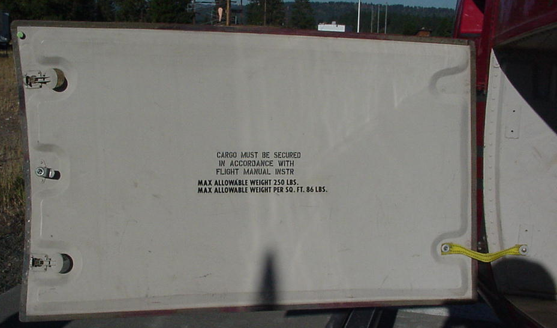
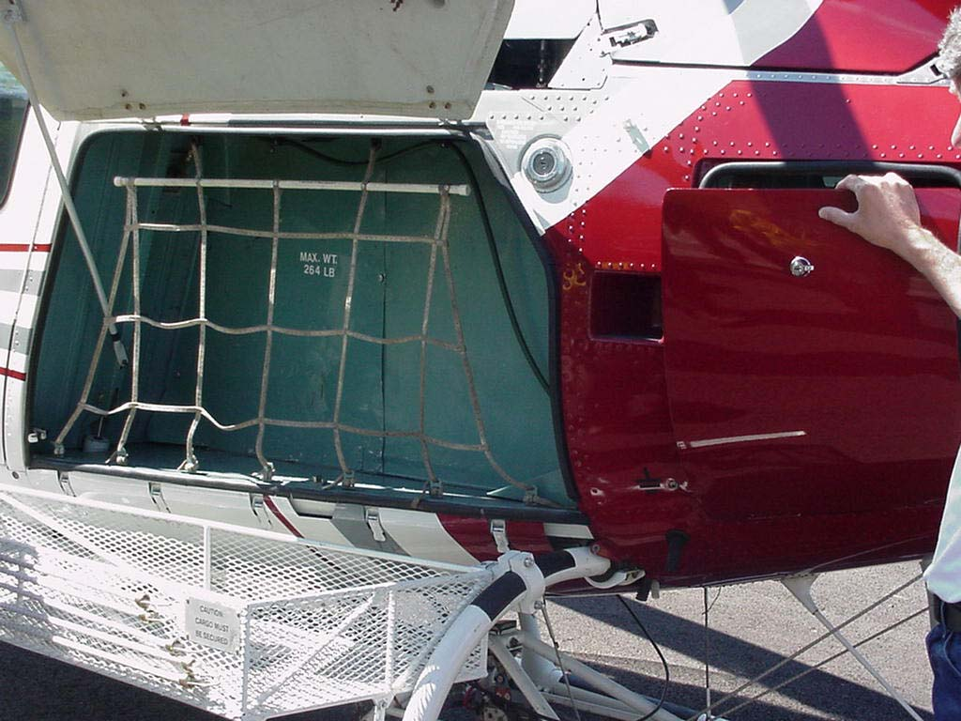
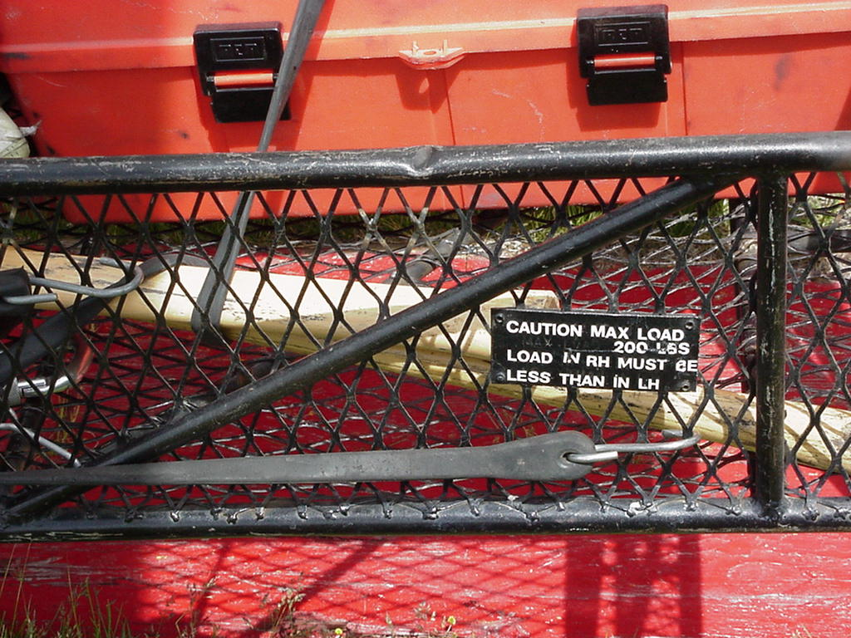
Internal Cargo
Weighing Cargo
Do not exceed weight limits of internal cargo compartments or baskets. Cargo baskets require a detailed briefing on loading and securing gear.

Slide 14
Internal Cargo
Loading Cargo
Pilot must be briefed on destination, weight of cargo, and if there are hazardous materials being transported.
Ensure all weight and balance concerns are addressed.
Follow the pilot’s direction for loading and securing all cargo, especially in external baskets.

Slide 15
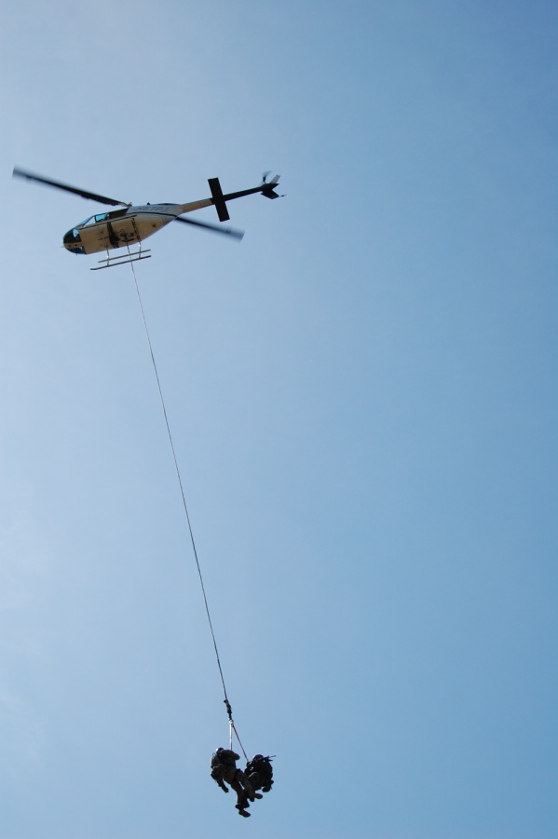
External Loads
Why External Loads?
No suitable landing area for internal cargo.
No ground vehicle access.
Reduces rotor wash

Slide 16
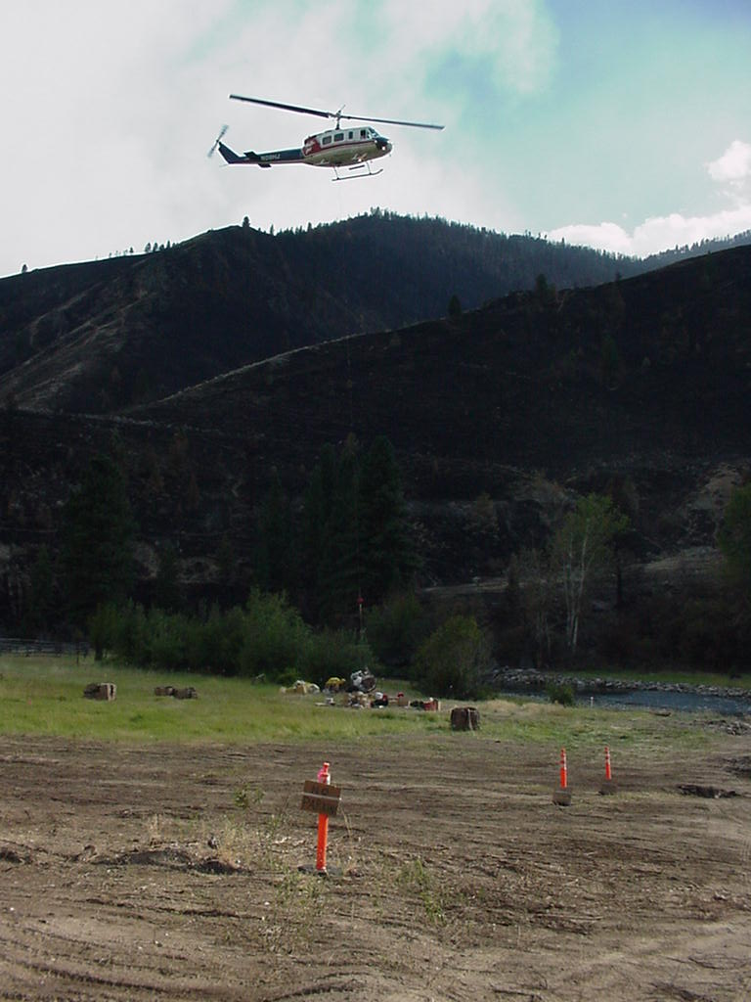
External Loads
Why External Loads?
Reduces number of people involved in operation.
Able to deliver loads without personnel on the ground.

Slide 17
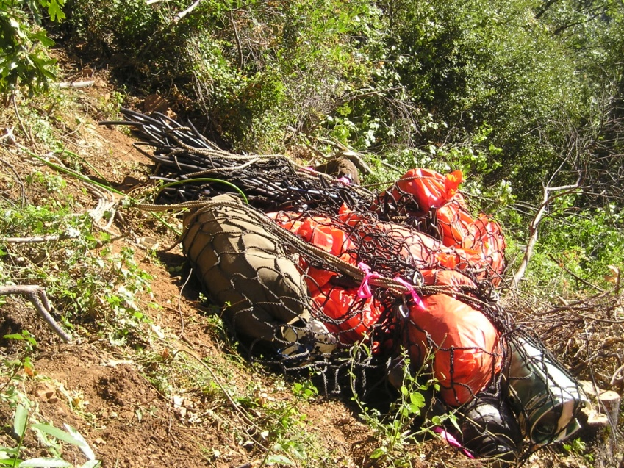
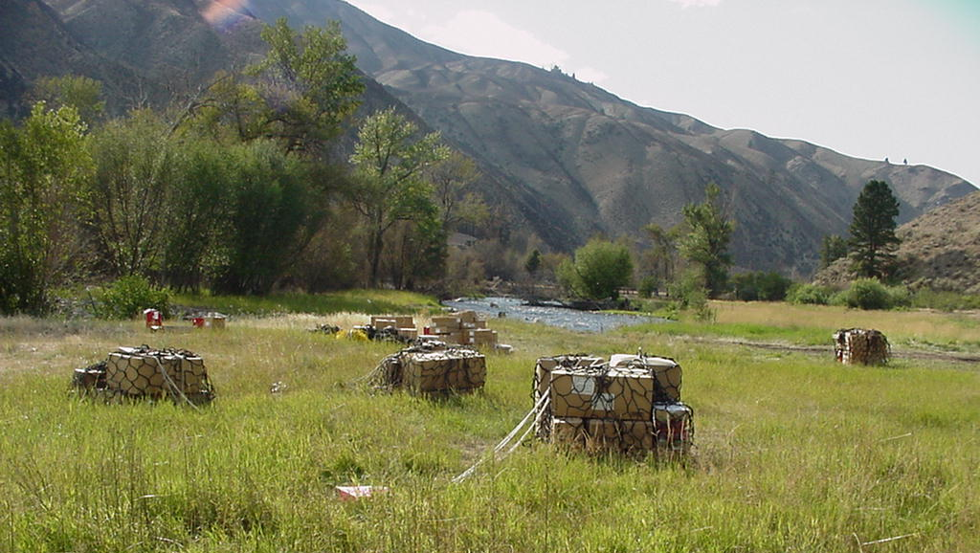
External Loads
Why External Loads?
Bulky or large cargo to be delivered.
Loads can be pre-packaged to reduce loading and unloading time.

Slide 18
External Loads
The safe and efficient transport of external loads relies on standard procedures being followed correctly.
Rigging an external load improperly can be disastrous to the pilot, the aircraft, and personnel on the ground.

Slide 19
External Loads
Only person’s essential to the operation should be positioned beneath a hovering helicopter; i.e., external loads, slinging, grappling hook.
Flying aboard the helicopter with an external load shall comply with agency policy.

Slide 20
External Loads
Remember Check, and then Double Check!
If it’s wrong on the ground, it will only get worse in the air.

Slide 21
Height Velocity Diagram
Discuss risks and hazards of external loads in regards to the height velocity diagram.

Slide 22
Prior to External Load Mission
Before any external load mission ensure:
A risk management process has been completed at the appropriate level.
The pilot is qualified and the aircraft is equipped for the mission.
A load calculation is completed for current conditions.

Slide 23
Prior to External Load Mission
Refer to block 14 on Load Calculations to determine maximum external cargo weight for the days mission. Do weights include: Remote hook, net, swivel, and line?
Ensure total weight on manifest is less than HOGE-J allowable payload for specific aircraft.
Submit manifest to helicopter or helibase manager at the end of shift.

Slide 24
Prior to External Load Mission
Hazardous materials have been identified and packaged properly.
Pilot must be briefed on destination, weight of cargo, and if there are hazardous materials being transported.
Pilot has approved of cargo to be transported.

Slide 25
Prior to External Load Mission
Cargo has been inspected, secured, and packaged properly.
Multiple loads have been identified and tagged according to destination.

Slide 26
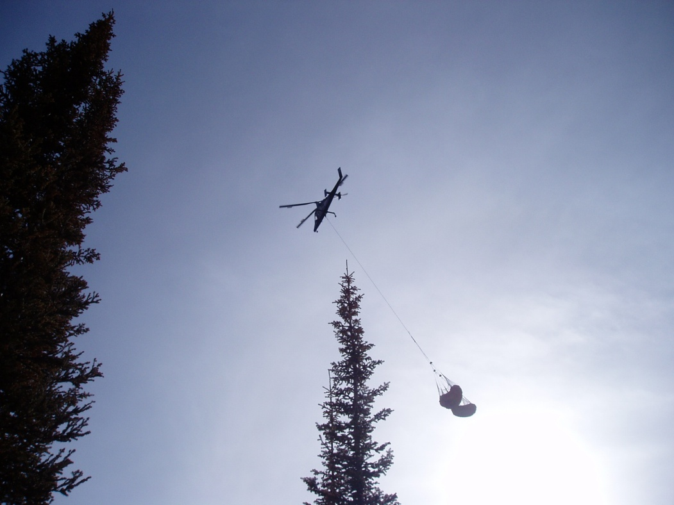
Prior to External Load Mission
Length of longline required for mission.
Personnel are qualified and minimum staffing requirements are met.

Slide 27
Preparing Sling Loads
Inspection
Bag and/or box items to prevent leaking.
Tape boxes and secure loose items.
Protect sharp edges.
Place liquid containers in upright position.
Cushion fragile items.
Daisy chains will require a swivel for each load attached.

Slide 28
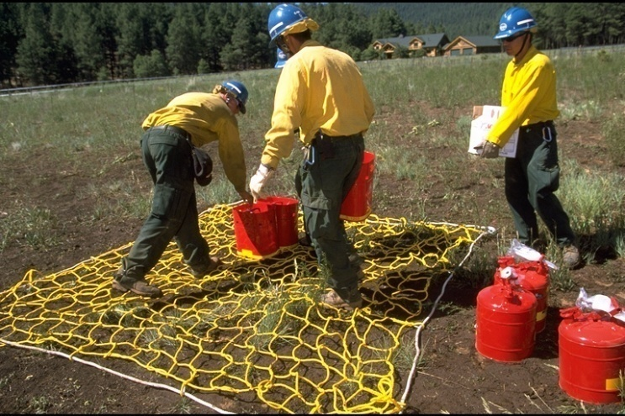
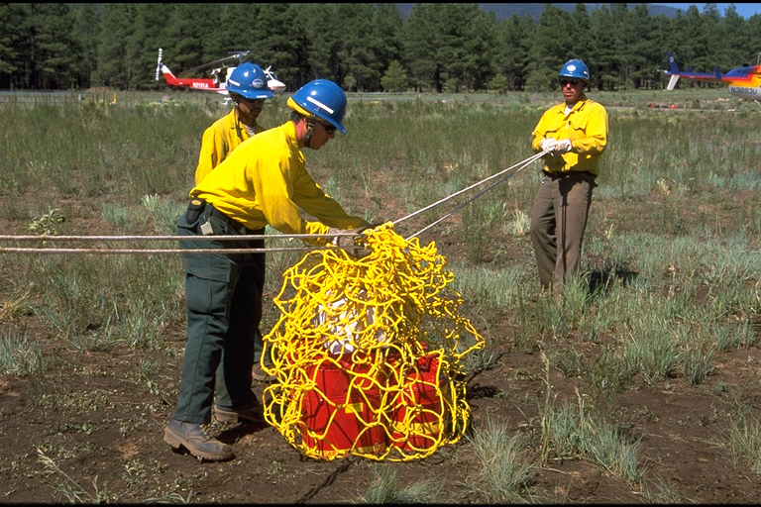
Preparing Sling Loads
Hazardous Materials
HazMat identified, packaged & transported in accordance with Interagency Transport of Hazardous Materials Guide NFES 1068.
Pilot must be notified verbally of the type and quantity of hazardous materials.

Slide 29
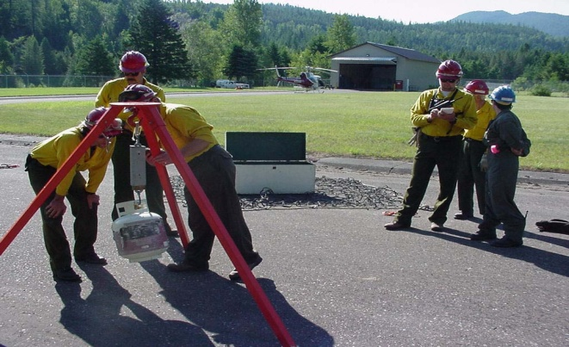
Preparing Sling Loads
Weighing Cargo
Cargo must be weighed if possible or provide an estimated weight and pilot notified.
Tag loads w/weight and destination when appropriate.
Don’t exceed helicopter allowable payload.

Slide 30
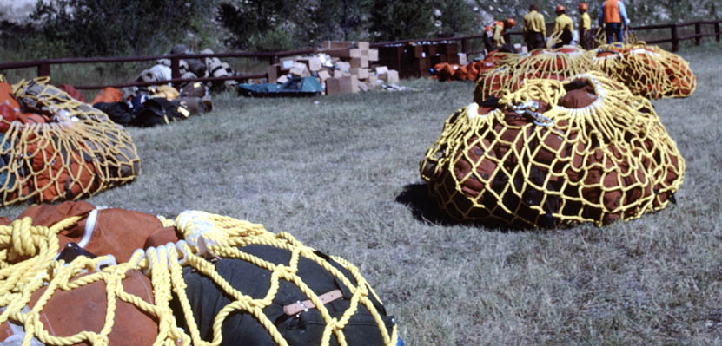
Preparing Sling Loads
Loading Nets
Place heavy/bulky items in center of net.
Build loads in pyramid shape.
Do not over-bulk net.

Slide 31
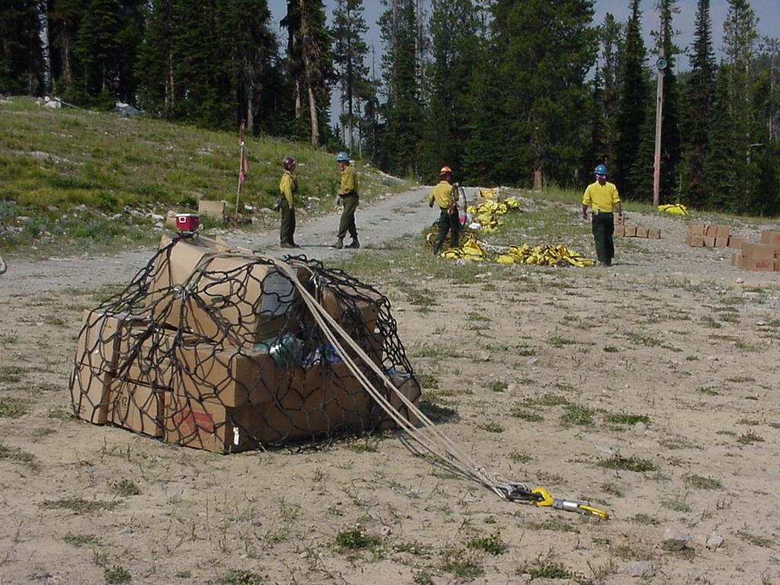
Preparing Sling Loads
Pull metal rings on perimeter rope to equal lengths.
Do not “stitch” or “weave.”
Add ballast (rocks, tools, etc.) to light loads.
Every load gets a swivel.

Slide 32
Assessing Sling Sites
Identify trees or snags that would pose a threat to the mission.
Gauge height of surrounding obstacles to determine length of longline needed.

Slide 33
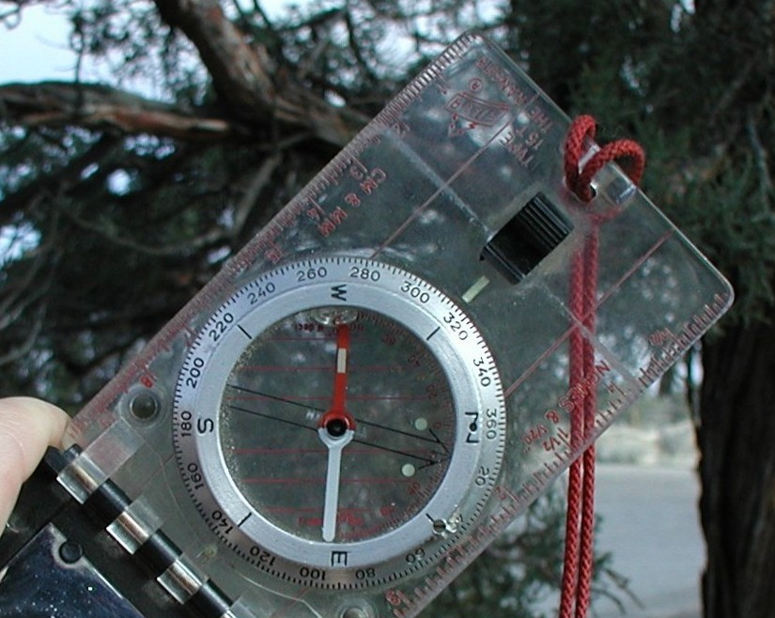
Compass
With compass, back up from the tree or hazard along level ground or along a line of elevation so that the top is roughly at a 45 degree angle above you.
Set the compass bezel to 315* degrees. *(360 - 45 = 315)
The North – South axis of the compass is your horizon line.

Slide 34
Compass
Eye the top of the tree or hazard along the edge of the compass.
Adjust your position to get an exact 45 degree angle.
Have a partner help in adjusting the compass and your position to get the angle right.

Slide 35
Compass
45 Degrees

Slide 36
Compass
Once you have a 45 degree angle and the top of the hazard lines up with the edge of the compass, pace the distance from that point back to the base of the tree or hazard.
Walk a direct line with no ups and downs.
Don’t gauge the height from higher or lower ground. Stay level with the base of the tree or hazard.
Know the length of your pace.
Add your height to the paced distance, which will equal tree height.

Slide 37
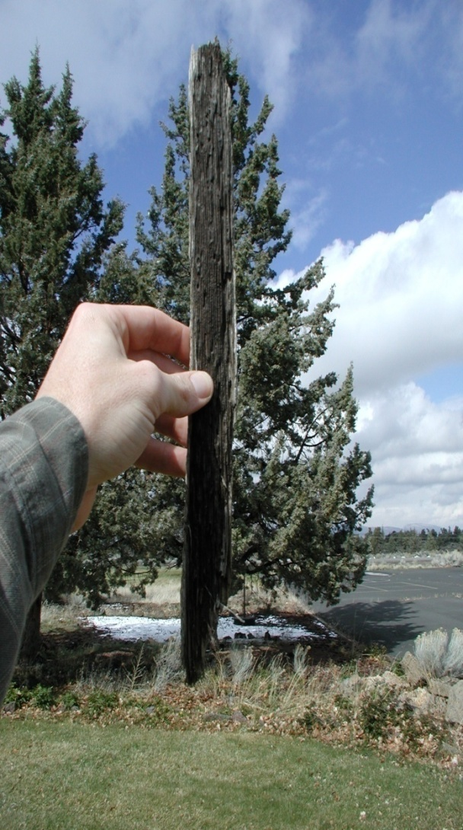
Stick or Pencil
Back up from the tree or hazard.
Bracket the tree or hazard with the stick or pencil.
The top and bottom of the tree or hazard needs to match up with the top and bottom of a stick or pencil held out at arm’s length.

Slide 38
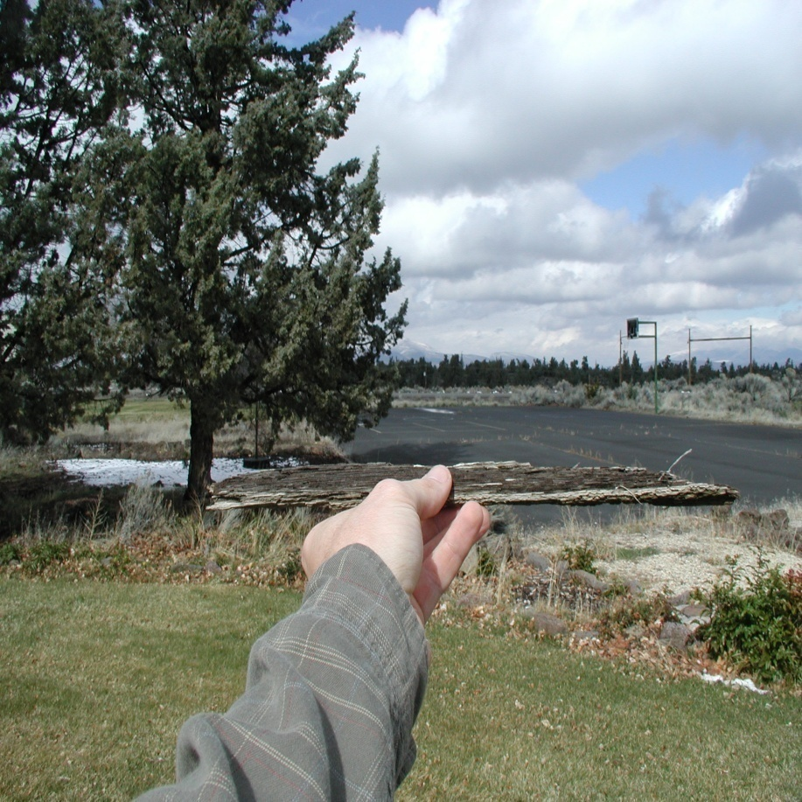
Stick or Pencil
Lay the stick or pencil on its side, (horizontal) with one end matched up to the bottom of the tree or hazard.
The point where the other end falls on the horizon, along level ground, is equal to the height of the hazard.
Pace from that point on the ground back to the base of the tree or hazard to get the height.

Slide 39
Fall a Tree
If all else fails, consider felling the tallest tree or snag around.
May need approval from a Resource Advisor if in the wilderness.
Once you have it on the ground, measure it by using the pacing method.
From that measurement, should be able to determine the general heights of surrounding trees.

Slide 40
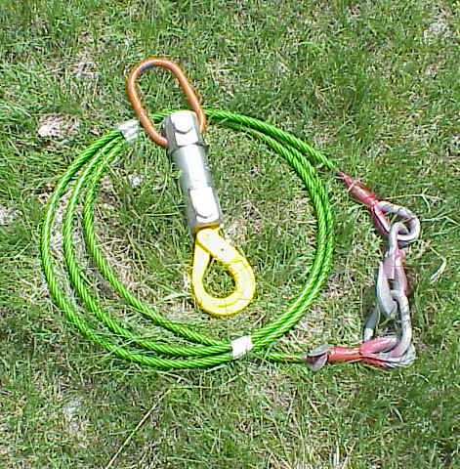
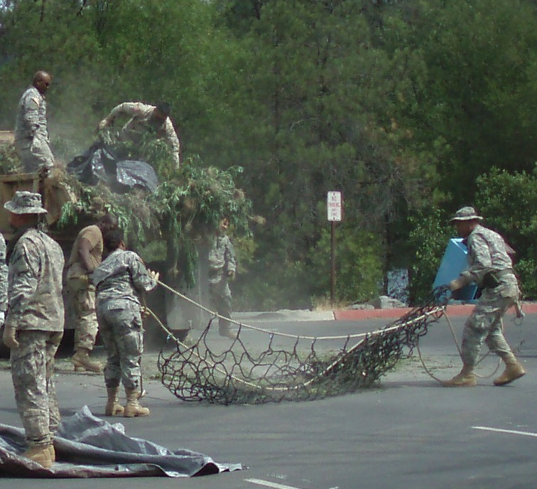
Equipment

Slide 41
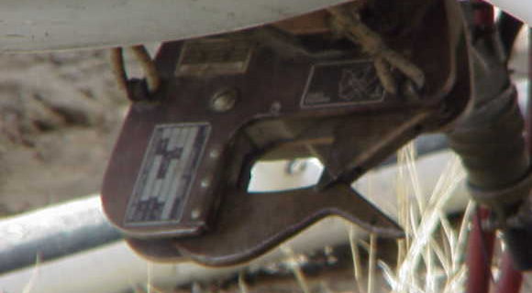
Helicopter Cargo Hook
Manually or electrically released.
Self-cocking with automatic locking.
Assist pilot when testing.
Inspect for damage and wear.

Slide 42
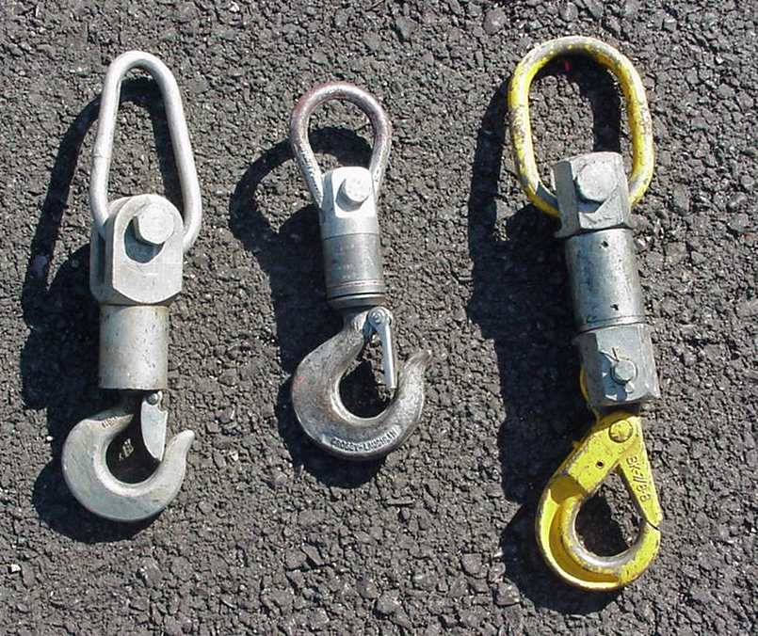
Swivel
Allows load to rotate during flight.
Always use a swivel for external cargo.
No Swivel – No Go!
Use only yellow
swivel.
Older swivels are
no longer in use
and need to be
dog tagged.
“Non-serviceable”
Maximum 3000 lb. working load

Slide 43
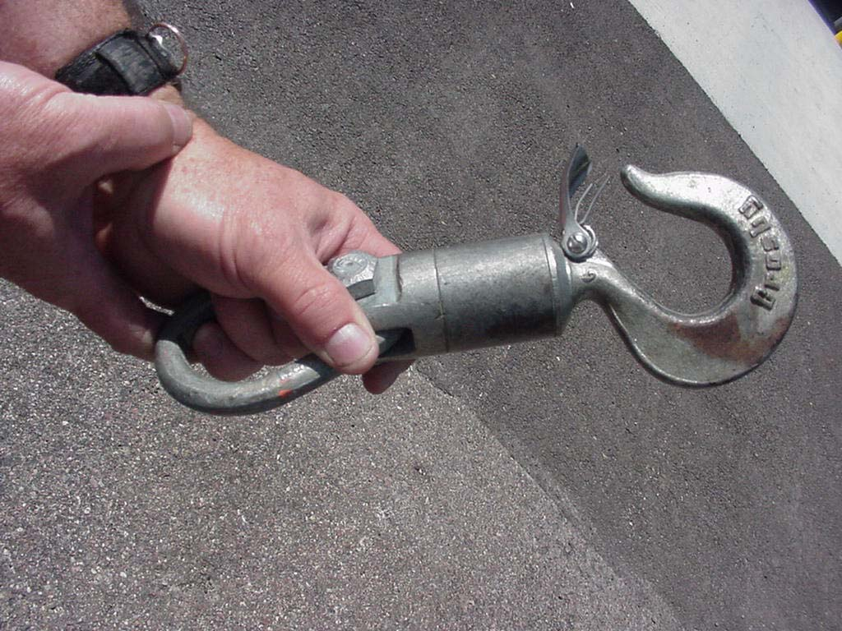
Swivel (cont.)
Inspect for damage and wear.
Don’t use if keeper gate is broken.
“Non-serviceable”
DO NOT USE!

Slide 44
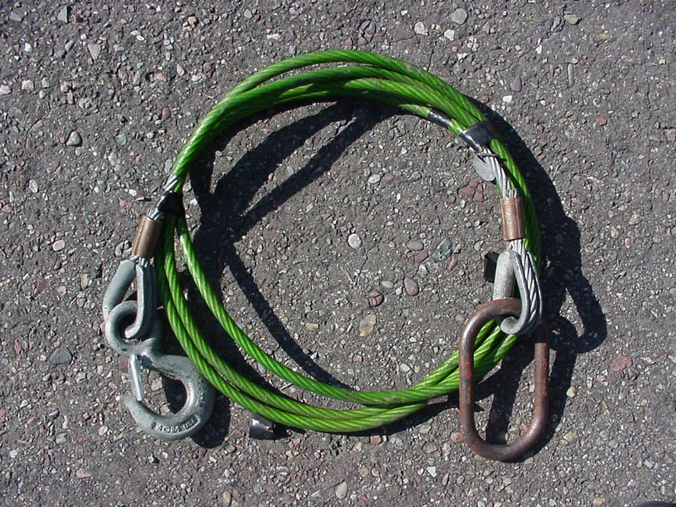
Lead Line
Connects load or multiple loads to helicopter.
Maximum 3000 lb. working load.
Normally, 12-feet long.

Slide 45
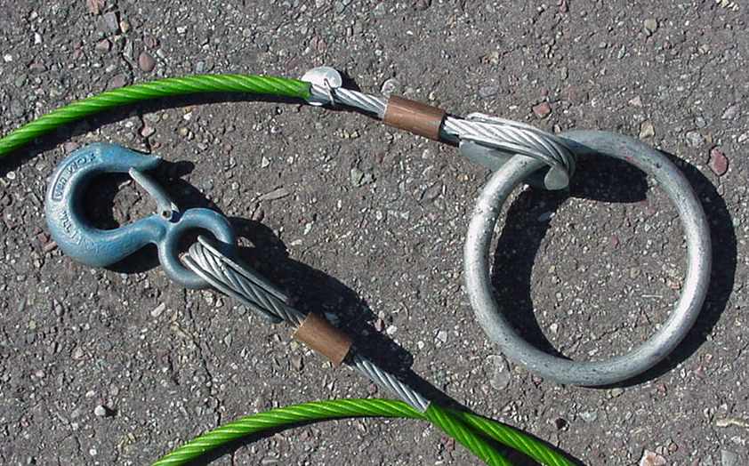
Lead Line (cont.)
Always use swivel.
Inspect for damage and wear.
Check keeper gate and swags.

Slide 46
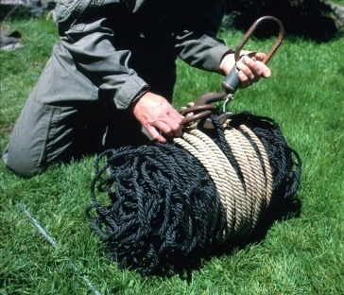
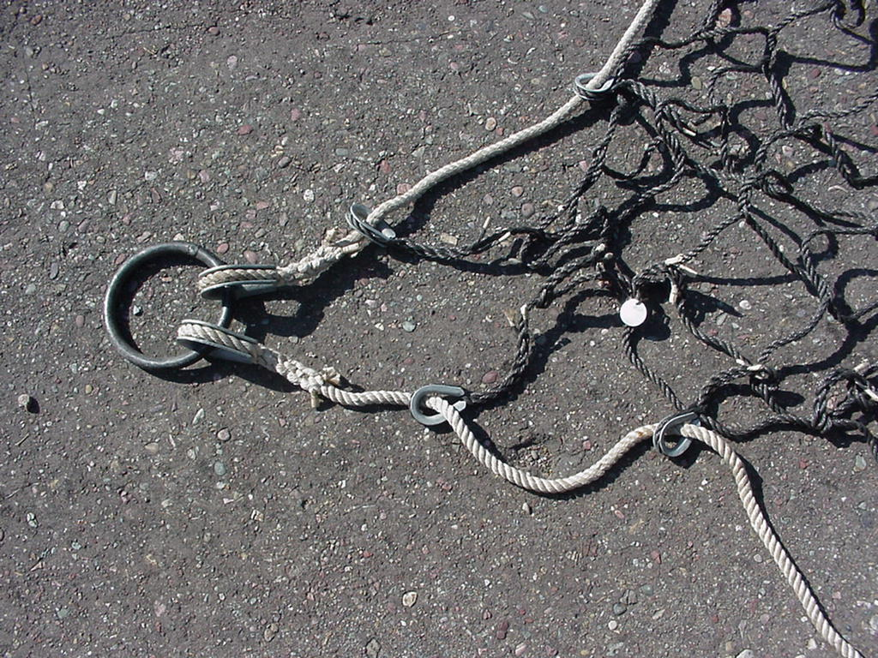
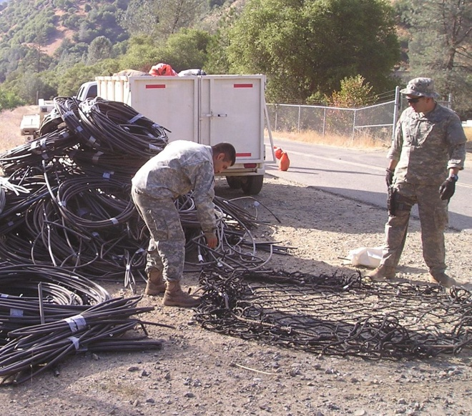
Cargo Net
Prepare for transport by loading cargo in net center, heavy objects first.
Inspect for damage and wear.
Typical size 12’ x 12’
Working load 3000 lbs.

Slide 47
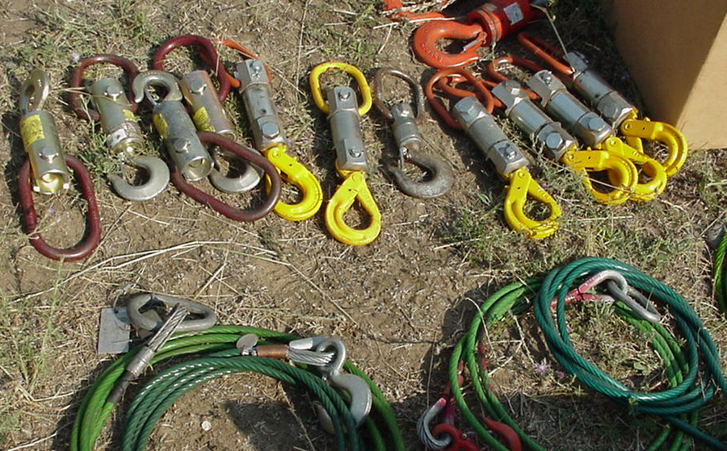
Equipment Inspection
Load limits not exceeded.
Inspect for damage and wear.
Functions properly.
Use only yellow
swivel.
Older swivels are
no longer in use
and need to be
dog tagged.
“Non-serviceable”

Slide 48
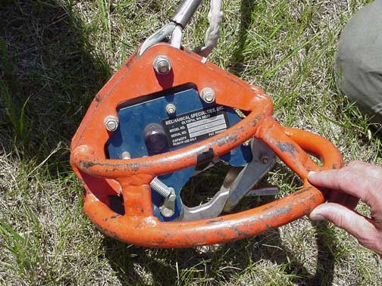
Standard Equipment
Longline
(various increments)
Remote cargo hook
(w/ cage)
Inspect for damage and wear prior to use. Check line for kinks.

Slide 49
Grappling Hook
Line Weight
Swivel
Grappling Hook

Slide 50
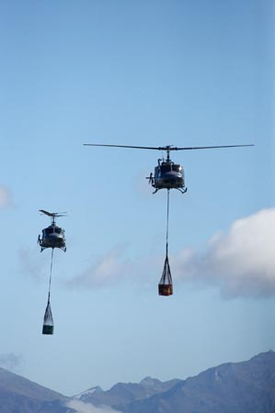
External Load Operations

Slide 51
Before any External Load Mission Ensure:
(It is imperative) a good briefing be provided to all personnel involved.
Pilot/aircraft approved for mission.
Load calculation completed.
Cargo weighed and manifested.
Hazardous materials packaged and labeled.

Slide 52
Before any External Load Mission Ensure: (Cont.)
Personnel qualified, minimum staffing.
Cargo packaged, inspected and secured.
Pilot has approved cargo.
Loads identified and tagged for destination.

Slide 53
Before any External Load Mission Ensure: (Cont.)
Sling/rigging equipment designed for load.
Flight following and crash/rescue procedures established.
Radios operational with correct frequencies.
Ground and flight hazards identified.

Slide 54
Identify Hazards
Wires
Obstructions in the approach and departure paths
Tall trees and snags
Weather
Other aircraft in area
Wrong helicopter for mission
Are identified hazards known to all?

Slide 55
Ground Personnel Long Line Procedures
Parking tender and hook-up person are in front and off to the side of the helicopter where the pilot is seated.
This clears the departure lane for the pilot, and reduces the exposure to ground personnel.
All other personnel should be in a safety area.

Slide 56
Ground Personnel Long Line Procedures
Try to keep the hover time to a minimum.
Allow remote hook to rest on the ground before hook-up person enters safety circle and attaches load.
Hook-up person attaches swivel to remote hook, walks back to parking tender.
Parking tender notifies pilot, hook-up person is clear, lifts at their discretion.

Slide 57
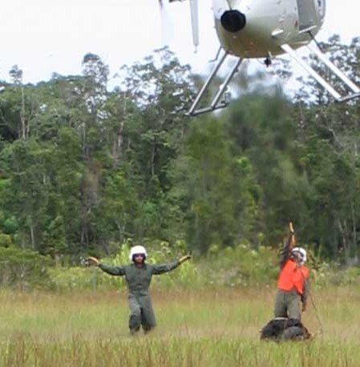
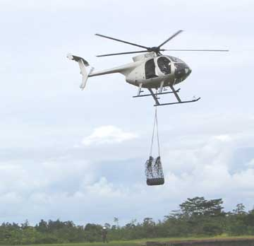
Hover Hook-Up

Slide 58
Hover Hook-Up – Preparation
Proper PPE
Two people recommended, one with radio.
Emergency procedures established.
Crash/rescues procedures identified.
Site preparation completed.
Keep area clear of unauthorized personnel.

Slide 59
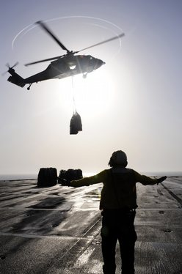
Hover Hook-Up – Procedures
Hook-up person stands facing helicopter with swivel extended overhead.
Parking tender directs pilot with hand signals and radio communication.

Slide 60
Hover Hook-Up – Procedures
Pilot approaches hook-up person and hovers over them.
Keep hover time to minimum.
Hook-up person attaches load and exits toward parking tender.
Never cross underneath skid of helicopter.

Slide 61
Hover Hook-Up – Procedures
Parking tender signals pilot to begin movement of the load.
Checks line for entanglement.
When load’s clear, give pilot “clear to depart” signal.
Parking tender should continue to check the load visually.
Loads can also be attached to the cargo hook, when the helicopter is on the ground.

Slide 62
Hand Signals
Review the Standard Helicopter Hand Signals out of the IRPG.

Slide 63
Remember!
Check and then Double Check!
If it’s wrong on the ground, it will only get worse in the air.

Slide 64
Lesson 7C Objectives
Describe proper procedures for handling hazardous materials.
Describe the entire internal cargo transportation process.
Describe the process to follow for safe external loads operations.

