Slide 1
Unit 7 - Operational Safety
Lesson D Parking Tender and Miscellaneous Roles and Responsibilities

Slide 2
Lesson 7D Objectives
Describe parking tender roles and responsibilities.
Describe plan for medivac procedures.

Slide 3
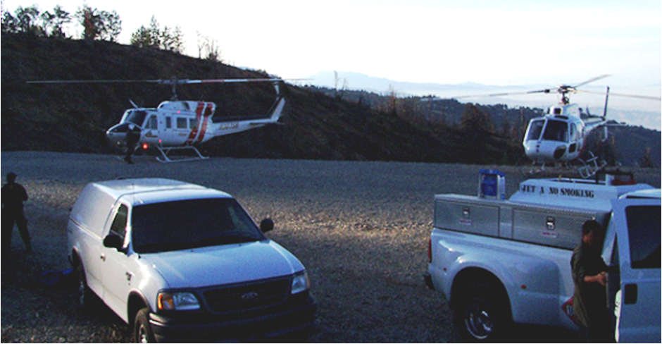
Parking Tender
The parking tender provides safety and oversight for all operations occurring within the safety circle of the helicopter.

Slide 4
Parking Tender
Personal Protective Equipment (PPE) It is essential that you wear all Personal Protective Equipment including a:
Non-flammable high visibility vest

Slide 5
Parking Tender
Roles and Responsibilities
Obtain briefing from appropriate supervisor; obtain radio frequencies and other information necessary to perform the job.
Whenever the assigned helicopter’s engine is running, or whenever it is approaching or departing the parking spot, supervise activities at the assigned landing pad, including personnel, ground vehicle, and helicopter movement. Keep unauthorized people out of safety circle.

Slide 6
Parking Tender
Roles and Responsibilities
Know and understand crash-rescue procedures; ensure that extinguishers are placed at the landing pad; be responsible for extinguisher operation in the event of the fire either on landing, takeoff, or refueling.
Ensure touchdown pad is properly prepared, numbered, and maintained.
Ensure there is adequate communication(s).

Slide 7
Parking Tender
Roles and Responsibilities
Provide wind advisories and other landing, takeoff, and holding directions to the pilot.
Communication with the pilot may be done either through hand signals or by way of radio communication.
Parking Tender should be positioned outside the safety circle.

Slide 8
Parking Tender
Roles and Responsibilities
Be alert for potential conflicts between inbound and/or outbound aircraft.
Coordinate with loadmasters on the loading and unloading of personnel and cargo; ensure that loading personnel check personal seatbelts, cargo restraints, and helicopter doors prior to departing the area.
Monitor the fueling of helicopters.
Immediately report any problems.

Slide 9
Parking Tender
Safety Precautions While Refueling
Parking tender’s job is to observe and maintain safety circle.
Keep out other vehicles and people.
Stage at fire extinguisher in the event of a fueling fire.
Parking tender should also know the positions and operation of emergency shut-off valve on fuel truck.

Slide 10
Parking Tender
Safety Precautions While Refueling
Fueling the helicopter is primarily the contractor’s responsibility.
Helicopter and fuel containers will be bonded.
There will be no passengers aboard.
No smoking or unauthorized personnel will be within 50 feet.
Rotor and engines will be stopped except for when agency approval is given for re-fueling.

Slide 11
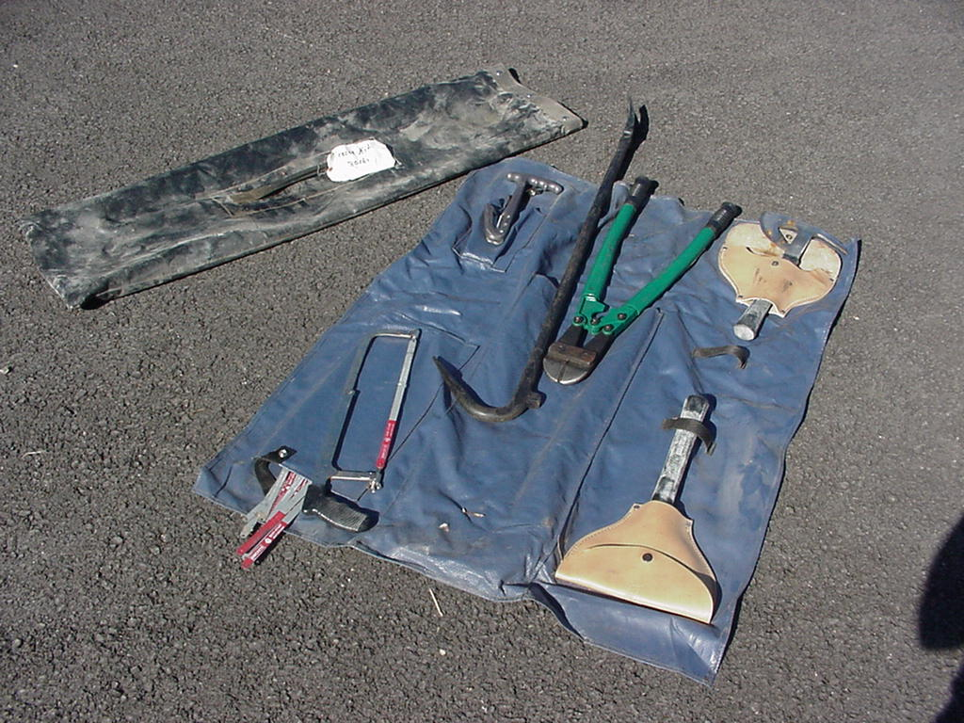
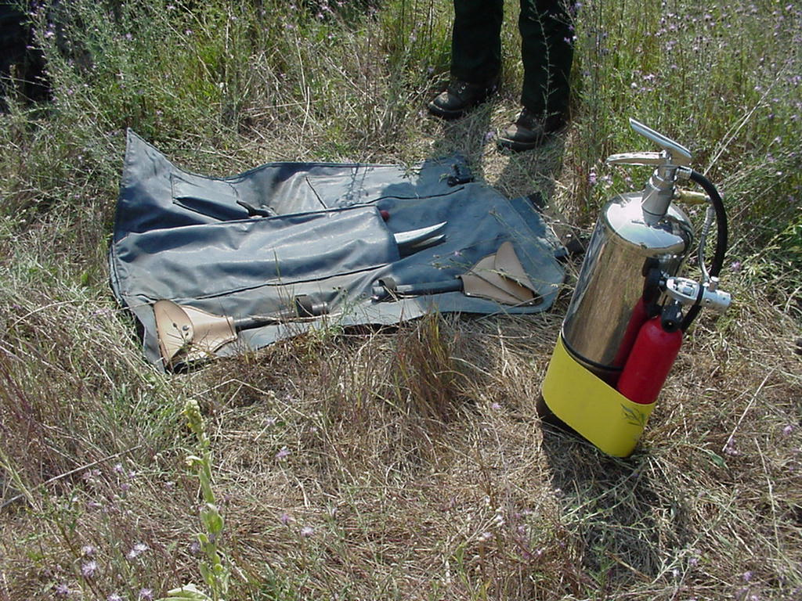
Parking Tender
Emergency Procedures – Take-off and Landing Area

Slide 12
Parking Tender
Emergency Procedures – Take-off and Landing Area
Clear landing areas, including: personnel, other aircraft, and vehicles.
Be familiar with the use and application of:
Crash Rescue Kit, NFES #1040. For entry and extrication.
Evacuation Kit, NFES #0650. Includes stokes combined package litter and 25-person first aid kit.
Fire extinguisher, 40 lb 20-B-C

Slide 13
Parking Tender
Emergency Plan
Activate Local Emergency Plan
It should include the following information:
How to contact specialized crash/fire rescue units.
Specialized medical facilities available such as burn and head injury treatment facilities.
Transportation methods available.
- Bureau or agency notification procedures.
- Refer to pre-accident plan for local specific actions.

Slide 14
Parking Tender
Emergency Plan
Only respond to aircraft accident if properly trained and briefed on procedures.

Slide 15
Medical Evacuation
Medical evacuation plans can be found in the incident action / Operation plan (IAP) and/or project aviation safety plan.
It is a pre-determined plan that provides procedures and protocols for crash rescue, medivac and helicopter evacuation missions.
The plan should be posted on the helibase information board and reviewed with all personnel involved.

Slide 16
Medical Evacuation
Review a HJA-4 (Crash Rescue/Medivac/ Evacuation Plan) located in IHOG. (Specifically VI accident response at helibase). Discuss roles and responsibilities of helicopter crewmembers and plan.
Review IAP handed out in Unit 1. Discuss what is in the medivac plan.

Slide 17
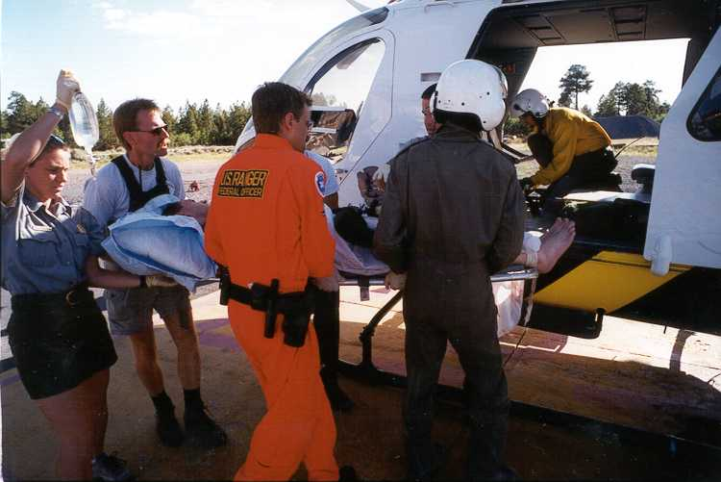
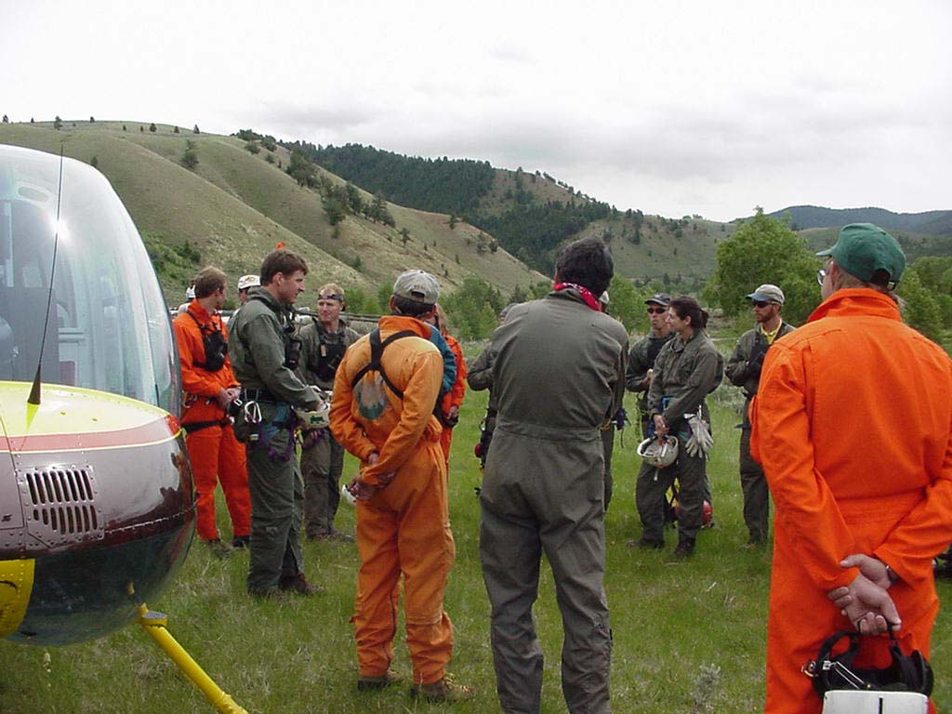
Medical Evacuation
Helicopter pilots, crews, and helibase personnel should all be briefed on roles, responsibilities, and procedures.

Slide 18
Aviation Mishap Types
Aircraft Accident
An aircraft accident is an occurrence associated with the operation of an aircraft, which takes place between the time any person boards the aircraft with the intention of flight and the time all such persons have disembarked, and in which any person suffers death or serious injury or in which the aircraft receives substantial damage. (350DM 1, FSM 5700)

Slide 19
Aviation Mishap Types
Incident with Potential
An incident that narrowly misses being an accident and which the circumstances indicate serious potential for damage or injury.
Classification of incidents with potential are determined by Aviation Safety Managers. (350DM 1, FSM 5700)

Slide 20
Aviation Mishap Types
Aircraft Incident
An occurrence, other than an accident, associated with the operation of an aircraft that effects, or could affect the safety of operations or the mission. (350 DM 1)

Slide 21
Aviation Mishap Types
Aviation Hazard
Any Condition, act or set of circumstances that exposes an individual to unnecessary risk or harm during aviation operations. (350 DM 1)

Slide 22
Aviation Mishap Types
Aviation Hazard Examples
Policy or procedure deviation.
Unsafe actions of pilots, mechanics, fuel handlers, support personnel, aviation user or manager.
Deviation from planned flight operations.
Failure to use required PPE, file a flight plan, use flight following procedures, or to conduct required load calculations or downloading.

Slide 23
Aviation Mishap Types
Maintenance Deficiency
A maintenance deficiency report is any serious defect or failure causing mechanical difficulties encountered in aircraft operations and not specifically identified as an aircraft incident or aviation hazard.

Slide 24
Aviation Mishap
Communicating Mishaps
SAFECOM
A reporting form to communicate any condition, act, maintenance problem or circumstance which has potential to cause an aviation related mishap.
Online searchable database of past events.

Slide 25
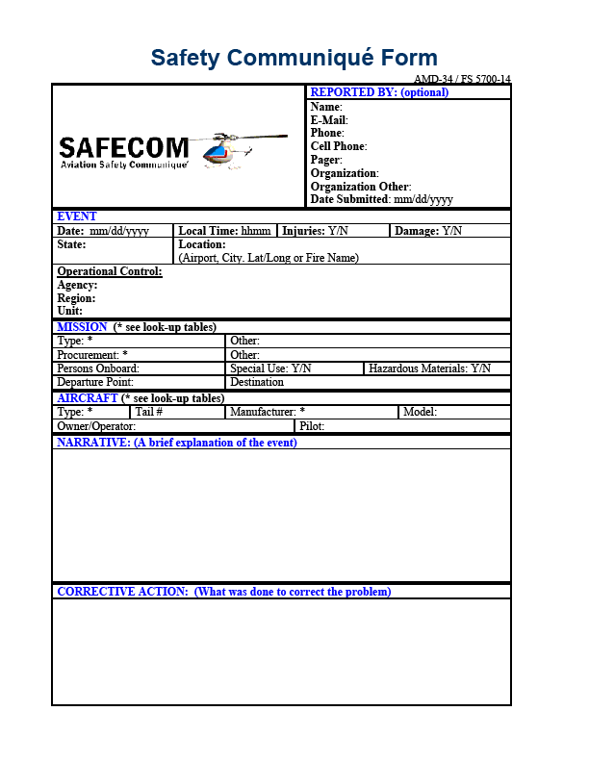
SAFECOM Form
Reported by
Event
Mission
Aircraft
Narrative
Corrective Action
http://www.safecom.gov

Slide 26
Aviation Mishaps
Take home message
If you see something, say something.
As a new Helicopter Crewmember you may be the one to prevent a serious accident.

Slide 27
Lesson 7D Objectives
Describe parking tender roles and responsibilities.
Describe plan for medivac procedures.

