Slide 1
Unit 8 - Helispot Operations

Slide 2
Unit 8 Objectives
Describe the process for staffing and preparing a landing area or helispot.
Define the methods for constructing landing areas or helispots.
Describe the duties performed in managing a helispot.

Slide 3
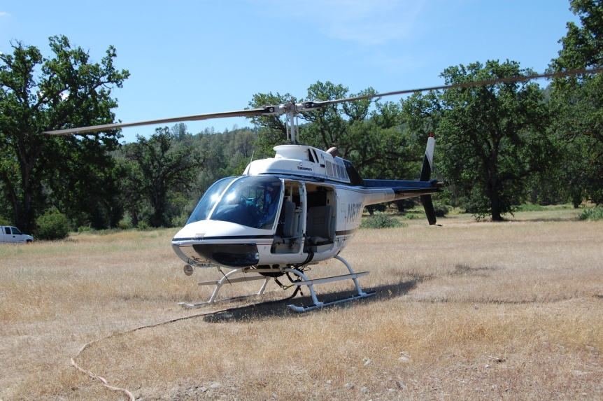
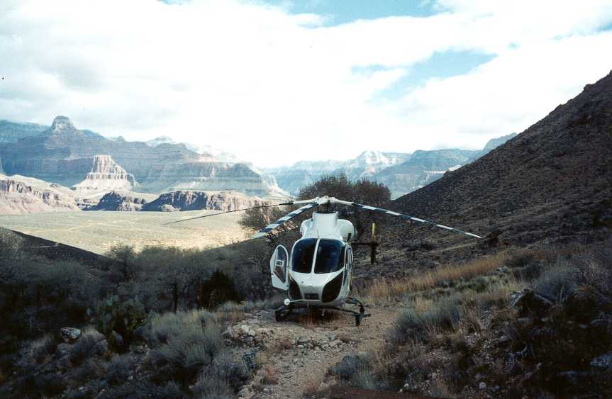
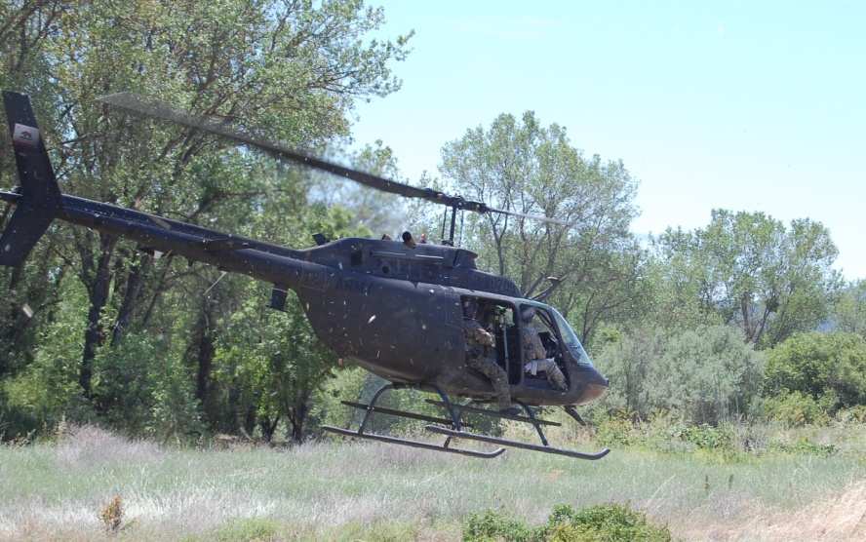
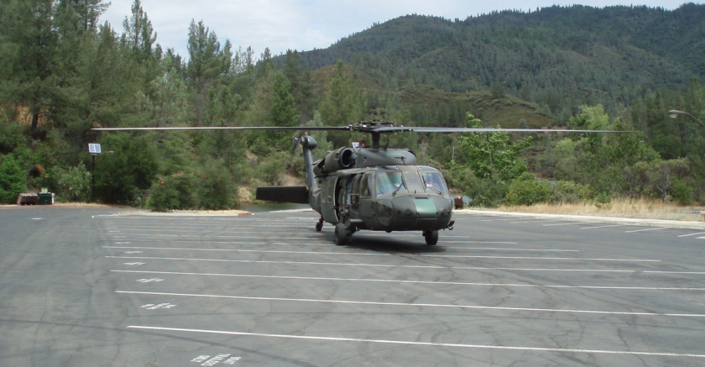
Take-off and Landing Areas

Slide 4
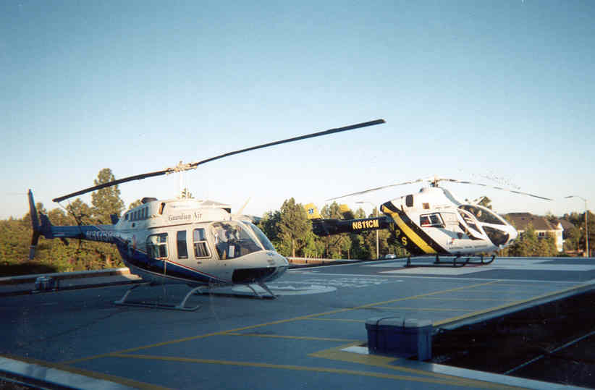
Heliport
Permanent facility built to FAA standards
typically at hospitals, city, county facilities.
A heliport has:
Permanent pad
Wind indicator
Road access
Parking area
Communications
Rest area (pilot and crew)

Slide 5
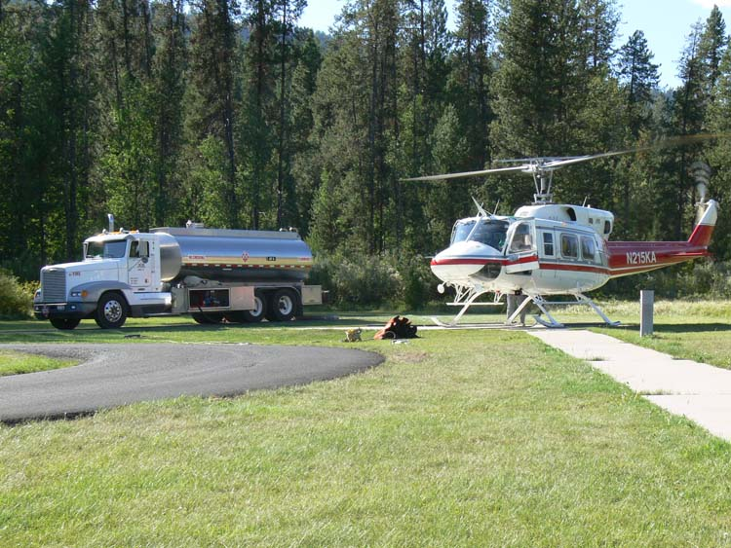
Permanent Helibase
Have the same components of a heliport
A permanent helibase has:
Permanent pad
Wind indicator
Road access
Parking area
Communications
Rest area (pilot and crew)

Slide 6
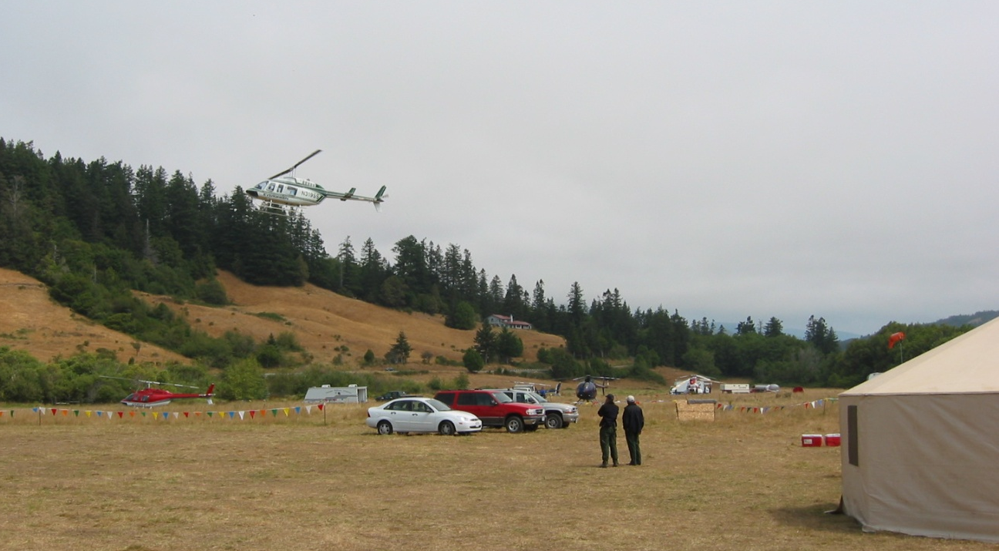
Temporary Helibase
Are established for a short duration.
A temporary helibase has:
Communications
Road access
Parking areas
Landing pads
Wind indicator
Rest area (pilot and crew)
Staging area (passengers/cargo)

Slide 7
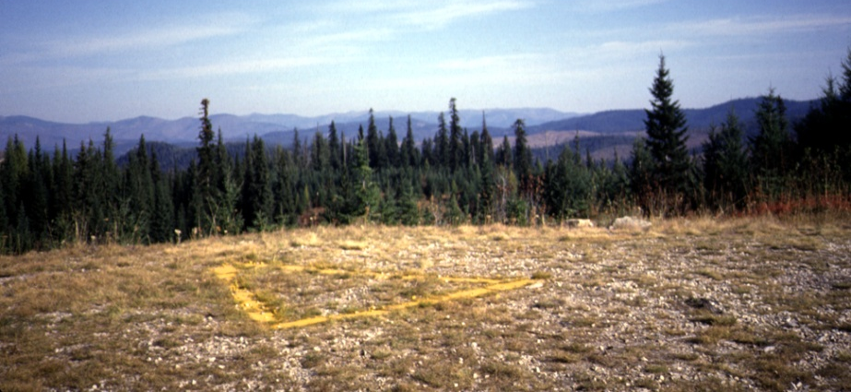
Helispot
Are natural or improved take-off and landing areas for temporary use.
A helispot has:
Communications
Landing pads
Wind indicator
Fire extinguisher
Crash-rescue kit
Staging area (passengers/cargo)
A helispot might not have:
Road access

Slide 8
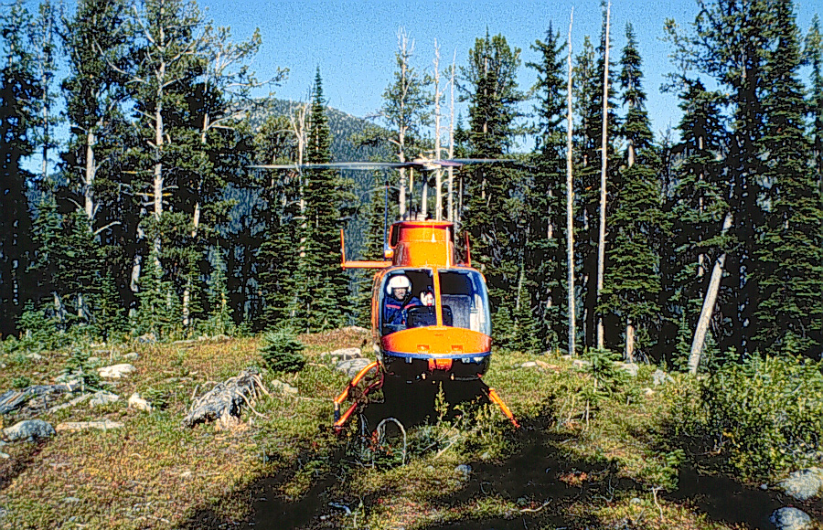
Unimproved Landing Area
Intended for one time use only and at the discretion of the pilot.
Unimproved landing areas are not intended for multiple use.

Slide 9
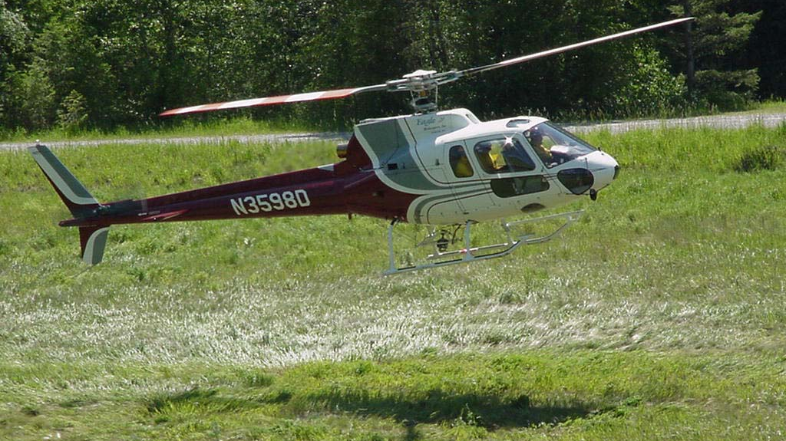
Take-off and Landing Area
Actual area where helicopter lands and takes off.
Includes touchdown pad and safety circle .

Slide 10
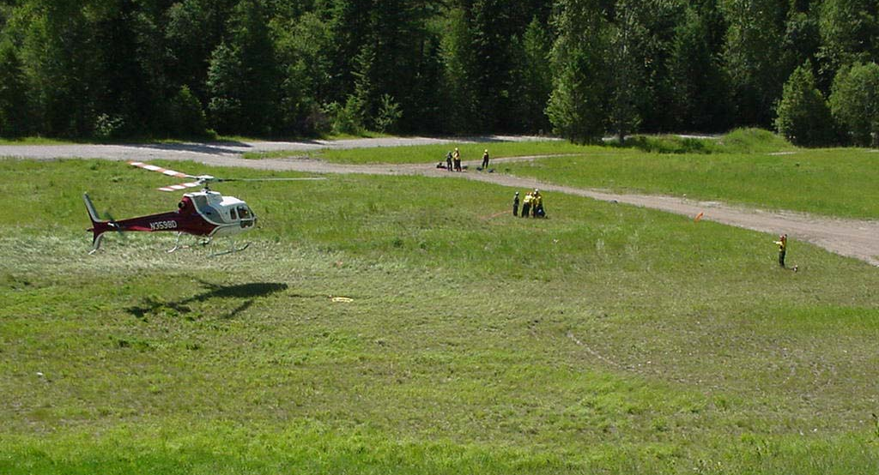
Safety Circle
Safety zone around touchdown pad
Obstruction-free area around touchdown pad
Minimum 1 1/2 times diameter of main rotor
1 ¹/2 times
rotor diameter

Slide 11
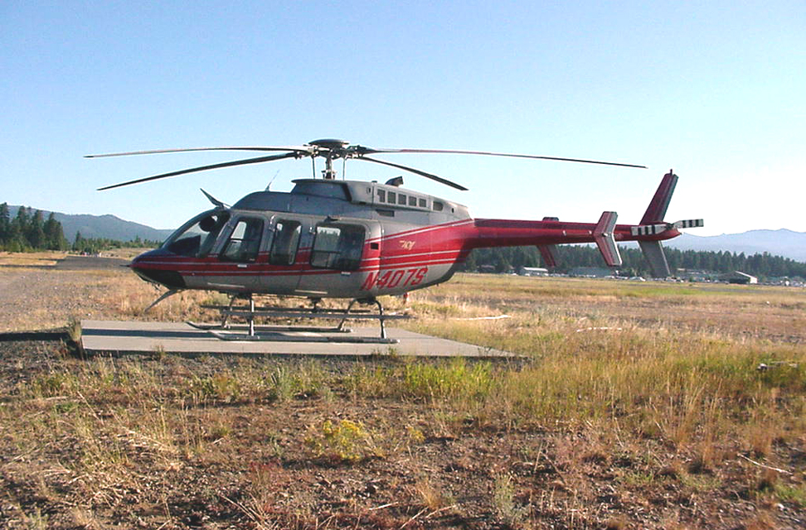
Touchdown Pad
Where wheels or skids sit
Usually a hard or improved surface

Slide 12
Standard Landing Area Size
Type 3 (Light Helicopters)
Safety Circle – 75’ Diameter
Touchdown Pad – 15’ X 15’
Type 2 (Medium Helicopters)
Safety Circle – 90’ Diameter
Touchdown Pad – 20’ X 20’
Type 1 (Heavy Helicopters)
Safety Circle – 110’ Diameter
Touchdown Pad – 30’ X 30’

Slide 13
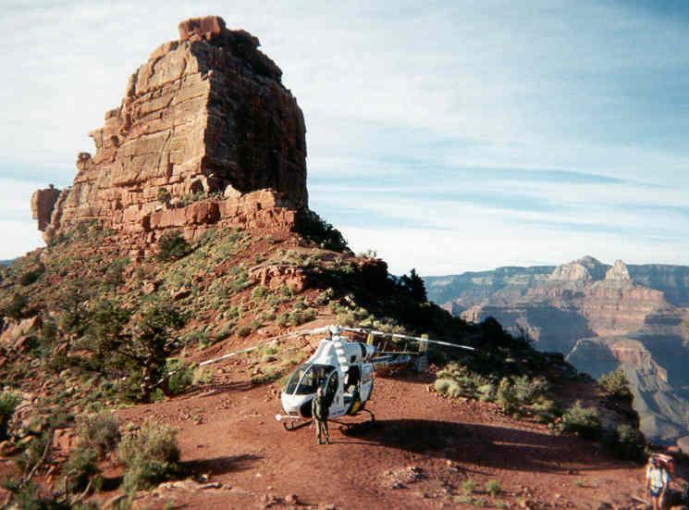
Selecting a Helispot Site
Ideal: 2-way approach/departure path
Ridge tops or exposed knobs
HIGE
Level pad
No obstructions
Requires minimum labor
Close to work area or incident
Natural dust abatement

Slide 14
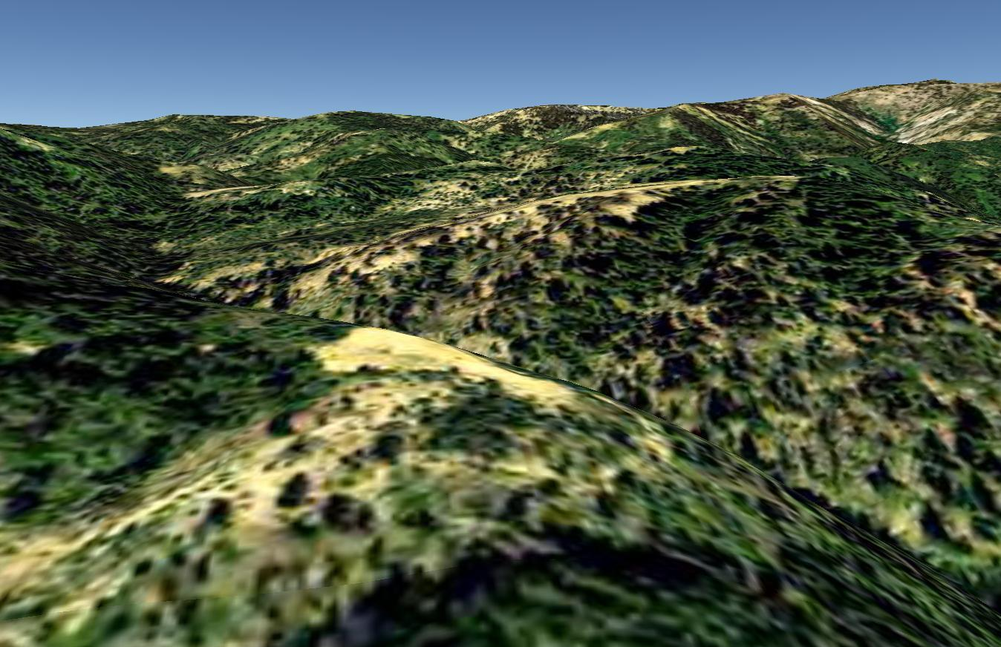
Selecting a Helispot Site
Proximity to safety zone
Ensure LCES can be established
Safety Zone
Helispot

Slide 15
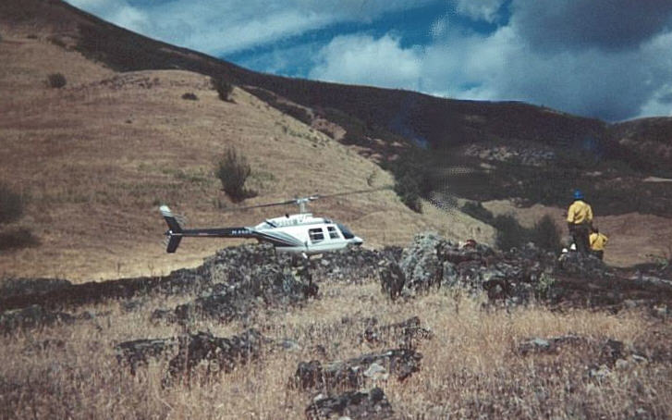
Site Selection Factors: Helispot
Avoid: 1-way approach/departure path
Fresh cut dozer lines
Rocky touchdown pads
HOGE limited
Dusty locations
Aerial hazards
Tall grass
Tundra and Boggy areas

Slide 16
Site Selection Factors: Helispot
Avoid: 1-way approach/departure path
Sloping touchdown pads
Lee side turbulence (downdrafts, wind shear)
Trash and debris
Pinnacles requiring high power-on landings
Nearby commercial flight patterns
Nearby populated area

Slide 17
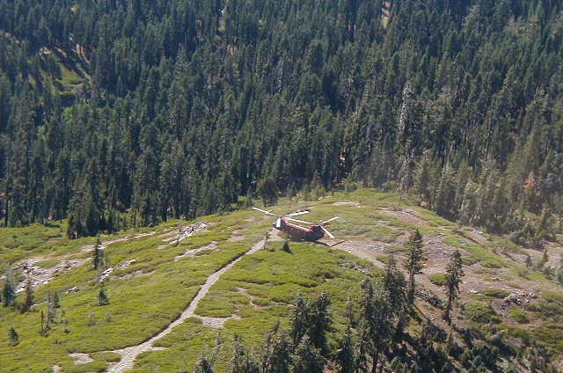
Approach/Departure Path
Extending upward and outward from safety circle
2-way approach/departure
Width same as safety circle
Obstruction free (300’ approach by 300’ departure)
Into prevailing wind
Prevailing Wind
Departure
Approach

Slide 18
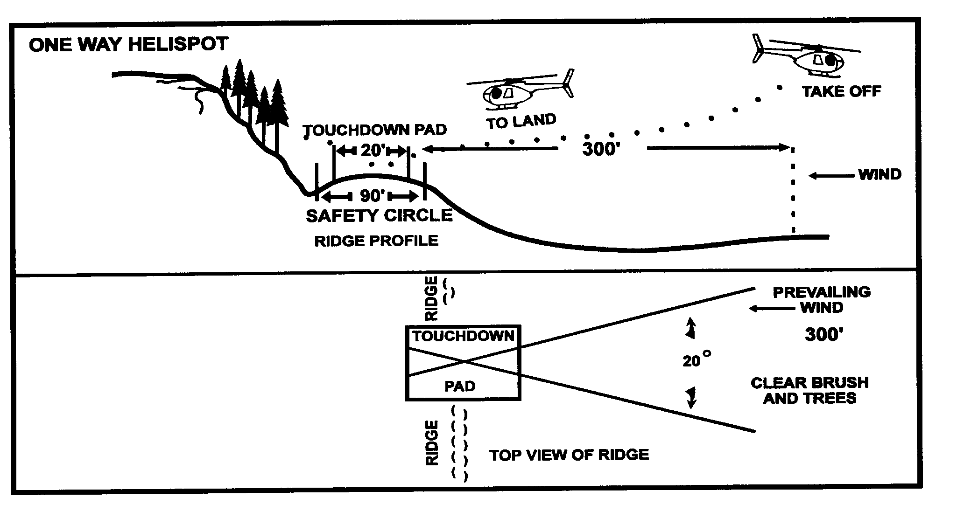
Approach and Departure Paths
One-Way Helispot

Slide 19
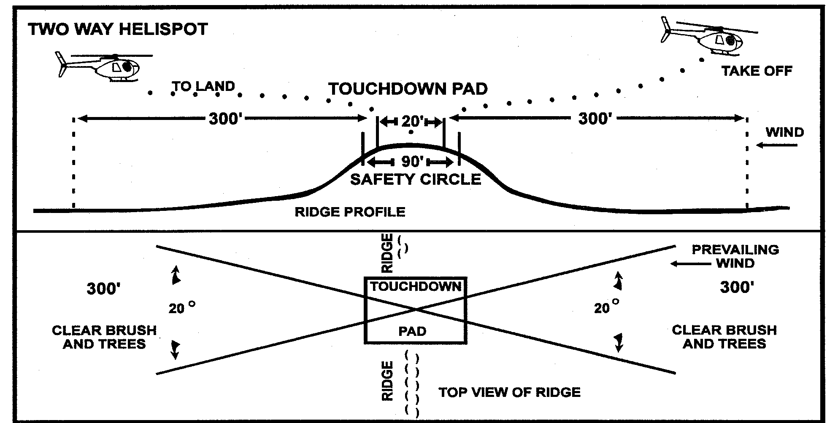
Approach and Departure Paths
Two-Way Helispot

Slide 20
Helispot Site Construction
Hand construction preferred, minimal impact.
Be aware of construction restraints follow local policy.
Construction in timber will take time to establish, take the extra time to find another location.

Slide 21
Helispot Construction
Remove all brush and trees with the following diameter safety circle around the touchdown pad according to the size of the helicopter.
75-feet for type 3 helicopters.
90-feet for type 2 helicopters.
110 feet for type 1 helicopters (such as
UH-60, S-61N, and Boeing-Vertol 107)

Slide 22
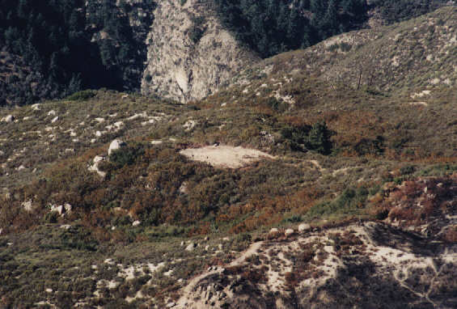
Helispot Site Construction
Sufficient approach/departure
Minimize ground disturbance

Slide 23
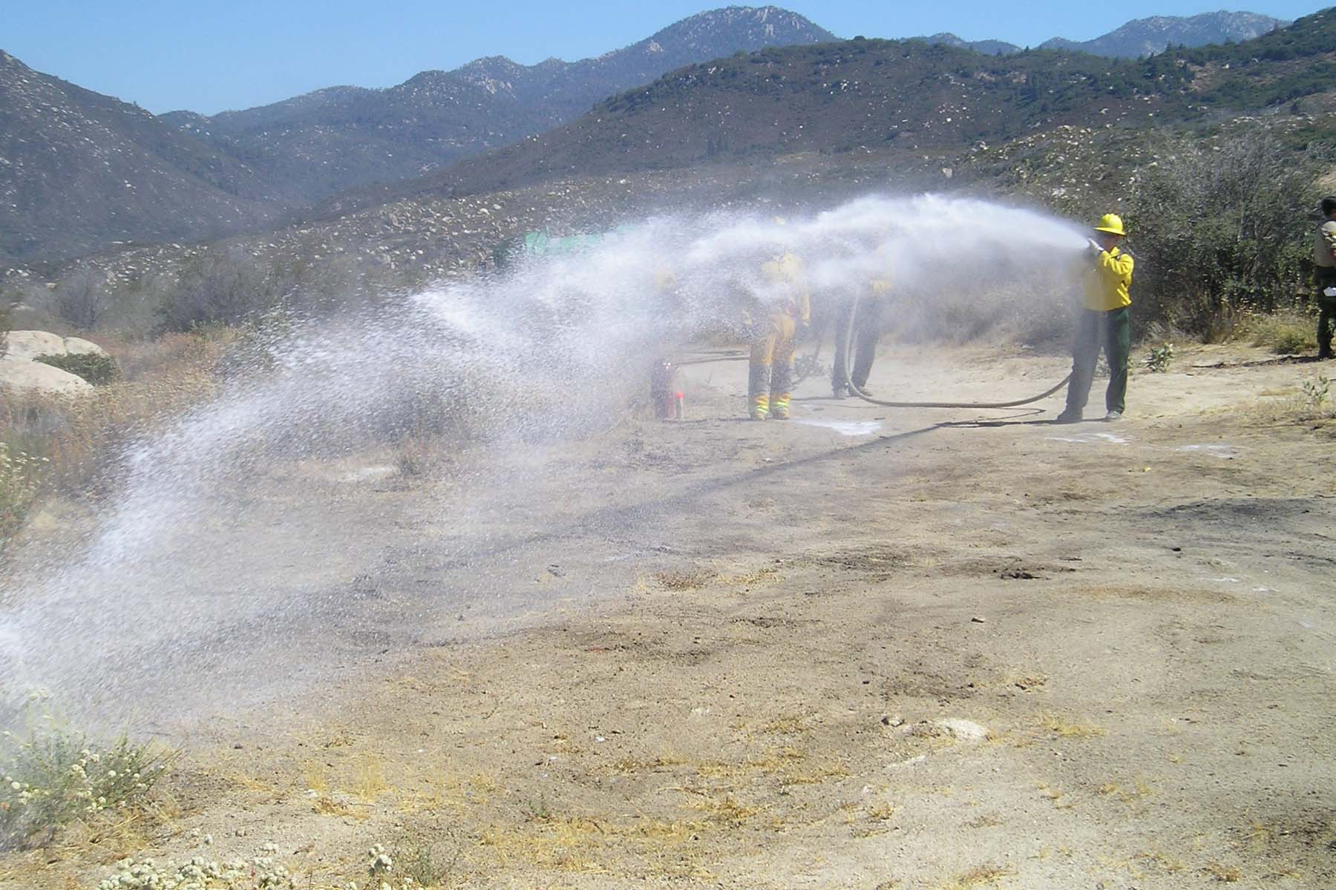
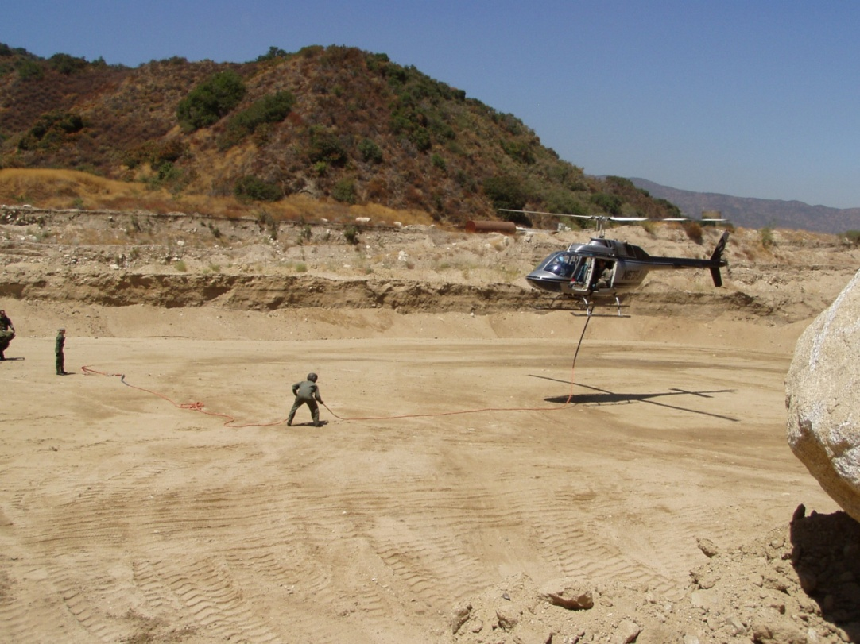
Helispot Construction
Dozer-constructed landing areas generally have
soil that is too disturbed, requiring dust
abatement procedures.

Slide 24
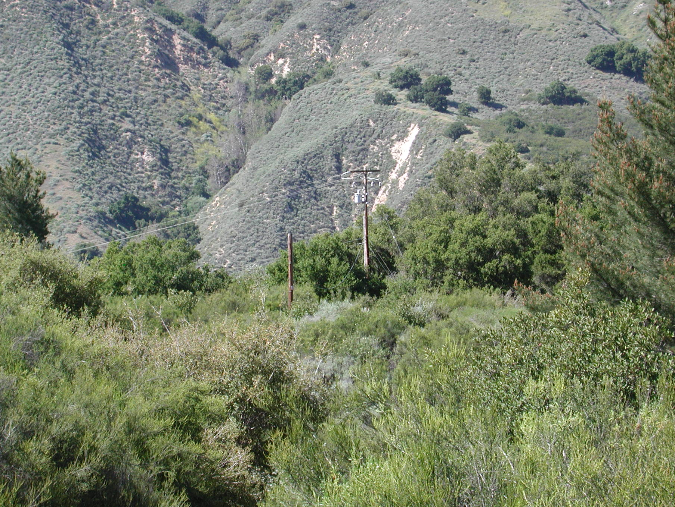
Helispot Construction
Helispot Hazards
- Wires, towers, fences, snags

Slide 25
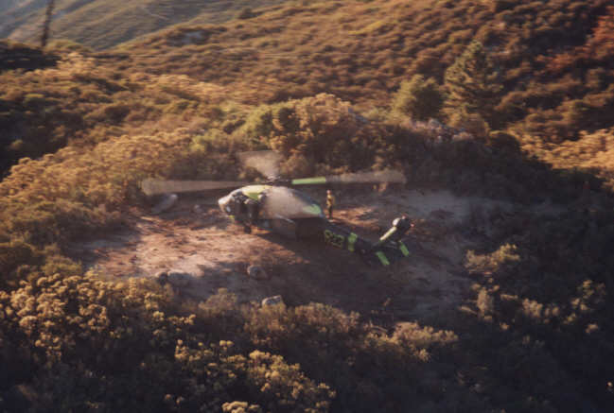
Helispot Construction
Helispot Hazards
- Construction incomplete, not level, or not cleared; ground cover not removed to a safe distance.

Slide 26
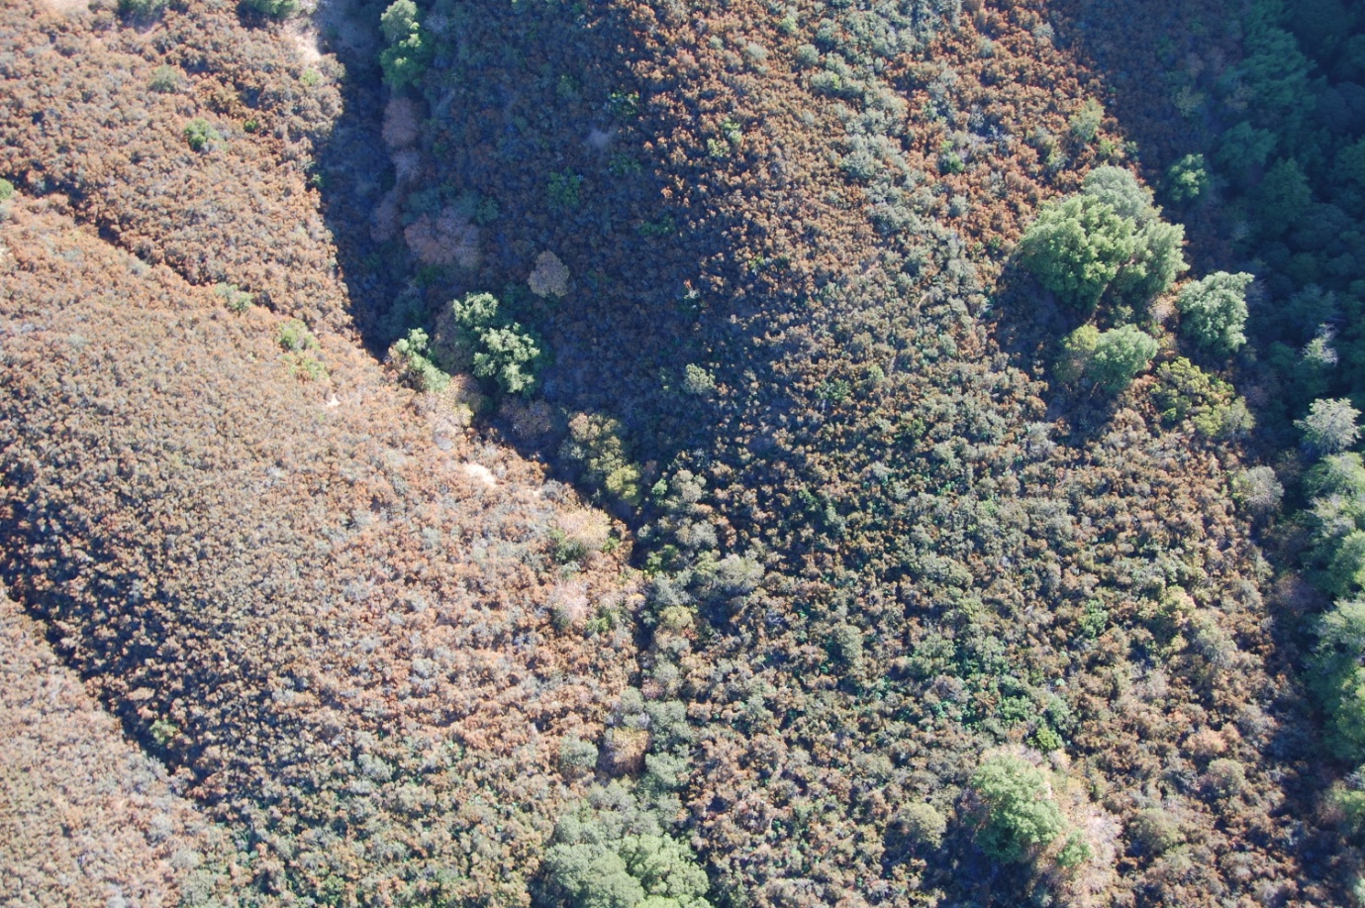
Helispot Construction
Helispot Hazards
- Canyon bottoms or converging canyons

Slide 27
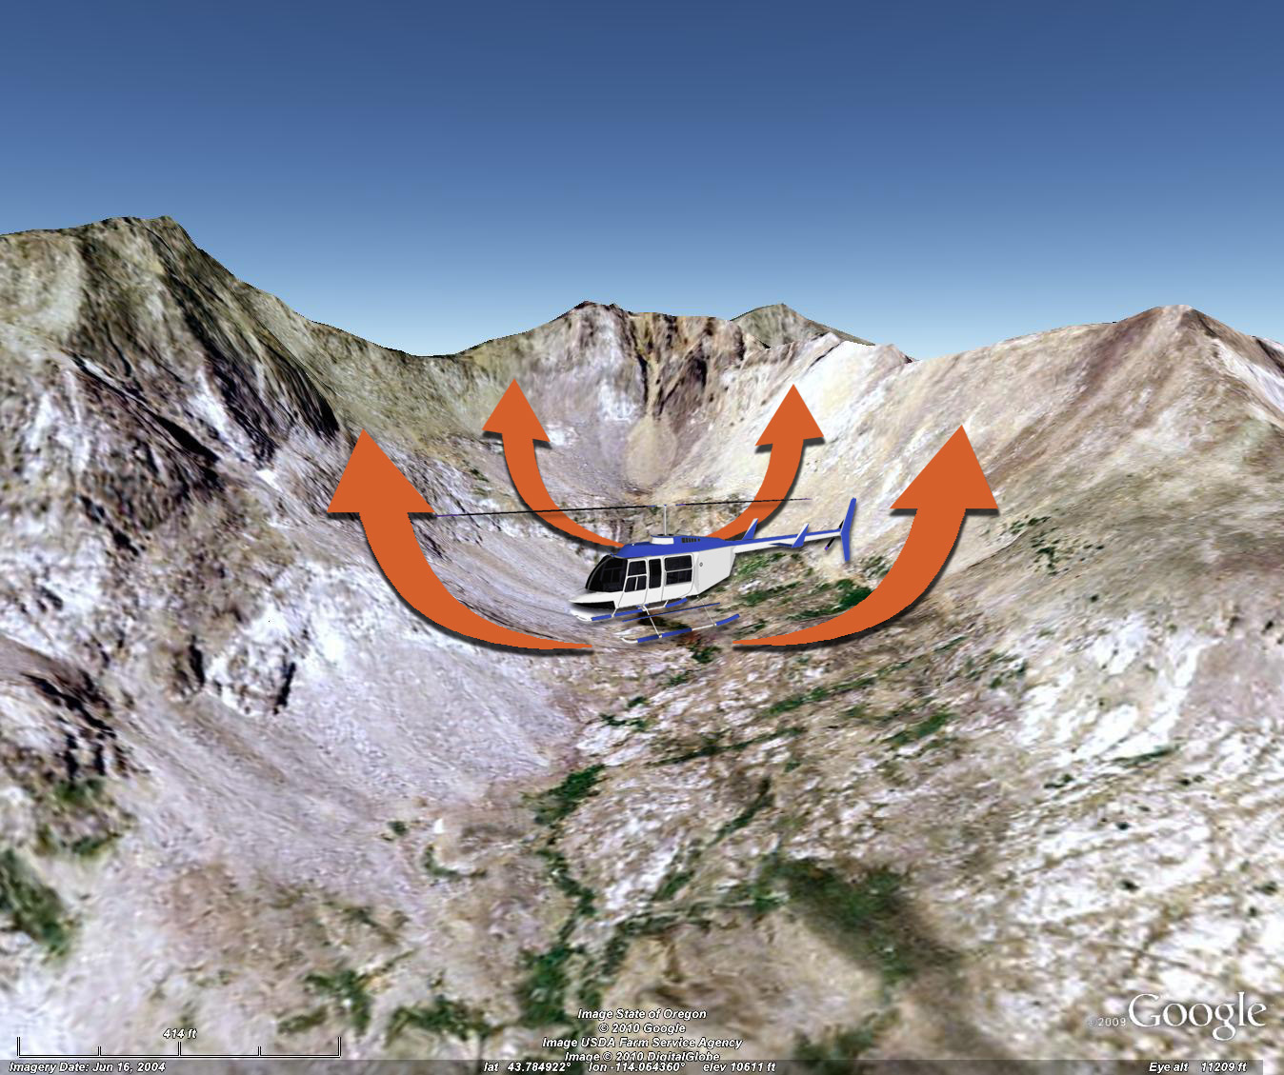
Helispot Construction
Helispot Hazards
- Cirque basins

Slide 28
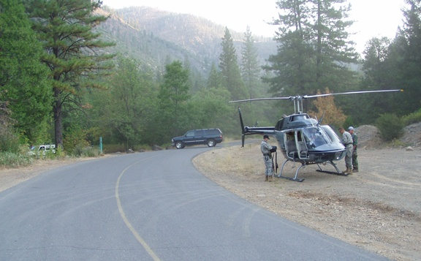
Helispot Construction
Helispot Hazards
- Roads

Slide 29
Helispot Construction
Helispot Hazards
- Tundra or boggy areas

Slide 30
Helispot Construction
Helispot Hazards
- Dusty, loose soil conditions

Slide 31
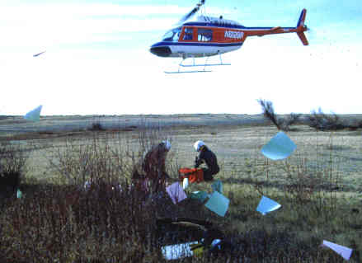
Helispot Construction
Helispot Hazards
- Litter, paper and plastic bags, boxes, sleeping bags or other light items.

Slide 32
Helispot Construction
Helispot Hazards
- Personnel working around landing area should brace themselves when larger helicopters are landing or taking off due to the velocity of the rotor downwash.

Slide 33
HELISPOT EXERCISE
As a class, evaluate advantages and disadvantages of each of the
following helispots.

Slide 34
Helispot Site Selection
Advantages:
2-way
Ridge
HIGE
Level
Min. labor
Disadvantages:
Dust

Slide 35
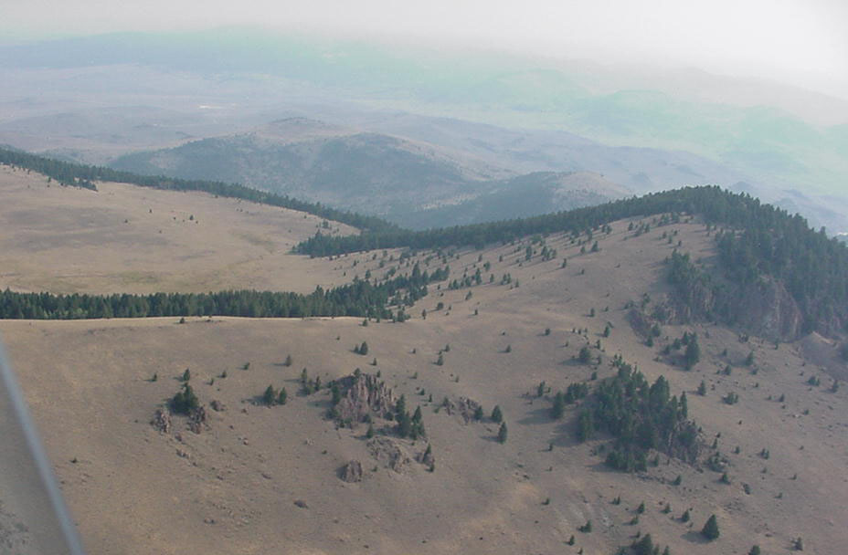
Helispot Site Selection
Advantages:
2-way
Ridge
HIGE
Level
Minimum labor
Natural dust abatement
Disadvantages:
potential problems with LCES

Slide 36
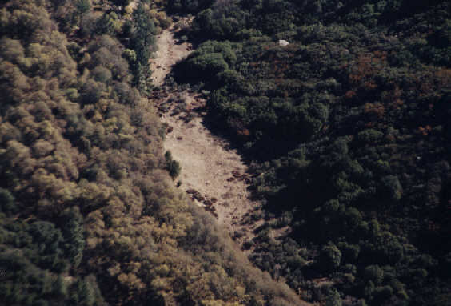
Helispot Site Selection
Disadvantages:
HOGE
Hover hole
Dust
Labor
Problems with LCES
Advantages:
2-way
Level

Slide 37
Helispot Manager Duties and Responsibilities
Helispot Equipment Needs
Required supplies at helispot:
Wind indicator
20 BC fire extinguisher (40 lbs.)
Evacuation/crash rescue kit
Pad marker or other marker
Hanging scale

Slide 38
Helispot Manager Duties and Responsibilities
Helispot Equipment Needs
Recommended supplies for personnel staffing helispot:
Allowable payloads (HIGE & HOGE) for all helicopters using helispot
Passenger/cargo manifest book
Fiber tape
Flagging

Slide 39
Helispot Manager Duties and Responsibilities
Helispot Equipment Needs
Recommended supplies for personnel staffing helispot:
Pocket calculator
Line gear
Food and drinking water
Passenger briefing cards
Radio
Incident action plan (IAP) and/or Operations Plan

Slide 40
Helispot Manager Duties and Responsibilities
Personnel Assigned to a Helispot Helispot management assignments will normally be given out at the morning briefing at helibase.
Ensure that daily missions to helispot are understood.
Flight helmets must be worn when flying to staff a helispot unless LE waiver in effect.
The helispot should not be made operational until the helispot manager informs the helibase that they are ready to receive personnel and/or cargo.

Slide 41
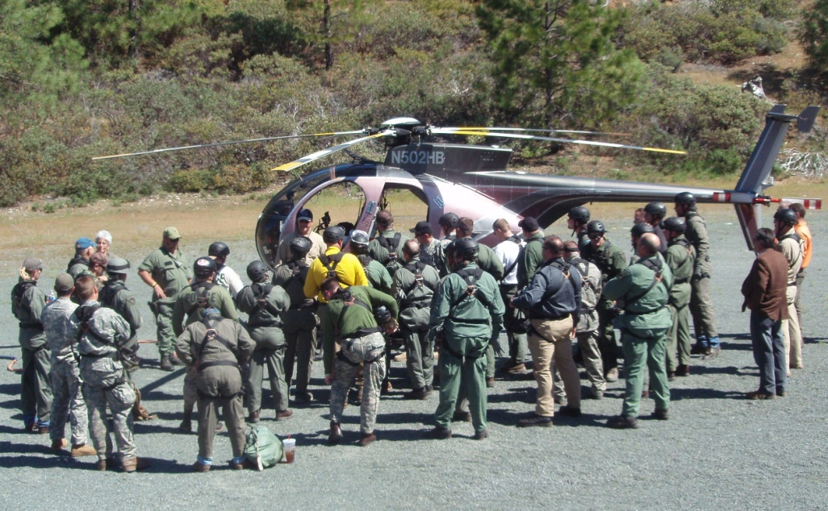
Helispot Manager Duties and Responsibilities
Helispot Management Helispot management is essential for safe and efficient operations.
Obtain briefing from Helibase Manager.
Minimum of two persons assigned.
Should be familiar with all helicopters at helibase.

Slide 42
Helispot Manager Duties and Responsibilities
Helispot Management
As the helispot operation becomes more complex, additional people may be needed to provide support.
Ensure that qualified helicopter crew members are assigned to assist in helispot management
Provide on-the-job training as necessary.
Conduct regular briefings with helispot crew.

Slide 43
Helispot Manager Duties and Responsibilities
Helispot Management
Ensure all assigned personnel understand their responsibilities and authority.
Manage resources/supplies dispatched to the helispot.
Ensure that all helispot personnel are capable and prepared to perform law Enfocement duties in and around the helispot.
Ensure that helispot crew is equipped to remain overnight, even in adverse weather conditions.

Slide 44
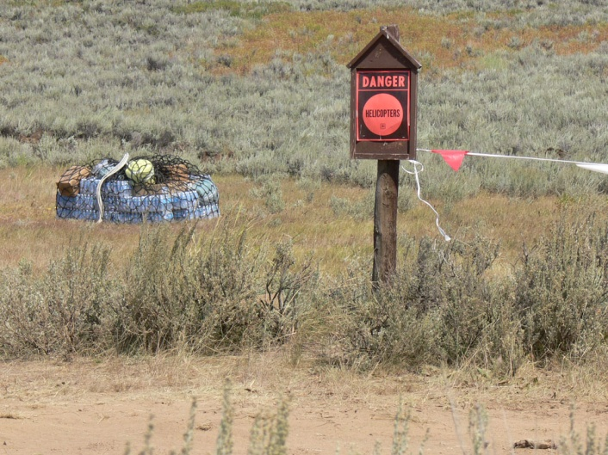
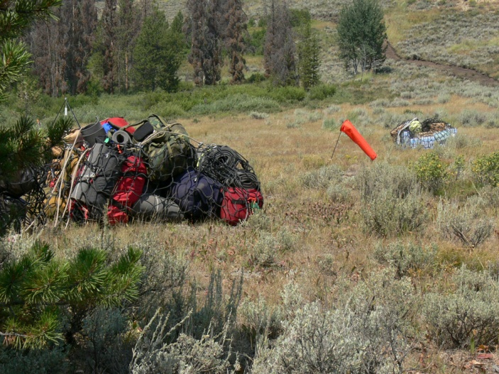
Helispot Manager Duties and Responsibilities
Helispot Management
Establish radio communications with the helibase.
Ensure the helispot and landing pad is constructed and prepared properly.
Install wind indicators and sign the area perimeter as necessary.

Slide 45
Helispot Manager Duties and Responsibilities
Helispot Management
Perform any necessary aerial and ground hazard reduction and safety improvements.
Anticipate dust abatement needs and provide or request as necessary.
Ensure crash-rescue equipment is available.
Ensure that flight routes and aerial hazards are made known to all pilots.
Ensure manifests and briefings are timely and accurate.

Slide 46
Helispot Manager Duties and Responsibilities
Helispot Management
Return external load equipment (nets, leadlines, swivels) and excess equipment to the helibase promptly.
Inform Helibase Manager of helispot activities.
If returned to the helibase, attend the nightly debriefing and provide feedback on the day’s operations; otherwise, provide by radio.
Helispot crews should be continuously cleaning the helispots of garbage and loose debris.

Slide 47
Apply Risk Management
Refer to IRPG and apply the Risk Management Process.
Follow the process to determine the helispot can function safely.
Inform helibase manager of changes.
Wait for instructions to cease or continue helispot operations.

Slide 48
Risk Management Applied
EXERCISE
Refer to Risk Management Process in IRPG

Slide 49
Questions and Review

Slide 50
Unit 8 Objectives
Describe the process for staffing and preparing a landing area or helispot.
Define the methods for constructing landing areas or helispots.
Describe the duties performed in managing a helispot.

