Slide 1
Unit 9 - Demobilization

Slide 2
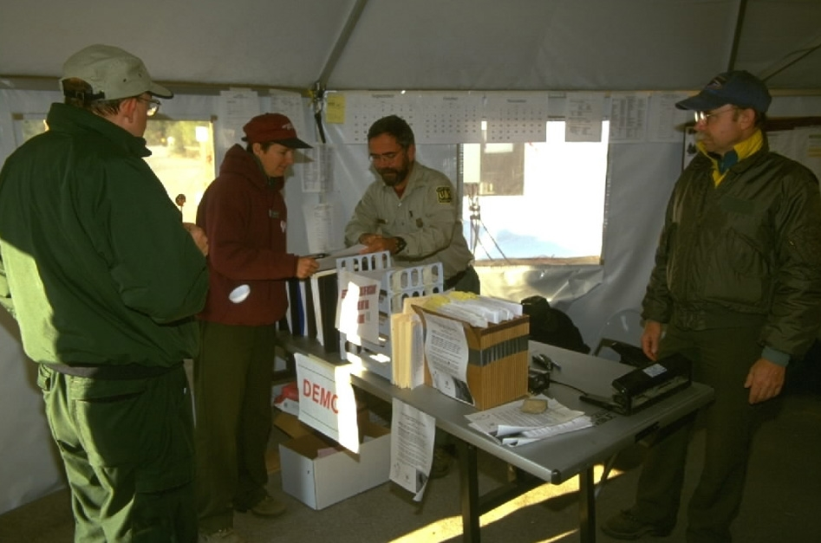
Unit 9 Objective
Describe the demobilization process
and mission debrief.

Slide 3
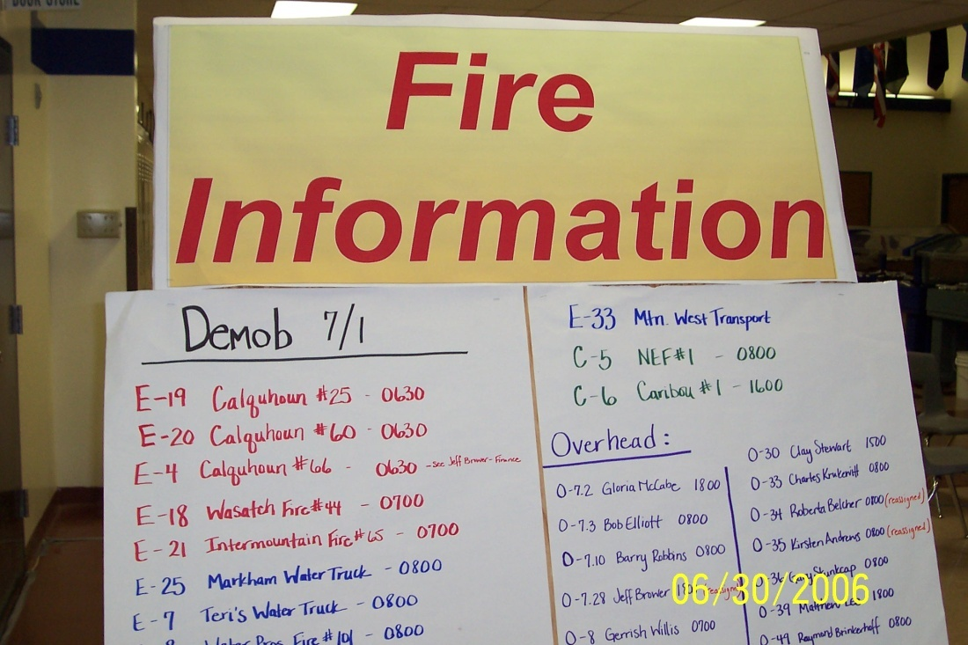
ICS Demobilization Process

Slide 4
ICS Demobilization Process
The following checklist identifies some of the key responsibilities:
Verify demobilization schedule with supervisor.
Ensure that your sleeping area is clean and free of debris and trash.
Clean and ready gear for another assignment and travel.
File required forms and report with the Documentation Unit

Slide 5
ICS Demobilization Process
Make sure travel time to your final destination is posted on your timesheet.
Verify your timesheet is correct before signing. By signing you are saying your time is correct.
Be sure to get your copy of your timesheet to give to your home unit for processing.

Slide 6
Emergency Fire Fighter Time Report OF-288

Slide 7
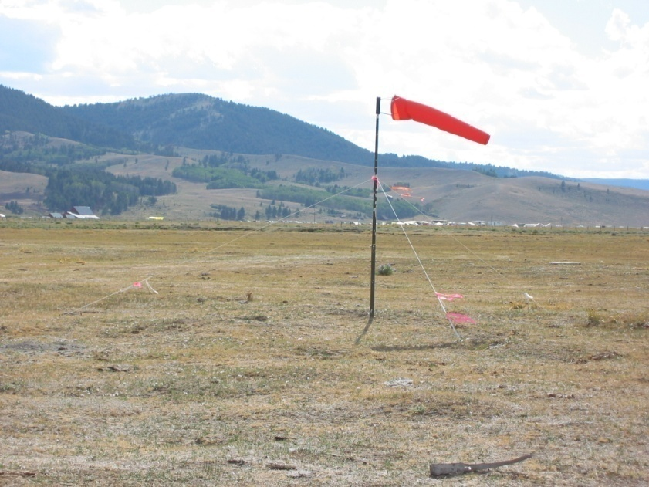
ICS Demobilization Process
Return incident issued communications equipment to the communications unit.
Return incident issued work materials to the supply unit.

Slide 8
ICS Demobilization Process
Follow check-out procedures, you may be asked to use Demobilization Checkout Form ICS-221

Slide 9
ICS Demobilization Process
Ensure you receive a performance evaluation from your incident supervisor.
Keep a copy for your records.

Slide 10
ICS Demobilization Process
Performance Evaluation for a LE helicopter crewmember could be any one of the following:
Helitack Crew Performance HBM-12
Helibase Personnel Performance Rating HBM-13
Individual Performance Rating ICS-226.

Slide 11
ICS Demobilization Process
Closeout with the Incident Training Specialist TNSP if you worked on a task book.
Report to departure points ahead of schedule.
Stay with your group until you arrive at your final destination.
Get feedback on overhead performance suggestions for improvement.

Slide 12
ICS Demobilization Process
Once you have completed the demobilization process double check to make sure you haven’t left any of the ICS 221 form incomplete.
Don’t leave without copies of your fire fighter
time sheet and your performance evaluation.

Slide 13
Mission Debriefing
All members of the mission, including pilot will debrief the days operations.

Slide 14
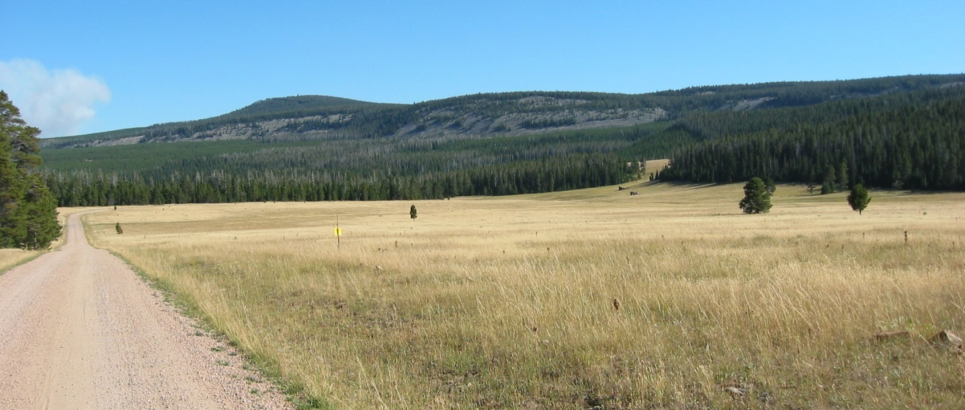
ICS Unit 9 Objective
Describe the demobilization process and mission debriefing.

