Slide 1
There are
currently
22 RFPA’s
Statewide
with one
more in the
formation
stage in
SummerLake
2018
over 800
volunteers

Slide 2
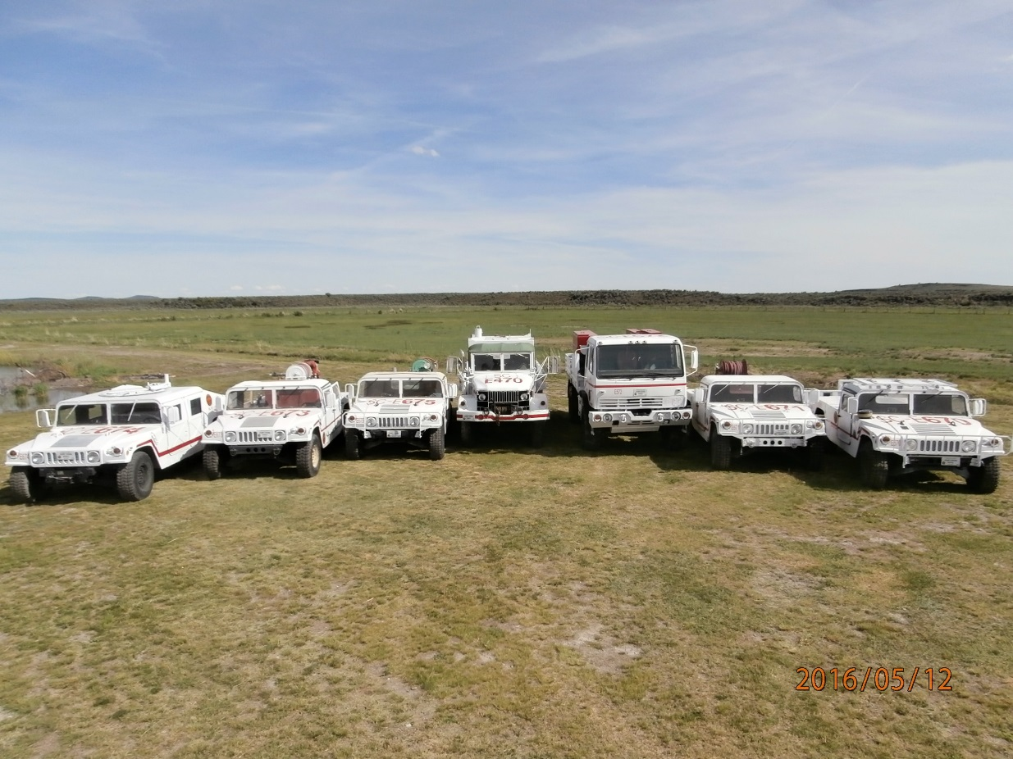
In 2016 listed equipment in the desert
272 engines
70 ATV or UTV with water tanks
50 Water tenders
98 Dozers
26 Road Graders
41 transports with Tractors
20 Tractors w/ Disks

Slide 3
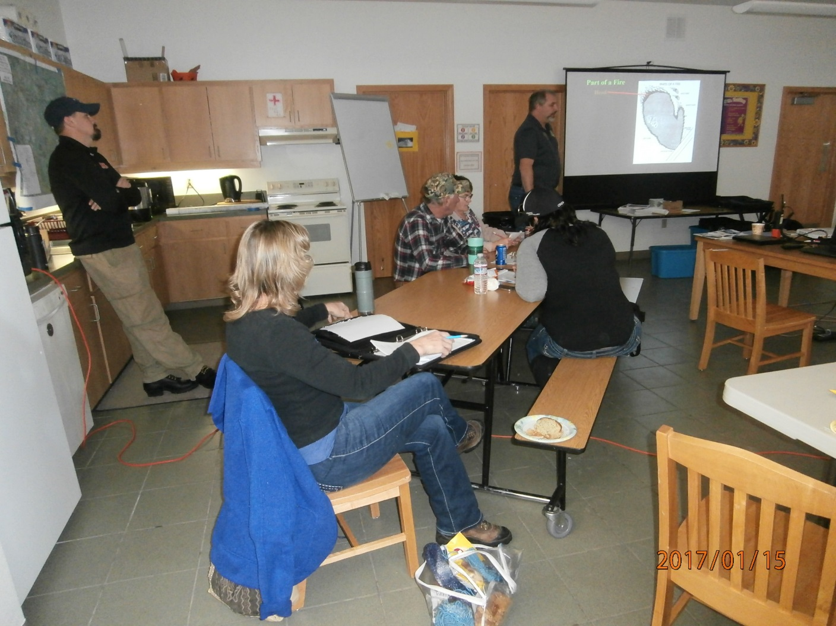
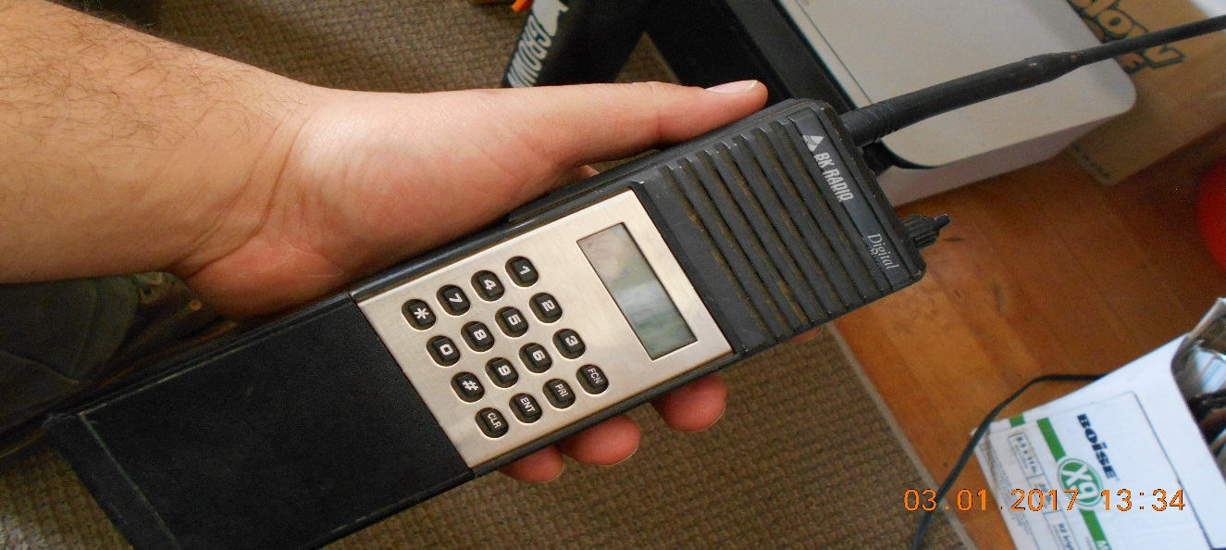
Training has been a focus for BLM and ODF
By 2016, 340 RFPA Volunteers Completed
the Basic Firefighting class.
Radio Communication was
A major focus for 2017

Slide 4
2017 Fire Season saw lots of action in Sage Habitat
Major Fires
Cinder Butte 52,400 Harney County
Upper Mine 4,200 Harney County
Coyote 1,700 Harney County
Powerline 700 Harney County
Bowden Hills 17,000 Malheur County
Horse Cross 6,300 Malheur County
Little 1,615 Malheur County
Hawk 1,433 Malheur County

Slide 6
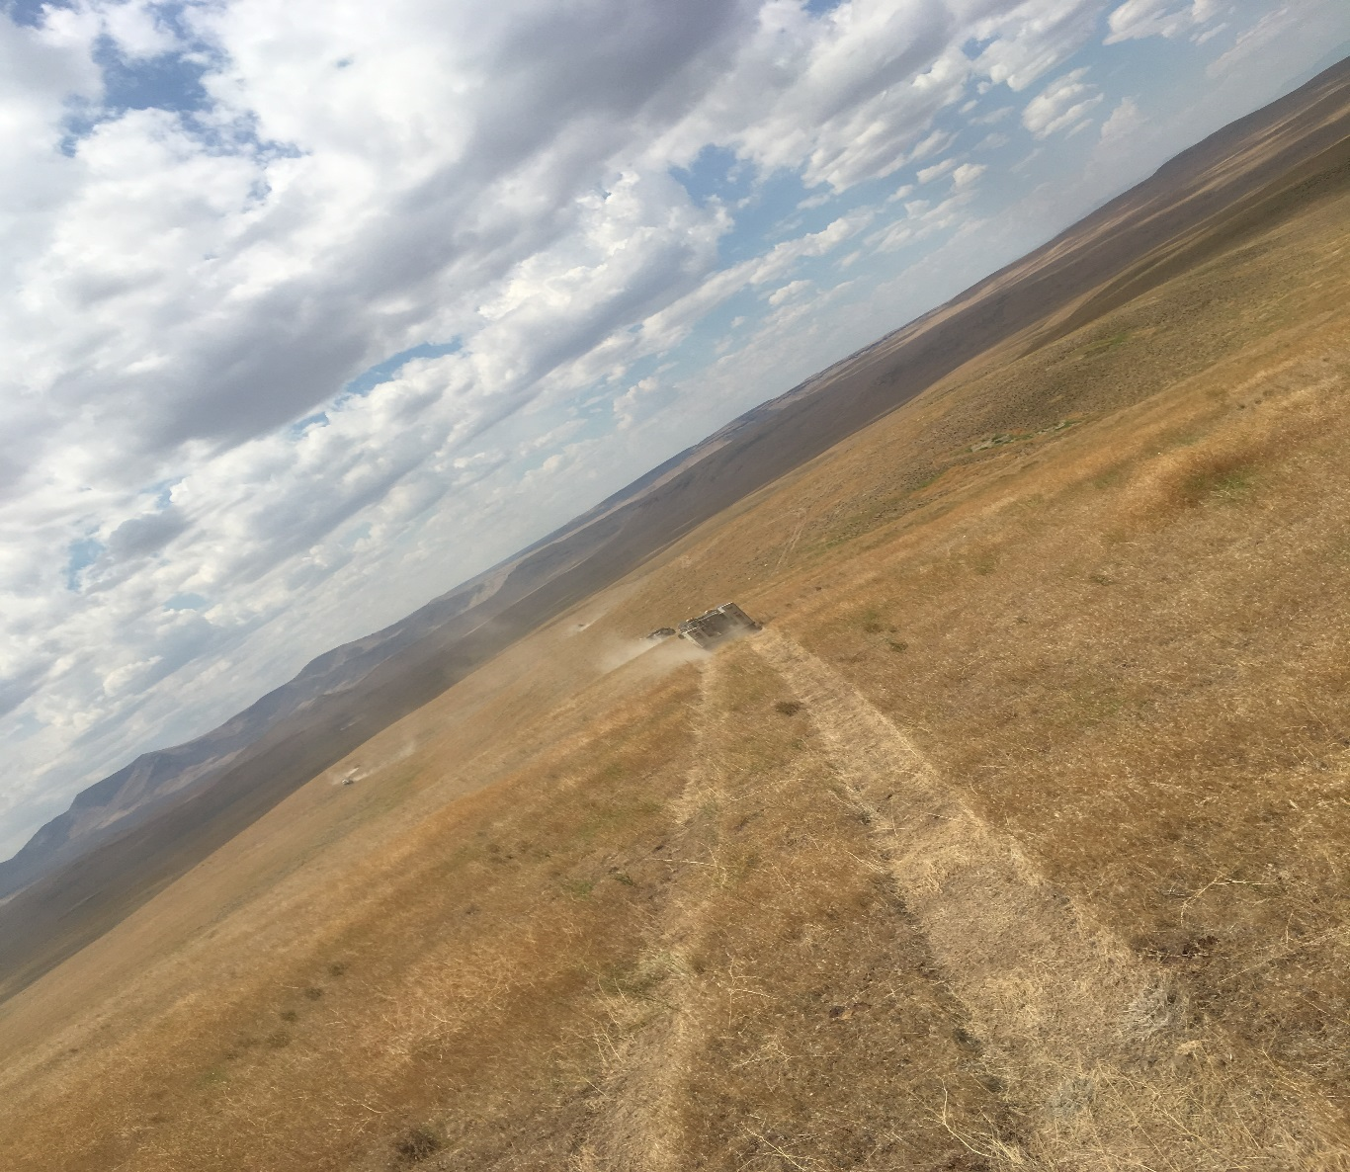
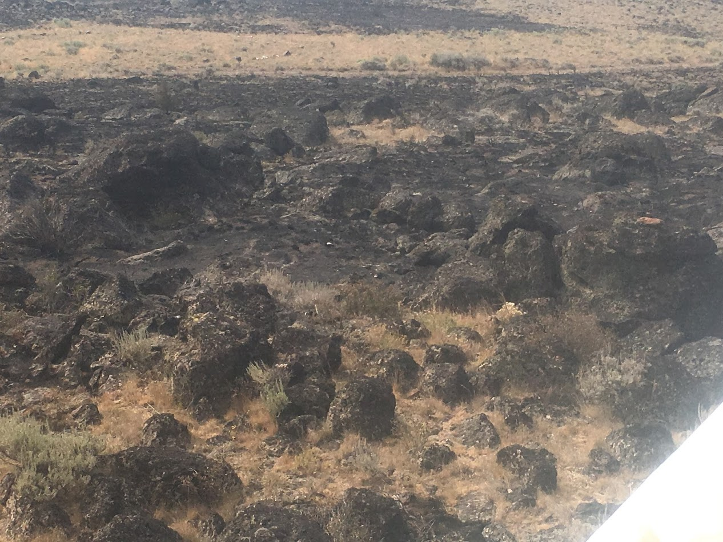
The benefit of the RFPAs is there response time to incidents and hitting the fires while they are still small.

Slide 7
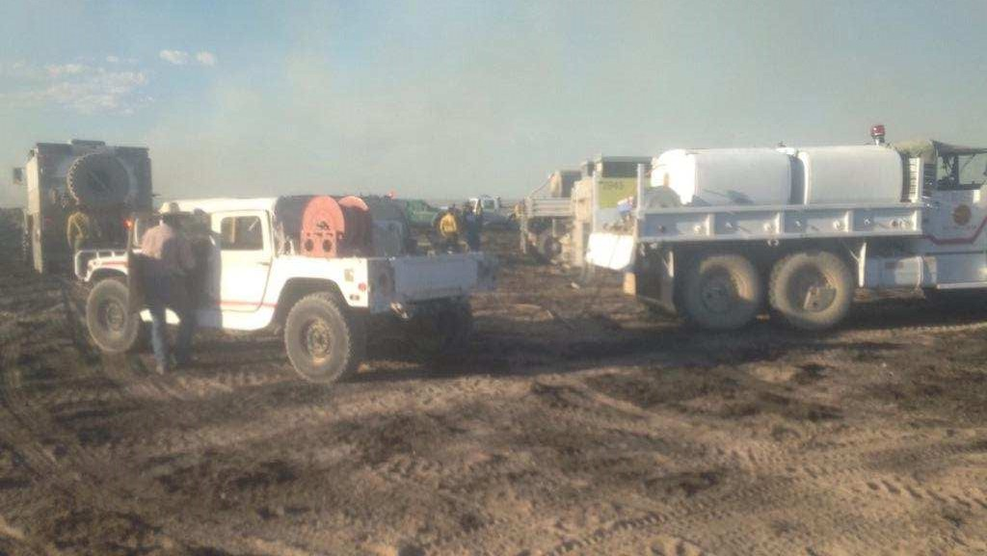
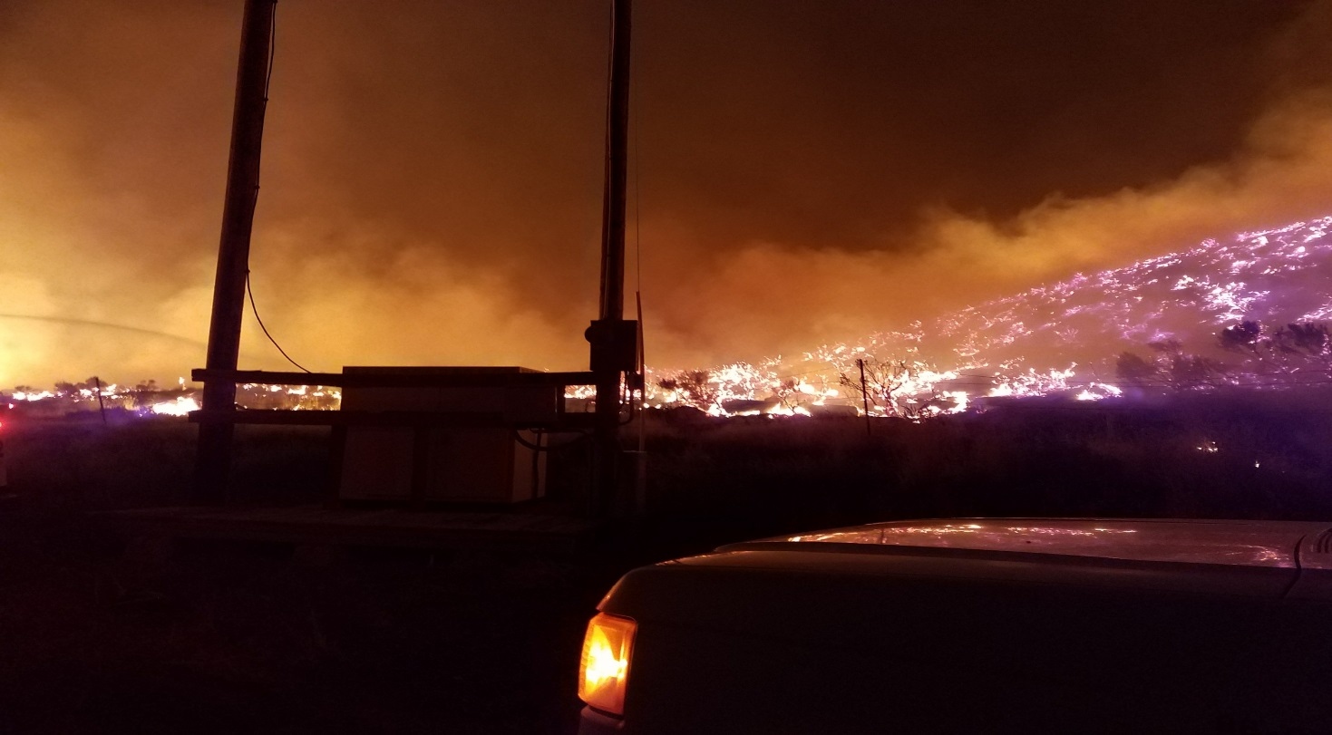
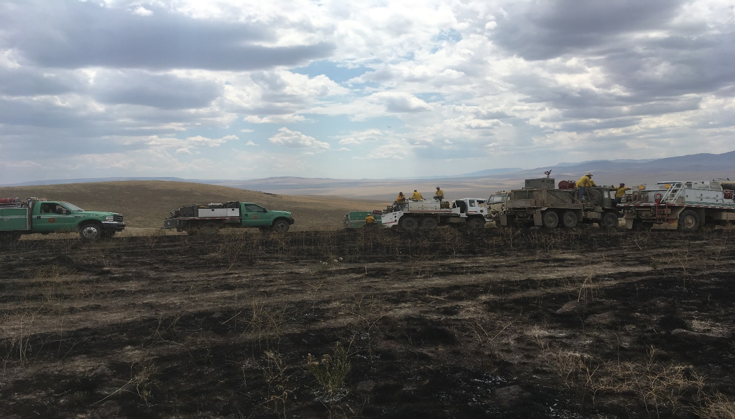
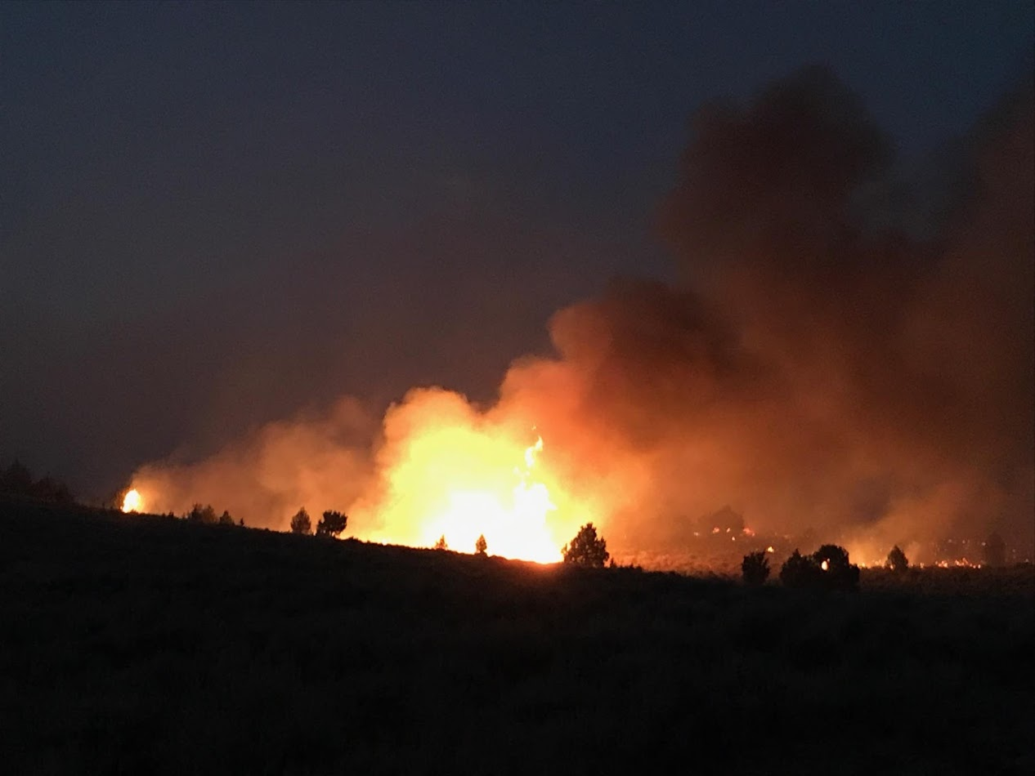
Coyote Fire
Upper Mine
Bowden Hills
Cinder Butte Fire

Slide 8
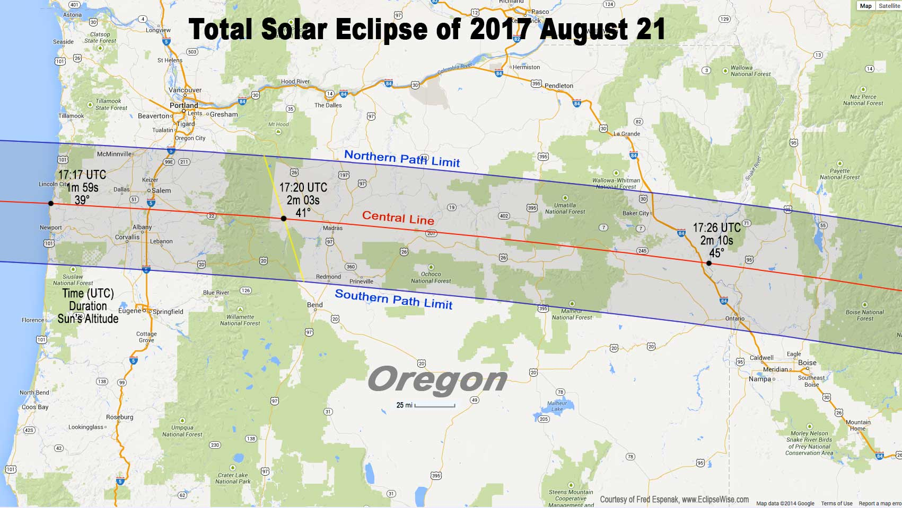
The RFPA’s are becoming more engaged with Partners and Community
Several of the RFPA’s were in this years solar eclipse path. They worked with the County Emergency Managers and the BLM in case of wildfires

Slide 9
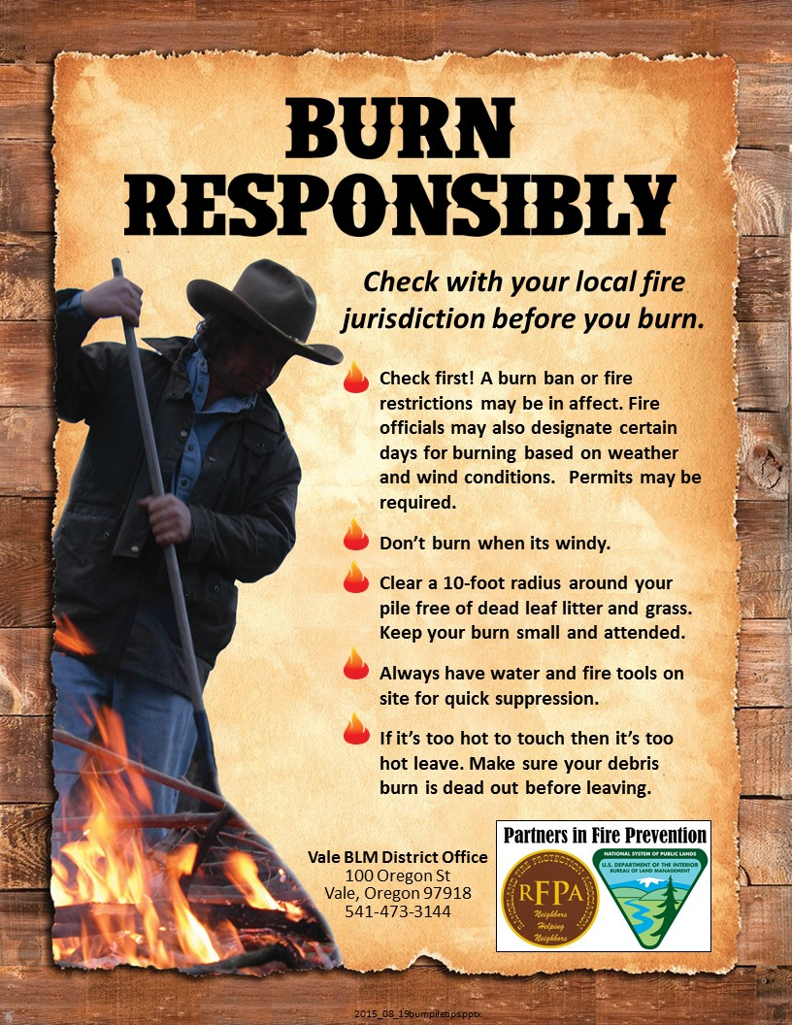
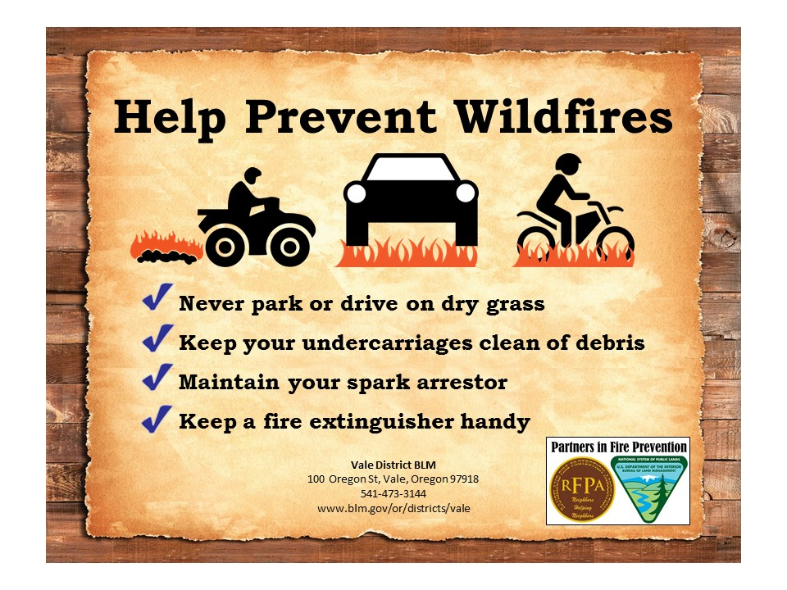
BLM and the RFPAs working together in Prevention

Slide 10
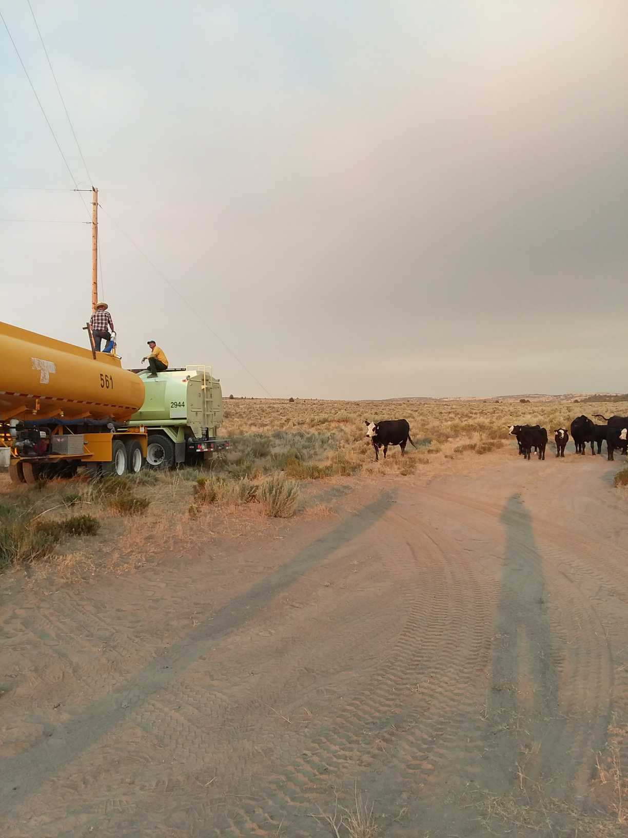
Working with Partners and to find Solutions in fuels reduction
Harney County Wildfire Collaborative
Jordan Valley Rancher, Vale BLM, OSU Extension Service

Slide 11
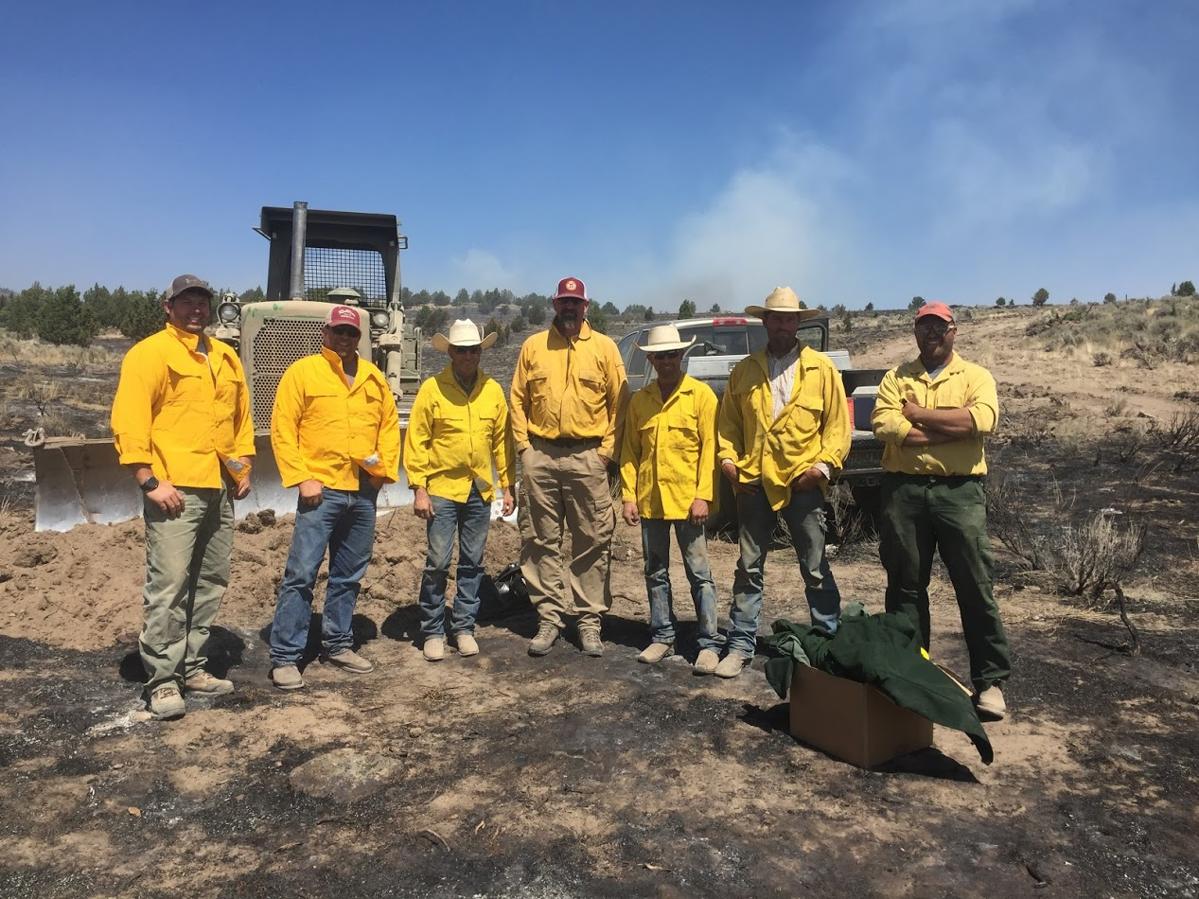
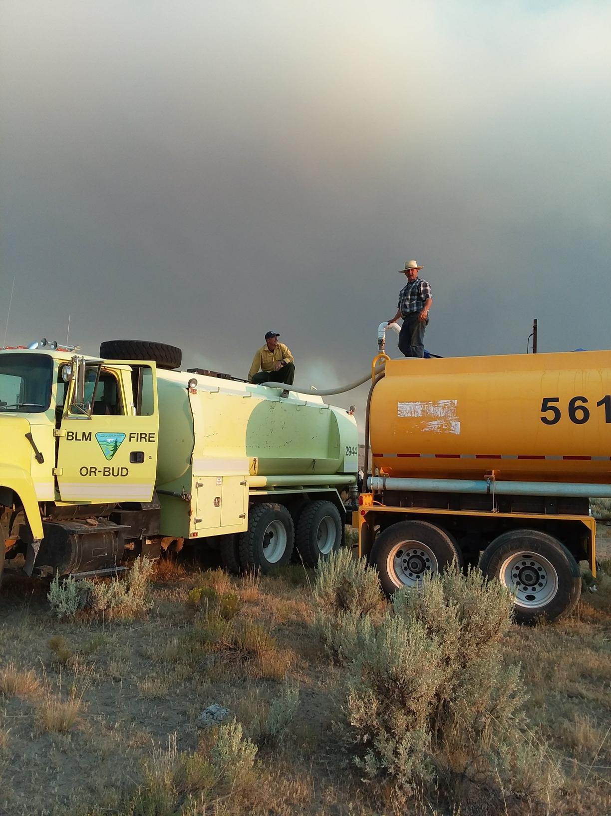
The last two years we have been working on:
Communication
Understanding
Working together

Slide 12
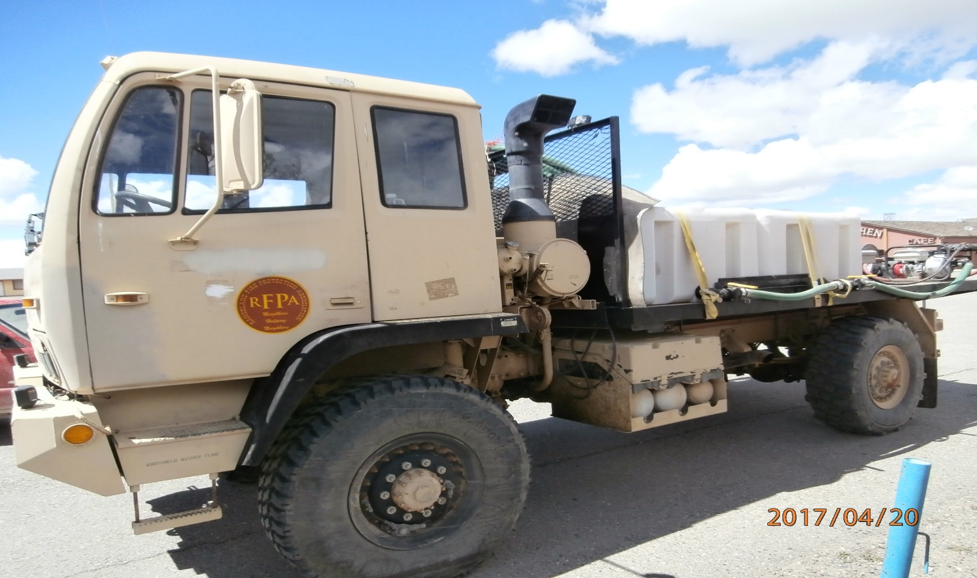
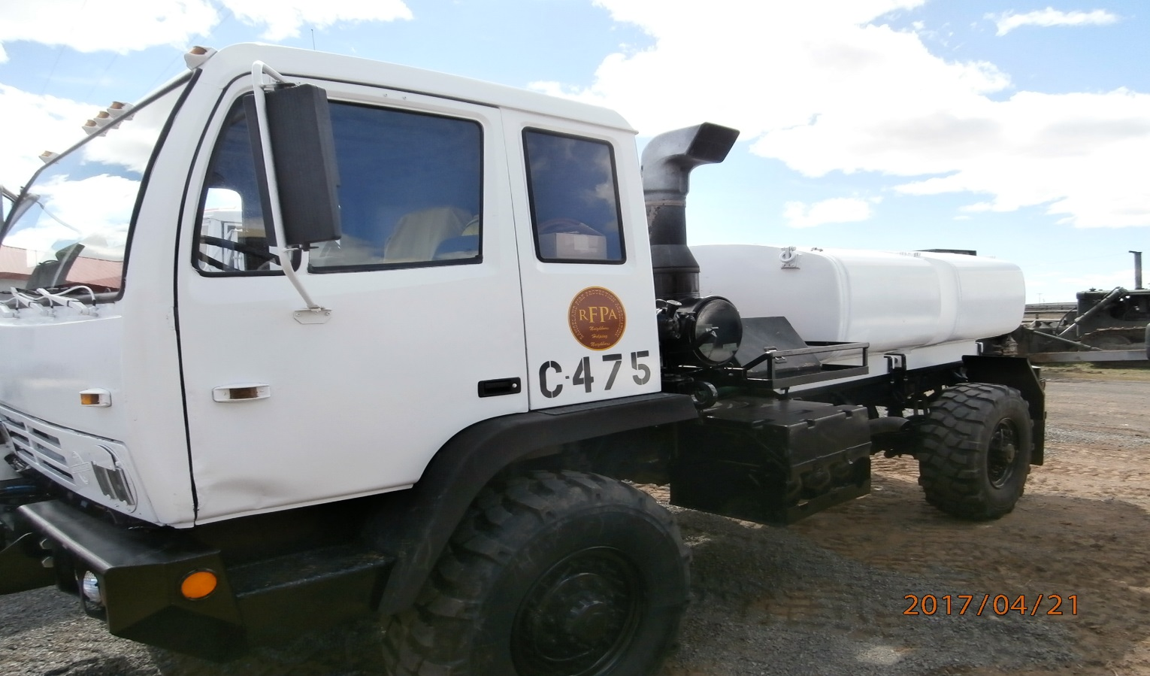
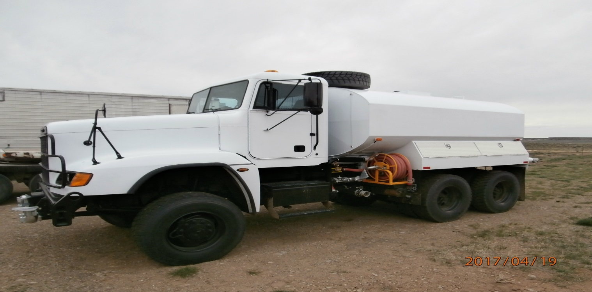
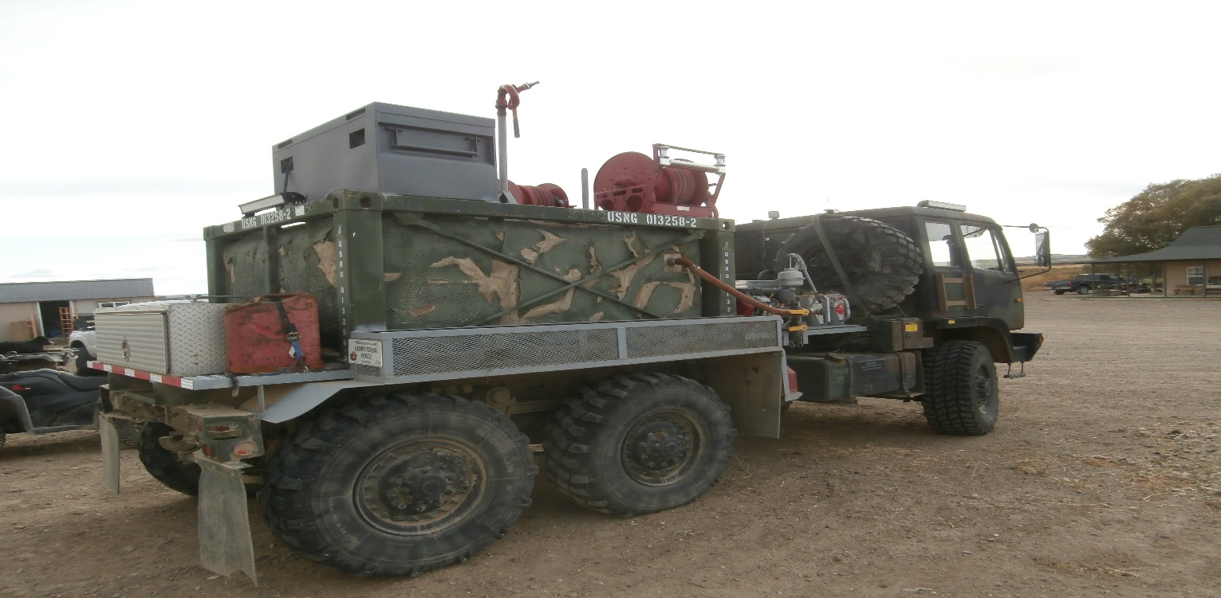

Slide 13
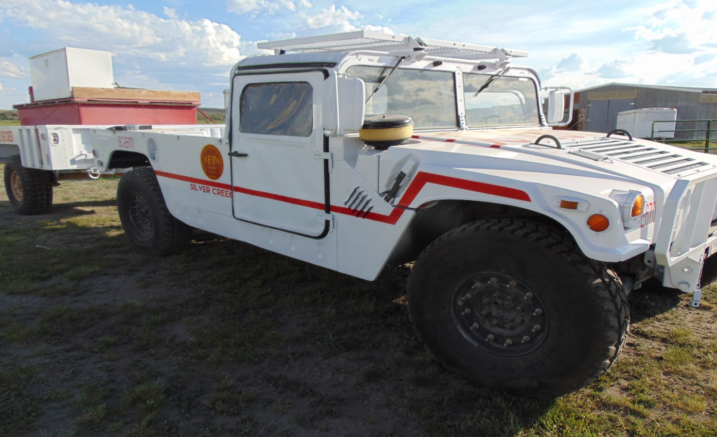
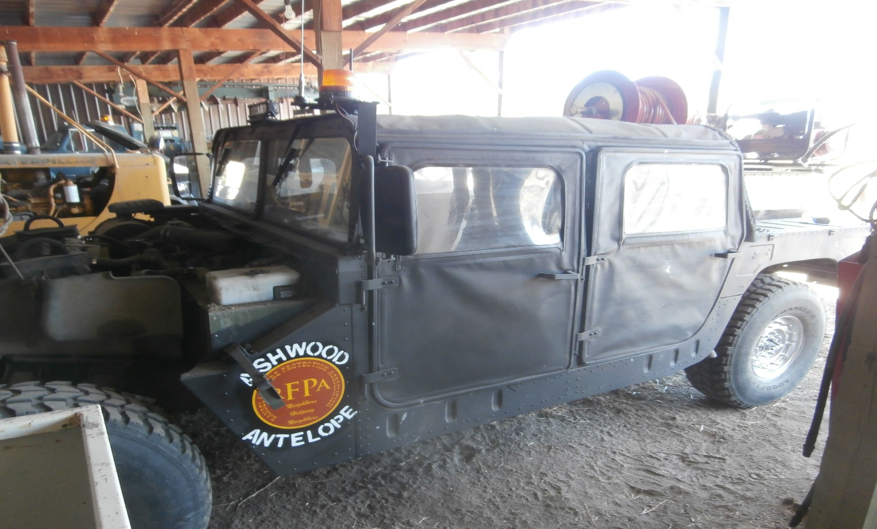
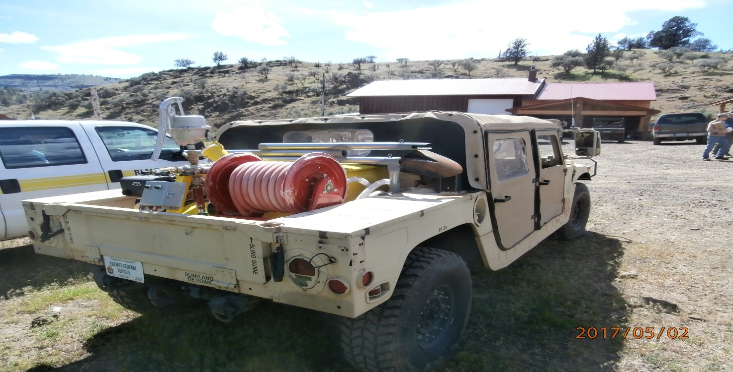
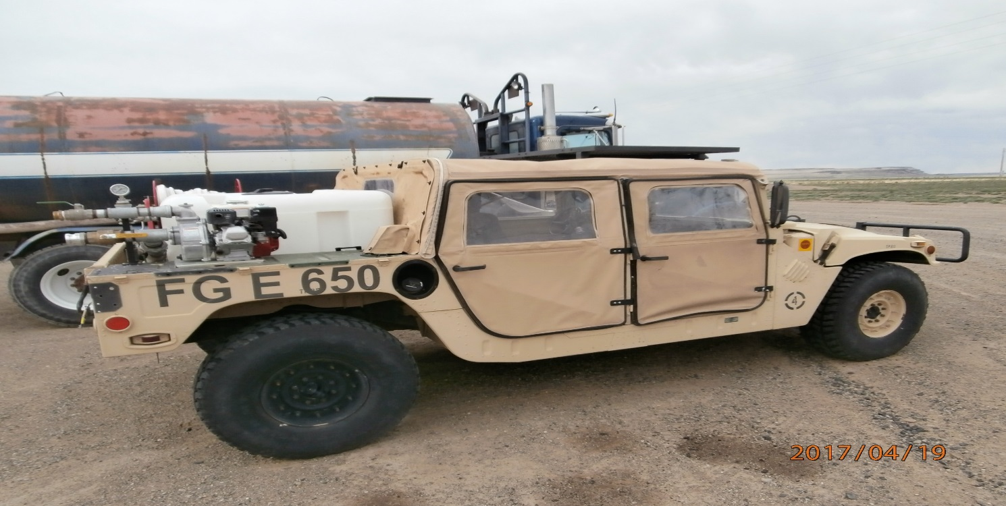

Slide 14
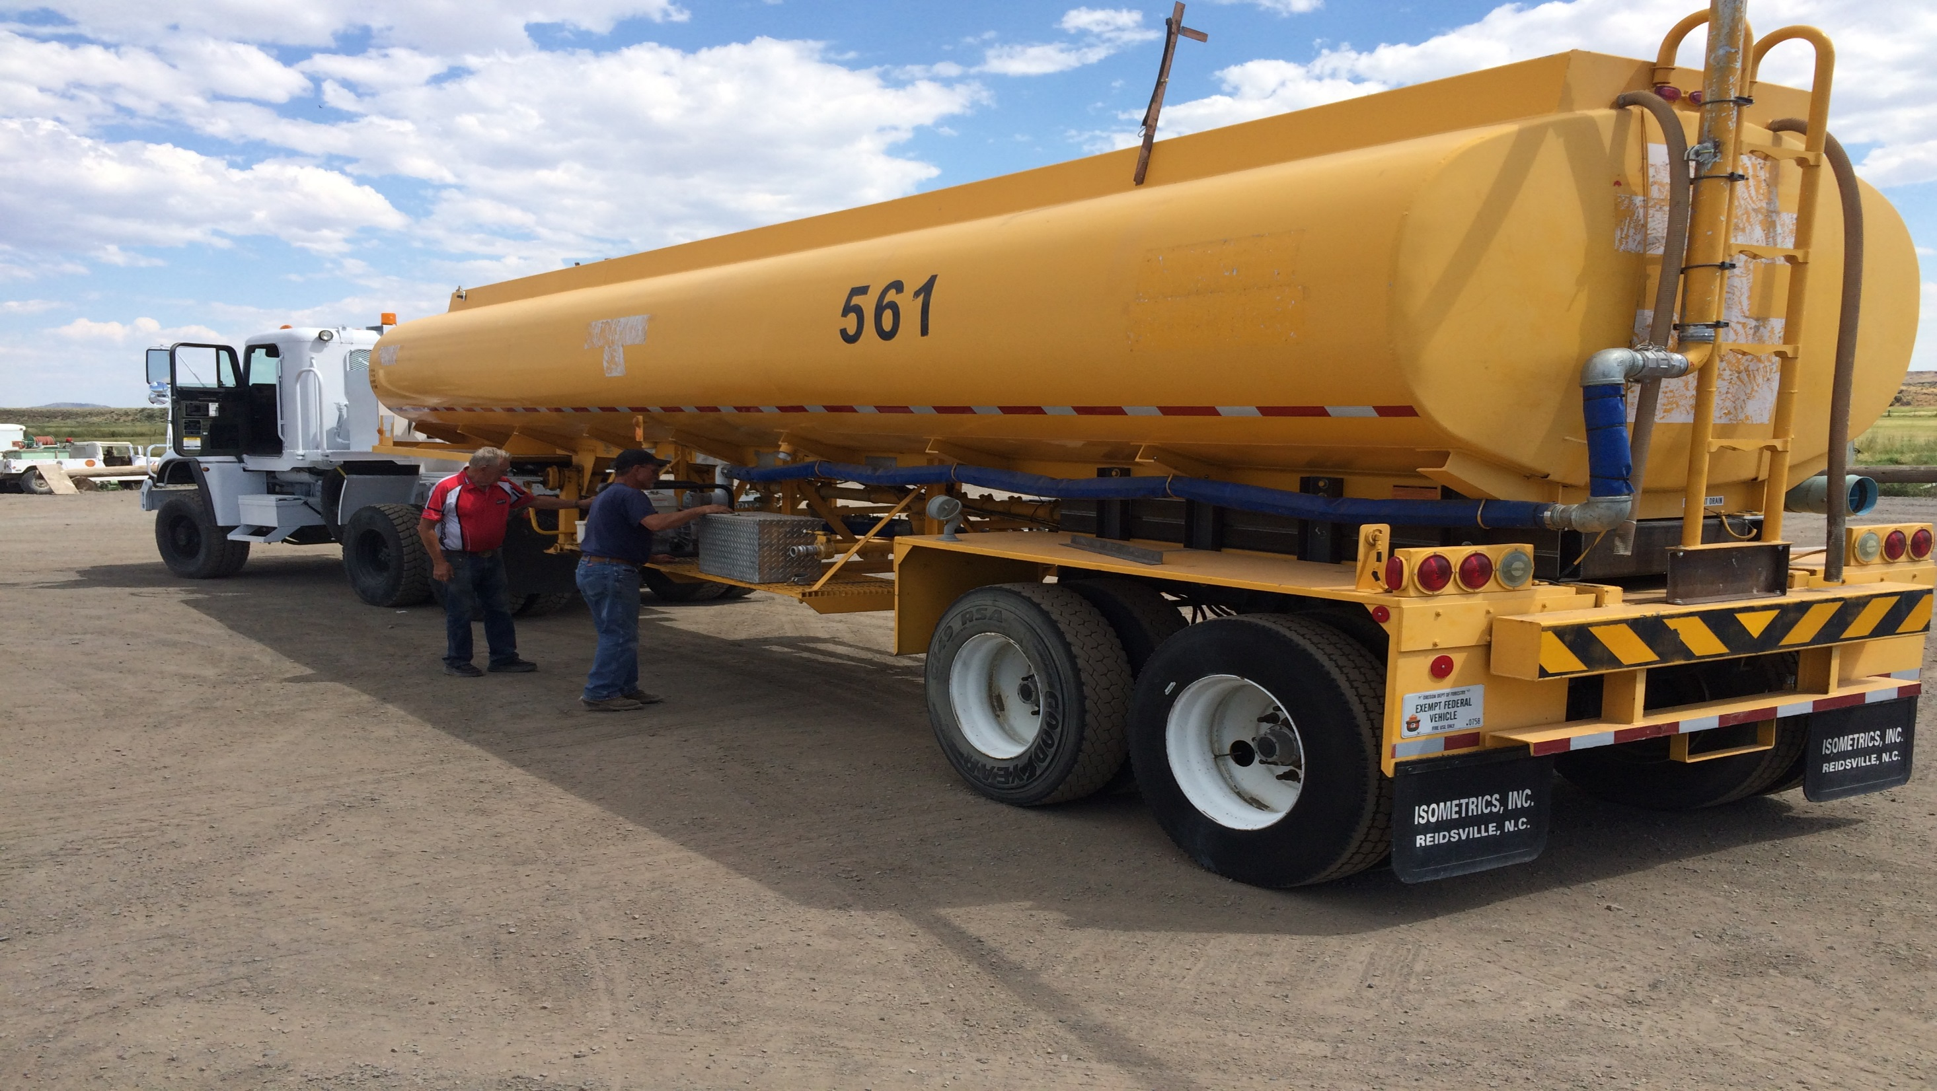

Slide 15
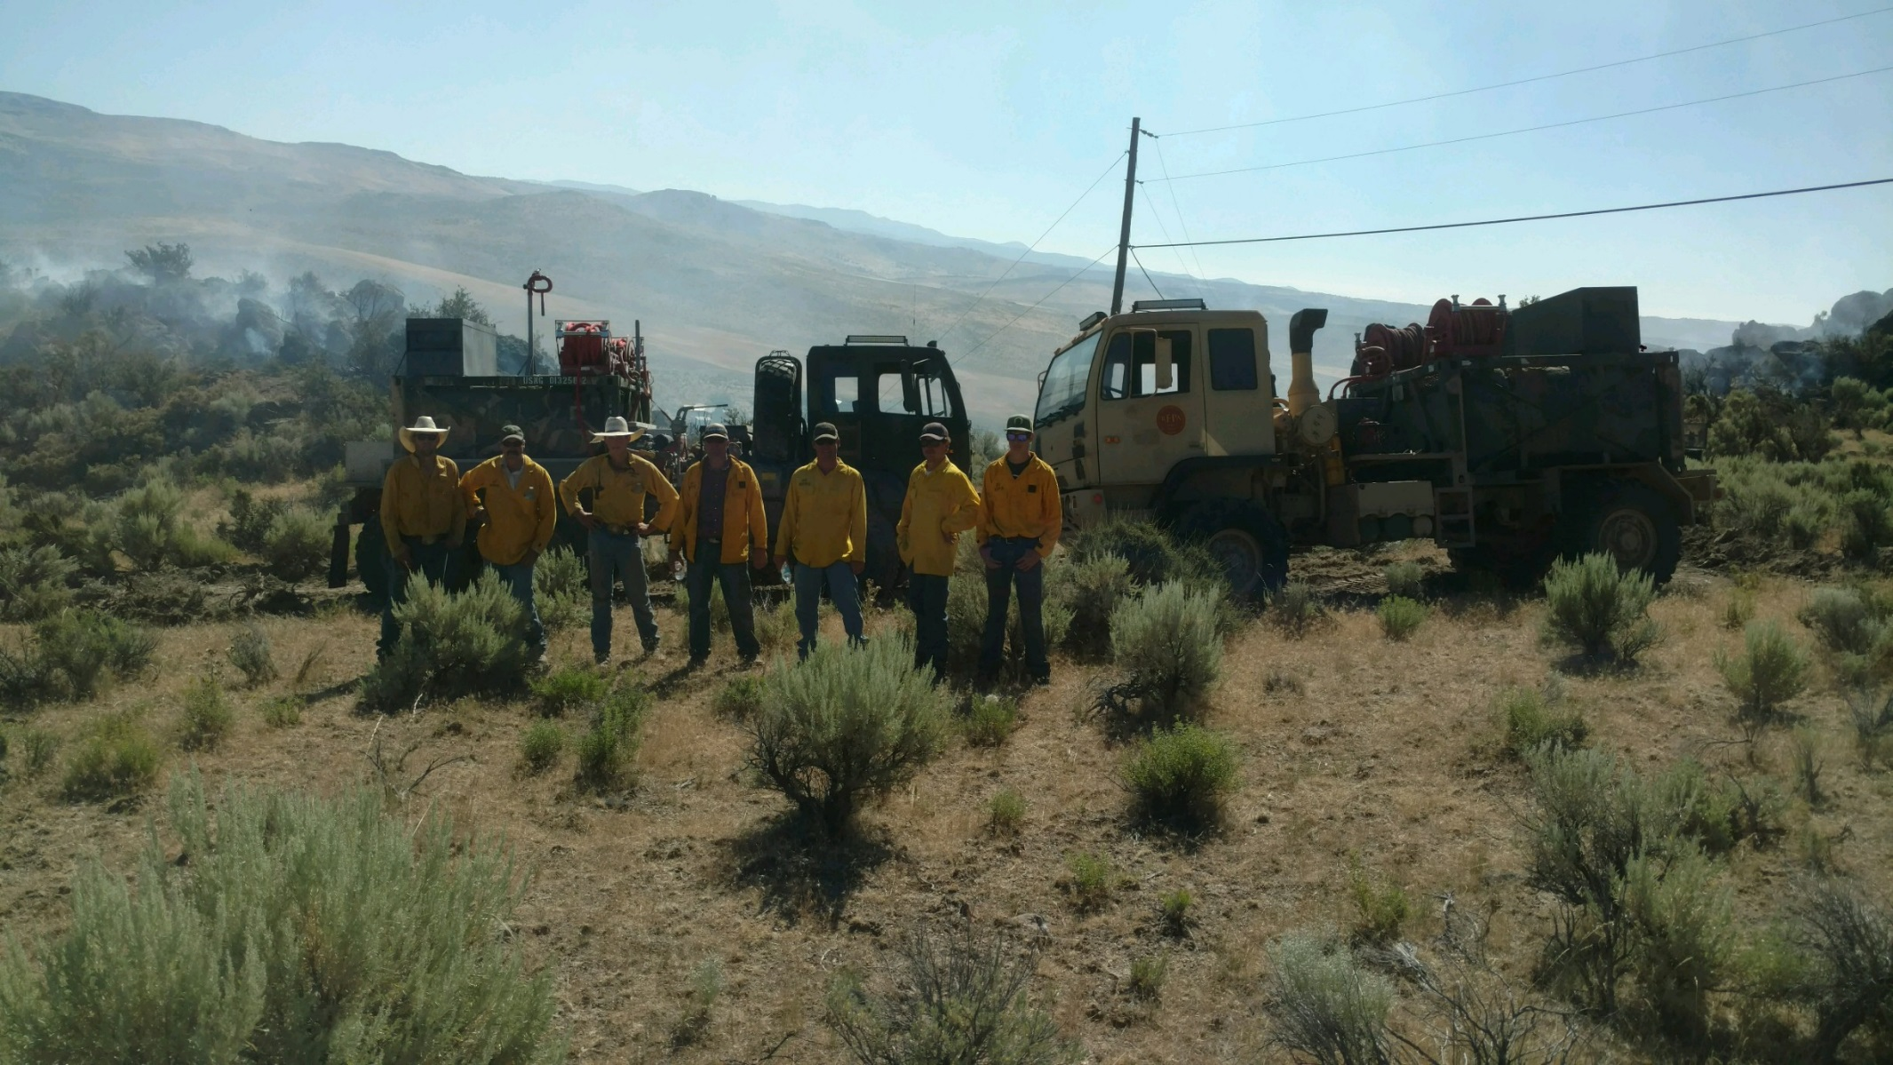
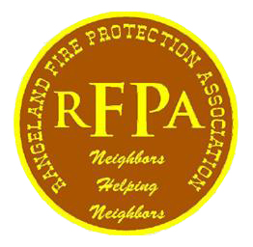
Rangeland Fire Protection Association
Neighbors Helping Neighbors

